Slide 1
April 4, 2024 Data Pipeline Town Hall
The goal of the webinar is to provide updates on the Data Pipeline, current, and upcoming data collections. These webinars also provide a forum for districts, BOCES, and Administrative Units to have questions answered about Data Pipeline.

Slide 2
Colorado Department of Education Identity Management (IdM)
Identity Management Site
Frequently Asked Questions
How do I add myself or others to the email listserv for town hall emails and/or a specific collection?
Email lists are dependent on a person’s access rights in IdM. Contact your LAM to get an account or be assigned to a specific collection.
Where can I find the IdM role mappings for Data Pipeline and other applications?
Role Mapping (XLS)
I am a LAM. How do I update the user permissions for someone in my district?
Follow the steps outlined in the IdM Quick Guide for Access Management (DOCX)
Important: Users are not automatically removed from IdM when their email address is no longer active in your district. The LAM must deactivate their IdM account to ensure only designated staff can access CDE’s data reporting system.

Slide 3
What is PII?
Student Personally Identifiable Information (PII) is defined by state and federal laws as information that, alone or in combination, personally identifies an individual
This includes direct identifiers (i.e. student and staff names, SASID, EDID, etc.)
Includes information that when combined is identifiable
Colorado’s Student Data Transparency and Security Act outlines requirements for how Student PII is collected, used and shared
See the Data Privacy and Security website for prepared guidance on how to comply with this and other privacy laws.

Slide 4
Sharing Data
Use secure methods to transfer any PII to CDE
Contact Data Collection leads with questions about how to transmit PII securely
Each Data Collection leads maintains their own Syncplicity folders for specific collections, reach out to the collection lead for access
Use Syncplicity to encrypt emails to CDE
Avoid sending PII via unencrypted email or to unsecured faxes when sharing data between or within districts
Use Syncplicity to encrypt emails to CDE
Check local policies for restrictions, requirements, etc. regarding PII
Do not use PII in trainings, presentations, etc.
Do not share PII with unauthorized individuals
Do not share passwords
Follow local policies when transmitting PII to any third party

Slide 5
Today’s Agenda
Agenda Topic | Presenter
Open Data Collections and Upcoming Deadlines in Data Pipeline
Report Card March | Peter Hoffman
Attendance | Brooke Wenzel
2023-2024 SSA File: Date First Enrolled in US Data Field | Reagan Ward
Student Discipline | Dawna Gudka
Special Education Discipline | Lindsey Heitman
READ Spring Assessment Reporting | Tara Rhodes
K-3 Literacy Programs & Assessment Reporting | Tara Rhodes
Summer EBT | Madeleine Breza

Slide 6
Open Collections and Upcoming Deadlines in Data Pipeline

Slide 7
Open Collections and Upcoming Dates
Name | Category | Status | Key Dates
RITS | Year Round | Open
EDIS | Year Round | Open
Directory | Year Round | Open | Reduced Academic Calendar Applications 3/6/2024 to 5/10/2024 School Code Change Requests 2/5/2024 to 6/28/2024
Student | Interchange | Open | Interim Deadline: 4/11/24 upload initial GG file
Title I | Interchange | Open
Special Education IEP | Interchange | Open
Staff | Interchange | Open
TSDL | Interchange | Open
Discipline | Interchange | Coming Soon | Opens 4/15/2024
Data Pipeline Resources: Data Pipeline Collection Dates (XLS)

Slide 8
Open Collections and Upcoming Dates cont.
Name | Category | Status | Final Deadline Date | Deadline Milestone | Looking Ahead
TSDL | Snapshot | Open | Aug. 30, 2024
Attendance | Snapshot | Coming Soon | July 12, 2024 |  | Opens 4/17/2024
Student Discipline | Snapshot | Coming Soon | July 31, 2024 |  | Interchange file opens 4/15/2024
Student End of Year | Snapshot | Soft Open | Nov. 19, 2024 | Interim Deadline: Upload initial GG file by 4/11/2024 | Training Event: 04/22/24 Collaborative Webinar - SPED Transition Services
Report Card March | Periodic | Open | Apr. 12, 2024
S-EBT | Periodic | Coming Soon | Apr. 30, 2024 |  | Opens 4/1/2024
Special Education Discipline | Snapshot | Coming Soon | August 29, 2024 |  | Snapshot opens 5/1/2024
Data Pipeline Resources: Data Pipeline Collection Dates (XLS)

Slide 9
Report Card March
Peter Hoffman

Slide 10
Report Card March: Collection Timeline
Date | Event | Event Description
March 6, 2024 | Report Card March Opens | Report Card March available to upload
April 12, 2024 | Report Card March Closes | Date that Report Card March must be submitted to CDE and sign off form returned to ReportCard@cde.state.co.us
Report Card March
ReportCard@cde.state.co.us

Slide 11
2023-2023 Report Card March
Edit Record – Status Dashboard
Sign off form
Reminder: If Edit Record method is used, the status dashboard will show 0 records. That is OK! If satisfied with the data – it is ok to proceed to submit the data.
Sign off forms can be sent to either hoffman_p@cde.state.co.us or ReportCard@cde.state.co.us
If you need an extension please reach out.
Ways to validate data
Edit Record Screen if that was how your data was submitted
COGNOS/CEDAR Reports
Pipeline Reports -> Report Card March -> Data Summary Report
Report Card March
ReportCard@cde.state.co.us

Slide 12
Questions & Resources: Report Card March
Peter Hoffman
720-965-8611
ReportCard@cde.state.co.us
Report Card March Website

Slide 13
Attendance
Brooke Wenzel

Slide 14
Attendance Timeline
Date | Event | Event Description
04/17/2024 | Open | Districts may begin creating snapshots. Attendance Snapshot dependencies are the Student Demographic File and Student School Association File.
05/08/2024 10:30-12:00 p.m. | Training Event | Collection Overview Training
05/09/2024 | Interim Deadline | Upload Student Demographic and Student School Association Files
05/28/2024 | Interim Deadline | Create an initial Attendance Snapshot
06/12/2024 | Interim Deadline | Error free Student Interchange file uploads
06/26/2024 | Interim Deadline | Error free Attendance Snapshot
07/05/2024 | Report Review | Review Attendance Cognos Reports for data validation. Submit Attendance Snapshot data as soon as review is complete.
07/12/2024 | Deadline | Submit Attendance Snapshot data.
07/26/2024 | Deadline | Collection closes Superintendent Verification (sign-off) form due. Data remains embargoed until the official release in August.
08/16/2024 | Data Release | Official data release
See the Attendance website for collection timeline
Attendance – Brooke Wenzel
Attendance@cde.state.co.us

Slide 15
Quick Guide for Attendance Reporting
All attendance student-level data will be reported in the Student Interchange: Student School Association File
You need the STD~LEA User role to make any updates to the Student files OR
You will need to work with the Student Interchange respondent to make updates during the Attendance snapshot process
IDM Roles – Can be assigned by your LAM (Local Access Manager)*
You will need at least 1 person in your district assigned to LEAPPROVER
Application | Collection | Role | Internal Name
Pipeline | Student Interchange | LEA USER | -STD~LEAUSER
Pipeline | Attendance | LEA USER or APPROVER | -ATS~LEAUSER -ATS~LEAAPPROVER
*Cannot assign just yet until we officially move changes to Production
Attendance – Brooke Wenzel
Attendance@cde.state.co.us

Slide 16
Creating Attendance Snapshot
Attendance Snapshot is now located under Student Profile!
Select Student Profile then Snapshot
Fill out prompts for Attendance (File Type: Attendance, School Year: 2023-24, Organization/LEA should auto-fill)
Attendance – Brooke Wenzel
Attendance@cde.state.co.us

Slide 17
Attendance Snapshot Layout
Purpose: This is where the Overview, Dependencies and Record Expectations are. You can find the criteria in the previous slide here under Record Expectations.
Field List: This is the list of fields that are included in the Attendance Snapshot. Each field will have their Name, Field Length (how many characters are within the field), Source Interchange (what interchange does this information come from), Source File (which specific file is this information pulled from: Student or Student School Association) as well as Remarks. Please note that while we have many of the data elements come from the Student Interchange files, we also have our Internal Flags shown as well like Chronically Absent Status.
Field Descriptions: This is where our internal flag definitions are described. Each internal flag will have a description on how it is calculated.
Attendance – Brooke Wenzel
Attendance@cde.state.co.us

Slide 18
Attendance Training
2023-2024 Collection Overview
May 8th, 2024
10:30-12:00 p.m.
Login information is posted on the Attendance Website under Training
Attendance – Brooke Wenzel
Attendance@cde.state.co.us

Slide 19
Questions & Resources: Attendance
Brooke Wenzel
Attendance@cde.state.co.us
720-441-7963
Attendance Webpage
Student Interchange Webpage

Slide 20
2023-2024 SSA File: Date First Enrolled in US Data Field
Reagan Ward

Slide 21
Field Definition & Expectations
Date First Enrolled in the U.S. – This field collects the date a student first enrolled in any public or non-public US school (not including Puerto Rico). The value should be report in MMDDYYYY format or zero-filled when applicable.
Districts may zero-fill this field and CDE will calculate the date of first enrollment based upon the date a student first had an entry date in a CDE student interchange data collection.
If a date has been entered for a student CDE will not override that field with a calculated value, though the entered value may not be more recent than the date CDE calculates. Implication: Error trigger if the date entered is more recent than the date CDE calculates.
Students with an entry type of 14 (Entry from another state) as their first entry may not have this field zero-filled. Implication: Districts should review transcripts/records to determine the applicable date first enrolled in US for transfer students. If one cannot be identified, use the earliest school entry date in the school year.
Schools on US military bases count as US schools
Home School does not count as a “public or non-public school.”
Notes:
Students with an entry code of 05 (Entry from another country) and 16 (Entry from homeschool) will generate a warning asking a district to confirm the Date of First Enrollment.
Student in grades greater than 010 (first grade) will generate a warning if their entry type is 01 (new to educational system) or 06 (entry from unknown educational setting).
Student’s date of first enrollment will be calculated based on the earliest entry date in the grades kindergarten and greater Implication: PK students are expected to have 00000000 as their date.
2023-2024 Student Interchange
StudentEndOfYear@cde.state.co.us

Slide 22
SSA Errors
SP552 – PK students must have Date First Enrolled 00000000
New Rule
Updated 4/3: CDE’s auto-calc for this field updated to keep pipeline from inputting a date for PK students.
SP553 – Date first enrolled in US is later than the value calculated by CDE using enrollment records. You must use the date calculated by CDE or an earlier date.
New rule to replace SP450
Similar to CS119 on Assessment SBDs
More accurately calculating this field across districts not just within a district
Error message details will indicate the date calculated by CDE
SP448 – Student with entry type 05 or 14 cannot have a zero-filled date first enrolled in US.
Updated 4/3: Exclude PK students since they must be zero filled.
2023-2024 Student Interchange
StudentEndOfYear@cde.state.co.us

Slide 23
SEY Business Rules
Expect new cross-checks for this field in 2023-2024
Assessment: The Date First Enrolled in US reported for this student in the current year Spring assessments (CMAS, PSAT, SAT, DLM, WIDA, CoALT) does not match the Date First Enrolled in US in SEY of the current year.
Error detail report will show a message with the expected date.
Cross LEA: The Date First Enrolled in US reported by your district is more recent than the Date First Enrolled in US reported by another Colorado district during the current year. Update your records to match the earlier reported date.
Error detail report will show a message with the expected earlier date.
2023-2024 Student Interchange
StudentEndOfYear@cde.state.co.us

Slide 24
CEDAR/COGNOS Report: Date First Enrolled in US Report
SASID lookup
Shows current SSA file grade level(s) and Date First Enrolled in US
Shows CDE calculated date first enrolled in US
Research dates when receiving errors
Will be very helpful for the new SP553 error
2023-2024 Student Interchange
StudentEndOfYear@cde.state.co.us

Slide 25
Questions & Resources: 2023-2024 Student Interchange
Reagan Ward
StudentEndOfYear@cde.state.co.us
720-484-9057
Student Interchange Webpage

Slide 26
Student Discipline
Dawna Gudka

Slide 27
Student Discipline: Collection Timeline
Date | Event | Event Description
March 20th | Webinar Training | 9-10AM Recording
April 15th | Interchange | Student Demographics, and Student School Association files need to be updated
April 15th | Discipline Interchange Opens | LEA’s can begin uploading the discipline by action interchange file
May 6th | Discipline Snapshot Opens | LEA’s can create a Student Discipline Snapshot
May 8th | Target deadline | LEA’s must upload at least one discipline interchange file
May 24th | Interchange files updated | LEA’s must update and upload the student demographics and student school association files into Data Pipeline
June 5th | Office Hours | 9-10AM Click here to join the meeting
June 14th | Target deadline | Interchange files error free
June 21st | Target deadline | Create at least one student discipline snapshot
July 8th | Target deadline | Discipline snapshot is error free
July 31st | DEADLINE | All LEA’s must have Student Discipline Snapshot approved and submitted to CDE
Student Discipline Snapshot
Student Discipline Snapshot email

Slide 28
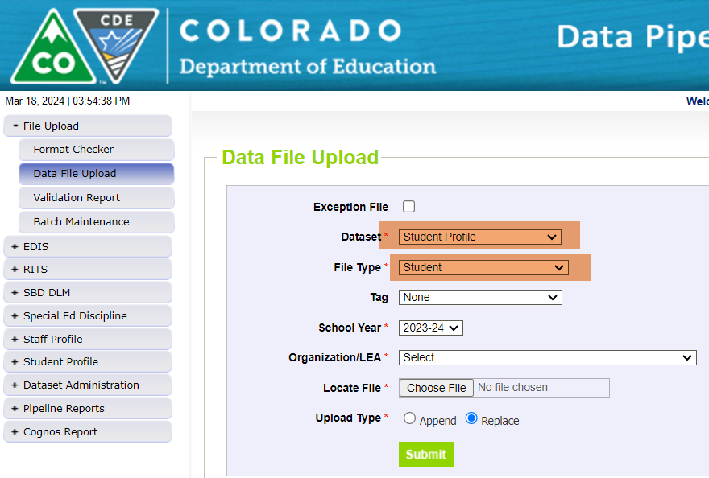
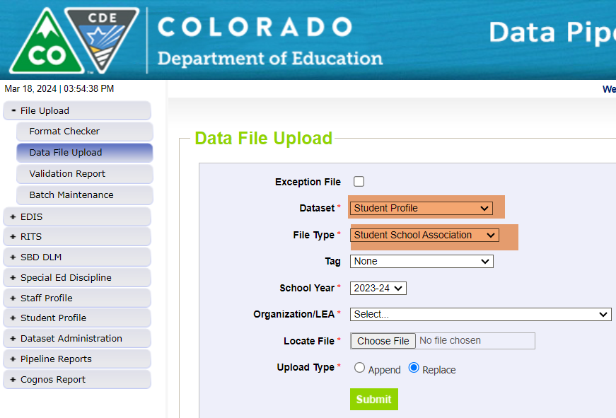
Student Discipline Snapshot Collection Preparing for the Student Discipline Interchange to OPEN-Upload Student Interchange files Student Demographics and Student School Association
What can I do to prepare for the Student Discipline Interchange to open?
Upload your current Student Profile (demographics) file
Upload your current Student School Association file
Discipline by Action interchange will open April 15th
Student Discipline Snapshot Collection
Student Discipline Snapshot Email

Slide 29
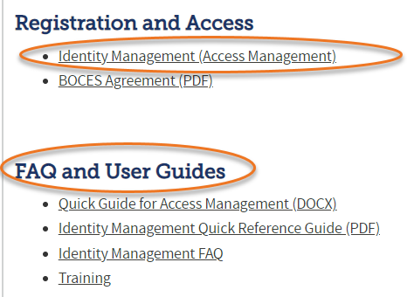
Student Discipline Snapshot Collection Roles in Identity Management System (IdM)
Identity Management (IdM)
Student Interchange Roles
STD-VIEWER
STD-LEAUSER
Discipline Interchange Roles
DIS-LEAVIEWER
DIS-LEAUSER
Discipline Snapshot Roles
STU-LEAVIEWER
STU-LEAUSER
STU-LEAAPPROVER
*Note: can only have 1 role under each role category
or you will get locked out of Data Pipeline
Student Discipline Snapshot Collection
Student Discipline Snapshot Email

Slide 30
Questions & Resources: Student Discipline
Student Interchange website
Student Demographics file layout
Student School Association file layout
Discipline Interchange website
Discipline file layout
Student Discipline Snapshot website
Student Discipline Snapshot file layout
Dawna Gudka-collection lead
(303) 598-7901
Email Student Discipline Snapshot

Slide 31
Special Education Discipline
Lindsey Heitman

Slide 32
Special Education Discipline Opening Soon
Special Education Discipline Interchange 23-24 will open 4/15
NOTE: File layout has changed
District respondents upload one Discipline Action file that includes ALL students
Must have DIS User Role to upload the file
File is at the student level and should include all disciplinary incidents and resulting actions that occurred between 7/1/2023 – 6/30/2024 (record for each action and associated incident)
Special Education Discipline Snapshot 23-24 will open 5/1
AUs will need the SPI Approver or User role and may start creating snapshots once the district has begun uploading the Discipline Action file
No change in the data fields that are pulled into this snapshot from the Discipline Action File
Data Pipeline Webpage Resources:
Data Pipeline Home - bookmark for quick access to all the Data Pipeline Resources: Interchanges, Snapshots, Year-Round, Periodic, Trainings (Town Halls), Frequently Requested Codes, and more.
Discipline Interchange – Discipline Action File Layout, Timeline, Excel Template
Special Education Discipline Snapshot - Snapshot File Layout, Timeline (same one)
Special Education Discipline
SpedDiscipline@cde.state.co.us

Slide 33
Special Education Discipline First Snapshot Training
Webinar Training Date:
Monday April 15 1:00 – 2:30
Who should attend? District data respondents with DIS role and AU data respondents with SPI role
Microsoft Teams meeting
Click here to join the meeting
Meeting ID: 285 117 173 53 Passcode: WvKNkh
Or call in (audio only)
+1 929-341-4269 280130110#
Phone Conference ID: 280 130 110#
Special Education Discipline
SpedDiscipline@cde.state.co.us

Slide 34
Questions & Resources: SPED Discipline
Discipline Interchange
Special Education Discipline Snapshot
SpedDiscipline@cde.state.co.us
Collection Lead:
Lindsey Heitman Heitman_l@cde.state.co.us

Slide 35
READ Spring Assessment Reporting
Tara Rhodes

Slide 36
READ Data Collections Overview
The READ Act provides per-pupil intervention funds to assist LEPs in providing intervention support to students identified as having significant reading deficiencies (SRDs).
For the 2023-24 reporting window, there are three file uploads required in Data Pipeline in order for a district to successfully complete the READ data collection:
2023-24 Spring READ Assessment Data (DUE 6/14/24)
2024-25 Literacy Programs & Assessment Data (DUE 6/28/24)
2024-25 Teacher Training Completion Data (DUE 8/30/24)
READ Act Data Collections – Spring Assessment Data
Readactdata@cde.state.co.us

Slide 37
READ Data Collections Purpose and Criteria
Purpose: Districts must annually report the data necessary to determine the prevalence of SRDs among K-3 students. This data determines the per-pupil funding for districts by dividing the amount of money available by the total number of K-3 students identified as having an SRD in the preceding budget year. Districts must also report whether students in grades 4-12th grade remain on a READ plan or not.
Criteria: Districts are required to report student level READ Act administered interim assessments along with the student’s score, READ plan status, intervention supports, and demographic data. All K-3 students enrolled in the district at the time of data submission are required to be reported. In addition, all 4-12th grade students who exited 3rd grade on a READ plan.
Link to view the READ data collections website:
https://www.cde.state.co.us/coloradoliteracy/readdatapipeline
READ Act Data Collections – Spring Assessment Data
Readactdata@cde.state.co.us

Slide 38
READ Data Collections Purpose and Criteria Cont.
Spring READ Assessment reporting window is scheduled to open April 10, 2024 and is scheduled to close June 14, 2024.
Timeline:
• April 10, 2024: Data collection opens, and files may be uploaded in Data Pipeline
• June 14, 2024: Date by which district must have error free and locked file in the Status Dashboard
• June 21, 2024: CDE conducts cross LEA validation process and districts will work with each other to remove duplicate SASIDS
• June 28, 2024: Date by which district must have file resubmitted with duplicate SASIDs removed
• July 25, 2024: CDE sends emails to data respondents with final SRD numbers through Data Pipeline for district confirmation
• July 29, 2024: CDE sends emails to superintendents with final SRD numbers
READ Act Data Collections – Spring Assessment Data
Readactdata@cde.state.co.us

Slide 39
READ Data Collections Changes for 23-24 Collection
There were no changes to the file layout for the Spring READ assessment data reporting for the 23-24 collection.
However, there have been updates to cut scores as well as approved programs. Please review the updates here: https://www.cde.state.co.us/coloradoliteracy/readactassessments
READ Act Data Collections – Spring Assessment Data
Readactdata@cde.state.co.us

Slide 40
READ Data Collections Preparation for Collection Openings
Steps to Take to Prepare for the Collection Opening:
For Spring READ Assessment Data Reporting:
• Begin having conversations with the READ leads in your district to see if any programming changes are planned for next year.
• The interim and diagnostic lists have been updated for the 2024-25 school year. Please reference this link to see which assessments will no longer be available for the 24-25 school year and which ones are new.
For Literacy Programs and Assessment:
• Extract your data file from the last reporting cycle to see what has been reported historically.
READ Act Data Collections – Spring Assessment Data
Readactdata@cde.state.co.us

Slide 41
Questions & Resources: READ Spring Assessments
Email: ReadActData@cde.state.co.us
Website: https://www.cde.state.co.us/coloradoliteracy/readdatapipeline

Slide 42
K-3 Literacy Programs & Assessment Reporting
Tara Rhodes

Slide 43
Literacy Programs & Assessment Reporting Purpose and Criteria
Purpose: The 2019 updates to the READ Act (SB19-199) require that districts report their K-3 instructional literacy programs and READ Act interim and diagnostic assessments by school and grade level (K-3). In addition, districts that use READ Act money and/or Early Literacy Grant funding for teacher professional development must provide information on how their professional development plan aligns to scientific and evidence-based literacy instruction. This requirement is annual, regardless of whether districts are eligible for biennial UIP flexibility.
Criteria: For the 23-24 school year, districts are required to report the READ Act administered interim and diagnostic assessments along with their core, supplemental, and intervention instructional literacy programs for grades K-3 for each school in their district (including charter schools)
Link to view the READ data collections website:
https://www.cde.state.co.us/coloradoliteracy/readdatapipeline
READ Act Data Collections – Literacy Programs
ReadActData@cde.state.co.us

Slide 44
Literacy Programs & Assessment Reporting Timeline
Literacy Programs & Assessment reporting window is scheduled to open on April 17, 2024 and close June 28, 2024.
Timeline:
• April 17, 2024: Data collection opens, and files may be uploaded in Data Pipeline
• June 28, 2024: Date by which district must have error free and locked file in the Status Dashboard
READ Act Data Collections – Literacy Programs
ReadActData@cde.state.co.us

Slide 45
Literacy Programs & Assessment Reporting Changes for 24-25 Collection
There were no changes to the ordering or inclusion of fields in the file layout for the literacy programs and assessment data reporting for the 24-25 collection.
However, a few field lengths were adjusted for the core, supplemental, and intervention programming code fields.
Additionally, updates have been made to the advisory list for the instructional programming. Please review the updates here: https://www.cde.state.co.us/coloradoliteracy/advisorylistofinstructionalprogramming2020
READ Act Data Collections – Literacy Programs
ReadActData@cde.state.co.us

Slide 46
Questions & Resources: K-3 Literacy Programs & Assessments
Email: ReadActData@cde.state.co.us
Website: https://www.cde.state.co.us/coloradoliteracy/readdatapipeline

Slide 47
Summer-EBT Program

Slide 48
Summer EBT Data Collection
Collection will open April 1 through April 30
All districts required to submit student level data by due date
All enrolled students must be included in collection
Provisional sites are required to use current year eligibility determinations
Utilize file layout to start building collection
Verify current student enrollment for missing information and up to date eligibility
Submit student data in data pipeline
Summer EBT
s-ebt@cde.state.co.us

Slide 49
S-EBT File Layout
 | Name of Field | Field Length | Text Start Position | Text End Position | CSV Order | Excel Column | Examples | Remarks
1 | School District Code* | 4 | 1 | 4 | 1 | A2 | 0000
2 | School Code* | 4 | 5 | 8 | 2 | B2 | 0000
3 | Entry Date* | 8 | 9 | 16 | 3 | C2 | 08152021 | Format is MMDDYYYY
4 | Exit Withdraw Date* | 8 | 17 | 24 | 4 | D2 | 10152021 | Format is MMDDYYYY; 0 fill if N/A
5 | Student’s State ID (SASID)* | 10 | 25 | 34 | 5 | E2 | 0000000000
6 | Local ID (LASID)* | 10 | 35 | 44 | 6 | F2 | 0000000000
7 | Student’s First Name* | 30 | 45 | 74 | 7 | G2 | Valid Name
8 | Student’s Middle Name* | 30 | 75 | 104 | 8 | H2 | Valid Name | NMN if none
9 | Student’s Last Name* | 30 | 105 | 134 | 9 | I2 | Valid Name
10 | Student’s Gender* | 2 | 135 | 136 | 10 | J2 | 01, 02
11 | Student’s Date of Birth* | 8 | 137 | 144 | 11 | K2 | 08152008 | Format is MMDDYYYY
12 | Student’s Grade Level* | 3 | 145 | 147 | 12 | L2 | 060
13 | Student’s Language Background | 3 | 148 | 150 | 13 | M2 | ENG
14 | Primary Parent/Guardian First Name* | 30 | 151 | 180 | 14 | N2 | Valid Name
15 | Primary Parent/Guardian Last Name* | 30 | 181 | 210 | 15 | O2 | Valid Name
16 | Primary Parent/Guardian Telephone Number | 10 | 211 | 220 | 16 | P2 | 5551231234; None
17 | Student’s Primary Mailing Address 1* | 44 | 221 | 264 | 17 | Q2 | 123 Star Quarry Road
18 | Student’s Primary Mailing Address 2 | 42 | 265 | 306 | 18 | R2 | Apt. 2 | Try to avoid special characters, i.e., #, &, @, etc.
19 | Student’s Primary Mailing City* | 50 | 307 | 356 | 19 | S2 | Nowhere
20 | Student’s Primary Mailing State* | 2 | 357 | 358 | 20 | T2 | CO
21 | Student’s Primary Mailing Postal Code* | 10 | 359 | 368 | 21 | U2 | 99999-0000, 99999
22 | Free/Reduced Lunch Price Eligible* | 2 | 369 | 370 | 22 | V2 | 00, 01, 02
23 | FRPL Eligibility Date | 8 | 371 | 378 | 23 | W2 | 10152021 | Format is MMDDYYYY
Summer EBT
s-ebt@cde.state.co.us

Slide 50
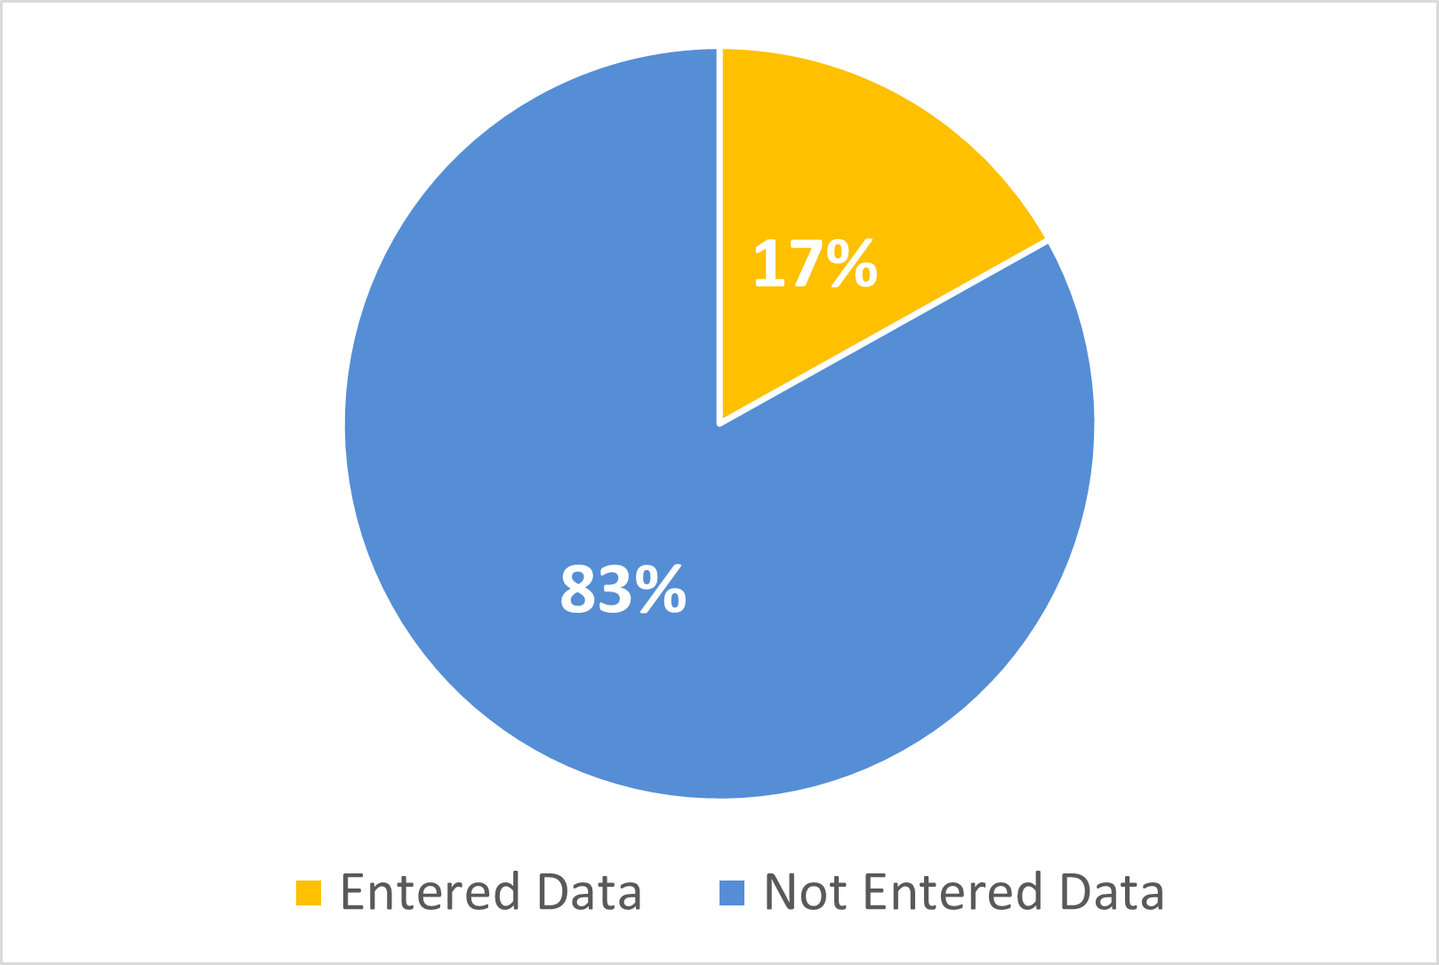
Submissions
*10/182 districts have submitted their final data

Slide 51
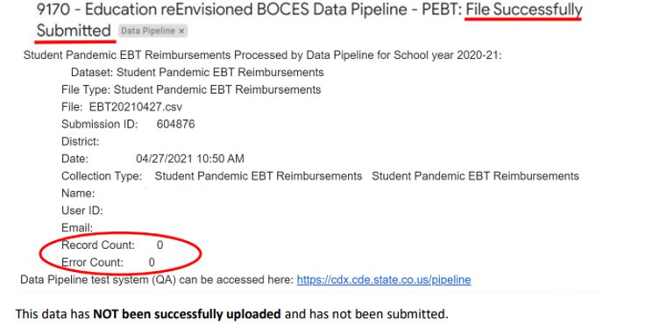
Common Errors
Common Error – Converting to excel losing leading zeros
Follow the formatting instructions: https://www.cde.state.co.us/datapipeline/convertcsvtoexcel
Common Error – No records uploaded

Slide 52
SIS Vendors
PowerSchool Update
PowerSchool has released the new S-EBT Report in SR_24.3.2.0 release. Districts need to ensure they have this version installed on their servers and it would be the most current version of the report. Once installed, the report would pull the latest data. Additionally, if they need help with installing or running the report, they can always reach out to PowerSchool Support.
The latest version of the P-EBT report (2023) is different from the new Summer EBT report (2024). The P-EBT would not fulfill the Summer-EBT requirements. Both reports can be distinguished by their names and versions as shown in the screenshot below.
*Please let us know if you are having issues with your SIS Vendor
Notes:
We’ve also reached out to Infinite Campus

Slide 53
Questions & Resources: Summer EBT
S-EBT General Email
Data Collection FAQ
School Nutrition Summer-EBT webpage
Data Pipeline S-EBT webpage
Office Hours Sign-up

Slide 54
Thank you for joining today!
Next Town Hall will be April 11th
Tip: Bookmark the Data Pipeline home page and the IdM landing page.
These two sites help respondents navigate to the collection websites and tools needed as a data respondent.

Slide 55
Collection Email Addresses
Additional support has been added to help manage emails for the CDE Team
Some emails may be signed as "Technical Help Support"
The data collection leads you know, and trust are:
Still responding and signing their names as needed
Training & assisting the Technical Help Support staff
Note: These email addresses are also posted on the Data Pipeline website and Contact list for reference
Data Collection | Email Addresses
Attendance | Attendance@cde.state.co.us
Directory | DirectoryData@cde.state.co.us
EDIS | EDIS@cde.state.co.us
Human Resources | HumanResourcesData@cde.state.co.us
READ Collections | ReadActData@cde.state.co.us
Report Card March | ReportCard@cde.state.co.us
RITS | RITS@cde.state.co.us
Special Ed December Count | SpedDecCount@cde.state.co.us
Special Ed Discipline | SpedDiscipline@cde.state.co.us
Special Ed End of Year | SpedEndOfYear@cde.state.co.us
Staff Evaluation | StaffEvaluation@cde.state.co.us
Student Discipline Snapshot | StudentDiscipline@cde.state.co.us
Student End of Year | StudentEndOfYear@cde.state.co.us
Student October Count | StudentOctober@cde.state.co.us
Teacher Student Data Link | TeacherStudentDataLink@cde.state.co.us

