Slide 1
February 27, 2025 Data Pipeline Town Hall
The goal of the webinar is to provide updates on the Data Pipeline, current, and upcoming data collections. These webinars also provide a forum for districts, BOCES, and Administrative Units to have questions answered about Data Pipeline.

Slide 2
Colorado Department of Education Identity Management (IdM)
Identity Management Site
Frequently Asked Questions
How do I add myself or others to the email listserv for town hall emails and/or a specific collection?
Email lists are dependent on a person’s access rights in IdM. Contact your LAM to get an account or be assigned to a specific collection.
Where can I find the IdM role mappings for Data Pipeline and other applications?
Role Mapping (XLS)
I am a LAM. How do I update the user permissions for someone in my district?
Follow the steps outlined in the IdM Quick Guide for Access Management (DOCX)
Important: Users are not automatically removed from IdM when their email address is no longer active in your district. The LAM must deactivate their IdM account to ensure only designated staff can access CDE’s data reporting system.
Notes:
LAMs, please check the IdM roles for your district. Remove permissions for users who have retired, left your district, or are no longer assigned to a collection. Add roles for new hires and newly assigned respondents for specific collections.

Slide 3
What is PII?
Student and Staff Personally Identifiable Information (PII) is defined by state and federal laws as information that, alone or in combination, personally identifies an individual
This includes direct identifiers (i.e. student and staff names, SASID, EDID, etc.)
Includes information that when combined is identifiable
Colorado’s Student Data Transparency and Security Act outlines requirements for how Student PII is collected, used and shared
See the Data Privacy and Security website for prepared guidance on how to comply with this and other privacy laws.

Slide 4
Sharing Data
Use secure methods to transfer any PII to CDE
Contact Data Collection leads with questions about how to transmit PII securely
Each Data Collection leads maintains their own Syncplicity folders for specific collections, reach out to the collection lead for access
Use Syncplicity to encrypt emails to CDE
Avoid sending PII via unencrypted email or to unsecured faxes when sharing data between or within districts
Use Syncplicity to encrypt emails to CDE
Check local policies for restrictions, requirements, etc. regarding PII
Do not use PII in trainings, presentations, etc.
Do not share PII with unauthorized individuals
Do not share passwords
Follow local policies when transmitting PII to any third party

Slide 5
Today’s Agenda
Agenda Topic | Presenter
Open Data Collections and Upcoming Deadlines in Data Pipeline | Host: Collin Slutzky
SBD Collections | Jasmine Carey/Leon Merker
Report Card March | Jessica Tribbett
Data Pipeline Website | Reagan Ward
Summer EBT | Collin Slutzky

Slide 6
Open Collections and Upcoming Deadlines in Data Pipeline

Slide 7
Open Collections and Upcoming Dates: Year-Round & Interchanges
Name | Category | Status | Key Dates
RITS | Year Round | Open | N/A
EDIS | Year Round | Open | N/A
Directory | Year Round | Open | Reduced Academic Calendar: 2/5/2025 to 5/9/2025 School Code Change Requests: 2/5/2025 to 6/30/2025
Student | Interchange | Open | February Recommendation: Update DEM & SSA files
At-Risk | Interchange | Closed | N/A
Title I | Interchange | Open | May 2025: Update file in preparation for SEY and ATS reporting
Special Education IEP | Interchange | Open | Final Dec Count Snapshot Submission Due by 2/21/2025
Staff | Interchange | Open
Discipline Action | Interchange | Opening soon | This interchange file is needed for Student Discipline Snapshot and Special Education Discipline Snapshot Collections
Teacher Student Data Link | Interchange | Open | Opened 12/11/2024
Data Pipeline Resources: Data Pipeline Collection Dates (XLS)

Slide 8
Open Collections and Upcoming Dates: Snapshots
Name | Category | Status | Final Deadline Date | Next Milestone | Looking Ahead
Special Education December Count | Snapshot | Closed | Feb. 21, 2025 | Interim Deadline: N/A
Human Resources | Snapshot | Closed | Feb. 21, 2025
Teacher Student Data Link | Snapshot | Coming Soon | Aug. 29, 2025 | Interchange Opened: 12/11/2024 | Snapshot Opens: 2/27/2025
Student End of Year | Snapshot | Coming Soon | Dec. 2, 2025 | Soft Open (Optional Phase): 3/31/2025 to 4/24/2025 | Training Event: Collection Overview Training—option 1 of 2 4/2/2025, 9:00-11:00am
Data Pipeline Resources: Data Pipeline Collection Dates (XLS)

Slide 9
Open Collections and Upcoming Dates: Periodic
Name | Category | Status | Final Deadline Date | Next Milestone | Looking Ahead
Summer EBT | Periodic | Closing Soon | Feb. 28, 2025 | Collection Closes: 2/28/2025 LEAs must submit an error-free file
SBD WIDA ACCESS for ELLs | Periodic | Coming Soon | Mar. 26, 2025, 5pm | Collection Opens: 3/17/2025 | Training: 3/1/2025, 1pm
Report Card March | Periodic | Coming Soon | Apr. 11, 2025 | Collection Opens: 3/5/2025
Alternative Education Campus | Periodic | Coming Soon | Jun. 27, 2025 | Application/Renewal File: 3/19/25 to 4/25/25 Planned Measures File: 3/19/2025 to 6/27/2025 | Actual Measures File: 5/19/25 to 6/27/25
Data Pipeline Resources: Data Pipeline Collection Dates (XLS)

Slide 10
SBD Collections
Jasmine Carey
Leon Merker

Slide 11
Introductions
Jasmine Carey
Back up SBD Collection Lead, SBD support
Carey_j@cde.state.co.us
Leon Merker
SBD Collection Lead, Primary SBD support
Merker_l@cde.state.co.us
SBD Collections
Merker_L@cde.state.co.us

Slide 12
What is the SBD Review?
SBD reviews provide districts with a final opportunity to verify the accuracy of student level demographic and testing administration data for all 3-11 state administered assessments prior to public reporting and accountability calculations.
The data being reviewed during SBD comes from the systems of the vendors who administer the assessment. SBD review gives a final opportunity to review the data within the CDE Data Pipeline system and provides additional checks such as State Student Identifier validation.
Once the review is complete, the data for districts that completed their review are updated and loaded back into the vendor system. The updated data are then used in the final data files and reports, as well as in public reporting and accountability calculations.
SBD Collections
Merker_L@cde.state.co.us

Slide 13
Student Biographical Data (SBD) Timeline
SBD Collections
There are four collections, one for each assessment vendor
Details are in the Periodic Collections on the Data Pipeline page
Documents are currently available for WIDA ACCESS SBD
Timelines are subject to change; please make sure you have users in each collection group to receive emails about the specific collection
 | Assessment | Data Pipeline Group | SBD Review Window
1 | ACCESS for ELLs® ACCESS for ELLs Alternate | ACC | March 17 – 26, 2025
2 | Colorado PSAT/SAT | SAT | May 13 – 21, 2025
3 | Colorado Measures of Academic Success (CMAS): Mathematics, ELA, CSLA, Science and Social Studies Colorado Alternate (CoAlt): Science and Social Studies | CMS | May 15 – 28, 2025
4 | Colorado Alternate (CoAlt): English Language Arts and Mathematics (Dynamic Learning Maps) | DLM | May 28 – June 4, 2025
SBD Collections
Merker_L@cde.state.co.us

Slide 14
Trainings
WIDA ACCESS for ELLs training webinar will be held March 4th at 1pm
A Teams invite will be sent to all active users in the ACC group and shared with District Assessment Coordinators
Trainings for the other SBD collections will be held in the first week of May
Assessment will continue to attend Townhall and provide updates when documents are available
SBD Collections
Merker_L@cde.state.co.us

Slide 15
Questions & Resources: SBD Collections
sbdsupport@cde.state.co.us
SBD WIDA ACCESS for ELLs
SBD PSAT9, PSAT10, and SAT
SBD CMAS and CoAlt
SBD Dynamic Learning Maps

Slide 16
Report Card March
Jessica Tribbett

Slide 17
Report Card March - Overview
Report Card March
Opens Wednesday, March 5th through Friday, April 11th.
IDM Roles Needed
RCM~LEAUSER – Submit and Modify Role
RCM~LEAAPPROVER – Approver Role
New Fields
HB 22-1376
1.District Wide Climate Survey
2. Climate Survey Results Posted Publicly
3. If Posted (Specify)
Report Card March
reportcard@cde.state.co.us

Slide 18
Report Card March – HB 22-1376
BEGINNING IN THE 2023-24 SCHOOL YEAR, THE DEPARTMENT OF EDUCATION SHALL ANNUALLY COLLECT INFORMATION CONCERNING SCHOOL CLIMATE SURVEYS ADMINISTERED TO STUDENTS OR FAMILIES, OR SCHOOL CLIMATE TOOLS UTILIZED BY SCHOOLS AND SCHOOL DISTRICTS, INCLUDING WHICH SURVEY OR TOOL IS USED, IF ANY, AND HOW THE RESULTS OF SUCH SURVEYS ARE MADE PUBLICLY ACCESSIBLE, IF AT ALL. THE DEPARTMENT OF EDUCATION SHALL INCLUDE THIS INFORMATION IN THE DISTRICT PROFILE REPORTS.
reportcard@cde.state.co.us
reportcard@cde.state.co.us

Slide 19
Report Card March – New Fields
District Wide Climate Survey 1 – yes, 0 - no
Climate Survey Results Posted Publicly 1 – yes, 0-no
If Posted (Specify) – Text Field
The climate survey is for students and parents only and does not include teaching conditions surveys.
This can include any survey asking about wellbeing, engagement, satisfaction, emotional / physical safety, sense of belonging.
Report Card March
reportcard@cde.state.co.us

Slide 20
Report Card March – Form Submission
Log in to the Data Pipeline Report Card March Collection
Click Edit Record tab and select the below fields:
File Type: Report Card
School Year: Select current school year
Organization/LEA: Your LEA should be auto-populated
School Code: Select 'All Schools' or a specific school code
Report Card March
reportcard@cde.state.co.us

Slide 21
Report Card March – Form Submission Continued – Data Fields
Data Fields for Form Submission
Select Y/N for all applicable fields.
Type number of professional development days and COVID Remote Response days in the fields that requests that information, and text in the other fields if applicable
Be sure to enter information into the new school climate survey fields
Report Card March
reportcard@cde.state.co.us

Slide 22
Report Card March – File Submission
Data Pipeline File Upload
You can do any of the following:
1) download the spreadsheet of the prior years’ data and make any needed changes and then re-upload or 2) download the file extract your vendor has established; or 3) use the file upload template on the Report Card March website.
File extract will have the 3 new climate survey fields 0 filled.
File name should not contain spaces and remember to use the file format checker!
NOTE: If you start out submitting by file you may not change and submit by form. This may result in errors.
Report Card March
reportcard@cde.state.co.us

Slide 23
Additional Notes
Pick one method to submit – either form or file upload
If you start by submitting a file upload and then submit by form, you may encounter errors.
Avoid apostrophes in text fields as it can cause an error with saving / submitting.
For professional development days and COVID remote response days, use only whole or half day numbers.
For half days use .5
For file uploads, use 1 for yes and 0 for no.
Report Card
reportcard@cde.state.co.us

Slide 24
Questions & Resources: Report Card March
Email: reportcard@cde.state.co.us Website: Report Card March Collection Website

Slide 25
Data Pipeline Website
Reagan Ward

Slide 26
Data Pipeline Website Overview
Link: Data Pipeline Home Page
Section of the CDE website designed to provide information on each of the data pipeline collections
Some pages designed for general support information
Training
Frequently Requested Code and Resources
OMB Clearance Packages
Specific collection pages provide critical information for that collection
Collection pages designed with similar types of information
Overview
Deadlines
File Layout and Definitions
Business Rules
Templates
Training
Additional Resources
Contact
Data Pipeline Website
Ward_R@cde.state.co.us

Slide 27
Navigation Updates
Trainings pages are being updated
Consolidated Town Hall page
Respondent Training
Will have general information that applies to all pipeline collections
More information/updates coming this Spring
Streamlined/combined subpages into single topics instead of multiple pages
Frequently Requested Codes and Resources
Combined these two pages
OMB Clearance Packages
Combined multiple subpages into one page
Civil Rights Data Collection (CRDC)
Combined Colorado provision into the main page
Moved READ collections under ‘Periodic’ and split into three pages, one per collection
Added quick link to Identity Management section of CDE website
Added quick link to Colorado Education Statistics section of CDE website
Data Pipeline Website
Ward_R@cde.state.co.us

Slide 28
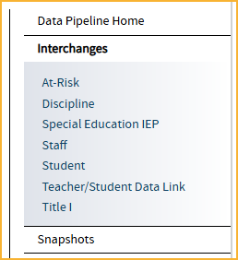
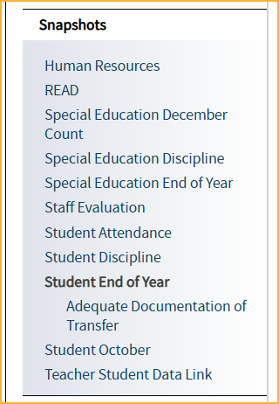
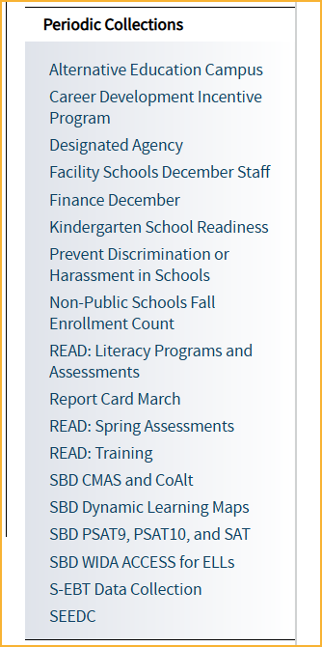
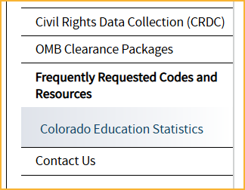
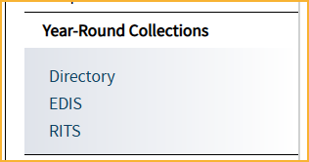
Navigation Updates cont.
Data Pipeline Website
Ward_R@cde.state.co.us

Slide 29
Data Pipeline Town Hall Page
Recently consolidated
Includes email to subscribe to the TH listserv
Email ‘subscribe’ to DATASERVICES-subscribe-request@cdelist.state.co.us
Follow directions on the confirmation email to confirm subscription within 48 hours
Upcoming
Upcoming agenda/PPT
Town Hall Meeting Link
Recent Presentations
Past 6 presentations
Agenda, Slides, Recording
Recordings set up with skip points for topics when using link instead of embedded version
Data Pipeline Website
Ward_R@cde.state.co.us

Slide 30
Questions & Resources: Data Pipeline Website
Data Pipeline Home Page
Contact Us Page
Please contact the specific collection inbox with questions about website resources for that collection
(Contact information is located at the bottom of each page)

Slide 31
Summer EBT
Collin Slutzky

Slide 32
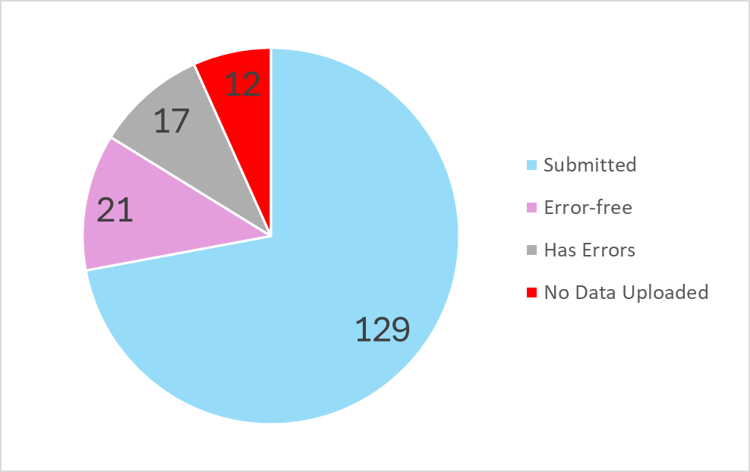
Summer EBT: Submissions
Summer EBT
s-ebt@cde.state.co.us

Slide 33
Summer EBT Data Collection
Data Collection opened February 3rd.
File layout is unchanged from last year.
Error-free files must be submitted by February 28th.
Districts have the following options for submitting student records:
Submit data for all students enrolled in National School Lunch Program sites only.
Submit data for all students enrolled in NSLP sites and data for any F/R eligible transfer students to non-NSLP sites during the school year (any student that was enrolled at a NSLP site, even for a short period of time, would be eligible for S-EBT benefits)
Submit data for all enrolled students at both NSLP sites and non-NSLP sites.
Submitting data for all enrolled students will be the easiest option for most districts, as your S-EBT reports from your SIS likely use this option.
Summer EBT
s-ebt@cde.state.co.us
Notes:
Your district schools are most likely receiving calls from families to update their address, make sure you are in contact with the appropriate people to make sure this updated information is being captured in the summer EBTcorrections.

Slide 34
Summer EBT Data Collection: Preparing your file
Verify that Free and Reduced Lunch status is up-to-date for all students.
Every student must have one listed parent/guardian with a valid address.
Issues with parent/guardian info will delay benefit issuance.
Check the S-EBT report in your SIS and make sure it matches the S-EBT file layout available on the data collection resource page.
If the S-EBT report from your SIS is missing or incorrect, please contact your vendor immediately and include Collin Slutzky (slutzky_c@cde.state.co.us) on communications.
Bookmark the form to schedule office hours in case you have issues uploading your file or resolving errors.
A data collection manual covering the basic process of submitting S-EBT data is available soon on the collection resources page.
Summer EBT
s-ebt@cde.state.co.us

Slide 35
Summer EBT Data Collection: Additional Notes
Some errors were not behaving correctly and have been changed to warnings:
PB272: There are students included in the October Student Count report that are not included in the S-EBT submission for the District.
This error did not account for students included in October Count for administrative purposes only.
PB276: Parent's Primary Telephone Number must be a valid year but phone number.
This error contradicts guidance in the file layout to use “None” for parents/guardians with no phone number.
If you are getting PB30 or PB34 errors for data you know is correct, contact us.
Emancipated minors and adult students living on their own can be listed as their own guardian.
Please let us know if you think any other errors are behaving incorrectly.
Summer EBT
s-ebt@cde.state.co.us

Slide 36
Questions & Resources: Summer EBT
Collin Slutzky
s-ebt@cde.state.co.us
(720) 760-3569
S-EBT Data Collection Resources

Slide 37
Thank you for Joining Today!
Next Town Hall will be March 6th
Reminder:
LAMs, please review your IdM users to ensure accurate permissions for data respondents in your district. Deactivate users who no longer oversee a data collection in your district.

