Slide 1
June 12, 2025
Data Pipeline Town Hall
The goal of the webinar is to provide updates on the Data Pipeline, current, and upcoming data collections. These webinars also provide a forum for districts, BOCES, and Administrative Units to have questions answered about Data Pipeline.

Slide 2
Colorado Department of Education
Identity Management (IdM)
Identity Management Site
Frequently Asked Questions
How do I add myself or others to the email listserv for town hall emails and/or a specific collection?
  Email lists are dependent on a person’s access rights in IdM. Contact your LAM to get an account or be assigned to a specific collection.
Where can I find the IdM role mappings for Data Pipeline and other applications?
  Role Mapping (XLS)
I am a LAM. How do I update the user permissions for someone in my district?
  Follow the steps outlined in the IdM Quick Guide for Access Management (DOCX)
Important: Users are not automatically removed from IdM when their email address is no longer active in your district. The LAM must deactivate their IdM account to ensure only designated staff can access CDE’s data reporting system.
Notes:
LAMs, please check the IdM roles for your district. Remove permissions for users who have retired, left your district, or are no longer assigned to a collection. Add roles for new hires and newly assigned respondents for specific collections.

Slide 3

What is PII?
Student and Staff Personally Identifiable Information (PII) is defined by state and federal laws as information that, alone or in combination, personally identifies an individual
  This includes direct identifiers
  (i.e. student and staff names, SASID, EDID, etc.)
  Includes information that when combined is identifiable
Colorado’s Student Data Transparency and Security Act outlines requirements for how Student PII is collected, used and shared
See the Data Privacy and Security website for prepared guidance on how to comply with this and other privacy laws.

Slide 4

Sharing Data
Use secure methods to transfer any PII to CDE
  Contact Data Collection leads with questions about how to transmit PII securely
    Each Data Collection leads maintains their own Syncplicity folders for specific collections, reach out to the collection lead for access
  Use Syncplicity to encrypt emails to CDE
Avoid sending PII via unencrypted email or to unsecured faxes when sharing data between or within districts
  Use Syncplicity to encrypt emails to CDE
Check local policies for restrictions, requirements, etc. regarding PII
  Do not use PII in trainings, presentations, etc.
  Do not share PII with unauthorized individuals
  Do not share passwords
  Follow local policies when transmitting PII to any third party

Slide 5
Today’s Agenda
Agenda Topic | Presenter
Open Data Collections and Upcoming Deadlines in Data Pipeline | Host: Jessica Tribbett
READ Collections | Tara Rhodes
Student Attendance | Peter Hoffman
School Code Changes | Jessica Tribbett
Instructional Days and Hours | Jessica Tribbett
Special Education Discipline | Lindsey Heitman
Special Education End of Year | Lindsey Heitman

Slide 6
Open Collections and
Upcoming Deadlines in
Data Pipeline

Slide 7
Open Collections and Upcoming Dates:
Year-Round & Interchanges
Name | Category | Status | Key Dates
RITS | Year Round | Open | N/A
EDIS | Year Round | Open | N/A
Directory | Year Round | Open | School Code Change Requests: 2/5/2025 to 6/30/2025
Student | Interchange | Open | Maintain error free files
At-Risk | Interchange | Closed | N/A
Title I | Interchange | Open | Maintain error free files
Special Education IEP | Interchange | Open | 6/26/2025 Interim Deadline: Error free interchange files
Staff | Interchange | Open | Staff Profile and Staff Evaluation interchange files are needed for the Staff Evaluation Snapshot
Discipline Action | Interchange | Open | This interchange file is needed for Student Discipline Snapshot and Special Education Discipline Snapshot
Teacher Student Data Link | Interchange | Open | 6/13/25 Interim Deadline: Error free interchange file
Data Pipeline Resources: Data Pipeline Collection Dates (XLS)

Slide 8
Open Collections and Upcoming Dates:
Snapshots
Name | Category | Status | Final Deadline Date | Next Milestone | Looking Ahead
Teacher Student Data Link | Snapshot | Open | Aug. 29, 2025 | Interim Deadline: 6/13/25, error free TSDL interchange | Interim Deadline: 6/27/25 create at least one snapshot
Staff Evaluation | Snapshot | Open | Oct. 15, 2025 | 06/19 Interim Deadline Error free Staff Evaluation Interchange file | 06/26 Interim Deadline, create at least one staff evaluation snapshot
Student End of Year: Regular Phase | Snapshot | Open | Sept. 4, 2025 | Interim Deadline: 7/15/25, 10:30-11:30 July SEY Office Hours | Interim Deadline: 7/31/25 submit reporting exception requests
Student Attendance | Snapshot | Open | July 25, 2025 | Interim Deadline: 6/11/25 error free interchange files | Interim Deadline: 6/20/25 submit exceptions for review
Special Education Discipline | Snapshot | Open | Aug. 1, 2025 | Interim Deadline: 6/26/25 Dis and IEP interchanges should be error free and at least one snapshot created | Other Date: June 30, 2025, end of 2024-2025 data reporting period
Student Discipline | Snapshot | Open | July 31, 2025 | Interim Deadline: 6/11/25 error free Student Interchange files (DEM and SSA) | Interim Deadline: 6/21/25 Create at least one student discipline snapshot
Special Education EOY | Snapshot | Open | Oct. 3, 2025 | Interim Deadline: 6/26/25 IEP Interchange files error free and at least one snapshot created | Interim Deadline: 9/4/25 all exception requests submitted to CDE for review
Data Pipeline Resources: Data Pipeline Collection Dates (XLS)

Slide 9
Open Collections and Upcoming Dates:
Periodic
Name | Category | Status | Final Deadline Date | Next Milestone | Looking Ahead
Summer EBT | Periodic | Open | Feb. 28, 2025 | Corrections Period: 5/19/2025 to 9/3/2025
Alternative Education Campus | Periodic | Open | Jun. 27, 2025 | Planned Measures File: 3/19/2025 to 6/27/2025 | Actual Measures File: 5/19/25 to 6/27/25
Prevent Harassment or Discrimination | Periodic | Open | August 1, 2025 | Interim Deadline: Upload Prevent Harassment or Discrimination File at least once by 6/5/25 | Interim Deadline: Error free Prevent Harassment or Discrimination file by 7/3/2025
READ Spring Assessments | Periodic | Open | June 13, 2025 | Other Date: 6/6/25 error free submission target | Report Review: 6/6/25 to 6/13/25
READ Literacy Programs & Assessments | Periodic | Open | June 13, 2025 | Other Date: 6/6/25 error free submission target | Report Review: 6/6/25 to 6/13/25
Data Pipeline Resources: Data Pipeline Collection Dates (XLS)

Slide 10
READ Collections
Tara Rhodes

Slide 11
Spring READ Assessment and
READ Literacy Programs and Assessment
Data Collections

Slide 12
Timeline
Date | Event | Event Description
4/1/2025 | Training Event | Spring READ Assessment Training Event; recording here
4/8/2025 | Training Event | READ Literacy Programs and Assessment Training Event; recording here
4/15/2025 | Collection Open | The Spring READ Assessment and READ Literacy Programs and Assessment data collections open
5/15/2025 | Other Date | Please complete a preliminary upload by this date; this does not have to be error-free
6/6/2025 | Other Date | Please complete an error-free submission by this date
6/6/2025 | Report Review | Assuming an error-free submission has been completed, use this time to review any reports
6/13/2025 | Collection Close | Spring READ Assessment and READ Literacy Programs and Assessment data collections close
Tara Rhodes
READActData@cde.state.co.us

Slide 13
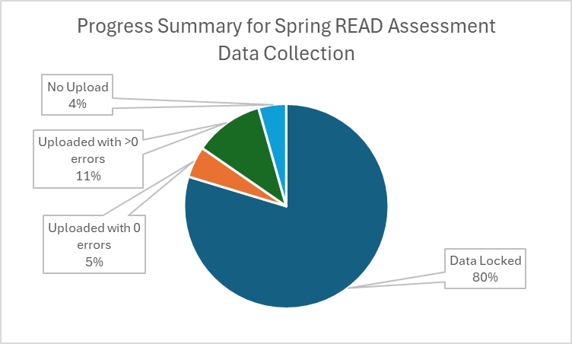
Spring READ Assessment Data Collection
Status Update
Status Update:
About three-fourths of the state has locked their file. Thank you!
Dates:
Collection Close Date: 6/13/25 (Tomorrow!)
Duplicate Phase: 6/16-6/20
Please use the week between 6/6 and 6/13 to confirm your SRD count and percentage.
Spring READ Assessment
READActData@cde.state.co.us

Slide 14
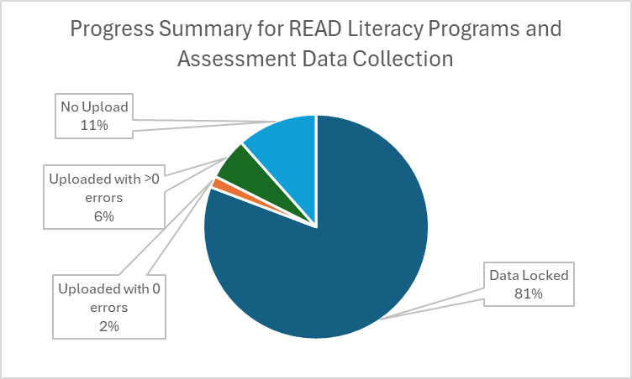
READ Literacy Programs and Assessment
Status Update
Status Update:
More than three-fourths of the state has locked their file. Thank you!
Dates:
Collection Close Date: 6/13/25 (Tomorrow!)
Target Date for an Error-Free File: 6/6/2025
Please note that this collection runs in the same window as the Spring READ Assessment collection but is a separate upload.
READ Literacy Programs and Assessment
READActData@cde.state.co.us

Slide 15
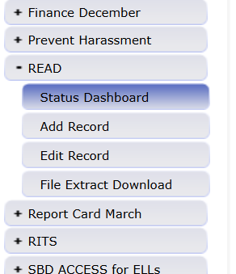
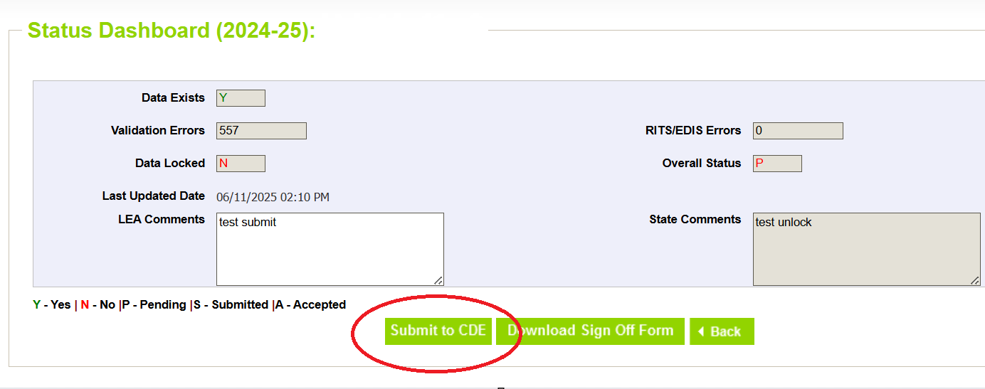
READ Data Collections
Final Steps to Close Out Collection
To Lock:
Please click on the READ gray box along the left-hand side;
Click on the Status Dashboard submenu;
On the main screen, select a file type (either READ Literacy or READ Assessment) and hit Search;
Then, scroll toward the bottom and find the "Submit to CDE" button.
Spring READ Assessment
READActData@cde.state.co.us

Slide 16
READ Training

Slide 17
READ Training
General Information
READ Training Collection:
Dates: 8/1/2025 - 8/31/2025
The READ Training Export Report is in production with the updated file layout.
Training Opportunities:
July 15 from 1-2pm; more oriented for district data respondents
  More information at this link
READ Training Collection
READActData@cde.state.co.us

Slide 18
Questions & Resources:
READ Act Data Collections
Tara Rhodes
READActData@cde.state.co.us
Phone: 720.601.4125
Websites:
Spring READ Assessment Collection
READ Literacy Programs and Assessment Collection
READ Training Collection

Slide 19
Student Attendance
Peter Hoffman

Slide 20
Student Attendance Collection Timeline
Date | Event | Event Description
05/23/2025 | Interim Deadline | Create an initial Attendance Snapshot
06/11/2025 | Interim Deadline | Error free Student Interchange file uploads
06/20/2025 | Interim Deadline | Submit any necessary reporting exceptions for review.
06/27/2025 | Interim Deadline | Error free Attendance Snapshot
07/03/2025 | Report Review | Review Attendance Cognos Reports for data validation. Submit Attendance Snapshot data as soon as review is complete.
07/11/2025 | Deadline | Submit Attendance Snapshot data.
07/25/2025 | Deadline | Collection closes Superintendent Verification (sign-off) form due. Data remains embargoed until the official release in August.
08/21/2025 | Data Release | Official data release
Student Attendance – Peter Hoffman
Attendance@cde.state.co.us

Slide 21
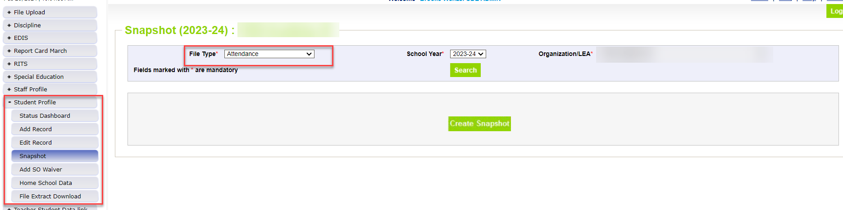
Creating Attendance Snapshot
Attendance Snapshot is located under Student Profile
  Select Student Profile then Snapshot
  Fill out prompts for Attendance (File Type: Attendance, School Year: 2024-25, Organization/LEA should auto-fill)
Student Attendance – Peter Hoffman
Attendance@cde.state.co.us

Slide 22
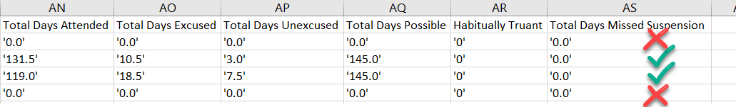
AS020 Error
Student must be in DEM and SSA file (error free!)
Check your Attendance Fields (Student School Association File)
Attendance Fields must be formatted correctly and not NULL
Zero-fill will automatically exclude the student from the snapshot (do not meet Total Days Possible >= 10.0)
  Attendance Snapshot Layout contains criteria to be included in snapshot
Exception Needed?
  Misreported in OCT
  Total Possible Attendance Days is less than 10.0
  Etc..
Student Attendance – Peter Hoffman
Attendance@cde.state.co.us

Slide 23

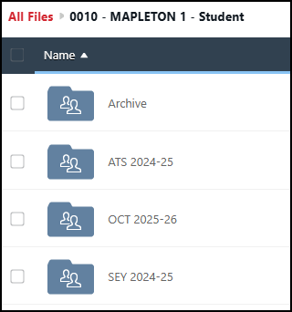
Student Exception Request Process
Process
Download exception request template
Select and complete the applicable tab of the request document
Save the exception to your computer with a unique name
Upload the complete request to your LEA’s student Syncplicity folder using the applicable subfolder for the collection/time of year
Email the applicable collection lead to notify them a request is ready for review
Remember to check the exception request directions.
Remember to use the Snapshot Tab for ATS exception requests!
Syncplicity Folder & Collections
Student Interchange, Student October, Student End of Year, and Student Attendance utilize the same Syncplicity folder
  District Code – DISTRICT NAME – Student
Subfolders indicate the collection
  Example: ATS 2024-25
Student Attendance – Peter Hoffman
Attendance@cde.state.co.us

Slide 24
Questions & Resources:
Student Attendance
Peter Hoffman
Attendance@cde.state.co.us
720-925-8611
Attendance Webpage
Student Interchange Webpage

Slide 25
School Code Changes
Jessica Tribbett

Slide 26
School Code Changes Reminders
DUE NO LATER THAN 6/30/25
School Code Changes Include
Closing or merging school codes
Adding or removing grades served
Changing a school name
Requesting a new school code
School Change Request Forms
School Code Change - Directory
Tribbett_Jessica@cde.state.co.us

Slide 27
School Code Change Resources
Tribbett_Jessica@cde.state.co.us

Slide 28
Instructional Days and Hours
Jessica Tribbett

Slide 29
Instructional Days and Hours – HB24-1063
HB24-1063 - the department shall collect from schools of a school district, district charter schools, school districts, institute charter schools, and the state charter school institute, at a minimum, the following data:
Instructional hours for elementary and secondary schools
Days of instruction for elementary and secondary schools
Estimated non-instructional hours, school closures, snow days, and time spent on lunch and passing between classes
Instructional Days and Hours
DirectoryData@cde.state.co.us

Slide 30
Instructional Days and Hours:
Timeline and Reminders
NEW! Collection Timeline
OPEN: Tuesday, September 2nd
CLOSE: Friday, December 5th
Where to start
Find your District's School Board Policy on instructional time to know if recess and/or passing is considered instructional time.
Collect planned calendars and bell schedules from all the schools in your district.
Instructional Days and Hours
DirectoryData@cde.state.co.us

Slide 31

Instructional Days and Hours – Relation to finance
Different data definitions for similar fields.
DO NOT mistake for October Count Audit data requirement.
Instructional Days and Hours
DirectoryData@cde.state.co.us

Slide 32
Instructional Days and Hours – Office Hours
Instructional Days and Hours Office Hours
Tuesday 6/17 - 1 p.m.- 2 p.m.
Register for 6/17 Office Hours here
Instructional Days and Hours
Tribbett_Jessica@cde.state.co.us

Slide 33
Questions & Resources:
Instructional Days and Hours Resources
Periodic Data Collection: Instructional Days and Hours Website
File Layout
FAQ's
Developing Resources
Office Hours?
DirectoryData@cde.state.co.us

Slide 34
Special Education Discipline
Lindsey Heitman

Slide 35
Special Education Discipline
Reporting Reminders
Timing is important to be aware of when processing this collection
Always check the status (see next 2 slides) of your district(s) Discipline Action file before creating a snapshot
  Confirm a file has been uploaded by each member district (unless they have no discipline actions for all students)
  Confirm the file has processed successfully and how many errors
    check # of records and # of errors
    If file has processed but has errors on every record, the data will still not pull into the Sped Disc Snapshot
      REMINDER: only error-free interchange records get pulled into any snapshot!
District respondents (DIS role) can see their AU snapshot errors in the following cognos report found in the Discipline Interchange folder:
  Sped Discipline Snapshot Error Detail Report (screenshot in 2 slides)
  Keep in mind, the AU is ultimately responsible for clearing the snapshot errors, but the data changes can be needed in one of several different files – SSA file, Participation File, or Discipline Action file
Special Education Discipline – Lindsey Heitman
SpedDiscipline@cde.state.co.us

Slide 36
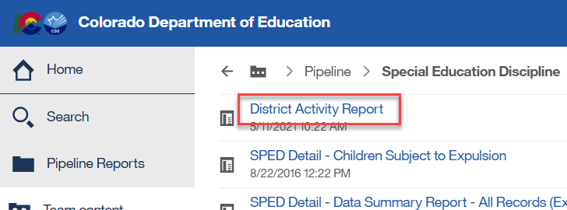
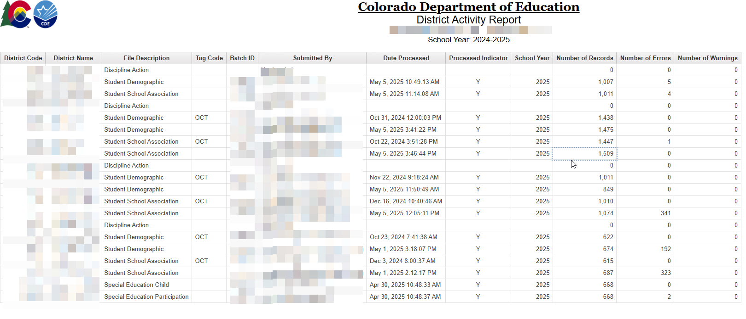
Special Education Discipline
Helpful Status Report for AU Respondents to see District Files Status
‘District Activity Report’ found under Cognos Reports/Special Education Discipline
Shows status of all interchange files that feed data into the snapshot
Special Education Discipline – Lindsey Heitman
SpedDiscipline@cde.state.co.us

Slide 37
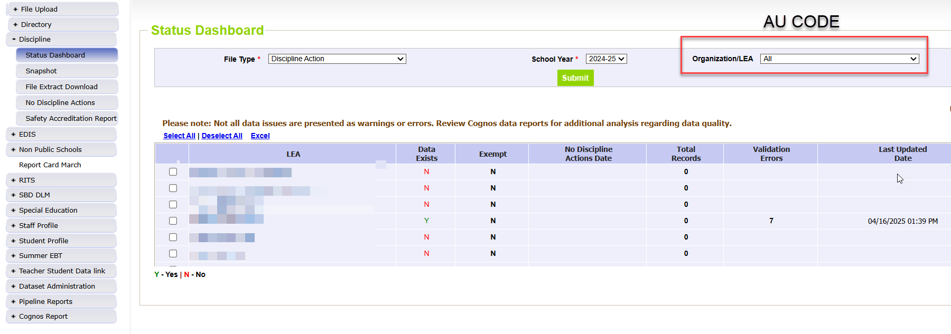
Special Education Discipline
Helpful status screen for AU respondent to see file upload status of their district(s)
AUs (SPI role) can see file status of all member districts under
Discipline/Status Dashboard by filtering on File Type: Discipline Action
Special Education Discipline – Lindsey Heitman
SpedDiscipline@cde.state.co.us

Slide 38
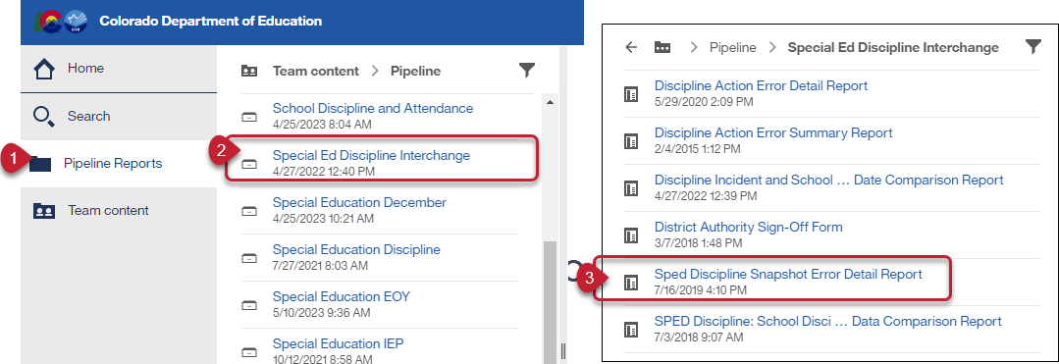
Special Education Discipline:
District Respondent Report For Viewing Snapshot Level Errors (DIS role)
This report allows the district respondent to see the Sped Discipline Snapshot errors.
Special Education Discipline – Lindsey Heitman
SpedDiscipline@cde.state.co.us

Slide 39
Questions & Resources:
Special Education Discipline
Lindsey Heitman
SpedDiscipline@cde.state.co.us
Discipline Interchange Webpage
Special Education Discipline Snapshot Webpage

Slide 40
Special Education End of Year
Lindsey Heitman

Slide 41
Special Education End of Year:
Timeline and Training
  Upcoming Training
  Special Education Discipline Annual Snapshot Training
    Tuesday May 6th 10:00 – 11:30
      Overview of the snapshot data required and process in Data Pipeline
  Upcoming Training
  Special Education Discipline Annual Snapshot Training
    Tuesday May 6th 10:00 – 11:30
      Overview of the snapshot data required and process in Data Pipeline
2024-2025 Special Education EOY Snapshot Timeline
  Upcoming Training
  SPED EOY Training/Office Hours –
    More coding scenarios and exit guidance
    Thursday June 12th - 1:00 –2:30
    Join the meeting now
  Posted Trainings:
  Special Education EOY Snapshot webpage
  5/13 - purpose, content, IEP Interchange, SPED EOY Snapshot, who to report
  5/21 - exceptions, Medically Nec Services, path data (initial referrals and delay codes)
  Should be posted soon:
  5/28 - coding initial referrals, Data Pipeline process
May 1, 2025 - SPED EOY Snapshot official open
June 26, 2025 – IEP Interchange files error-free (2 weeks away!)
September 4, 2025 - All Exception requests submitted to CDE
September 11, 2025 – All errors resolved at snapshot/interchange
September 12 -19, 2025 -Initial Report Review
September 22 - 26, 2025 – Resolving duplicates
September 29 – October 1, 2025 – Final Report Review
October 3, 2025 - Final submission due to CDE
Special Education EOY – Lindsey Heitman
SpedEndofYear@cde.state.co.us

Slide 42

Special Education EOY
Updates
Snapshot processing error for a couple of AUs
  Issue is not affecting most AUs so far
Special Education EOY – Lindsey Heitman
SpedEndofYear@cde.state.co.us

Slide 43
Special Education EOY
Business Rule Changes:
Errors or Warnings
Both of these warnings will switch to an error this year:
SY309: If student is currently in or will begin a Sped transition program next year, the Sped EOY Basis of Exit should be zero-filled
SY295: Student is being reported with an exit type of 01, 02, 05, 06, 14, 40, 70, 90, 92, 93, or 94 in the regular EOY collection. Please confirm and exit the record in Special Education EOY.
  Switched from a warning to an error and more exit codes added to the check
  Logic: Trigger an error if Student EOY Snapshot School Exit Type = 01, 02, 05, 06, 14, 40, 70, 90, 92, 93, or 94; UNLESS Retention Code is 3.
  Still in progress – not in production yet
  This will force Sped EOY exits to match their district(s) Student EOY exits in most cases
    This will help the AUs find those “missing exits” that can cause your indicator percentages to flag and require extra
    The “missed exits” affect your indicator 14 sample, indicator 1 graduates, Indicator 2 dropout percentage, etc.
    any feedback or concerns?

Slide 44
Questions & Resources:
SPED End of Year
Lindsey Heitman
SpedEndofYear@cde.state.co.us
Special Education IEP Interchange Webpage
Special Education End of Year Snapshot Webpage

Slide 45

Thank you for Joining Today!
Next Town Hall will be June 26th
Reminder:
No Town Hall June 19th due to the holiday!

