Slide 1
January 30, 2025
Data Pipeline Town Hall
The goal of the webinar is to provide updates on the Data Pipeline, current, and upcoming data collections. These webinars also provide a forum for districts, BOCES, and Administrative Units to have questions answered about Data Pipeline.

Slide 2
Colorado Department of Education
Identity Management (IdM)
Identity Management Site
Frequently Asked Questions
How do I add myself or others to the email listserv for town hall emails and/or a specific collection?
  Email lists are dependent on a person’s access rights in IdM. Contact your LAM to get an account or be assigned to a specific collection.
Where can I find the IdM role mappings for Data Pipeline and other applications?
  Role Mapping (XLS)
I am a LAM. How do I update the user permissions for someone in my district?
  Follow the steps outlined in the IdM Quick Guide for Access Management (DOCX)
Important: Users are not automatically removed from IdM when their email address is no longer active in your district. The LAM must deactivate their IdM account to ensure only designated staff can access CDE’s data reporting system.
Notes:
LAMs, please check the IdM roles for your district. Remove permissions for users who have retired, left your district, or are no longer assigned to a collection. Add roles for new hires and newly assigned respondents for specific collections.

Slide 3

What is PII?
Student and Staff Personally Identifiable Information (PII) is defined by state and federal laws as information that, alone or in combination, personally identifies an individual
  This includes direct identifiers
  (i.e. student and staff names, SASID, EDID, etc.)
  Includes information that when combined is identifiable
Colorado’s Student Data Transparency and Security Act outlines requirements for how Student PII is collected, used and shared
See the Data Privacy and Security website for prepared guidance on how to comply with this and other privacy laws.

Slide 4

Sharing Data
Use secure methods to transfer any PII to CDE
  Contact Data Collection leads with questions about how to transmit PII securely
    Each Data Collection leads maintains their own Syncplicity folders for specific collections, reach out to the collection lead for access
  Use Syncplicity to encrypt emails to CDE
Avoid sending PII via unencrypted email or to unsecured faxes when sharing data between or within districts
  Use Syncplicity to encrypt emails to CDE
Check local policies for restrictions, requirements, etc. regarding PII
  Do not use PII in trainings, presentations, etc.
  Do not share PII with unauthorized individuals
  Do not share passwords
  Follow local policies when transmitting PII to any third party

Slide 5
Today’s Agenda
Agenda Topic | Presenter
Open Data Collections and Upcoming Deadlines in Data Pipeline | Host: Lindsey Heitman
Teacher Student Data Link | Peter Hoffman
Special Education December Count | Lindsey Heitman
Human Resources | Dawna Gudka
Discipline Action Interchange Update | Dawna Gudka
Reduced Academic Calendar | Jessica Tribbett
School Code Change Requests | Jessica Tribbett
Summer EBT | Collin Slutzky

Slide 6
Open Collections and
Upcoming Deadlines in
Data Pipeline

Slide 7
Open Collections and Upcoming Dates:
Year-Round & Interchanges
Name | Category | Status | Key Dates
RITS | Year Round | Open | N/A
EDIS | Year Round | Open | N/A
Directory | Year Round | Open | Reduced Academic Calendar: 2/5/2025 to 5/9/2025 School Code Change Requests: 2/5/2025 to 6/30/2025
Student | Interchange | Open | February Recommendation: Update DEM & SSA files
At-Risk | Interchange | Closed | N/A
Title I | Interchange | Open | May 2025: Update file in preparation for SEY reporting
Special Education IEP | Interchange | Open | Error free files required for SPED December Count
Staff | Interchange | Open | Error free files required for SPED December and Human Resources
Teacher Student Data Link | Interchange | Open | Opened 12/11/2024
Data Pipeline Resources: Data Pipeline Collection Dates (XLS)

Slide 8
Open Collections and Upcoming Dates:
Snapshots
Name | Category | Status | Final Deadline Date | Next Milestone | Looking Ahead
Special Education December Count | Snapshot | Open | Feb. 21, 2025 | Interim Deadline: 01/30/2025 Snapshot error-free | 1/30/2025 – 2/07/2025 Report Review
Human Resources | Snapshot | Open | Feb. 21, 2025 | 1/24-1/31/2025 Report Review | Collection deadline 2/21/25
Teacher Student Data Link |  | Closed | Aug. 29, 2025 | Interchange Opened: 12/11/2024 | Snapshot Opens: 2/19/2025
Data Pipeline Resources: Data Pipeline Collection Dates (XLS)

Slide 9
Open Collections and Upcoming Dates:
Periodic
Name | Category | Status | Final Deadline Date | Next Milestone | Looking Ahead
Summer EBT | Periodic | Closed | Feb. 28, 2025 | Collection Opens: 2/3/2025 LEAs may begin uploading Summer EBT files to Pipeline
Data Pipeline Resources: Data Pipeline Collection Dates (XLS)

Slide 10
Teacher Student Data Link (TSDL)
Peter Hoffman

Slide 11
2024-2025 TSDL Timeline
Date | Event | Event Description
Wednesday, February 19, 2025 | Open | TSDL Snapshot opens.
Friday, May 16, 2025 | Interim Deadline | TARGET: Date by which you should have uploaded the TSDL Upload interchange file at least once
Friday, June 13, 2025 | Interim Deadline | TARGET: Date by which the TSDL Upload interchange should be uploaded and error free.
Friday, June 27, 2025 | Interim Deadline | TARGET: Date by which the TSDL snapshot should be created at least once.
Friday, August 22, 2025 | Interim Deadline | TARGET: Date by which you should have a complete Teacher Student Data Link Snapshot. Complete Teacher Student Data Link Snapshot means: All TSDL interchange errors are resolved All TSDL snapshot errors are resolved If you anticipate that you will not be able to meet this deadline, please contact CDE at TeacherStudentDataLink@cde.state.co.us
Monday, August 25, 2025 – Thursday, August 28, 2025 | Report Review | Final Snapshot Report Review – This is your opportunity to review reports in detail and make any data corrections you deem necessary to make sure you are reporting valid and reliable data. All data corrections must be completed during this time.
Friday, August 29, 2025 | Deadline | Required to have TSDL snapshot error free and finalized before or on this date. TSDL closed and final report is signed and provided to CDE via email TeacherStudentDataLink@cde.state.co.us
Teacher Student Data Link
TeacherStudentDataLink@cde.state.co.us

Slide 12
CDE Identity Management Roles for TSDL
Users will require 2 roles to complete TSDL, one for the interchange / data file upload, and one for the snapshot
Teacher Student Data Link Interchange Roles:
  TSL~ LEAUSER – upload and modify TSDL interchange files OR
  TSL~LEAVIEWER – view (only) TSDL interchange data
Teacher Student Data Link Snapshot Roles:
  TLS~LEAAPPROVER – Approves, creates, views Snapshot OR
  TLS~LEAUSER - creates, views Snapshot OR
  TLS~LEAVIEWER- views snapshot
Please note the swapped letters in the prefix TLS vs TSL
  Often, users are given 2 roles with the TLS prefix in error which does block access
  “S” at the end is for “Snapshot”
Teacher Student Data Link
TeacherStudentDataLink@cde.state.co.us

Slide 13
Tips for 2024-2025
Upload a file to the TSDL interchange early – use first half of the year data.
  This will give you a clear picture into what errors or missing data you will be encountering and give ample time to resolve them or reach out for assistance before the final deadline in summer.
Reminder: 2024-2025 TSDL data will be utilized as a part of 9th grade success reporting. Please ensure that your course completion status field is being calculated / populated correctly.
  Link to Colorado Legislature HB24-1282
Teacher Student Data Link
TeacherStudentDataLink@cde.state.co.us

Slide 14
Tips for 2024-2025 continued
Common Errors:
  Local Course Title Field (column D2) is where we see the most common error that prevents an upload into pipeline. If there are commas in your local course title this will cause a shift in data.
  Leading Zero's – Leading zeros being deleted by opening the file often cause the most errors. CDE has a resource if you need to open your file after extract to keep your leading zeros on our Data Pipeline Resources Page.
  TD087 – Course Completion Status must be valid
    This may be flagging for courses that are still in progress
    Double check what semester the error is flagging for – if it is for the first half of the year corrections may be needed. If it is for current classes, it may resolve once the school year ends.
Teacher Student Data Link
TeacherStudentDataLink@cde.state.co.us

Slide 15
Special Education
December Count Snapshot
Lindsey Heitman

Slide 16
Special Education December Count:
Staff and Student Snapshot Timeline
November Due Dates
December Due Dates
January Due Dates
30th - Thursday - All errors resolved – complete snapshot
February Due Dates
10th – 18th - Monday – Tuesday - Resolving Duplicates
1st - Sunday - Official count date (or last date prior your school was in session)
30th - Feb 7th Thursday – Friday - Report Review
18th – 21st - Tuesday - Friday - Final Report Review
21st - Friday - Final Submission Due
1st - Friday – Sped December Count Snapshot available in Data Pipeline
13th – Wednesday - Interchange files uploaded - Sped Child, Sped Participation, Staff Profile, Staff Assign
18th - Wednesday: Interchange files error free and at least one snapshot created
DEADLINE TODAY January 30th
  Date to have a complete Special Education December Count Snapshot:
    All Staff and IEP Interchange errors resolved
    All Dec Staff Snapshot errors resolved
    All Dec Student Snapshot errors resolved
Special Education December Count – Lindsey Heitman
SpedDecCount@cde.state.co.us

Slide 17
Special Education December Count – Status
December Count Snapshot Status *as of 7am this morning
45 Admin Units– error free in both student and staff snapshots
52 Admin Units – error free in one or both snapshots
  THANK YOU to AUs and Staff/HR respondents for working together on this data!
24 Admin Units – still working to get staff or student data error free
GREAT JOB!
Special Education December Count – Lindsey Heitman
SpedDecCount@cde.state.co.us

Slide 18
Special Education December Count - Student and Staff Signature Reports – Please review now but not due to signed or printed for upload until February 21
Cognos Reports→ Special Education December Folder:
December Student Cognos Validation Reports: 2.0 Student Data Validity Certification 2.1 Significant Year to Year Report by Age Group and Disability
2.2 Significant Year to Year Report by Age Group and Race/Ethnicity
2.3 Significant Year to Year Report by Age Group and Educational Environment
2.4 Significant Year-to-Year Educational Orphan Report
2.5 Indicator 5: Number of Students Aged 6-21 by Educational Environment
2.6 Indicator 6: Number of Students Aged 3-5 by Educational Environment
2.7 Number of Reported Students by Special Education Funding Status by Administrative Unit and Disability
2.8 Number of Reported Students Parentally Placed in a Private School by Disability and Type of Service
2.9 Indicator 9: Disproportionate Representation of Racial and Ethnic Groups in Special Education Ages 3-21
2.10 Indicator 10: Disproportionate Representation of Racial and Ethnic Groups in Specific Disability Categories in Ages 3-21
*Please review Student Warnings
December Staff Cognos Validation Reports:
1.0 Staff Data Validity Certification
1.1 Summary of Special Education Staff by Administrative Unit, District & Job Classification Category
1.2 Summary of Job Classification by District Purchased Service Staff
1.4 Special Education Directors & Child Find Coordinators
SAM 1.5 Non-Qualified Personnel Status
*Please review Staff SAM Warnings DC208, DC209, DC210, DC211
SpedDecCount@cde.state.co.us

Slide 19
Special Education December Count
Error DC234
DC234: A matching endorsement for the teaching subject area code reported was not found for this teacher in the license database. Please update the field 'Demonstrates In-Field Status 1' to another code (02= Degree; 03=36 Semester Hours; 04=Passed Exam; 05=Out of Field.
  A staff member with either a TEE or an interim authorization is technically not "in-field," as they have not yet demonstrated content knowledge to obtain a full initial or professional license.
  They do not hold a license (key word) with the endorsement.
    Examples - staff with a Temporary Educator Eligibility or Alternative Interim Authorization: Special Education Generalist endorsements cannot be marked with code 01 for Demonstrates In-Field Status.
    To clear error DC234, you will want to adjust it to a code other than 01 and it is common to have to report 05 – Out of Field.
SAM Note:
staff is on the path toward meeting full requirements so he/she should pass the Staff Approval Matrix warnings
SAM warnings are a separate validation from the Demonstrates In-Field Status check
Special Education December Count – Lindsey Heitman
SpedDecCount@cde.state.co.us

Slide 20
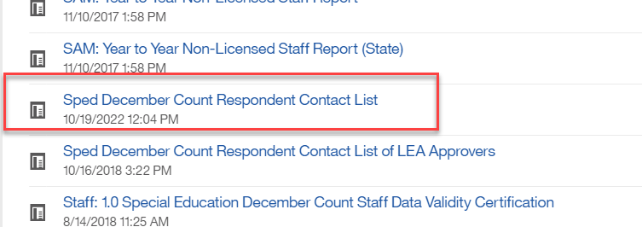
Special Education December Count:
Student Duplicate Warnings
Duplicate Students – check for these warnings
  DC154: Another AU is also claiming a Funding Status of 50 for this student. Please verify attendance and enrollment records for December 1st. If your record is correct, you may leave it the same.
  DC214: Another AU is reporting that this student is attending in their AU. Please verify attendance and enrollment records for December 1st. If your record is correct, you may leave it the same and ignore this warning.
    The other reporting AU is included in the far right column of the error report
    Reference ‘Pupils Attendance Information Codes’ document from December Count Snapshot webpage under Additional Links for help with PAI and Funding Status Codes.
    Contact List found in Cognos→Special Education December folder
Special Education December Count – Lindsey Heitman
SpedDecCount@cde.state.co.us

Slide 21
Questions & Resources:
Special Education December Count
Lindsey Heitman
SpedDecCount@cde.state.co.us
(720) 456-2033
Special Education IEP Interchange Webpage
Special Education December Snapshot Webpage

Slide 22
Human Resources
Dawna Gudka

Slide 23
Human Resources:
Collection Timeline
Date | Event | Event Description
1/24/25 | Interim Deadline | Human Resources Snapshot Error Free
1/24-1/31/25 | Report Review | Review Special Education Staff Report via Cognos in the Human Resources folder) for accuracy to ensure all special education staff reported within your district is appropriate. Collaborate with your LEA’s Administrative Unite during this process. Verify that all staff are accurately reported.
2/14/25 | Interim Deadline | Staff Profile and Staff Assignment interchange files, and Human Resources Snapshot Error Free
2/21/25 | Deadline* | Human Resources Snapshot must be submitted to CDE and verification emailed to Human Resources Snapshot
Human Resources Snapshot Collection
HumanResourcesData@cde.state.co.us

Slide 24
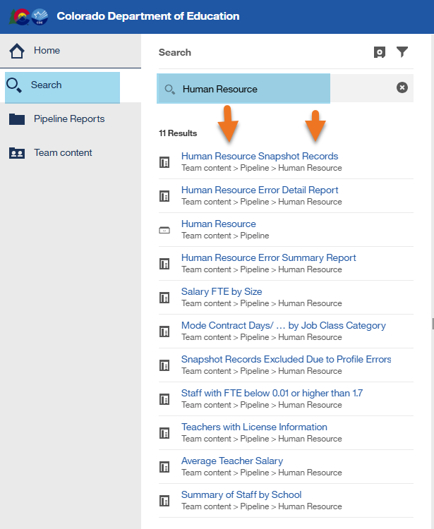
Human Resources Cognos Reports
Use the different Cognos Reports to validate your data before you submit your data
Snapshot Records get reported
Human Resources Snapshot Collection
humanresourcesdata@cde.state.co.us

Slide 25
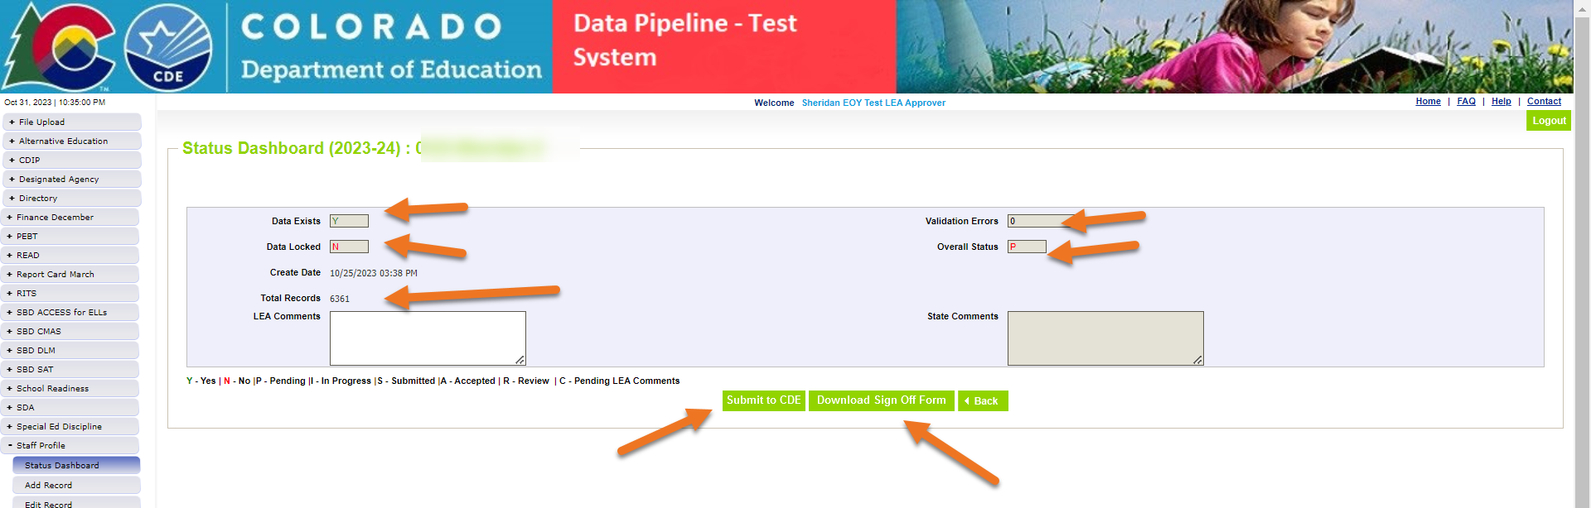
Submit your Human Resources Snapshot Data
Interchange files are error free
Snapshot files are error free
Data has been verified
Time to get you data to submitted
Human Resources Snapshot Collection
humanresourcesdata@cde.state.co.us

Slide 26
Questions & Resources:
Human Resources
Collection Resources:
Staff Interchange website
Human Resources Snapshot website
Dawna Gudka
HumanResourcesData@cde.state.co.us
(303) 598-7901

Slide 27
Discipline Action File Layout Change
Dawna Gudka

Slide 28
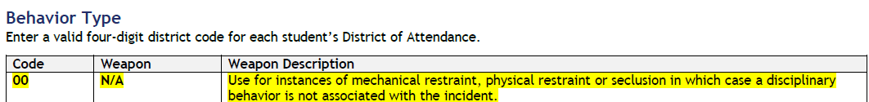
Changes approved by EDAC to the File Layout-Discipline Action File
New Behavior Type
00 N/A Use for mechanical restraint, physical restraint or seclusion
Student Discipline Snapshot
Student Discipline Snapshot

Slide 29

Example of a record in Discipline Action file for student restrained
  Example of Student Physically Restrained
  Discipline Action File
  Behavior 00 (Column G, Behavior code)
  Discipline 00 (Column P, Discipline Action Type)
  Physically Restrained 1 indicating yes (Column T, Physically Restrained)
  Discipline Action Length should be zero filled
Student Discipline Snapshot
Student Discipline Snapshot

Slide 30

Student Discipline Training
February 12th 10AM
Microsoft Teams Need help?
Join the meeting now
Meeting ID: 236 229 084 584
Passcode: of2ne7Ty
February 26th 10AM
Microsoft Teams Need help?
Join the meeting now
Meeting ID: 240 890 140 359
Passcode: gC2zh7Wp
Student Discipline Snapshot
Student Discipline Snapshot

Slide 31
Questions & Resources:
Student Discipline
Collection Resources:
Discipline Interchange Website
Student Discipline Snapshot Website
StudentDiscipline@cde.state.co.us
Dawna Gudka
(303) 598-7901

Slide 32
Reduced Academic Calendar formally 4 Day School Week
Jessica Tribbett

Slide 33
Reduced Academic Calendar - Overview
Reduced Academic Calendar Requests*
Fewer than 160 contact days
2/6/2025 – 5/9/2025
*Formally the 4 Day School Week
The general process is the same:
Complete Reduced Academic Calendar Request form in Data Pipeline.
If your district is on a district wide improvement plan, you will need to extra documentation to field services via this webform.
Field services and the commissioner will approve by 6/30/2025 and districts will be notified.
Contact me at Tribbett_Jessica@cde.state.co.us

Slide 34
Reduced Academic Calendar - Fields
Request form field updates:
Field Name | Previous Location | New Location
Reduced Academic Calendar (Y/N) | Previously named 4 Day Week Y/N - school level data | Name change – school level data
4 Day School Week | School level data | School level data
Day Not in Session | District level data | School level data
# of Days is Session | District level data | School level data
# of Elem. Hours Scheduled | District level data | School level data
#of Secondary Hours Scheduled | District level data | School level data

Slide 35
School Code Change Requests
Jessica Tribbett

Slide 36

School Code Change Requests Overview
School Code Changes for 2025-2026 opens on February 5th, 2025
School Code Changes considered are:
New School Code
School Name Change
School Grade Change
Request for Closing/Merging Schools
These request require the School Code Change Request Forms to be submitted for approval. The form requires your superintendents/directors' signature before the request can be reviewed.
Contact me at Tribbett_Jessica@cde.state.co.us

Slide 37
School Code Request Process
The process for a school code change request is as follows:
Request is submitted
School Code Review Committee reviews request
School Code Review Committee votes to approve request or suggest alternative scenarios for moving forward
District notified of approval or SCRC's suggestions for moving forward
Signature page is received
Contact me at Tribbett_Jessica@cde.state.co.us

Slide 38
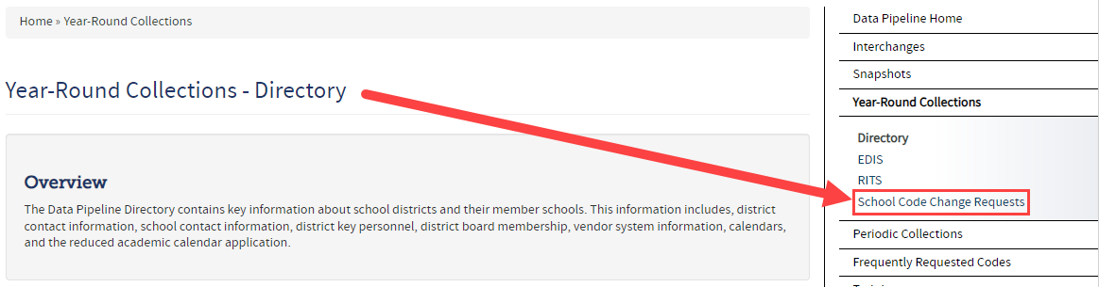
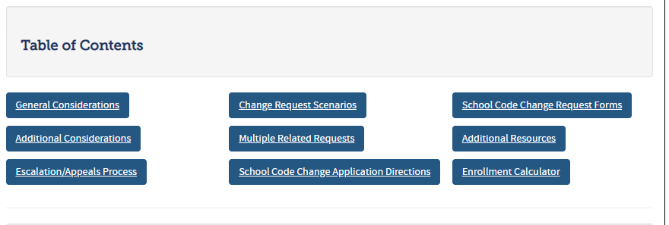
School Code Request Website and Information
School Code Change Request website:
https://www.cde.state.co.us/datapipeline/schoolcodechanges
Contact me at Tribbett_Jessica@cde.state.co.us

Slide 39
School Code Requests
Questions & Resources
Jessica Tribbett
Tribbett_Jessica@cde.state.co.us
720-693-6035

Slide 40
Summer EBT
Collin Slutzky

Slide 41
Summer EBT Data Collection
Data Collection begins February 3rd.
File layout is unchanged from last year.
Error-free files must be submitted by February 28th.
Districts have the following options for submitting student records:
  Submit data for all students enrolled in National School Lunch Program sites only.
  Submit data for all students enrolled in NSLP sites and data for any F/R eligible transfer students to non-NSLP sites during the school year (any student that was enrolled at a NSLP site, even for a short period of time, would be eligible for S-EBT benefits)
  Submit data for all enrolled students at both NSLP sites and non-NSLP sites.
Submitting data for all enrolled students will be the easiest option for most districts, as your S-EBT reports from your SIS likely use this option.
s-ebt@cde.state.co.us
Summer EBT
Notes:
Your district schools are most likely receiving calls from families to update their address, make sure you are in contact with the appropriate people to make sure this updated information is being captured in the summer EBTcorrections.

Slide 42
Summer EBT Data Collection:
Preparing for the Collection
Verify that Free and Reduced Lunch status is up-to-date for all students.
Every student must have one listed parent/guardian with a valid address.
  Issues with parent/guardian info will delay benefit issuance.
Check the S-EBT report in your SIS and make sure it matches the S-EBT file layout available on the data collection resource page.
  If the S-EBT report from your SIS is missing or incorrect, please contact your vendor immediately and include Collin Slutzky (slutzky_c@cde.state.co.us) on communications.
Plan to submit your first file by Friday, February 7th so you have plenty of time to correct errors.
Bookmark the form to schedule office hours in case you have issues uploading your file or resolving errors. Schedule a meeting with us in January if you would like additional training.
Summer EBT
s-ebt@cde.state.co.us

Slide 43
Summer EBT Data Collection:
Additional Resources
CDE Nutrition will be hosting a training today at 2PM.
  Use this link to register
A data collection manual covering the basic process of submitting S-EBT data will be available soon on the collection resources page.
Summer EBT
s-ebt@cde.state.co.us

Slide 44
Questions & Resources:
Summer EBT
Collin Slutzky
s-ebt@cde.state.co.us
(720) 760-3569
S-EBT Data Collection Resources

Slide 45

Thank you for Joining Today!
Next Town Hall will be February 5th
Reminder:
When emailing us, please provide your 4-digit district number or 5-digit AU number.

