Slide 1
July 24, 2025
Data Pipeline Town Hall
The goal of the webinar is to provide updates on the Data Pipeline, current, and upcoming data collections. These webinars also provide a forum for districts, BOCES, and Administrative Units to have questions answered about Data Pipeline.

Slide 2
Colorado Department of Education
Identity Management (IdM)
Identity Management Site
Frequently Asked Questions
How do I add myself or others to the email listserv for town hall emails and/or a specific collection?
  Email lists are dependent on a person’s access rights in IdM. Contact your LAM to get an account or be assigned to a specific collection.
Where can I find the IdM role mappings for Data Pipeline and other applications?
  Role Mapping (XLS)
I am a LAM. How do I update the user permissions for someone in my district?
  Follow the steps outlined in the IdM Quick Guide for Access Management (DOCX)
Important: Users are not automatically removed from IdM when their email address is no longer active in your district. The LAM must deactivate their IdM account to ensure only designated staff can access CDE’s data reporting system.
Support:
  Michael Threlkeld
  Forgot Password
  Request LAM Assistance
Notes:
LAMs, please check the IdM roles for your district. Remove permissions for users who have retired, left your district, or are no longer assigned to a collection. Add roles for new hires and newly assigned respondents for specific collections.

Slide 3

What is PII?
Student and Staff Personally Identifiable Information (PII) is defined by state and federal laws as information that, alone or in combination, personally identifies an individual
  This includes direct identifiers
  (i.e. student and staff names, SASID, EDID, etc.)
  Includes information that when combined is identifiable
Colorado’s Student Data Transparency and Security Act outlines requirements for how Student PII is collected, used and shared
See the Data Privacy and Security website for prepared guidance on how to comply with this and other privacy laws.

Slide 4

Sharing Data
Use secure methods to transfer any PII to CDE
  Contact Data Collection leads with questions about how to transmit PII securely
    Each Data Collection leads maintains their own Syncplicity folders for specific collections, reach out to the collection lead for access
  Use Syncplicity to encrypt emails to CDE
Avoid sending PII via unencrypted email or to unsecured faxes when sharing data between or within districts
  Use Syncplicity to encrypt emails to CDE
Check local policies for restrictions, requirements, etc. regarding PII
  Do not use PII in trainings, presentations, etc.
  Do not share PII with unauthorized individuals
  Do not share passwords
  Follow local policies when transmitting PII to any third party

Slide 5
Today’s Agenda
Agenda Topic | Presenter
Open Data Collections and Upcoming Deadlines in Data Pipeline | Host: Jessica Tribbett
District Calendars | Jessica Tribbett
Staff Evaluation | Dawna Gudka
Student End of Year | Reagan Ward
Student Discipline | Dawna Gudka on behalf of Carrie Martin
Prevent Harassment or Discrimination | Dawna Gudka on behalf of Carrie Martin
Instructional Days and Hours | Jessica Tribbett

Slide 6
Open Collections and
Upcoming Deadlines in
Data Pipeline

Slide 7
Open Collections and Upcoming Dates:
Year-Round & Interchanges
Name | Category | Status | Key Dates
RITS | Year Round | Open | N/A
EDIS | Year Round | Open | N/A
Directory | Year Round | Open | District Calendars: Open, due 8/29/25
Student | Interchange | 2025 & 2026 Open | 2024-2025: Maintain error free files 2025-2026: Open, register for 8/5 training
At-Risk | Interchange | Open | 2025-2026: Opened 7/16/25
Title I | Interchange | Open | 2024-2025: Maintain error free file 2025-2026: Coming Soon! Scheduled to open in Aug
Special Education IEP | Interchange | Open | Maintain error free files
Staff | Interchange | Open | Staff Profile and Staff Evaluation interchange files are needed for the Staff Evaluation Snapshot
Discipline Action | Interchange | Open | This interchange file is needed for Student Discipline Snapshot and Special Education Discipline Snapshot
Teacher Student Data Link | Interchange | Open | Maintain error free file
Data Pipeline Resources: Data Pipeline Collection Dates (XLS)

Slide 8
Open Collections and Upcoming Dates:
Snapshots
Name | Category | Status | Final Deadline Date | Next Milestone | Looking Ahead
Teacher Student Data Link | Snapshot | Open | Aug. 29, 2025 | Interim Deadline: 8/22/25 error free interchange and snapshot | Report Review: 8/25 to 8/28 Final snapshot report review
Staff Evaluation | Snapshot | Open | Oct. 15, 2025 | Report Review: 7/15 to 8/15 Final snapshot report review | State Deadline: Submitted snapshot and sign-off form
Student End of Year: Regular Phase | Snapshot | Open | Sept. 4, 2025 | Interim Deadline: 7/31/25 submit reporting exception requests *8/1 school level exceptions begin to be processed | Training Event: 8/12, 10:30-11:30am, SEY Office Hours—Reports and Data Validation
Student Attendance | Snapshot | Open | July 25, 2025 | Deadline: 7/11/25 Submit Attendance Snapshot | Deadline: 7/25/25 Collection closes; sign-off form due; data embargoed until Aug. release
Special Education Discipline | Snapshot | Open | Aug. 1, 2025 | Interim Deadline: 7/24 – all snapshot exception requests sent to CDE | Interim Deadline: 7/25 – all snapshot errors resolved
Student Discipline | Snapshot | Open | July 31, 2025 | Report Review: 7/8/25 to 7/26/25; validate data with COGNOS report and submit snapshot when review is complete | State Deadline: 7/31/25 submit data to CDE
Special Education EOY | Snapshot | Open | Oct. 3, 2025 | Interim Deadline: 9/4/25 all exception requests submitted to CDE for review | Interim Deadline: 9/11/25 error free snapshot
Data Pipeline Resources: Data Pipeline Collection Dates (XLS)

Slide 9
Open Collections and Upcoming Dates:
Periodic
Name | Category | Status | Final Deadline Date | Next Milestone | Looking Ahead
Summer EBT: Corrections Period | Periodic | Open | Sept. 3, 2025 | Corrections Period: 5/19/2025 to 9/3/2025
Prevent Harassment or Discrimination | Periodic | Open | August 1, 2025 | Report Review: 7/7/25 to 7/25/25, review reports and submit data once review is complete | State Deadline: 8/1/25 submit data to CDE
READ Training | Periodic | Coming Soon | Aug. 20, 2025 | Training: 7/15/25, 1:00-2:00pm Join via Zoom | Collection Opens: 8/1/25; Teachers, Principals, and Administrators should have training completed by this date
Data Pipeline Resources: Data Pipeline Collection Dates (XLS)

Slide 10
District Calendars
Jessica Tribbett

Slide 11
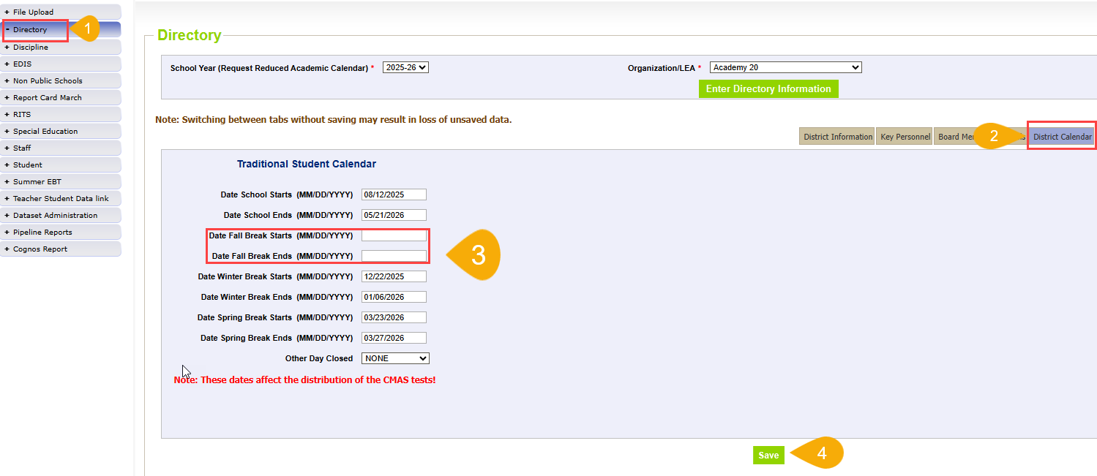
District Calendars: Data Pipeline Directory
DUE: 8/29/2025
Directory District Calendars
DirectoryData@cde.state.co.us

Slide 12
Staff Evaluation
Dawna Gudka

Slide 13
Staff Evaluation Timeline 2024-2025
Date | Event | Event Description
09-01-2024 | Open | Staff Profile Interchange Open
04-22-2025 | Training Event | Collection Training 1-2pm Microsoft Teams Meeting
05-12-2025 | Interim Deadline | Update and upload Staff Profile Interchange file
05-21-2025 | Open | Staff Evaluation Interchange Open
06-05-2025 | Interim Deadline | Error free Staff Profile Interchange file
06-19-2025 | Interim Deadline | Error free Staff Evaluation Interchange file
06-26-2025 | Interim Deadline | Create at least one Staff Evaluation Snapshot in Data Pipeline
07-15-2025 | Interim Deadline | Error free Staff Evaluation Snapshot
07-15- 08-15-2025 | Report Review | Final Snapshot Review- This is your opportunity to review reports in detail and make any data corrections you deem necessary to make sure you are reporting valid and reliable data. All data corrections must be completed during this time. If you anticipate that you will not be able to meet this deadline, please contact Dawna Gudka by email: Staff Evaluation
10-15-2025 | State Deadline | Staff Evaluation Snapshot Final Deadline Required to have Staff Evaluation Snapshot data submitted and sign off page signed and emailed to Staff Evaluation
10-16-2025 | Closed | Collection is no longer available for LEAs to make changes
Staff Evaluation
StaffEvaluation@cde.state.co.us

Slide 14
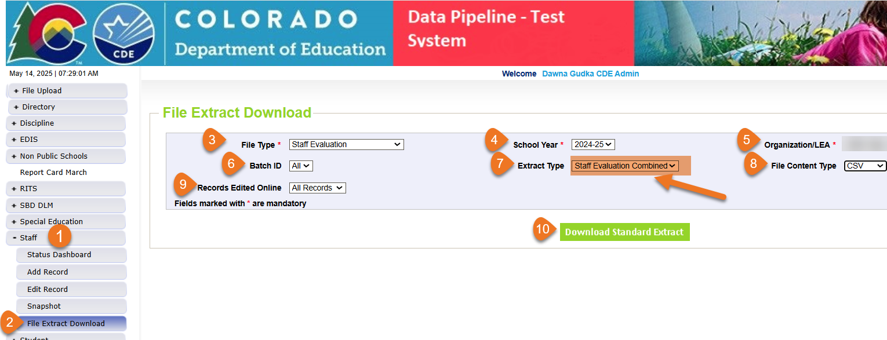
Staff Evaluation Interchange
Step that you should NOT SKIP if your LEA uses COPMS (RANDA)
Staff Evaluation Collection Manual
IMPORTANT STEP IF YOUR LEA USES COPMS (RANDA) do not skip this step. This step can be found on page 8 of the collection manual
Staff Evaluation
StaffEvaluation@cde.state.co.us

Slide 15

Staff Evaluation Snapshot Common Errors
EV030
EV004, EV005, EV006
This EDID was reported as a SSP, teacher or principal for the reported school year. Please add a record for this employee with their appropriate evaluation rating for the school year.
The EDID is listed in the more information section of the error.
The code 06 for teacher overall rating should be used minimally and only in extenuating circumstances (e.g., short-term disability). The percentage of records submitted exceeds 5%. To request an exception, visit cdeinfo.org/ses. For questions, contact EdTalentResearch@cde.state.co.us.
Copy and paste the URL address in a new browser window. There you will fill out EdTalents form to request the exception without providing any PII
Staff Evaluation
StaffEvaluation@cde.state.co.us

Slide 16
Questions & Resources:
Staff Evaluation
Staff Evaluation Snapshot Collection
Staff Interchange website
Staff Evaluation Snapshot website
Dawna Gudka
Collection Lead
(303) 598-7901
staffevaluation@cde.state.co.us

Slide 17
Student End of Year
Reagan Ward

Slide 18
SEY Collection Timeline
Date | Event | Event Description
7/31/2025 | Interim Deadline | Submit any necessary reporting exceptions for review School level errors will be processed beginning 8/1 (SE181, SE182, SE183, etc.)
8/12/2025, 10:30-11:30am | Training Event | August SEY Office Hours: August SEY Office Hours Registration Topic—Reviewing Reports and Data Validation
8/14/2025 | Interim Deadline | Error free SEY snapshot
8/14/2025 to 9/4/2025 | Report Review | Validate SEY data using CEDAR/COGNOS reports.
9/4/2025 | State Deadline | Submit SEY snapshot
9/5/2025 to 9/17/2025 | Closed | SEY Snapshot is closed until the start of the Cross LEA phase
9/18/2025 to 10/16/2025 | Cross LEA Phase | See the SEY Website for the detailed timeline
10/23/2025 to 11/18/2025 | Post-Cross LEA Phase | See the SEY Website for the detailed timeline
12/2/2025 | Deadline | Superintendent Verification (Sign-Off) form due. Collection Closes.
To be ‘on track’ for this collection, the following tasks should have been completed:
Error free interchange files (DEM, SSA, GG, Title 1 if applicable) with an upload date after 4/1/25
  OR waiting on an exception request to be reviewed for the remaining interchange errors
Collaborating with SPED reporting staff if applicable (IEP interchange files required to indicate a student as a SPED student in the SEY collection)
Created at least one SEY snapshot and begun resolving errors
Student End of Year
StudentEndOfYear@cde.state.co.us

Slide 19
7/31 Interim Deadline Checklist submit necessary exception requests for review
Error free student interchange files (DEM, SSA, GG)
  If applicable, updated and error free Title 1 interchange
  If applicable, updated and error free IEP Interchange Files
Create at least one SEY Snapshot
  At this point, most LEAs would have created multiple snapshots as they resolved errors
  Resource: SEY Collection Manual
SEY Snapshot is almost error free
  Remaining error scenarios
    Exception request submitted and pending review
      Resource: Directions and Template
    Approved school level exceptions waiting for 8/1 load
    Exit type/retention for potential summer graduates/completers being monitored through summer school
    Pending input from additional colleagues
Exception Request for Multilingual Learners include complete ML Change Request Forms when the student has 2+ years of ML history
  Resource: ML Request Template and ML Change Request Form (DOC) / fillable PDF
Student End of Year
StudentEndOfYear@cde.state.co.us

Slide 20
8/14 Interim Deadline Checklist
Error Free SEY Snapshot
Error free student interchange files (DEM, SSA, GG)
  If applicable, updated and error free Title 1 interchange
  If applicable, updated and error free IEP Interchange Files
Create as many SEY Snapshots as needed to become error free
  Errors are addressed by updating data on corresponding interchange file or with an approved and processed exception request
    A new snapshot must be created to pull in updated interchange data or reflect processed exceptions
  Resource: SEY Collection Manual
  Note: If any errors are remaining, the hope is you are already in communication with StudentEndOfYear@cde.state.co.us regarding the circumstance
Why is this interim deadline so important?
LEAs need ample time to validate data and review COGNOS reports
  Review window 8/14 through 9/4 with the state submission deadline of 9/4
  Error free does not mean accurate!
Student End of Year
StudentEndOfYear@cde.state.co.us

Slide 21
New Warnings
IEP Interchange + SEY Snapshot Comparison
SE319 Collection Level:
No students indicated as SPED Student = 1 (yes).
  Confirm with your SPED Reporting team that your LEA truly has no students with an IEP in the current year.
  Reminder: Students must have a record in the IEP interchange on the child file and participation file indicating your LEA as either the district of attendance or district of residence.
SASID Level Missing Record
  SE414: IEP interchange indicates your LEA as district of attendance, but no record exists in SEY
  SE415: IEP interchange indicates your LEA as district of residence and the student is attending a SPED Program, but no record exists in SEY with a non-school program code
Next Steps:
  Collaborate with your SPED reporting team to determine if IEP interchange is accurate
  If IEP interchange is accurate, ensure a record is included on your SSA file with PAI 01-08 for the student to include them in your SEY collection
  Resource: Contract Agreement Students—Impact of Student PAI Information
Student End of Year
StudentEndOfYear@cde.state.co.us

Slide 22
SEY Office Hours—Prior Topics
May 2025
  Collaborating with Program Staff
  School Level Errors and Exceptions
  Anticipated Year of Graduation (AYG)
  Federal vs State Graduation/Completion Data
  Contract Students and PAI Codes
June 2025
  Monitoring Potential Summer Graduates/Completers
  Retention Codes
  Grade Reassignment
  Prior to Current SEY Errors
    Entry/Exit Code Agreement
    SE313 Never been counted as a graduate but coded with exit indicating prior graduate
    Grade Level Misalignment
  COGNOS/CEDAR Report Categories
July 2025
  Status Dashboard Screen
  Expelled Students
  Adequate Documentation of Transfer
  Exception Request Reminders
  COGNOS/CEDAR Reports
    SASID Lookup Reports
    Student List Reports
August 2025 Agenda
  Validating Data/Rates in COGNOS
    Graduation/Completion
    Dropout
    Mobility/Stability
Student End of Year
StudentEndOfYear@cde.state.co.us

Slide 23
Questions & Resources:
Student End of Year
StudentEndOfYear@cde.state.co.us
720-484-9057
  Student End of Year Collection Website
  Student Interchange Website
  Graduation Guidelines (Program) Website

Slide 24
Student Discipline
Carrie Martin

Slide 25
Student Discipline
Collection Timeline
Date | Event | Event Description
7/08-7/26/2025 | Report Review | LEAs should use this time to review reports prior to the deadline. Typically, one week prior to the deadline.
7/31/2025 | State Deadline | All LEAs must have a Student Discipline Snapshot submitted in Data Pipeline
8/9/2025 | State Deadline | Signature page emailed to Student Discipline Snapshot
8/31/2025 | Data Release | Data published
StudentDiscipline@cde.state.co.us

Slide 26
LEA Student Discipline Snapshot Status as of 10 pm July 23
Thank you to all the LEAs that have completed the collection!
The state deadline is July 31, 2025!
StudentDiscipline@cde.state.co.us
Student Discipline Snapshot Status

Slide 27

Snapshot Reminder
  The Student Discipline Snapshot and the Special Education Discipline Snapshot are very closely related and utilize the same files.
  Please collaborate with your Special Education Discipline Snapshot respondent to ensure both snapshots are error free before submitting your data.
Student Discipline Snapshot Collection
StudentDiscipline@cde.state.co.us

Slide 28
Questions & Resources:
Student Discipline
Student Discipline Snapshot Site
Student Discipline Snapshot Timeline
Discipline Interchange Website
Discipline Action File Layout
StudentDiscipline@cde.state.co.us
Carrie Martin-Collection lead
(720) 665-4456

Slide 29
Prevent Harassment or Discrimination
Carrie Martin

Slide 30
Prevent Harassment or Discrimination
Collection Timeline
Date | Event | Event Description
7/7-7/25/2025 | Report Review | LEAs should use this time to review reports prior to the deadline. Typically, one week prior to the deadline.
8/1/2025 | State Deadline | PHD Collection Closes- All LEAs must have Prevent Harassment or Discrimination submitted in Data Pipeline.
8/8/2025 | State Deadline | Signature page emailed to Prevent Harassment or Discrimination
PHD Collection
PreventHD@cde.state.co.us

Slide 31
LEA Prevent Harassment or Discrimination Status as of 10 pm Yesterday
Thank you to all the LEAs that have completed the collection!
The state deadline is August 1, 2025!
Prevent Harassment or Discrimination Collection
PreventHD@cde.state.co.us

Slide 32
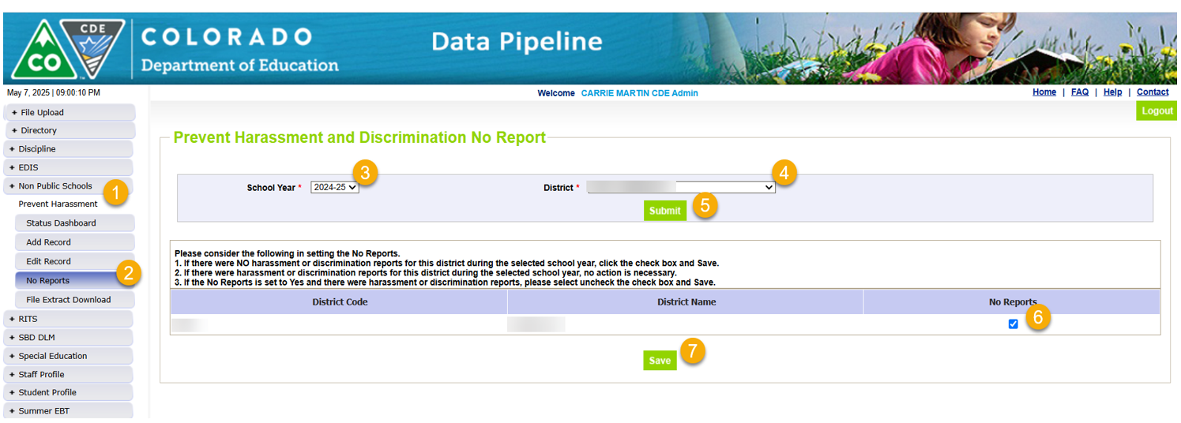
Prevent Harassment or Discrimination
No Reports Reminder
If your LEA has No Incidents of Harassment or Discrimination to report
Prevent Harassment or Discrimination Collection
PreventHD@cde.state.co.us

Slide 33

Reminder: Completing the Collection (Even if you have no reports!)
  Error free and ready to complete the collection?
    Verify the data using Pipeline Reports
    Submit to CDE
    Download and complete verification form
    Return form to PreventHD@cde.state.co.us
Prevent Harassment or Discrimination Collection
PreventHD@cde.state.co.us

Slide 34
Questions & Resources:
Prevent Harassment or Discrimination
Prevent Harassment or Discrimination Site
PHD Training Manual, Exception Request Template , Exception Request Instructions
PreventHD@cde.state.co.us
Carrie Martin-Collection lead
(720) 665-4456
Additional Resources and CDE contacts for Harassment, Discrimination, Title IX, and Bullying
Prevention of Harassment, Discrimination, and Bullying in Colorado Schools Site

Slide 35
Instructional Days and Hours
Jessica Tribbett

Slide 36
Instructional Days and Hours:
Timeline and Reminders
Collection Timeline
OPEN: Tuesday, September 2nd
CLOSE: Friday, December 5th
Where to start
Find your District's School Board Policy on instructional time to know if recess and/or passing is considered instructional time.
Collect planned calendars and bell schedules from all the schools in your district.
The LAM will determine who will be the LEA approver for the collection.
Instructional Days and Hours
DirectoryData@cde.state.co.us

Slide 37
Instructional Days and Hours: Submission Determination
Required to Submit
  Districts,
  BOCES operating schools,
  and the Charter School Institute
will need to submit data for all public schools serving grades K-12 (006-120).
Do NOT submit data for:
  Pre-k
  Public schools serving only grades 004-004
  100% Home Options Schools (school system code 10)
Instructional Days and Hours
DirectoryData@cde.state.co.us

Slide 38
Total Teach Workdays – Field Calculation
The total number of scheduled days teachers are working.
Includes student-contact and non-student contact days.
Non-student contact days include professional development, data-review, teacher-in-service, or parent-teacher conference days.
Total Teacher Workdays are teacher contract days.
Must be between 100.0 and 260.0. Use .5 decimal for half days.
To calculate: use full-time, full school year average of teacher contract days.
Do not include: Training or orientation days specific to new teachers.
Instructional Days and Hours
DirectoryData@cde.state.co.us

Slide 39
Total Days of Instruction/Student Contact Days – Field Calculation
The total number of whole and partial scheduled student contact days. This means mandatory attendance days.
Include testing days.
If the total number of school days varies by grade level, and new record must be submitted for that grade level.
Must be between 100.0 and 250.0. Use .5 decimal for half days.
To calculate: Review school calendar and count the number of full and partial mandatory attendance days.
Do not include: Student non-attendance days or optional attendance days.
Instructional Days and Hours
DirectoryData@cde.state.co.us

Slide 40
Total Hours for the School Year – Field Calculation
The total number of hours that the school is in session for student-contact days. counting first bell to last bell.
This includes passing, recess, and meal or other breaks that occur between the first and last bell.
To calculate: Determine the Start and End of the School Day.
  The start of the instructional day is the time at which the first scheduled period of the day begins.
    If a school has periods that begin prior to the arrival of scheduled bus routes to the school, then these periods should not be considered as part of the instructional day.
  The end of the instructional day is the time at which the last scheduled period of the day ends.
    If a school has periods that do not end prior to scheduled bus routes leaving the school, these periods should not be considered as part of the instructional day.
Do not include: Non-student contact days in this hour calculation.
Instructional Days and Hours
DirectoryData@cde.state.co.us

Slide 41
Questions & Resources:
Instructional Days and Hours
Instructional Days and Hours website: Frequently Asked Questions
DirectoryData@cde.state.co.us
More information each week at DSU Town Halls
Trainings coming soon

Slide 42

Thank you for Joining Today!
Next Town Hall will be July 31st
Reminder:
Syncplicity folders are specific to a collection. Email the collection lead if you need access to your LEA’s Syncplicity folder for a collection.
Tip: Bookmark the Syncplicity login site.

