Slide 1
July 10, 2025
Data Pipeline Town Hall
The goal of the webinar is to provide updates on the Data Pipeline, current, and upcoming data collections. These webinars also provide a forum for districts, BOCES, and Administrative Units to have questions answered about Data Pipeline.

Slide 2
Colorado Department of Education
Identity Management (IdM)
Identity Management Site
Frequently Asked Questions
How do I add myself or others to the email listserv for town hall emails and/or a specific collection?
  Email lists are dependent on a person’s access rights in IdM. Contact your LAM to get an account or be assigned to a specific collection.
Where can I find the IdM role mappings for Data Pipeline and other applications?
  Role Mapping (XLS)
I am a LAM. How do I update the user permissions for someone in my district?
  Follow the steps outlined in the IdM Quick Guide for Access Management (DOCX)
Important: Users are not automatically removed from IdM when their email address is no longer active in your district. The LAM must deactivate their IdM account to ensure only designated staff can access CDE’s data reporting system.
Support:
  Michael Threlkeld
  Forgot Password
  Request LAM Assistance
Notes:
LAMs, please check the IdM roles for your district. Remove permissions for users who have retired, left your district, or are no longer assigned to a collection. Add roles for new hires and newly assigned respondents for specific collections.

Slide 3

What is PII?
Student and Staff Personally Identifiable Information (PII) is defined by state and federal laws as information that, alone or in combination, personally identifies an individual
  This includes direct identifiers
  (i.e. student and staff names, SASID, EDID, etc.)
  Includes information that when combined is identifiable
Colorado’s Student Data Transparency and Security Act outlines requirements for how Student PII is collected, used and shared
See the Data Privacy and Security website for prepared guidance on how to comply with this and other privacy laws.

Slide 4

Sharing Data
Use secure methods to transfer any PII to CDE
  Contact Data Collection leads with questions about how to transmit PII securely
    Each Data Collection leads maintains their own Syncplicity folders for specific collections, reach out to the collection lead for access
  Use Syncplicity to encrypt emails to CDE
Avoid sending PII via unencrypted email or to unsecured faxes when sharing data between or within districts
  Use Syncplicity to encrypt emails to CDE
Check local policies for restrictions, requirements, etc. regarding PII
  Do not use PII in trainings, presentations, etc.
  Do not share PII with unauthorized individuals
  Do not share passwords
  Follow local policies when transmitting PII to any third party

Slide 5
Today’s Agenda
Agenda Topic | Presenter
Open Data Collections and Upcoming Deadlines in Data Pipeline | Host: Reagan Ward
Student End of Year | Reagan Ward
Student Interchange | Reagan Ward
Instructional Days and Hours | Jessica Tribbett

Slide 6
Open Collections and
Upcoming Deadlines in
Data Pipeline

Slide 7
Open Collections and Upcoming Dates:
Year-Round & Interchanges
Name | Category | Status | Key Dates
RITS | Year Round | Open | N/A
EDIS | Year Round | Open | N/A
Directory | Year Round | Open | School Code Change Requests: Closed
Student | Interchange | Open | 2024-2025: Maintain error free files 2025-2026: Coming Soon! Scheduled to open 7/14/25
At-Risk | Interchange | Closed | 2025-2026: Coming Soon! Scheduled to open 7/16/25
Title I | Interchange | Open | 2024-2025: Maintain error free file 2025-2026: Coming Soon! Scheduled to open in Aug
Special Education IEP | Interchange | Open | Maintain error free files
Staff | Interchange | Open | Staff Profile and Staff Evaluation interchange files are needed for the Staff Evaluation Snapshot
Discipline Action | Interchange | Open | This interchange file is needed for Student Discipline Snapshot and Special Education Discipline Snapshot
Teacher Student Data Link | Interchange | Open | Maintain error free file
Data Pipeline Resources: Data Pipeline Collection Dates (XLS)

Slide 8
Open Collections and Upcoming Dates:
Snapshots
Name | Category | Status | Final Deadline Date | Next Milestone | Looking Ahead
Teacher Student Data Link | Snapshot | Open | Aug. 29, 2025 | Interim Deadline: 8/22/25 error free interchange and snapshot | Report Review: 8/25 to 8/28 Final snapshot report review
Staff Evaluation | Snapshot | Open | Oct. 15, 2025 | Interim Deadline: 7/15, error free Staff Evaluation Snapshot | Report Review: 7/15 to 8/15 Final snapshot report review
Student End of Year: Regular Phase | Snapshot | Open | Sept. 4, 2025 | Training: 7/15/25, 10:30-11:30 July SEY Office Hours | Interim Deadline: 7/31/25 submit reporting exception requests
Student Attendance | Snapshot | Open | July 25, 2025 | Report Review: 7/3/25 to 7/11/25; validate data with COGNOS report and submit snapshot when review is complete | Deadline: 7/11/25 Submit Attendance Snapshot
Special Education Discipline | Snapshot | Open | Aug. 1, 2025 | Interim Deadline: 7/24 – all snapshot exception requests submitted to CDE. | Interim Deadline: 7/25 – all snapshot errors resolved.
Student Discipline | Snapshot | Open | July 31, 2025 | Report Review: 7/8/25 to 7/26/25; validate data with COGNOS report and submit snapshot when review is complete | State Deadline: 7/31/25 submit data to CDE
Special Education EOY | Snapshot | Open | Oct. 3, 2025 | Interim Deadline: 9/4/25 all exception requests submitted to CDE for review | Interim Deadline: 9/11/25 error free snapshot
Data Pipeline Resources: Data Pipeline Collection Dates (XLS)

Slide 9
Open Collections and Upcoming Dates:
Periodic
Name | Category | Status | Final Deadline Date | Next Milestone | Looking Ahead
Summer EBT | Periodic | Open | Feb. 28, 2025 | Corrections Period: 5/19/2025 to 9/3/2025
Prevent Harassment or Discrimination | Periodic | Open | August 1, 2025 | Report Review: 7/7/25 to 7/25/25, review reports and submit data once review is complete | State Deadline: 8/1/25 submit data to CDE
READ Training | Periodic | Coming Soon | Aug. 20, 2025 | Training: 7/15/25, 1:00-2:00pm Join via Zoom | Collection Opens: 8/1/25; Teachers, Principals, and Administrators should have training completed by this date
Data Pipeline Resources: Data Pipeline Collection Dates (XLS)

Slide 10
Student End of Year
Reagan Ward

Slide 11
SEY Collection Timeline
Date | Event | Event Description
7/15/2025, 10:30-11:30am | Training Event | July SEY Office Hours: July SEY Office Hours Registration Topic—TBD based upon FAQs from past month
7/31/2025 | Interim Deadline | Submit any necessary reporting exceptions for review School level errors will be processed beginning after this date (SE181, SE182, SE183, etc.)
8/12/2025, 10:30-11:30am | Training Event | August SEY Office Hours: August SEY Office Hours Registration Topic—Reviewing Reports and Data Validation
8/14/2025 | Interim Deadline | Error free SEY snapshot
8/14/2025 to 9/4/2025 | Report Review | Validate SEY data using CEDAR/COGNOS reports.
9/4/2025 | State Deadline | Submit SEY snapshot
9/5/2025 to 9/17/2025 | Closed | SEY Snapshot is closed until the start of the Cross LEA phase
9/18/2025 to 10/16/2025 | Cross LEA Phase | See the SEY Website for the detailed timeline
10/23/2025 to 11/18/2025 | Post-Cross LEA Phase | See the SEY Website for the detailed timeline
12/2/2025 | Deadline | Superintendent Verification (Sign-Off) form due. Collection Closes.
To be ‘on track’ for this collection, the following tasks should have been completed:
Error free interchange files (DEM, SSA, GG, Title 1 if applicable) with an upload date after 4/1/25
  OR waiting on an exception request to be reviewed for the remaining interchange errors
Collaborating with SPED reporting staff if applicable (IEP interchange files required to indicate a student as a SPED student in the SEY collection)
Created at least one SEY snapshot
Student End of Year
StudentEndOfYear@cde.state.co.us

Slide 12
Suggested Monthly Checklist: July/August
July
August
7/15 Training: July SEY Office Hours
7/31 Interim Deadline: Submit all exception requests for review
SEY snapshot should almost be error free
  Types of remaining errors:
    Pending exception requests
    Exit type/retention for potential summer graduates/completers being monitored through summer school
    Pending input from additional colleagues
Review and address SEY warnings
8/12 Training: Aug SEY office hours
8/14 Interim Deadline: Error free snapshot
8/14 to 9/4 Report Review
  Student List: Dropouts
  Student List: AYG Cohort
  Other COGNOS/CEDAR reports
Ensure accurate retention codes
  Check SEY 2025 grade and retention code compared to 2026 grade level for students at beginning of year
Verify coding for SPED Transition and Postsecondary Program students
9/4 State Deadline: Submit error-free SEY Snapshot
Student End of Year
StudentEndOfYear@cde.state.co.us

Slide 13
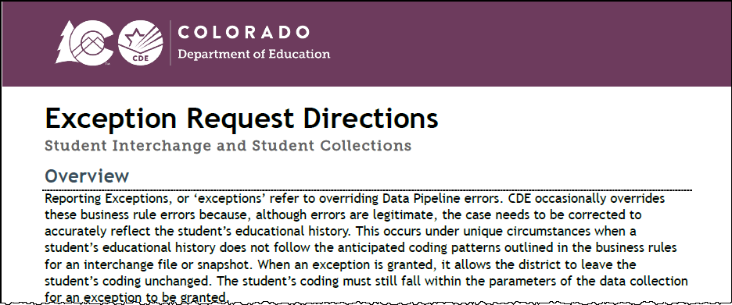
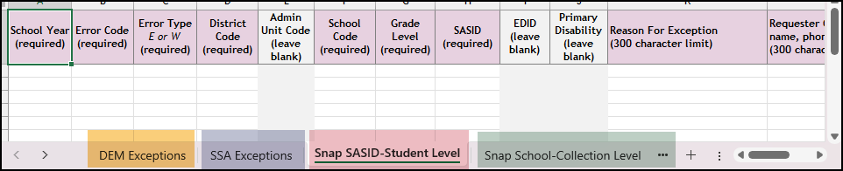
New (June 2025) Exception Request Templates and Directions
Updated Directions (PDF)
Provides information regarding all student collections using the same template and process (Student Interchange, OCT, SEY, ATS)
Shows required information for different exception types
DEM, SSA, Snapshot SASID-Student Level, Snapshot School-Collection Level
Syncplicity instructions
Details regarding situations that require ‘additional information’ forms
Collection/File Specific Notes
Updated Request Template (XLS)
Include multiple tabs to accommodate different types of exceptions
Not all exception requests require the same data fields
Each error code requires a separate row
Leading zeros are required
Multilingual Learner Request Template (XLS)
Separate request form with an extra tab with sample ‘reasons for request’ by request of the field due to the complex nature of these requests.
Multilingual Learner: Sequence Change Request Form (DOC) and fillable PDF
Student End of Year
StudentEndOfYear@cde.state.co.us

Slide 14
Exception Request Process
Download exception request template
  Detailed directions also available
Select and complete the applicable tab of the request document
  Form was updated to include tabs for DEM, SSA, Snapshot Student Level, and Snapshot School/Collection level requests
Save the exception to your computer with a unique name
Upload the complete request to your LEA’s student Syncplicity folder using the applicable subfolder for the collection/time of year
  Folder Name: District Code – DISTRICT NAME – Student
    Subfolder: SEY 2024-25
Email StudentEndOfYear@cde.state.co.us to notify SEY a request is ready for review
Student End of Year
StudentEndOfYear@cde.state.co.us

Slide 15
Monitoring Potential Summer Graduates/Completers
8/31/2025 is the last date a student may be counted as a graduate or completer of the 2024-2025 school year (school exit types 90-96)
Summer Grad/Completer?
  Option 1: Wait to update potential summer grad/completer’s student’s school exit type/retention code until August
    Triggers SE171 error until student’s school exit type or retention code are updated
    Preferred method because the error serves as a reminder
  Option 2: Code student as retained and update their coding if they meeting requirements over the summer
    School Exit Type 00 with Retention Code 1
    Does not trigger SE171 error
    LEAs must have internal methods to check summer graduates aren’t overlooked
Post-Cross Business Rule: SE906
  12th grade student marked retained in SEY without a record in next year’s OCT
  Opportunity to catch summer graduate/completers that slipped through with school exit type 00 and retention 1 instead of being updated in August.
Student End of Year
StudentEndOfYear@cde.state.co.us

Slide 16
Retention Codes
Retention Code always indicates the expected grade level for the student in the following school year.
  A retention code in 2024-2025 SEY indicates the student will be in the same grade level again in 2025-2026.
Retention Code = 1 may be used for any student K-12
  Must have school exit type 00 with school exit date 00000000
Retention Codes 2 and 3 are reserved for 12th grade students with special circumstances only
  See Section 5 of SEY Collection Manual
Students with retention codes in 2024-2025 should have at least a one-day record in 2025-2026
Code | Definition
0 | No/Not Applicable
1 | Yes – student will repeat this grade the next school year
2 | Yes – 12th grader who will return to participate in an approved postsecondary program in the next year (i.e. ASCENT, P-TECH, and TREP).
3 | Yes – 12th grader with an IEP who will return to participate in 18-21 transition services in the next year.
Student End of Year
StudentEndOfYear@cde.state.co.us

Slide 17
Questions & Resources:
Student End of Year
StudentEndOfYear@cde.state.co.us
720-484-9057
  Student End of Year Collection Website
  Student Interchange Website
  Graduation Guidelines (Program) Website

Slide 18
Student Interchange
Reagan Ward

Slide 19
Student Interchange 2024-2025
Date | Event | Event Description
6/11/2025 | Interim Deadline | Error Free interchange files: DEM, SSA, GG
6/12/2025 to 12/2/2025 | Other Date | Maintain error-free interchange files. Errors on DEM or SSA file prevent record from pulling into snapshots and/or may cause errors on student level data collections. Errors on GG file prevent record from connecting to student when validating graduates in SEY collection, causing SE301 SEY Errors Errors on Adj file prevent record from connecting to student to adjust final exit in SEY collection, which may cause Cross-LEA Errors
12/2/2025 | Closes | Student Interchange 2024-2025 Closes
Remaining Connected 2024-2025 Student Collection | Final Deadline
Student Attendance Snapshot | 7/25/2025
Student Discipline Snapshot | 7/31/2025
SPED Discipline Snapshot | 8/1/2025
Teacher Student Data Link Snapshot | 8/29/2025
SPED End of Year Snapshot | 10/3/2025
Student End of Year Snapshot Note: This is the only collection that utilizes GG and ADJ files | Regular Phase: 9/4/2025 Cross LEA Phase: 10/16/2025 Post-Cross LEA Phase: 11/18/2025 noon Superintendent Verification: 12/2/2025
Student Interchange
StudentOctober@cde.state.co.us
StudentEndOfYear@cde.state.co.us

Slide 20
Student Interchange 2025-2026
Date | Event | Event Description
7/14/2025 | Open | DEM, SSA, and GG files open
10/2/2025 | Interim Deadline | Student October: Upload initial DEM & SSA files
10/9/2025 | Interim Deadline | Student October: Error-free DEM & SSA files
12/17/2025 Tentative | Interim Deadline | SPED December: Error-Free DEM & SSA files
11/1/2025 | Other Date | Upload GG file to utilize CEDAR/COGNOS reports to monitor potential 2025-2026 graduates for GG completion, allowing ample time for LEAs to work with students to complete any missing measures during the year.
1/30/2026 | Other Date | Upload DEM, SSA, and GG files and address errors related to mid-year transfers.
4/1/2026 | Other Date | Prepare for Spring student level collections, uploading interchange files and addressing errors as needed.
4/30/2026 | Open | ADJ file opens
5/8/2026 | Interim Deadline | Upload the initial end of year interchange files. (DEM, SSA, GG) LEAs are expected to have an upload date 4/1/2026 or later to meet this interim deadline.
6/1/2026 | Other Date | Error free DEM and SSA records for K-3 students and 4-12 READ Cohort students to prevent errors in the READ Spring Assessments collection
6/10/2026 | Interim Deadline | Error free interchange files. (DEM, SSA, GG)
12/1/2026 | Closed | DEM, SSA, GG, and ADJ files close
Primary Point of Contact:
July 2025 to December 2025 – StudentOctober@cde.state.co.us
January 2026 to December 2026 – StudentEndofYear@cde.state.co.us
Student Interchange
StudentOctober@cde.state.co.us
StudentEndOfYear@cde.state.co.us

Slide 21
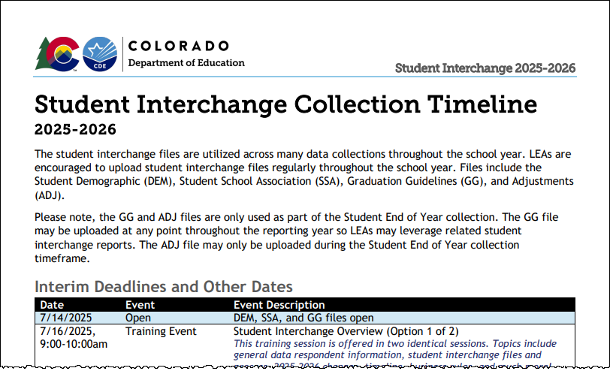
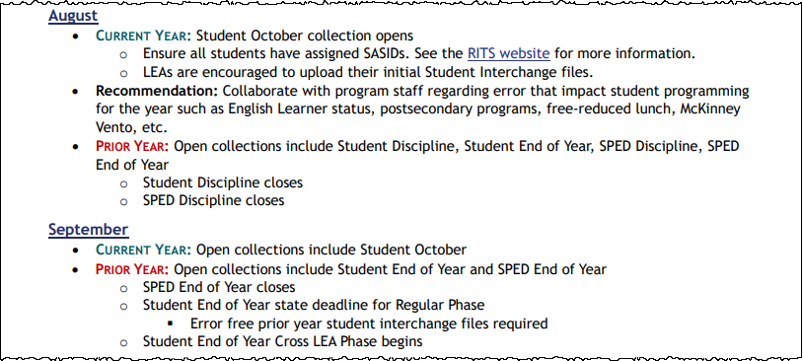
Interchange Timeline Resources
Collection Timeline:
Combined Interim Deadlines
Month-by-Month Timeline
Interim Deadlines for file uploads and error free files
Combines interim deadlines across student data collections
Broad overview of how Student Interchange is utilized throughout the school year
Highlights Prior Year and Current Year tasks each month when two interchange years are open
Student Interchange
StudentOctober@cde.state.co.us; StudentEndOfYear@cde.state.co.us

Slide 22

Upcoming Training
2025-2026
Student Interchange Overview
Collaborative Webinar:
ML Enrollment and Data Reports
This training session is being offered in two identical sessions.
  Topics include general data respondent information, student interchange files and process, 2025-2026 changes, timeline, business rules, and much more!
Option 1 of 2
  July 16, 9:00-10:00am
  Register for 7/16 Training
Option 2 of 2
  August 5, 9:00-10:00am
  Register for 8/5 Training
This collaborative webinar is designed for Data Staff and program staff who support Multilingual Learner identification and placement in LEAs.
  We will cover updates to data reports and business rules designed to support Colorado's standardized ELD Program Requirements.
July 23, 9:00-10:00am
Register for 7/23 Training
Student Interchange
StudentOctober@cde.state.co.us; StudentEndOfYear@cde.state.co.us

Slide 23
2025-2026 File Layout Changes
Student Demographic (DEM)
  No new data fields
  Changed ‘English Learners’ to ‘Multilingual Learners’ throughout file
Graduation Guidelines (GG)
  No new data fields
  Field Expectation update: School Year of Completion is required and cannot be zero filled
Adjustments (ADJ)
  No new data fields
  Some language updates for clarification
Student School Association (SSA)
  New data fields
    Abbreviated School Day Schedule Status
    Total Days on an Abbreviated School Day Schedule
  Removed Data Field
    ILOP (Innovative Learning Opportunities Pilot)
  Renamed Field
    Student Pupil Attendance Information
  New School Entry Types
    31 = Transfer from a HS Diploma Program at a Colorado Community College
    60 = Enrollment Status Change in the same School
    98 = Prior Graduate from a public school in another Colorado LEA transferring to participate in Special Ed 18-21 services
  New School Exit Types
    31 = Transfer to a HS Diploma Program at a Colorado Community College
    60 = Enrollment Status Change in the same School
    88 = TBD—waiting on documentation of transfer; Student absent 10+ days
Resource:
2025-2026 Student Interchange Updates/ Changes (PDF)
Student Interchange
StudentOctober@cde.state.co.us
StudentEndOfYear@cde.state.co.us

Slide 24
2025-2026 Additional Changes
Updated ML business rules
  Consolidated many errors into a single ‘out of sequence’ error code
  ‘Error Details’ column on error reports will show prior year coding for many ML rules
Updated ML History Reports
  SASID Lookup & District List
  Includes prior year ACCESS scores when available (overall and literacy)
  Includes prior year SEY coding to support LEAs in identifying mid-year changes
SSA Grade Level sequence warnings
  Helps LEAs catch out of sequence issues earlier in the year instead of waiting until the errors in the SEY collection
  SP572: First record should be one grade higher than prior year (if not retained)
  SP573: First record should be same as prior year because student indicated as retained in prior year
Update name of Dataset
  Student Profile → Student
Update name of COGNOS report category
  Student Profile → Student Interchange
Student Interchange
StudentOctober@cde.state.co.us; StudentEndOfYear@cde.state.co.us

Slide 25
Questions & Resources:
Student Interchange
Student Interchange Website
2024-2025 Student Interchange StudentEndOfYear@cde.state.co.us
2025-2026 Student Interchange
July 2025-Dec 2025: StudentOctober@cde.state.co.us
Jan 2026-Dec 2026: StudentEndOfYear@cde.state.co.us

Slide 26
Instructional Days and Hours
Jessica Tribbett

Slide 27
Instructional Days and Hours – HB24-1063
HB24-1063 - the department shall collect from schools of a school district, district charter schools, school districts, institute charter schools, and the state charter school institute, at a minimum, the following data:
Instructional hours for elementary and secondary schools
Days of instruction for elementary and secondary schools
Estimated non-instructional hours, school closures, snow days, and time spent on lunch and passing between classes
Instructional Days and Hours
DirectoryData@cde.state.co.us

Slide 28
Instructional Days and Hours:
Timeline and Reminders
Collection Timeline
OPEN: Tuesday, September 2nd
CLOSE: Friday, December 5th
Where to start
Find your District's School Board Policy on instructional time to know if recess and/or passing is considered instructional time.
Collect planned calendars and bell schedules from all the schools in your district.
Instructional Days and Hours
DirectoryData@cde.state.co.us

Slide 29
Instructional Days and Hours: Submission Determination
Required to Submit
  Districts,
  BOCES operating schools,
  and the Charter School Institute
will need to submit data for all public schools serving grades K-12 (006-120).
Do NOT submit data for:
  Pre-k
  Public schools serving only grades 004-004
  100% Home Options Schools (school system code 10)
Instructional Days and Hours
DirectoryData@cde.state.co.us

Slide 30
Questions & Resources:
Instructional Days and Hours
Instructional Days and Hours website: Frequently Asked Questions
DirectoryData@cde.state.co.us
More information each week at DSU Town Halls
Trainings coming soon

Slide 31

Thank you for Joining Today!
Next Town Hall will be date 7/17/2025
Reminder:
When emailing us, please provide your 4-digit district number or 5-digit AU number.

