Slide 1
Short Bytes
Attendance Strategies and Statute in Colorado

Slide 2

Attendance matters!
Research tells us that attendance is important at all levels
within the K-12 education system.
By third grade, children who missed too much of kindergarten and 1st grade are more likely to fall behind in reading.
Chronic absenteeism in middle school is a warning sign that students are on a path to disengagement and dropping out.
In ninth grade, attendance is a clear predictor, more than test scores that a student will leave before completing high school.
Notes:
Johann

Slide 3
Attendance at CDE
Data Services
Dropout Prevention
Manage annual attendance data collection process
Main point of contact for districts for collection
Current Attendance Collection Lead: Brooke Wenzel (wenzel_b@cde.state.co.us)
Provide training, build guidance, forms, etc.
Produce reports, summary information, and manage data requests
Support LEAs and the public in understanding and implementing Colorado attendance policy
Support development of data dashboards and use of attendance data by CDE staff, districts, and schools
Compile resources on effective strategies for addressing attendance
Notes:
Brooke/Johann

Slide 4
Colorado Attendance Laws
§22-1-102, C.R.S.
§22-33-104, C.R.S.
School Attendance Act – Compulsory School Attendance
§22-33-104, C.R.S.
Requires the Colorado State Board of Education to adopt guidelines for the standardized calculation of unexcused absences of students from school.
§19-1-104, C.R.S.
§22-33-107, C.R.S.
Allows a criminal justice agency investigating a matter under the "School Attendance Law of 1963" to seek, prior to adjudication, disciplinary and truancy information from the juvenile's school.
Requires school district to have policy for a truancy plan with the goal of assisting the child to remain in school.
§22-54-103, C.R.S.
“Pupil enrollment" means the number of pupils enrolled on the pupil enrollment count day within the applicable budget year, as evidenced by the actual attendance of such pupils prior to said date.
Every public school shall be open for the admission of all children, between the ages of five and twenty-one years, residing in that district without the payment of tuition.
School Attendance Act – Residence of child
Requires that each child between the ages of six and 17 shall attend public school unless otherwise excused.
Standardizing Truancy Reporting and Expanding the Resources
School Attendance Law of 1963 - Truancy Court
Truancy enforcement
FINANCE ACT OF 1994
Notes:
Johann

Slide 5
Attendance data collection
Districts submit student-level attendance data as part of the annual CDE Attendance Data Collection.
The submission includes the attendance data fields: Total Days Attended, Total Days Unexcused, Total Days Excused and Total Days Possible for each student allowing for overall disaggregated categories by ethnicity/race, gender, special education, English language learner status, homeless status and free-and-reduced lunch status.
Notes:
Brooke

Slide 6
Student attendance overview
Important student attendance definition of rates and terms include:
Truancy: Truancy is defined as an unexcused absence. The rate is calculated by dividing the reported Total Student Days Unexcused Absences by the Total Student Days Possible.
Habitually Truant (Student Count): A student is counted as habitually truant if the student has four unexcused absences in one month and/or 10 absences in one school year.
Chronically Absent: A student absent 10 percent or more of the days enrolled during the school year. All absences are included – unexcused, excused and suspensions. The rate is the percentage of students enrolled who are chronically absent.
Notes:
Johann

Slide 7
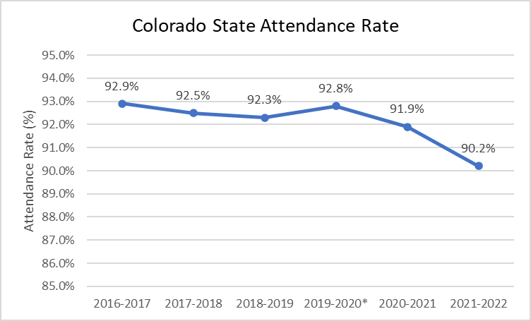
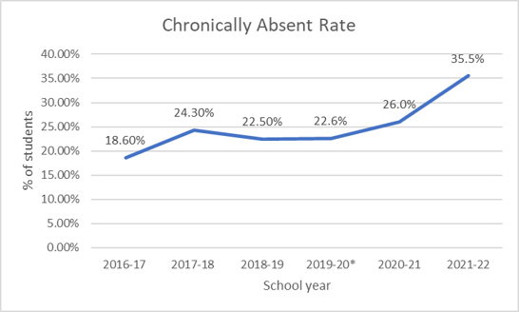
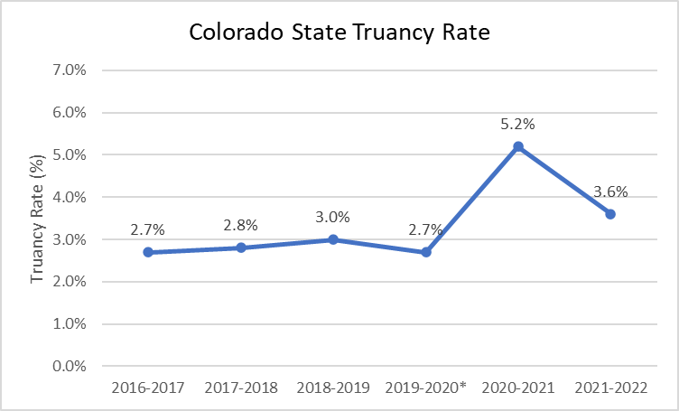
Colorado attendance trends
*2019-2020 Only collected up until March 2020
Notes:
Johann
Overall, we have seen declines in student attendance over the past five years.
Review upper left chart.
Second, we calculate a truancy rate, which looks at unexcused absences.
Review bottom chart
Lastly, we look at a rate for chronic absenteeism, which shows us all absences.
As opposed to truancy, or unexcused absences where we saw a decline last year and a small change over the five years, we see a large increase in rates of chronic absenteeism

Slide 8
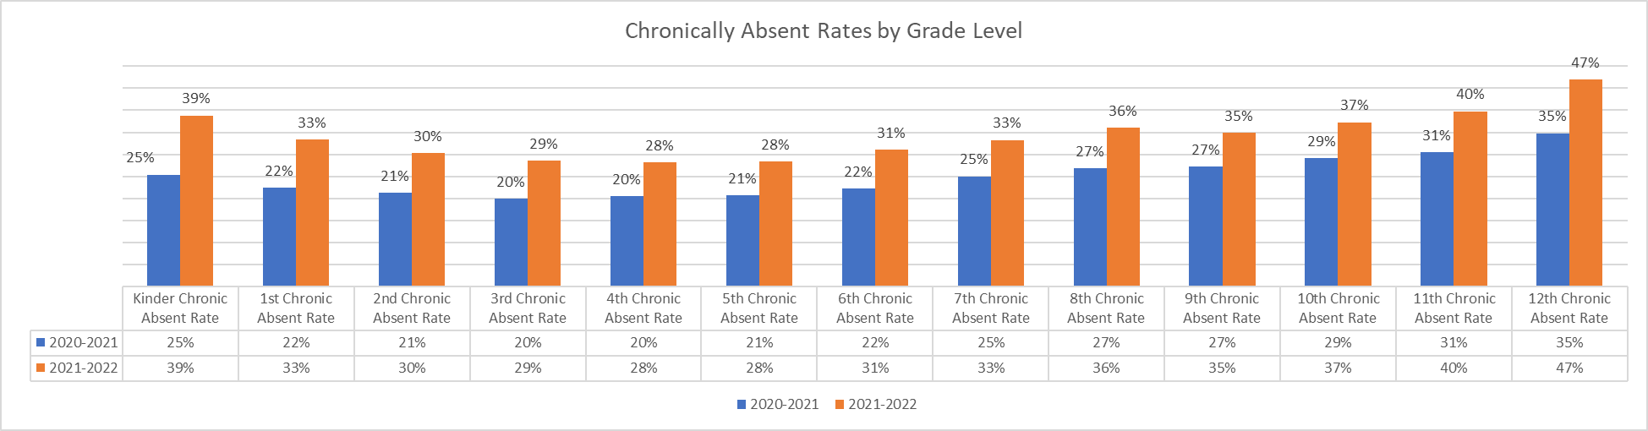
Grade level comparison
*Started collecting grade level in 2020-2021
Notes:
Johann

Slide 9
Strategies and Best Practices
There are a variety of research-based approaches that support regular school attendance that CDE organizes in the Dropout Prevention Framework to help organize resources.
All links and information can be found here:
www.cde.state.co.us/dropoutprevention/studentattendancefaq
www.cde.state.co.us/dropoutprevention
Early Warning Systems
Combine predictive student data with student support structures to keep students engaged and achieving in school. Early warning systems often use the ABC framework (attendance, behavior and course performance) when examining data.
Sample data tool for attendance
Family and Community Engagement
Family Relationships have been shown to improve attendance, lower dropout rates and improve attitudes towards school.
CDE toolkit for establishing a family and community partnership
School-based health centers
Can have a direct impact on educational outcomes, like attendance.
Sample guidance on developing partnerships with community health partners
Sample 3 Tiers of Intervention for attendance
Promising practice overview for home visits
CDE guidance on conducting workshops for families on attendance
Community engagement resources
CDE Model for Healthy Schools
Notes:
Johann

Slide 10
For more information, please contact the Attendance Collection Lead.
Notes:
Brooke

