Slide 1
Student October Veteran Respondent Training
2024-2025
Brooke Wenzel
StudentOctober@cde.state.co.us

Slide 2
Agenda
Purpose/Student October Timeline
Summary of Process
How the Snapshot Works
2024-2025 Changes
Pupil Attendance Information
School Auditing Office
Preschool Reporting

Slide 3
Purpose of Student October

Slide 4
Purpose of Student October – PSF Act
Obtain student level data required by state and federal statute
  From the Public-School Finance Act of 1994 (CRS 22-54-101)
  From the Elementary and Secondary Education Act ; reauthorized as Every Student Succeeds Act (ESSA)
Data collected in Student October is used to determine district funding
  Visit this webpage for details
Also used for school and district demographic data reported to the federal government as a part of EDFacts

Slide 5
Purpose of Student October Continued
Data from Student October is also used in reports, grants, news articles, and official decision making about schools, districts, and the state.
Student October is meant to be a snapshot in time that gives a general overview of education in Colorado.
Accuracy is paramount
  CDE wants to make sure that districts receive the correct amount of funding
  That demographic reports accurately represent school and district populations
  And finally, accurately reported English Learner (EL) student data is necessary for Federal and State reporting as well as for state funding through ELPA (English Language Proficiency Act)

Slide 6
Ensure Accurate Data
Complete the basics of the collection early (Get files error free and create snapshots by the middle of October)
An error free snapshot does not guarantee accurately reported data
Review, Review, Review!
Make sure exception requests are needed before submitting them!
Pull in Subject Matter Experts to assist with verifying data (Finance Department, English Learner Department, Special Education, Registrar)
COGNOS Reports for verification
How to ensure your data is accurate?

Slide 7
2024-2025 Student October Timeline/Trainings

Slide 8
Data Collection and Cleanup Phase Timeline
Date | Event | Event Description
07/15/2024 | Open | Districts may begin uploading Student Interchange Files (Student Demographic and Student School Association).
08/23/2024 | Open | Districts may begin creating snapshots. Student October Snapshot dependencies are the Student Demographic File, Student School Association File, Title I File (if applicable) and At-Risk File.
08/28/2024 | Training Event | Data Pipeline Training 10-11 a.m.
09/05/2024 | Training Event | New Respondent Training 1-2 p.m.
09/10/2024 | Training Event | English Language Learner Training 11-12 p.m.
09/12/2024 | Training Event | Veteran Respondent Training 11-12 p.m.
09/16/2024 | Training Event | Postsecondary Program Coding Training 11-12 p.m.
09/24/2024 | Other Date | First day of Student October Count Window for districts with 5-day school week.
10/01/2024 | Other Date | Official Count Day 2024
10/02/2024 | Interim Deadline | Upload Student Demographic and Student School Association Files. Upload Title I Interchange File (if applicable). Upload At-Risk Interchange File.
10/08/2024 | Other Date | Last day of Student October Count Window for districts with 5-day school week.
10/09/2024 | Interim Deadline | Error free Student Interchange File uploads
10/14/2024 | Training Event | Mid-Collection Office Hours 10-11 a.m.
10/14/2024 | Interim Deadline | Create an initial Student October Snapshot
10/22/2024 | Interim Deadline | Error free Student October Snapshot
10/24/2024 | Training Event | Data Validation, Transfer Enrollment Exceptions and Cognos Reports 1-2 p.m.
10/28/2024 | Training Event | Data Pipeline Duplicate Process and Submission 9-10 a.m.
11/01/2024 | Report Review | Review Student October Cognos Reports for data validation. Submit Student October Snapshot data as soon as review is complete.
11/08/2024 12:00 p.m. | State Deadline | Submit Student October Snapshot data

Slide 9
Duplicate Count Phase Timeline
Date | Event | Event Description
11/12/2024 12:00 p.m. | Deadline | Duplicate funding documentation due to School Auditing Office
11/18/2024 | Other Date | School Auditing makes decisions on funding duplicates
11/27/2024 | Deadline | Resubmit Student October Snapshot data to CDE based on decisions from School Auditing
12/06/2024 | Deadline | Collection closes Secretary of the Board of Education Verification (sign-off) form due. Data remains embargoed until the official release in January.
01/15/2025 | Data Release | Official data release
General Duplicate Count Process
  Begins once all districts have submitted their Student October Snapshot to CDE, Friday, November 8th
  ~3 business days after running the duplicate process Duplicate Documentation is due to The CDE School Auditing Office
  ~2 business days after documentation received decisions will be sent to districts
Signature Page
  Due Friday, December 6th: Signed by Secretary of Board of Education AND the Chief Financial Officer
    If your district needs an extension, please send Student October Collection lead an email with the day when your School Board Secretary will be able to sign the form

Slide 10
Summary of Process

Slide 11
Snapshot Process - Described
0. Make sure Student Information System is updated
Extract Interchange Files from SIS and upload Interchange files to Pipeline (Student Demographic, Student School Association Files, At-Risk, Title I)
Check Business Rules Associated with Interchange files
Errors on Interchange files?
  Yes – Correct Errors in SIS and go back to step 0
  No – Move on to step 4*
Create Snapshot
Check Additional Business Rules Associated with Snapshot
Errors?
  Yes - Correct Errors in SIS and go back to step 0
  No – Move on to step 7
Review Reports and Finalize
  If you need to correct any data, you will need to go back to step 0
*Note: Error-free interchange files are not required to take a Snapshot but recommended. Get your interchange files as close to error free as possible before taking a snapshot!

Slide 12
Tagging

Slide 13
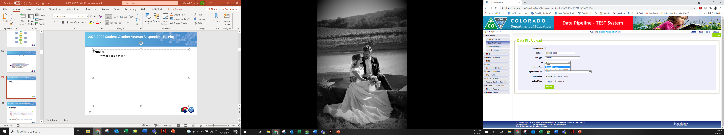
Tagging
Mark a file upon upload that allows you to track information for a particular collection
What is the point?
  We have three, or more, collections that occur at the same time, Student October (as of October 1st), December Count (as of December 1st) and your current student values that pull into multiple snapshots
  Tagging allows districts to store data for a collection and work on more recent data at the same time
SASID | Homeless | Tag
1234567890 | 0 | OCT
1234567890 | 3
1234567890 | 0 | DEC
Different sets of data for the same student
  October 1st
  Current Value
  December 1st

Slide 14
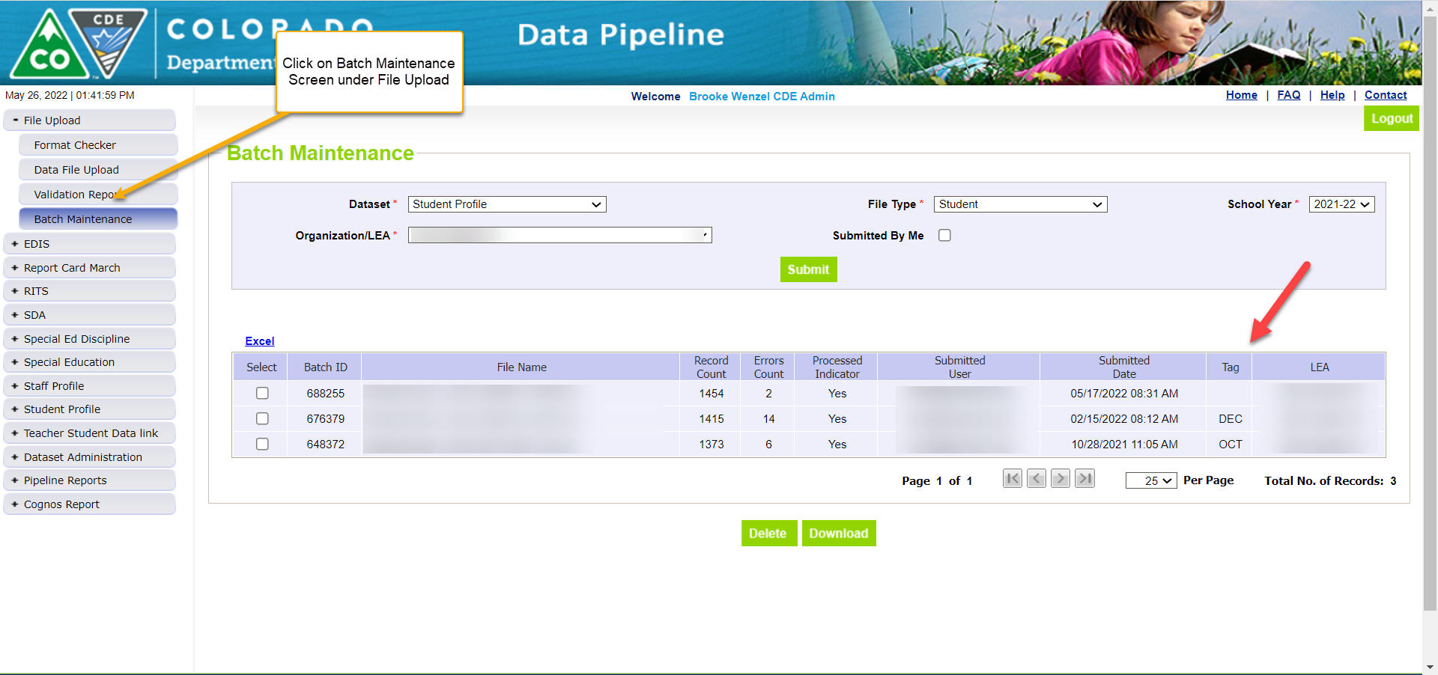
Tagging – Batch Maintenance
Batch Maintenance Screen
Will list all files uploaded, along with the record count, error count, whether it has processed or not, when it was processed and the tag on the file
Tag column is blank -> no tag on the file
There are certain collections that require untagged files
  Student End of Year Collection, Attendance Collection, etc

Slide 15
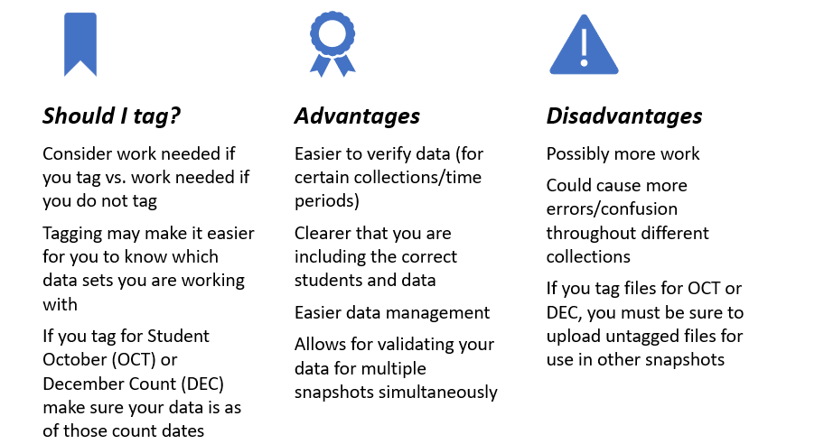
Tagging – Should I tag?

Slide 16
Errors/Warnings

Slide 17
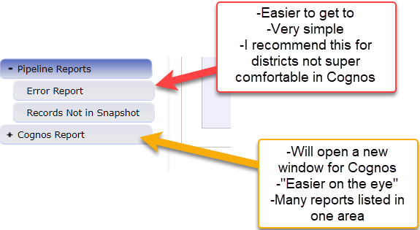
Reviewing Errors from Uploaded Files
Review your errors
1. Pipeline -> Pipeline Reports -> Error Report
2. Cognos Report -> Student Profile -> Error Detail Reports

Slide 18
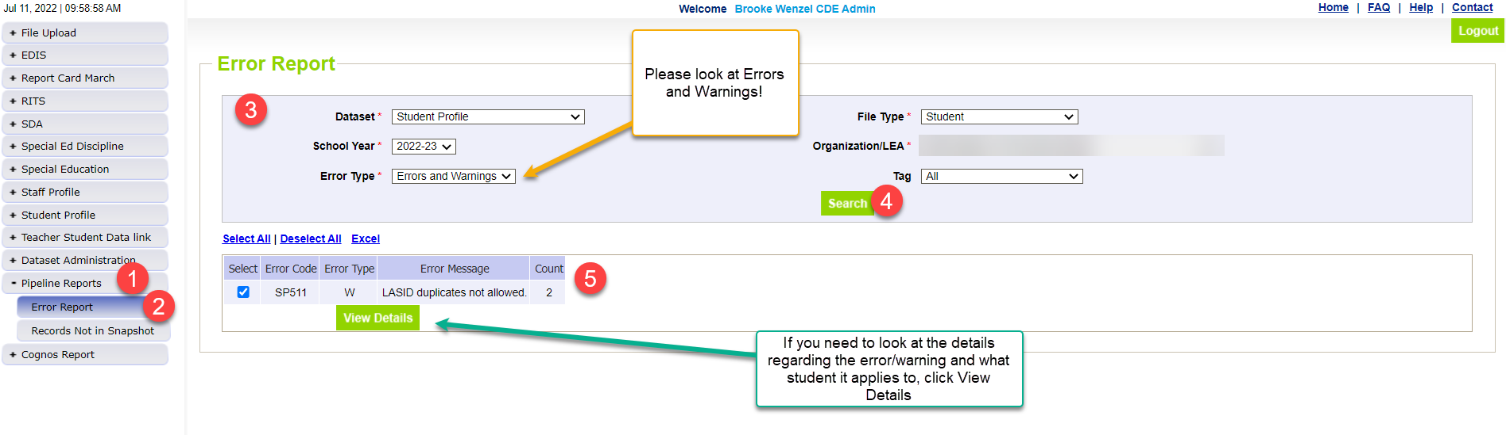
Pipeline Error Report
Errors
Warnings
Must be addressed
  Update data fields to clear
  Request reporting exception if student data is accurate but does not follow the typical coding pattern as indicated by the error message
Snapshot cannot be submitted if there are any errors
Indicate possible data inconsistencies/coding issues
Snapshot can be submitted even if warnings are present
Pro Tip: Review warnings to look for patterns/areas where district data could be documented in a more accurate manner

Slide 19
Resolving Errors
  Carefully read the error message to understand the error and why it is being triggered.
Option 1 – Edit Record(s)
Change Coding
Make changes in Student Information System
Option 2 – Request an Exception
Student is coded correctly and should not be triggering error
Do not change coding to clear error!
Re-Extract file from SIS, and reupload to Data Pipeline
Request exception through Syncplicity with Exception Template
Send me an email!
Exception processes, resubmit files/recreate snapshot

Slide 20
Exceptions

Slide 21
When are reporting exceptions needed?
Sometimes a student’s records will have accurate information, but their educational history will not follow the anticipated coding patterns outlined in the business rules for an interchange file or snapshot
  These are unique circumstances and apply to few students
Reporting exceptions are used to clear the errors associated with a student’s record without changing the data
Data respondents must work with the data collection lead for a given file/snapshot to request an exception be granted

Slide 22
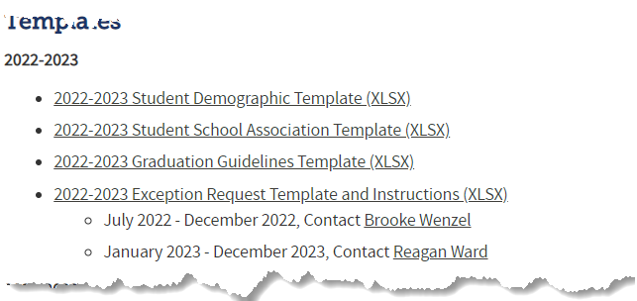

Reporting Exception Process (Option 2)
Complete exception request template
Upload exception request template to your district’s Syncplicity student folder
Folder: 1234 – DISTRICT NAME – Student
Notify the OCT collection lead (StudentOctober@cde.state.co.us) that you’ve uploaded a document for review
Collection lead will review your request and notify you of the outcome
Approved requests – reupload interchange file and/or create a new OCT snapshot
Denied requests – collection lead will provide next steps for clearing the error
Additional information needed – collection lead will request information
Available on Student Interchange Website
Pro Tip: Include the date in name of your exception request file as you may upload more than one exception during the collection cycle

Slide 23
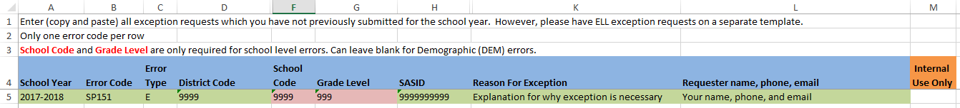
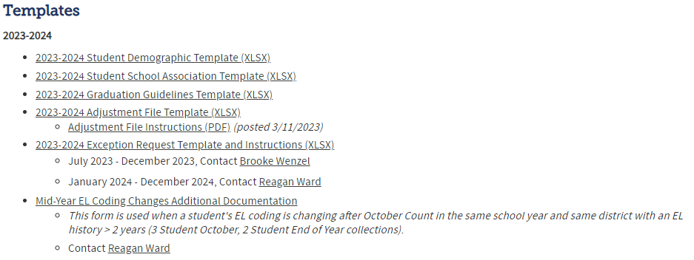
Requesting Exceptions (Option 2)
Each error needs a row, even if the same SASID is generating multiple errors
  You can use the same explanation multiple times though
Fields Required for exceptions to errors in Demographic File
Where do I find the Exception Request Template?
Student Interchange Website

Slide 24
Other Reporting Pieces
(Home School Data and Title I)

Slide 25
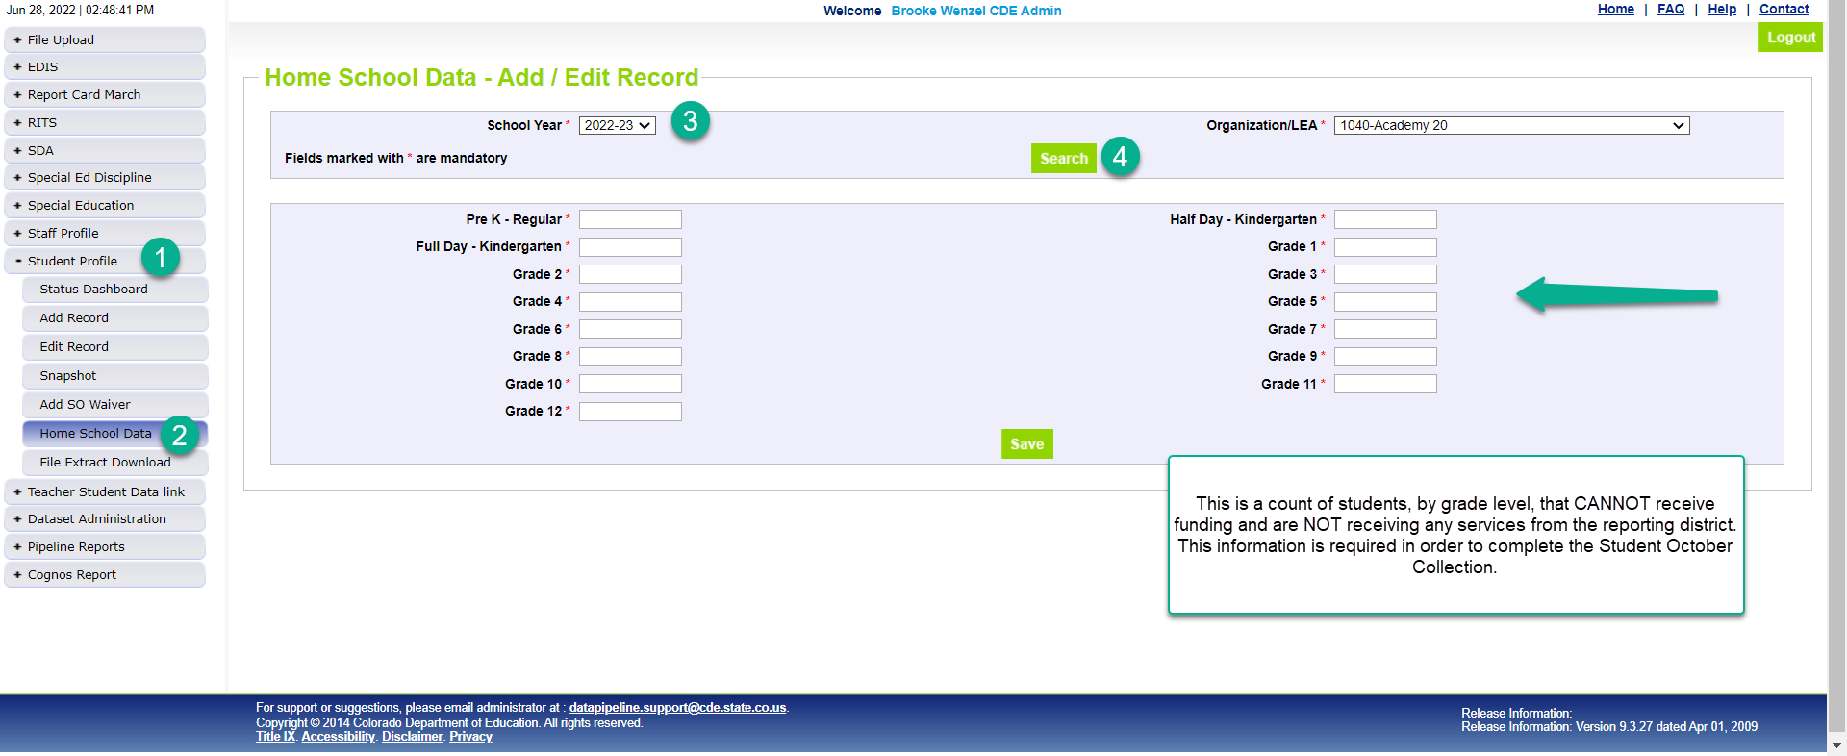
Home School Data – Add/Edit Record
*Please note that you’ll need to include any homeschool students receiving some regular education services provided by the district in your interchange files. They are only eligible for a maximum of part-time funding. For homeschool student receiving no services report them in Home School Data under Student Profile. These students who are not taking any classes offered through the district are not eligible for funding.

Slide 26
New: At-Risk Measure Interchange File Overview
Beginning with the 2024/2025 school year, there is a new Data Pipeline At-Risk Interchange.
The purpose of the At-Risk Interchange is to obtain student level census block information needed to implement the new at-risk measure as described in HB22-1202 with data collection to begin with the 2024-2025 school year as provided for under SB24-188.
The new at-risk measure will be implemented starting with the 2025/2026 school year, and included in the Total Program funding calculation as described in the Public-School Finance Act which will continue to utilize student level data reported through the Student October Count data collection
Information on At-Risk:
  ARMeasure@cde.state.co.us
  At-Risk Interchange Website

Slide 27
Title I Interchange File
Upload Title I Interchange file if necessary
If your district has a Title I Targeted Assistance (TA) funded school you will need to submit a Title I file
Information on Title I:
  Melissa Chaffin
  Title I Interchange Website
The method districts use to report students served with Federal Title I Targeted Assistance (TA) funds.
Data from the Title I Interchange are captured in October Count and End-of-Year snapshots.
  States that accept Title I $$ must report Title I data to the U.S. Department of Education:
  District overall and disaggregated by:
    student groups (race/ethnic, IEP, FRM, EL)
    program (Schoolwide vs. Targeted Assistance)
Accepts TA students only. All students in SW programs are coded Title I.

Slide 28
Snapshot

Slide 29
What is a Snapshot? - Visual
Source File A
Source File B
Internal Flags
File A: Element 2
File A: Element 5
File B: Element 3
Internal Flag: 3
Snapshot
File A: Element 1
File B: Element 1
File A: Element 3
File A: Element 4
File B: Element 2
File B: Element 4
Internal Flag: 1
Internal Flag: 2
Notes:
A data snapshot begins with uploading the corresponding interchange files. These interchange files become the source of information, or source file for specific data fields on a snapshot.
When a snapshot is triggered, it pulls needed information from the source (interchange) files into a new file called the snapshot.
Snapshots typically won’t use every data element on a source file.
Snapshots often pull in information called “internal flags.” These are calculated pieces of data from information provided on the interchange files or from other internal data in data pipeline.

Slide 30
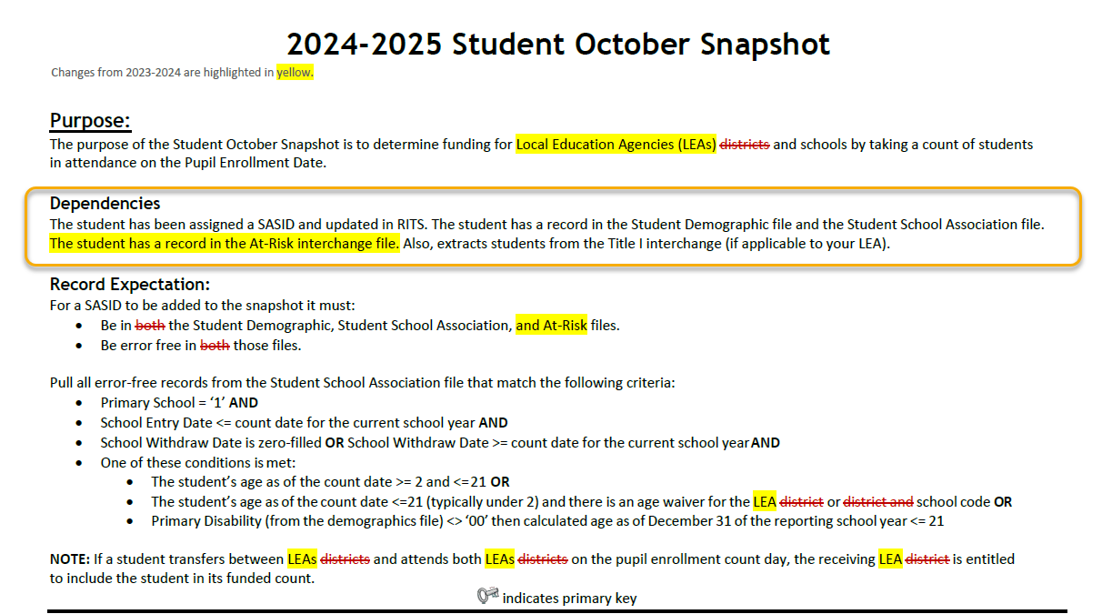
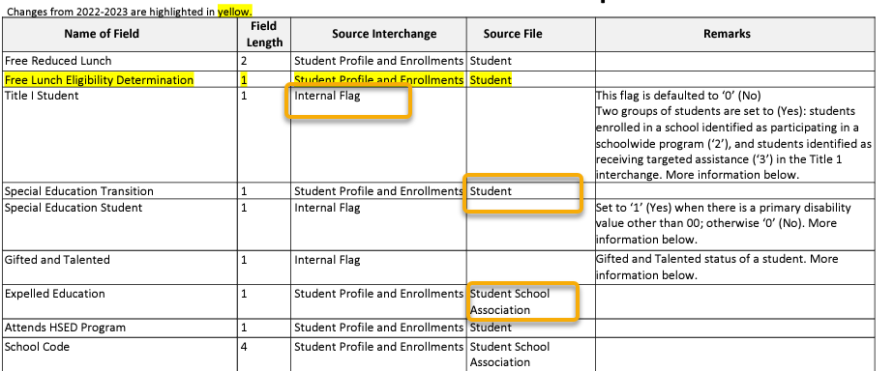
What is a Snapshot?
Interchange File Layout
  Provides a list of each data field included on an interchange (source) with detailed descriptions and codes.
Snapshot File Layout
  Dependencies: List of source interchange files needed for the snapshot
  Criteria: Rules regarding the types of records pulled from a source file into a snapshot
  Data Fields: Includes a list of specific source files for each data field or indicates the field is an internal flag.
  Internal Flag Definitions: Provides detailed descriptions of each internal flag data field and codes.

Slide 31
Another Snapshot Visual
Student October
Student Demographic
Student School Association
At-Risk
Title I (if applicable)
Supporting Files (TREP Allocation, Foster, etc.)
Light Green – District Uploads
Gray – CDE Uploads
Light Blue – District “Triggers”

Slide 32
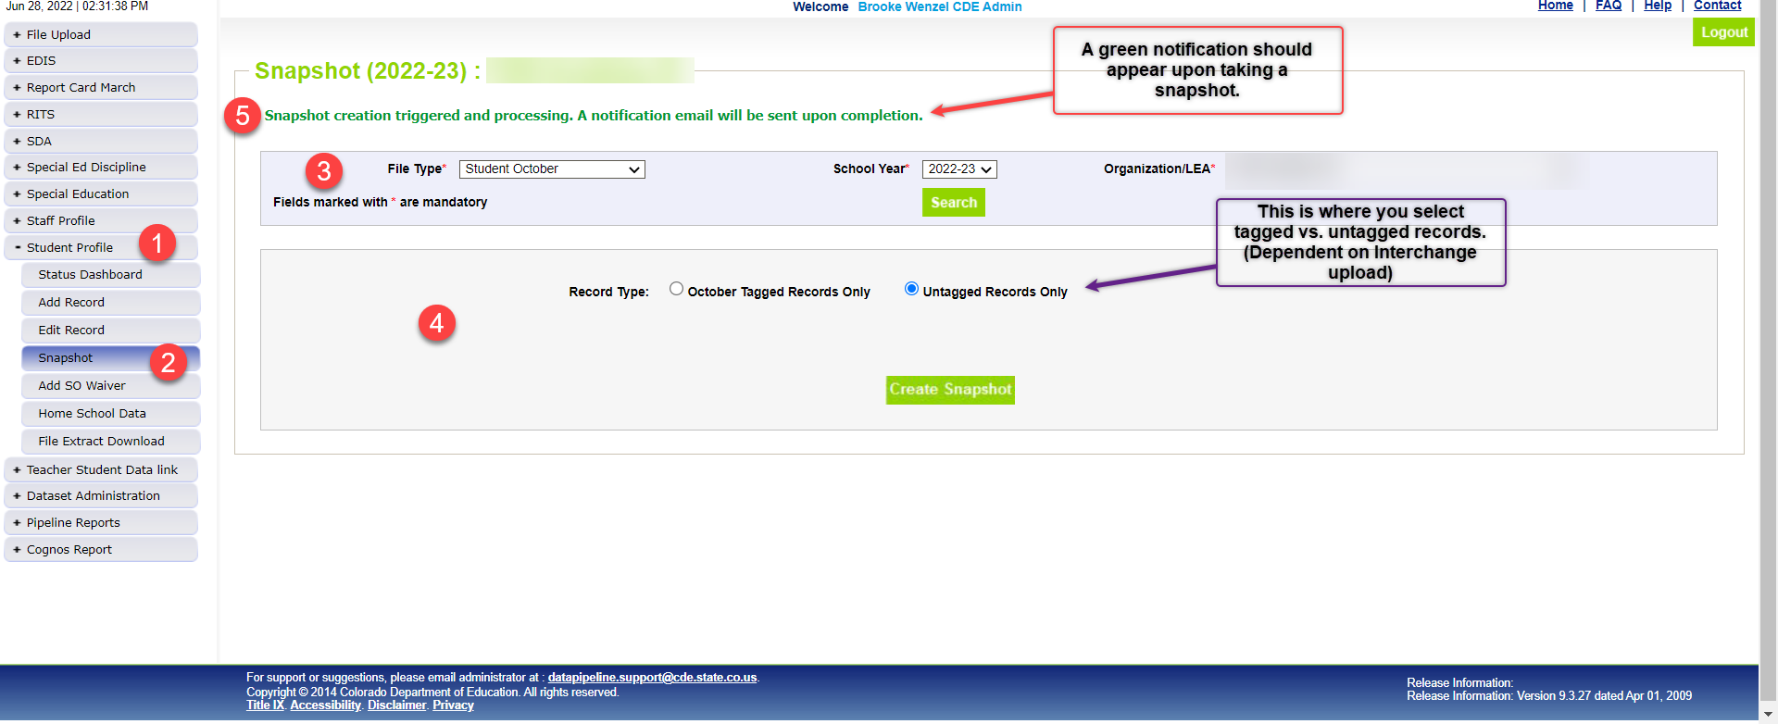
Snapshot Screen
Create a Student October Snapshot
  Record Type: Choose based on use of tagging
  Always Create Snapshot

Slide 33
Snapshot Process – Described (again)
0. Make sure Student Information System is updated
Extract Interchange Files from SIS and upload Interchange files to Pipeline (Student Demographic, Student School Association Files, At-Risk, Title I)
Check Business Rules Associated with Interchange files
Errors on Interchange files?
  Yes – Correct Errors in SIS and go back to step 0
  No – Move on to step 4*
Create Snapshot
Check Additional Business Rules Associated with Snapshot
Errors?
  Yes - Correct Errors in SIS and go back to step 0
  No – Move on to step 7
Review Reports and Finalize
  If you need to correct any data, you will need to go back to step 0
*Note: Error-free interchange files are not required to take a Snapshot but recommended. Get your interchange files as close to error free as possible before taking a snapshot!

Slide 34
Cognos Reports (CEDAR)

Slide 35
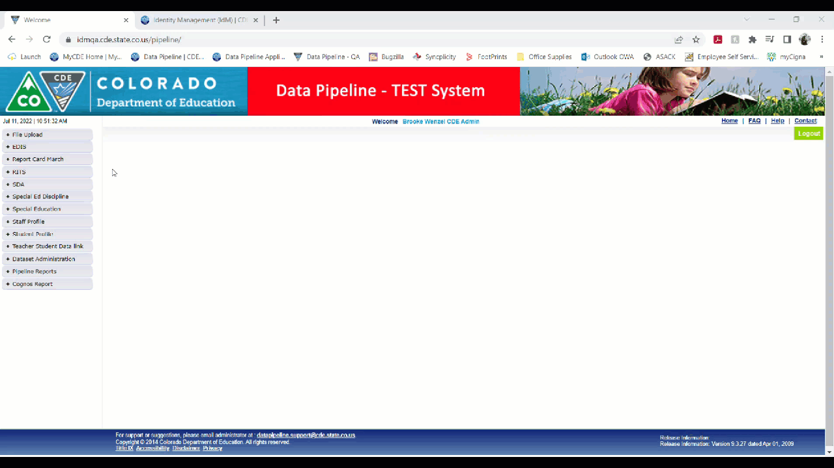
Logging Into Cognos

Slide 36
REVIEW, REVIEW, REVIEW
Once you have error free interchanges and snapshot
  Verify accuracy of the data using Cognos
Important Data Verification Reports
  EL Students
    District Summary of EL Students (Summary by Grade Level)
    District Summary of English Learners (Summary by School)
    ELPA Report – Updated (by Student)
  District Summary of Pupil Counts
  October Snapshot Records
  Pupil Count by Language, Section 504, & Program Service
  Student October and IEP Comparison
  Summary of Pupils by Race/Ethnicity and Gender

Slide 37
Submit Data to CDE

Slide 38
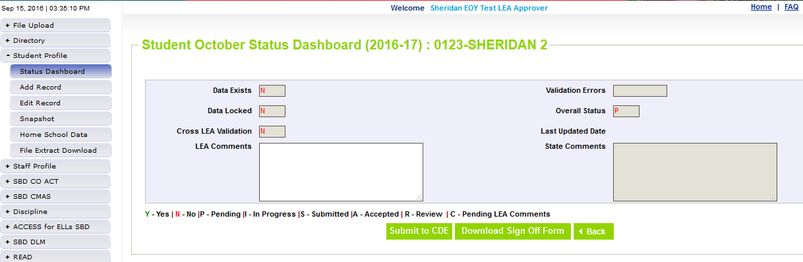
Ready to Submit
Once you have verified the data, submit the snapshot to CDE. Go to:
  Student Profile -> Status Dashboard and click ‘Submit to CDE’
  Must have LEAAPPROVER role in IDM to complete this step
  Once data is submitted it will be locked, must request unlock to make changes (email or call me to request)

Slide 39
Other Helpful Screens – Data Pipeline

Slide 40
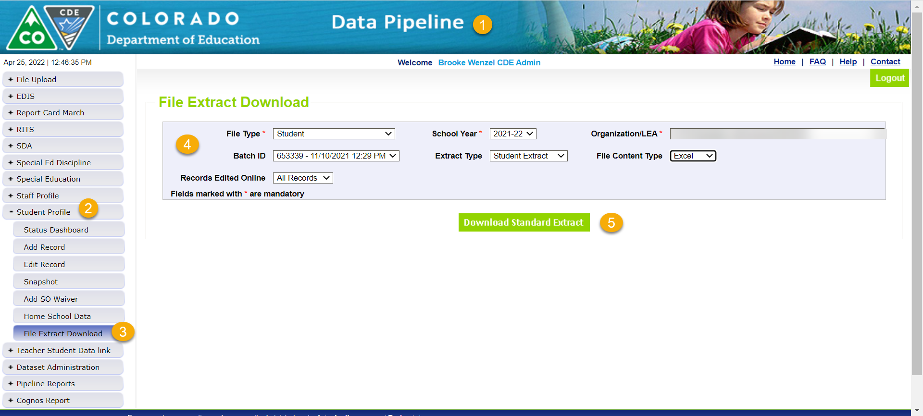
File Extract Download Screen
Want to see what was submitted last year?
Note: File Layouts/Field Options can change from year to year!

Slide 41
Batch Maintenance Screen
Displays Files that were uploaded in Pipeline
Note: This is especially helpful for those districts that use the tag option

Slide 42
Duplicate Process

Slide 43
Phase 2 (Duplicate Process)
Duplicate Process
  Once all districts have submitted data CDE will begin the duplicate process
  Will compare SASIDs across all districts and determine if any students are receiving funding greater than allowed
    For most students this is 1.0 FTE, but there are some instances where a student is only eligible for 0.5 FTE (e.g. home-school students)
  Districts will receive email if they have a duplicate
    Email will include instructions on how to submit documentation to the CDE School Auditing Office to determine who receives funding
    Districts have 3 business days to submit this documentation
Date | Event | Event Description
11/12/2024 12:00 p.m. | Deadline | Duplicate funding documentation due to School Auditing Office
11/18/2024 | Other Date | School Auditing makes decisions on funding duplicates
11/27/2024 | Deadline | Resubmit Student October Snapshot data to CDE based on decisions from School Auditing
12/06/2024 | Deadline | Collection closes Secretary of the Board of Education Verification (sign-off) form due. Data remains embargoed until the official release in January.
01/15/2025 | Data Release | Official data release

Slide 44
What happens if you have duplicate students?
Duplicate Students?
Audit Exception Report
  Created after duplicate process has been run.
  Helps determine which students need documentation to send to CDE School Auditing team during duplicate process
Summary of Pupils Being Reported by Another District
  Like the Audit Exception Report used during the duplicate process, but can be accessed prior to your snapshot being submitted
  Lists SASIDs being reported by another district
  You can then use the Student October Contact List to contact the other district to resolve duplicates prior to duplicate process
Date | Event | Event Description
11/12/2024 12:00 p.m. | Deadline | Duplicate funding documentation due to School Auditing Office
11/18/2024 | Other Date | School Auditing makes decisions on funding duplicates
11/27/2024 | Deadline | Resubmit Student October Snapshot data to CDE based on decisions from School Auditing
12/06/2024 | Deadline | Collection closes Secretary of the Board of Education Verification (sign-off) form due. Data remains embargoed until the official release in January.
01/15/2025 | Data Release | Official data release

Slide 45
End of the Collection!
After documentation received
  CDE School Auditing Duplicate Process
Once data is final and no duplicates remain
  Print out signature page (status dashboard -> Student October)
    Will look like the Cognos Report “District Summary of Pupil Count”
Get it signed by the Secretary of Board of Education AND the Chief Financial Officer and then scan and email to Brooke the Student October Collection Lead at CDE.
Once CDE has received your signature page you are done!
Date | Event | Event Description
11/12/2024 12:00 p.m. | Deadline | Duplicate funding documentation due to School Auditing Office
11/18/2024 | Other Date | School Auditing makes decisions on funding duplicates
11/27/2024 | Deadline | Resubmit Student October Snapshot data to CDE based on decisions from School Auditing
12/06/2024 | Deadline | Collection closes Secretary of the Board of Education Verification (sign-off) form due. Data remains embargoed until the official release in January.
01/15/2025 | Data Release | Official data release

Slide 46
How the Snapshot Works

Slide 47
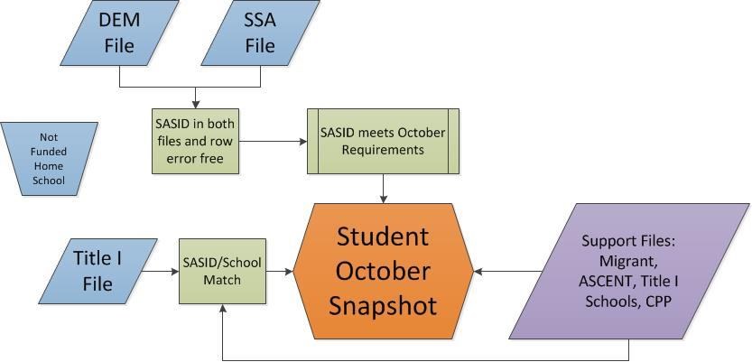
Data Feeds into Snapshot
Student October Snapshot Criteria
  Student record in DEM file, error free
  Student has at least one record in SSA file , error free
  Student has record in At-Risk file, error-free
  Primary School flag = 1
  Entry Date before or on count day and Exit Date after count day
    Or SASID is in Transfer/Alternate Count Day exception file
Support Files/data: Foster, Migrant, Title I School, TREP
At-Risk File

Slide 48
What is a Snapshot? – Back to the Visual
Source File A
Source File B
Internal Flags
File A: Element 2
File A: Element 5
File B: Element 3
Internal Flag: 3
Snapshot
File A: Element 1
File B: Element 1
File A: Element 3
File A: Element 4
File B: Element 2
File B: Element 4
Internal Flag: 1
Internal Flag: 2

Slide 49
2024-2025 Changes

Slide 50
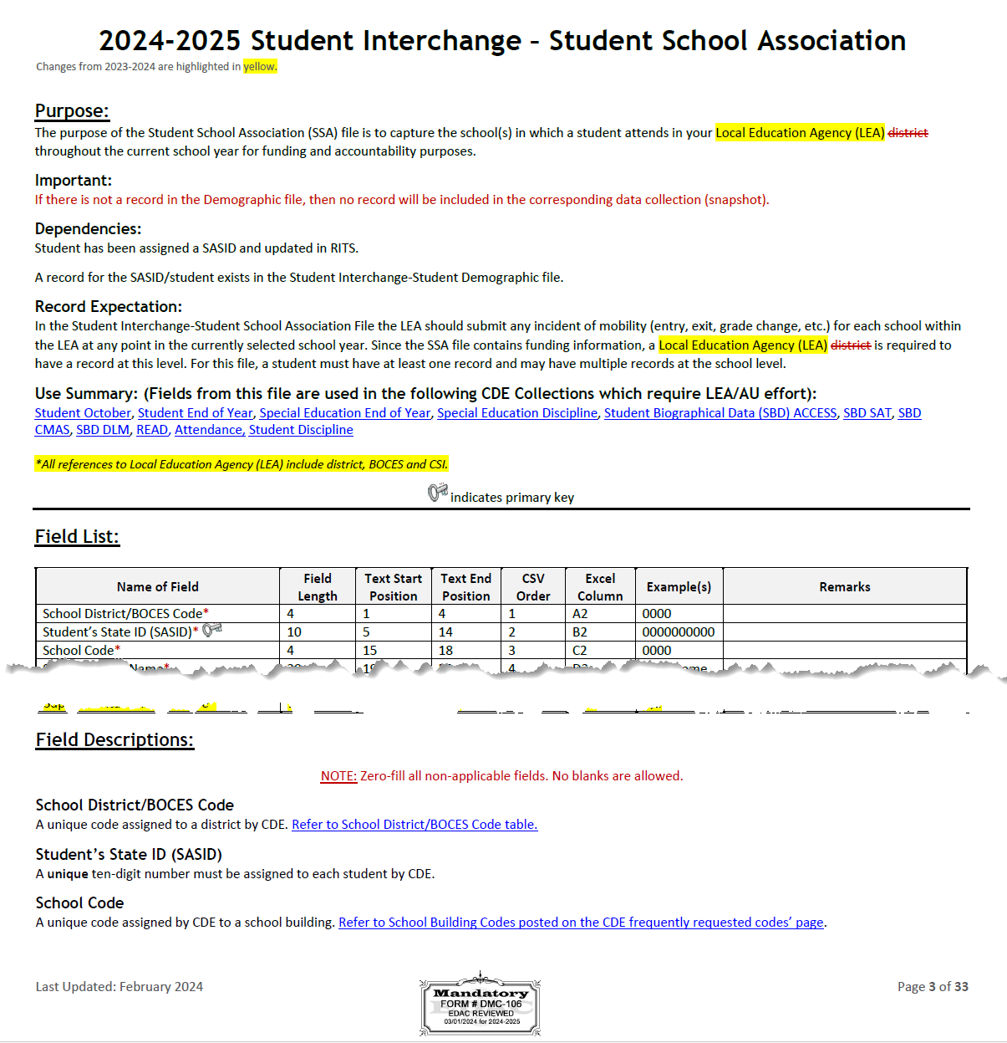
2024-2025 Student School Association
2024-2025 Student School Association File Layout
Added Independent Study Course, Work-Based Learning Opportunity Course, Blended Learning Course and Supplemental Online Course fields
  Will help determine student’s funding eligibility based on documentation (finance/auditing)

Slide 51
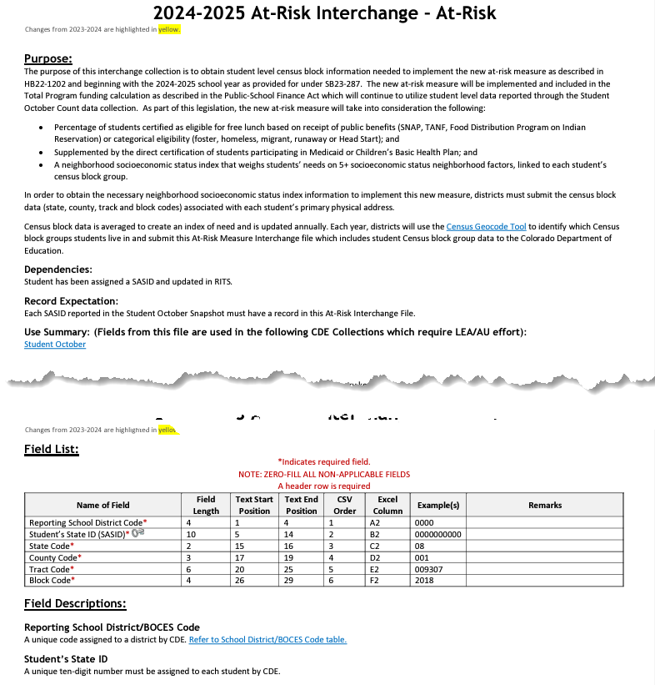
2024-2025 At-Risk
2024-2025 At-Risk Interchange File Layout
Obtain student level census block information needed to implement the new at-risk measure as described in HB22-1202.
At-Risk Interchange Website

Slide 52
Pupil Attendance Information

Slide 53
PAI Overview
Pupil Attendance Information (PAI)
Students in membership at a given school or program
Students in membership at another district/BOCES school or program

Slide 54
Criteria for PAI Codes
Which Students get included in Student October?
  Students in membership at your district’s schools (PAI=01-08)
  Students your district is contracting with an outside program/district/BOCES to educate (PAI=24-33)
What is membership?
    Enrolled by the count day (or alternate count day)
    Attendance on count day OR
    Has established attendance prior to count day during the current school year AND resumes attendance within 30 days following the count day
Enrollment
Attendance
Membership

Slide 55
01-08 PAI Codes
Resident Pupils Attending an Educational Program Operated by the Reporting District
  01-Resident, Designated School
  02-Resident, School of Choice (Open Enrollment)
  03-Resident, Non-District Site (Expelled, Preschool)
  04-Non-Resident, Choice (Public Schools of Choice)
  05-Non-Resident, Non-Choice
  08-Resident, Non-Choice
These codes are for students being educated in the district reporting them. Resident/Non-resident should be determined by the district associated with the residence of the parent(s).

Slide 56
24-33 PAI Codes
Resident Pupils Attending an Educational Program Not Operated by the Reporting District
  24 – Court Mandated Juvenile Detention
  27 – Non-Public Schools (Contractual Agreement)
  28 – Outside of Colorado Public Education Agency
  29 – Outside of Colorado Non-Public School
  30 – Colorado Public Agency (Contractual Agreement)
  31 – School District or BOCES (Contractual Agreement)
  33 – Online Schools (Contractual Agreement)
These codes are used for students who are residents of reporting district, but the district is not educating the student

Slide 57
OCT: Students attending BOCES Schools/Programs
Contract with a BOCES?
School: BOCES has own school code
Home District: OCT record,
Group B PAI = 31 or 33,
Funding Code = Applicable
BOCES District: OCT record,
Group A PAI = 02 or 04,
Funding Code = not funded
Program: BOCES does NOT have a school code
Home District: OCT Record with Group A PAI 01-08 and Non-School Program Code 03
BOCES Program: no state reporting
Notes:
PAI Codes (on the SSA file):
Group A = Pupils attending an educational program operated by the reporting district
Group B = Resident Pupils attending an educational program not operated by the reporting district
Special Education PAI Codes:
See the Special Education IEP Interchange – Child Participation file layout for information
Based upon students within the Administrative Unit (AU) – which means codes may vary from the PAI codes used on the SSA file since those are based upon district level information

Slide 58
School Auditing Office

Slide 59
Reporting vs. Requirements
  Reminders:
  Reporting vs. Requirements (Auditing)
  Review the Student October Count Audit Resource Guide
    Identify unique student and course types that are relevant to your district.
    Make sure you have processes in place for collecting required audit documentation in an electronic format.
    Coordinate with district program staff.
  Auditing has their own trainings!
  https://www.cde.state.co.us/cdefinance/auditunit_trainings

Slide 60
Audit Syncplicity Folders
All districts have an audit Syncplicity folder for transferring and sharing audit documentation for audit purposes
Naming convention for district folders is: District Number_District Name_Audit_FAST
  For example: 0010_Mapleton 1_Audit_FAST
Each audit Syncplicity folder contains subfolders:
  Annual Audit Review
  At-Risk Count
  Audit Report
  Duplicate Count
  English Language Learner Count
  Pupil Count
  Transportation

Slide 61
Preschool Data Reporting

Slide 62
Student October Expectations
LEAs Will Report
LEAs Will Not Report
All PK students receiving services from the LEA (regardless of UPK funding status)
  These students should have a SASID assigned
All PK students as Not Funded (Public School Finance Funding Status ‘86’, ’87’ or ‘96’) for enrollment purposes
All related Demographic and School information
Any PK students not receiving services from the LEA (optional)
An alternate count date for PK students (if applicable)
  All students will fall under the October Count Date
CPP/ECARE Funding Information – no longer applicable
*LEA = Local Education Agency (district, Charter School Institute and BOCES are included)

Slide 63
Resources

Slide 64
Resources/Helpful Webpages
Site Name/Link | Information/Uses
Data Pipeline Home | Main landing page for the data pipeline information/resources. From here you can navigate to all the various data collection sites
Identity Management (IdM) | This is the landing page with login links to the various CDE data platforms. Data Pipeline COGNOS/CEDAR Reporting RITS EDIS
Data Pipeline Collection Dates (XLS) | Excel document that shows the open/close dates of all data collections & the point of contact at CDE for the collection (collection lead)
Student Interchange | Contains file layouts, templates, business rules, training materials, and resources Student Demographic file Student School Association file Graduation Guidelines file
Syncplicity | Secure file transfer site used to communicate personally identifiable information with CDE if you have questions on specific students during reporting or have exception requests. You should get a separate email from them today to set up an account to access the student file for your district. Other collection leads will need to give you access to the Syncplicity folders (same login, just extra folders) for their collections if you need them.

Slide 65
Thank You for Attending!
720-441-7963
StudentOctober@cde.state.co.us
Student October Website
Student Interchange Website
Identity Management/Data Pipeline
Auditing Office’s Pupil Count Website
At-Risk Interchange Website
Title I Interchange Website

