Slide 1
2024-2025
Special Education December Count
Office Hours
^{November 20, 2024}
^{Lindsey Heitman}

Slide 2
Special Education December Count
Contact Information
Lindsey Heitman – SpedDecCount@cde.state.co.us 720-456-2033
  Special Education Dec Count Snapshot submission
  Includes IEP Interchange and Staff Interchange and Sped December Count SPED staff questions
*Please include your AU #, District #, Error code # or cognos report name (if applicable) in emails
Resource Webpages
  Special Education IEP Interchange
  Staff Interchange
  Special Ed December Count Snapshot
  ESSU Data Management System

Slide 3
Special Education December Count:
Staff and Student Snapshot Timeline
November Due Dates
December Due Dates
January Due Dates
30th - Thursday - All errors resolved – complete snapshot
February Due Dates
10th – 18th - Monday – Tuesday - Resolving Duplicates
1st - Sunday - Official count date (or last date prior your school was in session)
30th - Feb 7th Thursday – Friday - Report Review
18th – 21st - Tuesday - Friday - Final Report Review
21st - Friday - Final Submission Due
1st - Friday – Sped December Count Snapshot available in Data Pipeline
13th – Wednesday - Interchange files uploaded - Sped Child, Sped Participation, Staff Profile, Staff Assign
18th - Wednesday: Interchange files error free and at least one snapshot created
These files must be uploaded AND records error-free before they will pull into your December Count Snapshot.
The “missing” staff records will triggers errors DC114-DC115, DC225 – DC229 until they are included
Please download the full 24-25 Timeline from the Special Education December Count Snapshot webpage.

Slide 4
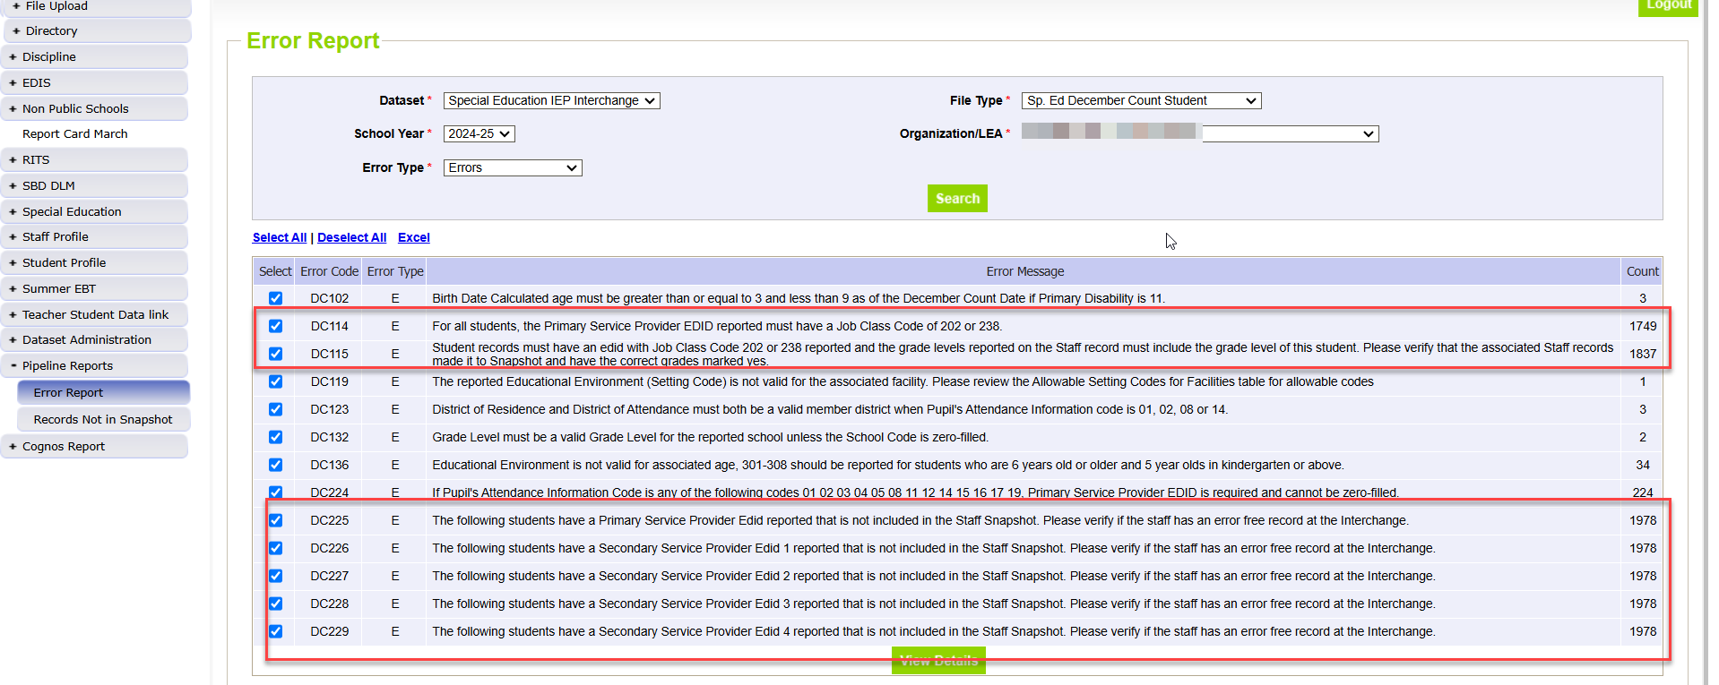
Sped December Count Student:
Errors Related to Missing Staff Records

Slide 5
Transfer Students – going through evaluation by current AU and still receiving services
Student transferred to AU with an IEP
  IEP lapsed in another AU or soon after student started attending and is still going through the evaluation process as of 12/01
  If an interim plan is in place and the student is receiving services, they may be reported with Funding Status =50
  Date of Entry to Special Education = date student began attending in your AU/receiving services

Slide 6
SASID CLARIFICATION
SASIDs are required for private school student records (except PPPS = 02)
  Required for Special Education reporting
  These records are not required to be reported in the Student Interchange
    Please ask your RITS contact to submit for a SASID
    In RITS, there’s an option for School Type - Non-Public School
    Many non-public schools have a school code already and may be listed in the dropdown. If not, select NON-ATTENDING.
Not Required for these record types - AU must create and report a LASID for these records:
Those who are preschool age or younger and found not eligible and do not receive Special Education service hours.
  These records do not pull into your December Count Snapshot, only Sped EOY
PPPS = 02 Parentally Placed in Private School students cannot have a SASID (edits will require you to zero-fill it)
  These records only pull into your December Count snapshot, they do not pull into Sped EOY

Slide 7
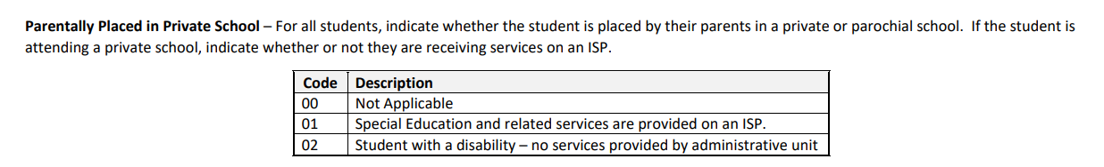
December Count:
Private School Student Reporting Tips
PPPS (Parentally Placed in Private School) Field reporting guidance:
Watch PPPS short video posted here under the Trainings section (last bullet point)
Reach out to non-public schools located within your AU boundaries- list posted here https://www.cde.state.co.us/datapipeline/org_orgcodes
  Check school code lists for non-public school code #’s
These are both reported for proportionate share calculations on two Dec reports
You may need to request for a non-public school code https://www.cde.state.co.us/schoolcoderequest-nonpublic

Slide 8
Parentally Placed in Private School
Parentally Placed in Private School = 01
  Special Education and related services are provided on an ISP
  SASID is required for these records
  PAI Codes 14-17 depending on where the services are received and resident AU
  Funding Status = 54 (not eligible)
    PAI Code 14 – AU resident student who are PPPS but come to district site for services per the ISP
    PAI Code 15 – non-resident AU student who is PPPS and comes to district site for services per ISP
      School Code – you may report 0000/Sped Program Code 0003 or the public school code where services are provided
      Primary Provider EDID - required
    PAI Code 16 – resident student who is PPPS and receives services at the private school
    PAI Code 17 – non-resident student who is PPPS and receives services at the private school
      School Code = non public school code
      District of Attendance = 0000
      Primary Provider EDID - required
Parentally Placed in Private School= 02
Student with a disability but not receiving services from your AU
SASID = 0000000000 (must be zero-filled)
LASID = 1234567891 (# created by AU)
District of Residence = resident district
District of Attendance = 0000
Primary Disability = 08 (example-code required)
School Code = non-public school code https://www.cde.state.co.us/schoolcoderequest-nonpublic OR
  Special Education Program Code = 0003 (private facility)
Special Education Referral Type = 00
Date of Entry to SPED =00000000
PAI Code = 00
Funding Status = 00
Educational Environment = 000
Provider EDIDS = 00000000 (all zero-filled)

Slide 9
How the coding differs between PPPS = 01 and 02?
December Count
PPPS = 01 Special Education and related services are provided on an Individual Service Plan (ISP)
PPPS = 02 Student with a disability – no services provided by AU
9

Slide 10
IEP Team Placed in Private School
IEP team placed in a private school
  Parentally placed in private school = 00
  Student is receiving services from the private school staff on a tuition contract
  PAI Code = 27
  SASID = required
  District of Residence= member district
  District of Attendance = 0000
  School Code = must report non-public school code OR
    Sped Program Code =0003 (private facility)
  Funding Status = 50 (eligible)
  Provider EDIDS = all zero-filled

Slide 11
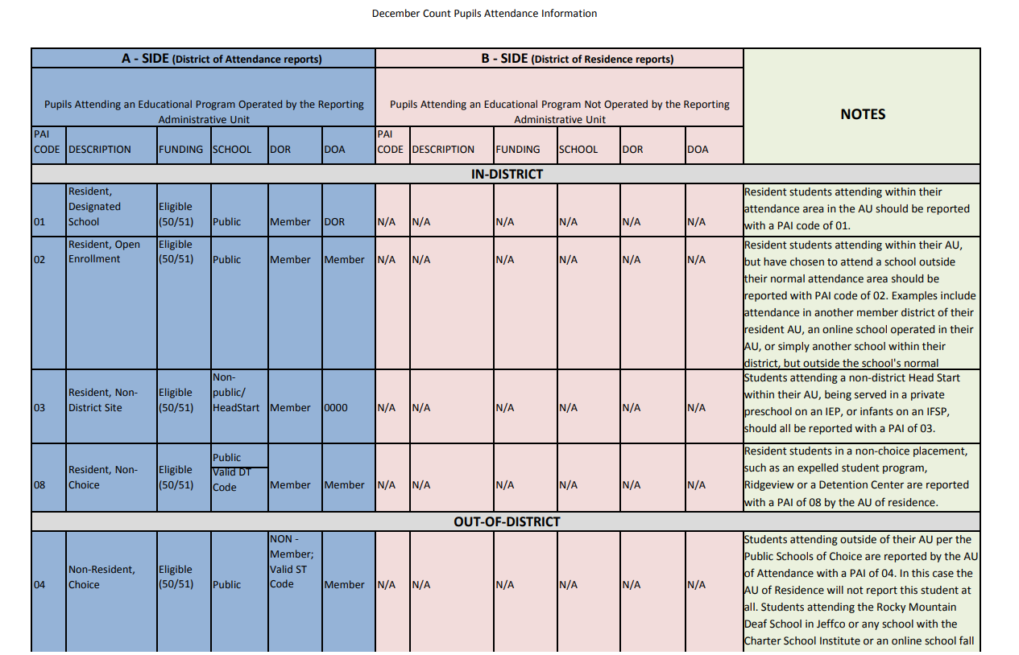
PAI Codes – Please Print for PAI Coding Help
Information on how to report these fields:
School Code
PAI Code
Funding Status
District of Attendance
District of Residence
Helpful coding chart with notes about each code:
http://www.cde.state.co.us/datapipeline/decembercountpaicodes

Slide 12
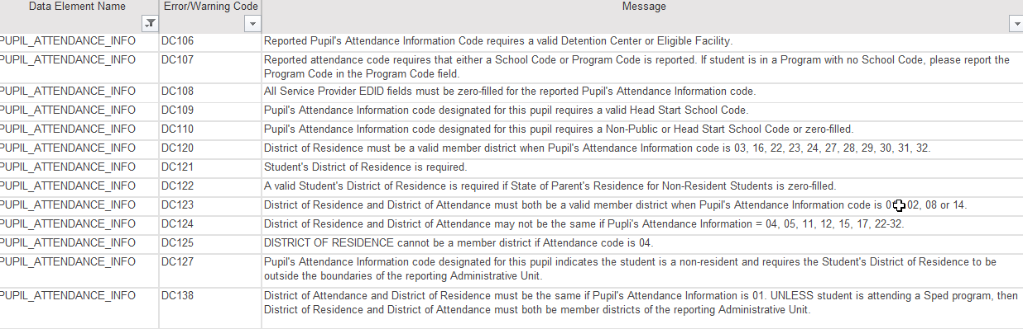
PAI Code Snapshot Errors:
Coding Student Records
What type of school is it? Check for correct school code and school type
How did student come to attend that school? parentally placed, choice, etc.
Is there a contractual agreement between your district/AU and attending AU?
Determine the student’s District of Attendance Code
Determine the student’s District of Residence Code
Use school, DOA, and DOR codes to determine applicable PAI Code
Use PAI Coding Chart to determine Funding Status Code

Slide 13
Special Education December Count: Troubleshooting Errors DC191 – DC205 (grades of staff and students served must match)
DC191 thru DC205 – these errors look at each individual grade level and compare student grades to grades marked on the staff assignment records.
What to check:
  Use Cognos Reports/Special Education December report “Included Snapshot Records: Staff Interchange” to compare grades for your student and staff snapshot records
    Cognos Reports/Special Education December Included Snapshot Records: IEP Interchange
    Cognos Reports/Special Education December Included Snapshot Records: Staff Interchange
  In the IEP snapshot records report, filter/search all 5 EDID fields for each EDID triggering one of the DC191-DC205 error codes and then highlight all student records this staff member is attached to. Then check/highlight the the Entry Grade Level fields to reference all student grades being served by that EDID. Similarly, you can pull up the Staff snapshot records to reference all grade levels marked with 1 on the staffs record(s).

Slide 14
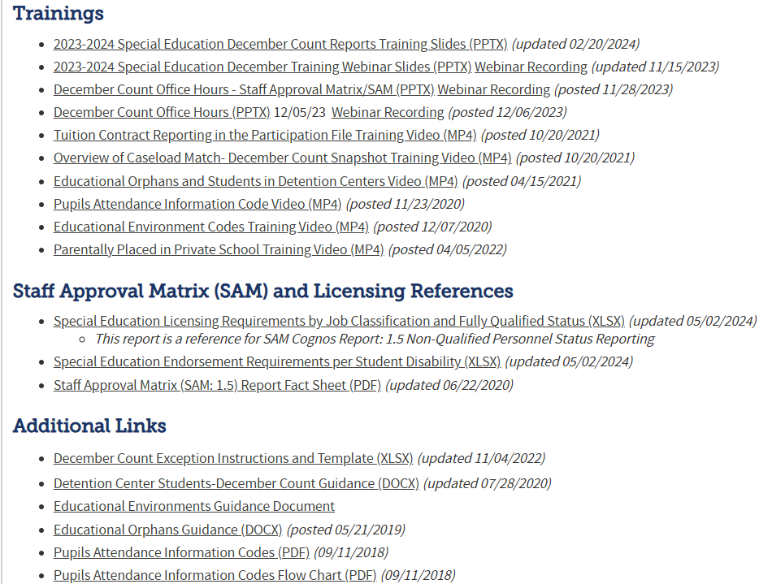
December Count:
Snapshot Resources Webpage
Special Education December Count Snapshot Resources
December Count Snapshot Training(s)
Staff Approval Matrix Training slides
Includes short training videos on these topics:
  Tuition Contract Reporting
  Overview of Caseload Match
  Pupils Attendance Information Codes
  Ed Orphans and Detention Center Students
  Ed Environment Codes
  Parentally Placed in Private School
SPED Licensing Requirements by Job Code
SPED Endorsement Requirements per Student Disability
December Count Exception Template
Detention Center Students – Guidance Doc
Educational Environment Guidance Doc
Pupils Attendance Information Codes
Pupils Attendance Information Codes Flow Chart

Slide 15

SNAPSHOT PROCESS

Slide 16
Snapshot Steps
Prior to creating a Sp Ed Dec Count snapshot:
Verify that all 4 files are uploaded and have processed successfully:
  Child, Participation, Staff Profile, Staff Assignment
Utilize:
District/AU Activity Report -->Cognos Reports/Special Education December Count
  This report is how AUs are able to track status of their districts staff file uploads!
If you have the STF viewer role, you have more options for viewing in the system:
Batch Maintenance screen
Email confirmations
Status Dashboard
Ideally files are error free, but not required to create a snapshot

Slide 17
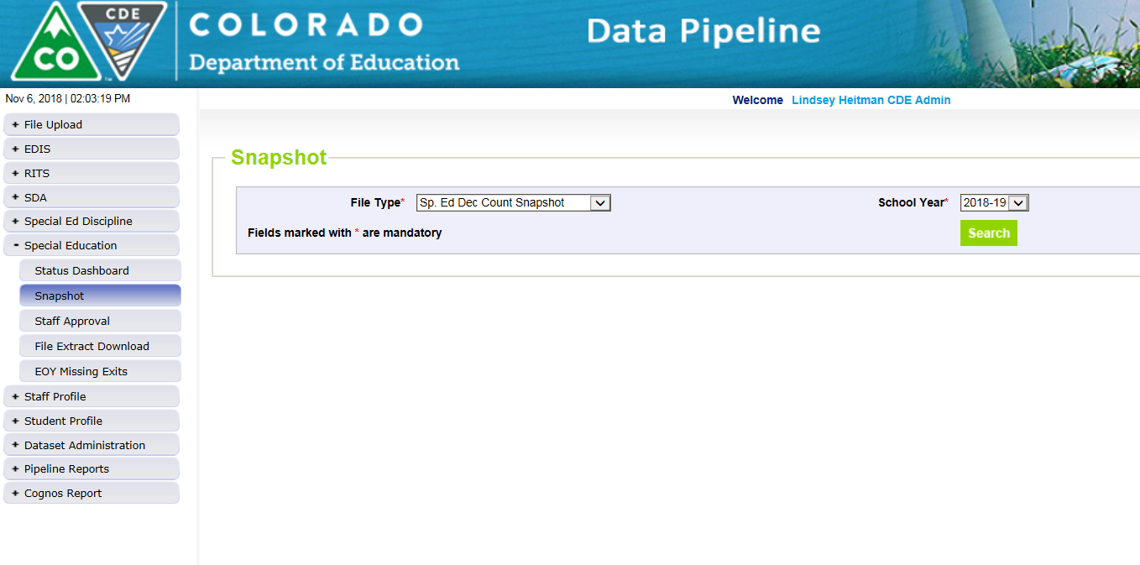
How to Create a Special Education
December Count Snapshot
1. Click on Special Education tab
2. Click Snapshot from expanded list
3. Select File Type – Sp. Ed Dec Count Snapshot
  School Year – automatically populates with 2024-2025
  Organization/LEA – automatically populates based on IdM role
4. Click Search and then screen will display the Create Snapshot green button.
5. Click Create Snapshot button.
  you should see a message display across the top left in green: “Snapshot creation triggered and processing. A notification email will be sent upon completion”
Watch for snapshot email confirmation. Snapshot is not finished
processing until confirmation email is sent

Slide 18
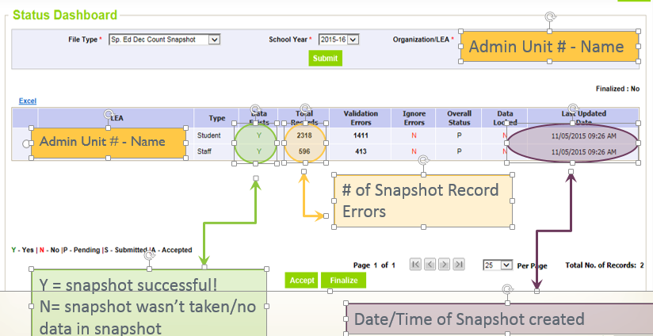
Check Status Dashboard for
Dec Student and Staff Snapshot Details
*Email confirmation is the green light for checking status dashboard!
Checking the Status of the Snapshot
Click Special Education->Status Dashboard:

Slide 19
Reviewing Snapshot Errors
Options for viewing errors:
  Pipeline Reports - Error Reports/Special Education IEP Interchange
    File Type: Sp. Ed December Count Staff OR
    File Type: Sp. Ed December Count Student
  Cognos Reports – Special Education December Count
    Errors: Student Detail Report of Errors to Correct
    Errors: Staff Detail Report of Errors to Correct
The list of all December Count Student and Staff Business rules (errors and warnings) can be found at: http://www.cde.state.co.us/datapipeline/snap_sped-december under the ‘Business Rules’ section.

Slide 20
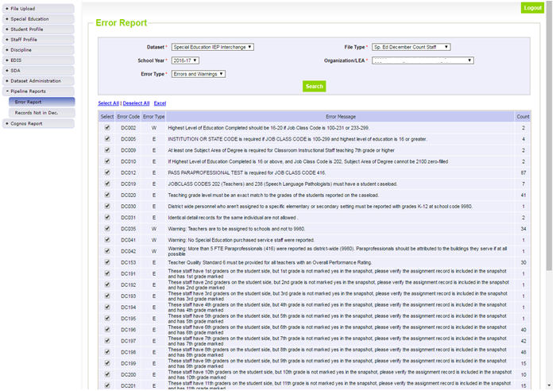
Pipeline Error Reports
File Type may be:
Sp. Ed December Count Staff OR
Sp. Ed December Count Student
Both are ‘DC’ error codes

Slide 21
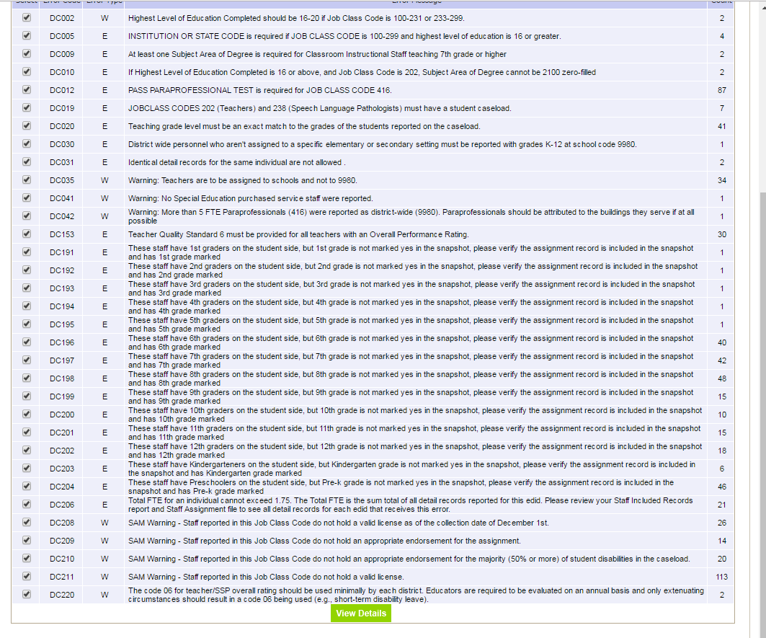
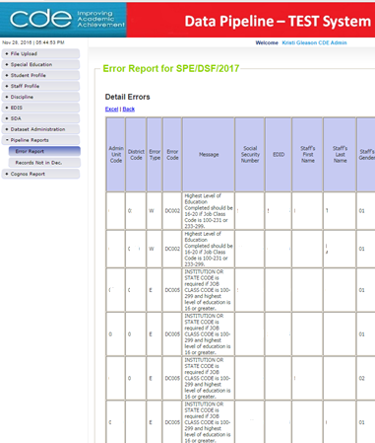
Click Excel
Pipeline Error Report:
Viewing detail error records in Excel
*Only shows first 1000 errors
Click View Details

Slide 22
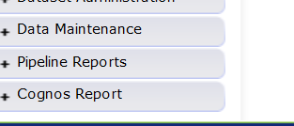
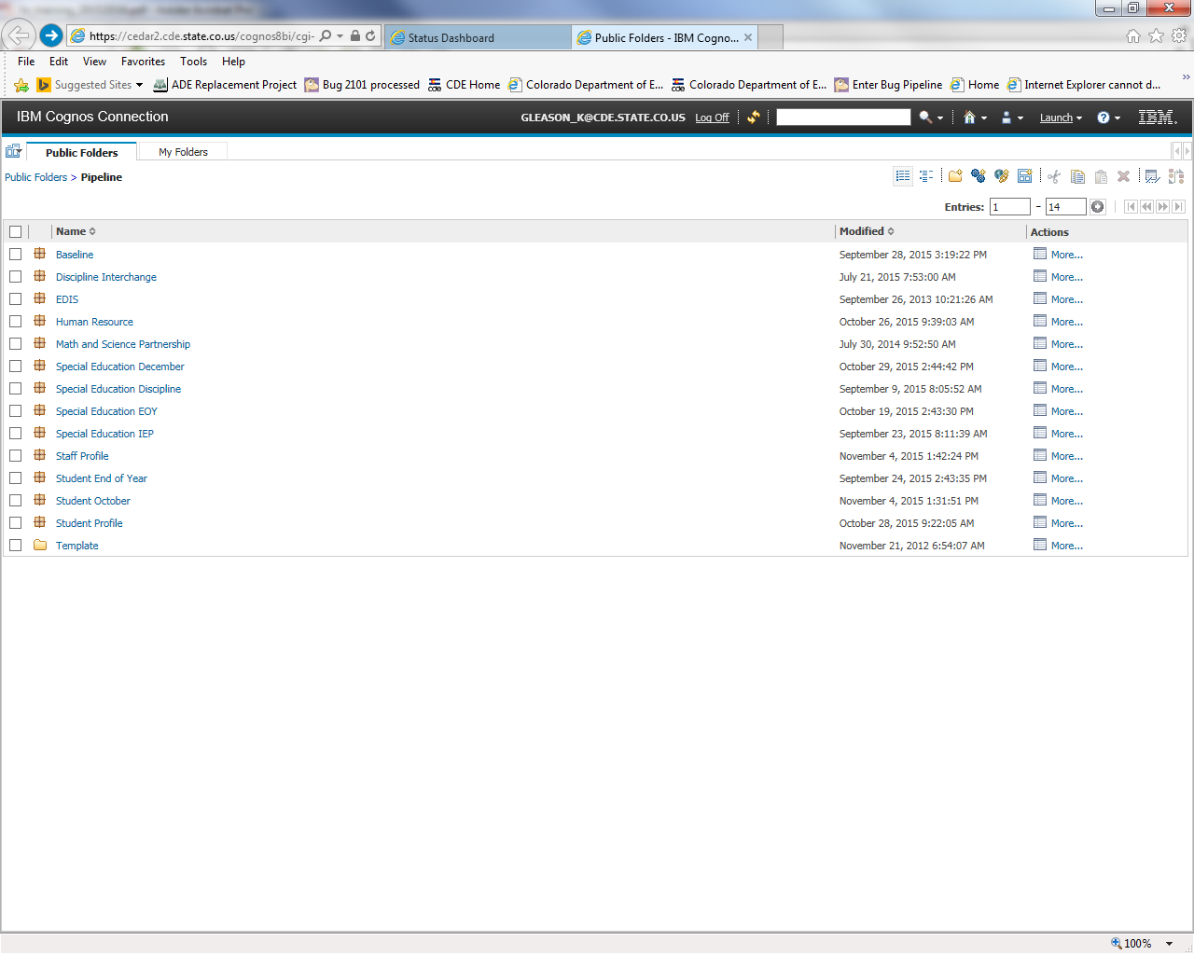
Cognos Reports – option for checking snapshot errors
Opens new window
Special Education December

Slide 23
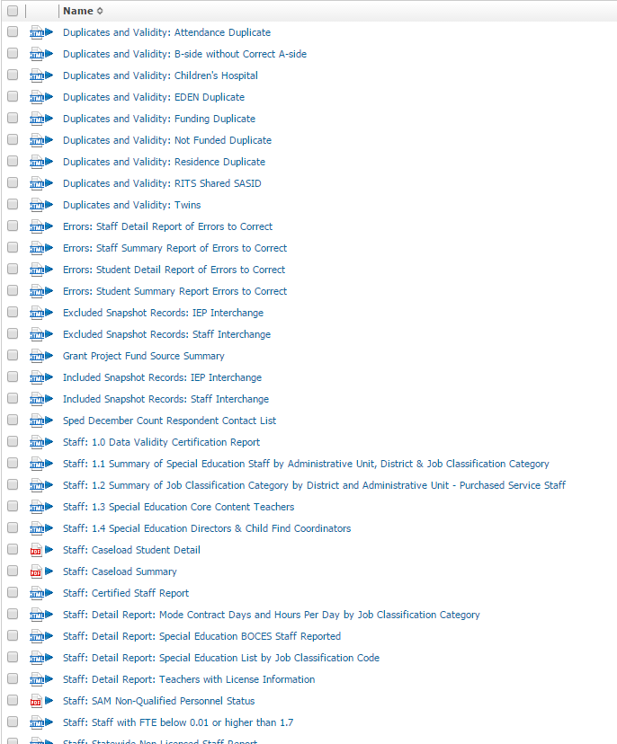
Error Reports: Staff and Student have separate reports
Special Education December Cognos Reports
-->Cognos Reports/Special Education December
Excluded Report: Includes excluded records – those w/ interchange errors

Slide 24
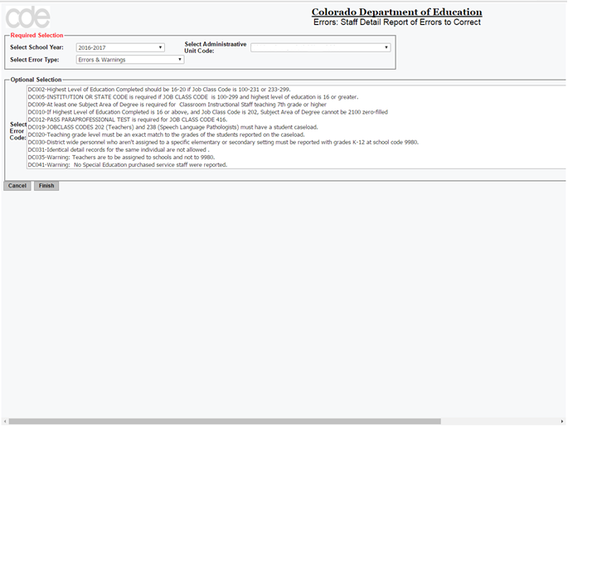
Cognos Error Reports

Slide 25
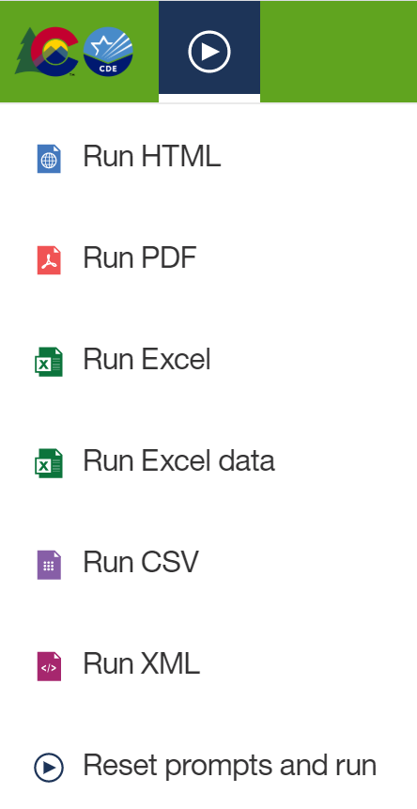
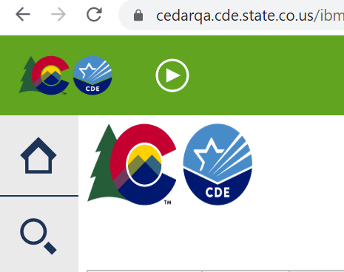
Exporting Cognos Report to Excel
Click on ‘Play’ Button
(available when a report is showing)

Slide 26
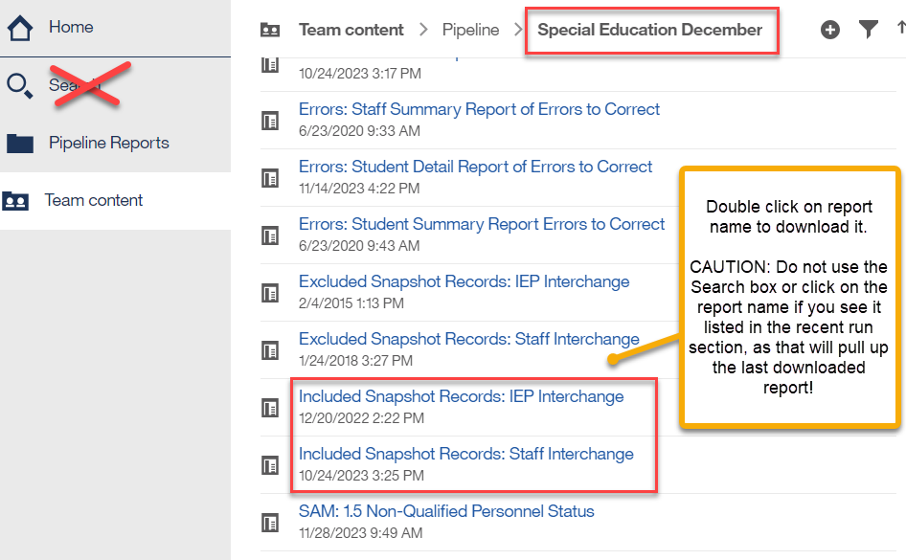
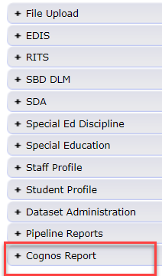
Special Education December Count
Snapshot Records Reports
These are your December Student and December Staff Snapshot records.
This is the data you will ultimately approve and submit to CDE.
These reports contain all records in your final snapshots and can be run for any school year going back at least 10 years.
You can use these reports for internal data requests, to compare and search various data fields, and to see which records are pulling into your snapshot.
I recommend saving a copy of these reports for each snapshot (once final).

Slide 27
Data Pipeline Process Overview – IEP Interchange
Steps can take place throughout the school year
1. Extract Child File and Participation File from SIS and upload files to Data Pipeline
  Enrich system uses web transfer to send both files at once to Data Pipeline (no manual upload necessary in Pipeline)
    Enrich users select ‘Child Count 24-25’ option when working on December Count Snapshot
    Enrich users select ‘EOY 24-25’ option when working on Sped EOY Snapshot
2. Check Batch Maintenance for file upload status and wait for a confirmation email from Data Pipeline system
  The email will show you the number of errors in your upload
    NOTE: If the file didn’t process, the email should show you which row of data contains a formatting “error”
3. Check and resolve interchange errors in each file
  Many of the same IEP Interchange file errors are found in both the Enrich system and the Data Pipeline system
    NOTE: Data Pipeline system is the official error source!
  Ideally data field corrections are made in SIS (Enrich, IC, PowerSchool, or other IEP systems used)
    Extract revised files and upload revised files to Data Pipeline. Repeat steps 1-3 until interchange errors are resolved.

Slide 28
Data Pipeline Process Overview – Snapshot, Report Review, Final Approval
4. Create Snapshot
  It is not required to have ALL interchange errors resolved when you start taking snapshots, but it is recommended. Any records with interchange errors will not be pulled into your snapshot.
5. Check and resolve snapshot errors (review warnings too)
  Changes made in SIS (Enrich or other IEP systems) and files reloaded to interchange
  Go back to steps 1 and 3 – check for new interchange errors before taking a new snapshot
6. Review reports and make any changes necessary
  Go back and redo steps 1 – 4 until all errors are resolved and data is accurate
7. Print reports, sign, and upload signed reports to the Data Management System
8. Approve and finalize snapshot in Data Pipeline

Slide 29

29

