Slide 1
November 8, 2023
Student Discipline Training
Dawna Gudka-Collection Lead

Slide 2
Today's agenda, November 8th , 2023
Townhall
Discipline Interchange
Data Pipeline Process
How we share PII data
PII data
Why is it important to report accurate data
Collection Resources
What makes up the Student Discipline Snapshot

Slide 3
Townhalls
Every Thursday from 9-10AM Data Services Unit host Townhall
  Upcoming Townhalls and Trainings
  Archived Townhall Presentations
Email DATASERVICES-subscribe-request@cdelist.cde.state.co.us to sign up for weekly town hall email reminders.

Slide 4
Student Discipline Snapshot Collection
Dawna Gudka

Slide 5
Student Discipline Changes
2023-2024 Discipline is now collected at the Student level
This collection is now a Snapshot collection
What does that mean?
One discipline interchange file 2023-2024 Student Discipline File Layout
Plus, the student demographics interchange file 2023-2024 Student Demographics File Layout
And the Student School Association file 2023-2024 Student School Association File Layout
will make up the Student Discipline Snapshot Collection
Student Discipline
Student Discipline Snapshot

Slide 6
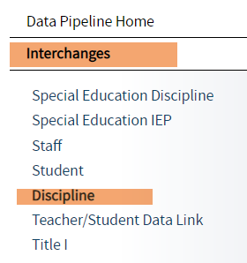
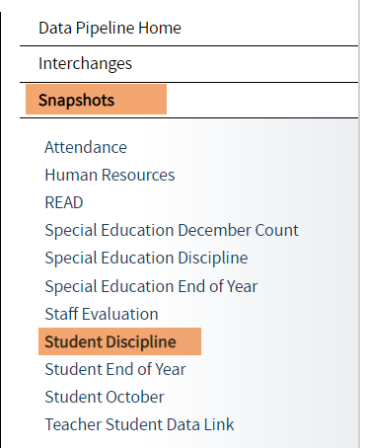
Student Discipline websites
  2023-2024 Discipline Interchange Website
  2023-2024 Student Discipline Snapshot Website
Student Discipline
Student Discipline Snapshot

Slide 7
Student Discipline Snapshot Collection Process at a Glance
Discipline Interchange file
Student Demographics file
Student School Association
Student Discipline Snapshot

Slide 8
Student Discipline Snapshot Collection-HB22-1376 passing
The Discipline Interchange updates the Special Education Discipline Interchange file with data fields required per HB22-1376 which includes data previously collected in the periodic files for the School Discipline files (Discipline by Action, Discipline by Demographics and Firearm Data). The updated Discipline Interchange file process will start in the 2023-2024 school year and will contain one file: the Discipline Action File. In the file, all students who were disciplined during the reporting school year will be reported. This information is used in the Student Discipline Snapshot for all students and Special Education Discipline snapshot for students with an active IEP.

Slide 9
Staff Interchange-purpose
The purpose of the Discipline Action File is to capture the students disciplined, including the type of behavior and the resulting disciplinary action taken for each disciplinary incident.
This data can also be utilized to pre-populate data in the Civil Rights Data Collection file. The fields/codes noted with ** is for this purpose only and are not required

Slide 10
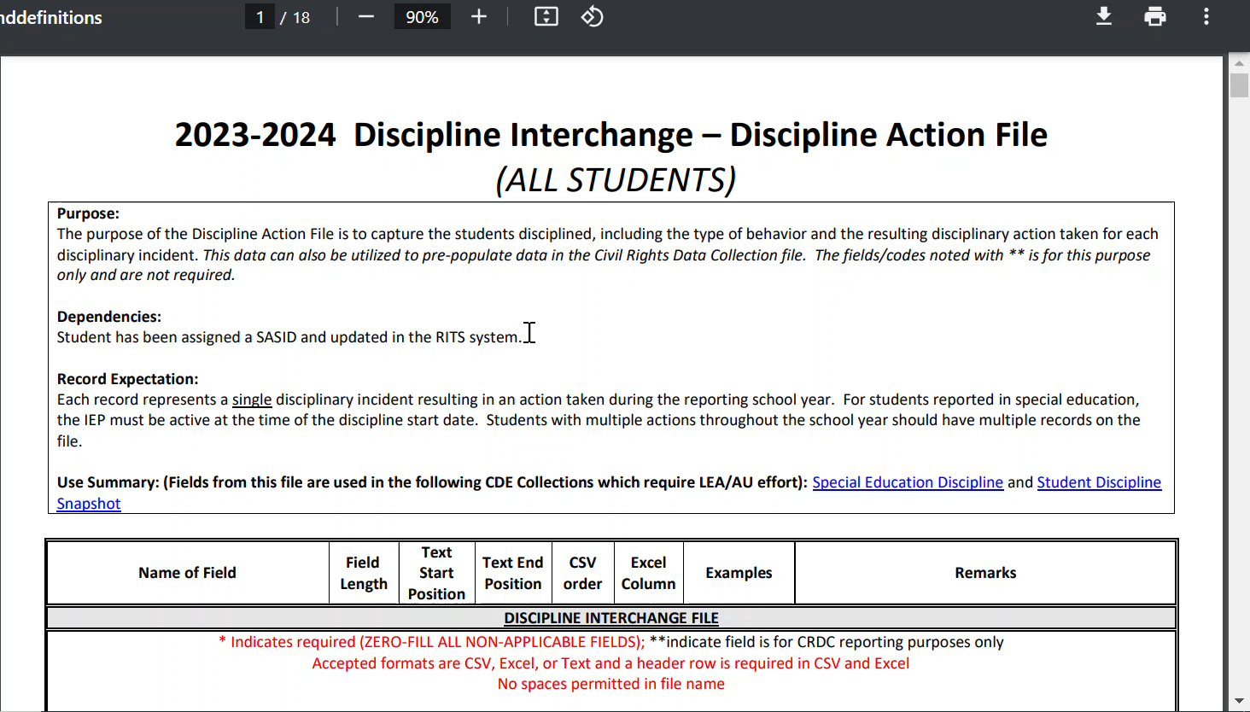
Staff Interchange-website
Discipline Interchange File layout

Slide 11
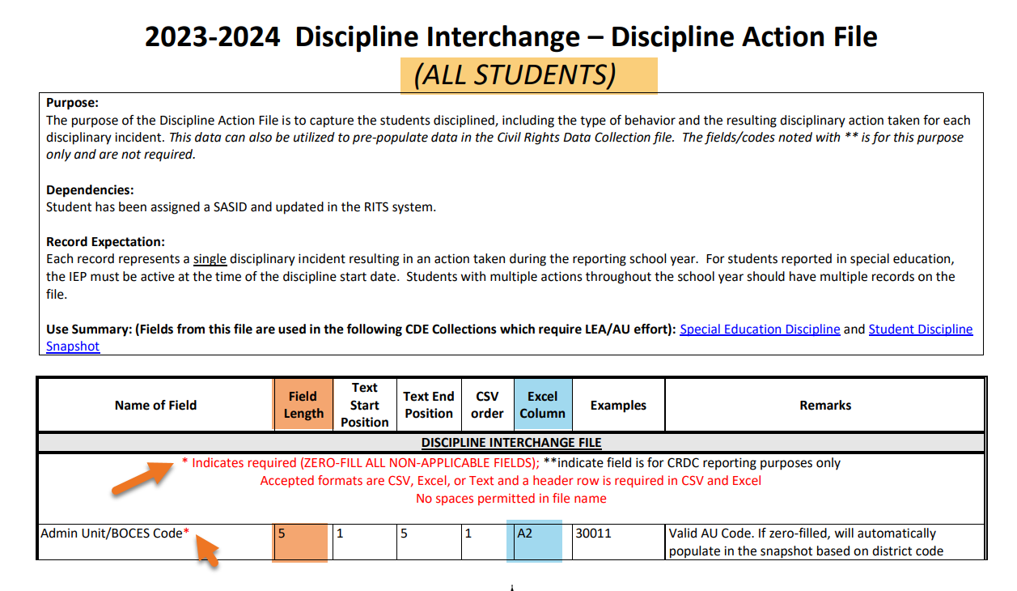
Staff Interchange file layout
Discipline Interchange File layout

Slide 12
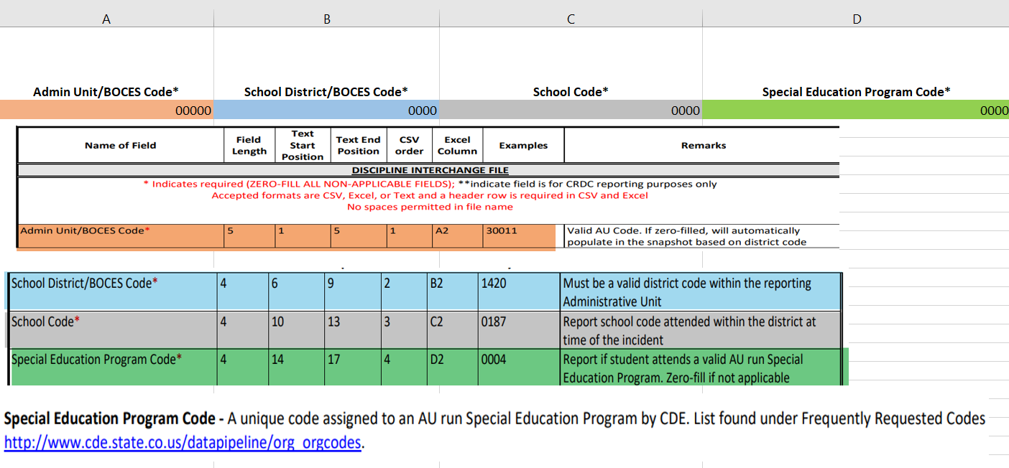
Staff Interchange file layout What data elements are needed
Discipline Interchange File layout

Slide 13
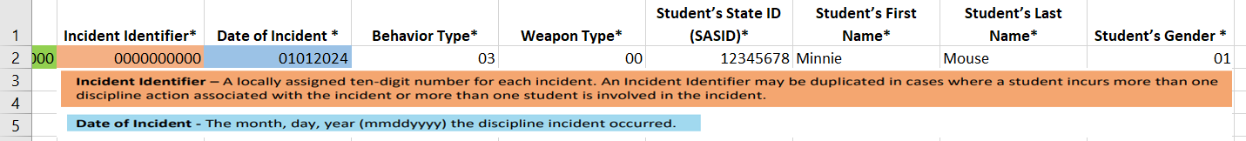
Staff Interchange file layout data needed
Discipline Interchange File layout

Slide 14
Student Discipline Behavior Codes
01 Drug Violation Use
02 Alcohol Violation Use
03 Tobacco Violation Use
04 1st, 2nd Degree or Vehicular Assault
05 Dangerous Weapons Carrying
06 Robbery
07 Other Felony
08 Disobedience/ Defiant or Repeated Interference
09 Detrimental Behavior
10 Destruction of School Property
11 Bullying
12 Other Violation of Code of Conduct
13 3rd Degree Assault/Disorderly Conduct
14 Marijuana Violation
15 Sexual Violence/ Battery (other than Rape)
16 Rape or Attempted Rape

Slide 15
Student Discipline Behavior Codes- CRDC Codes
This data can also be utilized to pre-populate data in the Civil Rights Data Collection file. The fields/codes noted with ** is for this purpose only and are not required.
17 Threats of Physical Attack**
18 Allegations of harassment or bullying on the basis of sex**
19 Allegations of harassment or bullying on the basis of race, color or national origin**
20 Allegations of harassment or bullying on the basis of disability**
21 Allegations of harassment or bullying on the basis of sexual orientation**
22 Allegations of harassment or bullying on the basis of religion**
31 Reported as Harassed or Bullied on the basis of Sex**
32 Reported as Harassed or Bullied on the basis of Race or Color or National Origin**
33 Reported as Harassed or Bullied on the basis of Disability**
41 Disciplined for Bullying or Harassment on the basis of Sex**
42 Disciplined for Bullying or Harassment on the basis of Race or Color or National Origin**
43 Disciplined for Bullying or Harassment on the basis of Disability**

Slide 16
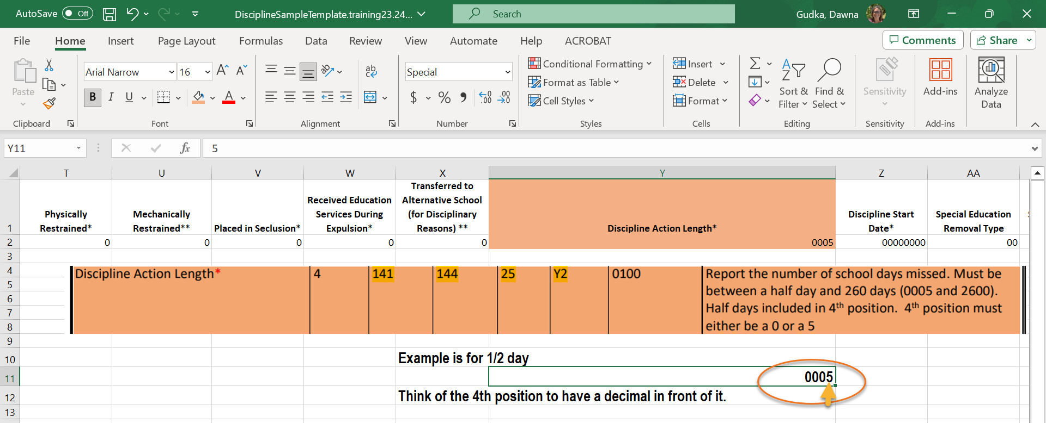
Student Discipline-Discipline Action Length

Slide 17
Data Pipeline Process

Slide 18
Interchange files need to be uploaded into Data Pipeline
Student Demographics interchange file
Student School Association interchange file
Discipline Interchange file

Slide 19
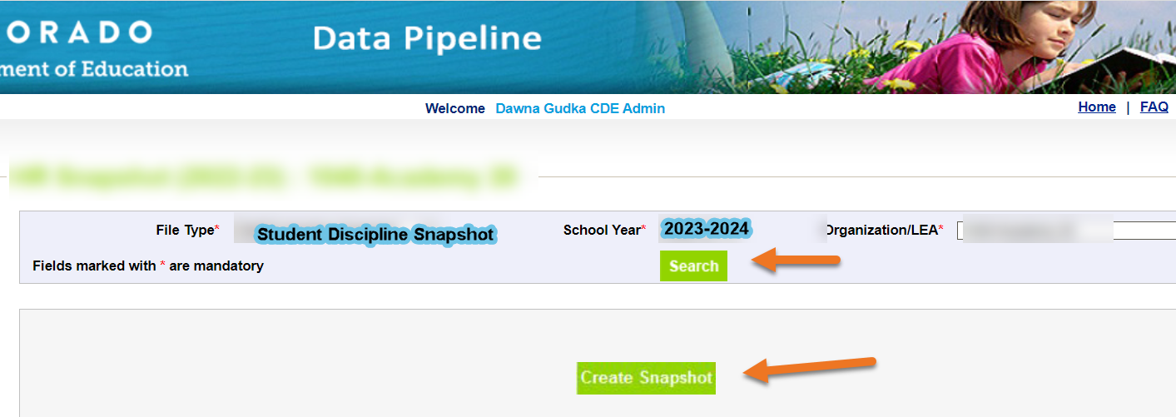
Creating a Student Discipline Snapshot
Creating a snapshot in Data Pipeline-by clicking on the create snapshot button Data Pipeline merges all 3 interchange files together pulling in the Snapshot records

Slide 20
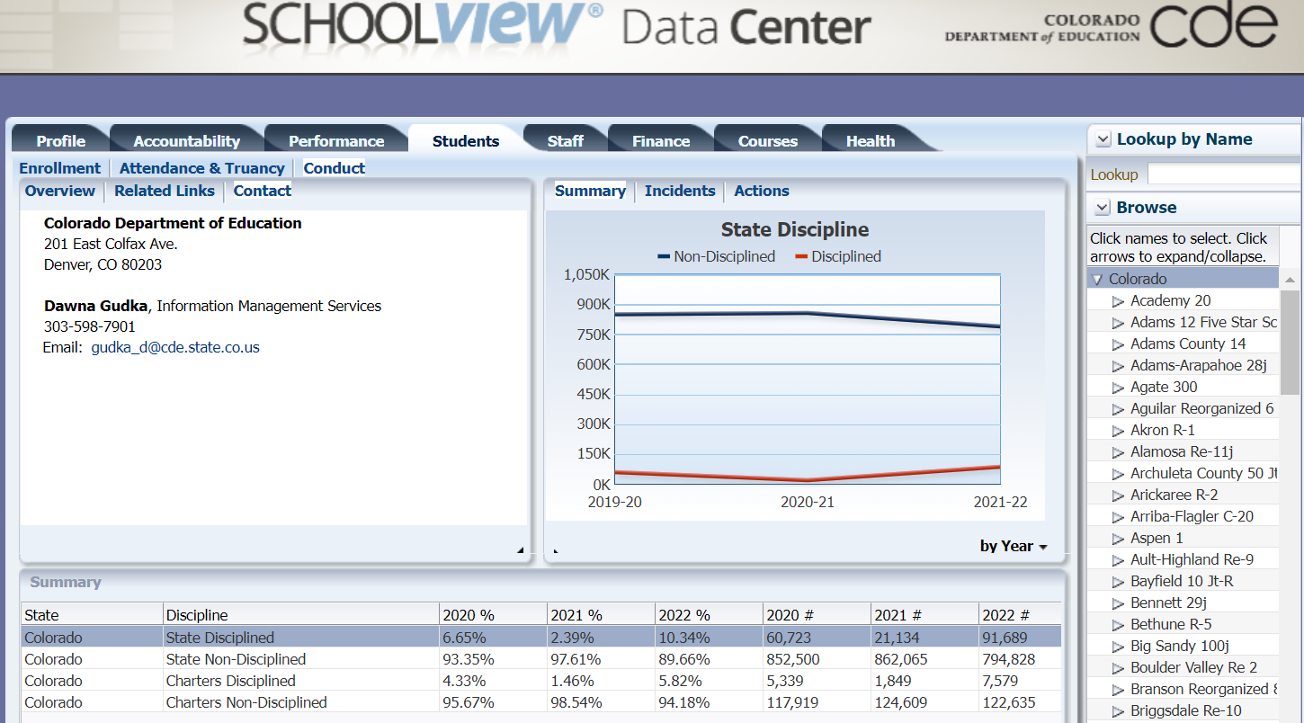
Published Staff Data-School View, Data Center
School View

Slide 21
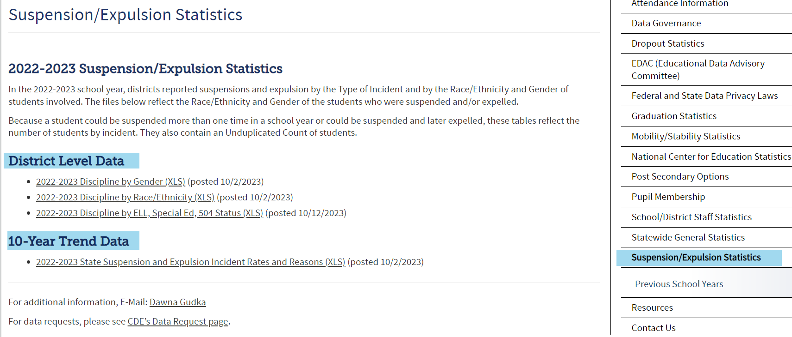
Published Staff Data-published reports
Posted Data

Slide 22
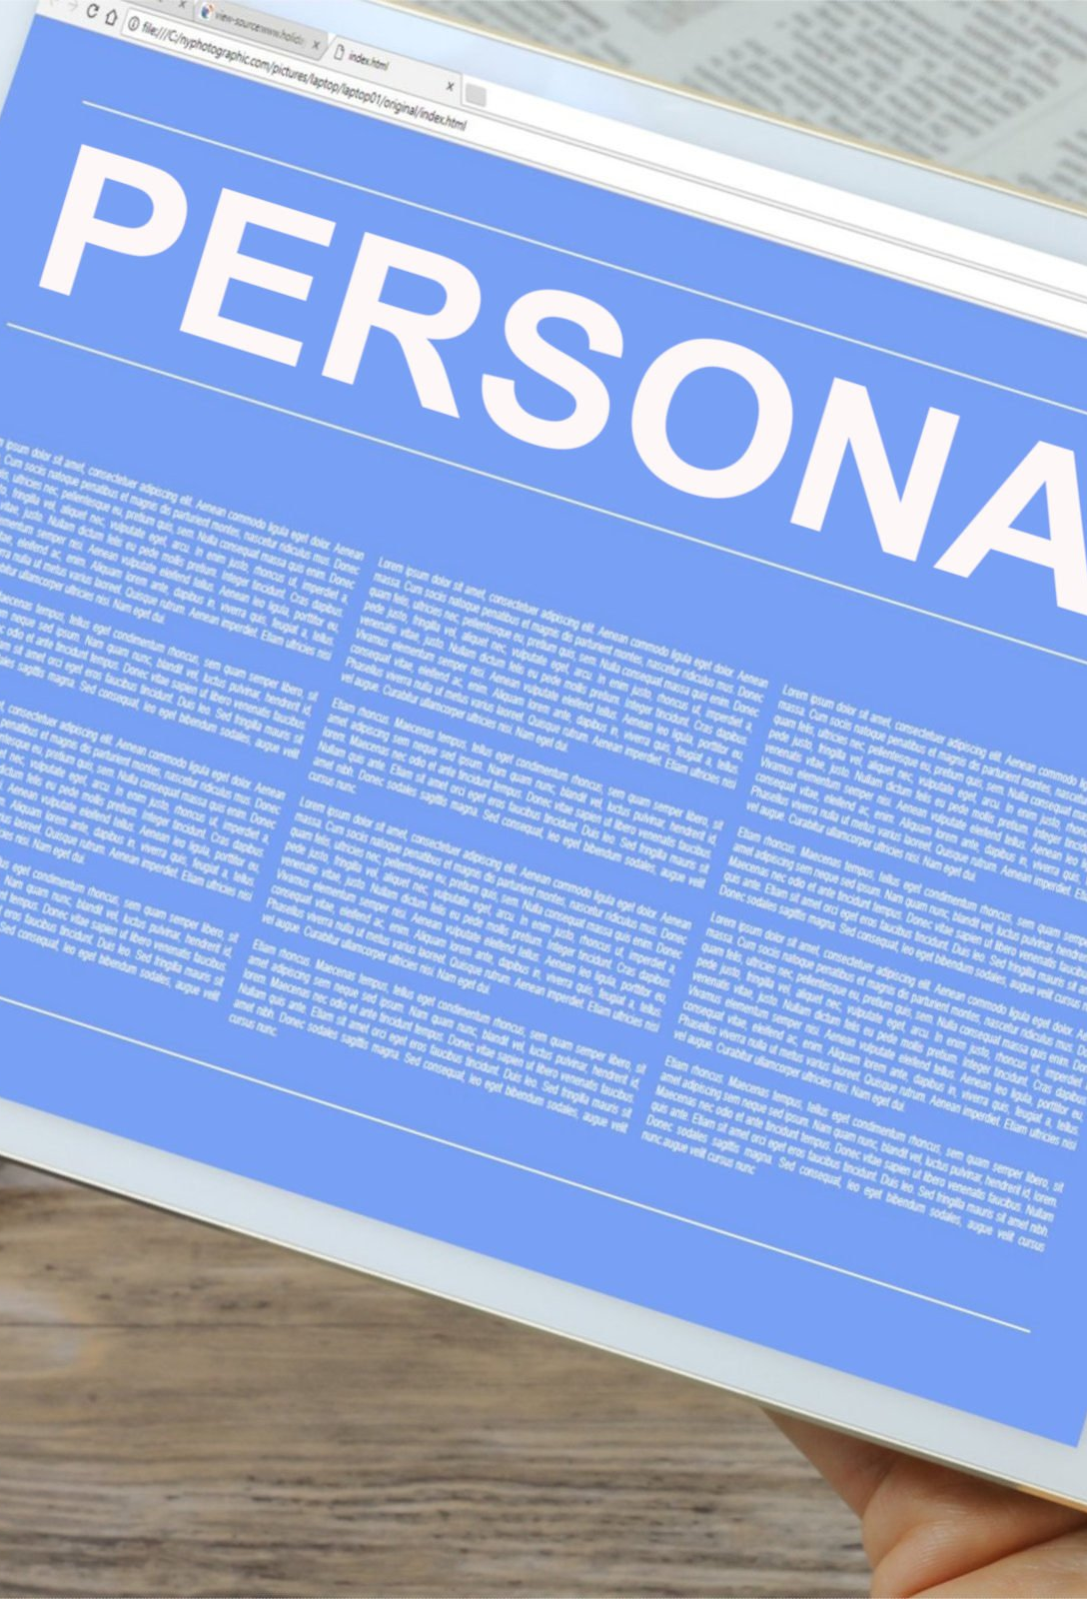
What is PII?
Student Personally Identifiable Information (PII) is defined by state and federal laws as information that, alone or in combination, personally identifies an individual
  This includes direct identifiers
  (i.e. student and staff names, SASID, EDID, etc.)
  Includes information that when combined is identifiable
Colorado’s Student Data Transparency and Security Act outlines requirements for how Student PII is collected, used and shared
CDE has prepared guidance on how to comply with this and other privacy laws which can be found here.

Slide 23

Sharing Data
Use secure methods to transfer any PII to CDE
  Contact Data Collection leads with questions about how to transmit PII securely
    Each Data Collection leads maintains their own Syncplicity folders for specific collections, reach out to the collection lead for access
  Use Syncplicity to encrypt emails to CDE
Avoid sending PII via unencrypted email or to unsecured faxes when sharing data between or within districts
  Use Syncplicity to encrypt emails to CDE
Check local policies for restrictions, requirements, etc. regarding PII
  Do not use PII in trainings, presentations, etc.
  Do not share PII with unauthorized individuals
  Do not share passwords
  Follow local policies when transmitting PII to any third party

Slide 24

QUESTIONS
Student Discipline Collection Questions
Email assistance Student Discipline Snapshot Collection Support
(303) 598-7901
Dawna Gudka-Collection Lead
Special Education Discipline Questions
Email assistance SPED Discipline Snapshot
Lindsey Heitman- Collection Lead

