Slide 1
May 7th, 2024
Student Discipline Office Hours
Dawna Gudka-Collection Lead

Slide 2

May 7th, 2024
AGENDA
IdM Identity Management Roles
Safe Schools Act Accreditation-Resources & Data Pipeline Process
Collection Overview
Data Pipeline Process
Questions

Slide 3
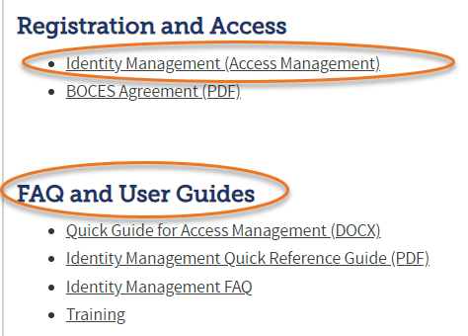
Data Pipeline
Roles in the Identity Management (idM) Roles
Identity Management (IdM)
Student Interchange Roles
STD-VIEWER
STD-LEAUSER
Discipline Interchange Roles
DIS-LEAVIEWER
DIS-LEAUSER
Discipline Snapshot Roles
STU-LEAVIEWER
STU-LEAUSER
STU-LEAAPPROVER
*Note: can only have 1 role under each role category
or you will get locked out of Data Pipeline

Slide 4
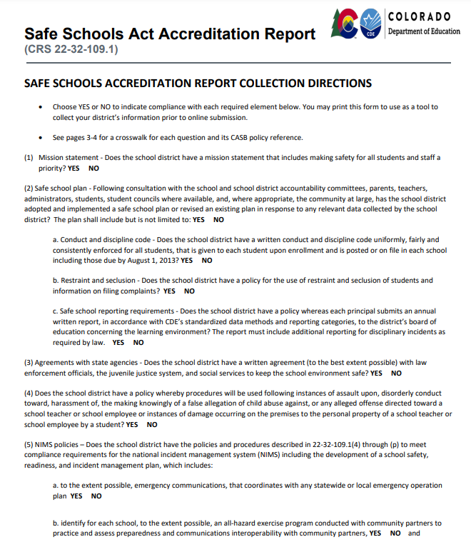
Safe Schools Act Accreditation Report Resource

Slide 5
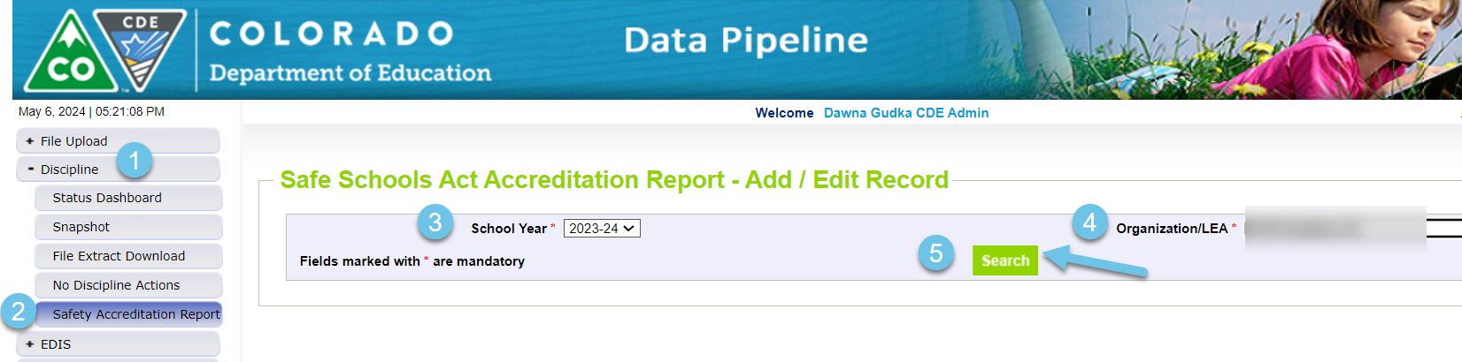
Safe Schools Act Accreditation

Slide 6
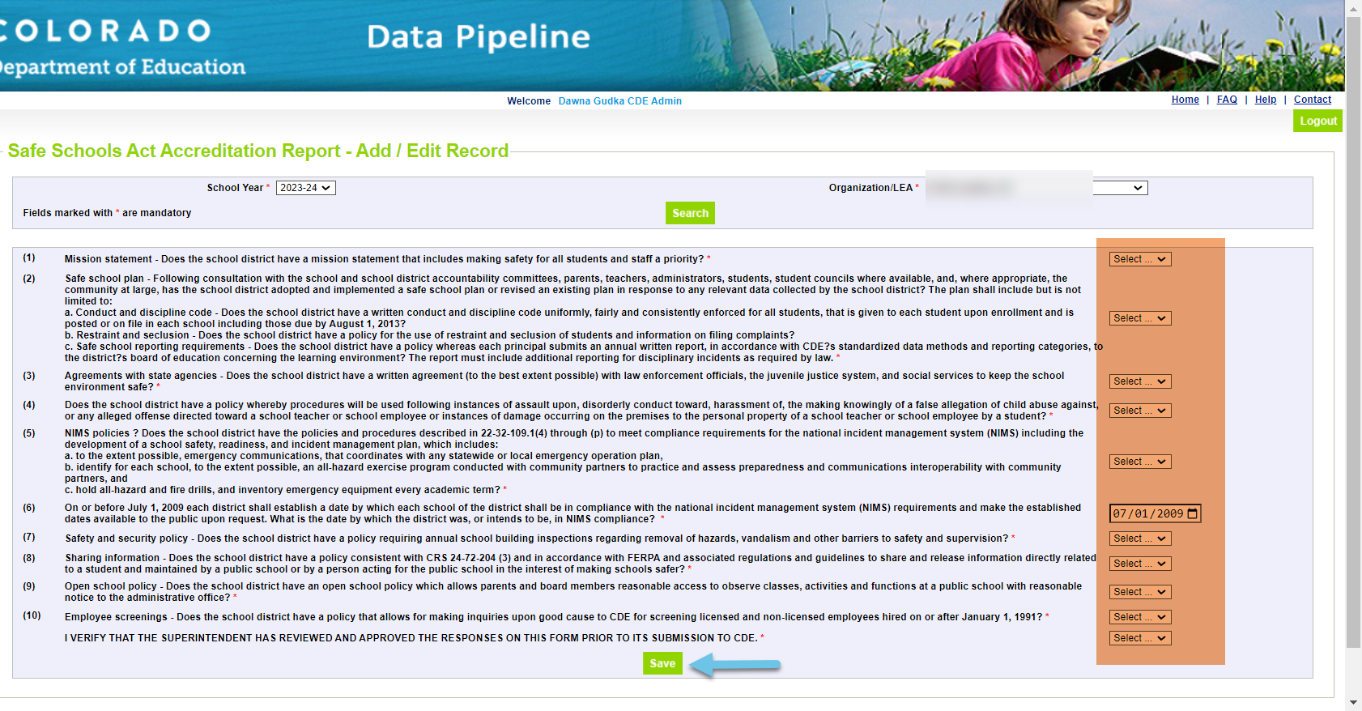
Complete the form, and click on SAVE

Slide 7
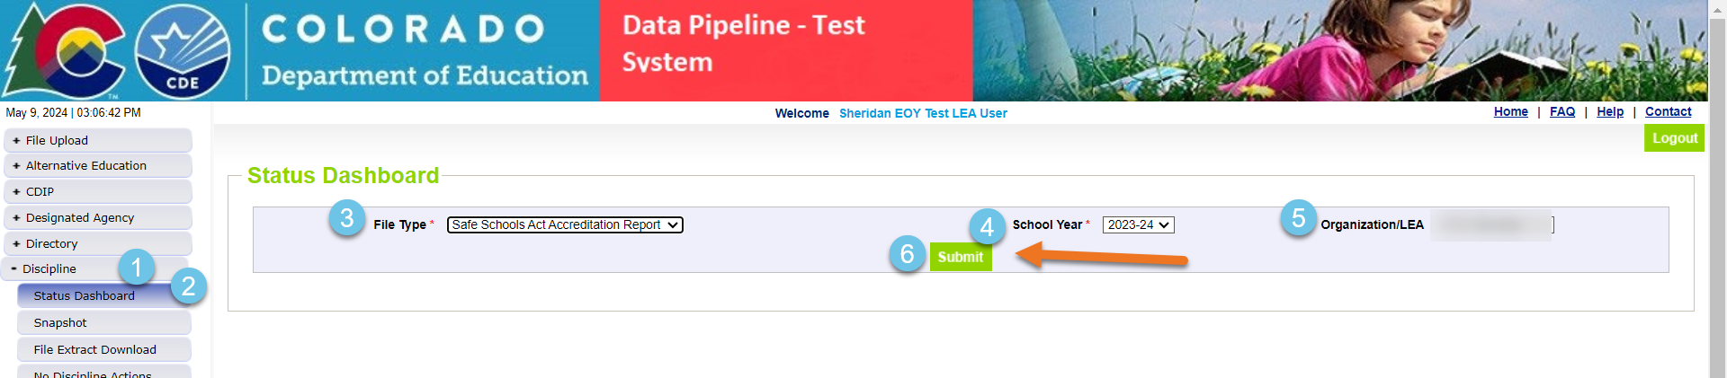
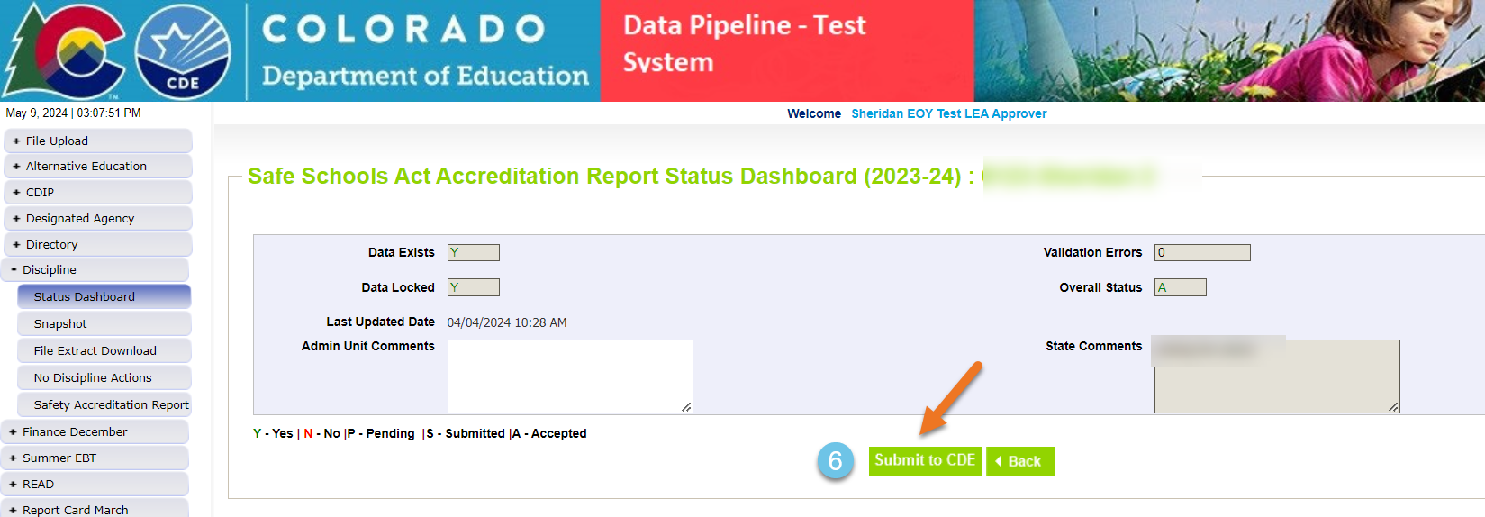
Submit your Safe Schools Act Accreditation Report to CDE

Slide 8
Student Discipline Snapshot Collection-HB22-1376 passing
The Discipline Interchange updates the Special Education Discipline Interchange file with data fields required per HB22-1376 which includes data previously collected in the periodic files for the School Discipline files (Discipline by Action, Discipline by Demographics and Firearm Data). The updated Discipline Interchange file process will start in the 2023-2024 school year and will contain one file: the Discipline Action File. In the file, all students who were disciplined during the reporting school year will be reported. This information is used in the Student Discipline Snapshot for all students and Special Education Discipline snapshot for students with an active IEP.

Slide 9
Student Discipline Changes
2023-2024 Discipline is now collected at the Student level
This collection is now a Snapshot collection
What does that mean?
One discipline interchange file 2023-2024 Student Discipline File Layout
Plus, the student demographics interchange file 2023-2024 Student Demographics File Layout
And the Student School Association file 2023-2024 Student School Association File Layout
will make up the Student Discipline Snapshot Collection
Student Discipline
Student Discipline Snapshot

Slide 10
Student Discipline collection
The purpose of the Discipline Action File is to capture all the students disciplined, including the type of behavior and the resulting disciplinary action taken for each disciplinary incident.
2023-2024 is scheduled as a reporting year for the Office of Civil Rights collection (Civil Rights Data Collection aka CRDC)

Slide 11
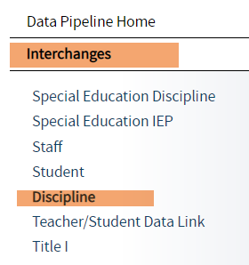
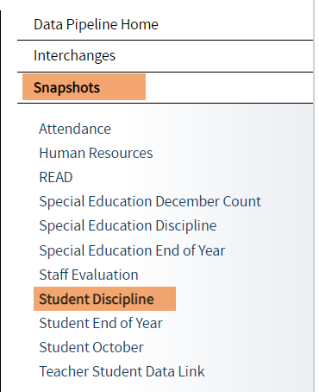
Student Discipline websites
  2023-2024 Discipline Interchange Website
  2023-2024 Student Discipline Snapshot Website
Student Discipline
Student Discipline Snapshot

Slide 12
Student Discipline Snapshot Collection Process at a Glance
Discipline Interchange file
Student Demographics file
Student School Association
Student Discipline Snapshot

Slide 13
SPED Discipline Snapshot Collection Process at a Glance
Discipline Interchange
Discipline Action file
Student Interchange Files
Student Demographics
School Association
Special Education IEP Interchange
Child file
Participation file
Special Education Discipline Snapshot

Slide 14
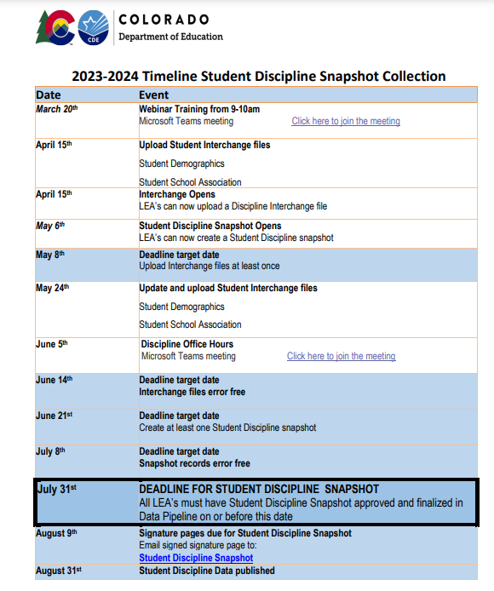
Student Discipline Timeline
Student Discipline
Student Discipline Snapshot

Slide 15
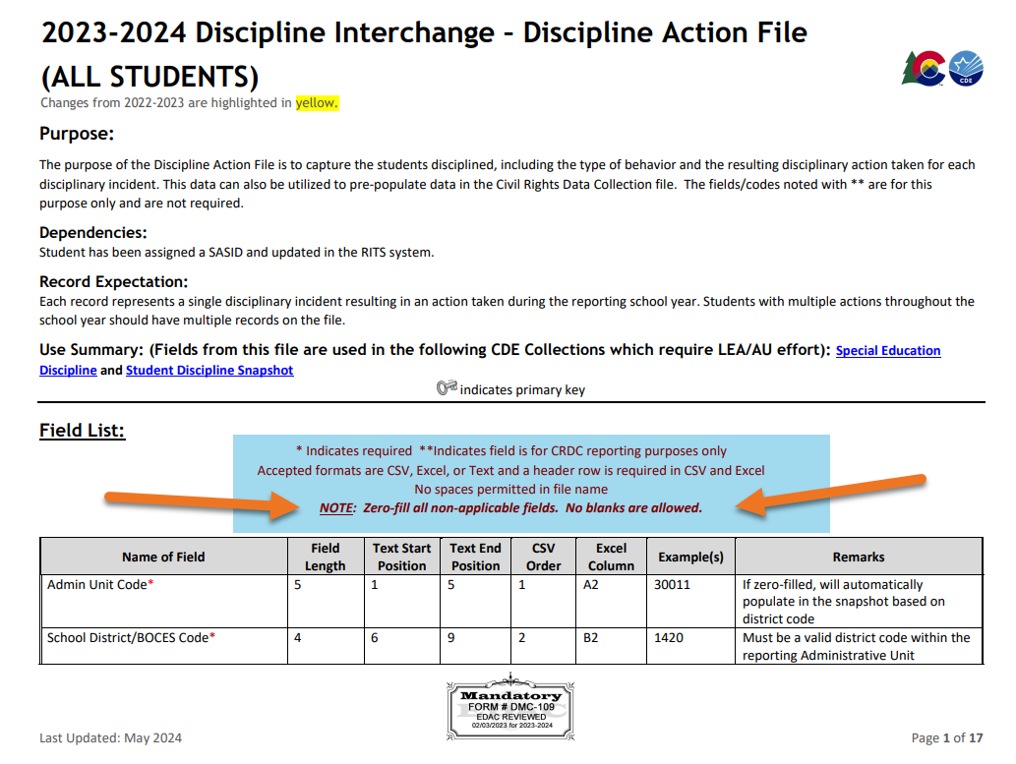
Discipline Interchange website
Discipline Interchange File layout

Slide 16
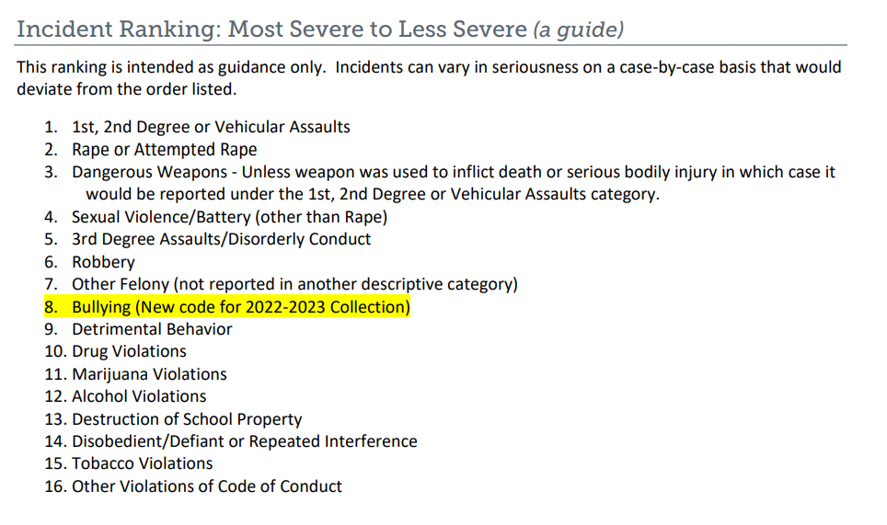
Student Discipline Behavior Codes
Guide for Determining “Most Serious” Incident
01 Drug Violation Use
02 Alcohol Violation Use
03 Tobacco Violation Use
04 1st, 2nd Degree or Vehicular Assault
05 Dangerous Weapons Carrying
06 Robbery
07 Other Felony
08 Disobedience/ Defiant or Repeated Interference
09 Detrimental Behavior
10 Destruction of School Property
11 Bullying
12 Other Violation of Code of Conduct
13 3rd Degree Assault/Disorderly Conduct
14 Marijuana Violation
15 Sexual Violence/ Battery (other than Rape)
16 Rape or Attempted Rape

Slide 17
Student Discipline Behavior Codes- CRDC Codes
This data can also be utilized to pre-populate data in the Civil Rights Data Collection file. The fields/codes noted with ** is for this purpose only and are not required.
17 Threats of Physical Attack**
18 Allegations of harassment or bullying on the basis of sex**
19 Allegations of harassment or bullying on the basis of race, color or national origin**
20 Allegations of harassment or bullying on the basis of disability**
21 Allegations of harassment or bullying on the basis of sexual orientation**
22 Allegations of harassment or bullying on the basis of religion**
31 Reported as Harassed or Bullied on the basis of Sex**
32 Reported as Harassed or Bullied on the basis of Race or Color or National Origin**
33 Reported as Harassed or Bullied on the basis of Disability**
41 Disciplined for Bullying or Harassment on the basis of Sex**
42 Disciplined for Bullying or Harassment on the basis of Race or Color or National Origin**
43 Disciplined for Bullying or Harassment on the basis of Disability**

Slide 18
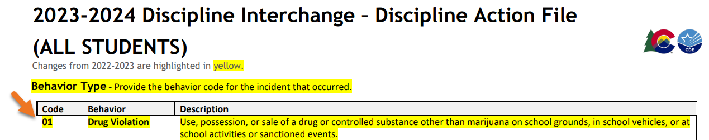
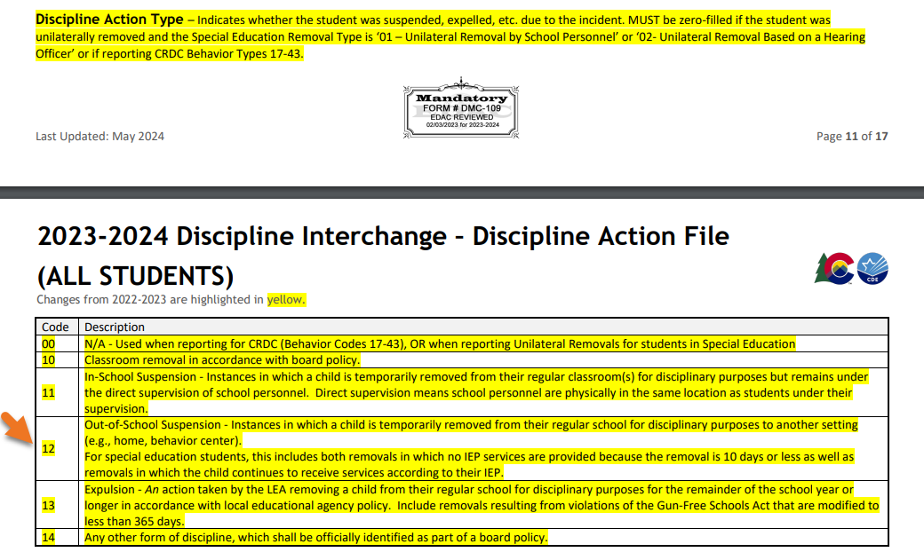
Example: Behavior-student was in possession of drugs; student was disciplined with 5 days of out of school suspension and student was referred to law enforcement

Slide 19
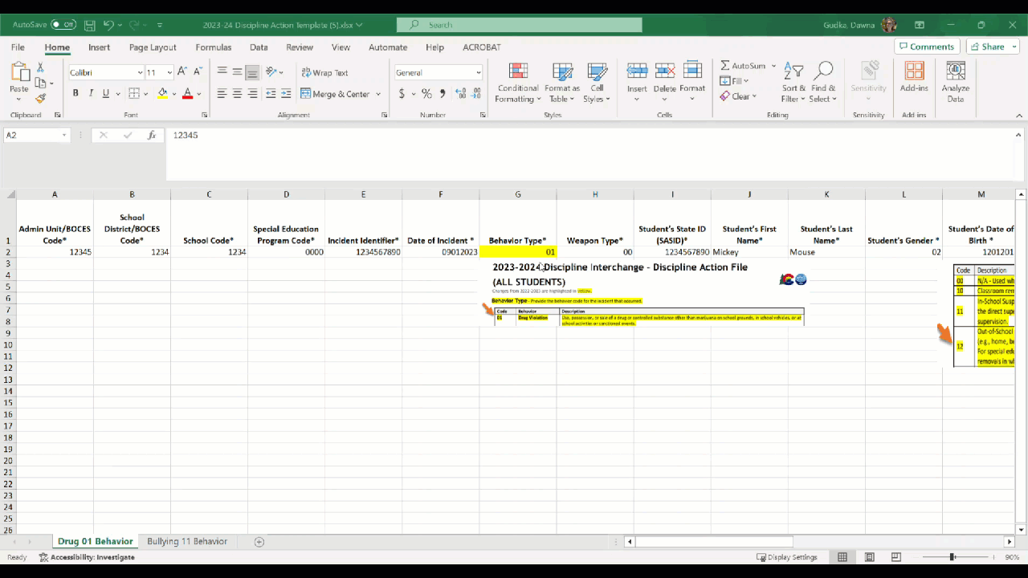
Example of file

Slide 20
Discipline Reporting Examples
Student is disciplined for Bullying (11 Behavior code)
  Student Receives 5.5 days in school suspension
  Action Length 0055
Student is disciplined for Destruction of School Property (10 Behavior code)
  Student Receives 1/2 day in school suspension
  Action Length 0005
Student is disciplined for Detrimental Behavior (09 Behavior code)
  Student Receives 3 days out of school suspension
  Action Length 0030
Student is disciplined for Robbery (06 Behavior code)
Student Receives 10 days out of school suspension
  Student was also referred to law enforcement
  Action Length 0100

Slide 21
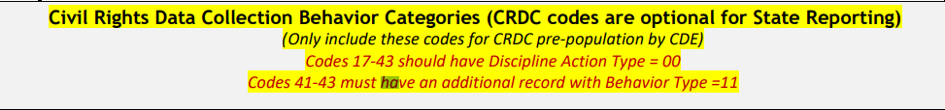
Discipline Reporting Examples CRDC-Optional Reporting
  Civil Rights Data Collection Behavior Categories (CRDC codes are optional for State Reporting) (Only include these codes for CRDC pre-population by CDE)
  Codes 17-43 should have Discipline Action Type = 00
  Codes 41-43 must have an additional record with Behavior Type =11

Slide 22
Data Pipeline Process

Slide 23
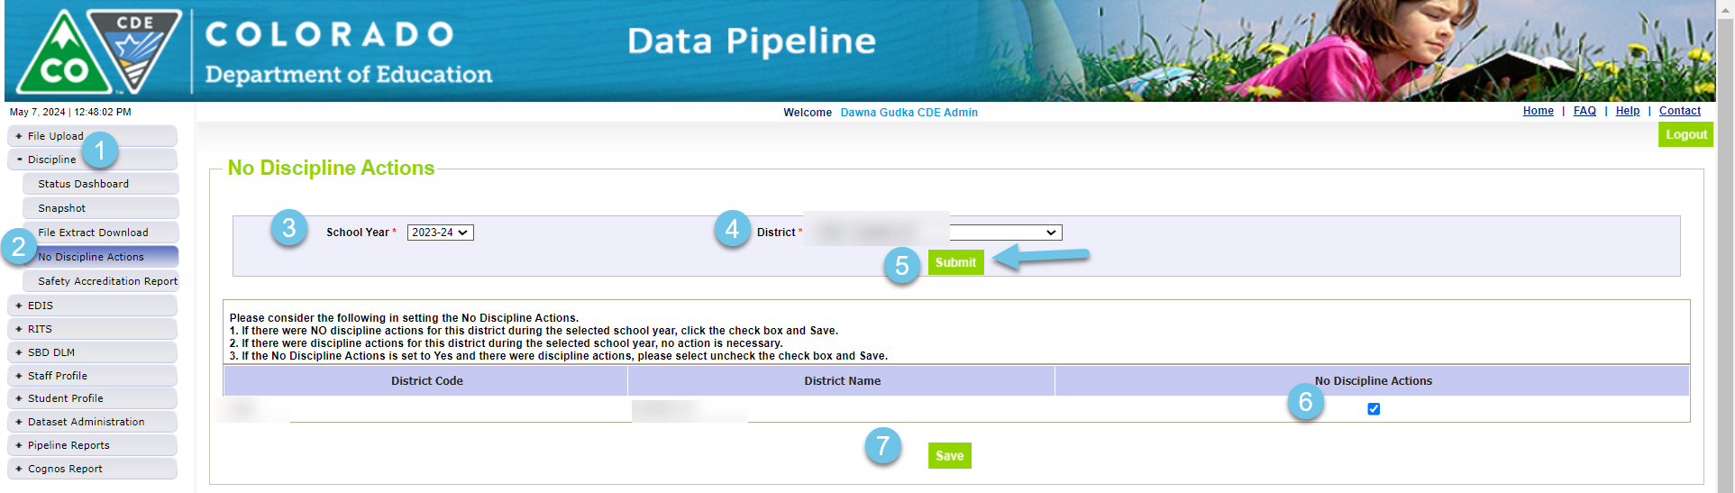
Data Pipeline Process
If there are no incidents to report, the corresponding file(s) are NOT uploaded into pipeline
THIS IS ONLY NEEDED IF YOUR DISTRICT HAS NO DISCIPLINE DATA TO REPORT

Slide 24
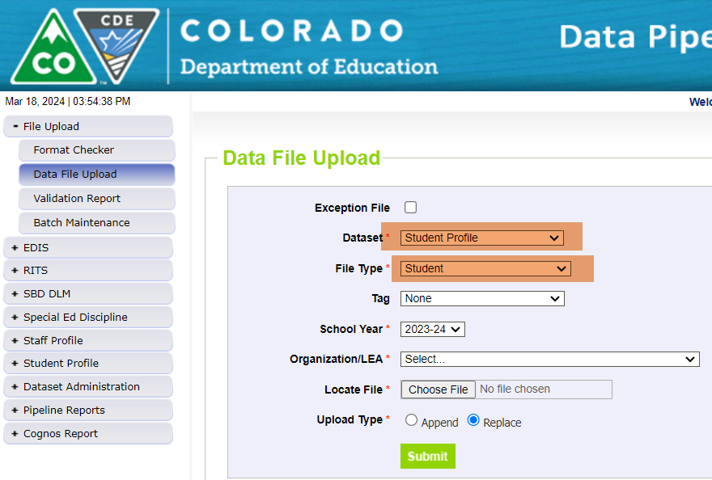
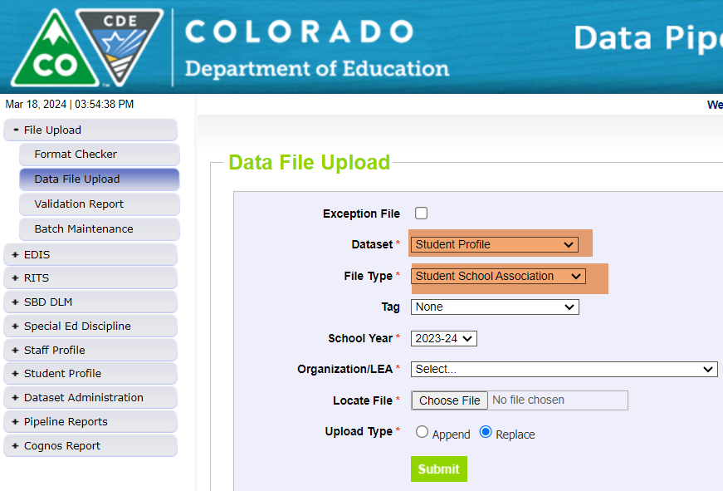
Interchange files need to be uploaded into Data Pipeline
Student Profile Demographics and School Association file

Slide 25
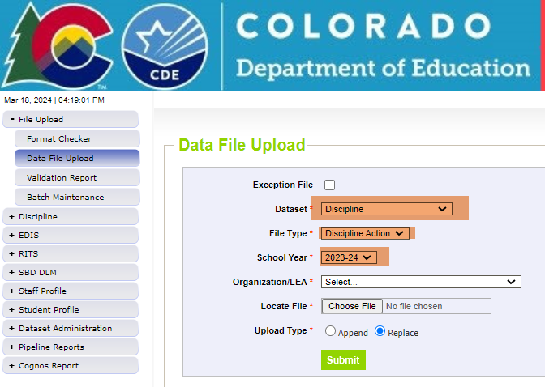
Interchange files need to be uploaded into Data Pipeline
Discipline Interchange file

Slide 26
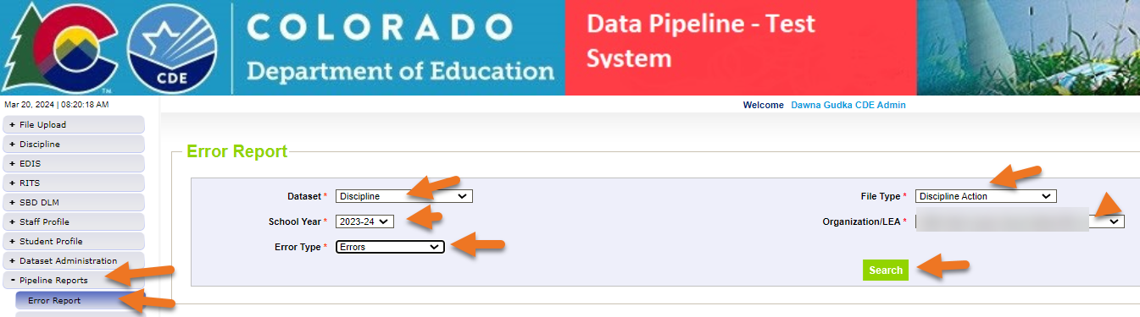
Discipline Action Interchange file
Checking for Student Discipline Interchange errors
Then click on View Details to see the errors in Detail

Slide 27
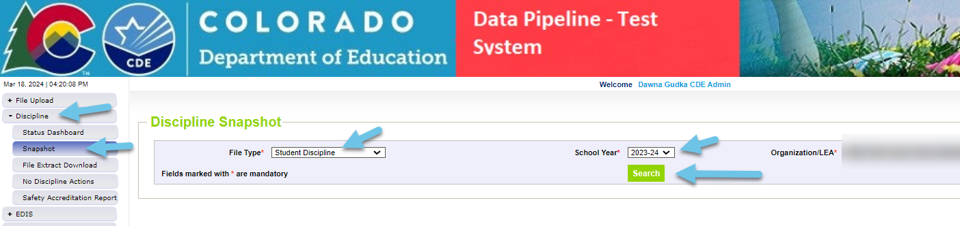
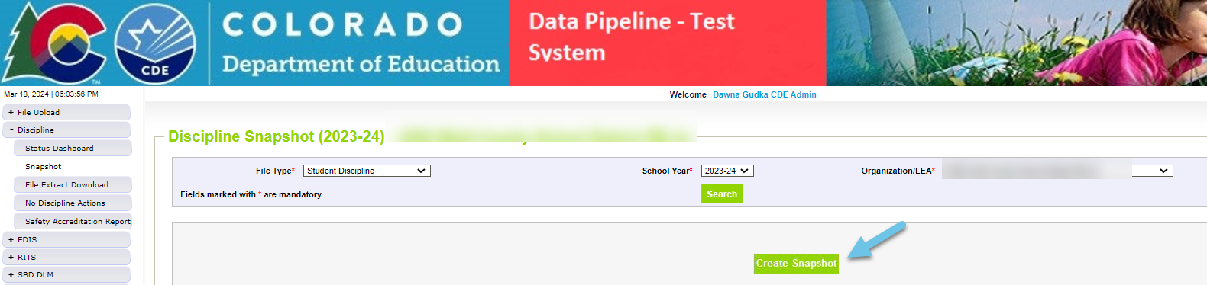
Creating a Student Discipline Snapshot
Creating a snapshot in Data Pipeline-by clicking on the create snapshot button Data Pipeline merges all 3 interchange files together pulling in the Snapshot records

Slide 28
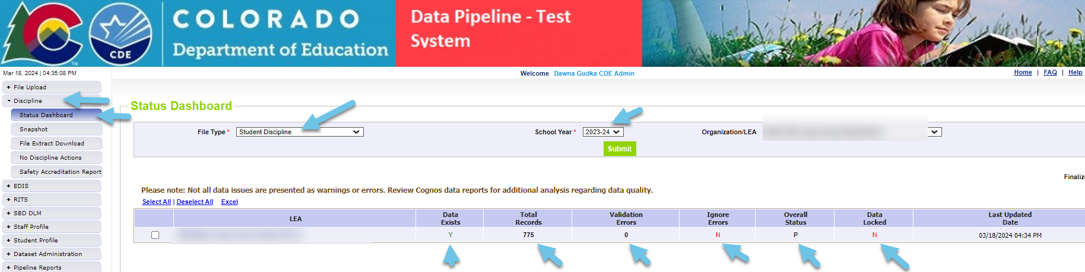
Interchange files
Checking status of snapshot

Slide 29
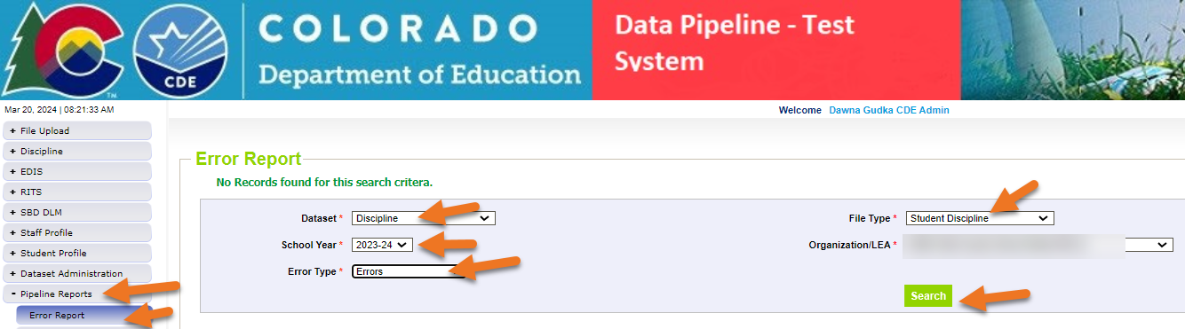
Data Pipeline
Checking for Student Snapshot errors
Then click on View Details to see the errors in Detail

Slide 30
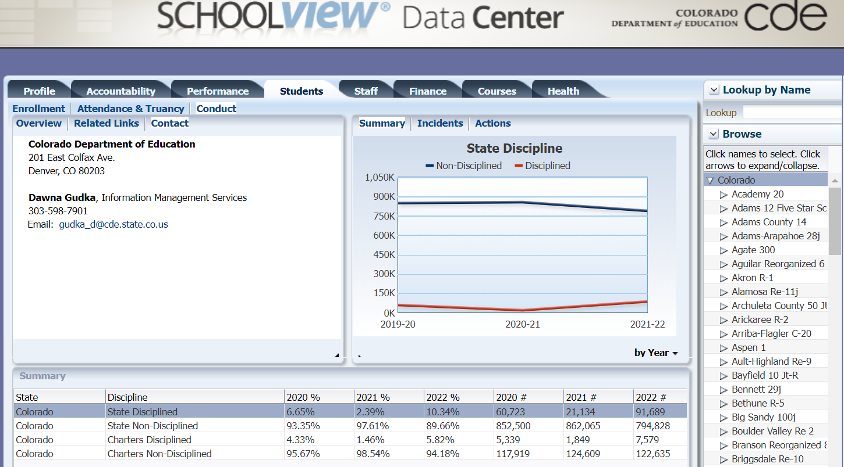
Published Staff Data-School View, Data Center
School View

Slide 31
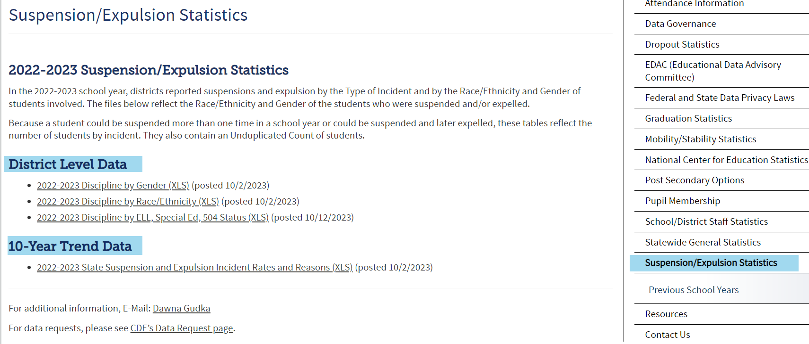
Published Staff Data-published reports
Posted Data

Slide 32

What is PII?
Student Personally Identifiable Information (PII) is defined by state and federal laws as information that, alone or in combination, personally identifies an individual
  This includes direct identifiers
  (i.e. student and staff names, SASID, EDID, etc.)
  Includes information that when combined is identifiable
Colorado’s Student Data Transparency and Security Act outlines requirements for how Student PII is collected, used and shared
CDE has prepared guidance on how to comply with this and other privacy laws which can be found here.

Slide 33

Sharing Data
Use secure methods to transfer any PII to CDE
  Contact Data Collection leads with questions about how to transmit PII securely
    Each Data Collection leads maintains their own Syncplicity folders for specific collections, reach out to the collection lead for access
  Use Syncplicity to encrypt emails to CDE
Avoid sending PII via unencrypted email or to unsecured faxes when sharing data between or within districts
  Use Syncplicity to encrypt emails to CDE
Check local policies for restrictions, requirements, etc. regarding PII
  Do not use PII in trainings, presentations, etc.
  Do not share PII with unauthorized individuals
  Do not share passwords
  Follow local policies when transmitting PII to any third party

Slide 34
Questions
Feel free to unmute yourself or use the chat

Slide 35

Collection Leads
Student Discipline Collection Questions
Email assistance Student Discipline Snapshot Collection Support
(303) 598-7901
Dawna Gudka-Collection Lead
Special Education Discipline Questions
Email assistance SPED Discipline Snapshot
Lindsey Heitman- Collection Lead

