Slide 1
Staff Evaluation Snapshot
Collection Training
May 29th, 2024

Slide 2
Today’s Agenda
Identity management Roles Needed for this collection
Why is this data collected
Timeline for collection
Collection resources
Data collected
Data Pipeline Process
Validating Data
Submit Staff Evaluation Snapshot Data

Slide 3
Identity Management System (idM) Roles needed for this collection
Staff Interchange Roles (both 4-digit LEAs and 5 digit AUs):
  STF~ LEAUSER – upload and modify staff interchange files OR
  STF~LEAVIEWER – view (only) staff interchange data
Staff Evaluation Snapshot Roles (only 4-digit LEA codes):
  EVS~LEAAPPROVER – Approves, creates, views Snapshot OR
  EVS~LEAUSER - creates, views Snapshot OR
  EVS~LEAVIEWER- views snapshot
Staff Evaluation Snapshot Collection
staffevaluation@cde.state.co.us

Slide 4

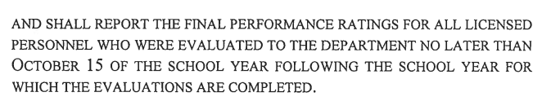
Why is the data collected?
SB22-070
Staff Evaluation Snapshot Collection
staffevaluation@cde.state.co.us

Slide 5
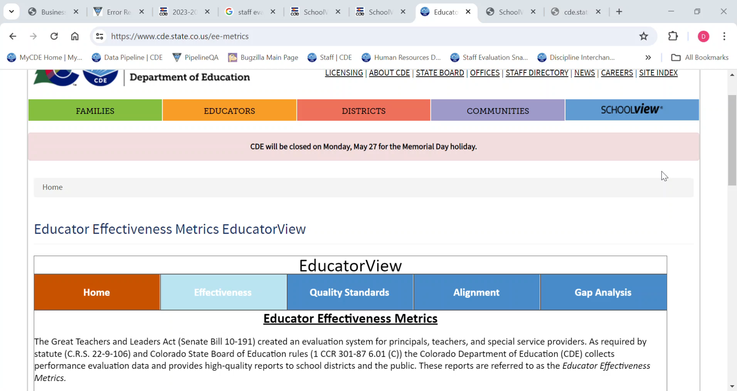
Published Data
Educator View
Staff Evaluation Snapshot Collection
staffevaluation@cde.state.co.us

Slide 6
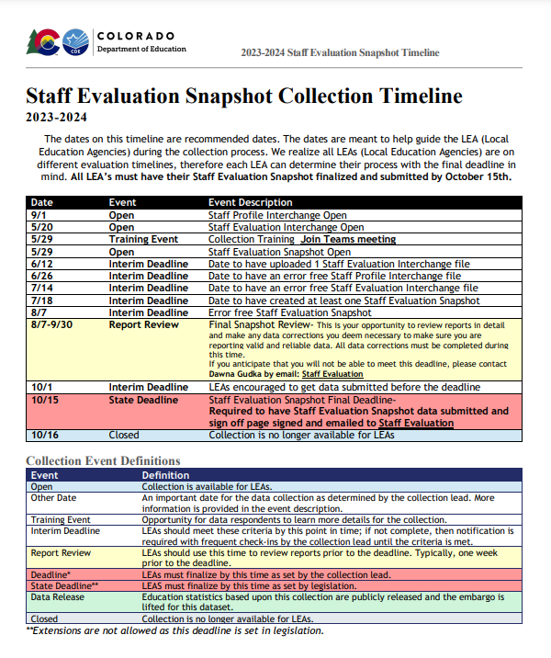
Staff Evaluation Timeline
Staff Evaluation Snapshot Collection
staffevaluation@cde.state.co.us

Slide 7
Collection Timeline
Date | Event | Event Description
9/1 | Open | Staff Profile Interchange Open
5/20 | Open | Staff Evaluation Interchange Open
5/29 | Training Event | Collection Training Join Teams meeting
5/29 | Open | Staff Evaluation Snapshot Open
6/12 | Interim Deadline | Date to have uploaded 1 Staff Evaluation Interchange file
6/26 | Interim Deadline | Date to have an error free Staff Profile Interchange file
7/14 | Interim Deadline | Date to have an error free Staff Evaluation Interchange file
7/18 | Interim Deadline | Date to have created at least one Staff Evaluation Snapshot
8/7 | Interim Deadline | Error free Staff Evaluation Snapshot
8/7-9/30 | Report Review | Final Snapshot Review- This is your opportunity to review reports in detail and make any data corrections you deem necessary to make sure you are reporting valid and reliable data. All data corrections must be completed during this time. If you anticipate that you will not be able to meet this deadline, please contact Dawna Gudka by email: Staff Evaluation
10/1 | Interim Deadline | LEAs encouraged to get data submitted before the deadline
10/15 | State Deadline | Staff Evaluation Snapshot Final Deadline- Required to have Staff Evaluation Snapshot data submitted and sign off page signed and emailed to Staff Evaluation
10/16 | Closed | Collection is no longer available for LEAs
Staff Evaluation Snapshot Collection
staffevaluation@cde.state.co.us

Slide 8
CDE Website, Data Pipeline Collections overview & Staff Evaluation Snapshot Collection Resources

Slide 9
Data Pipeline
Bookmark suggestions
Identity Management/Single Sign-On: Data Pipeline
Data Pipeline
Log into Data Pipeline
Staff Evaluation Snapshot Collection
staffevaluation@cde.state.co.us

Slide 10
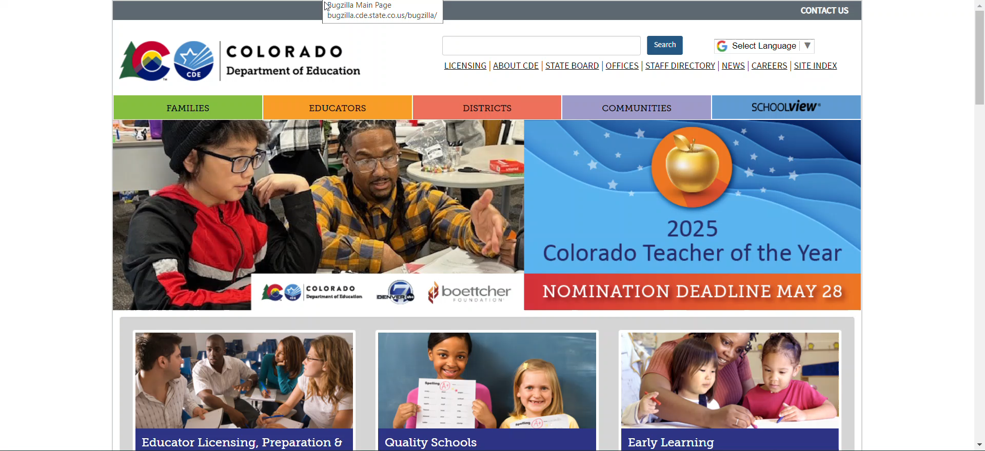
CDE website and Data Pipeline Overview
Staff Evaluation Snapshot Collection
staffevaluation@cde.state.co.us

Slide 11
Staff Evaluation Snapshot Collection Resources
  Staff Evaluation Snapshot Collection Resources
    Data Pipeline Interchange Website-Staff
      Staff Interchange-Staff Profile file layout
      Staff Interchange-Staff Evaluation file layout
    Staff Evaluation Snapshot website
      Staff Evaluation Snapshot file layout
Staff Evaluation Snapshot Collection
staffevaluation@cde.state.co.us

Slide 12
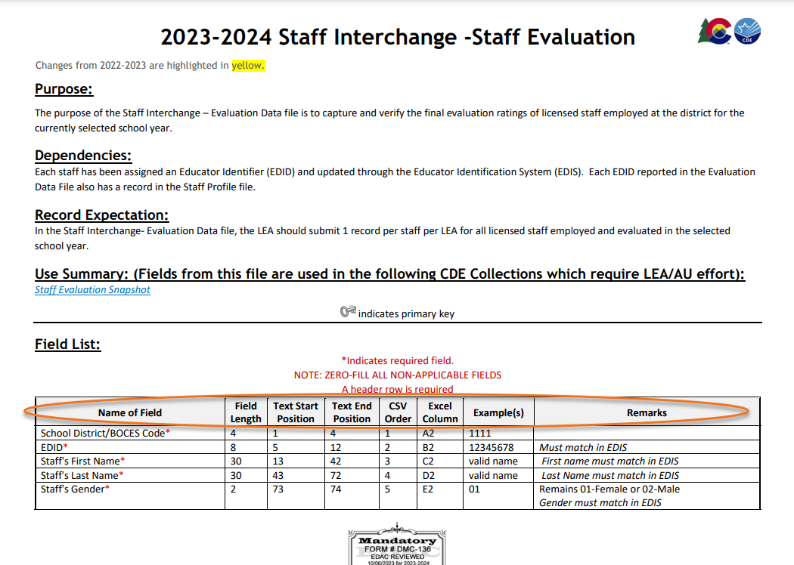
File Layout
Staff Evaluation Snapshot Collection
staffevaluation@cde.state.co.us

Slide 13
Evaluation Data Collected

Slide 14
Evaluations for Teachers
Job Codes
201 Teacher, Regular
202 Teacher, Special Education
206 Teacher, Title 1
216 Librarian/Media Consultant
222 Reading Interventionist
223 Math Interventionist
Evaluation Ratings
Teacher Overall Performance Evaluation Rating
Teacher Quality Standard 1: Know Content
Teacher Quality Standard 2: Establish Environment
Teacher Quality Standard 3: Facilitate Learning
Teacher Quality Standard 4: Professionalism
Teacher Measures of Student Learning
Staff Evaluation Snapshot Collection
staffevaluation@cde.state.co.us

Slide 15
Evaluations for Principals
Job Codes
Principals
Assistant/Deputy/Associate Principal
Evaluation Ratings
Principal Overall Performance Evaluation Rating
Principal Quality Standard 1: Strategy
Principal Quality Standard 2: Culture
Principal Quality Standard 3: Instruction
Principal Quality Standard 4: Professionalism
Principal Measures of Student Learning
Staff Evaluation Snapshot Collection
staffevaluation@cde.state.co.us

Slide 16
Evaluations for Special Service Providers
Job Codes
211 Counselors
231 Audiologist
233 School Nurse, Registered Nurse
234 Occupational Therapist
235 Physical Therapist
236 Psychologist
237 Social Worker
238 Speech Language Pathologist
242 School Orientation and Mobility Specialist
Evaluation Ratings
Special Services Provider (SSP) Overall Performance Evaluation Rating
Special Services Provider (SSP) Quality Standard 1: Professional Expertise
Special Services Provider (SSP) Quality Standard 2: Learning Environment
Special Services Provider (SSP) Quality Standard 3: High Quality Delivery
Special Services Provider (SSP) Quality Standard 4: Professionalism
Special Services Provider (SSP) Measures of Student Outcomes
Staff Evaluation Snapshot Collection
staffevaluation@cde.state.co.us

Slide 17
Data Pipeline Process

Slide 18
What makes up the Staff Evaluation Snapshot
Staff Profile Interchange file
Staff Evaluation Interchange file
Staff Evaluation Snapshot Data
(This is the actual data that gets reported for the Staff Evaluation Snapshot collection)
Staff Evaluation Snapshot Collection
staffevaluation@cde.state.co.us

Slide 19
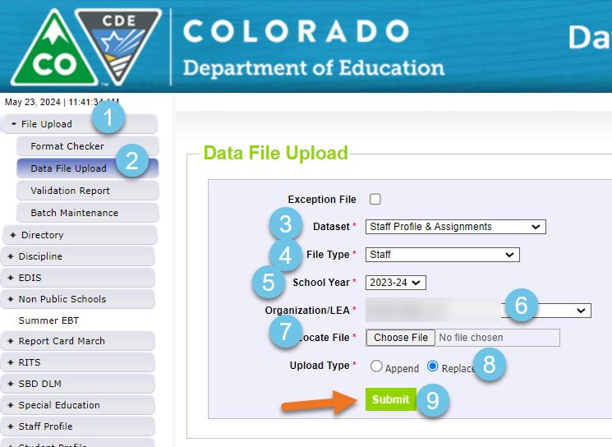
Staff Profile Interchange file upload
Staff Profile must contain all staff 2023-2024 school year
Staff Evaluation Snapshot Collection
staffevaluation@cde.state.co.us

Slide 20
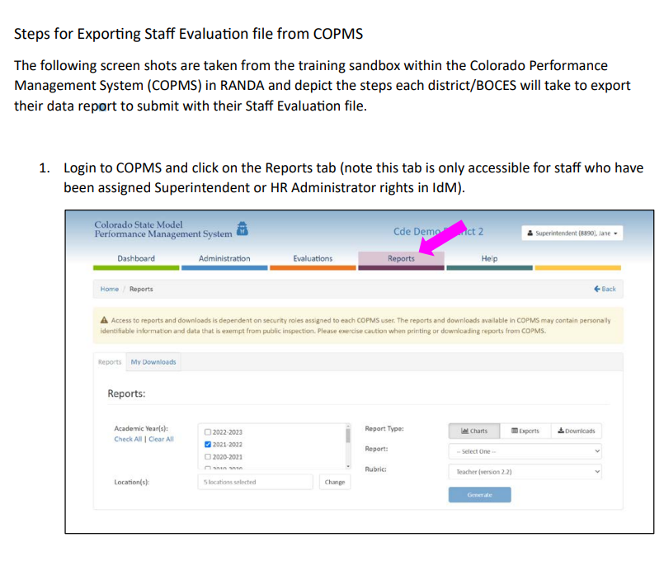
Staff Evaluation-Steps for Exporting Staff Evaluation file from COPMS-RANDA
Extract file from Vendor
Steps for Exporting Staff Evaluation file from COPMS (RANDA)
Staff Evaluation Snapshot Collection
staffevaluation@cde.state.co.us

Slide 21
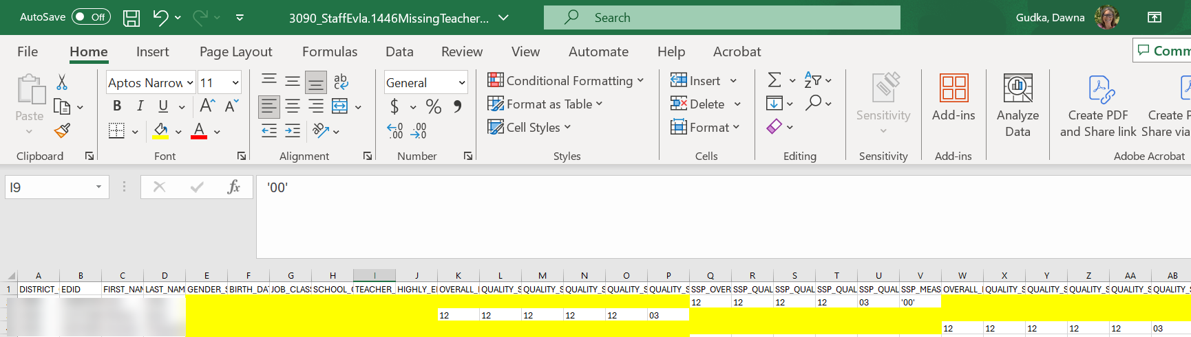
Staff Evaluation COPMS (Randa) Extract
Staff Evaluation Snapshot Collection
staffevaluation@cde.state.co.us

Slide 22
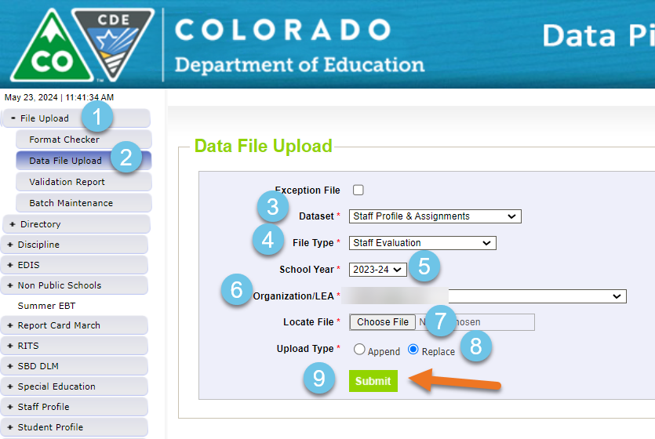
Staff Evaluation interchange file upload
Teachers
201 Teacher, Regular
202 Teacher, Special Education
206 Teacher, Title 1
216 Librarian/Media Consultant
222 Reading Interventionist
Math Interventionist
Special Services Providers
211 Counselors
231 Audiologist
233 School Nurse, Registered Nurse
234 Occupational Therapist
235 Physical Therapist
236 Psychologist
237 Social Worker
238 Speech Language Pathologist
242 School Orientation and Mobility Specialist
Principals
Principals
Assistant/Deputy/Associate Principal
Staff Evaluation Snapshot Collection
staffevaluation@cde.state.co.us

Slide 23
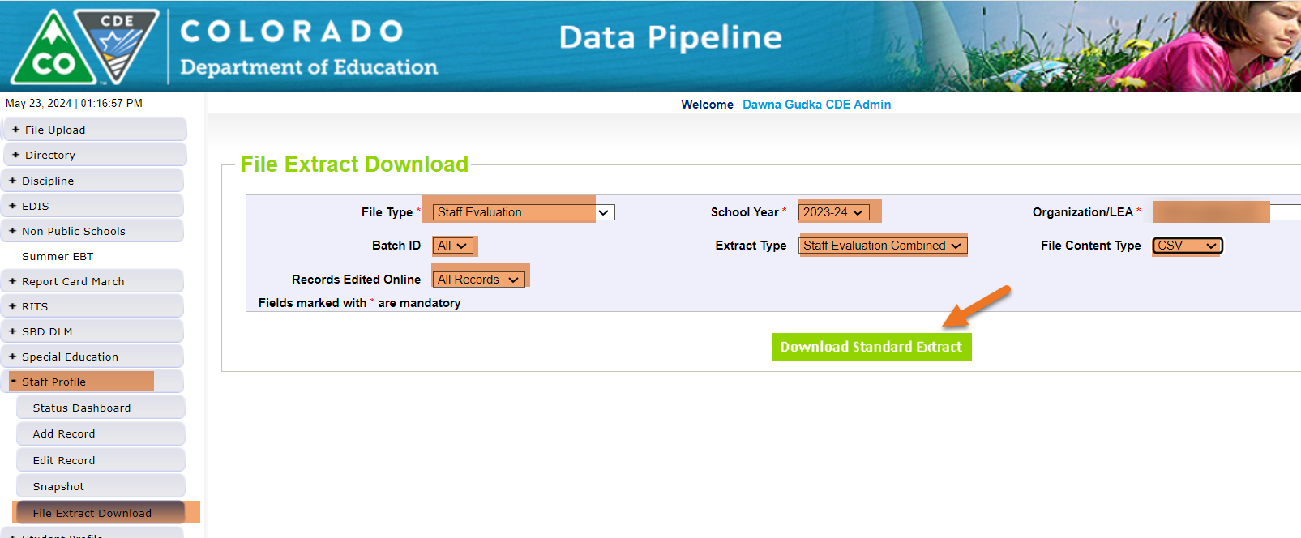
Optional Extract Process
Once you upload your incomplete staff evaluation interchange file from COPMS (RANDA) into Data Pipeline
You can now extract a staff evaluation file that will produce all staff that CDE is looking for evaluation data for: Staff Evaluation Combined
Staff Evaluation Snapshot Collection
staffevaluation@cde.state.co.us

Slide 24
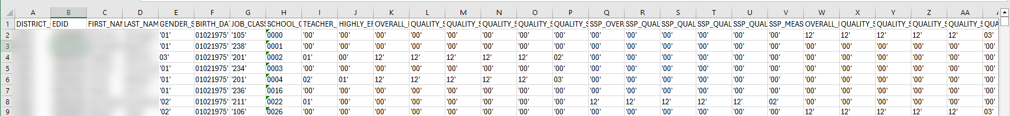
Staff Evaluation completed file
Staff Evaluation Snapshot Collection
staffevaluation@cde.state.co.us

Slide 25
Using the Staff Evaluation Combined Extract complete
Staff Evaluation Snapshot Collection
staffevaluation@cde.state.co.us

Slide 26
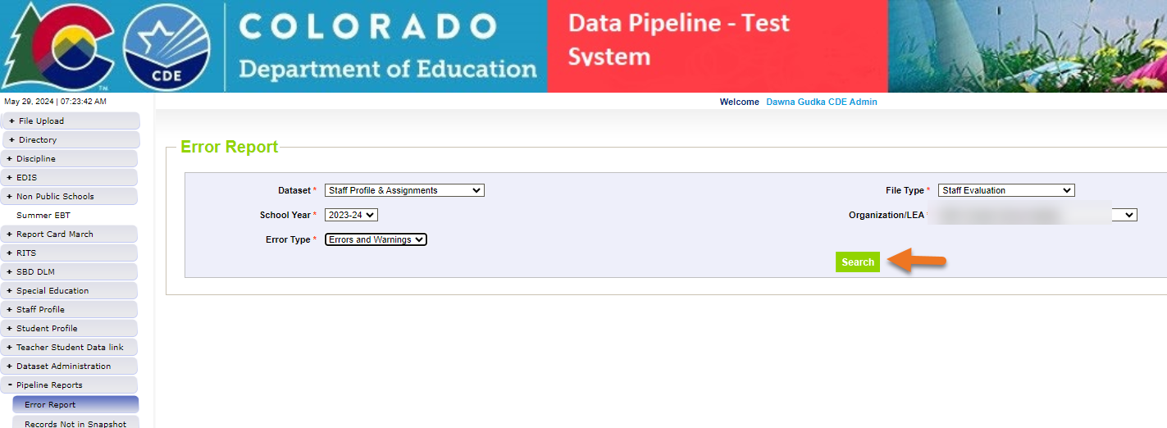
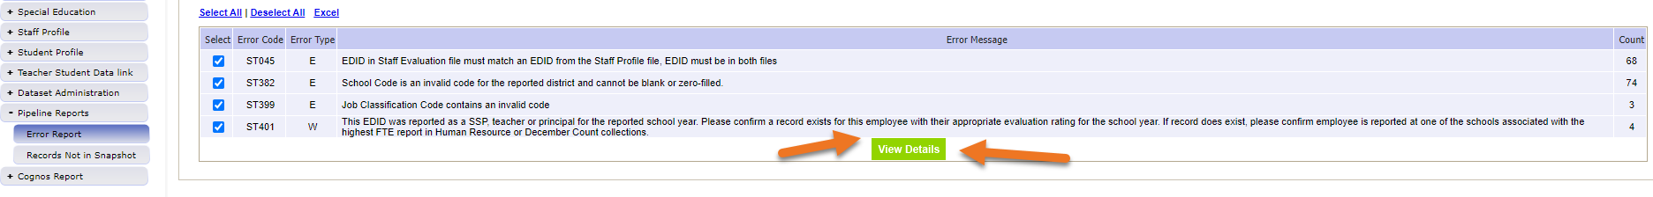
Checking for errors-Interchange level
Staff Evaluation Snapshot Collection
staffevaluation@cde.state.co.us

Slide 27
Correct your errors and upload corrected interchange file
Staff Evaluation Snapshot Collection
staffevaluation@cde.state.co.us

Slide 28
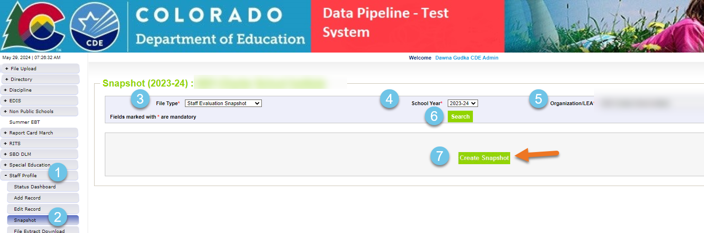
Creating Staff Evaluation Snapshot
Staff Evaluation Snapshot Collection
staffevaluation@cde.state.co.us

Slide 29
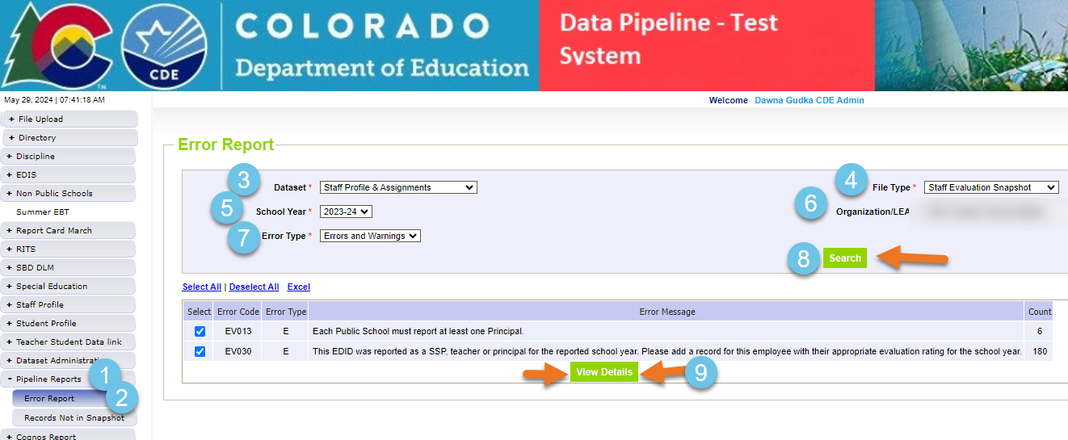
Checking for errors-snapshot level
Staff Evaluation Snapshot Collection
staffevaluation@cde.state.co.us

Slide 30
Reminder to create a new snapshot each time to correct your interchange file or files
When creating a snapshot, Data Pipeline takes a snapshot of your data at the time that you clicked on the create snapshot button.
Staff Evaluation Snapshot Collection
staffevaluation@cde.state.co.us

Slide 31
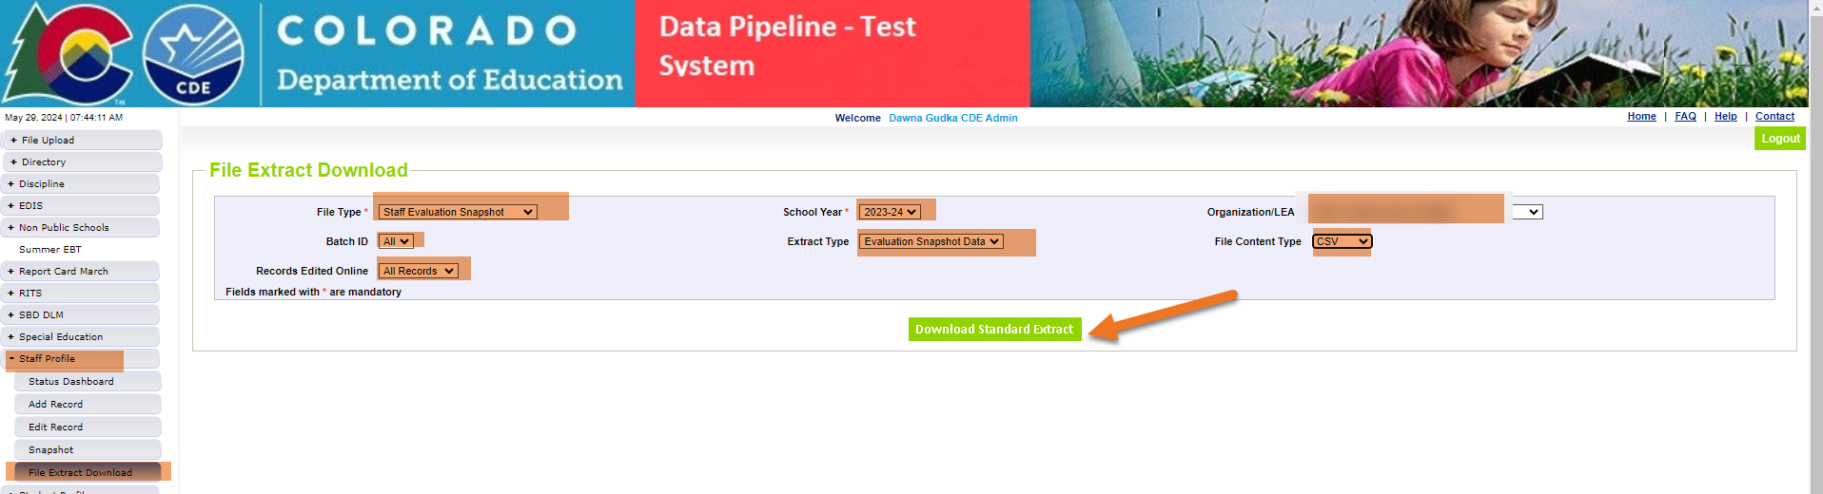
Once Snapshot is error free-Validate data
Review your snapshot records using Data Pipeline snapshot extract
Staff Evaluation Snapshot Collection
staffevaluation@cde.state.co.us

Slide 32
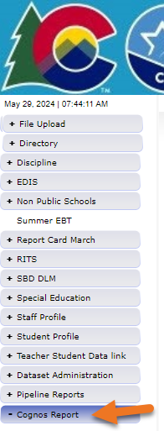
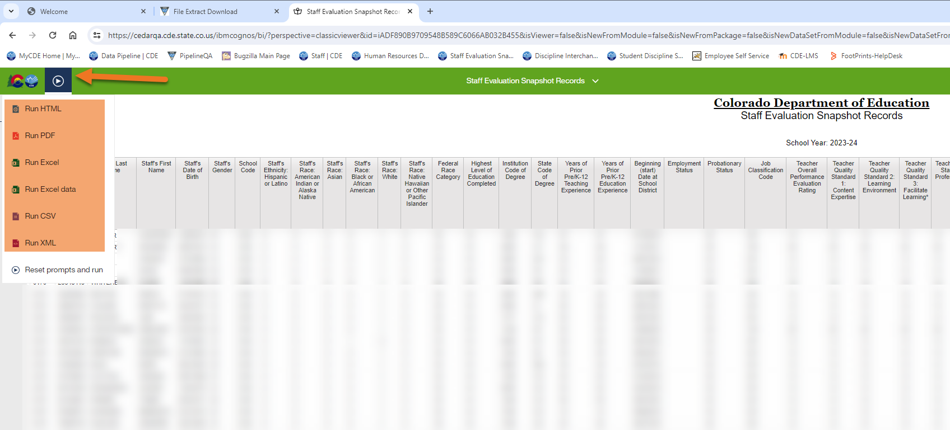
Validate your data
Using Cognos (Cedar) Reports
Staff Evaluation Snapshot Collection
staffevaluation@cde.state.co.us

Slide 33
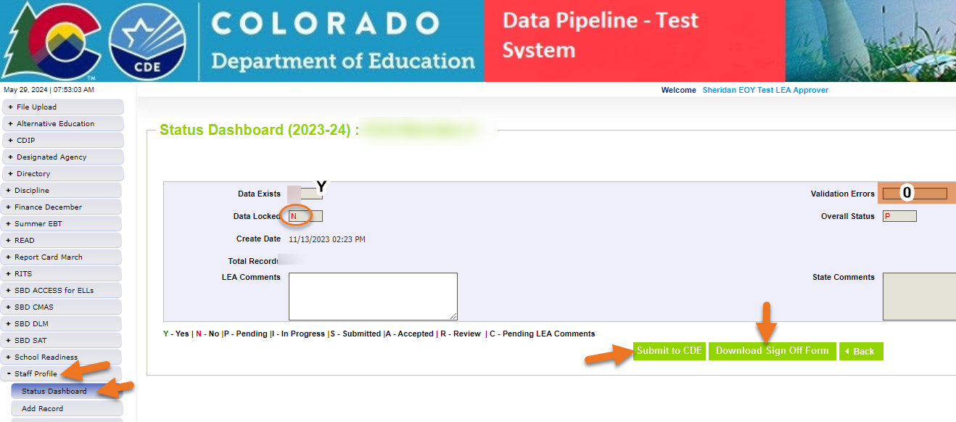
Submit data and download signature page
Staff Evaluation Snapshot Collection
staffevaluation@cde.state.co.us

Slide 34
Collection Recommendations

Slide 35
Collection Recommendations-Get it completed early
Get this collection completed early
  COPMS rolls over to the new school year
  Evaluators leave for summer break
  Some Evaluators will not be returning for the next school year
Staff Evaluation Snapshot Collection
staffevaluation@cde.state.co.us

Slide 36

Thank you for joining today!
When emailing CDE, please include your 4-digit LEA number or your 5-digit AU number this helps us answer your questions quickly.
Please do not send PII (Personally Identifiable Information) via email. This includes exception requests!

Slide 37
Questions & Resources:
Staff Evaluation Snapshot Collection
Staff Evaluation Snapshot Collection
StaffEvaluation@cde.state.co.us
Dawna Gudka
(303) 598-7901

