Slide 1
2023-2024
Special Education December Count
Student and Staff
Snapshot Training
^{November 14, 2023}

Slide 2
Special Education December Count
Contact Information
Lindsey Heitman – SpedDecCount@cde.state.co.us 303-866-5759
  Data Pipeline SPED Snapshot submission questions
  Includes Staff Interchange Sped staff questions
Orla Bolger – bolger_o@cde.state.co.us December Count Staff and Student Content Expert
Josh Fails – Fails_J@cde.state.co.us DMS Access questions
Dawna Gudka – Gudka_D@cde.state.co.us Human Resources Snapshot Submission
*Please include your AU #, District #, Error code # or cognos report name (if applicable) in emails
Resource Webpages
  Special Education IEP Interchange
  Staff Interchange
  Special Ed December Count Snapshot
  ESSU Data Management System

Slide 3
AGENDA
Purpose, Overview, Timeline – slides 4-16
IdM: Access to Data Pipeline – slides 17-22
Special Ed IEP Interchange: Sped Student Data/Content – slides 22-39
Staff Interchange: Staff Data/Content – slides 40-49
December Count Snapshot Process – slides 50-64

Slide 4
Timeline & Collection Overview

Slide 5
Special Education December Count
Collection Purpose
Purpose
Obtain data on students actively receiving Special Education services as of the annual count date of December 1st
Obtain data on special education staff employed by Administrative Units on December 1st of each year so that appropriate licensure and endorsement of staff may be verified
Student:
  determine ECEA funding for students with disabilities
  calculate State Performance Plan Indicators
    Indicator 5 – LRE Placement
    Indicator 6 – Early Childhood Settings
    Indicator 9 – Disproportionate Representation in Special Education
    Indicator 10 – Disproportionate Representation in Specific Disability Categories
  calculate significant disproportionality
  generate sample lists for Indicator 8 - Parent Involvement and IEP Record Reviews
  used to meet federal reporting requirements - EdFacts
Staff:
  linked to the student data to fulfill required staff qualifications
  used to meet federal reporting requirements – EdFacts
  reports generated for the State Legislature, Federal government, local Administrative Units, and the public

Slide 6
Special Education Student Funding Clarification
IDEA federal funding is calculated from Student October Snapshot data
ECEA (Exceptional Children’s Educational Act) state funding is calculated from December Count Snapshot data
  Funding is based on Special Education status as of 12/01 as well as tier A and tier B disability types
  Detail Report found in the Special Ed December Count Cognos folder –
    Student: Detail Funded by Disability Tier and Member District
You’ll find the funding amount and breakdown for each district/AU at this link:
  https://www.cde.state.co.us/cdefisgrant/allocations

Slide 7
Special Education December Count:
Staff and Student Snapshot Timeline
November Due Dates
December Due Dates
January Due Dates
25th - Thursday - All errors resolved – complete snapshot
February Due Dates
7th – 15th - Wednesday – Thursday - Resolving Duplicates
1st - Friday - Official count date
25th - Feb 2nd Thursday – Friday - Report Review
15th – 22nd - Thursday - Thursday - Final Report Review
23rd - Friday - Final Submission Due
1st -Wednesday – Sped December Count Snapshot available in Data Pipeline
17^{th -} Friday- Interchange files uploaded - Sped Child, Sped Participation, Staff Profile, Staff Assign
8th - Friday: Interchange files error free and at least one snapshot created
Link to full timeline https://www.cde.state.co.us/datapipeline/2023-2024specialeducationdecembercounttimeline

Slide 8
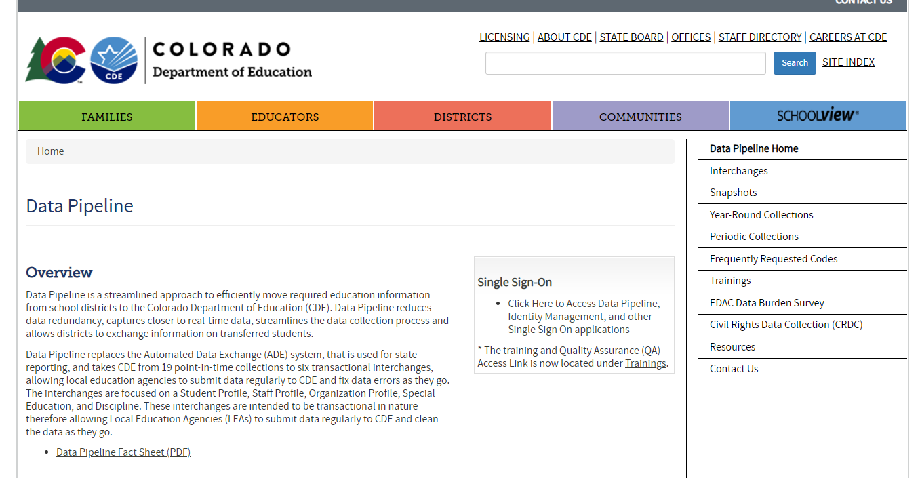
Website Overview
http://www.cde.state.co.us/datapipeline
Staff/IEP Interchange Information
To login to Data Pipeline System
click here:
December Count Snapshot Information
Collection dates, Mandatory Collections- legislation and uses, converting csv files to excel, etc.
Codes Available (district codes, school codes, institutes of higher education codes, etc.)

Slide 9
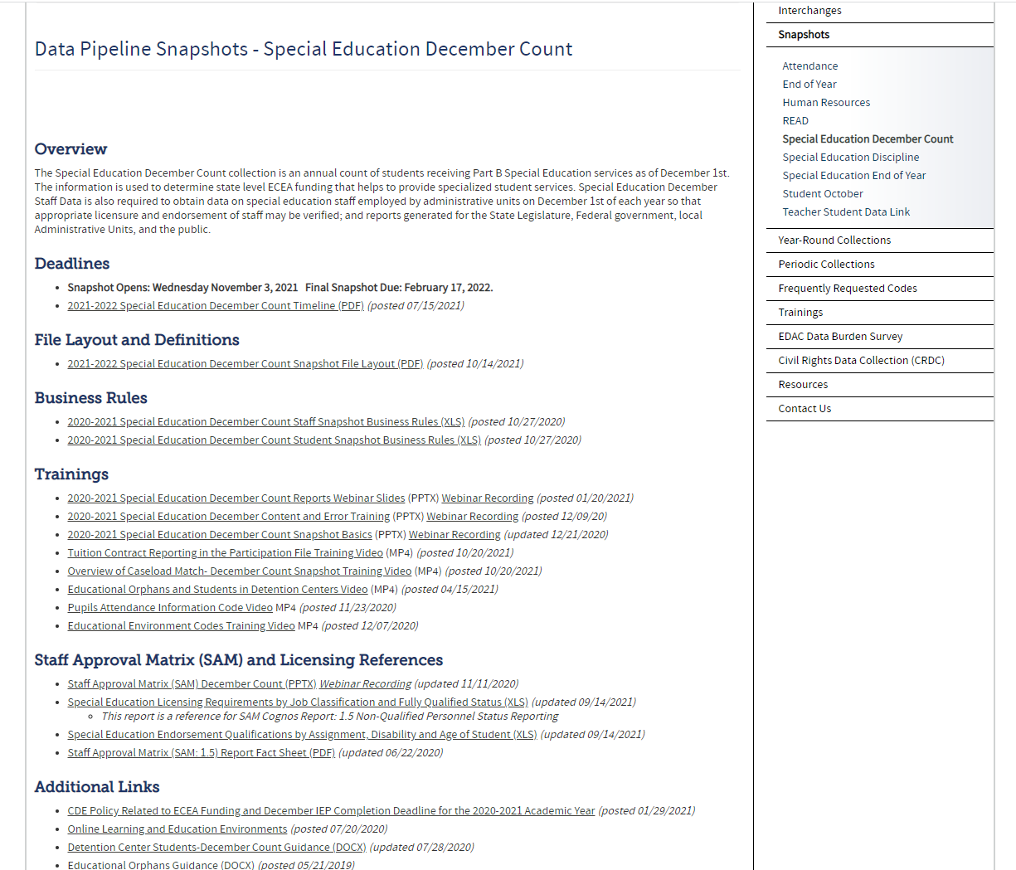
December Count:
Snapshot Webpage
Special Education December Count Snapshot Resources
Includes short training videos on these topics:
Tuition Contract Reporting
Overview of Caseload Match
Pupils Attendance Information Codes
Ed Orphans and Detention Center Students
Ed Environment Codes
Staff Approval Matrix Training Slides
Sped Licensing Requirements

Slide 10
Weekly Data Pipeline Town Hall Webinars
Every Thursday from 9-10 am during the school year and every other during the summer
  Updates on open and upcoming data collections
  Ask questions via chat
  Find archived town hall slides and recordings here: http://www.cde.state.co.us/datapipeline/datapipelinetownhallpresentations
  Login Information:
  Microsoft Teams meeting
  Click here to join the meeting
To Subscribe to the town halls, email: DATASERVICES-subscribe-request@cdelist.cde.state.co.us
To Unsubscribe from the town halls, email: DATASERVICES-unsubscribe request@cdelist.cde.state.co.us

Slide 11
Syncplicity – How to Share
Personally Identifiable Information
Syncplicity is an online platform used for secure file sharing. This is what CDE uses to share anything with PII http://www.cde.state.co.us/datapipeline/syncplicityinstructions
Please email me if you do not yet have a folder. I will send you an email with a link to set up your AU # Syncplicity folder, used for all three SpEd collections.
Once a file has been shared you can access Syncplicity at: my.syncplicity.com
File name is your AU code
Used for Exception requests, questions that include PII, facility student information, etc
Please email CDE to notify us you’ve placed something in the folder. We aren’t automatically notified when you’ve saved something in your Syncplicity folder.

Slide 12

Special Education December Count Snapshot
1. Student Snapshot
2. Staff Snapshot
Special Education Child
Special Education Participation
Staff Profile
Staff Assignment
Data is pulled from these Data Pipeline Interchanges and files:
Student School Association
Student Demographic
STUDENT
STUDENT
STUDENT
STUDENT
District Responsibility:
Student Interchange
Staff (include Sped staff if AU is not uploading staff data)
AU Responsibility:
Special Education IEP Interchange
Sped Staff (ONLY if district is not uploading Sped staff)
STAFF
STAFF

Slide 13
December Count Staff and Student
Snapshot Criteria
Staff records will be included in the snapshot when:
Must be error free at the Staff Interchange
Special Education Flag = 1
AU code is populated in both Staff files
Start date of Assignment is <= 12/01
End Date of Assignment is blank or > 12/01
Employment Status Code = 11, 12, 13, 23, 25 or 26
The Staff Profile and Staff Assignment Association File will be joined based on the following criteria: School year, EDID, Sped Assignment Flag = 1, District (or Admin Unit), and error-free records.
Student records will be included in the snapshot when:
Date of Entry to SpEd is <= 12/01
Date of Exit from SpEd is zero-filled or > 12/01
OR Parentally Placed in Private School is 02
Pull all error-free records meeting above criteria from the SpEd Participation file and match them with records in the Student Interchange. Student Interchange is the authoritative source for: SASID, LASID, First Name, Middle Name, Last Name, Gender, Date of birth, Ethnicity, Race and Grade level.
Data from the Student Interchange will pull primarily from a DEC tagged file. If the district has not tagged a file for DEC, it will pull from the latest student DEM file uploaded and the grade will pull from the SSA file and record with the latest School Entry Date.
If student is not required to be submitted in the Student Interchange, the demographic data and grade level will pull from the Child and Participation files.
The Child file, Participation file and Student DEM files will be joined based on the following criteria: SASID, LASID, school year, district (or Admin Unit), and error free records.

Slide 14
December Count Fields in which the data should pull primarily from the Student Interchange district files
Student Interchange- District Sourced Fields
Student Demographic File
*LASIDs must match for these fields to pull primarily from Student Interchange
SASID
LASID
Student First Name
Student Middle Name
Student Last Name
Student Gender
Student Date of birth
Student Ethnicity
Student Race
Student School Association File
*Grade will pull primarily from Student Interchange if record is included in the SSA file
Grade Level
Data from the Student Interchange will pull primarily into the December snapshot from a DEC tagged file. If the district has not tagged a file for DEC, it will pull from the latest Student DEM file uploaded and the SSA file record with the latest School Entry Date.
Tagging a file for OCT or DEC is not required! An Untagged file works for both snapshots.
*Student’s LASID must match between the Student Interchange and IEP Interchange for the demographic data to be pulled from the Student Interchange into the December Count Snapshot.

Slide 15
Special Education December Count Snapshot:
File Layout and Definitions Document
http://www.cde.state.co.us/datapipeline/snap_sped-december
Snapshot Purpose
Dependencies
Criteria for records being pulled in
Name of each field in both the Student and Staff Snapshots
Source interchange and source file the data is pulled from. Also referred to as primary interchange.
  Ex: Grade level comes from Student Interchange – SSA file
Secondary interchange and secondary file the data is pulled from if record doesn’t exist in the primary interchange.
  Ex. Approved facility students are usually not submitted in the Student Interchange
Helpful remarks/details
Internal flags– fields calculated from existing data fields
  Ex: Federal Race and ELL Status

Slide 16
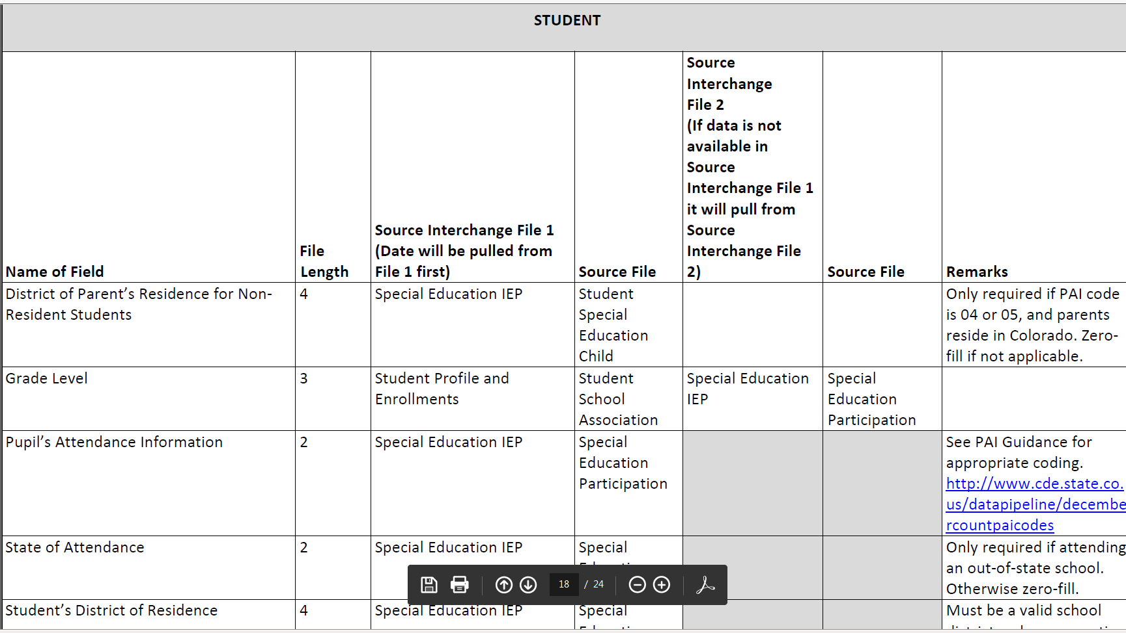
Snapshot File Layout – lists source file and secondary file data is pulling from

Slide 17

IdM: Access to the
Data Pipeline

Slide 18
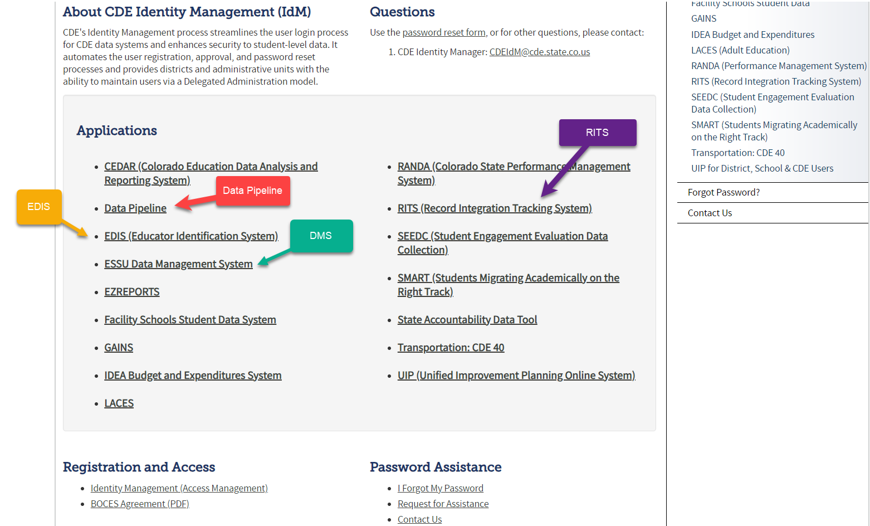
IdM Webpage – recommended link to bookmark for access to CDE applications
*single sign-on used for all CDE applications listed here
*LAMS: Click Identity Management to add or modify IdM accounts
IdM Quick Guide and FAQs located under Registration and Access

Slide 19
December Count:
Identity Management Roles
DATA PIPELINE ROLES NEEDED TO COMPLETE DECEMBER COUNT:
Special Education IEP Role:
  SPE~LEAUSER – upload and modify Special Education IEP Interchange Files
Special Education December Count Snapshot Roles:
  DEC~LEAAPPROVER – Approves, creates, views Snapshot OR
  DEC~LEAUSER - creates, views Snapshot OR
  DEC~LEAVIEWER- views snapshot
Staff Interchange Roles:
  STF~ LEAUSER – upload and modify staff interchange files OR
  STF~LEAVIEWER – view (only) staff interchange data
    EACH LEA MUST DETERMINE WHO WILL REPORT THE SPED STAFF- DISTRICT OR AU RESPONDENT?
IMPORTANT NOTES
* Only 1 role per Group
*Data Pipeline email/collection contact lists are generated from these roles. We do not keep manual email lists! Please ask your LAM to update as necessary.
December Count - Lindsey Heitman - heitman_l@cde.state.co.us (303) 866-5759

Slide 20
Identity Management – Staff Roles
Staff role needed for District respondent -
  STF Associated with the 4 Digit District Code
    User may report ALL staff data for the district - regular ed staff and Special Education staff OR just regular ed staff
    District respondent’s reporting all staff must collaborate with AU respondent in accordance with December Count timeline
    Example: 0050-STF~LEAUSER
Optional - Staff role needed for AU respondent uploading SPED staff
  STF Associated with the 5 Digit AU Code
    User may only report Special Education staff (flag=1)
    Example: 64043-STF~LEAUSER
Optional - Staff role needed for BOCES respondent uploading BOCES staff-
  STF Associated with the 4 Digit BOCES Code
    User can report ALL staff for the BOCES – regular ed staff and Special Ed staff.
    Example: 9025-STF~LEAUSER
December Count - Lindsey Heitman - heitman_l@cde.state.co.us (303) 866-5759

Slide 21
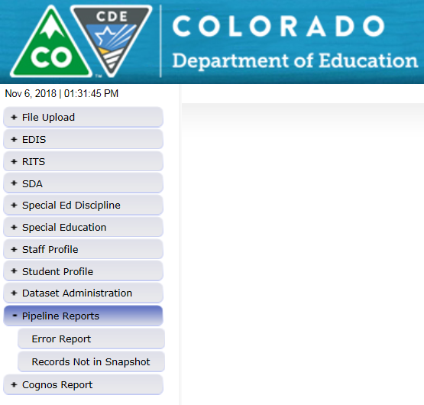
Correct Access
The menu items listed on the left depend upon your IdM roles
  Be sure you see the ‘Special Education’ tab (SPE and/or DEC role)
  Be sure you see the ‘Staff Profile’ tab IF you’re uploading staff data. (must have AU STF User role)
    If district is uploading all staff data, the AU respondent will not be able to see the Staff Profile tab unless a single district AU has given you the STF viewer role.

Slide 22
Special Education IEP Interchange- Student Data/Content

Slide 23
Special Education IEP Interchange:
Data collection process/flow for Enrich Users
SIS
I.C., PowerSchool, etc
SIS = student information system
Enrich/Frontline
Includes most Child File and Participation File level 1 edits (these should mirror the Pipeline)
Data Pipeline/CDE
IEP Interchange level 1 edits (full edit list - includes additional edits)
Decenmber Staff and Student Snapshot level 2 edits
Ideally changes should be made here or in Enrich, depending on the field
IEP student data system
State reporting system
OFFICIAL ERROR SOURCE
Ideally, IEP data changes should be made here or in SIS
Child File and Participation File
Note about IEP Interchange errors:
Path 1, 4, and 5 interchange errors have not been removed in Enrich just yet – coming soon.
  Ignore any errors related to path 1, 4, and 5 or move your data to the Pipeline and view Interchange errors there.
  The errors in the Data Pipeline system are all valid and up to date

Slide 24
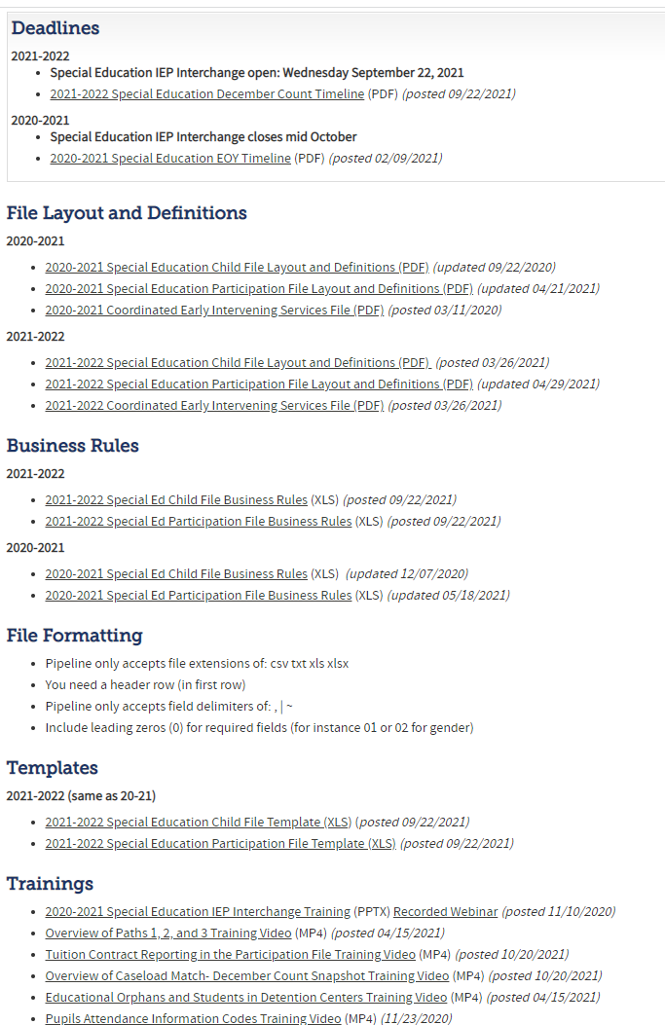
December Count:
Special Education IEP Interchange Resources
http://www.cde.state.co.us/datapipeline/inter_sped-iep
At this link you will find:
Timelines
File Layouts
Templates
Business Rules
Training Slides/ Webinars
Additional Resources

Slide 25
Who to Report
Who to Report?
Students in Special Ed who were receiving services per an IEP as of 12/01/2023
  includes students attending public schools, on-line schools, non-public schools, detention centers or programs located within your Administrative Unit and resident students who attend in other Administrative Units.
Parentally Placed Private School Students with a disability – those receiving services per an ISP and those not receiving services from the AU
  NOTE: Exclude pre-k and K, only include 1st grade and above
Please Include:
All AU residents, regardless of where they attend
All students who attend your AU, regardless of where they live
Resident students who are attending an allowed eligible facility school that you pay tuition.
Resident students for whom you are paying tuition to attend a Special Education Program, non-public school, or out-of-state school.

Slide 26
December Count:
Private School Student Reporting Tips
Be sure to report private school students-
Private school students that were IEP team placed at the private school and receiving services per an IEP on a tuition contract with the AU (eligible for funding- PAI code 27 or 03)
Private school students on an ISP and receiving services from your AU staff
  Only grades 1st and above – exclude Pre-k and K as they are not entitled to an ISP per federal funding
  AU may use state or local funds to provide ISP services to the Pre-K and K PPPS students. They should be reported for Sped EOY, but not December Count.
Parentally Placed Private School Students w/ a disability (grades 1st or above)
PPPS (Parentally Placed in Private School) Field reporting guidance:
Reach out to non-public schools located within your AU boundaries- list posted here https://www.cde.state.co.us/datapipeline/org_orgcodes
Please include students who attend a private school within your AU boundaries and receive services on an ISP. Report like any other student on an IEP and the Parentally Placed in Private School field (PPPS) should =01.
Please include students who attend a private school within your AU boundaries and receive no services whatsoever from the AU. Report with a zero-filled SASID and Sped Referral Code and the Parentally Placed in Private School field (PPPS) should = 02.
These are both reported for proportionate share calculations on two Dec reports.
Special Education December Count - Lindsey Heitman - heitman_l@cde.state.co.us

Slide 27
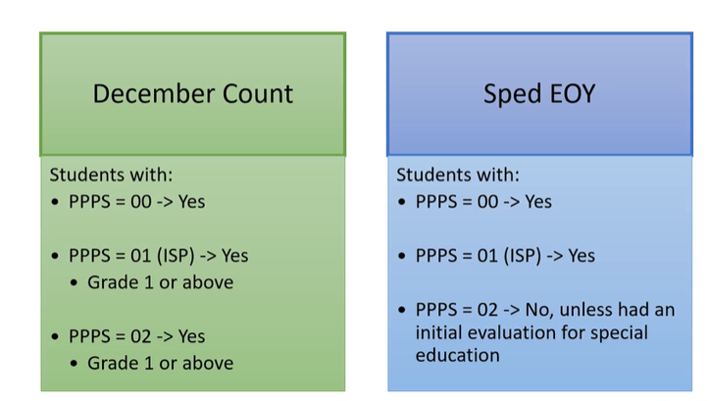
What snapshots do the PPPS students pull into?

Slide 28
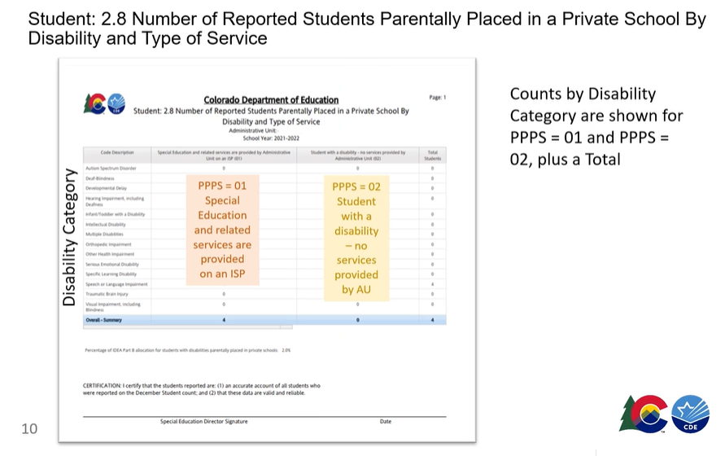
PPPS Cognos Report:
Student 2.8 Number of Reported Students in Parentally Placed in a Private School By Disability and Type of Service

Slide 29
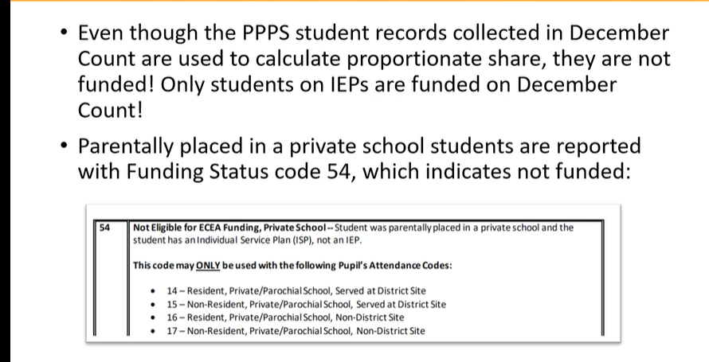
PPPS and Funding Clarification

Slide 30
Educational Environment Codes
Educational Environment Code (also known as Setting Code):
is a 3-digit code representing the major (more than 50% of the student's special education program) instructional setting.
depends on the age of the student as of December 1st, with the exception of 5 year-olds
Coding:
Early Childhood ages 3-5 | Must be reported with 200 level codes (Excludes 5 year-olds in Kindergarten)
School Age ages 6-21 | Must be reported with 300 level codes (Includes 5 year-olds in Kindergarten)

Slide 31
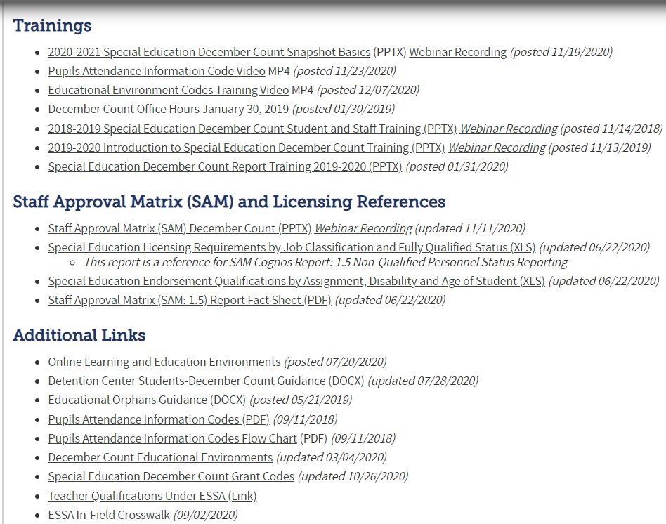
December Count Ed Env Resources
At these links you will find the following helpful resources:
December Count Snapshot Webpage
Participation File Layout pages 24 – 25
https://www.cde.state.co.us/datapipeline/inter_sped-iep
Ed Env Code Training Video
Helpful Ed Env coding chart

Slide 32
Pupils Attendance Information Code (PAI Code)
Pupil’s Attendance Information (PAI Code) –
A - side:
Pupils Attending an Educational Program Operated by the Reporting Administrative Unit, including students served under Schools of Choice and on a tuition contract.
  Students attending in the AU
  Use codes 01 - 17
  Operated by the reporting AU
  State Operated Programs must use code 19 for their students
B - side:
Resident Pupils Attending an Educational Program Not Operated by the Reporting Administrative Unit. Do not include students served by another administrative unit under Public Schools of Choice, even if you are paying tuition.
  Resident students attending outside the AU
  Use codes 22 – 32
  Not operated by the reporting AU
  Report students based on where they receive their educational services
If a student is served by more than one Administrative Unit, the two entities must determine who is eligible for funding prior to submission of the file. Please contact CDE if you need help in determining which Administrative Unit will claim the funding.

Slide 33
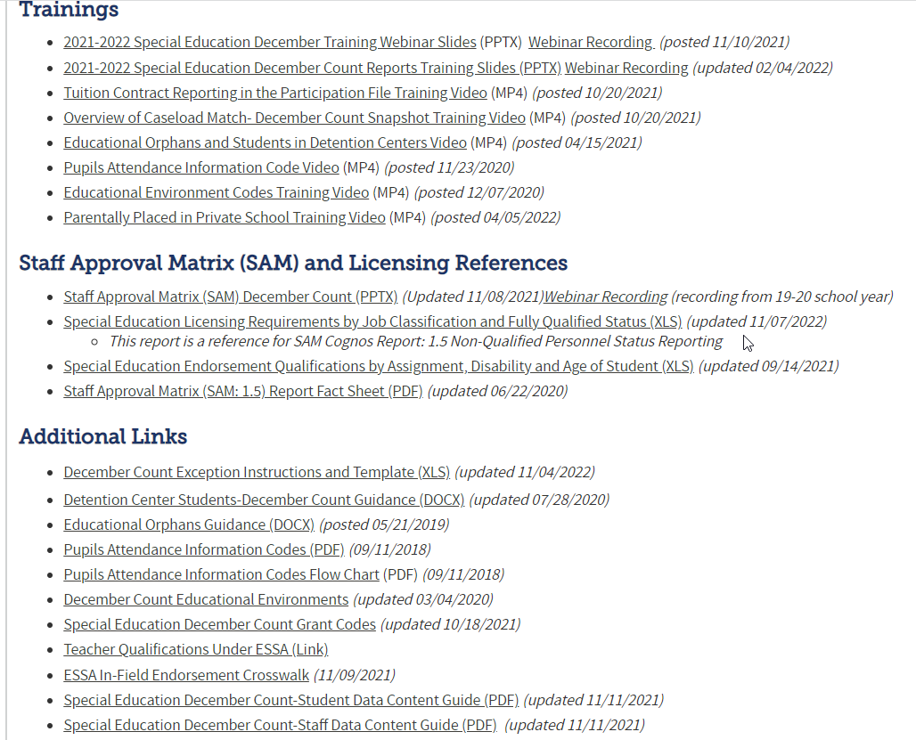
December Count Helpful Resources
At this link you will find the following helpful resources: http://www.cde.state.co.us/datapipeline/snap_sped-december
PAI Code Training Video
PRINT this PAI coding chart

Slide 34
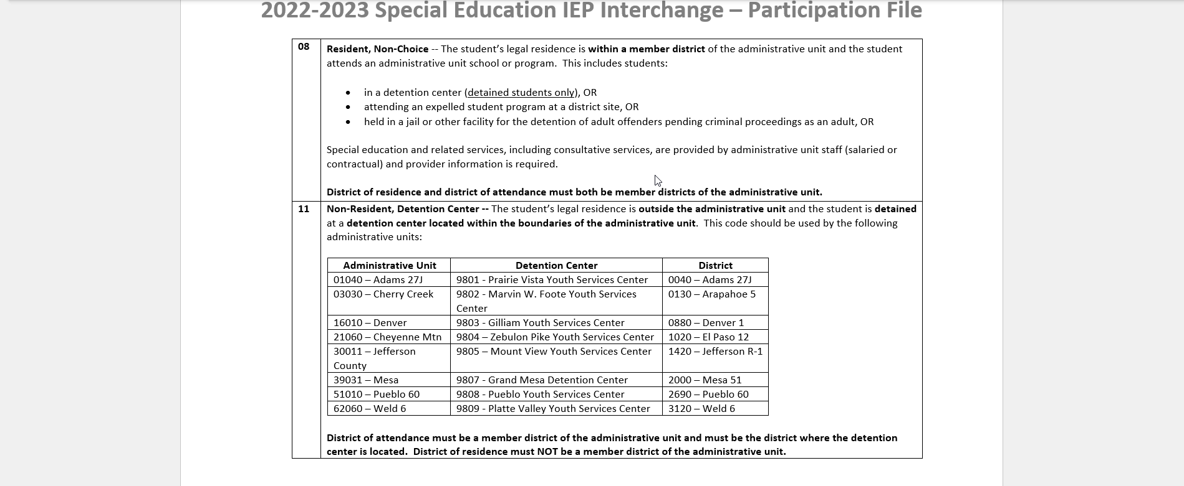
Special Ed Participation File Layout and Definitions: PAI Coding Help pages 12-20
2023-2024
Participation File Layout pages 12 – 20
https://www.cde.state.co.us/datapipeline/inter_sped-iep

Slide 35
List of A – side and B – side PAI Codes
A-Side District of Attendance Reporting |  | B-Side District of Residence Reporting
01 | Resident, Designated School | n/a | n/a
02 | Resident, Open Enrollment | n/a | n/a
03 | Resident, Non-District Site | n/a | n/a
08 | Resident, Non-Choice | n/a | n/a
04 | Non-Resident, Choice | n/a | n/a
n/a | n/a | 22 | Licensed Eligible Facility Attending On-Grounds School (Approved Facility School)
05 | Non-Resident, Non-Choice | 23 | Licensed Facility, Attending Public School
11 | Non-Resident, Detention Center | 24 | Court-Mandated Juvenile Detention
n/a | n/a | 27 | Non-Oublic School (Contractual Agreement)
n/a | n/a | 28 | Outside of CO, Public Education Agency
n/a | n/a | 29 | Outside of CO, Non-Public School
n/a | n/a | 30 | CO Public Agency (Contractual Agreement)
12 | Non-Resident Administrative Unit Placement | 31 | Administrative Unit (Contractual Agreement)
14 | Resident, Served at District Site | n/a | n/a
15 | Non-Resident, Served at District Site | n/a | n/a
16 | Resident, Non-District Site | n/a | n/a
17 | Non-Resident, Non-District Site | n/a | n/a
19 | State Operated Program | 32 | State Operated Program (AU of residence reporting is optional)

Slide 36
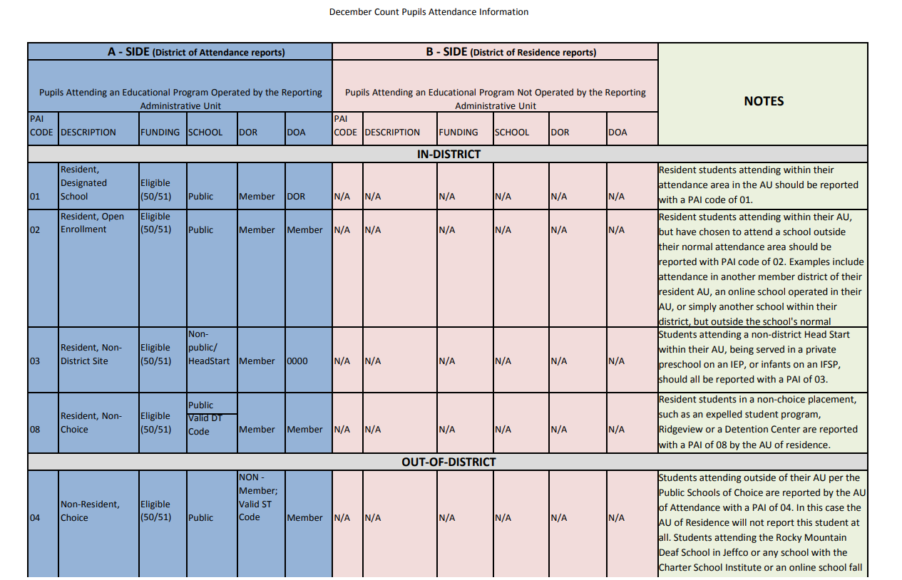
PAI Codes – Must Print for PAI Coding
Information on how to report these fields:
School Code
PAI Code
Funding Status
District of Attendance
District of Residence
Helpful coding chart with notes about each code:
http://www.cde.state.co.us/datapipeline/decembercountpaicodes

Slide 37
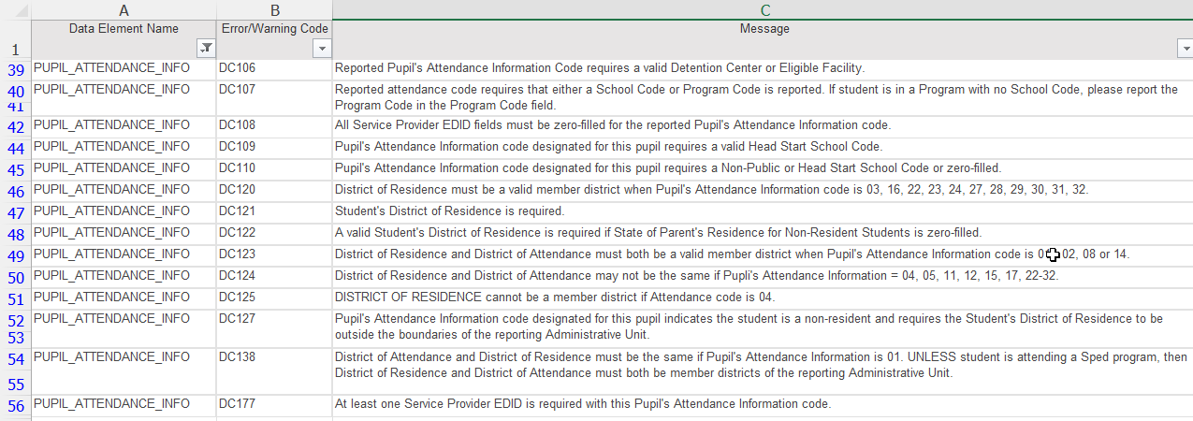
PAI Code Snapshot Errors:
Coding Student Records
What type of school is it? Check for correct School Code and school type
How did student come to attend that school? Parentally placed, choice, etc
Determine the student’s District of Attendance Code
Determine the student’s District of Residence Code
Use school, DOA, and DOR codes to determine applicable PAI Code
Use PAI Coding Chart to determine Funding Status Code

Slide 38
Funding Status Codes
Funding Status Codes
Only codes relevant for Special Education are listed here
50 | Eligible for ECEA Funding | For use with PAI codes 01, 02, 03, 04, 05, 08, 11, 19, 22, 24, 27, 28, 29, 30, 31
51 | Not Eligible for ECEA Funding, Lapsed IEP | For use with PAI codes 01, 02, 03, 04, 05, 08, 11, 19, 22, 24, 27, 28, 29, 30, 31
52 | Not Eligible for ECEA Funding | For use with PAI codes 23, 24, 32
53 | Not Eligible for ECEA Funding, Tuition Contract | For use with PAI code 12
54 | Not Eligible for ECEA Funding, Private School | For use with PAI codes 14, 15, 16, 17
55 | Not Eligible for ECEA Funding, Detained Student | For use with PAI code 11
This field will be used to determine if the student record being submitted is eligible for ECEA (Exceptional Children's Educational Act) funding.
NOTE: Students with lapsed IEP’s will NOT be fundable with a 51 this year!
Participation File Layout pages 21 – 24
https://www.cde.state.co.us/datapipeline/inter_sped-iep

Slide 39
Staff to Student
Caseload Match
Every IEP Student Participation File record must have a Primary Provider EDID of a 202 or a 238
Two distinct caseload match processes exist for Special Education Teachers (202) and Speech-Language Pathologists (238):
Grade Caseload Match in the Data Pipeline
  happens when a Snapshot is created
  grades marked “Yes” in the staff assignment record must exactly match the grades of students in the IEP Participation file
Disability/50% Caseload Match in SAM (Staff Approval Matrix)
  Primary provider staff must hold an appropriate special education endorsement for the majority of student disabilities in the IEP Participation file
    Student caseload for SAM is based on the staff EDID reported in the Primary Provider field in the IEP Participation file.
    Staff EDID reported in any one of the four Secondary Provider fields do not generate a student disability caseload.

Slide 40
Staff Interchange:
Staff Data/Content

Slide 41
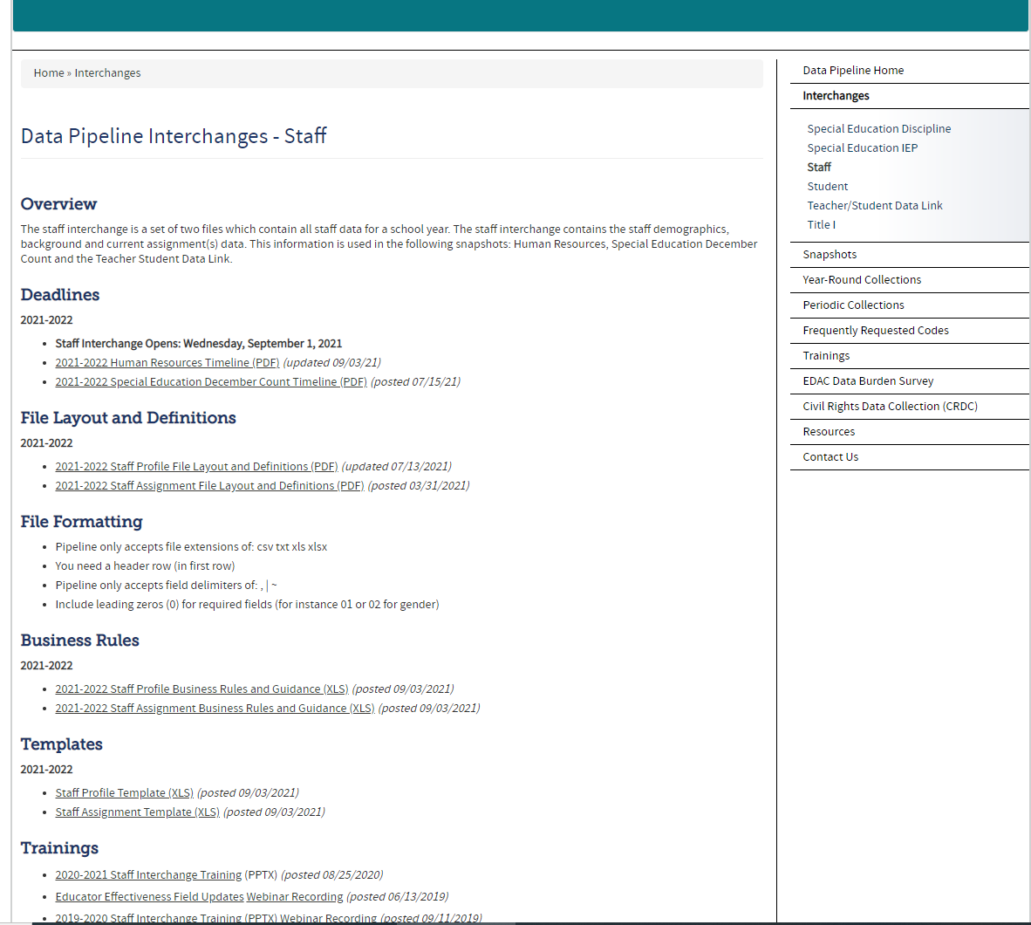
December Count:
Staff Interchange Resources
For information on Staff data reporting: http://www.cde.state.co.us/datapipeline/inter_staff
At this link you will find:
Timelines
File Layouts
Templates
Business Rules
Training Slides/ Webinars
Additional Resources

Slide 42
Staff Records Included in December Count Snapshot
Included:
  All Special Education staff employed as of December 1st
  Full or Part-time including including direct service providers, teachers, paraprofessionals, administrators and support staff
  Office/clerical, teachers, administrators, purchased/contract staff
Excluded:
  Staff that do not support the education of students with disabilities, such as regular education teachers (they pull into the Human Resources snapshot)
  Substitutes unless they are permanent (90 days or more in the same classroom consecutively)
  Temporary workers, such as after school coaches
  Staff not employed December 1st of the current reporting period

Slide 43
Special Education December Count:
Staff
Long Term Sub Requirements in December Count:
If they are the primary provider for a Sped student, they must be reported with a 202
A long-term sub for sped purposes is held to the same licensing requirements as a regular sped teacher. If the Special Ed license has expired or is not renewed by 12/01 and they are reported with job code 202, they will trigger a SAM (Staff Approval Matrix) warning.
  If a “long term” substitute does not hold the appropriate special education endorsement, the staff’s name will appear in one of the Cognos reports in the December Count collection that identifies non-approved/non-qualified staff.

Slide 44
Staff Interchange Files
    Staff Profile
  General information per staff
  Only 1 record per staff
  Must be uploaded first
    Staff Assignment
  Provides specifics to actual duties and locations
  Multiple records per staff allowed
District status report found under Cognos Reports/Special Education December Count (DEC role):
Staff: District/AU Activity Report
Lists the status of all Staff Profile and Staff Assignment file uploads
Breaks it out by district and AU

Slide 45
Staff Assignment File Overview
Multiple records are allowed per person based on
  Special Education Status
  Location
  Job Class Code
  Administrator Instructional Area (AIA Code)
  School Code
    Teachers (202’s) should break out separate Staff Assignment records for each school served 3 or less
    Teachers serving 4 or more schools may be reported with School Code 9980 – District Wide.
  SSPs may be reported with School Code 9980 (238, 236, 237)
When reporting 2 or more records for a staff member…
  Base Salary would be split accordingly
  Hours per day would be split accordingly
  Contract days would not be split

Slide 46
Grade Caseload Match
(Data Pipeline)
Staff serving multiple grade levels are reported with all grades served.
Separate assignment record is required for staff serving- must break out AIA Codes:
Pre-K grade (AIA 0035 Early Childhood/Prekindergarten)
Grades K, 1, 2 (AIA 0041 Early Childhood/Elementary)
Grade K only (AIA 0036 Kindergarten)
The grade caseload match captures EDIDs reported in the Primary Provider or any of the Secondary Provider fields in the student IEP Participation file.

Slide 47
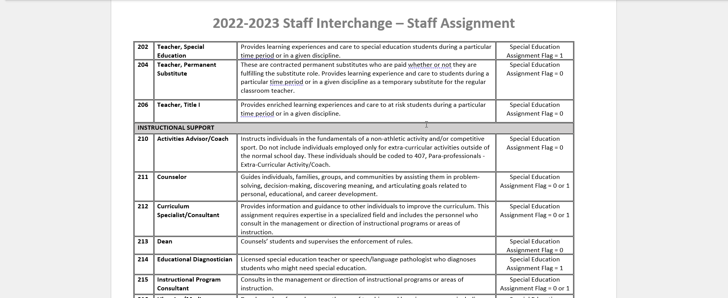
Staff Assignment File Layout
Job Codes are listed on the Staff Assignment File layout (starting on page 8).
Each code indicates Sped or non-Sped only by a 1 or a 0 or both in the Special Education Flag field.

Slide 48
Special Education December Count:
Grant Codes Clarification
Only these job codes require a Grant Code:
201 (general education teacher)
202 (special education teacher) *SPED DEC job code
206 (Title I teacher)
222 (reading interventionist) *SPED DEC job code
223(math interventionists) *SPED DEC job code
415 (general education teaching assistant)
416 (special education teaching assistant) *SPED DEC job
419 (Title I teaching assistant)
Grant Code in the HR/Sped December Count is only needed for Title 1 purposes to determine whether title 1 staff are state or federally funded
0000 | Not Applicable (to use for staff that are not required to report the grant/project funding code | Special Education Assignment Flag = 0 or 1
0001-2999 | Local and Intermediate Project/Grants (can ‘roll-up’ codes to be combined). Use ‘0001’ if multiple local/intermediate projects/grants | Special Education Assignment Flag = 0 or 1
3000-3999 | State Projects/Grants (can use 3000 as a general indicator of State funded)). Use ‘3000’ if multiple state project/grants | Special Education Assignment Flag = 0 or 1
4010 | Title I, Part A | Special Education Assignment Flag = 0 or 1
5010 | Title I, Part A: Competitive Grant | Special Education Assignment Flag = 0 or 1
9900 | Other Federally Funded - not Title I | Special Education Assignment Flag = 0 or 1
3130 | State ECEA - Special Education | Special Education Assignment Flag = 1
3131 | State ECEA - Special Education Preschool | Special Education Assignment Flag = 1
4027 | IDEA: Part B (Formula) | Special Education Assignment Flag = 1
4173 | IDEA: Preschool (Formula) | Special Education Assignment Flag = 1

Slide 49
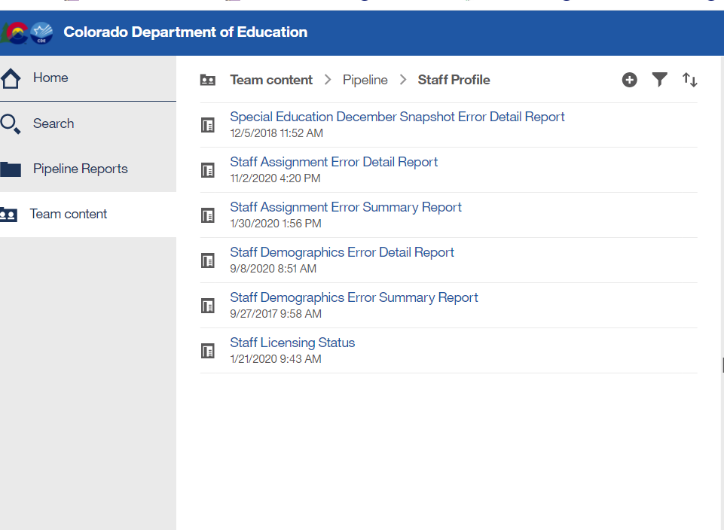
Special Education December Count – Report available for Staff Interchange User to see snapshot errors
Staff Interchange Users and Viewers are able to see their district’s December Count snapshot errors by downloading this report under:
  Cognos Reports- Staff Profile- Special Education December Snapshot Error Detail Report
Those with STF role have access to this error report

Slide 50

SNAPSHOT PROCESS

Slide 51

Step 1: UPLOAD INTERCHANGE FILES (or verify they have been uploaded)
IEP
Staff
Student
Step 2: Create Snapshot
Step 3: ONCE EMAIL is received check status dashboard
Step 4: Download DEC STUDENT and DEC STAFF error reports and work with staff respondent on changes needed
Step 5: UPLOAD UPDATED INTERCHANGE FILES and go through steps again

Slide 52
Snapshot Steps
Prior to creating a snapshot:
Verify that all 4 files are uploaded and have processed successfully – Child, Participation, Staff Profile, Staff Assignment
  Batch Maintenance screen
  District/AU Activity Report -->Cognos Reports/Special Education December Count
  Email confirmations
  Status Dashboard
  Ideally files are error free, but not required in order to create a snapshot

Slide 53
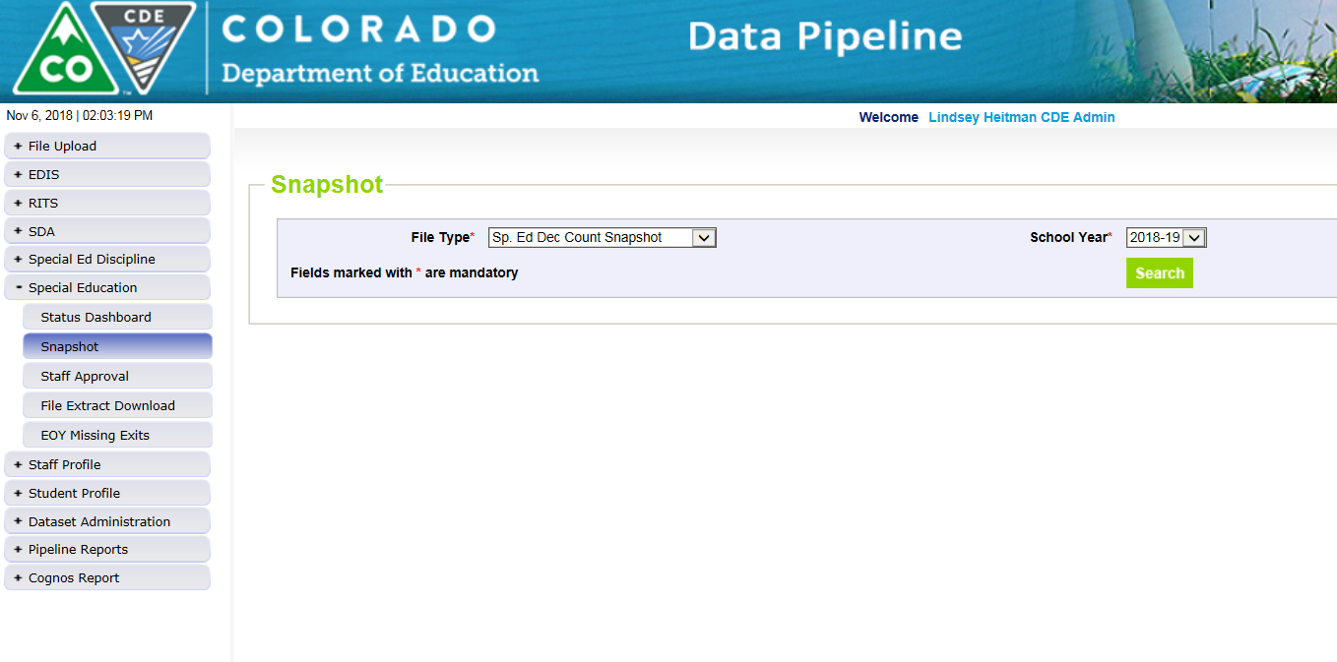
How to Create a Special Education
December Count Snapshot
1. Click on Special Education tab
2. Click Snapshot from expanded list
3. Select File Type – Sp. Ed Dec Count Snapshot
  School Year – automatically populates with 2023-2024
  Organization/LEA – automatically populates based on IdM role
4. Click Search
5. Click Create Snapshot button.
  you should see a message display across the top left in green: “Snapshot creation triggered and processing. A notification email will be sent upon completion”
Watch for snapshot email confirmation. Snapshot is not finished processing until email is sent

Slide 54
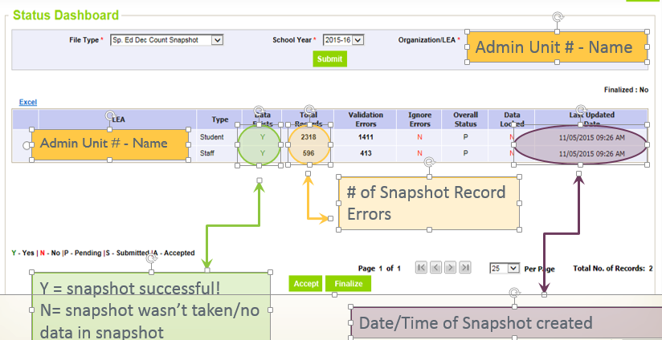
Check Status Dashboard
*Email confirmation is the green light for checking status dashboard!
Checking the Status of the Snapshot
Click Special Education->Status Dashboard:

Slide 55
Reviewing Snapshot Errors
2 options for viewing errors:
  Pipeline Reports - Error Reports/Special Education IEP Interchange
    File Type: Sp. Ed December Count Staff OR
    File Type: Sp. Ed December Count Student
  Cognos Reports – Special Education December Count
    Errors: Student Detail Report of Errors to Correct
    Errors: Staff Detail Report of Errors to Correct
The list of all December Count Student and Staff Business rules (errors and warnings) can be found at: http://www.cde.state.co.us/datapipeline/snap_sped-december under the ‘Business Rules’ section.

Slide 56
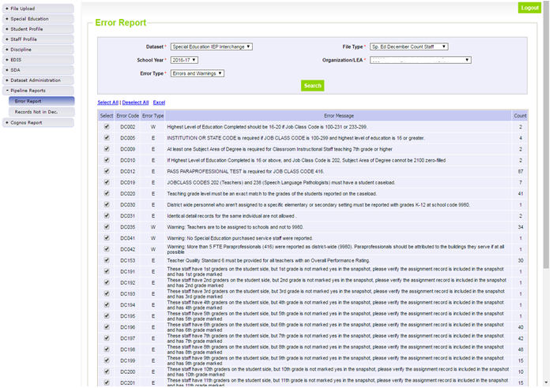
Pipeline Error Reports
File Type may be:
Sp. Ed December Count Staff
Sp. Ed December Count Student
Both are ‘DC’ error codes

Slide 57
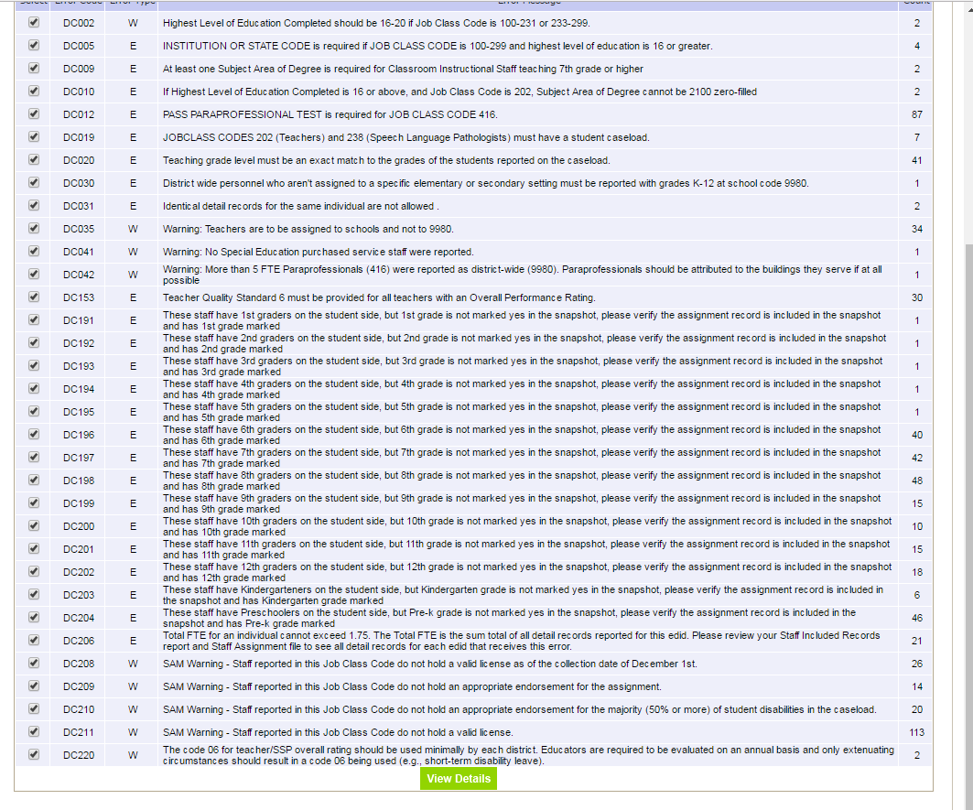
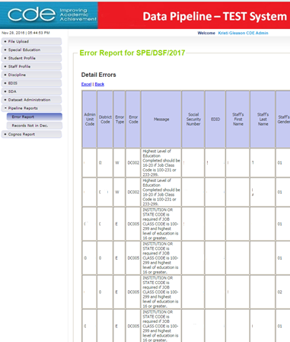
Pipeline Error Report:
Viewing detail error records in Excel
Click Excel
*Only shows first 1000 errors
Click View Details

Slide 58
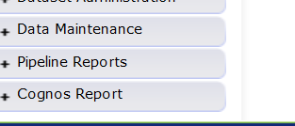
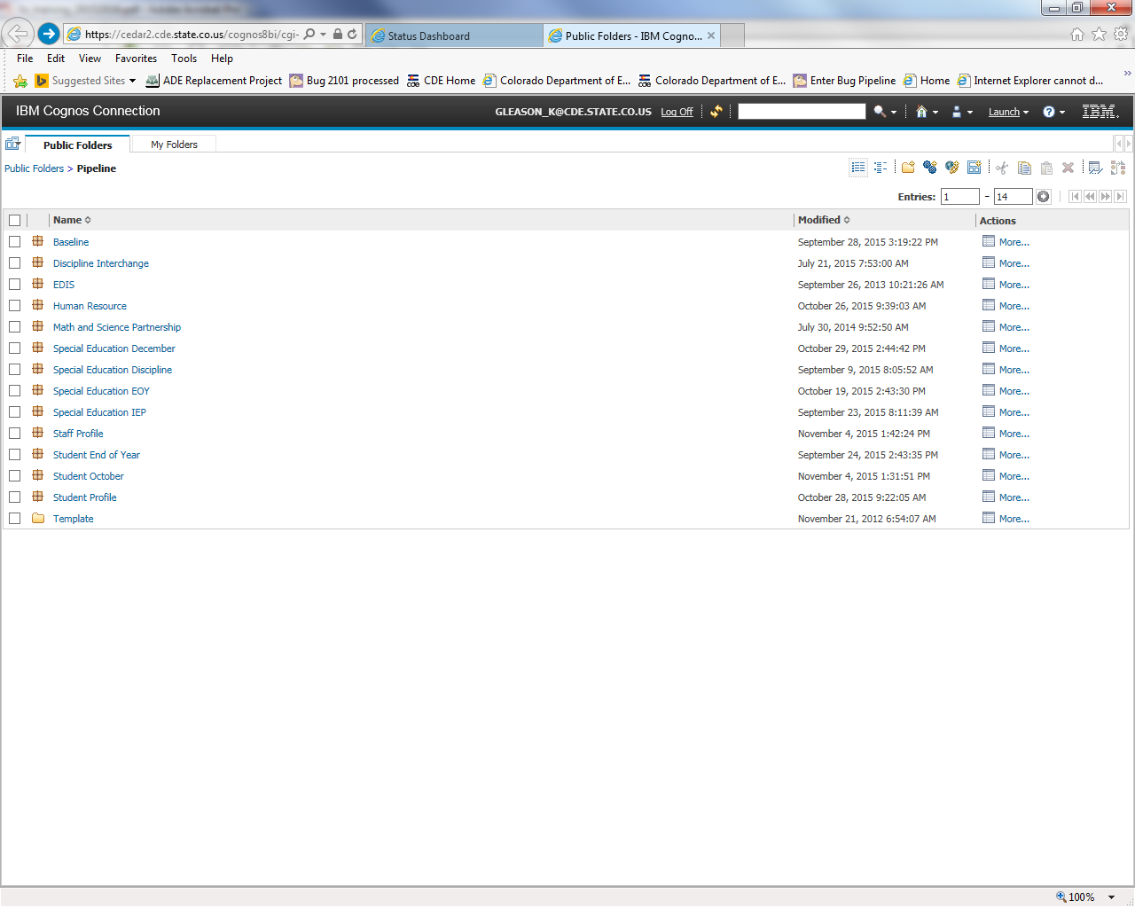
Cognos Reports – option for checking Snapshot errors
ERROR REPORTS
“COGNOS”
Opens new window
Special Education December

Slide 59
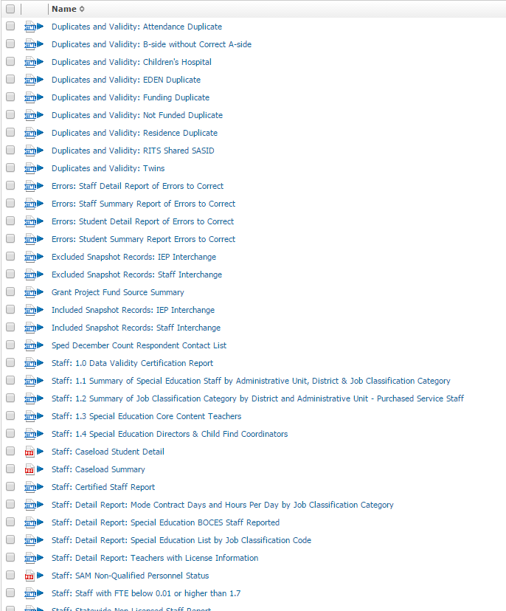
Special Education December Count Cognos Reports
-->Cognos Reports/Special Education December Count
Error Reports: Staff and Student have separate reports
Excluded Report: Includes excluded records – those w/ interchange errors
Included Report: Includes records that are included in the snapshot
*The included reports help to troubleshoot snapshot errors DC114, DC115, DC225, DC019, DC020, DC225, DC191-204

Slide 60
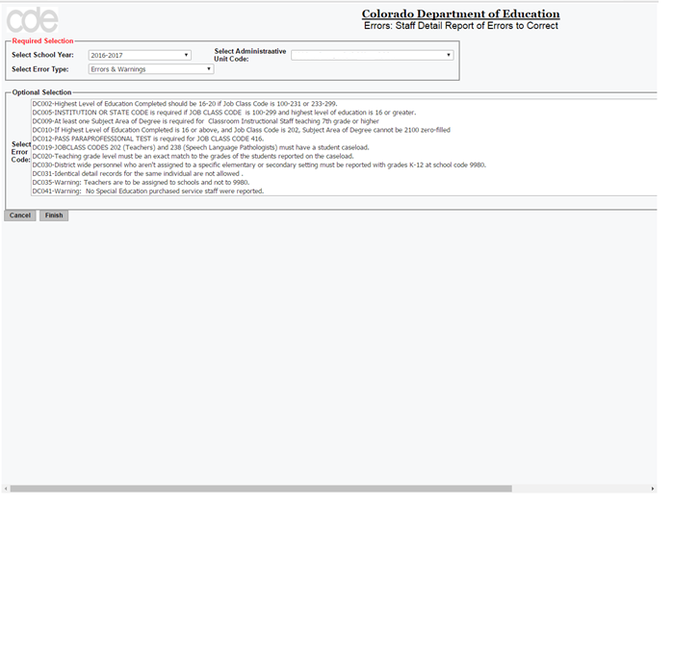
Cognos Error Reports

Slide 61
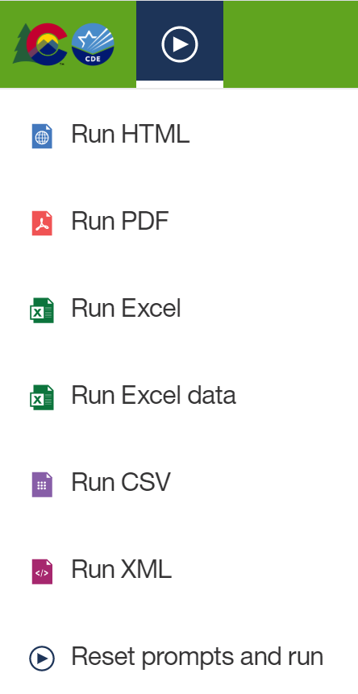
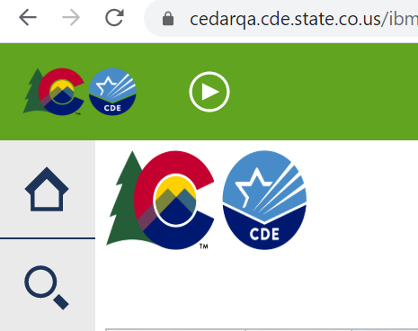
Exporting Cognos Report to Excel
Click on ‘Play’ Button
(available when a report is showing)

Slide 62
Correcting Snapshot Errors
View Status of December Count snapshot
  Email will be sent with status
  Then check Status Dashboard screen –shows if processed and # of errors
View errors in the Detail Error Reports (Pipeline Error Reports or Cognos)
Option to export the report to Excel
Correct the errors in the appropriate Interchange File
  Ideally in Enrich or your source system
  Student/Staff files- will need to contact district respondent to resolve these errors (unless AU is submitting staff)
Re-upload your corrected files to the IEP Interchange. If errors only exist in 1 of the files, you can resubmit only the 1 file containing corrections.
Re-Create the Snapshot
Repeat as many times as needed

Slide 63
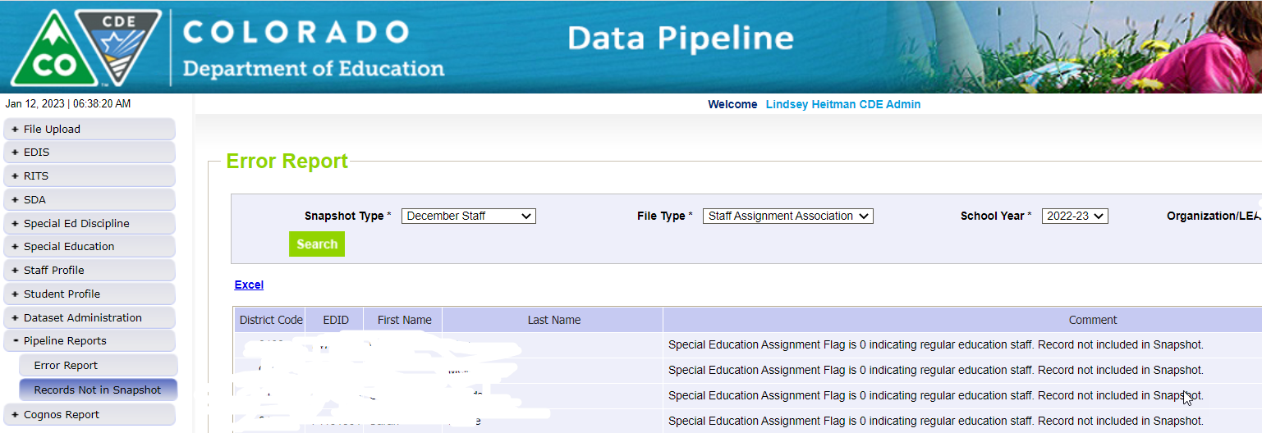
Records not found in Snapshot Report
Due to Criteria Issue
Records that are not in the Included Snapshot Records report may be located in the ‘Records Not in Snapshot’ report for December Staff or December Student
Missing records are broken out by
Student or Staff and file types for each
Pipeline Reports: Records Not in Snapshot

Slide 64
December Count Snapshot Error Exceptions
The Special Education December Count has 5 Allowable Exceptions.
If you receive one of the following errors it will be necessary to send us in an Exception. You may find the template under Additional Links here: http://www.cde.state.co.us/datapipeline/snap_sped-december
Student:
DC104 Age is outside of the min/max range for this grade level.
Staff:
DC033 No Special Education Director was reported.
DC043 No Child Find Coordinator was reported.
DC157 FTE total for an individual is outside of 0.005 and 1.71 allowable range
DC206 TOTAL FTE for an individual is outside of allowable range
Please see the Instructions tab for directions in completing the exception template. Paste the template into your AU # Syncplicity folder and let us know via email to look for it. Once approved, CDE will upload the exceptions and let you know to recreate the snapshot bypassing the business rule for the approved record.

Slide 65
Live Demonstration of Data Pipeline System and Website

Slide 66


