Slide 1
Special Education Discipline
2023-2024
April 15, 2024
Lindsey Heitman
SpedDiscipline@cde.state.co.us

Slide 2
Special Education Discipline
Welcome and thank you for joining this webinar!
Slides and recording will be posted on both webpages:
  Discipline Interchange
  Special Education Discipline Snapshot
Agenda
  Collection overview
  Data collected in Sped Discipline Snapshot
  Breakdown of collection process
  Questions or concerns – Time for discussion

Slide 3
Discipline Interchange and Snapshots
Contact Information
Discipline Interchange- Discipline Action File
Student Discipline Snapshot
Special Education Discipline Snapshot
For Student Discipline questions, email StudentDiscipline@cde.state.co.us
Collection lead is Dawna Gudka Gudka_d@cde.state.co.us
Today we are going to focus on the Special Education Discipline Snapshot Process
For Special Education Discipline questions, email SpedDiscipline@cde.state.co.us
Collection lead is Lindsey Heitman Heitman_l@cde.state.co.us

Slide 4

Special Education Discipline Snapshot
Data pulls from these interchanges to make up the snapshot:
Special Education Discipline Snapshot
Discipline Interchange
Student Interchange
Special Education IEP Interchange
AU Responsibility
District(s) Responsibility
*An Interchange is the data holding place where your data files may be uploaded and validated throughout the school year
*A snapshot is a point in time “picture” of your data extracted from the Interchange files

Slide 5
What Changed from 22-23 to 23-24 in relation to the SpEd Discipline Snapshot?
Discipline Interchange 2023-2024 – now open
  ‘Special Education Discipline Interchange’ changed to ‘Discipline Interchange’
  Discipline Action File layout has changed
    Combined the data elements from the 3 SDA files and the Special Ed Discipline Interchange file into ONE FILE
    District respondents upload one Discipline Action file that includes ALL students
    Data now collected at the student level
  Must have DIS User Role to upload the file
  File should include all disciplinary incidents and resulting actions that occurred between 7/1/2023 – 6/30/2024 (record for each action and associated incident)
  Discipline Action Type Codes for ISS, OSS, and Expulsion have changed from codes 01, 02, 03 to 11, 12, 13
  Cannot mark ‘No Discipline Actions’ for Sped students in Data Pipeline (adding warnings for this at both interchange and snapshot levels)
What hasn’t changed?
Special Education Discipline Snapshot 2023-2024 will open 5/1
  AUs will need the SPI Approver or SPI User role and may start creating snapshots once the district has begun uploading the Discipline Action file
  No change in the data fields that are pulled into this snapshot from the Discipline Action File

Slide 6
Overview of Collection Process
District Respondents – need DIS User role
AU Respondents – need SPI Approver or User SPI role
Upload and validate Discipline Action File containing discipline actions given to ALL students between July 1, 2023 - June 30, 2024
  Record for each student with a reportable disciplinary incident and resulting action
  Records containing active Sped student at time of Discipline Action Start Date will pull into the Sped Snapshot for the following:
    ISS (11), OSS (12), Expulsion (13), Sped Unilateral Removals (01 or 02)
Timeline
  At least one file uploaded by May 8th
  Resolve Interchange errors by June 14th
  Work with AU respondent to resolve Sped Disc Snapshot errors by end of July
Upload and validate Special Education IEP Child and Participation Files for current reporting period July 1, 2023 – June 30, 2024
  One record per student for Sped EOY reporting purposes – report last attendance details occurring in school year
Create Special Education Discipline Snapshots and work with district respondent to validate data and resolve errors
Timeline
IEP files uploaded at least once by May 23rd with data to reflect full school year (files need to be uploaded with Sped EOY focused data, at least once by this date)
IEP files error-free by June 27th
Sped Discipline Snapshot errors resolved by end of July if possible
Submit final Sped Disc Snapshot and signed reports to CDE by no later than August 29th
Collaboration

Slide 7

Special Education Discipline:
Identity Management: Data Pipeline Access
DISTRICT RESPONDENT – DIS GROUP
INTERCHANGE ROLE OPTIONS | ENABLES USER TO:
DIS~LEAVIEWER | read-only access
DIS~LEAUSER | upload files, view interchange level errors
Data Pipeline responsibility breakdown:
Districts (DIS role) upload Discipline Action File
Districts (DIS role) research and resolve Discipline Action File errors and upload corrected file
AUs (SPI role) create Special Education Discipline Snapshot
AUs (SPI) work with districts (DIS) to resolve snapshot errors
*Roles assigned by Local Access Manager (LAM)
*Only 1 role per group per account!
AU RESPONDENT – SPI GROUP
SNAPSHOT ROLE OPTIONS | ENABLES USER TO:
SPI~LEAVIEWER | read-only access
SPI~LEAUSER | create snapshots and view snapshot level errors
SPI~LEAAPPROVER *Need at least 1 | create snapshots, view snapshot level errors, AND approve the final snapshot (by clicking submit to CDE)
Process ongoing until all interchange and snapshot errors are resolved

Slide 8
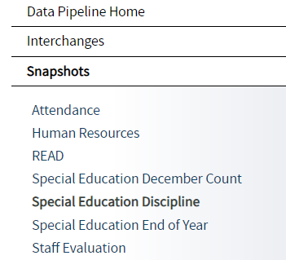
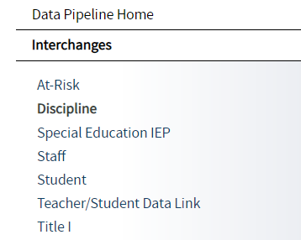
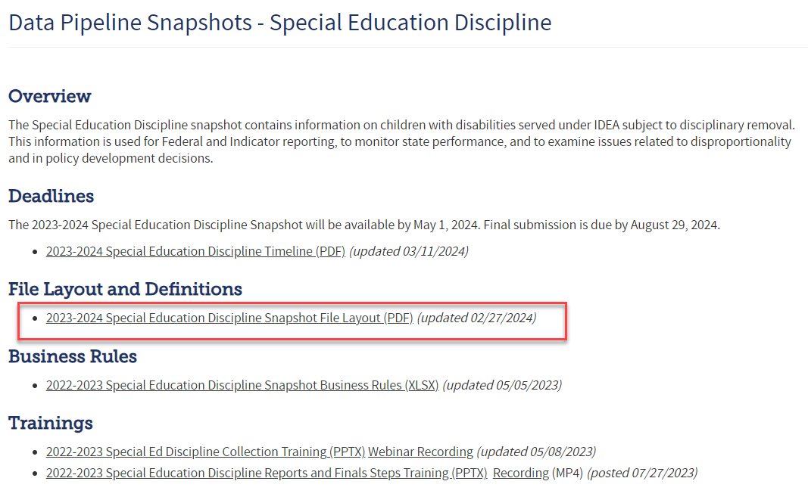
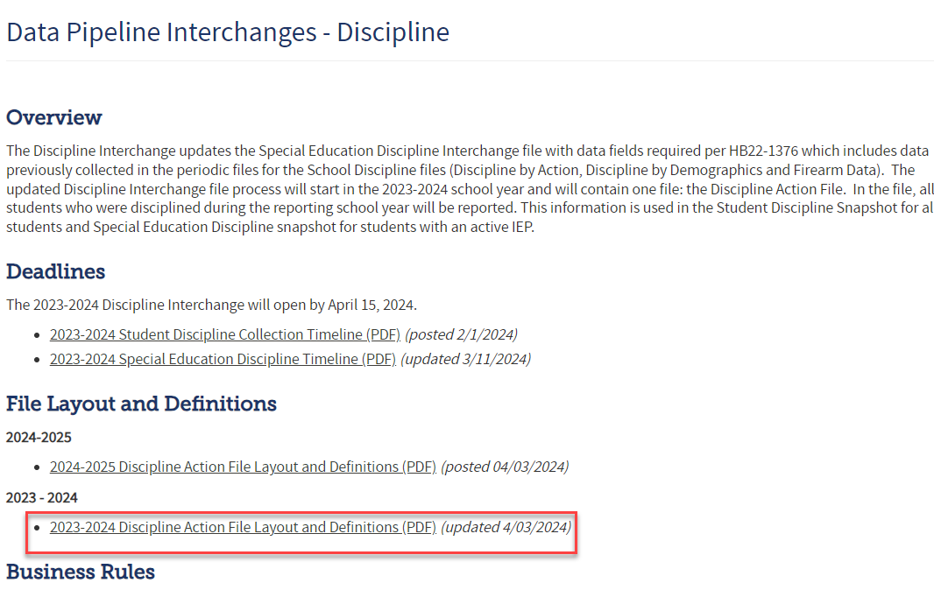
Resource Webpages
Bookmark this link for quick access to the Data Pipeline Collection Resources
Data Pipeline Homepage
Special Education Discipline Snapshot Link
Discipline Interchange Link
The snapshot file layout is where you will find all the data fields that pull into the snapshot and which Interchange and file they pull from.
The interchange file layout and definitions is where you will find all of the data fields collected, their definitions, and code options and definitions

Slide 9
Data Collected in the Sped Discipline Snapshot
Section 618(a)(I)(A)(vii) of IDEA requires that states report to the federal government the number of children with disabilities by race, ethnicity, and disability category who are removed to an interim alternative educational setting or are subject to long-term suspensions or expulsion.
Students with an active IEP at the time of the discipline action/removal that were subject to:
  1. DISCIPLINE ACTION TYPE - Suspensions
    In-School
    Out-of-School
  2. DISCIPLINE ACTION TYPE - Expulsions
    With or without educational services
  3. SPECIAL EDUCATION REMOVAL TYPE - Unilateral Removals by School Personnel to an IAES for one of the following reasons
    Drugs
    Weapons
    Serious Bodily Injury
  4. SPECIAL EDUCATION REMOVAL TYPE - Removal based on a Hearing Officer Determination based on the hearing officer’s determination that maintaining the child’s current placement is substantially likely to result in injury to the child or others.

Slide 10
Special Education Discipline:
How are records pulled into the snapshot?
Criteria:
pull error-free records from Discipline Action file where Special Education Action Flag = 1 AND Discipline Action Type = 11, 12, 13 OR Special Education Removal Type = 01 or 02
Dependencies:
Student has been assigned a SASID and updated in the RITS system
Student has a record in the Discipline Interchange:
  Discipline Action File
Student has a record in the Student Interchange:
  Student Demographic (demographic data) *file must be untagged
  Student School Association (grade level, school code) *file must be untagged
Student has a record in the Special Education IEP Interchange:
  Participation File – Primary Disability, Dates of Entry/Exit to Special Education
  Child File – demographics pulled in rare case that student is missing from Student Interchange
Notes:
The records selected will be joined with data from the Student Interchange- Demographic and Student School Association Files and the Special Education IEP Interchange- Participation file.
For joining to Student Demographic- use District Code, School Year, and SASID.
For joining to Student School Association- use District Code, School Code, School Year, and SASID where Discipline Date >= School Entry Date and <= School Exit Date.
For joining to Special Education Participation- use Admin Unit Code, School Code, School Year, and SASID where Discipline Date >= Date of Entry to Special Education and <= Date of Exit from Special Education

Slide 11
Special Education Discipline Snapshot
Data Breakdown
Discipline Action
Suspensions
In-school (11)
Out of School (12)
Expulsion (with or without services)
(13)
Sped Removal
Unilateral Removal to an *IAES by school personnel for up to 45 days
(01)
Removal by a hearing officer to an *IAES for up to 45 days
(02)
OR
Special Education Removal Reason required-
Incident involving drugs (01), weapons (03), or serious bodily injury (02)
*IAES – Interim Alternative Educational Setting
Received Services During Expulsion (0- No, 1- Yes)
Each record should contain a Discipline OR a Removal. Not both!

Slide 12
Special Education Removal Type
Special Education Removal Type- temporary change in placement to an IAES (determined by IEP team)
01 - Unilateral Removal By School Personnel – school personnel order the removal of child with disabilities from their current educational placement to IAES for not more than 45 school days for drugs, weapons, or serious bodily injury.
  - extreme situation, school personnel made decision without parent consent for a change in placement for typically 45 days.
02 - Unilateral Removal Based on a Hearing Officer’s Determination – impartial hearing officer orders the removal of child with disabilities from current educational placement to IAES for not more than 45 school days.
Interim Alternative Educational Setting (IAES) – An appropriate setting determined by the child’s IEP team or hearing office in which the child is placed for no more than 45 school days. This setting enables the child to continue to receive educational services and participate in the general education curriculum (although in another setting) and to progress toward meeting the goals set out in the IEP.

Slide 13
Discipline Action Length Field
Discipline Action Length must be between a half day and 260 days
Field must end in 0 or 5
should reflect number of actual school days missed within the reporting period of 7/1 – 6/30
  Examples:
  ½ day =0005
  1 days = 0010
  10 days = 0100
  60 days = 0600
  260 days = 2600

Slide 14
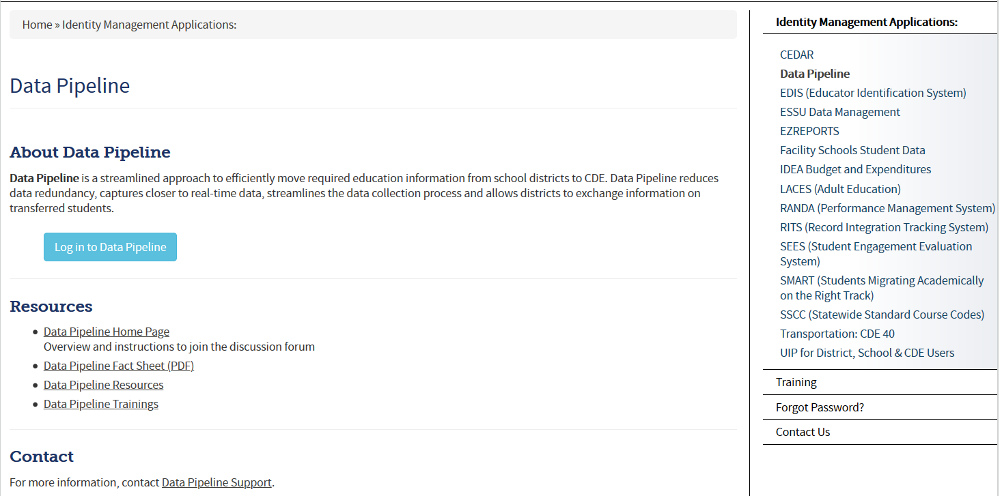
Accessing the Data Pipeline
Bookmark this link: https://www.cde.state.co.us/idm
From link click Data Pipeline to get to this screen.
Next click the blue login button.
*your single sign-on login may be used for all CDE applications listed here that you have access to

Slide 15
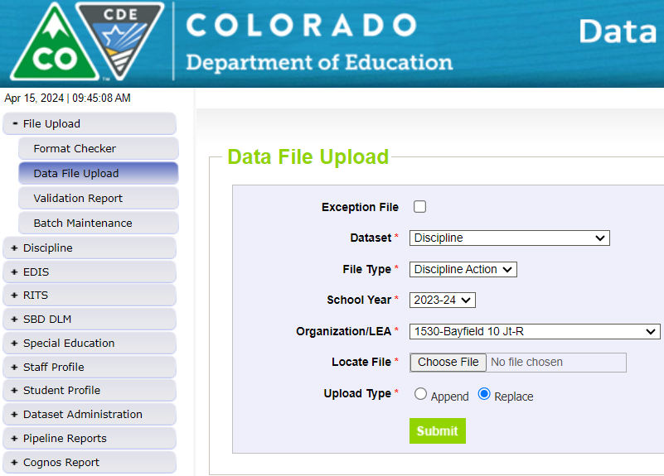
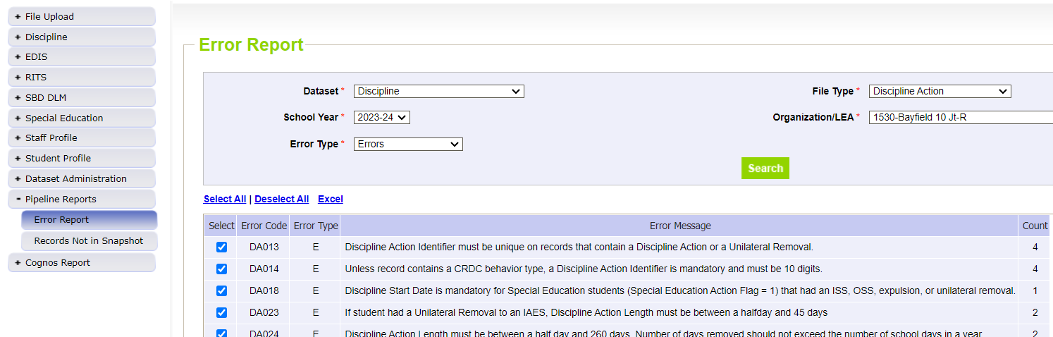
Discipline Interchange Process – District Respondent
District respondents (DIS User Role) upload the files
Click Date File Upload tab →Select Dataset Discipline/File Type Discipline Action to upload the Discipline Action File
Click Pipeline Reports/Error Report to find Discipline Action File Error Detail Report
District respondent (DIS User role)

Slide 16
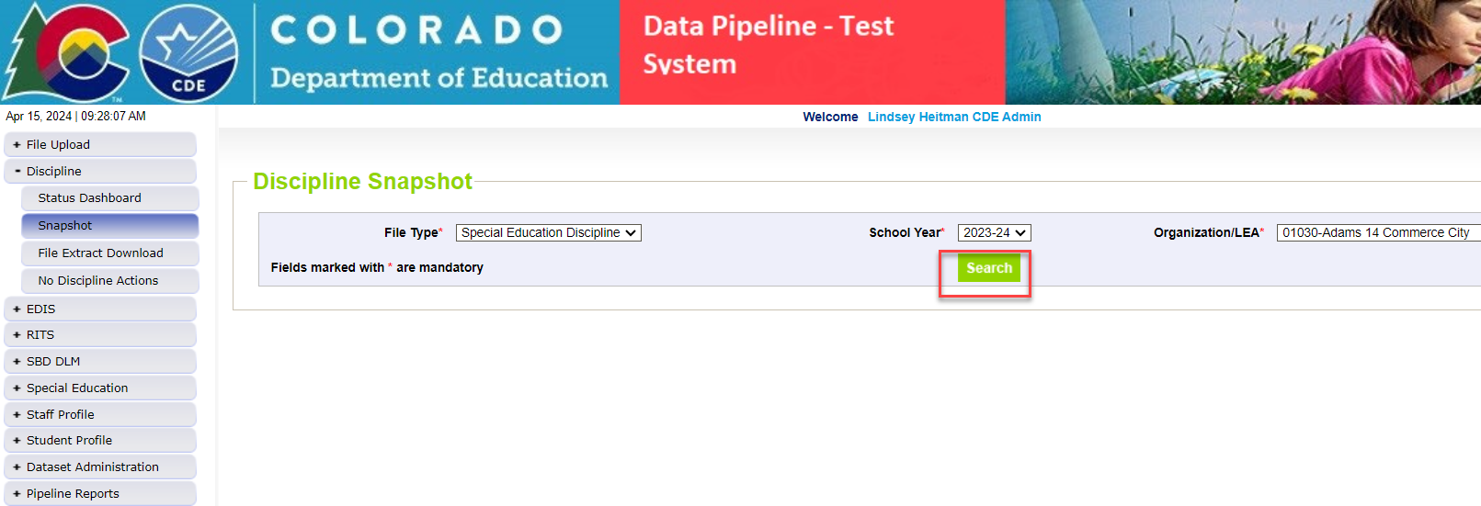
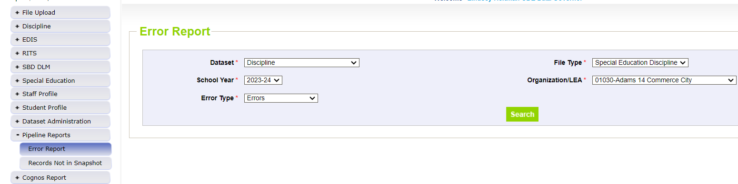
Special Education Discipline Snapshot Process – AU Respondent
AU respondents (SPI Approver or User Role) create the snapshots here
Click Snapshot tab – Select File Type Special Education Discipline, School Year, and Org Code is 5-digit AU code
Click Pipeline Reports/Error Report –> Select Dataset Discipline and File Type – Special Education Discipline
AU respondents (SPI Approver or User Role)

Slide 17
Special Education Discipline
Action Items
District Respondents
  Be sure someone is assigned the DIS User role
  Confirm when vendor updates will be ready and who will be uploading the Discipline Action File for each district
  Reference collection resources (both interchange and snapshots) for an understanding of requirements for each
AU Respondents
  Be sure someone is assigned the SPI Approver role
  check in with member district(s) – person with DIS user role
  Touch base on snapshot collection schedule and timeline (i.e. summer vacations or breaks)

Slide 18

Assistance Needed?
If you have any questions about the Special Education Discipline Data Collection, please feel free to contact us!
Lindsey Heitman SpedDiscipline@cde.state.co.us SpEd Discipline Snapshot Collection Manager
  heitman_l@cde.state.co.us
  (303) 866-5759
Dawna Gudka StudentDiscipline@cde.state.co.us Student Discipline Snapshot Collection Manager
Orla Bolger 303-866-6896 bolger_o@cde.state.co.us ESSU Contact – data content
Josh Fails 303-866-6308 Fails_j@cde.state.co.us ESSU Contact – DMS/reports upload process
Email protocol – please include:
District # and Administrative Unit #
Subject of the email/applicable error codes/school codes referenced

