Slide 1
2024 CMAS and DLM SBD Review Process Training Webinar
Tara Rhodes, Assessment Division
Aislinn Wales, Accountability & Continuous Improvement Unit

Slide 2
Welcome!
As we are getting started:
  Please mute your microphones.
  Cameras have been turned off for participants for privacy reasons.
  This session will be recorded and posted to the SBD collection webpages as soon as possible after the session ends.

Slide 3
Outline
Presentation Outline:
General Information
  Purpose
  Collection Timeline
  Role Assignments in Identity Management (IdM)
SBD Step-by-Step Guide
Additional Resources
Deeper Dive into CMAS and DLM
Accountability Implications
Time for Questions

Slide 4
SBD: Purpose
The Student Biographical Data (SBD) Review Process provides districts with an opportunity to verify the accuracy of student data after testing but prior to reporting and accountability calculations.
This process is completed for the following four assessments:
  WIDA ACCESS for ELLs Assessment
  CMAS Assessments
    -ELA/Math (including CSLA) and Science
    -CoAlt Science
  CO PSAT/SAT
  CoAlt ELA/Math via Dynamic Learning Maps (DLM)

Slide 5
SBD: General Process
Vendors provide portals for district use prior to and during testing.
Test Administration
Data used in SBD windows comes from vendors post-test administration.
Notes:
For each collection:
1. Data used in the SBD review process comes from the vendor system after testing.
2. Most vendors provide portals for districts to use to validate data prior to testing.
3. The SBD review process can be used to validate/update student information that is not in the vendor portal. One example is SASID validation.
4. The SBD review process is not required BUT is highly recommended because inaccurate data can impact accountability.

Slide 6
SBD: Collection Timelines
 | Assessment | Dates | Data Pipeline Group
1 | ACCESS for ELLs | 3/11/24-3/20/24 | ACC
2 | CO PSAT/SAT | 5/15/24-5/22/24 | SAT
3 | CMAS ELA/Math (including CLSA) and Science CoAlt Science | 5/16/24-5/29/24 | CMS
4 | CoAlt: ELA/Math (DLM) | 5/29/24-6/5/24 | DLM

Slide 7
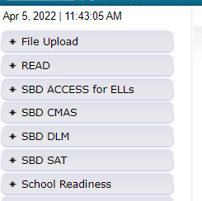
SBD: Group Role Assignments
You can learn whether you have access to the collections by logging into Data Pipeline and reviewing the gray boxes on the left-hand side.
If you do not have access to the collections, please reach out to your district’s local access manager (LAM). Please ensure that the APPROVER role is assigned.
CDE cannot provide access for district users.
Collection | Data Pipeline Group
WIDA ACCESS for ELLs | ACC
CO PSAT/SAT | SAT
CMAS: ELA/Math CoAlt: Science | CMS
CoAlt: ELA/Math (DLM) | DLM
The table to the left shows the group code for each SBD collection (also provided on Slide 5).
Notes:
If you are unsure of who your LAM is, please reach out to me, either through my email or to the SBDSupport inbox and I can help you locate that person.

Slide 8
SBD: Support Email/Phone
SBD support is available by phone or email
  CDE has a team that responds to emails and to phone calls. Please use the SBD Support phone number and email address. Do not contact a specific person at CDE or the general CDE Helpdesk.
  This provides a single point of contact for all collections.
  Emails create support tickets that can be tracked to ensure that questions are answered quickly. Remember: DO NOT send student personally identifiable information (PII) by email!
  Members of multiple CDE units are available to answer different questions (Assessment, Accountability, and Information Management Systems).
Phone Number: 720-696-0185
Email address: sbdsupport@cde.state.co.us

Slide 9
SBD Review: Step-by-Step Guide

Slide 10
Overview of SBD Steps
1. Review SBD Manual
2. Log into Data Pipeline
3. Download a Vendor SBD Extract
4. Upload Vendor SBD Extract
5. Review Data Errors and Warnings
6. Correct Data Errors and Warnings*
7. Complete Data Validation
8. Submit Final SBD Data
Step 6 could include multiple uploads into Data Pipeline, although the primary amount of this work is done in the downloaded document in your chosen program (Excel, etc).
Step 7 could include pulling reports out of Data Pipeline.

Slide 11
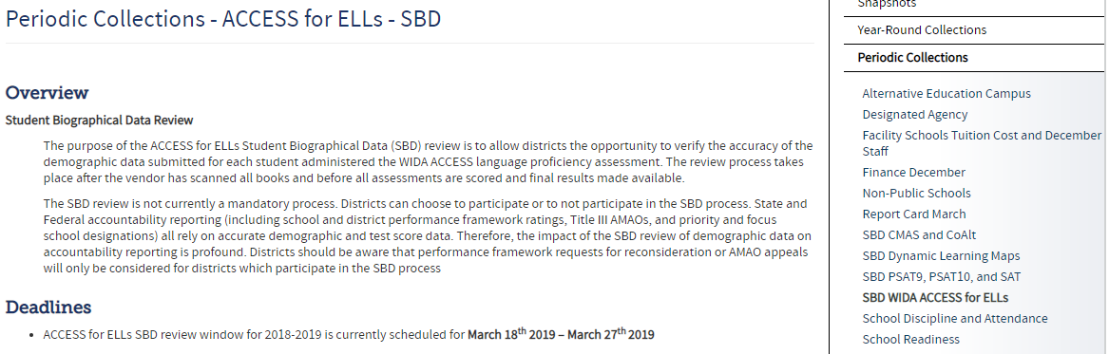
Step 1: Download the SBD Manual and Collection Specific Information
Please download the SBD Manual and collection specific information.
  Link for Manual: SBD Manual 2023-24
    The manual provides a detailed, step-by-step process with screenshots on how to complete the four SBD collections.
  Link for collection specific information: Data Pipeline Collections Website
    Please download and review:
      SBD File Layout (includes specific instructions for each field)
      Business Rules (includes how to resolve errors)
      Training materials (including the SBD Manual)

Slide 12
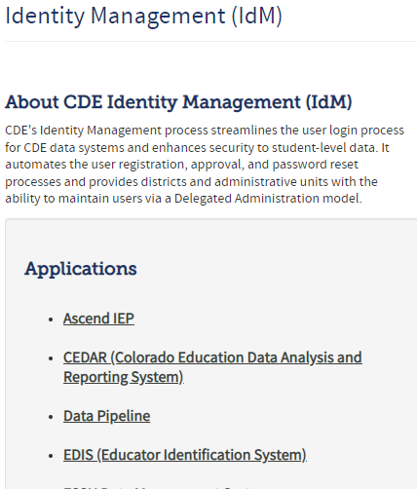
Step 2: Log in to Data Pipeline
On the Identity Management website, select “Data Pipeline” under Applications on the left side of the screen.
Enter your username and password
Check to ensure:
  There is no red banner at the top of the screen
  Your user role is correct
  The collection you are working on appears on the left side of the screen
Most log-in issues must be handled by your LAM.

Slide 13
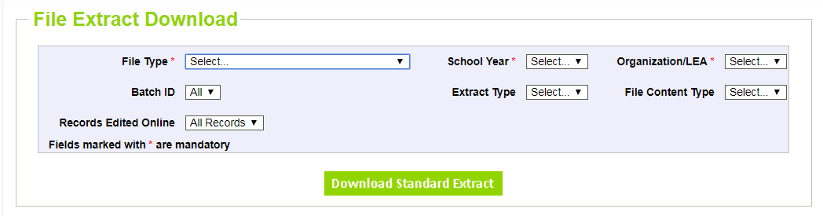
Step 3: Download a Vendor SBD Extract
Navigate to the collection tab along the left-hand side.
Select “File Extract Download” for the appropriate assessment.
Make the following selections:
  File Type: Vendor File
  Extract Type:
    SBD Extract – Vendor demographic data (CMAS only)
    SBD Extract using Student Profile – Student Interchange demographics
  File Content Type:
    Excel: If you are using Excel for data review, use this option and not the .csv format
    CSV: Comma delimited
    Text: Fixed format

Slide 14
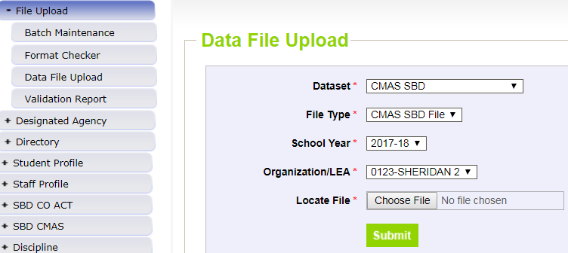
Step 4: Upload Vendor SBD Data Extract
Upload back into Data Pipeline prior to editing the file
  Allows access to COGNOS reports
    Error Summary
    Error Detail
  The number of errors found can help guide data clean up and give a sense of how much work needs to be done on the file
  Activates the Edit Records screen
This is done by:
  Select “File Upload” tab -> Data File Upload
  Choose file and submit
  Emails:
    Submission Notification
    File Upload Summary

Slide 15
Step 5: Review Errors and Warnings
The number of errors and warnings are available in two places:
  Error Report under “Pipeline Reports” along the left-hand side
  COGNOS Error Summary Report under “Cognos Reports”
Identifying specific records with errors can be done in three places:
  COGNOS Error Detail Report
    Download as an Excel file to review
  Pipeline Report – View Details
    Same layout as the Error Detail Report
  Edit Records Page
    Choose records with errors and warnings
    Fields with errors will be red; warnings will be yellow

Slide 16
Step 6: Correct Data Errors
Method 1: Correcting errors using the Vendor SBD Extract File
  Open the vendor file in your chosen program
  Update data in records with errors
    Start with SASID errors
    Use the Data File Layout with field definitions and the Business Rules documents to figure out how to correct the data
      Business rules will explain errors. For example, “Date First Enrolled US cannot be blank”.
  Upload the file periodically and re-run COGNOS reports to check your progress
    Once you are down to just a few errors, it may be faster to use the Edit Records screen

Slide 17
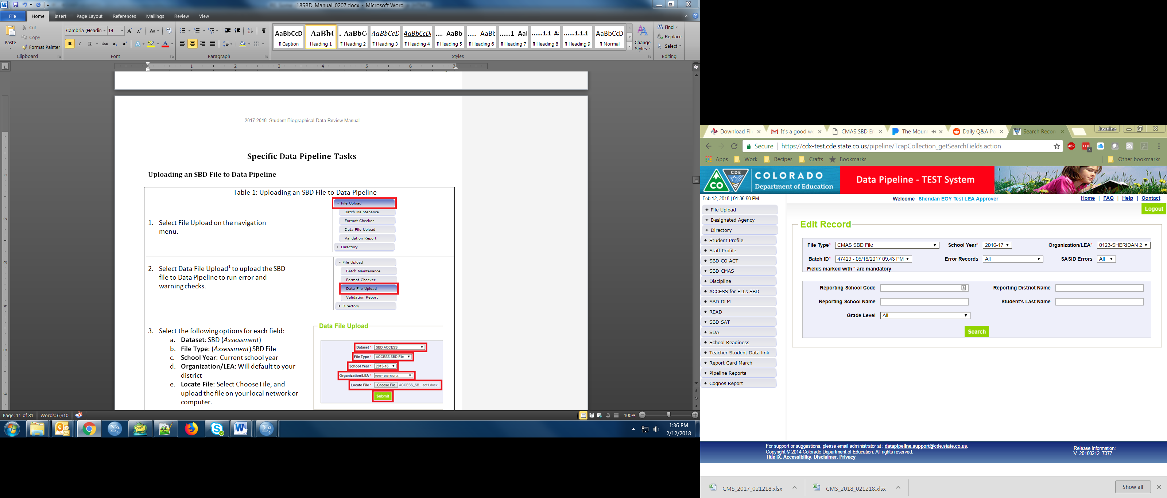
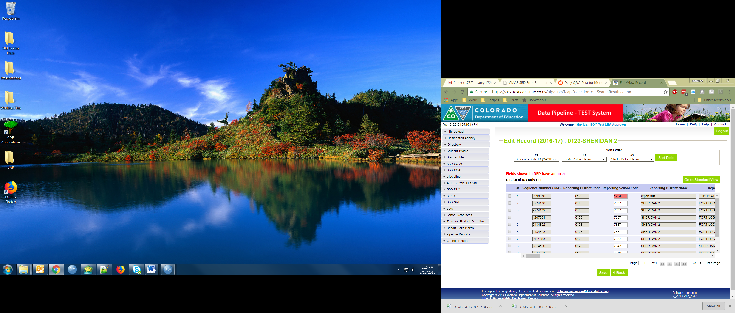
Step 6: Correct Data Errors (Continued)
Method 2: Correcting errors using the Edit Records page
  On the Edit Records page, select the appropriate drop downs
  Check the box next to record you would like to edit
  Correct the data in the fields highlighted in red
  Make sure that the box along the left-hand side is checked, and then click “Save” to save the edits

Slide 18
Step 7: Data Validation
Data Pipeline can only check for certain types of errors
  It cannot check that your demographic data are accurate (i.e., a student is actually Hispanic or not)
  It cannot validate that students have the correct invalidation
    The Data File Layout will have instructions for how to select the appropriate invalidation
Do not change/make up data just to clear errors!
  If you have a lot of missing data, check a different extract
    Maybe the interchange data or vendor data are better
  Making up data can cause issues with reporting and accountability
  If you have an error that cannot be cleared but the data are correct, contact SBD Support.
Warnings
  Warnings are used to inform users of situations that may indicate, but not necessarily are, issues with the data (such as an unusually low or high percent of the student population classified in a particular category)
  Warnings do not prevent data submission, but Errors do

Slide 19
Step 7: Data Validation (Continued)
Download the COGNOS SBD Summary Report
  Compare your district summary numbers to last year’s final data
    Large changes in the number of students in a category could indicate a coding error or incorrect data submitted to the Interchange or vendor system
  Review Invalidations
    Check for students who were invalidated who may have scores
    Check that Parent Excuses are correctly applied
      CMAS has a calculated invalidation code to combine all the different fields that go into determining the invalidation.
      For DLM, some districts have chosen not to apply Parent Excuses in the vendor system. Make sure to review with your DAC if you are expected to add these during SBD.

Slide 20
Step 8: Submit SBD Data
Download your final SBD extract for your records through the File Extract Download option
  This is especially important if you use the Edit Records screen
Select “Status Dashboard” under the appropriate assessment collection
Review the data on the Status Dashboard to make sure you are ready to submit
  Validation Errors and RITS Errors must be zero unless you have contacted SBD Support specifically to ignore errors
  If errors are ignored, you must submit without making any additional changes or uploading a new file or it will reset the ignore errors status
Click “Submit to CDE” and “Yes” in the pop-up window
If you need to make additional changes after submission, please contact SBD Support to unlock your data. This can be done until the end of the window.

Slide 21
Troubleshooting
See the SBD Manual for common issues and trouble shooting techniques
Users generally have issues at three different points in the SBD process:
  Logging in to Data Pipeline
    Generally these issues must be resolved by the district LAM.
    CDE cannot change or grant user permissions.
  Uploading a Data file
    This is usually an issue with the file format. See the manual for common issues and how to identify them.
  Clearing Errors
    Usually the Data File Layout and Definitions and Business Rules documents are enough to identify why an error is occurring.
    If you think an error is triggering incorrectly, contact SBD Support.

Slide 22
Moving Students
All SBD collections allow a district to move students between schools within their district
Moving between districts is a collection specific process
  CMAS – submit a failsafe document to CDE through Syncplicity
  DLM – Do not send a failsafe document
    The SBD layout includes the Responsible and the Testing School
    Responsible school is updateable
    If you are moving a student out of your district, contact the receiving district to make sure that they are aware of the student and agree to the move (CDE will also verify moves against RITS and Interchange data)

Slide 23
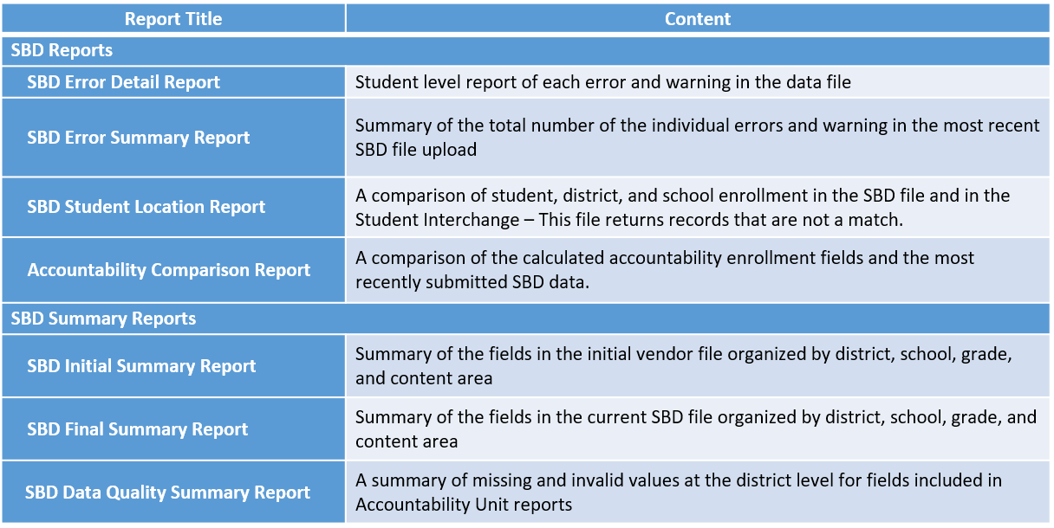
COGNOS Reports

Slide 24
Additional Resources

Slide 25
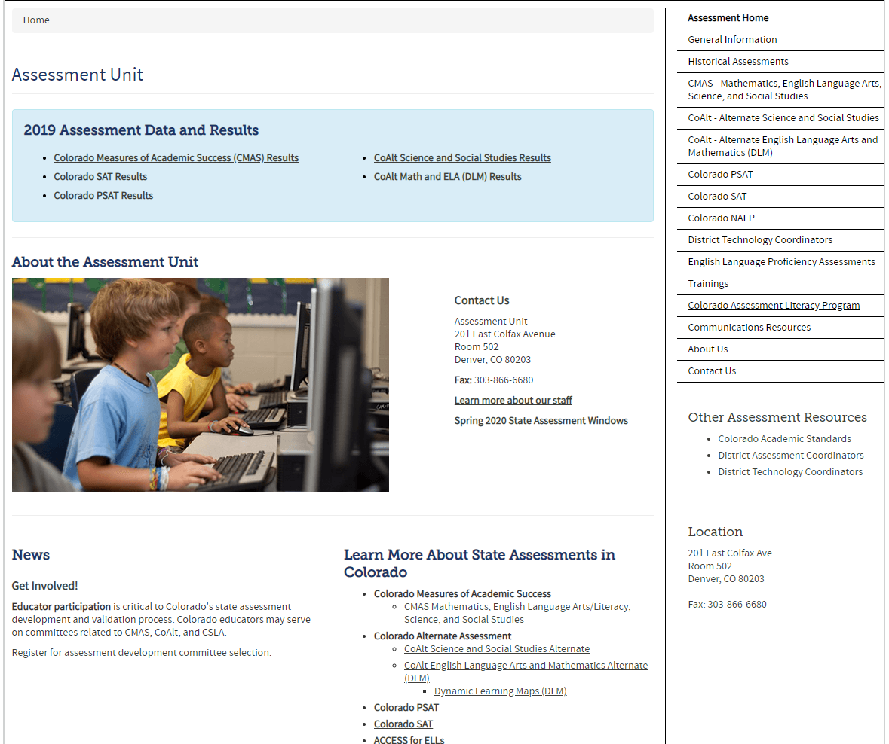
Assessment Division Homepage
https://www.cde.state.co.us/assessment

Slide 26
Invalidation Instructions
Instructions for applying invalidations during SBD are in the File Layout and Definitions documents.
There are also instructions for applying invalidations in the assessment materials with details on the appropriate uses of each code:
  CMAS Procedures Manual
    https://www.cde.state.co.us/assessment/cmas_coalt_proceduresmanual_sp24
  DLM – DLM Special Circumstance Codes
    http://www.cde.state.co.us/assessment/dlmspecialcircumstancecodes

Slide 27
Deeper Dive:
CMAS SBD Specific Fields
(CMAS and CoAlt: Science)

Slide 28
CMAS: Changes for 23-24 Collection
Coding adjustments:
  The gender field was updated to include a third category of “03” (Nonbinary).
  References to the Grade 8 Science assessment were changed from “SCMSS” and “SCMSA” to “SC08S” and “SC08A”, respectively.
  References to the Grade 11 Science assessment were changed from “SCHSS” and “SCHSA” to “SC11S” and “SC11A”, respectively.
  An additional code was added to the Calculated Invalidation Code field: “11-Extenuating Circumstances”.
Notes:
I also wanted to provide some more information about the new 11-Extentuating Circumstances code. This is for students who are new to the United States after the October Count date and are a NEP/LEP Student with Limited
or Interrupted Formal Education. The definition we are using for students with limited or interrupted formal education means that the student either did not have formal schooling (or very limited formal schooling) in their prior country or had an interruption in their formal education due to war, civil unrest, migration to the U.S., or limited access to school resulting in less time spent in formal schooling in their prior country compared to similarly-aged peers in the United States. The file layout has more detail around this code as well as specific examples to help guide and inform the use of this code.

Slide 29
CMAS: Changes for 23-24 Collection (Continued)
Business Rules:
  Business rules have been updated to reflect the coding adjustments for the gender, calculated invalidation code, and test code fields.
  An additional business rule has been added to the Not Tested Reason field around the “9-Parent Excuse” code. If a “9-Parent Excuse” code is entered into the Not Tested Reason field but the student has answered at least one question in all three of the unit tests, the business rule will trigger and provide an error.

Slide 30
Accommodation Type Used
Accommodation Type Used
  Certain accommodations used on the CMAS assessments are tied to the student having an IEP or being a multilingual learner (ML). The Pearson system will not allow changes to these fields if a student is registered for an accommodation
  This field is not updateable, but it shows you if a student was registered for an accommodation:
    IEP/504 – Student had an accommodation that requires an IEP/504
    ML - Student had an accommodation that requires NEP or LEP status
    Both – Student had multiple accommodations requiring both IEP and EL
    Either – Some accommodations can used for either status (i.e. Extended Time)
  If you try to change IEP/504 to blank or Language Proficiency to 0 when they had an accommodation as indicated, it will cause an error
  If a student truly was misidentified during testing and should not have received an accommodation, contact SBD Support to review the record and determine the appropriate course of action
    The records may need to be invalidated or suppressed

Slide 31
Grade
Grade
  A student’s grade cannot be updated in the Pearson system
    Any grade changes will only be reflected in CDE Accountability data. It will not change in any Pearson provided reports or data files.
  If the student completed a test (Attemptedness = ‘Y’) in the wrong grade based on their grade at the time of testing:
    Contact SBD Support to ignore errors to allow the grade change
    If the student is still in a grade that should have been tested, then a Report Suppression code of “Misadministration” will be applied
    If the student is no longer in a grade that should have tested (e.g. 2nd or 9th grade) then an accountability exempt Report Suppression will be applied post-SBD
    In both cases, the student will still receive a Student Performance Report if they tested
  If the student did not test (Attempt Status = ‘Assign’ or Attemptedness = ‘N’)
    Apply an appropriate invalidation (Misadministration or Took Other Assessment)
    You may choose not to update the grade in this case

Slide 32
Test Status and Attemptedness
Test Status
  Assign – Student was assigned a test but did not take it
  Attempt – Student began testing and either completed the test or was marked complete at the end of the session
    Attempt status does not mean that the student will receive a score
Attemptedness
  Y – Student responded to enough items to receive a score
  N – Student began the test but did not complete enough items to receive a score
  Blank
    If Test Status is ‘assign’, then attemptedness will be blank
Notes:
Rare situation:
If Test Status is ‘attempt’, then the student test has not been processed by scoring and this could be N or Y in the final data. However, this only happens with paper records.

Slide 33
Not Tested and Void Score Reason
Not Tested Reasons apply to records that are in “Assign” test status
Void Score Reasons apply to records that are in “Attempt” test status (ignoring Attemptedness)
  Applying a Void Score Reason will prevent the student from receiving a score even if they completed the test
Available codes are the same in most cases:
  00 - Absent is only valid as a Not Tested Reason
  02 - is ‘Newcomer to US’ (only for ELA) as a Not Tested Reason and ‘Interrupted not Completed’ as a Void Score Reason
  03 - Records for students who withdrew from the district before or during testing should be coded as 03
  05 - is ‘State use only’ as a Not Tested Reason and ‘Non-approved Accommodation’ as a Void Score Reason

Slide 34
Parent Excuse
Parent Excuse
  If Parent Excuse is indicated as a Not Tested Reason, but the student test is in Attempt Status, then it will not be carried through as the final invalidation
    Some schools create “Parent Excuse Test Sessions” and then mark all the tests complete which puts them in Attempt Status incorrectly. In this case, the Parent Excuse will have to be indicated as a Void Score code instead of an invalidation code.
  Before updating Void Score Reason to Parent Excuse, check to see if Attemptedness = ‘Y’
    If a student completed the test, then they should not be voided as a Parent Excuse
    A parent excuse code will not be processed and will not appear in the final data if the student responded to all 3 units (2 units for grade 11 science)*
    If CDE finds multiple incidences of this in your final submitted SBD data, we will contact the district DAC and may revert the records to Valid Scores
    *In the rare case that a parent excuse was received while a student was participating in Unit 3 (Unit 2 for grade 11 science), contact CDE.

Slide 35
Report Suppression Codes
Report suppression codes allow a student to receive their individual report while suppressing their scores in certain situations.
  Suppression codes can only be applied by CDE
  Misadministrations reported during testing will already be applied prior to SBD
  Some can be reported during SBD by changing certain data fields and the suppression fields will be updated after SBD
Code Number | Explanation
01 | Student is home schooled and will have a Report Suppression Action of 05. To have CDE apply this code to a record, change the Reporting School code to ‘HHHH.’
03 | Student was not supposed to take a CMAS test because they are in a grade that takes a different assessment.
06 | Used for misadministrations caused by registration errors (e.g., text-to-speech for ELA, taking the wrong test for their grade). Misadministrations from student misconduct should be indicated through the Void Score Reason field. This code was applied according to discussions with CDE.

Slide 36
Calculated Invalidation Code
Calculated Invalidation Code
  Combines Test Status, Attemptedness, Not Tested Reason, Void Score Reason, and Report Suppression Code to show which invalidation will be assigned to the record
  The SBD Layout document covers all available options and how to change them if they are not what you are expecting
  The most common issue is Not Tested Codes assigned by the school and not updated to Void Score Codes if the test session was started (either by a test administrator or the student)
  Codes based on Report Suppression Codes cannot be changed during SBD. Contact SBD Support if you think these have been applied incorrectly or were missed.
    Home schooled students will be coded automatically after SBD if their responsible school is changed to HHHH

Slide 37
Deeper Dive:
DLM SBD Specific Fields
(CoAlt: ELA/Math)

Slide 38
DLM: Changes for 23-24 Collection
Coding adjustments:
  The gender field was updated to include a third category of “03” (Nonbinary).
  Two additional codes were added to the Special Circumstance Code field:
    10002 – Extenuating Circumstances
    13830 – Newcomer ELA exemption
Business rules have been updated to accommodate these adjustments.

Slide 39
Accountability School Identifier
Responsible District and School Codes
  This is the district and school where the student should be counted for accountability purposes
  Both are updateable in SBD
    If you are changing the Responsible District, be sure to confirm the move with the receiving district
  School must be a valid school with a school number, not a district or BOCES program unless that program has a valid school number

Slide 40
Grade and Race/Ethnicity Fields
Grade Field:
The student’s grade cannot be updated during SBD.
  If a student tested in the wrong grade, they should be invalidated using 13836 – Misadministration
Race/Ethnicity Fields:
  Race fields have been updated to match other CDE collections rather than using the vendor codes.
  Fill out the individual fields as usual.
  The calculated Federal Race and Ethnicity field has been removed from the layout.
  A summary of the calculated field is still available in the Final Summary report in COGNOS.

Slide 41
Primary Disability and IEP
DLM is a test specifically for students with the most significant cognitive disabilities.
All students must have an IEP and a Primary Disability assigned.
If Primary Disability is missing and you do not have it documented that the student should have taken an alternate assessment, please contact SBD Support.

Slide 42
Special Circumstances Code - Invalidations
Special Circumstances Code
  DLM collects invalidations as “Special Circumstances Codes”
  These are entered in the system on the test administration page by test so they may vary in ELA and Math records
  In some districts, teachers may not have entered Parent Excuse codes if they did not complete the student information necessary to get a test assigned to the student
    In this case, the Parent Excuse codes may have been sent to the DAC to be entered during SBD
  If a record is given a Special Circumstances Code, the student will not receive a report for that subject

Slide 43
Questions and Discussion
Questions?
Please feel free to unmute or use the chat box.

Slide 44
Accountability Implications

Slide 45
Why should districts participate in the SBD review?
Districts are highly encouraged to participate in SBD because:
Student test records are used to calculate school plan types (e.g., Performance, Turnaround) and district accreditation ratings (e.g., Accredited with Distinction, Accredited with Turnaround Plan)
Student test records are used to identify schools under Every Student Succeeds Act (ESSA) as Comprehensive Support (CS), Targeted Support (TS), and Additional Targeted Support (ATS)
The request to reconsider (R2R) process cannot be used to address district reporting errors that should have been corrected during SBD (i.e., miscoded parent excusals cannot be appealed).

Slide 46
Major Impacts on Accountability
Students may be excluded from achievement, growth, & participation calculations
State accountability ratings can be decreased due to participation
Schools may be identified due to participation under the federal accountability process
For federal accountability, a school that is not already identified as CS, TS, or ATS can be identified “Due to Participation” based on non-participants in excess of 5 percent.
Low total participation rates are added as a descriptor in performance frameworks
Test administration and student demographic codes impact which students are included in accountability calculations. Assessment student data fields used for accountability exclusion rules include ‘Continuous in District’, ‘Continuous in School’, ‘Language Proficiency’ combined with ‘Date First Enrolled in US’, ‘Expelled’, and ‘Not Tested Reason.’
A school/district’s rating can be decreased due to participation. This occurs when the accountability participation rate (parent excusals are excluded) is below 95% in English language arts and math*.
Schools/districts below 95% total participation in English language arts and math are noted on the performance framework to indicate that the results may not be representative of the entire student population. The plan type is not impacted by this participation descriptor.
* For the official 2024 plan types, science results are not included or factored into participation calculations.

Slide 47
Lessons Learned
Complete SBD to ensure your district’s student test records are error free and accurate.
Collect, document, and report all parent excusals and student accommodations.
Reconcile any student transfers (between schools or out of district) that occur after October Count.
Do not make up data or give all students the same value to clear errors.
If there are persistent errors, make sure your district’s data respondents, assessment coordinators, and accountability contacts communicate to address any issues.
Contact CDE with any questions or concerns.

Slide 48
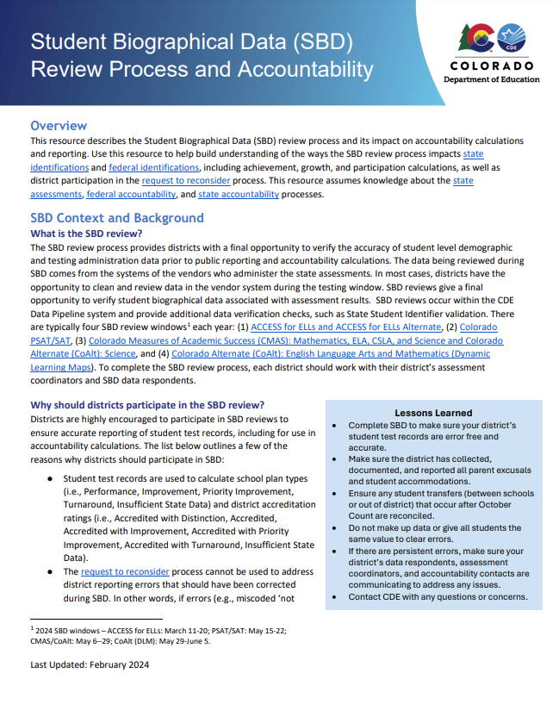
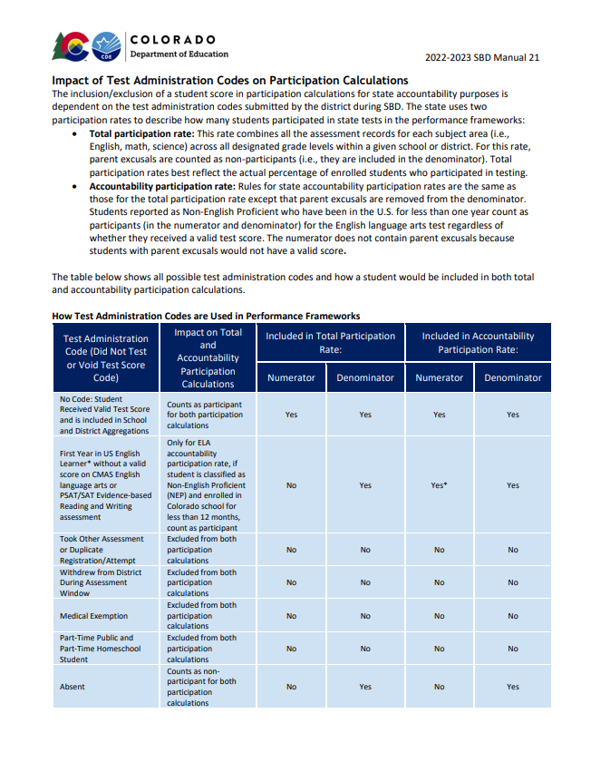
Resources
SBD and Accountability Fact Sheet
SBD Manual – beginning on pg. 19
Other 2024 Accountability Resources:
https://www.cde.state.co.us/accountability/accountability-resources

Slide 49
Questions and Discussion
Questions?
Please feel free to unmute or use the chat box.

Slide 50
Contact Information and Resources
Please contact SBD Support with any technical SBD questions:
Email: sbdsupport@cde.state.co.us
Phone: 720.696.0185
For state accountability questions, Email: accountability@cde.state.co.us
For federal accountability questions, Email: ESSAquestions@cde.state.co.us
Data Collection Webpages:
PSAT/SAT: https://www.cde.state.co.us/datapipeline/per_sat
CMAS: https://www.cde.state.co.us/datapipeline/sbd-cmas
DLM: https://www.cde.state.co.us/datapipeline/dynamiclearningmapssbd
SBD Manual Link:
https://www.cde.state.co.us/datapipeline/2024_sbdmanual

