Slide 1
Special Education End-of-Year
2022-2023
Report Review and Final Steps Training

Slide 2
Special Education End of Year (EOY) Reports Training
  Welcome to the Special Education EOY Reports Training
Data Pipeline Submission
    Lindsey Heitman SpedEndofYear@cde.state.co.us (303) 866-5759
Special Education Content
      Orla Bolger bolger_o@cde.state.co.us
Data Management System
      Josh Fails fails_j@cde.state.co.us

Slide 3
Agenda
Special Education End-of-Year
Purpose/Timeline
Error Reports
Detail Reports
Signature Reports
Year-to-Year Flag Explanations
Uploading Reports to the Data Management System (DMS)

Slide 4
Purpose and Content
State Performance Plan/Annual Performance Report (SPP/APR) Indicators 1, 2, 11, and 12
  Indicator 1: Graduation – Percent of youth with Individualized Education Programs (IEPs) exiting special education due to graduating with a regular high school diploma.
  Indicator 2: Dropout – Percent of youth with IEPs who exited special education due to dropping out.
  Indicator 11: Percent of children who were evaluated within 60 days of receiving parental consent for initial evaluation.
  Indicator 12: Part C to B Transition - Percent of children referred by Part C prior to age 3, who are found eligible for Part B, and who have an IEP developed and implemented by their third birthday.
Special Education Fiscal Advisory Committee (SEFAC) CRS 22-20-114
Reporting Period: July 1, 2022 – June 30, 2023
Link to CDE webpage- State Performance Plan/Annual Performance Reports – Please read!

Slide 5
Special Education EOY – Deadline Today!
Thursday, September 7: Complete Snapshot – all errors resolved (except SY260)
Remaining Timeline:
Date | Task
9/8 -9/15 | Initial Report and Warning Review: Director/Data Respondent review signature and detail reports *signatures and submission to CDE are not needed until the final report review (after duplicates are resolved)
9/18 – 9/22 | Resolving Duplicates (Error SY260/Duplicates Cognos Reports) and Date Validity Issues: Resolve records that are being reported by your AU and another AU on the same date *All changes made, and errors cleared by Monday 9/25
9/25-9/29 | Final Report Review Week: Print new reports following your final EOY Snapshot to ensure the reports reflect the current data
9/29 | Final EOY Snapshot Complete
9/29 | Final Data File Approval and Reports Due: EOY Snapshot due through electronic submission to the Data Pipeline and Signed reports uploaded to the Data Management System
Note: 23-24 Special Education IEP Interchange will not open until October 1st

Slide 6
EOY Last Steps
All Errors Resolved
9/7/2023
Initial Report Review
Week
9/8-9/15
Signed Reports Uploaded to the DMS/Approve Snapshot in Data Pipeline
9/29/2023
Final Report Review Week
9/25-9/29
Duplicates Resolved, CDE runs data validity checks 9/18-9/22
All File Changes Due 9/29

Slide 7
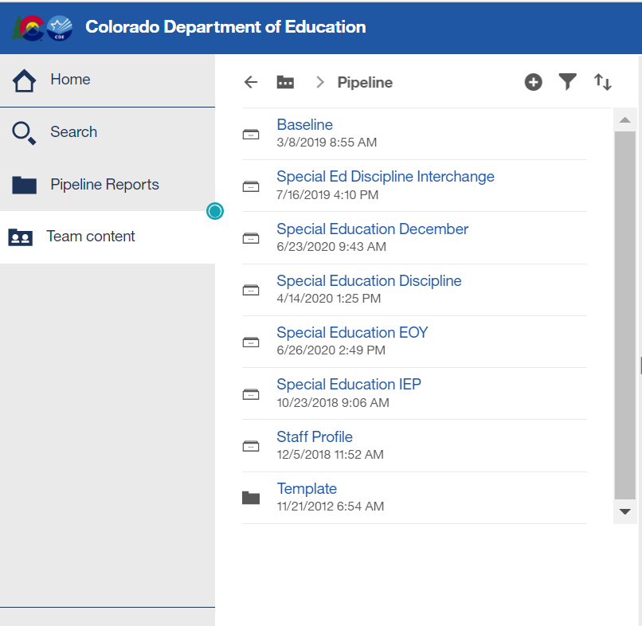
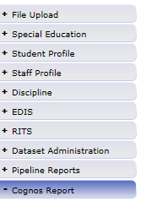
Where to Find SPED EOY Reports
From Single Sign On → select Data Pipeline → Click Cognos Report → Special Education EOY:

Slide 8
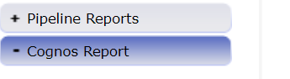
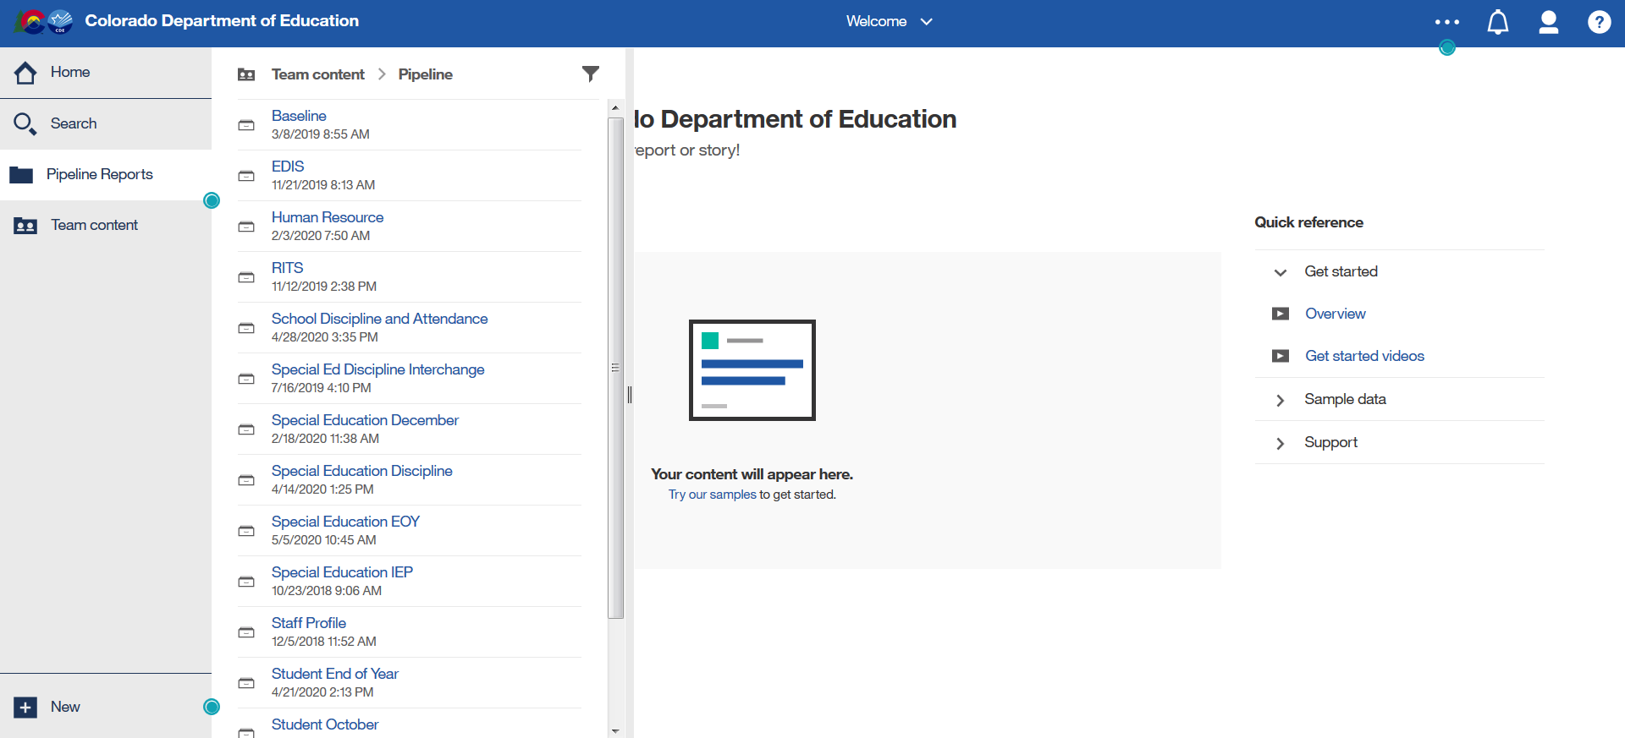
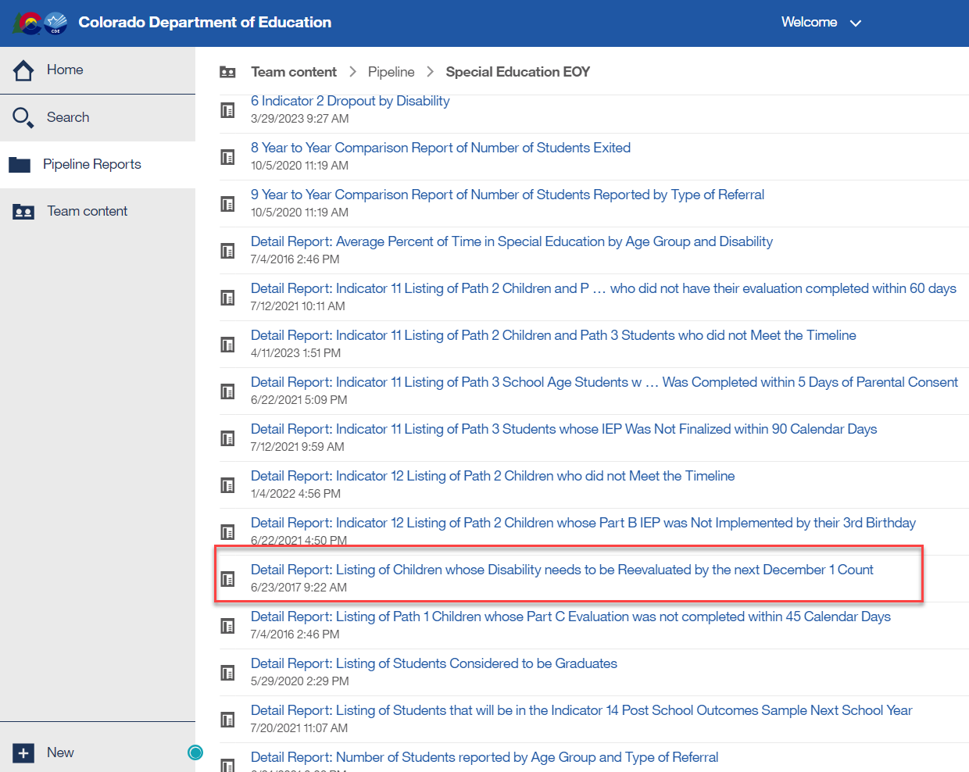
Special Education EOY:
Cognos Reports CAUTION
Do not use Search feature to pull up reports!
Do not click a report listed in the white screen under ‘Recent’ and not in the actual folder. You must download new reports every time for the most up to date data.
1.
2.
3.
*Be sure to always download Cognos Reports from the actual folder. Follow these steps and double click on the name of the report to download it

Slide 9
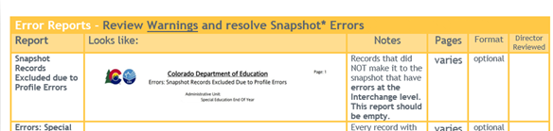
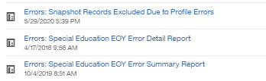
Available Error Reports
Note that slides are color coded to the checklist
Error Reports (3) - view errors in detail.
  Errors: Snapshot Records Excluded Due to Profile Errors -
  records that did NOT make it to the snapshot that have errors at the INTERCHANGE level.
  Errors: Special Education EOY Error Detail Report –
  records with an error or warning at the SNAPSHOT level.
  Errors: Special Education EOY Summary Report –
  count of errors and warnings by code and description at the SNAPSHOT level. Directors may want to start with this report.

Slide 10
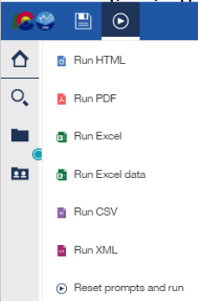
Reviewing and Downloading Error Reports
You can view the errors and the records receiving the error on-line in the browser or you can download the report as PDF, HTML, or Excel.
Be sure to choose the “Excel” Option if you prefer Excel.
Remember if you are reviewing the report in the browser, hit page down to see the next set of records and their errors.
FIXING ERRORS
Once you know what records have which error: go to the source, make a correction, upload the new interchange file into the Data Pipeline and then create a snapshot.

Slide 11
Key Warnings – Please Check
SY263 - This Path 3 student was reported in your AU last year as a Path 3 student, please verify whether your current reporting is correct.
SY295 - Student is being reported as exiting with an exit type of 70, 90, 92, 93, or 94 in the regular EOY collection- please double check the student's exit records to ensure you're reporting applicable exits from Special Education. Ignore the warning on transition students that met graduation requirements in regular EOY, this is a valid difference.
SY297 - No graduates (Exit Type code= 90) are reported by your AU this year. Please double check your records.
SY501-SY507 – records missing from snapshot due to criteria issues. You will find details under Pipeline Reports/Records Not in Snapshot.

Slide 12
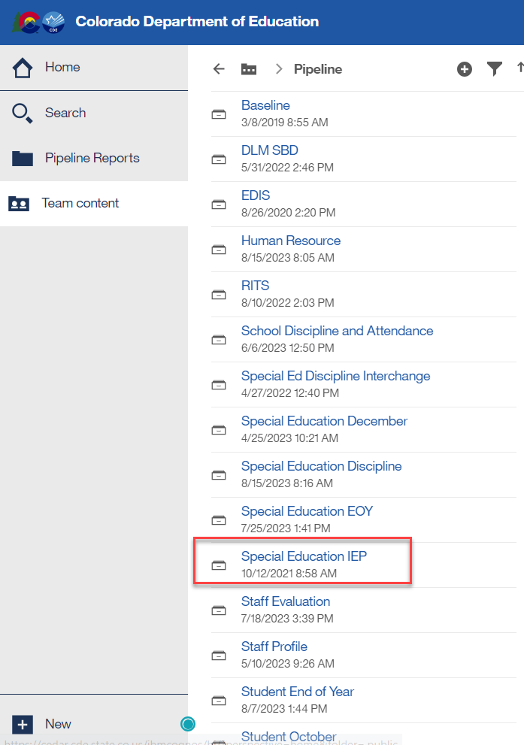
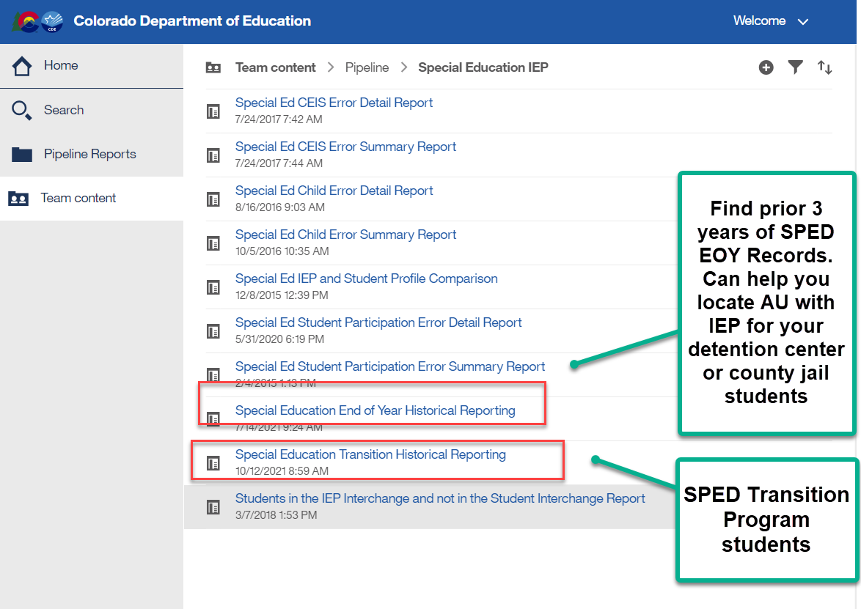
Special Education EOY
New Warnings
New Warnings- Please Check
Sped Transition Program Students –new warning for these type of records
  SY309: If student is currently in or will begin a Sped transition program next year, the Sped EOY Basis of Exit should be zero-filled.
    Check to be sure you are not exiting your students moving to a transition program.
    They may be reported with exit code 90 in Student EOY snapshot if they met grad requirements, but should not be exited in Sped EOY until they exit the program or age out
    Reference SPED transition Cognos report to see transition students based on district reporting
Reporting accurate Start and End Dates of Sped
  SY307: This record has overlapping attendance dates with another AU. Please verify the dates of attendance in your AU and adjust if necessary.
    Other AU and their start and end dates listed in the error report
    AU respondent contact list found in Sped EOY Cognos folder
Not Reporting students found Not Eligible for Sped
  SY308: Your AU has not reported any records as not eligible (04), all initial evaluations should be reported regardless of the eligibility outcome
Must have ‘SPE User’ role to access these reports

Slide 13

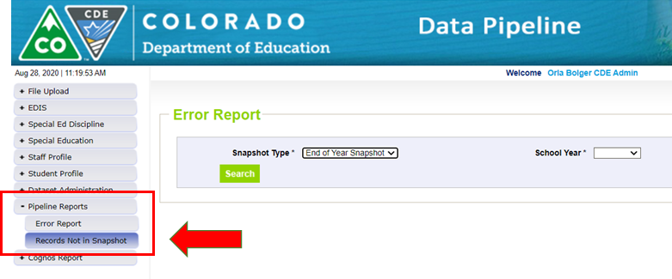
Special Education End of Year
– Missing Snapshot Records
Missing Snapshot Records Report- Must Check!
Identify records missing from snapshot due to:
  Interchange errors
  Criteria issues such as excluded PAI (Pupil Attendance Information) codes or mismatched SASIDs (State Assigned Student Identifier) or LASIDs (Locally Assigned Student Identifier)
  Records missing from either Child or Participation file
  Snapshot error SY108 will trigger on any missing records from prior year
*These missing records will also show up as 500 level snapshot warnings

Slide 14
Records Missing from Snapshot (Cont’d)
Warning messages for missing snapshot records:
*These are the same warnings you will see in the Pipeline Report: Records Not in Snapshot
WARNING CODE | Description
SY501 | Participation Record missing from EOY snapshot due to PAI code (Note: Records with PAI Code 23, 24, 31, 32 are not pulled into snapshot).
SY502 | Participation record missing from EOY snapshot due to interchange error.
SY503 | Child Record missing from EOY snapshot due to Interchange error.
SY504 | Child Record missing from EOY snapshot not in error (there should be another message for this record with details).
SY505 | Participation record does not have a corresponding child record.
SY506 | Participation record and child record have different LASIDS.
SY507 | Child record does not have a corresponding participation record.
SY508 | Participation Record missing from EOY Snapshot due to a Special Education or Part C Referral code of 00 (Note: records with a Special Education or Part C Referral Code of 00 are not pulled into the EOY snapshot).

Slide 15
Special Education EOY- Data Checks
Do you have any duplicate records with another AU?
  The SY260 Error identifies these records and your Cognos - Duplicate Students Without Exit Date or Exit Code - report shows the reporting details
  Student can’t be in two places at once. The Dates of Entry and Exit to Special Education must align (check warning SY307 for this as well)
  Contact lists found under Cognos Reports/Special Education EOY
    Special Education EOY Contact List
Do you have all exits from Special Education in your AU reported?
    Review reports to verify all exits are making it into your Pipeline file:
      #5 Number of Students Exited by Disability and Discrete Age
      #9 Year to Year Comparison Report of Number of Students Exited
    TIP: Compare exit data with your district data respondent

Slide 16
Special Education EOY – Cross AU (LEA) Validation – Resolving Duplicates
Monday, September 18
Every AU will need to create a new snapshot
Once a new snapshot has been created check Cognos Duplicate Reports that list records also being reported by another AU (on the same dates)
    Duplicate Students Without Exit Date or Exit Code
    Duplicate Students – Basis of Exit
  Found under Cognos Reports/Special Education EOY
  Special Education EOY contact list in your Syncplicity folder
3. Work with other AU to resolve the reporting overlap

Slide 17
Two Report Review Weeks
Initial Report Review: Friday, September 8 to Friday, September 15
(you do not have to print reports, do not sign reports until the final review week)
Final Report Review: Monday, September 25 to Friday, September 29
  Must have an EOY – USER or APPROVER role in order to download/view the Special Education EOY reports in the Data Pipeline
  Directors should review the signature reports and the detail reports that support them

Slide 18

Special Education EOY Reports Checklist
Helpful guide to use while reviewing reports
Can be found under Snapshots/Special Education EOY- posted under the Reports section
Link to reports checklist: http://www.cde.state.co.us/datapipeline/specialeducationeoyreportschecklist

Slide 19
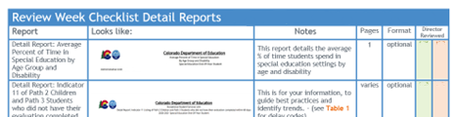
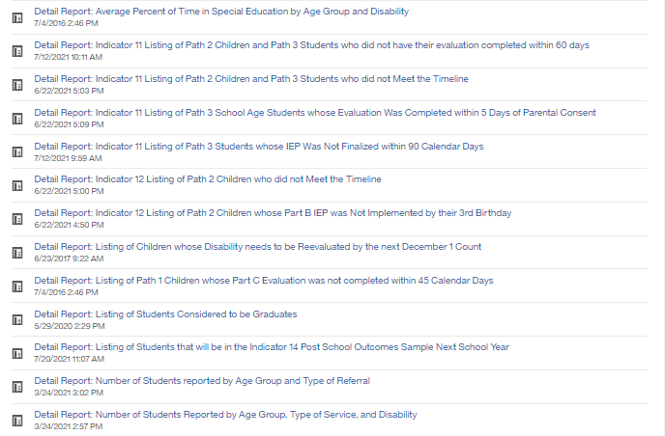
Detail Reports in Cognos
Detail Reports start on page 3 of the Checklist
Detail Reports are for your information, they will not be submitted to the CDE.

Slide 20
Detail Reports – Indicator 11
Detail Report: Indicator 11 of Path 2 Children and Path 3 Students who did not have their evaluation completed within 60 days - This report lists all students whose evaluation was not completed within 60 days regardless of the reason or if it was an allowable reason.
Detail Report: Indicator 11 Listing of Path 2 Children and Path 3 Students who did not meet the timeline – This report lists the students who account for your percentage being less than 100%, because of the “Not Valid” delay codes – 58, 59, 60.
Detail Report: Indicator 11 Listing of Path 3 Students whose evaluation was completed within 5 days of parental consent – This report is a good tool to use in reviewing your data to be sure the right dates are reported in your data.
Detail Report: Indicator 11 Listing of Path 3 Students whose IEP was not finalized within 90 days – This report lists all students whose IEP was not finalized within 90 days regardless of the reason.

Slide 21
Detail Reports – Indicator 12
Detail Report: Indicator 12 Listing of Path 2 Children who did not meet the timeline - Includes students that did not meet the evaluation and/or implementation timeline because the Not Valid reason for delay codes of “58, 59, 60”.
  Note: students who were referred to Part C in the 90 days before their 3rd birthday will not appear on this report because ALL delay reasons are accepted for this situation. In other words, these students do not count against your final Indicator 12 finding, even if there was a 'not valid reason' for the delay.
Detail Report: Indicator 12 Listing of Path 2 Students whose Part B IEP was not implemented by their 3rd birthday - Provides the record of every student who had a delay of the Initial Eligibility Meeting or IEP Implementation.

Slide 22
Detail Report - Students to Re-evaluate by 12/01
Detail Report: Listing of Children whose disability needs to be reevaluated by the next December 1 Count – Listing of students who will be three-years old or older by the next December 1 and who still have “12 – Infant/Toddler with a Disability” or will be 9 years old or older and who still have “11 – Developmental Delay” as their primary disability.
  Students who are 9 or older cannot be reported in the December Count with disability 11. They will miss out on funding if the re-evaluation is not completed by their 9th birthday.

Slide 23
Detail Reports – Graduates and Other Exits from SPED
Detail Report: Listing of Students Considered to be Graduates – All students with Exit Code 90.
Detail Report: Listing of Students that will be in the Indicator 14 Post School Outcomes sample next school year - Check that this list is complete. Is it missing a group such as graduates or is there an entire school unrepresented? This should be a list of all students who have exited by aging out, dropping out, graduating or getting a certificate.

Slide 24
Detail Reports by Demographics
Detail Report: Number of Students Reported by Age Group and Type of Referral – This report gives a cross-tabulation of students by age group and their type of referral.
Detail Report: Number of Students Reported by Age Group, Type of Service, and Disability – This report gives a cross-tabulation of students by age group broken out by Evaluation status including students not evaluated, evaluated and found not eligible, students who received early intervening services only and students who received Special Education Services by disability group.

Slide 25
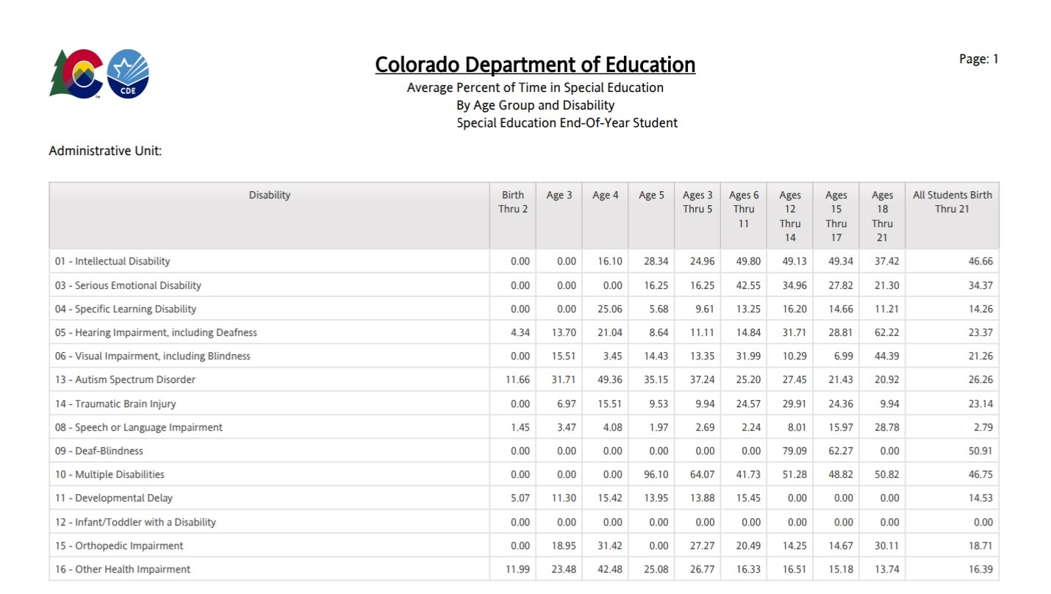
Detail Report: Average Percent of Time in Special Education by Age Group and Disability
Notes:
We are including a quick look at this detail report here because we receive questions each year about how the average percent of time in Special Education is calculated. The next slide explains this calculation.

Slide 26
Detail Report: Average Percent of Time in Special Education by Age Group and Disability (focus)
The Average Percent of Time in Special Education is calculated by:
  Totaling the SPED hours for a group of students and dividing by the totaled school hours for that same group of students.
  The “All Students” column is not a sum of the individual age columns; it is a calculation for all students with a particular disability: SPED hours totaled divided by total school hours totaled.
Student | Hours of Sped Services Per Week | Total School Hours
1 | 0500 | 4000
2 | 2000 | 4000
3 | 1000 | 4000
4 | 1500 | 4000
5 | 1000 | 4000
Sum Total | 6000 | 20000
Percent of Time in Sped | 6000/20000 = 30.00%

Slide 27
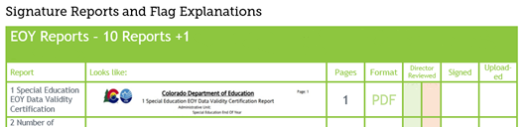
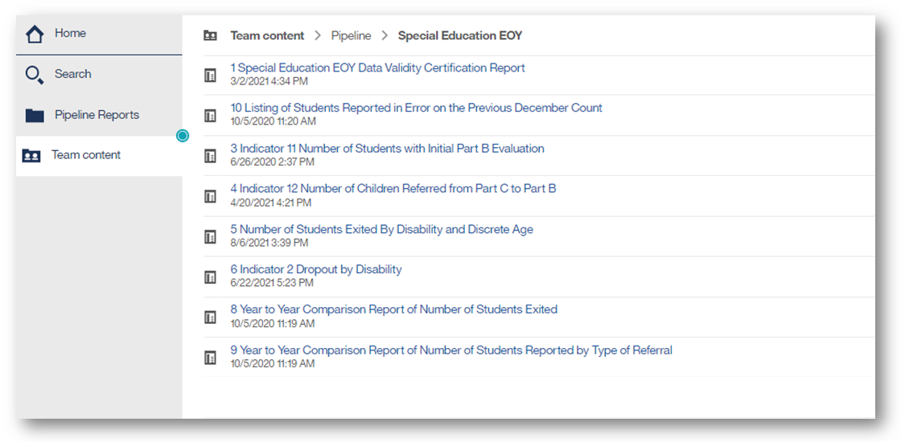
Signature Reports in Cognos
Signature Reports start on page 6 of the Checklist
8

Slide 28
Selecting the right format for your report
ALWAYS export the Signature Reports (the numbered reports) in PDF Format.
This will ensure:
The best layout of the report for a printed page (no columns will be cut off).
Informative headers and footers will appear on every page, including the time and date the report was generated.
Pages will be
automatically numbered.
You will see ALL the pages
including the
Signature Page.

Slide 29
8 Reports +1 Due September 29 With Final Snapshot Submission
8 Reports require a signature from your Director (No report 2 or 7):
  1 Special Education EOY Data Validity Certification
  3 Indicator 11 Number of Students with Initial Part B Evaluations
  4 Indicator 12 Number of Children Referred from Part C to Part B
  5 Number of Students Exited by Disability and Discrete Age
  6 Indicator 2 Dropout by Disability
  8 Year to Year Comparison of Number of Students Exited
  9 Year to Year Comparison of Number of Students Reported by Type of Referral
  10 Listing of Students Reported in Error on the Previous December Count
  *Please upload each signed report in full to the Data Management System by Friday, September 29, 2023
  + Flag Explanations (if applicable) for significant changes in Year-to-Year counts (this report does not require a signature and is uploaded separately as a Word document)

Slide 30
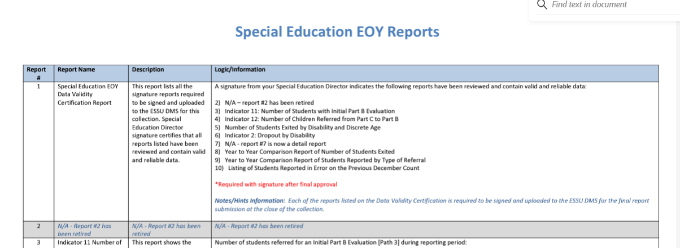
Signature Report Criteria Details
Special Education EOY Data Reports from the Cognos system have very specific parameters for the data they pull into the report. The data for each report can be found in the “Special Education EOY Cognos Reports Logic”
Link to Special Education EOY Cognos Reports Logic, will open a linked PDF

Slide 31
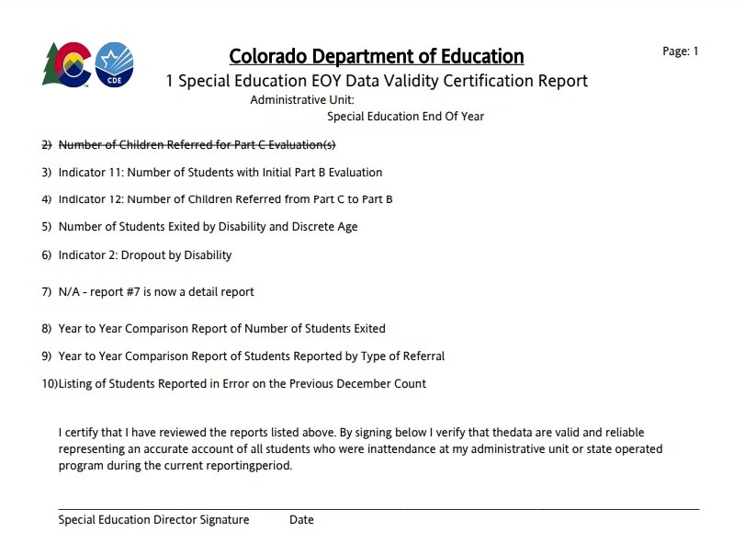
1 Special Education EOY Data Validity Certification Report

Slide 32
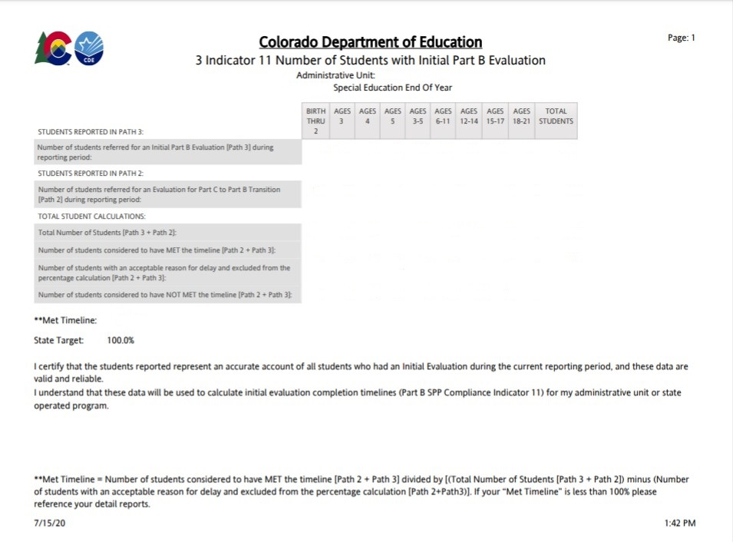
3 Indicator 11 Number of Students with Initial Part B Evaluations
Related Detail Reports:
Indicator 11 Listing of Path 2 Children and Path 3 Students who did not have their evaluation completed within 60 days
Indicator 11 Listing of Path 2 Children and Path 3 Students who did not Meet the Timeline
Indicator 11 Listing of Path 3 School Age Students whose Evaluation Was Completed within 5 Days of Parental Consent
Indicator 11 Listing of Path 3 Students whose IEP was not Finalized within 90 Calendar Days

Slide 33
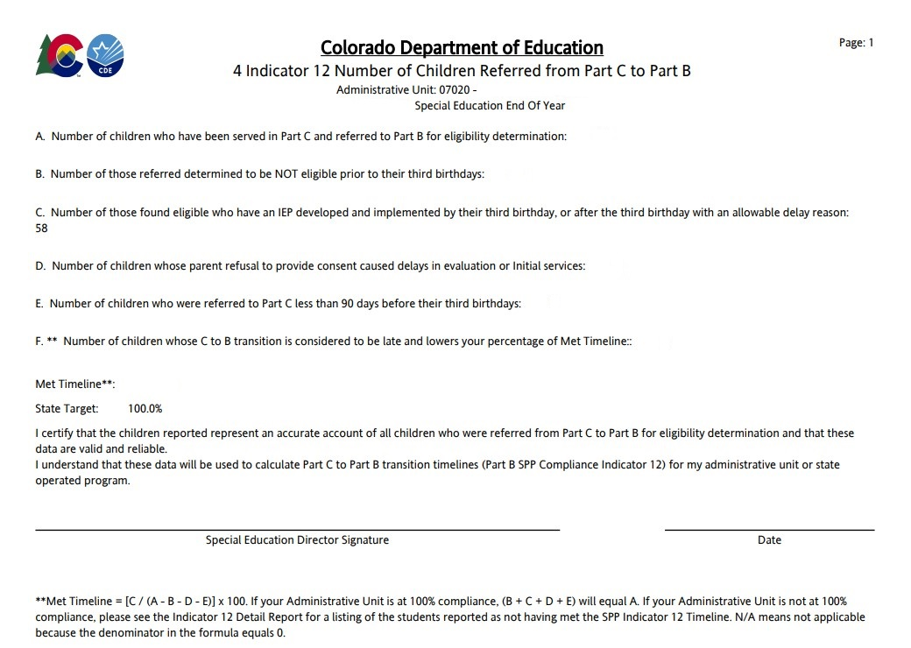
4 Indicator 12 Number of Children Referred from Part C to Part B
Related Detail Reports:
Indicator 12 Listing of Path 2 Children who did not Meet the Timeline
Indicator 12 Listing of Path 2 Children whose Part B IEP was Not Implemented by their 3rd Birthday

Slide 34
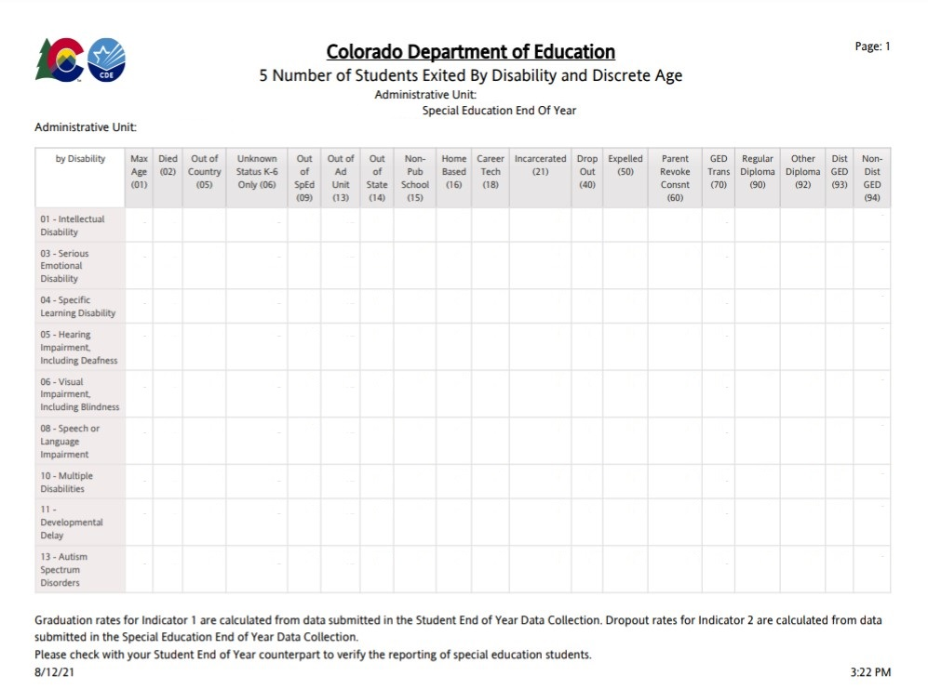
5 Number of Students Exited by Disability and Discrete Age
Related Detail Reports:
Listing of Students Considered to be Graduates
Listing of Students that will be in the Indicator 14 Post School Outcomes Sample Next School Year

Slide 35
Age Calculation
Federal Reporting rules state we must calculate a student’s age on the most recent December Count prior to their exit.
Anyone who exited after the December 1 Count date would have their age calculated on 12/1/2022.
Those who exited before the December 1 Count date would have their age calculated on the previous count date 12/1/2021.

Slide 36
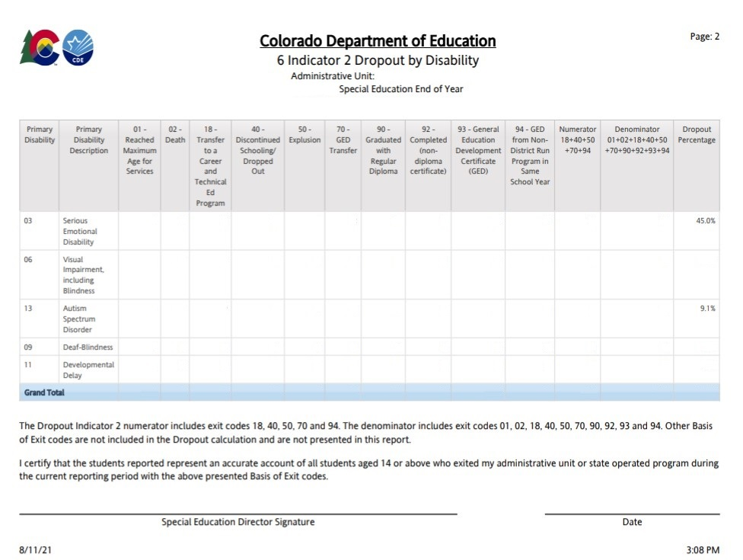
6 Indicator 2 Dropout by Disability

Slide 37
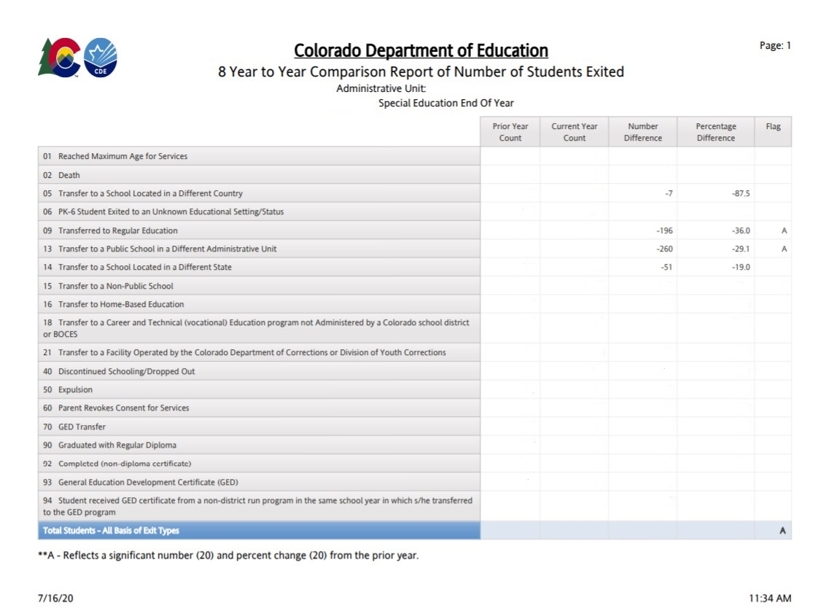
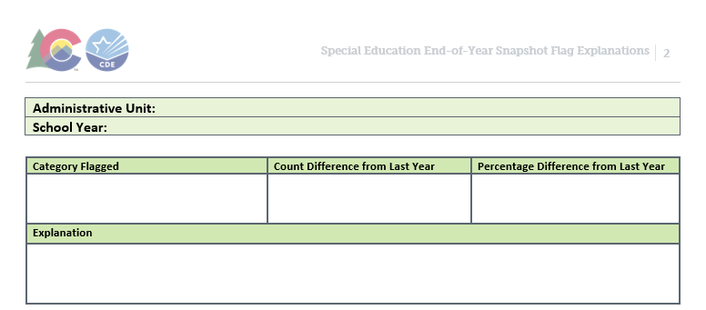
8 Year to Year Comparison Report of Number of Students Exited
Provide explanations for any rows that are flagged with an A. An “A” flag indicates a number count and percentage change of 20 or more from prior year.

Slide 38
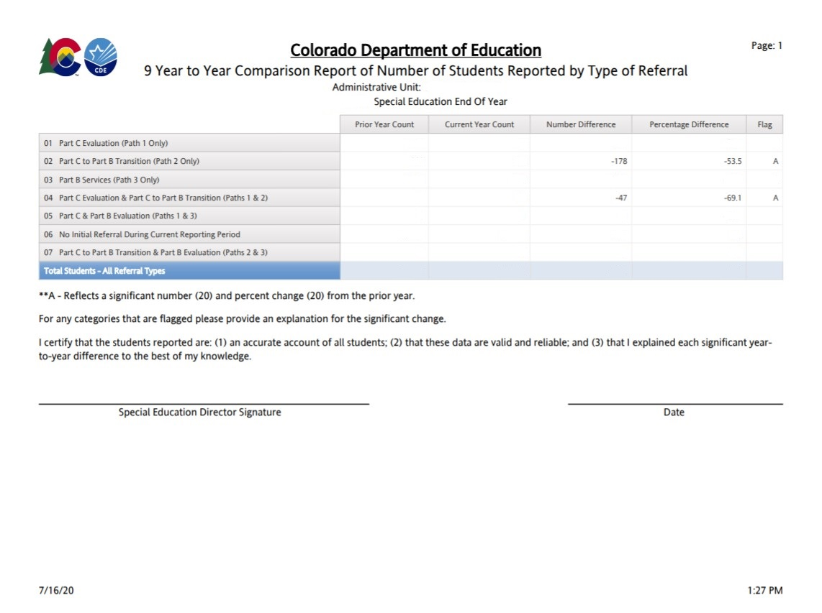
9 Year to Year Comparison of Number of Students Reported by Type of Referral
Provide explanations for any rows that are flagged with an A. An “A” flag indicates a number count and percentage change of 20 or more from prior year.
Exception for 2022-23: You do not need to provide a flag Explanation for “01 Part C Evaluations (Path 1 Only).” All AUs are dropping to zero this year due to Part C evaluation moving to Human Services.

Slide 39
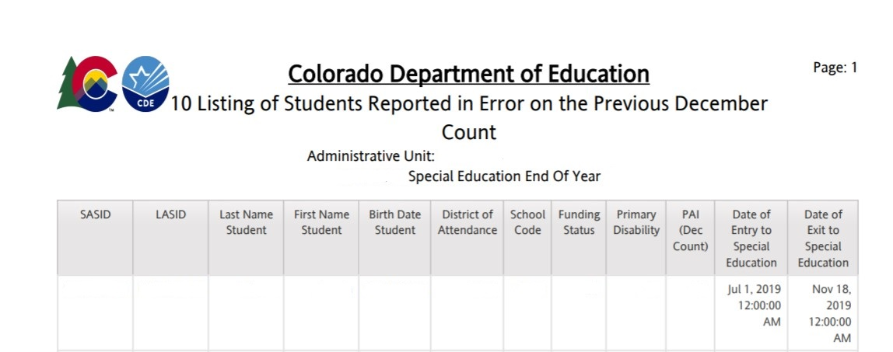
10 Listing of Students Reported in Error on the Previous December Count
*No exception required for these
These are students that you reported in error on December Count. These students exited at some point between 7/1 and 11/30 (after last EOY and before the December Count date) and they should not have been reported.

Slide 40
Example of an EOY Report Flag
The count has changed by at least 20
The % has changed by at least 20

Slide 41
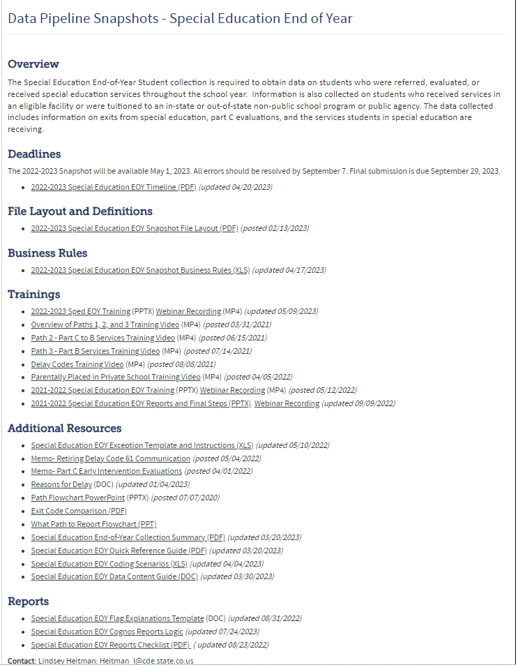
Flag Explanations
AUs are required to submit an explanation for each A flag
  2022-23 Exception - flags associated with Part C counts dropping to 0.
Use the flag explanation templates in the technical assistance document found here under the Reports section: http://www.cde.state.co.us/datapipeline/snap_sped-eoy

Slide 42
Flag Explanations – The Why
We use AUs’ explanations to:
  Inform CDE's response to any state-level and LEA-level year-to-year differences to OSEP
  Identify the best practices and support needs in the field
We appreciate explanations with:
  Great details
  Cause and effect (e.g., program implementation, unusual mobility)
Category Flagged | Inadequate Explanation | Informative Explanation
Transferred to Regular Education (increase) | Better re-evaluation process. | We reported more students who transferred to regular education than the year before due to Professional Development classes that helped providers better understand and identify disability. This professional development helped us strengthen our re-evaluation processes. Consequently, we had more students who exited special education and entered general education across grade levels this year.
Transfer to Public School in a Different State/Country (increase) | Increased mobility | Historically, our AU has seen big swings in the student population as a reflection of the local economy. This year, families working in the energy industry (a large part of our students’ families’ employments) moved to North Dakota due to the increased job availability there. The families of students with IEPs were also included in this movement.

Slide 43
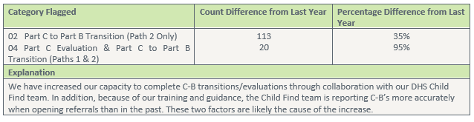
Flag Explanations-The How
Categories can be grouped (more than one category can be listed in the box) if they are closely related to the same explanation.
This is to avoid copy and pasting the same explanation in multiple places.

Slide 44
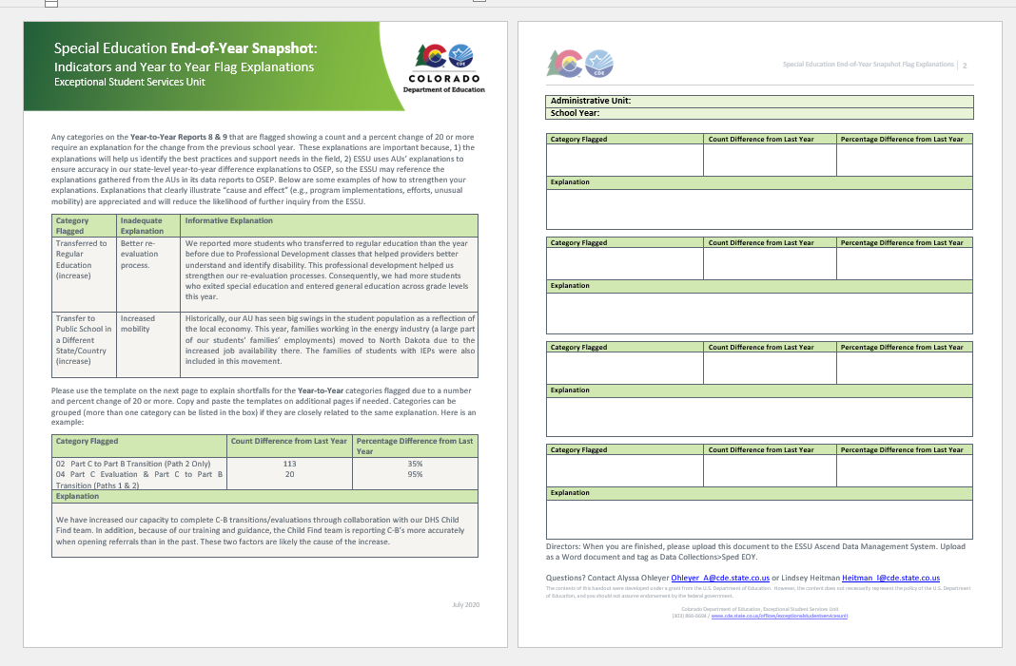
Flag Explanations Template Visual
Flag Explanation Template

Slide 45
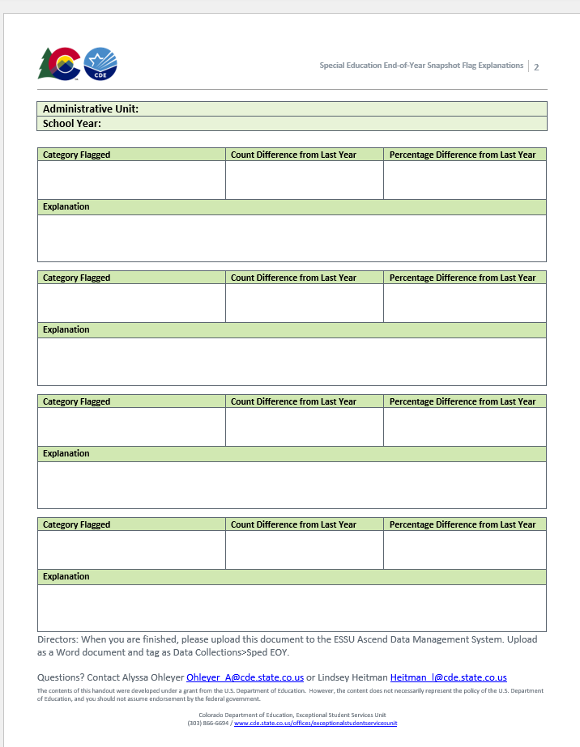
Completing Flag Explanations
Use the second page of the technical assistance document to give us explanations for each flag.
Copy and paste the template on a new sheet as needed.
Upload this page to the Data Management System along with other signed reports.

Slide 46
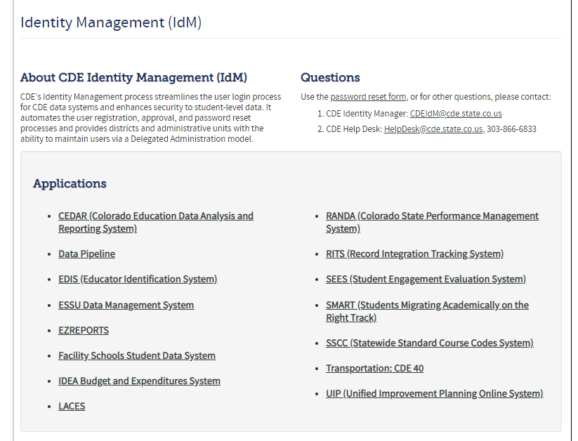
Uploading to the Ascend Data Management System
Log into the Ascend Data Management System
Click “ESSU Data Management System” Link to Data Pipeline Single Sign-on Page (opens in browser)

Slide 47
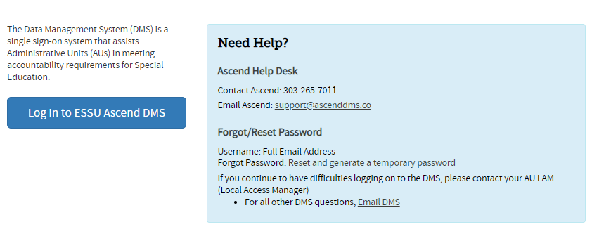
Logging into the Data Management System
Link to Data Management System log-in page

Slide 48
Uploading to Ascend DMS
Please Note:
In order to upload files to the “Documents,” you must be able to log into the Ascend DMS.
Please check that you can do this before the upload deadline.
Your Local Access Manager (LAM) can assign you an appropriate role that will allow you to log in.
  If you encounter any trouble with the Ascend DMS, please email Josh Fails (fails_j@cde.state.co.us).

Slide 49
Quick Navigation in the Data Management System – Overview
Ascend DMS Dashboard
Upon logging into Ascend DMS, you will land on the “My Dashboard” page.
Note that when uploading documents, the year in the top dropdown is not important.

Slide 50
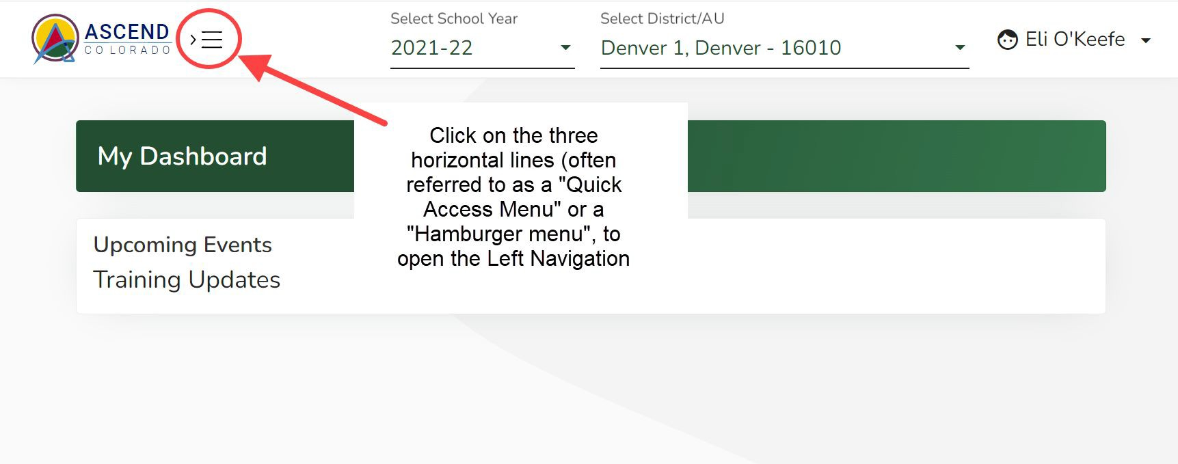
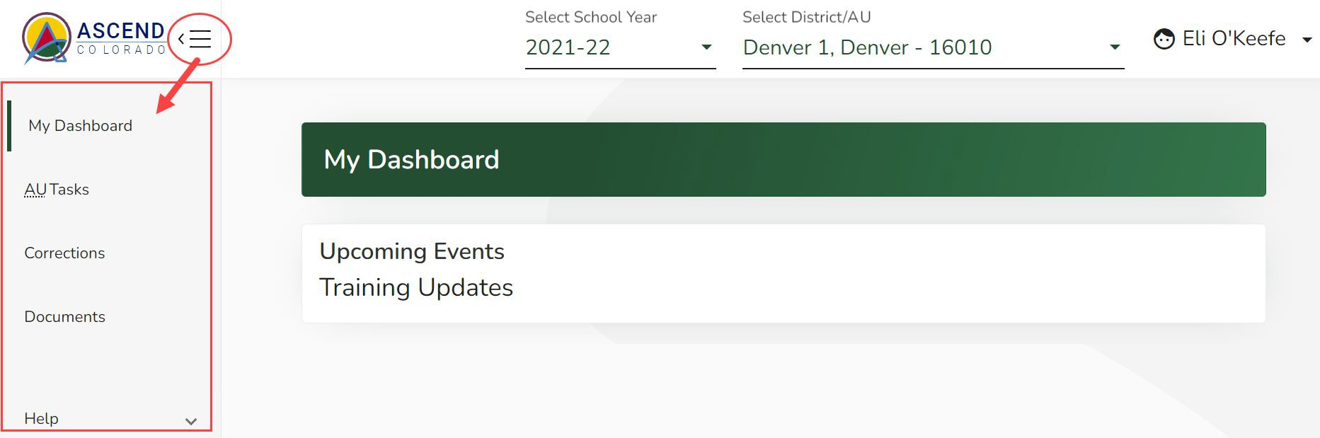
Ascend DMS Left Navigation Pane
Ascend may open with the left navigation pane closed. The left navigation pane contains the links to the various module pages such as AU Tasks, Corrections, Documents, and Help.
To open the left navigation pane:
Click on the Quick Access menu (3 horizontal lines icon) located to the right of the ASCEND logo located in the upper left corner of the screen.
To upload your EOY Reports, select Documents from the menu
50

Slide 51
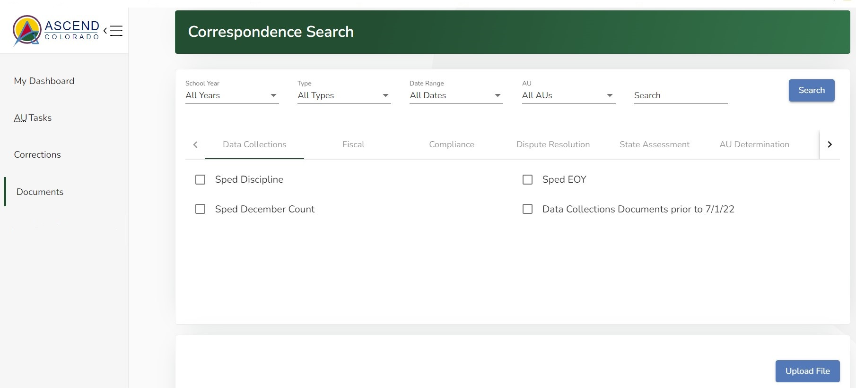
To Upload Documents
Click the “Upload File” button on this Documents Dashboard

Slide 52
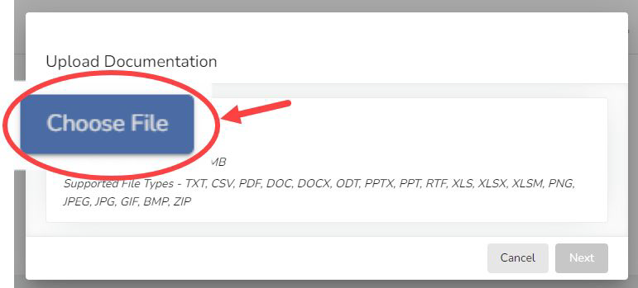
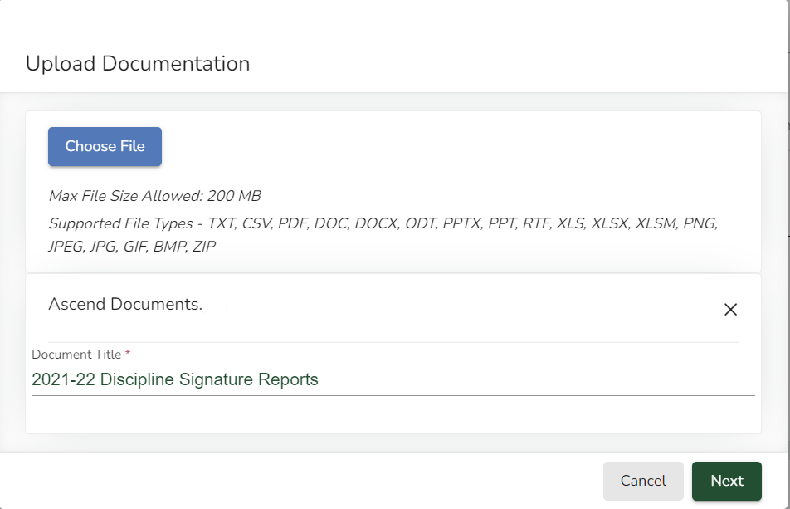
Uploading Sped EOY Report Documents
To upload documents:
Choose the file(s) from your computer
Type in the Document Title using the exact examples below.
“2022-23 Sped EOY Signature Reports” for the PDFs
“2022-23 Sped EOY Flag Explanations” for the Flag Explanations Word file
2022-23 Sped EOY Signature Reports

Slide 53
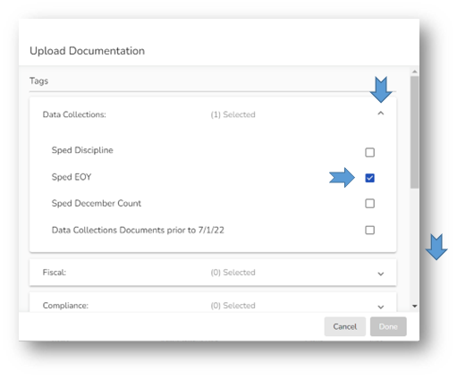
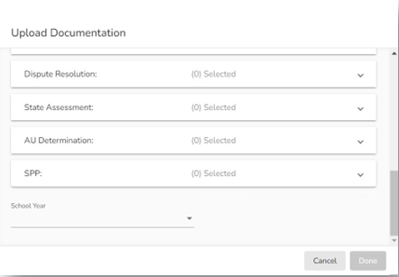

Tagging your Document
Use the carets on the right side of the Upload Documentation box to open Tag selection field for Data Collections
Select Sped EOY
Scroll down
Select 2022-23 for the School Year
Click the “Done” button when it turns green (if it has not turned green, you have missed required info)

Slide 54
Flow of Reports’ Submission
Download the 8 numbered reports from Pipeline (export to PDF) and make sure all the reported numbers are accurate.
Directors sign the reports, then scan them into one PDF.
Download the “Year-to-Year Flag Explanation Document” found under the Reports section: https://www.cde.state.co.us/datapipeline/snap_sped-eoy.
Explain the ‘A’ flagged count differences using the template in the flag document (2nd page).
Upload the following to the profile tab of the Data Management System:
  Signed and scanned reports (in one single pdf).
  Completed year to year explanation template (separate Word document).

Slide 55
Last Step: By September 29th, Approve your final Snapshot in the Data Pipeline by clicking ‘Submit to CDE’ button.
Within Data Pipeline
1. Click Special Education on the left menu
2. Click Status Dashboard
3. Use the drop downs to select the appropriate values
  File Type: End of Year Snapshot
  School Year: 2022-23
  Organization/LEA: defaults to your AU
Notice the Data Locked value on this screen is set to N
Notice the Overall Status is set to P (pending) indicating the data has not been submitted to CDE.
4. Click the Submit to CDE button (Only EOY-APPROVERS will have this ability) (must have 0 errors)
5. Click OK
  A green message should display above the File Type box indicating the data was submitted
  The Data Locked value should change to Y
  The Overall Status should change to S

Slide 56

Special Education EOY Contact Information
SpedEndofYear@cde.state.co.us
(303) 866-5759
*Please include your AU # and/or Error code or report # (if applicable) in emails

