Slide 1
Conceptual and Factual Questions
What are they and how can you use them in planning and instruction?

Slide 2
Purpose of this Presentation
This presentation is intended to provide the viewer with:
a clearer understanding of the role of guiding questions in the District Sample Curriculum unit overviews and instructional units
definitions and examples of conceptual and factual questions
considerations for the use of guiding questions in the classroom

Slide 3
The District Sample Curriculum Project
For the past 2 years, teachers from across Colorado have been working to develop sample curriculum based on the Colorado Academic Standards (CAS).
The two main products completed as a result of this work are:
Unit Overviews (more information may be found at: http://www.cde.state.co.us/standardsandinstruction/curriculumoverviews)
Instructional Units (more information may be found at: http://www.cde.state.co.us/standardsandinstruction/instructionalunitsamples)

Slide 4
The Role of Guiding Questions
Each sample unit overview includes examples of guiding questions
The guiding questions are directly connected to the generalizations ~ the premise is that if students are able to answer the guiding questions, then they should arrive at the generalization
Notice that the guiding questions are broken down into conceptual and factual questions

Slide 5
For Discussion:
How do you think an instructional shift to using conceptual and factual questions benefits students’ understanding of the generalizations?

Slide 6
Conceptual Questions
Conceptual questions are broader and may be answered across time and contexts, for example:
"In what ways does the uneven distribution of resources limit economic and political opportunities?"
"Why might a country restrict the migration of its people both within and outside of the country?"
NOTE: These questions could be asked and answered whether students are studying African Kingdoms or present day United States

Slide 7
Brainstorm:
What are some examples of factual questions that could be asked to support these conceptual questions?:
"In what ways does the uneven distribution of resources limit economic and political opportunities?"
"Why might a country restrict the migration of its people both within and outside of the country?"

Slide 8
Factual Questions
Factual questions are content specific, and generally, are answered either right or wrong; for example:
"What are some of the push factors for the migrations of the Bantu peoples between the 13th and 15th centuries?"
"How does the construction of hydroelectric plants (dams) differentially impact populations in China and Egypt?"

Slide 9
For Discussion:
How might you plan for the intentional use of conceptual and factual questions?

Slide 10
Examples of Guiding Questions
Ok, let’s take a look back at an example of conceptual and factual questions and how/why those questions may change from the sample unit overview to the sample instructional unit.
Social Studies Unit Overviews: http://www.cde.state.co.us/standardsandinstruction/curriculumoverviews/socialstudies
Social Studies Instructional Units: http://www.cde.state.co.us/standardsandinstruction/instructionalunits-socialstudies

Slide 11
Back to the Sample Curriculum
You may notice that some factual and/or conceptual questions from some original unit overviews changed as teams built the sample instructional units (see, for example, the 7th grade instructional unit sample, “Ch…Ch…Ch…Changes").
These changes occurred as teachers built out the instructional units and made decisions around the content of the unit that required different factual questions and/or conceptual questions.

Slide 12
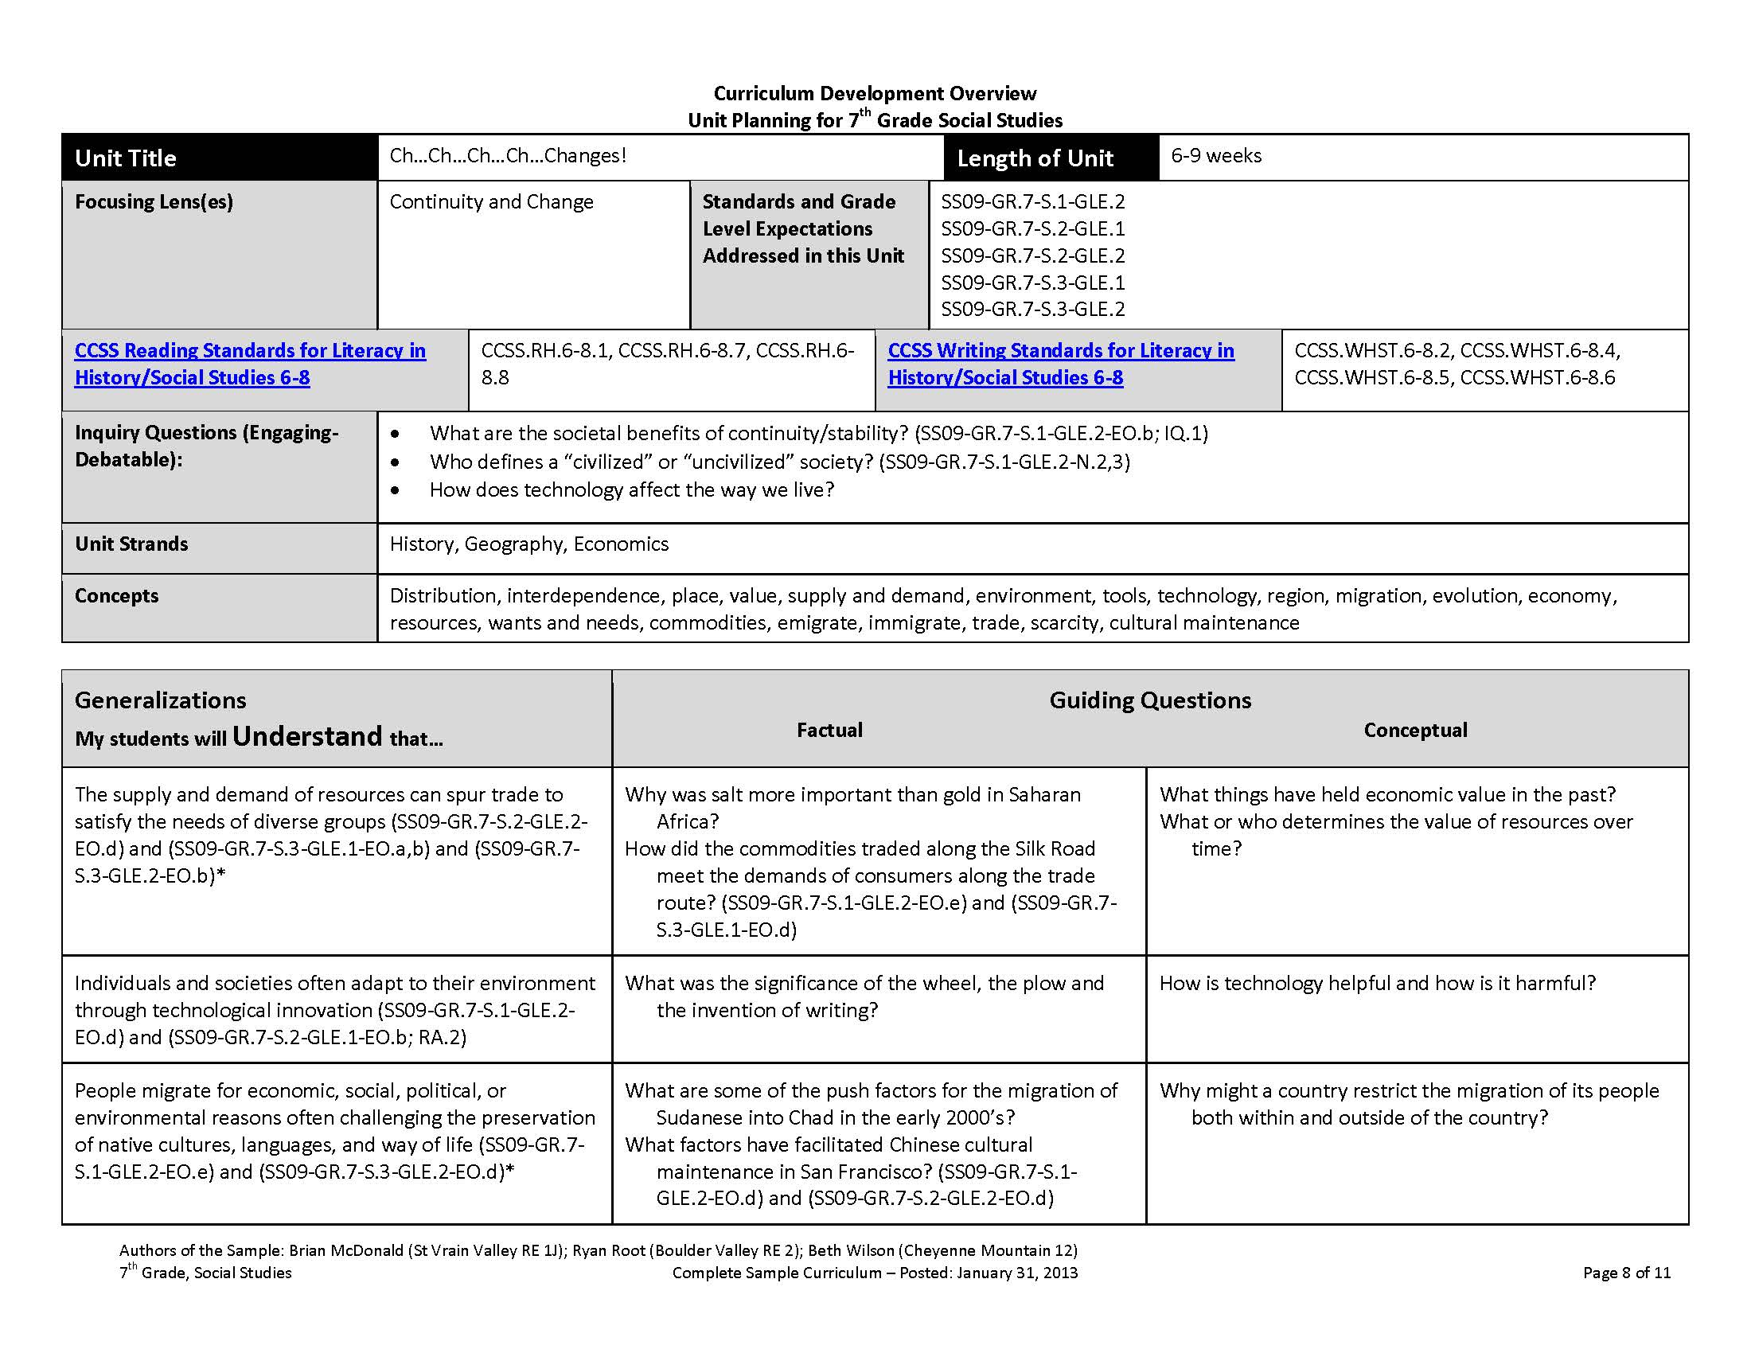
Here are the original factual questions from the unit overview

Slide 13
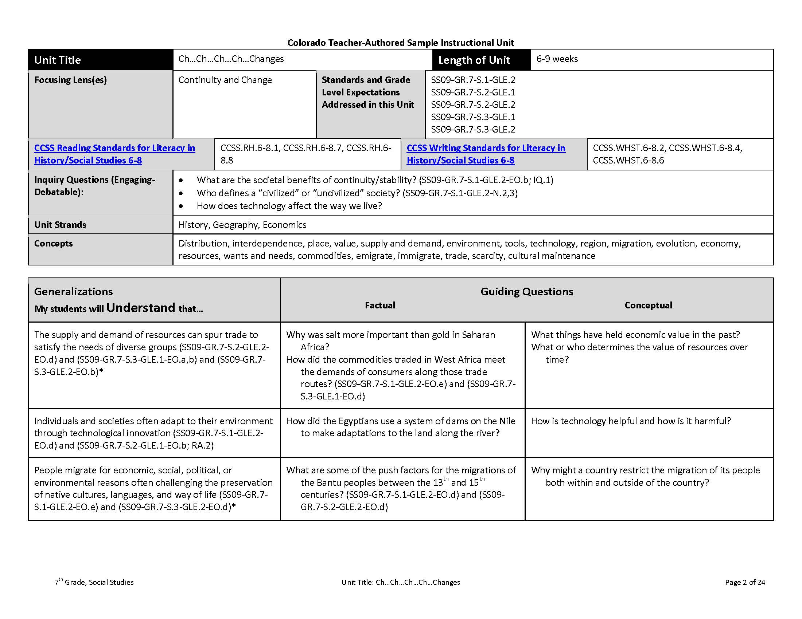
Instructional Unit
Notice that the factual questions now more accurately reflect the focus of this instructional unit which is Africa; however, they still support the generalization(s)
Here are the new factual questions from the instructional unit

Slide 14
Important to Note:
The guiding questions in the sample curriculum unit overviews are intended to be just a sampling, not comprehensive; therefore, when utilizing or developing instructional units, it may be necessary to revise or create additional questions

Slide 15
Consider:
Select a lesson or unit that you teach…
What changes could be made to a lesson or the unit so that it focuses more on conceptual learning and uses conceptual and factual questions to guide that learning?

Slide 16
For More Information:
Stephanie Hartman
Social Studies Content Specialist
Colorado Department of Education
hartman_s@cde.state.co.us

