Slide 1
Taking a closer look at the 2020 CAS for Science

Slide 2
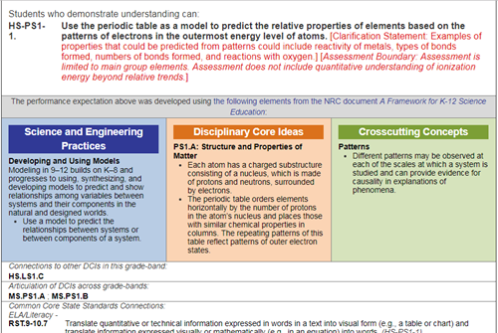
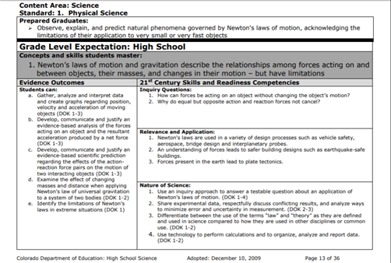
A Quick Comparison
NGSS
2020 CAS-Science
2009 CAS-Science

Slide 3
Teamwork
In teams of 2-3, Conduct a comparison of the 2009 and the 2020 Colorado Academic Standards for Science.
-Quick whole group share out
In your same teams, now make comparisons of the 2020 CAS and the NGSS.
-Where do you see similarities and differences?
-Quick whole group share out

