Slide 1
CDE Science of Reading Literacy Series
Vocabulary
Explicit Vocabulary Routine
Notes:
Speaker Notes:
Welcome to the Science of Reading professional development series brought to you by the Colorado Department of Education Elementary Literacy and School Readiness office. This lab session focused on building an explicit vocabulary routine.

Slide 2
Preparing for this Session
Prior to this session, trainers and participants should view this brief video for an overview of key concepts and terminology:
Overview of Vocabulary
For this session, participants will need:
Vocabulary Routine Handout
Writing utensils
Additional Support Materials (optional):
Leader Look-Fors
Features of Effective Instruction Checklist

Slide 3
Introduction
Notes:
This lab session is designed to provide teachers and administrators with foundational knowledge in implementing an explicit vocabulary routine. This session is designed as a turnkey presentation that a teacher leader or administrator can present to staff and then follow up with the implementation progress in subsequent observations and meetings.

Slide 4

Objectives
Understand the foundational knowledge for high-impact vocabulary instruction
Engage in academic discourse on evidence-based instructional considerations
Incorporate a vocabulary routine through modeling and practice
Determine personalized next steps for implementation
Notes:
Speaker Notes:
During this session, participants will
Understand the foundational knowledge for high-impact vocabulary instruction
Engage in academic discourse on evidence-based instructional considerations
Incorporate a vocabulary routine through modeling and practice
Determine personalized next steps for implementation

Slide 5
Terminology
Phonological: Referring to speech sounds
Orthographic: Referring to written language
Semantic: Referring to meaning
Syntactic: Referring to language structures/grammar
Lexicon: A person’s vocabulary
Notes:
Speaker Notes:
There are five key terms that are important to review. If these terms still feel unfamiliar to you, take a moment to write them down for later reference.
(Click) The first term we will review is the word “phonological.” When we use this term, it is referring to speech sounds. For example, if we use the phrase “phonological representation,” we mean the representation of the speech sounds in a word.
(Click) The next term to know is “Orthographic.” The term orthographic refers to written language. Orthographic representation, for example, is a word in its written form.
(Click) The term semantic refers to meaning. Semantic knowledge means the understanding of a word’s meaning.
(Click) Syntactic is a term referring to language structure or grammar. Using a word correctly in a sentence indicates we have syntactic knowledge about that word.
(Click) Finally, the term lexicon refers to a person’s individual vocabulary.

Slide 6
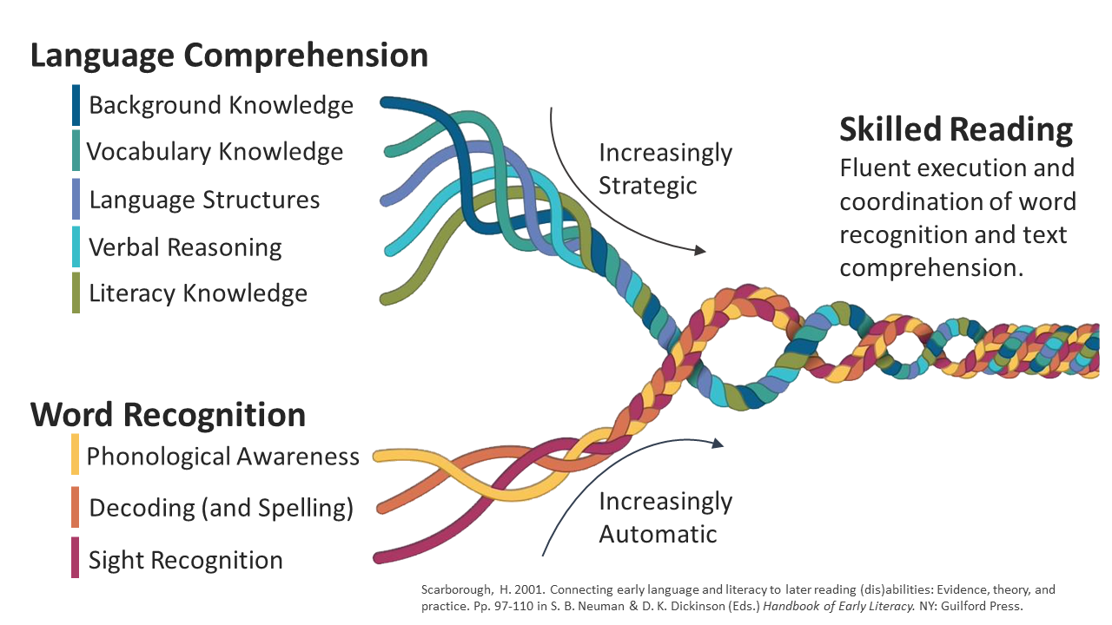
Scientifically Based & Evidence-Based
Scarborough’s Reading Rope
Language Comprehension
Reading Comprehension
Word
Recognition
Notes:
Speaker Notes:
In what should now be a familiar model, Scarborough’s Reading Rope (2001) demonstrates how the subskills that comprise word recognition and language comprehension work in tandem and allow students to read fluently and coordinate automatic word recognition with text comprehension.
Notice that vocabulary knowledge is one of the five strands of language comprehension. Language comprehension skills begin to develop from the moment a child is born and continue to develop while a child acquires the skills needed for automatic word recognition. Both breadth and depth of vocabulary knowledge supports students reading development.

Slide 7

Warm Up
fudgel
groak
bourgeois
petrichor
deipnosophist
debris
apricity
amok
detritus
rendezvous
persnickety
malaprop
Notes:
Speaker notes:
Ask participants to read the list of words and discuss with a partner (or team, small group, etc.) the following:
1.“Think about the phonology and orthography of each word. Which words have you heard before that exist in your phonological lexicon? Are there words that you can read but are not sure how to pronounce?”
(Give participants a few moments to discuss).
2.“Now that you have previewed these words, take a moment to listen to the terms read aloud”
(CLICK the on the first word in the list, “fudgel”, to begin the audio of the list of words read aloud. Word list is read across rows).
Ask: “Were any of the pronunciations a surprise?”
“Which words are easily decodable through common English spelling rules?” (fudgel, groak, apricity, persnickety, malaprop, detritus)
“Which words require more knowledge about morphology or etymology (word origin)?” (bourgeois, debris, petrichor, deipnosophist, amok, rendezvous)
4. “Think about semantics. Which words are already part of your semantic lexicon (you know the meaning)? Which words are new to you?”

Slide 8
Warm Up
fudgel (v.) Pretending to work but actually goofing off | deipnosophist (n.) A person skilled in the art of dining and dinner conversation | detritus (n.) Loose material that results directly from disintegration; leftover debris
groak (v.) To stare silently at someone while they eat, hoping you’ll be invited to join them. | debris (n.) Scattered pieces of waste or remains. | rendezvous (n.)a place appointed for meeting (v.) to meet or come together at a particular time and place
bourgeois (adj) Having crude, materialistic taste | apricity (n.) The warmth of the sun in winter. | persnickety (adj) Fussy about small details
petrichor (n.) The pleasant smell that accompanies the first rain after a dry spell. | amok (adv) In a violently raging, wild or uncontrolled manner | malaprop (n) Unintentional and often humorous misuse of a word or phrase
Notes:
Speaker Notes:
“Take a moment to read the definitions of the words that are new to you.
Does knowing the definition and part of speech help you understand how these words could be used in a sentence?
Are there words for which an example in context is needed?
Would it help your understanding to explore any of these words with examples and non-examples?
Take a moment to discuss with a partner (or grade level team, small group, etc.).”

Slide 9
Setting the Foundation
Notes:
Speaker Notes:
In this section, we will review the essential elements for providing quality explicit vocabulary instruction.

Slide 10
Word Learning Continuum
Never heard the word
Heard the word; has some sense of its meaning
Knows the word in specific context
Has knowledge but not able to recall & use in appropriate situations
“Owns” the word. Uses word correctly and flexibly across multiple contexts
(Beck, McKeown, and Omanson, 1987, as cited in Beck, McKeown, and Kucan, 2013)
Notes:
Speaker Notes:
When we think about all of the aspects of deep individual word knowledge, it helps to understand that word learning happens along a continuum (Beck, McKeown and Omanson, 1987). As the warm up activity may have demonstrated, at any given time, we are learning about different words at different places along the continuum. (Go over each component of the continuum).
Talking Points:
There are many levels of “knowing” a word, from hearing it for the first time, all the way to knowing it deeply and being able to use it flexibly.
Our level of knowledge about an individual word is personal and unique.
We have greater knowledge about some words than others.
Word learning is not finite; we continue to build our knowledge throughout our life.
We can grow our depth of word knowledge with exposure, instruction, and use.
The purpose of explicit vocabulary instruction is to ensure that students learn carefully selected words in depth that are critical to both comprehending the text or content being taught and to impact overall academic development.

Slide 11
Semantic and Phonological Lexicons
Phonological Lexicon
Words that are orally familiar but meanings are unknown
Familiar Word Parts
Semantic Lexicon
Words for which an individual has partial or full knowledge of each words meaning. “Mental Dictionary.”
(Kilpatrick, 2015)
Notes:
Speaker Notes:
Remember that
Because word learning happens along a continuum and develops over time, it is important to expose students to words at both the phonological and semantic levels. Remember that our lexicon is a person’s individual vocabulary “bank.” All the words we are familiar with orally or auditorily are part of our phonological lexicon. This includes words we have heard but don’t know the meaning of, as well as familiar word parts.
Our semantic lexicon is part of our phonological lexicon, typically, but includes the words for which we have partial or full knowledge of the words’ meanings. This is also referred to as our “mental dictionary.”
Expanding word knowledge at both levels means improving teacher talk, expanding on student conversations, and providing opportinities for incidental word learning while also providing deeper instruction of words we want students to “own” in their semantic lexicon.
This is where breadth of word knowledge intersects with depth of word knowledge.
If students have been exposed to more words at the phonological level, it will be easier for them later to recognize those words when they encounter them in text, and they will learn the word’s meaning more quickly.
Students may have many more words in their phonological lexicon than in their semantic lexicon, especially if they have been read to or encountered the language of text frequently.
Kilpatrick, D.A. (2015). Essentials of Assessing, Preventing, and Overcoming Reading Difficulties. Wiley.

Slide 12



Lexical Quality Hypothesis
Phonology
(PH)
Orthography
(OR)
PHORSE
Semantics/Syntax
(SE)
(Perfetti & Hart, 2002)
Notes:
Speaker Notes:
Charles Perfetti and Lesley Hart developed the Lexical Quality Hypothesis, which explains that high quality knowledge of a word includes three variables:
Phonological Knowledge - recognition of the way the word sounds or is pronounced (syllables, phonemes, intonation, pronunciation)
Exposure to a word at the phonological level supports storing of the correct pronunciation and makes it easier for students to recognize those words when they encounter them in text, and they will learn and connect the word’s meaning more quickly.
Orthographic Knowledge - recognizing the spelling of the word and familiar word parts; visual recognition of the word once reading has begun)
Introducing the spelling and features of a printed word in isolation, before students will encounter it in text, supports more fluent decoding, which enhances comprehension.
Semantic/Syntactic Knowledge- understanding the word’s meaning, or multiple meanings, its appropriate use within a sentence, antonyms/synonyms, and use in particular contexts.
The more knowledge a student has about a word, the better flexibility the student has to monitor comprehension when the word is encountered in text.
When we are planning for explicit vocabulary instruction, our teaching must include all three variables to ensure that students develop a deep understanding of the words we choose for instruction.

Slide 13



Plan for Deep Word Knowledge
Part of Speech
Word Structure
(phonemes, syllables,
morphemes, orthography)
Synonyms/Antonyms
WORD
Connections
Connotations
Meaning and Multiple Meanings
Contexts
Notes:
Speaker Notes:
There are many layers of understanding that contribute to deep individual word knowledge.
To know a word deeply means that we have a clear understanding of the word’s structure, including how it is pronounced, and the individual phonemes, syllables, and morphemes that make up the word, as well as its spelling. We know how and when to use the word grammatically, and we can identify both synonyms and antonyms as well as the types of connotations that are associated with the word. A well-known word can be used flexibly in appropriate contexts, and we can explain or describe the word’s meaning and if it has multiple meanings. And finally, we can make connections between words to establish networks of word knowledge.
When we hear or read a word we know well, all the layers of knowledge about the word are triggered. Explicit vocabulary instruction builds these layers of understanding intentionally to support listening and text comprehension and contextual knowledge.

Slide 14
Preparing for Instruction
Notes:
In this section, we will break down the components of the vocabulary routine and provide tips for preparation and implementation.

Slide 15




Tiers of Word Learning – Select Words Carefully
Tier 3: Content Specific words
Low frequency
Pertain to specific area or domain
Often defined in textbooks
chlorophyll
coefficient
isotope
Tier 2: Academic Vocabulary
High utility
Used across content domains/contexts
Less commonly used in typical conversation
Critical to understanding the text
Infrequently defined in texts
fortunate
hustle
predict
determine
Tier 1: Basic, “Everyday” Words
High frequency
Occur often in conversation
ball
sing
move
idea
(Beck, McKeown, Kucan, 2002)
Notes:
Note: This slide is animated.
Speaker Notes:
Since there is limited time in a school day, and we know from research that students can typically learn about 10 words in-depth per week, careful selection of words to teach is especially important to ensure words that are high utility, used across content and critical to understanding of text are explicitly addressed. The Three Tier Model for word learning was developed by Beck, McKeown, and Kucan and is a helpful model for helping educators select words to teach in-depth.
(Click) Tier 1 words are words that occur with high frequency in the language and are often used in typical, everyday conversations. These are words that native speakers of a language tend to be familiar with and do not typically have to be defined or explained.
(Click) Some examples of tier 1 words are ball, sing, move, and idea. Oftentimes, these basic words come from the Anglo-Saxon layer of our language. In general, these words are not selected to teach in depth.
It is important to note, however, that multilingual learners learning English may still need explicit support with Tier 1 words, especially words that have multiple meanings.
(Click) Skipping to the top of the tiers, tier 3 words are content specific terms that are encountered infrequently. They typically pertain to specific content areas or domains, and while understanding these terms is important to comprehension, their specificity and importance mean that they are often clearly defined within the text, and often bolded to ensure attention is drawn to them. Because these words are frequently already highlighted, they do not typically need to be selected for additional instruction. However, you will still want to ensure students HEAR and READ these words, not just encounter them in text.
(Click) Oftentimes, tier 3 words come from the Greek layer of our language, and include examples like chlorophyll, coefficient, and isotope.
(Click) That brings us to Tier 2 words. These words are the academic vocabulary that we need to focus on for in-depth, explicit instruction. These words are high-utility and are often used across content domains and in a variety of academic contexts. They are not typically used in everyday conversation, so students are less likely to have encountered them outside of texts. However, these terms are often critical to understanding the text, but are infrequently defined for students.
(Click) Often stemming from the Latin layer of our language, examples include words like fortunate, hustle, predict, or determine. Tier 2 words can sometimes be identified by their connection to Tier 1 words students already know (for example: fortunate is similar to lucky, determine is similar to decide, etc.) but explicit teaching to learn these terms is vital to expanding a student's academic lexicon.

Slide 16
Selecting Tier II Words for Instruction
Importance and Utility: Will the word be used across multiple domains? Is the word useful in many contexts? Is the word important to understanding the text?
Conceptual Understanding: Does the word allow students to be more specific or precise in describing a known context?
Instructional potential: Does the meaning of the word change based on context? Can multiple meanings be explored? Are there word parts that can help students connect to future words?
(Beck, McKeown, Kucan, 2013)
Notes:
Speaker Notes:
When selecting Tier 2 words for explicit instruction, teachers should analyze words through the following lenses:
(Read slide)
Importance and Utility: Will the word be used across multiple domains? Is the word useful in many contexts? Is the word important to understanding the text?
Conceptual Understanding: Does the word allow students to be more specific or precise in describing a known context?
Instructional Potential: Does the meaning of the word change based on context? Can multiple meanings be explored? Are there word parts that can help students connect to future words?
In addition, it is always important to look at vocabulary to teach explicitly through the lens of the students in front of you. Adjustments to the words we choose to teach should be made to meet the needs of our students, so word choice is always a flexible process!

Slide 17
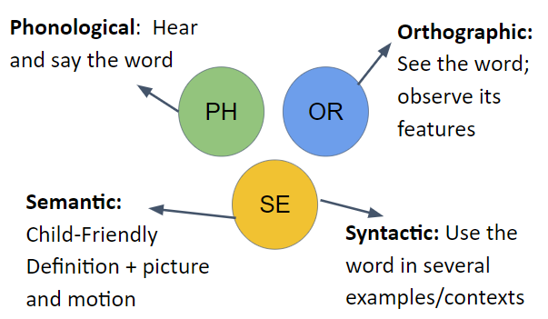
Plan Explicitly
Notes:
Speaker Notes:
As we discussed earlier, lexical quality depends on integrating three variables. An explicit vocabulary lesson should include:
a phonological component so that students can both hear the introduced term pronounced correctly, and opportunities to say the word aloud themselves, with corrective feedback if necessary.
the orthographic representation of the word, so that students can see how it is spelled and observe its features.
A clear, student-friendly definition of the word so students understand its meaning. This can also include a picture and a motion to help students understand and remember the word, and
The word should be embedded in several examples or used in multiple contexts, so students understand its role syntactically.

Slide 18

Features of Effective Instruction
Explicit Vocabulary Routine
Explicit – clear explanations, teacher modeling, student practice
Engaging – motivating, multisensory, and snappy pace to keep interest
Elicit Word Use- Ensure students have many opportunities to think, speak and engage with the word
Repetition – Multiple exposures and opportunities to use the word in meaningful contexts
Notes:
Speaker Notes:
Effective vocabulary instruction is:
Explicit, with clear explanations, teacher modeling, and ample opportunities for student practice.
Engaging, with a planned sequence that is motivation, multisensory and moves at a snappy pace.
It ensures that we elicit word use, so that students have many opportunities to speak, think, and engage with the word. This includes positive corrective feedback during instruction.
Effective vocabulary instruction also includes repetition, with multiple exposures to the word and opportunities to use the word in meaningful contexts

Slide 19

Vocabulary Instructional Routine
1. Introduce the word
2. Present a student-friendly explanation
3. Clarify the word’s meaning
4. Actively engage students in using the word
6. Expand students’ understanding and use of the word
5. Check for students’ understanding of the word
Notes:
Speaker Notes:
The components of an effective explicit vocabulary lesson using the vocabulary instructional routine include six basic steps:
Step 1: Introduce the word
Step 2: Present a student-friendly explanation
Step 3: Clarify the word’s meaning
Step 4: Actively engage students in using the word
Step 5: Check for students’ understanding
Step 6: Expand students’ understanding and use of the word.

Slide 20
Step 1: Introduce the Word
Phonological
Say the word
Prompt students to repeat the word
Break into syllables
Watch for proper pronunciation
Orthographic
Show the word
‘Scoop’ the syllables
With older children, highlight meaningful word parts
Notes:
Speaker Notes:
After carefully selecting the words that you will teach explicitly, plan for how you will introduce the word. The introduction of the word should include both the phonological and the orthographic representations of the word. This allows students to hear the word and to see it in print, and to say the word aloud and see a model of how it is decoded.
When introducing the word, we say and show the word, and prompt students to repeat it.
Then, we break the word into syllables and model “scooping” the syllables with the printed word.
Recognizable spelling patterns that help with decoding can be noted, as well as spelling patterns that are irregular or unfamiliar.
The introduction of the word is also an opportunity to look for meaningful word parts such as prefixes, suffixes or roots that students may be familiar with or that will expand their understanding and connect to other words they know.

Slide 21

Step 2: Present a Student-Friendly Explanation
Short, easy to understand
Connect to words and concepts a child already knows
States distinguishing attributes
Sprinkling means raining lightly.
Apparently is an adverb used when it appears something is true, but you are not certain.
Exasperated describes feeling frustrated or annoyed.
Spanish cognate: exasperada/exasperado
Notes:
Note: This slide is animated.
Speaker Notes:
The next step in planning is to thoughtfully craft student-friendly explanations for the words you’ve selected. These definitions should be short and easy to understand utilizing connections to words or concepts a child already knows and stating distinguishing attributes. Avoid dictionary definitions that are complex or confusing.
(Click to reveal examples) Read the example explanations in the purple box.
Whenever possible, include in your planning a visual representation or a motion or gesture that represents the word.
(Click) Here we have a picture of a woman showing what it might look like to be exasperated; this could also be a motion you teach to students to support their understanding of the word.
If you support Multilingual learners, take the time to investigate whether there are cognates (similar words with the same meaning) in their home language(s) for the terms you are teaching. A quick connection to concepts in their first language can significantly enhance English vocabulary knowledge.
(Click) For example: exasperated has a Spanish cognate: exasperada/exasperado

Slide 22
Step 3: Clarify the Word’s Meaning
When I am running late for work and my son won’t put his shoes on, I feel exasperated.
When I want a bowl of ice cream, but I find out my sister took the last scoop, I am ____________.
When my mom is not listening and I have to repeat myself three times, I feel __________.
Give examples/use in context (concrete, visual, or verbal)
Elicit word use by students
Notes:
Speaker Notes:
The third step is to clarify the words meaning.
This is when we provide thoughtful, relatable examples of the word in context. These can be concrete, visual, or verbal examples.
Examples provide an excellent opportunity for the students to repeat the word aloud, providing repetition and embedding the word’s pronunciation in their phonological lexicon.
The example sentences in the purple box give several relatable examples of how the word is used in context. Once the first example is given, plan to pause and have the students say the word to fill in the examples you share.
(READ the examples, modeling pausing for participants to say the word “exasperated” on the second and third example sentences).

Slide 23
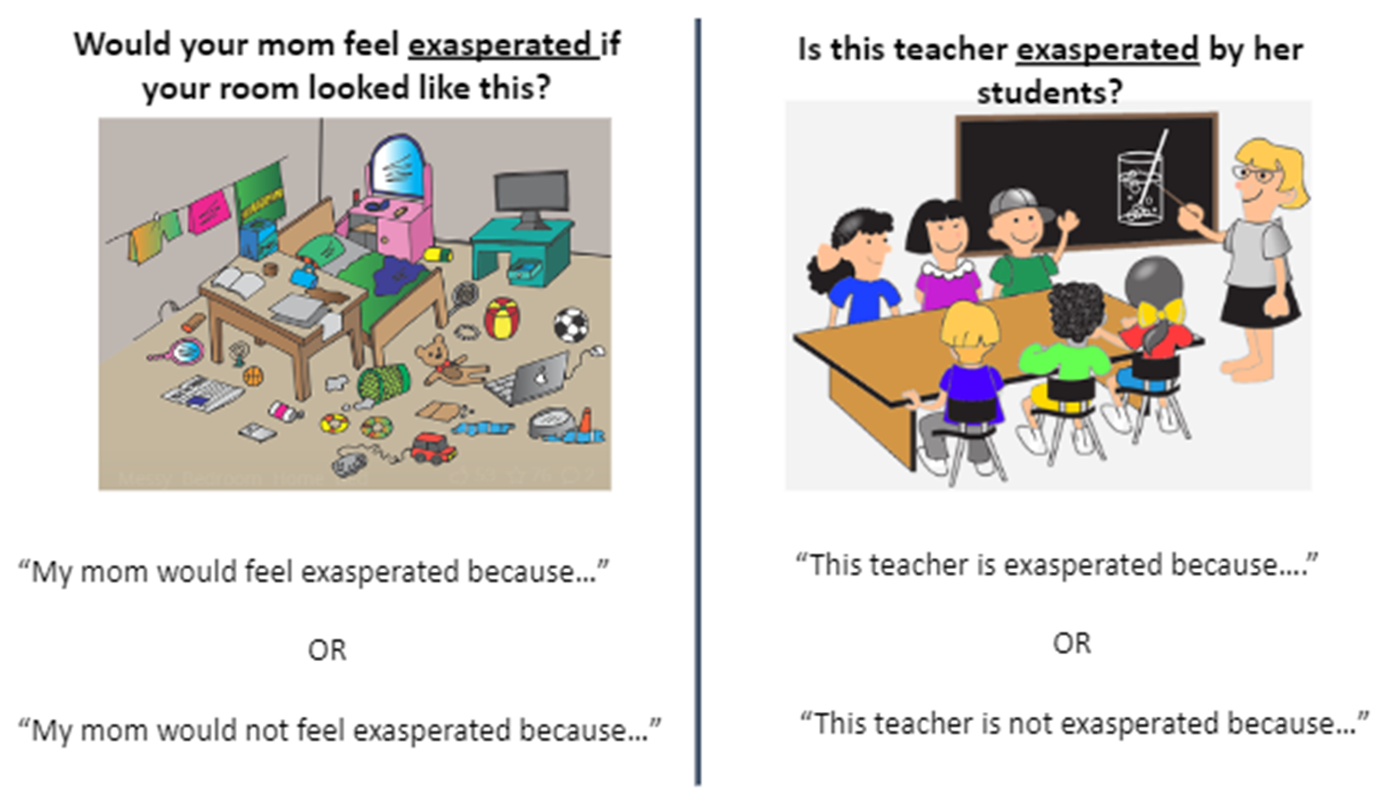
Steps 4 & 5: Actively Engage Students in Using the Word and Check for Understanding
Notes:
Speaker Notes:
A part of monitoring students understanding is to elicit word use. Here is an example of how examples and non examples can be used to engage students in using new vocabulary while also thinking deeply about its meaning.
(go over examples, pointing out that the sentence stems provide oral language scaffolds and encourage students to use the new terms in complete sentences.)
There are no right or wrong answers to these examples if the student can use the vocabulary term correctly, and having to provide a reason for their thinking supports a student’s oral language and critical thinking skills as well as a deeper understanding of the word.
Listening in as student’s share their thinking together provides excellent opportunities to give corrective feedback or extend oral language practice.

Slide 24






Step 6: Expand Understanding and Use of the Word
What are some other situations that could make you feel exasperated?
If you are feeling exasperated, what could you do to calm down?
Notes:
Speaker Notes:
Step 6: Expand understanding and use of the word.
The last step provides and opportunity for students to think more deeply about how the word is used and expand it to new contexts or situations. It also allows an opportunity to explore opposites (or antonyms), connotations of the word, word origin or etymology, or historical contexts that might interest students. It can also be a great way to connect to other vocabulary you have taught or connect to situations that may arise in your text, content area, or classroom context.
For example, once students have learned the word “exasperated”, they can be asked to apply that term to additional situations.
(CLICK) Students might identify that a younger sibling throwing a temper tantrum might make them feel exasperated, or making a mess that is difficult to clean up. A traffic jam could be an exasperating experience that students connect to if they have seen a parent lose their cool in that situation!
(CLICK) Asking a questions like “if you are feeling exasperated, what could you do to calm down?” creates a deeper understanding of the word by connecting to its opposite.
(CLICK) Students may be able to identify that listening to soothing music, doing breathing exercises, or taking a run outside are all ways they could calm themselves if they were feeling exasperated.

Slide 25
Instructional Routine Look Fors
The teacher introduces the word (orally and written) and has students say the word.
The teacher expands students’ understanding and use of the word.
The teacher presents a student friendly explanation.
The teacher clarifies the word’s meaning.
Teacher actively engages students in using the word.
Teacher checks students’ understanding of the word.
After teaching a word, the teacher poses a set of questions that contain examples and non-examples of the word. Ask students, “Is ___ an example of ____?”
The teacher prepares sentence stems that require students to complete the sentence using vocabulary words that relate to the meaning in the context provided.
Words selected for direct instruction are high-utility, Tier 2 vocabulary applicable across content areas.
When appropriate, the teacher provides a visual and/or gesture to support word learning.
Notes:
Speaker Notes:
Here is a checklist to keep in mind when providing or observing explicit vocabulary instruction. This list can be used to guide grade level meetings to track implementation progress. This list can also be used to support coaching conversations and corrective feedback after administrator walkthroughs.

Slide 26
Modeling Instruction
Notes:
Speaker Notes:
In this section, we will model each component of the vocabulary routine.
Facilitator note: In order to model the vocabulary lesson effectively, it works best to have participants engage in the lesson as though they were students. This means participating in the lesson when asked to echo back, turn and talk to discuss the word or utilize a sentence stem, etc.
If you have reluctant participants or you know that a group you are working with will be difficult to engage in this type of modeling, you may decide to pull a few willing participants to be the “students” to model for the group. Use your best judgement as a facilitator so the modeling task goes smoothly and provides a good example of appropriate pacing, engagement, and collaboration. Further, it is important to practice the modeling section until you are comfortable delivering the lesson at a snappy pace. A solid model is key to supporting the efforts of participants as they plan their own instruction.

Slide 27
Step 1: Introduce the Word
descend
Notes:
Speaker Notes: Present as if teaching a lesson to a group of students.
“This word is descend. What’s the word? (descend)
“Clap it.” CLICK TWICE to see “scoops” in animation). “De--scend. How many syllables?” (2)
“The accent, or stress in this word is in the second syllable. de-SCEND. Say it with me!” (de-SCEND)
“This word has the letters SC in the middle. Lots of times these two letters say /SK/, but in this word, they simply say the /s/ sound: DESCEND. What’s the word? (DESCEND)”

Slide 28

Step 2: Provide a Student-Friendly Explanation
descend
Descend is an action that means to move downward.
Notes:
Speaker Notes: Present as if teaching a lesson to a group of students.
(Select a motion to use when giving the definition, and have participants model the motion when they repeat the definition. For example, simply moving your hand to indicate a downward motion, or walking fingers down your arm to mimic walking down a set of stairs. )
“Descend is an action that means to move downward. What does descend mean?” (to move downward)

Slide 29



Step 3: Clarify the Word’s Meaning
Notes:
Speaker Notes:
“When we walk down a flight of stairs, we descend the stairs.”
(Pause at the vocabulary word for participants to fill in the term in the two remaining examples):
“A hang glider coming in for a landing will (descend) from the sky.”
“A squirrel in a tree must (descend) to get back to the ground.”
Your turn!
Use the word in your own sentence. (This is an ideal situation to have students paired for “turn and talk”, to listen in and assess understanding.)
Optional sentence frame: “A ___________descends when _______________.” OR “I descend when I ________________.”

Slide 30


Steps 4 & 5: Actively Engage Students in Using the Word and Check for Understanding
Which picture is an example of descend? Which is not an example of descend?
Why?
The (first/second) picture is an example of descend because ___________.
The (first/second) picture is NOT an example of descend because ________.
Notes:
Speaker Notes:
Use Turn and Talk with a partner to explain your thinking about the word descend.
(e.g. “The first picture is an example of descend because the parachutes are floating down from the sky/the plane is flying downward, etc.
“The second picture is not an example of descend because the climbers are going up the mountain, not down.”
(This discussion with students would be a great time to introduce an antonym, for example “ascend”, with students. This can be mentioned during the modeling activity.)

Slide 31
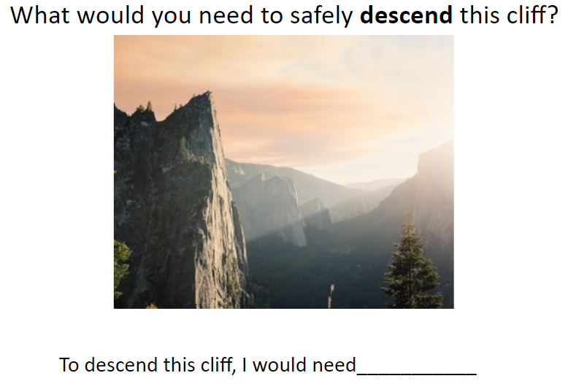
Step 6: Expand students’ understanding and use of the word
Notes:
Speaker Notes:
"What would you need to safely descend this cliff?"
Encourage participants to think like their students. There is no truly wrong answer if the creative mind can defend their response. “Suction cup shoes” would work if the student can explain how that would help them descend the cliff.

Slide 32

Scaffolding and Differentiation
Visual supports
Breaking the word into syllables or word parts (orally and visually)
Preparing in advance and providing sentence stems
Providing opportunities for discussion (e.g., Turn and Talk)
Identifying cognates in other languages
Careful consideration of words that may include Tier 1 word support, particularly for English Learners
Expanded word study
Notes:
The vocabulary routine contains a variety of scaffolds that naturally support all learners. When providing differentiation for your students, consider how the inclusion or exclusion of specific scaffolds may impact learners.
Scaffolding and differentiation can include:
Visual supports
Breaking the word into syllables or word parts (orally and visually)
Preparing in advance and providing sentence stems
Providing opportunities for discussion (e.g., Turn and Talk)
Identifying cognates in other languages
Careful consideration of words that may include Tier 1 word support, particularly for English Learners
Expanded word study for more advanced students, such as multiple meanings, morphological structures and etymology

Slide 33
Practice
Notes:
Speaker Notes:
In this section, we will provide time for you to plan and practice the vocabulary routine.

Slide 34

Interactive Activity
Partner Practice
Plan with your grade level team or colleagues
Practice the vocabulary routine with adjustments for your classroom
Select words to teach for an upcoming lesson
Identify student-friendly definitions, motions and/or visuals.
Plan examples/non-examples, and expansion activities
Notes:
Speaker Notes:
This is your opportunity to facilitate the practice with your participants.
Depending on whether you are presenting this session in person or virtually, it is important to provide time to plan and practice so that lessons are explicit, well-paced and engaging.

Slide 35

Implementation Considerations
Let’s take a few minutes to discuss how you will implement these routines in your classroom.
Consider:
Stages of understanding
Existing vocabulary routines or lessons
Cross-curricular applications
Corrective feedback
Opportunities for review
Extensions and connection
Notes:
Speaker Notes:
Let’s take a few minutes to discuss how you will implement these routines in your classroom.
Consider:
Stages of understanding
Existing vocabulary routines or lessons
Cross-curricular applications
Corrective feedback
Opportunities for review
Extensions and connection
Facilitator Notes:
This is the time to review expectations and discuss any roadblocks or plans for implementation. As a READ lead or administrator, you will want to tailor this discussion to include what is expected during walkthroughs and on lesson plans.

Slide 36


Debrief
After practicing this explicit vocabulary routine,
what questions do you still have?
Notes:
After practicing this routine, what questions do you still have?

Slide 37
Next Steps

Slide 38

Looking Ahead
Take a minute and think about all that you learned during this session.
Write down what you plan to do with the information you learned today during this session and how it will impact your students learning.
  How will you include this vocabulary routine in your daily lessons?
  What will this look like when an administrator does a walkthrough?
Notes:
Take a minute and think about all that you learned during this session.
Write down what you plan to do with the information you learned today during this session and how it will impact your students learning.
How will you include this vocabulary routine in your daily lessons?
What will this look like when an administrator does a walkthrough?
Facilitator Notes: You can follow up with this reflection later when meeting with teachers to guide PLCs, etc.

Slide 39
Vision | +
 | +
Vision | +
Vision | +
Vision | +
Vision | +
Skills | +
Skills | +
 | +
Skills | +
Skills | +
Skills | +
Incentives | +
Incentives | +
Incentives | +
 | +
Incentives | +
Incentives | +
Resources | +
Resources | +
Resources | +
Resources | +
 | +
Resources | +
Action Plan | =
Action Plan | =
Action Plan | =
Action Plan | =
Action Plan | =
 | =
CHANGE
CONFUSION
ANXIETY
RESISTANCE
FRUSTRATION
FALSE STARTS
Adapted from Lippett, M. Model for Complex Change (1987) and Knoster, T., Villa R., & Thousand, J. (2000). A framework for thinking about systems change. Villa, R. & J. Thousand (eds), Restructuring for caring and effective education: piecing the puzzle together (pp. 93-128). Baltimore: Paul H. Brookes Publishing Co.
Notes:
Remember, lasting positive change happens when we have carefully planned for all of the components.
Planning, practicing, and implementing high quality explicit vocabulary instruction provides a vision for what instruction should look like, gives both teachers and students the skills for success, and informs a plan of action in the classroom, but all pieces are necessary to ensure success.
As a staff, consider:
What components of the change model are in place in your school/district that support improving vocabulary instruction?
What could be improved upon to ensure success?

Slide 40
References

Slide 41
References
Archer, A. L., & Hughes, C.A. (2011). Explicit Instruction. New York, NY: Guilford Press.
Beck, I.L., McKeown, M.G., Kucan, L. (2002). Bringing Words to Life: Robust vocabulary instruction. New York, NY: Guilford Press.
Beck, I.L., McKeown, M.G., Kucan, L. (2013). Bringing Words to Life: Robust vocabulary instruction, 2nd Ed. New York, NY: Guilford Press.
Beck, I.L., McKeown, M.G., & Omanson, R.C.(1987). The effects and uses of diverse vocabulary instructional techniques. In M.G. McKeown & M.E. Curtis (Was.), The nature of vocabulary acquisition (pp. 147-163). Hillsdale, NJ: Erlbaum.
Biemiller, A. (1999). Language and reading success. In J. Chall (Ed.), From reading research to practice: A series for teachers. Cambridge, MA: Brookline Books.
Biemiller, A. (2001). Teaching vocabulary: Early, direct, and sequential. The American Educator, 25(1), 24–28.
Biemiller, A. (2005). Size and sequence in vocabulary development: Implications for choosing words for primary grade instruction. In E.H. Hiebert &M.L. Kamil (Eds.), Teaching and learning vocabulary: Bringing research to practice (pp. 223-242). Mahwah, NJ: Lawrence Erlbaum.

Slide 42
References
Gough, P. B. & Tunmer, W.E. (1986). Decoding, reading, and reading disability. Remedial and Special Education, 7(1).
Kilpatrick, D. A. (2015). Essentials of assessing, preventing and overcoming reading difficulties. Hoboken, NJ: Wiley.
Moats, L.C. (2009). The mighty word: Building vocabulary and oral language, 2nd ed. Longmont, CO: Sopris West.
National Reading Panel. (2000). Teaching children to read-An evidence-based assessment of the scientific research literature on reading and its implications for reading instruction (NIH Publication No. 00-4769) Washington, DC: National Institutes of Child Health and Human Development.
Perfetti, C.A. & Hart, L. (2002) The lexical quality hypothesis. In L. Verhoeven, C. Elbro and P. Reitsma Precursors of Functional Literacy, v. 11. (pp. 67-86). Philadelphia, PA: John Benjamins Publishing Co.
Scarborough, H. S. (2001). Connecting early language and literacy to later reading disabilities: Evidence, theory, and practice. In S.B. Neuman and D.K. Dickinson (Eds.), Handbook of early literacy research (p. 98) New York, NY: Guilford Press. ​
​
Stahl, S.A., & Nagy, W.E. (2006). Teaching word meanings. Mahwah, NJ: Erlbaum.

