Slide 1
Structured Partner Reading Routine
CDE Science of Reading Literacy Series
Fluency
Notes:
Welcome to the Science of Reading professional development series brought to you by the Colorado Department of Education Elementary Literacy and School Readiness office. This lab session is focusing on implementing a structured partner reading routine for fluency.

Slide 2
Preparing for this Session
Prior to this session, trainers and participants should view this brief video for an overview of key concepts and terminology:
Overview of Fluency
For this session, participants will need:
CDE Sample Fluency Passage
Fluency Structured Partner Reading Routine
Writing utensils
Additional Support Materials (optional):
Leader Look-Fors
Features of Effective Instruction Checklist

Slide 3
Introduction
Notes:
This lab session is designed to provide teachers and administrators with foundational knowledge in implementing a structured partner fluency reading routine. This session is designed as a turnkey presentation that a teacher leader or administrator can present to staff and then follow up with the implementation progress in subsequent observations and meetings.

Slide 4
Objectives
Understand the foundational knowledge for fluency skills
Engage in academic discourse on evidence-based instructional considerations
Incorporate a structured partner reading routine through modeling and practice
Determine personalized next steps for implementation
Notes:
Speaker Notes:
During this session, participants will
Understand the foundational knowledge for fluency skills
Engage in academic discourse on evidence-based instructional considerations
Incorporate a structured partner reading routine through modeling and practice
Determine personalized next steps for implementation

Slide 5
Key Terminology
Definitions
Fluency – the capacity to read words in connected text with sufficient accuracy, rate, and prosody to comprehend what is read
Accuracy – ability to orally read the words correctly
Rate – how quickly and accurately a reader reads connected text
Prosody – reading orally with expression, including proper intonation, pausing, and phrasing
Automaticity – the ability to read letters or words automatically without having to think about it
Orthographic Mapping – the mental process used to store words for immediate, effortless retrieval
Notes:
Speaker Notes:
(Option to read slide or allow a few minutes for participants to read slide)
Fluency is the capacity to read words in connected text with sufficient accuracy, rate, and prosody to comprehend what is read.
Accuracy is the ability to orally read the words correctly.
Rate refers to how quickly and accurately a reader reads connected text.
Prosody is reading orally with expression, including proper intonation, pausing, and phrasing.
Automaticity is the ability to read letters or words automatically without having to think about it.
Orthographic Mapping is the mental process used to store words for immediate, effortless retrieval.
References
Birsh, J. R. & Carreker, S. (2018). Multisensory teaching of basic language skills (4th ed.). Baltimore, MD: Brookes Publishing Co.
Colorado State Board of Education. Rules for the Administration of the Colorado Reading to Ensure Academic Development Act (READ act). 1 CCR 301-92, March, 2020.
Ehri, Linnea C. (2014) “Orthographic mapping in the acquisition of sight word reading, spelling memory, and vocabulary learning.” Scientific Studies of Reading, 18:1, 5-21.
International Dyslexia Association. https://dyslexiaida.org/definition-of-dyslexia/
Kilpatrick, D. A. (2015). Essentials of assessing, preventing and overcoming reading difficulties. Hoboken, NJ: Wiley.
Sedita, Joan. (2019). Keys to beginning reading teacher training manual. Rowley, MA: Keys to Literacy.
Moats, L.C. (2020). Speech to Print Workbook: Language Exercises for Teachers (3rd ed.). Baltimore, MD: Brookes Publishing Co.
“What Is the Science of Reading.” The Reading League, 8 Apr. 2022, https://www.thereadingleague.org/what-is-the-science-of-reading/.
* Definitions obtained from READ act rules from the State Board of Education

Slide 6
Scientifically Based & Evidence-Based
Simple View of Reading (SVR)
Fluency
Word
Recognition
Language Comprehension
Reading Comprehension
Gough, P. B. & Tunmer, W.E. (1986). Decoding, reading, and reading disability. Remedial and Special Education, 7(1).
Notes:
Speaker Notes:
Several decades of reading research have given us a clear understanding of how students best learn to read. One way to conceptualize reading is through the Simple View of Reading model. This model, developed by Gough and Tunmer, organizes the skills needed to become a proficient and successful reader into two categories: word recognition and language comprehension. The Simple View of Reading is a basic formula for reading comprehension. It says this: reading comprehension is the product of word recognition skills and language comprehension skills. We need both sides of the equation for students to become skilled, proficient readers.
How does fluency fit in this model?
Fluency is the bridge connecting word recognition and language comprehension.
Fluency is the result of early reading skills and subskills being explicitly taught with ample practice and review
Fluency is an integrating skill needed for phoneme awareness, letter naming, phoneme-grapheme mapping, sight word learning, vocabulary, passage context, metacognition and more.
This is illustrated within Scarborough’s Reading Rope on the next slide.
References:
Gough, P. B. & Tunmer, W.E. (1986). Decoding, reading, and reading disability. Remedial and Special Education, 7(1).
Note Source: https://www.cde.state.co.us/coloradoliteracy/scienceofreadingresources

Slide 7
Scientifically Based & Evidence-Based
Scarborough’s Reading Rope
Language Comprehension
Reading Comprehension
Word
Recognition
Notes:
Speaker Notes:
Scarborough’s Reading Rope (2001) demonstrates how the subskills that comprise word recognition and language comprehension work in tandem and allow students to read fluently and coordinate automatic word recognition with text comprehension. This infographic continues to inform the design and delivery of effective reading instruction.
(Click) The top portion of the rope details the skills needed in the language comprehension category shown here in green. These skills are: background knowledge, vocabulary, language structures, verbal reasoning, and literacy knowledge.
(Click) The word recognition, or word reading skills, are phonological awareness, decoding, and sight recognition.
(Click) As the language comprehension skills become strategic and word recognition skills become automatic, a student becomes a skilled reader.
(Click) This means their reading is fluent and their language skills are adequate so that the reader isn’t having to focus their mental energy on either the language comprehension, or the word recognition and they are able to focus on understanding what they are reading.
Students need to develop all these skills to become successful, proficient readers.

Slide 8
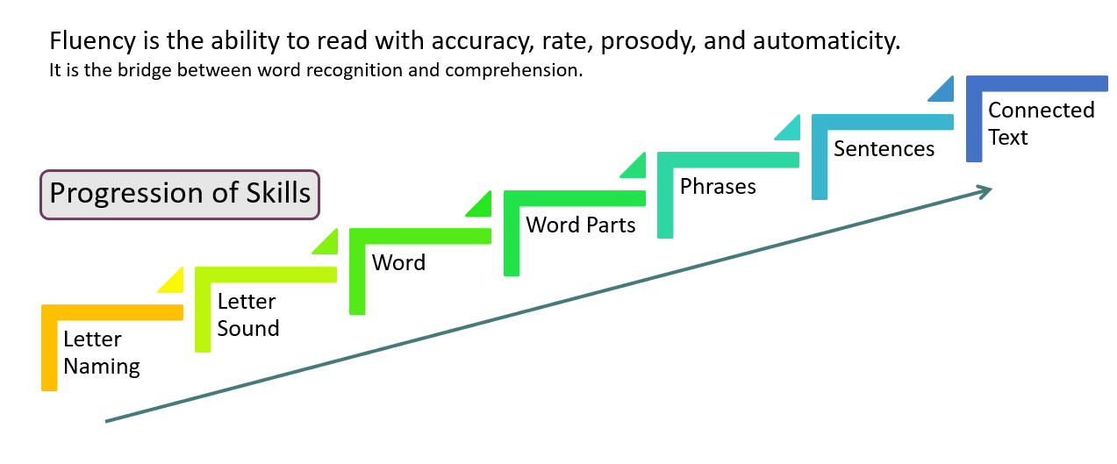
Progression of Fluency Skills
Notes:
Speaker Notes:
To accurately gain insight about students’ literacy development, it is important to consider the progression of fluency skills, beginning with letter naming and letter sound fluency, then word, word parts, phrases, sentences, and lastly, fluency with connected text.
When looking at this progression, it is important to note that when we move from the letter sound level to word level, we are focusing on CVC, CVCC, etc. base words and at the word part level, we are focusing on prefixes, suffixes, and multisyllabic word parts.
This process starts early. “Fluency develops in progressions: Accuracy then automaticity at the letter, letter-pattern, and word levels plus semantic and syntactic processes at the word and phrase level.” (Wolf & Katzir-Cohen, 2001)
Jan Hasbrouck describes this process as “we start with accuracy at each of those component skills and then we move through our instruction and practice to automaticity at those individual skill levels and hope that leads to overall passage fluency.” (Hasbrouck & Glaser, 2019)

Slide 9
Levels of Fluency Practice
PHRASE READING
The frog jumped /into the pond.
SENTENCE READING
The frog jumped into the pond.//
READING CONNECTED TEXT
The frog jumped into the pond.// He made a big splash.//
Notes:
Speaker Notes:
Fluency is the outcome of a progression of mastered skills and subskills.
Once students have become increasingly automatic with letter and word recognition skills, they should be provided with multiple opportunities to practice in connected text.
When students are reading text with a high degree of accuracy, targeted fluency practice can be provided to improve prosody and rate.
At the phrase reading level, practice includes isolated practice with commonly used phrases and breaking or scooping text into meaningful chunks to develop prosody.
Sentence level practice includes attending to punctuation, morphology, and syntax.
Fluency practice in connected text allows students to coordinate all of these components and maintain rate over a larger volume of text. Utilizing connected text also supports the development and maintenance of text comprehension.

Slide 10
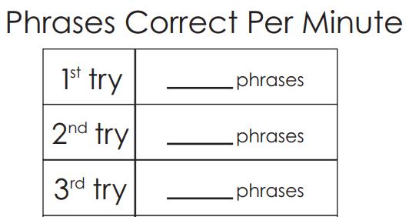
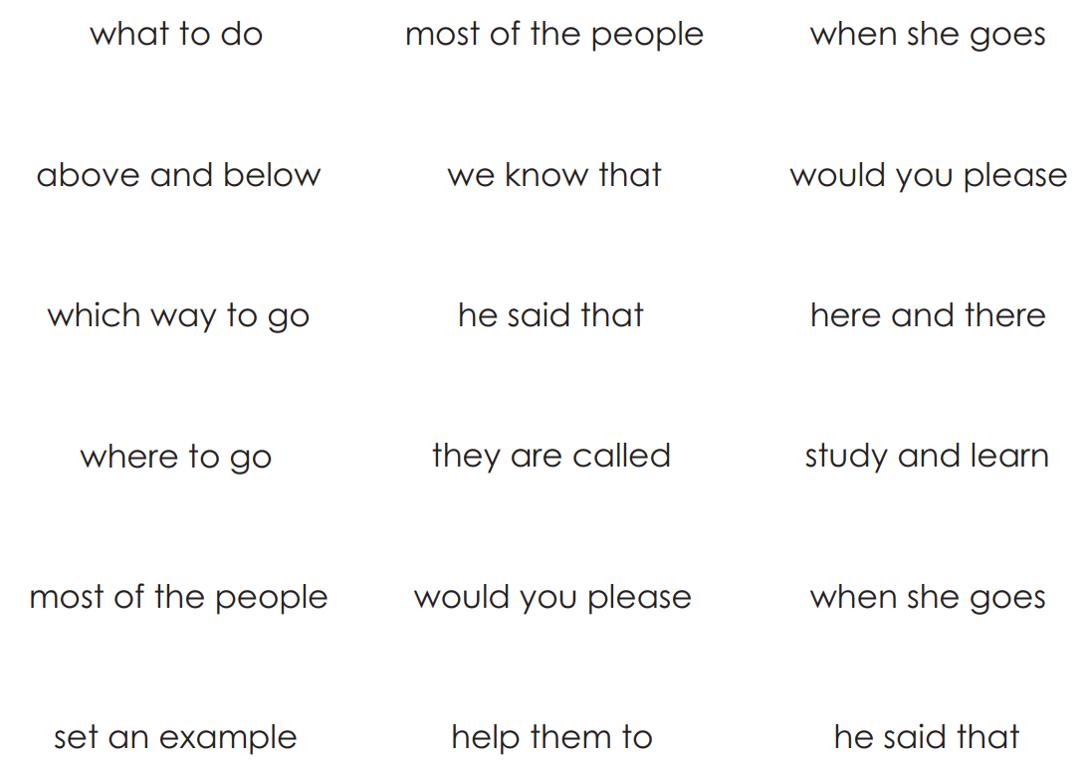
Warm-Up
FCRR Phrase Speed Practice
Notes:
Facilitator Notes: For this warm-up, you will use this activity to facilitate a guided discussion about how and when to incorporate this type of fluency practice in your classroom.
Speaker Notes:
What would we need a student to know before using this as a fluency practice?
At what skill level would this practice be appropriate?
How could this kind of practice support improved fluency in connected text that contains these phrases?
How could this practice support building prosody?
Possible talking points:
Procedure for teaching heart words
Model what phrase reading looks like
Partnership protocols
How to calculate phrases or total words read per minute
https://fcrr.org/sites/g/files/upcbnu2836/files/media/PDFs/student_center_activities/23_fluency_phrases/23_f014_phrase_speed_practice.pdf

Slide 11
Setting the Foundation
Notes:
This is a review of essential elements necessary for providing quality fluency instruction.

Slide 12
How to Develop Fluency Skills
Direct and explicit instruction in phonological awareness and decoding skills
Ample guided practice to develop automaticity
Corrective feedback to ensure accuracy
Building reading fluency is comparable to learning any new skill whether it is playing a sport, riding a bike, playing an instrument, etc.
Notes:
Speaker Notes:
To develop fluency skills appropriately, it is crucial to provide direct, explicit instruction in phonological awareness and decoding skills with ample opportunities to practice and corrective feedback to ensure accuracy.
A reader who does not attain automaticity in word recognition is said to be “glued” to the print. (Chall,1983) The reader must focus all their attention on sounding out words and is diverted away from figuring out the meaning.
Research shows that the number of repetitions needed to reach reliable word reading accuracy for average young readers is 4-14 repetitions and more than 40 repetitions for students with reading difficulties (Reitsma,1983a, 1983b).
Building reading fluency is comparable to learning any new skill whether it is playing a sport, riding a bike, playing an instrument, etc.

Slide 13
Effective Fluency Activities
Effective fluency practice activities:
choral reading
cloze reading
structured partner reading
repeated reading
augmented silent reading for readers that are already reasonably fluent
Struggling readers do not benefit from silent reading practice.
Notes:
Speaker Notes:
How do you know when students are ready for direct fluency practice?
Students should be at least 90% accurate in connected text. A typical reader might reach this by the middle of first grade.
Effective practice activities include choral reading, cloze reading, structured partner reading, repeated reading, and augmented silent reading for readers that are already reasonably fluent.
Struggling readers do not benefit from silent reading practice.
Also, it’s important to note that once a student can read accurately and fluently at or above the 50% percentile for their grade level, efforts focused on just increasing rate are likely not beneficial.

Slide 14
How Fluency Skills Progress
Kindergarten
Focus on accuracy with decoding
Fluency practice with letter naming, letter sounds, word reading
Can extend practice to connected decodable text that has been explicitly taught
First Grade
Focus is still primarily on accuracy with decoding
Fluency practice with letter sounds, word reading, connected text
Once students are accurate, can provide additional practice to increase rate with word reading and connected text
Second/Third Grades
Focus shifts to include all aspects of fluency; accuracy, rate, and prosody
Fluency practice in connected text
This is a continuum, and you can go back to skills based on individual student needs to ensure mastery
Notes:
Speaker Notes:
This is a general progression for fluency skills from kindergarten to third grade.
Typically, in kindergarten, these activities would be done in whole group or one on one with the teacher with a focus on accuracy and automaticity. Kindergarten students should not be expected to calculate WCPM and time each other to calculate rate.
Structured partner practice for fluency is appropriate for middle of 1st-3rd students and beyond with letter sounds, word and phrase reading, and connected text. In upper grades, partner practice for fluency will primarily be with connected text.
It is important to note that this is a continuum of skills and that you can go back to skills based on individual student needs to ensure mastery before moving on.

Slide 15
Calculating Words Correct Per Minute
Rate is calculated by taking the total number of words read from a text in 1 minute and subtracting the number of errors. This total is called WCPM – Words Correct Per Minute.
Accuracy is calculated by taking the number of words read correctly by the total number of words read to get the percentage of words read accurately.
Notes:
Speaker Notes:
A student’s reading fluency can be calculated to pinpoint the level of accuracy and rate.
Reading rate is calculated by taking the total number of words read from a text in 1 minute and subtract the number of errors. This total is called WCPM – Words Correct Per Minute.
When assessing fluency, it is important to note that a higher WCPM is not necessarily better. Speed should not be emphasized over accuracy or prosody. The goal is for students to read accurately with an adequate rate and appropriate prosody to facilitate comprehension.
Accuracy is calculated by taking the number of words read correctly by the total number of words read to get the percentage.
For more accurate scores, do this 3 times and find the average among the 3 scores.
In practice, it is also important to allow time for listening to students read for more than 60 seconds. This will help you observe and informally assess all 3 components of fluency and the student’s overall grasp of the mechanics of fluency as the year progresses.
During structured partner fluency practice, partner 2 will set a timer for 1 minute and track how many words are read by partner 1 on their recording sheet. At the end of the time, partner 2 will calculate how many total words read and then subtract the number of errors to get the words correct per minute. Most fluency practice sheets will have the number of words per line out to the side.

Slide 16
Corrective Feedback
During an untimed reading, | After a timed reading,
When an error occurs, the student politely says, “Pause, you read that word incorrectly. Try again.” | “You read ____ words. I heard ___ errors.
If the reader cannot pronounce the word, their partner provides the word. | You read ___ correct words per minute.”
The reader then reads the word in the sentence and then continues reading. | Student will point to any reading errors their partner made, one word at a time, and pronounce the word correctly. The partner will then read the word again correctly."
Notes:
Speaker Notes:
Corrective Feedback Prior to implementing Partner Reading, students should be taught an error-correction procedure to help correct word-reading errors. When an error occurs, the student politely says, “Pause, you read that word incorrectly. Try again.” If the reader cannot pronounce the word, their partner provides the word. The reader then reads the word in the sentence and then continues reading.
It is important to note, however, that this error correction procedure during the timed reading routine will affect how many words the student gets to. In this case, you can direct students to share the errors and provide corrective feedback after the timing is complete.
“You read ____ words. I heard ___ errors. You read ___ correct words per minute.”
Student will then point to any reading errors, one at a time, and can use dialogue and procedure on this slide.
For our practice today, we will be timing the text reading and utilizing the corrective feedback dialogue after reading.
In order for the partnership model to be successful, students need to work together in a polite and respectful manner. Students need to be instructed in appropriate fluency partnership behavior (e.g., leaning in and whispering), remembering that the only people who need to hear them are their partners, and providing appropriate corrective feedback on missed words or letter-sounds. Addressing classroom noise level during training is key to preventing many potential problems.
As a reminder, it is also important to ensure that your students can work independently by choosing appropriate text, providing direct pre-teaching support and an established procedure for what to do if both partners encounter a word they don’t know.

Slide 17
Preparing for Instruction
Notes:
In this section, we will break down the components of the structured partner reading routine and provide tips for preparation and implementation.

Slide 18
Features of Effective Instruction
Structured Partner Fluency Practice Routine
Explicit – clear explanations, teacher modeling, student practice
Systematic – focus on 1 or 2 skills at a time moving from simpler to more complex progression
Engaging – motivating and snappy pace to keep interest
Duration – once established, this routine can be done in less than 10 minutes daily
Notes:
Speaker Notes:
When planning for effective structured partner fluency practice, it is important to have a routine using these features of effective instruction.
Instruction should be:
Explicit –including clear explanations, teacher modeling, student practice
Systematic – instruction moves from simpler to more complex skills, with a focus on 1 or 2 skills at a time
Engaging – instruction should move at a snappy pace, include motivating tasks or activities that keep students focused on the task
Duration – once established, this routine can be done in less than 10 minutes daily

Slide 19
Structured Partner Fluency Practice Routine
1. Set the purpose
2. Select materials and partners
4. Practice
3. Provide a model
Notes:
Speaker Notes:
This routine is broken up into 4 main parts.
Step 1: Set the purpose
This is where we tell students the learning objective and why it is important. The purpose sets the tone for the routine and reminds students to focus on the task at hand.
Step 2: Select materials and partners
For this routine, it is important to pre-select partners and text to support student goals.
Step 3: Provide a model
Effective instruction should be explicit with clear, concise directions and teacher modeling so students know exactly what to do each time they are instructed to do fluency partner practice.
Step 4: Practice
At this point, students know the task and should be able to move through text practice with the timer and documenting progress. Providing ample practice and corrective feedback helps students to develop accuracy and automaticity with the skill.

Slide 20
Step 1: Set the Purpose
Structured Partner Fluency Reading Routine
What do you want students to know about the task? What are students expected to do?
Consider carefully the procedures, materials, and verbiage you will use with students for corrective feedback.
State the purpose/objective in student-friendly language.
Structured Partner Reading
Set the Purpose
“When we read, we focus on decoding the words accurately and at a good pace. This is called reading fluency. Today, we are going to practice reading fluently with a partner.”
Notes:
Speaker Notes:
When planning to implement a structured partner reading routine, we want to intentionally set the purpose with students, so they are clear about what they are being asked to do and what the objective is for learning and practicing.
Consider which task students will be asked to perform. What do you want them to know about the task? What do you want them to do?
Consider carefully the procedures, materials, and verbiage you will use with students for corrective feedback.
Finally, state the purpose or objective explicitly, clearly and in student-friendly terms. Here is an example of setting the purpose for this routine.
Set the Purpose
“When we read, we focus on decoding the words accurately and at a good pace. This is called reading fluency. Today, we are going to practice reading fluently with a partner.”

Slide 21
Step 2: Select Partners and Materials
Selecting Text
Levels of Text Difficulty
Level | Accuracy | Use For
Independent Level | 95-100% (fewer than 5 errors per 100 words) | Independent Reading Choral Reading Phrase Reading Computer-Assisted Partner Reading Timed Reading
Instructional Level | 90% to 100% (fewer than 10 errors per 100 words) | Teacher-Assisted Reading With Feedback and Support Small-Group Reading to Instruct
Frustration Level | Less than 90% (more than 10 errors per 100 words) | Teacher Read-Aloud Hearing fluent reading modeled, but not appropriate for instruction
Notes:
Speaker Notes:
When selecting text for partner practice, it is important to provide reading material at both reader’s independent text level.
One easy way to match books to students’ text difficulty levels is to give the students a list of words from the text. If students have difficulty with no more than approximately 1 in 10 words, the text is considered to be at their instructional level. To develop fluency when students read independently, the text should be at their independent level, and when students read with feedback from the teacher, the text should be at their instructional level.
Model and explain partner reading procedures before students begin the process of reading together and have a few students partner and role-play the procedures.

Slide 22
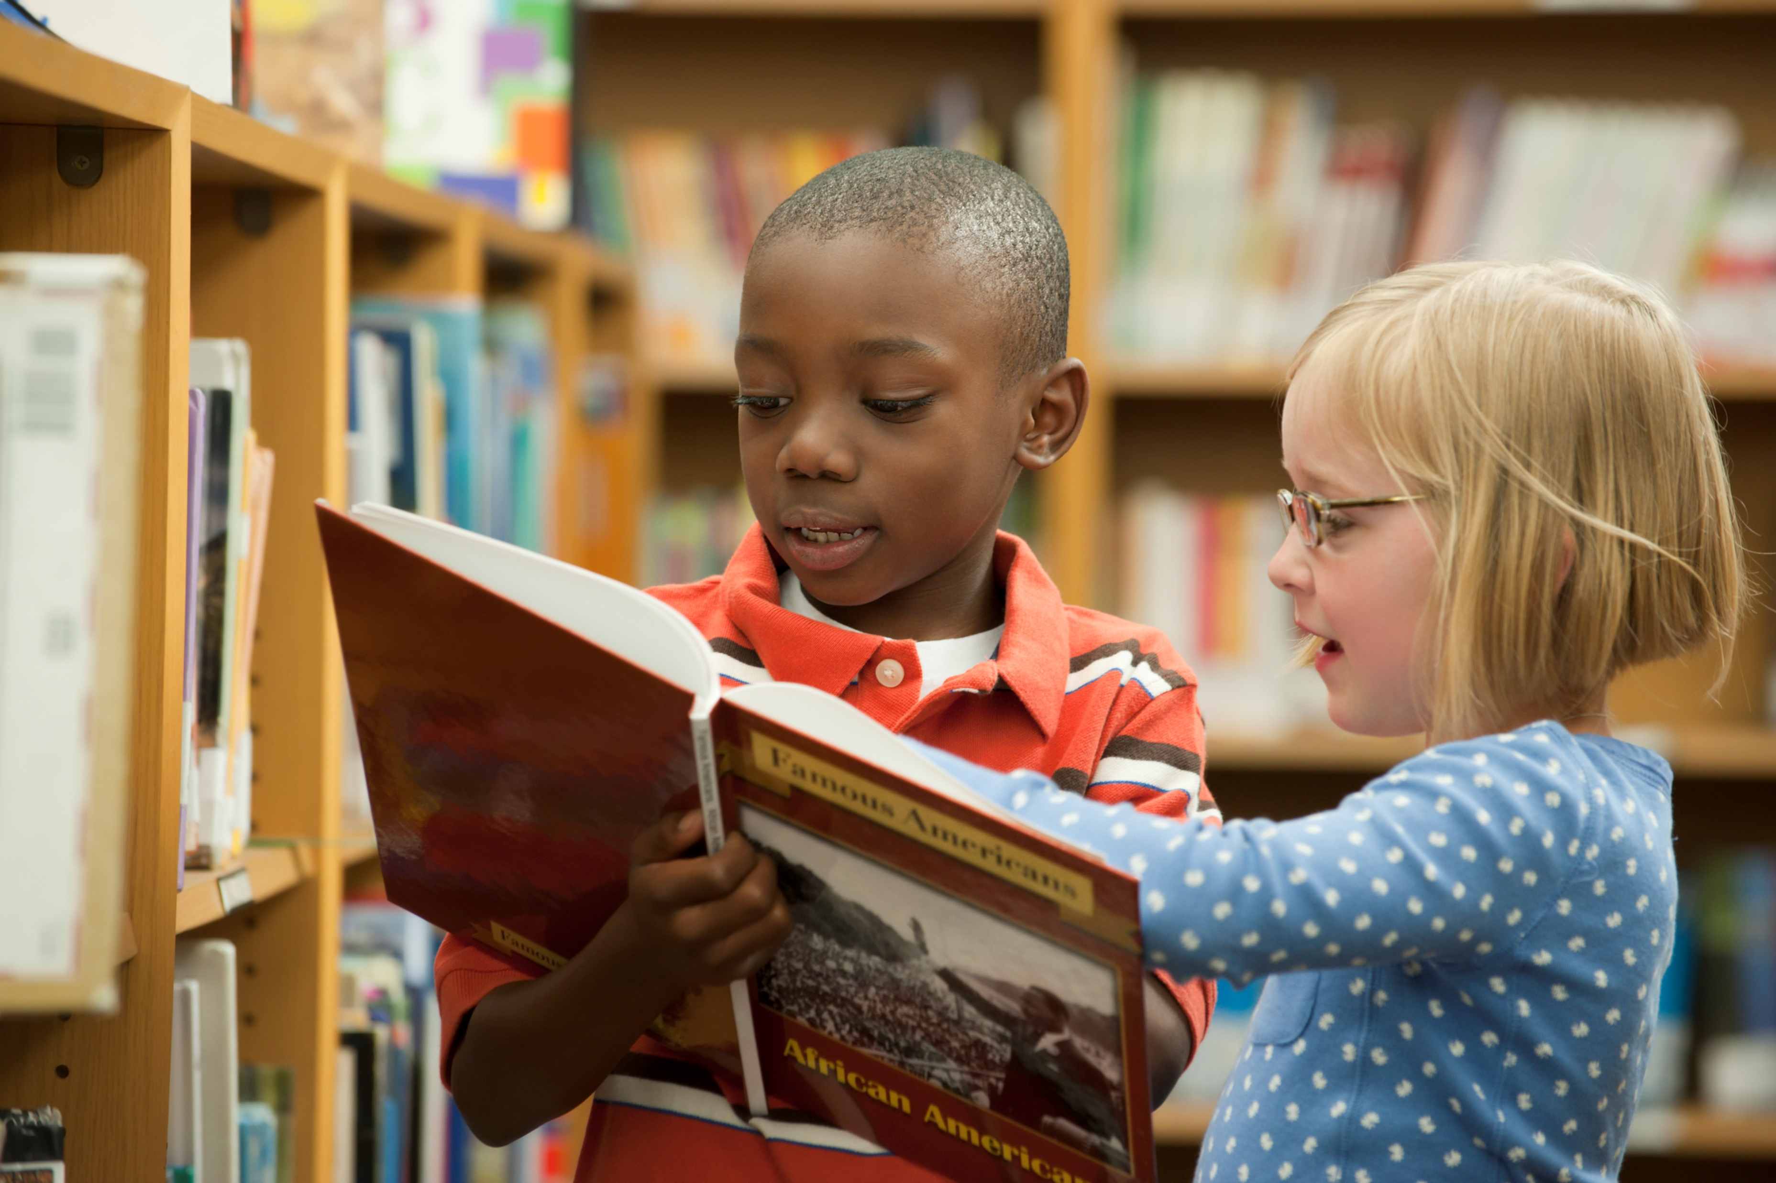
Step 2: Select Partners and Materials
Adapted from 6 Minute Solution
Student 1 | Student 9
Student 2 | Student 10
Student 3 | Student 11
Student 4 | Student 12
Student 5 | Student 13
Student 6 | Student 14
Student 7 | Student 15
Student 8 | Student 16
Small Group with Teacher
Student 17 Student 18 Student 19 Student 20 Student 21
Notes:
Speaker Notes:
Next, let’s focus on selecting partners for this routine.
Keep in mind, this does not mean asking students to read with the person sitting closest to them.
First, establish partners based on similar reading ability. This can be done by creating a list of your students from most proficient to least proficient in reading. This list is based on your observational, formative data as well as the initial screening and diagnostic assessments.
An example of an appropriate match is a partnership between two third-grade students whose shared independent text level and whose oral fluency rates are within ten words of each other.
Then, look at your students at the bottom of the list. Would it be more beneficial for these students to be in a small group with you focused on more explicit instruction in foundational skills instead of partnering independently?
If you have students at the top of the list who are significantly advanced, you can consider pairing them together and providing an activity more focused on prosody.
After updating the list to include the students that can do partner reading, partner the students by splitting the list in half and pairing the top reader (student 1) with the reader at the top of the second half of the list. In this example, student 1 is paired with student 9, student 2 is paired with student 10, etc.
This allows for heterogenous grouping within reason so that the most proficient reader is paired with an average reader and mitigates frustration for the partnership. It also ensures that a struggling reader is paired with a more proficient reader for modeling and support.
When selecting partners, make sure to designate the more proficient reader in each partnership to go first. From there, ensure that the pairs will work well together and adjust as needed.
These pairings will change throughout the year based on assessments, growth, and progress monitoring.

Slide 23
Tools and Materials
Folders
Student copies of the text
Pencils
Highlighters
Timer
Notes:
Speaker Notes:
For this routine to be successfully implemented, materials should be prepared in advance and organized in a way that allows for quick and easy access. Students will need copies of the text to read and write on along with writing utensils. A timer can be used per pair of students or one for the class used by the teacher.
While this routine will focus on practicing a timed text reading, partner reading can also be utilized as an untimed practice where students can read and reread text together and provide corrective feedback during reading.

Slide 24
Step 3: Provide a Model
Structured Partner Fluency Reading Routine
Students pair up.
Teacher sets a timer for one minute.
One student reads while the partner follows along, underlining any word errors and circling the last word read.
Partner tells the reader how many correct words were read, and the reader records the number on their fluency record.
Reset the timer for another minute. Students repeat the process, with roles reversed.
(Adapted from 6 Minute Solution)
Notes:
Speaker Notes:
As we move through the preparation of this routine, it is important to note the general procedure for this effective practice. Once this routine is established with partners and materials, it can be facilitated in a short amount of time at an engaging and snappy pace.
Prior to starting this routine, teachers will need to set up structure for what texts will be used, how to work with a partner, and provide recording sheets for accountability.
Students pair up. Teacher sets a timer for one minute. One student reads while the partner follows along, underlining any word errors and circling the last word read. Partner tells the reader how many correct words were read, and the reader records the number on their fluency record. This is the final timing. The teacher then resets the timer for another minute. Students repeat the process, with roles reversed.

Slide 25
Step 4. Practice
Structured Partner Fluency Reading Routine
What will you say and do? What are students expected to say and do?
What language will you use to set this procedure and provide corrective feedback? Plan your materials and partners in advance, adjusting with data updates. Explain and model all the parts of this routine before starting so students are aware of expectations during this time.
Be mindful of:
Organization of materials
Additional partner considerations
Adequate modeling and practicing the procedure
Structured Partner Reading
"Now it is your turn. I am going to set the timer for one minute.
“Partner 1s will start whisper reading so only their partner can hear.”
“Partner 2s, while your partner is reading, you will follow along and underline any errors you hear.”
“When the time is up, Partner 2 will circle the last word where Partner 1 stopped.”
“Then Partner 2 will figure out Partner 1's correct words per minute, or cwpm, score.”
"Finally, you will point to any reading errors your partner made, one word at a time, and pronounce the word correctly for your partner. Your partner will then read the word again correctly.“
Notes:
Speaker Notes:
When you are ready for students to practice the skill you have modeled, effective planning includes having a prepared text and a predictable process for practicing the skill at a snappy pace.
Consider how you will prompt students and what students are expected to say and do in return.
Plan the text that you will use to practice the skill. Some curriculums will have materials readily available; other times, you will be responsible for finding texts to work with. When developing or reviewing materials, be mindful of any spelling patterns that students have and have not yet received explicit instruction on.

Slide 26
Modeling Instruction
Notes:
In this section, we will model each component of the structured partner practice routine and provide support for scaffolding and differentiation.

Slide 27
Step 1: Set the Purpose
Structured Partner Fluency Reading Routine
“When we read, we focus on decoding the words accurately and at a good pace. This is called reading fluency. Today, we are going to practice reading fluently with a partner.”
Notes:
Speaker Notes:
Step 1 of the routine is to set the purpose. The Sample Structured Partner Reading Routine provides this scripting:
“When we read, we focus on decoding the words accurately and at a good pace. This is called reading fluency. Today, we are going to practice reading fluently with a partner.”
As a reminder, it is important to have the more proficient reader read to the less proficient reader first. Make sure that this is established before the students practice.

Slide 28
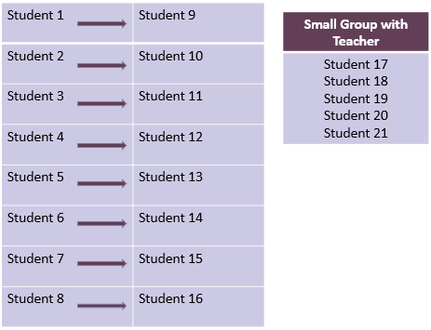
Step 2: Select Partners and Materials
Structured Partner Fluency Reading Routine
"In your partnerships, one of you will be Partner 1 and one of you will be Partner 2. All Partners 1s will read at the same time while all Partner 2s will listen, follow along, and underline any reading errors.”
Notes:
Speaker Notes:
Clearly model the expectations for this practice with the materials and defined partner roles. Once the routine is set, this part can be shortened or eliminated.
Prior to starting this routine with your class, prepare the materials and partners by assessing each student’s current level of oral reading proficiency.
Materials should be selected based on students’ ORF scores, placement within the skill progression, and any other relevant data.
Text for fluency practice is at the students’ independent level with at least 95% accuracy.
For organization, set up procedures for meeting up with partners and gathering materials. The timer for 1 minute can be used per pair or as whole class by the teacher.

Slide 29
Step 3: Provide a Model
Structured Partner Fluency Reading Routine
Students pair up.
Teacher sets a timer for one minute.
One student reads while the partner follows along, underlining any word errors and circling the last word read.
Partner tells the reader how many correct words were read, and the reader records the number on his/her fluency record.
Reset the timer for another minute. Students repeat the process, with roles reversed.
Notes:
Speaker Notes:
Lead the participants through this activity by reviewing the outline of this routine on the slide.

Slide 30
Step 4: Practice
Structured Partner Fluency Reading Routine
"Now it is your turn. I am going to set the timer for one minute.
“Partner 1 will start whisper reading so only their partner can hear.”
“Partner 2, while your partner is reading, you will follow along and underline any errors you hear.”
Notes:
"Now it is your turn. I am going to set the timer for one minute.
“Partner 1 will start whisper reading so only their partner can hear.”
“Partner 2, while your partner is reading, you will follow along and underline any errors you hear.”

Slide 31
Step 4: Practice
Structured Partner Fluency Reading Routine
“When the time is up, Partner 2 will circle the last word where Partner 1 stopped.”
“Then Partner 2 will figure out Partner 1’s words correct per minute, or WCPM, score.”
"Finally, you will point to any reading errors your partner made, one word at a time, and pronounce the word correctly for your partner. Your partner will then read the word again correctly.“
Notes:
“When the time is up, Partner 2 will circle the last word where Partner 1 stopped.”
“Then Partner 2 will figure out Partner 1's words correct per minute, or WCPM, score.”
"Finally, you will point to any reading errors your partner made, one word at a time, and pronounce the word correctly for your partner. Your partner will then read the word again correctly.“

Slide 32
Practice
Notes:
In this section, we will provide time for you to practice the structured partner fluency practice routine with a partner or small group.

Slide 33
Instructional Routine Look Fors
Fluency Routine
The teacher selects an evidence-based practice for fluency instruction (see criterion description for this indicator).
The teacher sets a purpose for the fluency task so students know the objective of the activity.
The teacher establishes appropriate partnerships for fluency practice.
The text provided to students for fluency practice is matched to each student’s needs and can be read with 95%-100% accuracy.
When appropriate to the task, the teacher has taught students how to accurately calculate WCPM.
The teacher has trained students how to mark errors and indicate the stopping point on a timed reading (when applicable).
Lesson/task is appropriate for student skill level/age/ grade.
Lesson/task duration is appropriate for student skill level/age/grade.
The teacher demonstrates appropriate knowledge of fluency skills to provide effective instruction to students.
Notes:
Here is a checklist to keep in mind when providing or observing fluency instruction. This has been pulled from the Leader Look Fors Observation Tool. This list can be used to guide grade level meetings to track implementation progress. This list can also be used to support coaching conversations and corrective feedback after administrator walkthroughs.
Facilitator Notes:
Provide this checklist as a reminder before participants break up into groups to plan and practice the routines. This can also serve as a walkthrough form after providing teachers with this training and setting this routine implementation as a focus for your evaluations and subsequent meetings.

Slide 34
Interactive Activity
Partner Practice
Plan with your grade level teams or colleagues
Practice the routine with adjustments for your classroom
1. Set the Purpose
2. Select Materials and Partners
3. Provide a Model
4. Practice
Clear up any misconceptions
Select fluency partners with current data and observations
Select text to practice and organize materials
Share feedback based on materials and practice
Sample Fluency Structured Partner Reading Routine
Sample Fluency Passage
Notes:
Speaker Notes:
This is your opportunity to facilitate the practice with your participants.
Depending on whether you are presenting this session in person or virtually, it is important to provide time to practice.
Participants will need a printed or digital copy of the Sample Fluency Structured Partner Reading Routine and CDE Sample Fluency Passage as well as curriculum materials. This can include lesson plans, scope and sequence, and current teaching manuals.
During this time, participants can create or adjust their current lesson plans to ensure that they are teaching fluency appropriately with their existing curriculum materials.
The time can also be used to practice the structured partner fluency practice with colleagues.

Slide 35
Implementation Considerations
Let’s take a few minutes to discuss how you will implement these routines in your classroom.
Consider:
Existing fluency instruction
Physical classroom set up during lesson and organization of materials
Logistics of whole group/small groups
Adjusting the gradual release to keep pace with students’ level of skill mastery
Students’ current ability to manage partner practice tasks
Notes:
Let’s take a few minutes to discuss how you will implement these routines in your classroom.
Consider:
Existing fluency instruction
Physical classroom set up during lesson and organization of materials
Logistics of whole group/small groups
Adjusting the gradual release to keep pace with students’ level of skill mastery
Students’ current ability to manage partner practice tasks
Speaker Notes:
This is the time to review expectations and discuss any roadblocks or plans for implementation. As a READ lead or administrator, you will want to tailor this discussion to include what is expected during walkthroughs and on lesson plans.

Slide 36
Debrief
After practicing this fluency routine,
what questions do you still have?
Notes:
After practicing this routine, what questions do you still have?

Slide 37
Next Steps
Notes:
Now, let’s discuss next steps for implementation.

Slide 38
Looking Ahead
Take a minute and think about all that you learned during this session.
Write down what you plan to do with the information you learned today during this session and how it will impact your students learning.
How will you include this structured partner reading routine in your daily lessons?
What will this look like when an administrator does a walkthrough?
Notes:
Take a minute and think about all that you learned during this session.
Write down what you plan to do with the information you learned today during this session and how it will impact your students learning.
How will you include this structured partner reading routine in your daily lessons?
What will this look like when an administrator does a walkthrough?

Slide 39
Adapted from Lippett, M. Model for Complex Change (1987) and Knoster, T., Villa R., & Thousand, J. (2000). A framework for thinking about systems change. Villa, R. & J. Thousand (eds), Restructuring for caring and effective education: piecing the puzzle together (pp. 93-128). Baltimore: Paul H. Brookes Publishing Co.
Vision | +
 | +
Vision | +
Vision | +
Vision | +
Vision | +
Skills | +
Skills | +
 | +
Skills | +
Skills | +
Skills | +
Incentives | +
Incentives | +
Incentives | +
 | +
Incentives | +
Incentives | +
Resources | +
Resources | +
Resources | +
Resources | +
 | +
Resources | +
Action Plan | =
Action Plan | =
Action Plan | =
Action Plan | =
Action Plan | =
 | =
CHANGE
CONFUSION
ANXIETY
RESISTANCE
FRUSTRATION
FALSE STARTS
Notes:
Remember, lasting positive change happens when we have carefully planned for all of the components.
Planning, practicing, and implementing high quality explicit fluency instruction provides a vision for what instruction should look like, gives both teachers and students the skills for success, and informs a plan of action in the classroom, but all pieces are necessary to ensure success.
As a staff, consider:
What components of the change model are in place in your school/district that support improving fluency instruction?
What could be improved upon to ensure success?

Slide 40
References

Slide 41
References
Adams, G. N., & Brown, S. (2007). The six-minute solution: a reading fluency program (primary level) : grades K-2 and remedial grade 3. Longmont, Colo., Sopris West Educational Services.
Archer, A. L., & Hughes, C. A. (2010, November 9). Explicit Instruction: Effective and Efficient Teaching (What Works for Special-Needs Learners) (Illustrated). The Guilford Press.
Birsh, J. R. & Carreker, S. (2018). Multisensory teaching of basic language skills (4th ed.). Baltimore, MD: Brookes Publishing Co.
Cardenas-Hagan, E. (2020, May 20). Literacy Foundations for English Learners: A Comprehensive Guide to Evidence-Based Instruction (1st ed.). Brookes Publishing.
Chall, J. S. (1983). Stages of reading development. McGraw-Hill.
Colorado Reading to Ensure Academic Development Act, Colo. Rev. Stat. §§ 22-7-1201-1214, (2019).
Ehri, Linnea C. (2014) “Orthographic mapping in the acquisition of sight word reading, spelling memory, and vocabulary learning.” Scientific Studies of Reading, 18:1, 5-21. International Dyslexia Association. https://dyslexiaida.org/definition-of-dyslexia/
Foorman, B., Beyler, N., Borradaile, K., Coyne, M., Denton, C. A., Dimino, J., Furgeson, J., Hayes, L., Henke, J., Justice, L., Keating, B., Lewis, W., Sattar, S., Streke, A., Wagner, R., & Wissel, S. (2016). Foundational skills to support reading for understanding in kindergarten through 3rd grade (NCEE 2016-4008). Washington, DC: National Center for Education Evaluation and Regional Assistance (NCEE), Institute of Education Sciences, U.S. Department of Education. Retrieved from the NCEE website: http://whatworks.ed.gov.

Slide 42
References
Gough, P. B. & Tunmer, W.E. (1986). Decoding, reading, and reading disability. Remedial and Special Education, 7(1).
Hasbrouck, J. (2020). An update to the National Reading Panel Report: What we know about fluency in 2020. The Reading League Journal, 1(3), 29-31.
Kilpatrick, D. A. (2015). Essentials of assessing, preventing and overcoming reading difficulties. Hoboken, NJ: Wiley.
Kuhn, M. R., Schwanenflugel, P. J., Meisinger, E. B., & Levy, B. A., & Rasinski, T. V. (Eds.). (2010). Aligning theory and assessment of reading fluency: Automaticity, prosody, and definitions of fluency. Reading Research Quarterly, 45(2), 230–251. https://doi.org/10.1598/RRQ.45.2.4
Moats, L. C. (1999, June). Teaching reading is rocket science: What expert teachers of reading should know and be able to do. American Federation of Teachers, 39-0372. https://doi.org/https://www.aft.org/sites/default/files/reading_rocketscience_2004.pdf.
National Institute of Child Health and Human Development (NICHD). (2000). Report of the National Reading Panel. Teaching children to read : An evidence-based assessment of the scientific research literature on reading and its implications for reading instruction. (NIH Publication No. 00-4769). Washington, DC: U.S. Government Printing Office.
Reitsma, P. (1983a). Printed word learning in beginning readers. Journal of Experimental Child Psychology,36,321-339.
Reitsma, P. (1983b). Word-specific knowledge in beginning reading. Journal of Research in Reading, 6(1), 41–56.

Slide 43
References
Rules for the Administration of the Colorado Reading to Ensure Academic Development Act, 1 Colo. Code Regs. 301-92, (2017).
Scarborough, H. S. (2001). Connecting early language and literacy to later reading (dis)abilities: Evidence, theory, and practice. In S. Neuman & D. Dickinson (Eds.), Handbook for research in early literacy. New York: Guilford Press.
Vaughn, S. & Linan-Thompson, S. (2004). Research-based methods of reading instruction. Alexandria, VA: ASCD.
Wolf, M. & Katzir-Cohen, T. (2001). Reading fluency and its interventions, Scientific Studies of Reading, 5, 211-239.

