Slide 1
READ Act Office Hours Body of Evidence
Thursday, March 30, 2023
Notes:
Thank you for joining us for the Elementary Literacy and School Readiness Team office hours. The READ Act topic we will be discussing today is Body of Evidence.

Slide 2
READ Act Office Hours Introductions
READ Act Office Hours
Scheduled Dates and Times
Body of Evidence
March 30, 2023: 3-4 p.m.
Exiting Students from a READ Plan
April 13, 2023: 3-4 p.m.
April 27, 2023: 3-4 p.m.
EOY Parent Meeting (READ Act Requirements)
May 11, 2023: 3-4 p.m.
Planning for the Year Ahead
May 25, 2023: 3-4 p.m.
Lindsey Beveridge
Senior Literacy Consultant,
Elementary Literacy and School Readiness
Melissa Ahlstrand
Literacy Program Supervisor,
Elementary Literacy and School Readiness
Notes:
I just wanted to take a moment to introduce myself and some of the members of our team. I am ….. I am here along with Melissa Ahlstrand who is the Literacy Program Supervisor for the Elementary Literacy and School Readiness office. Also joining us today is Gionna Pembroke, READ Act Program Assistant and additional senior literacy consultants….. Our office offers monthly office hours on a variety of READ Act topics. Today we will be discussing body of evidence.
April’s READ Act office hour topic is Exiting Students from a READ plan. Gionna will drop a link into the chat that will direct you to the READ Act Office Hours page.
http://www.cde.state.co.us/coloradoliteracy/elsrliteracyteam-officehours

Slide 3
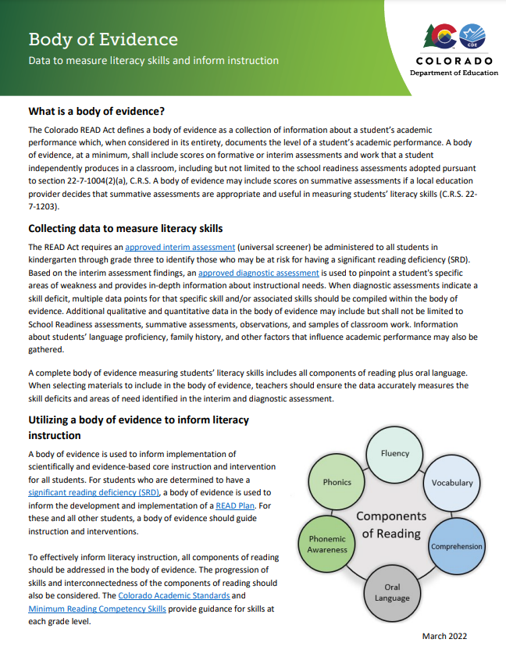
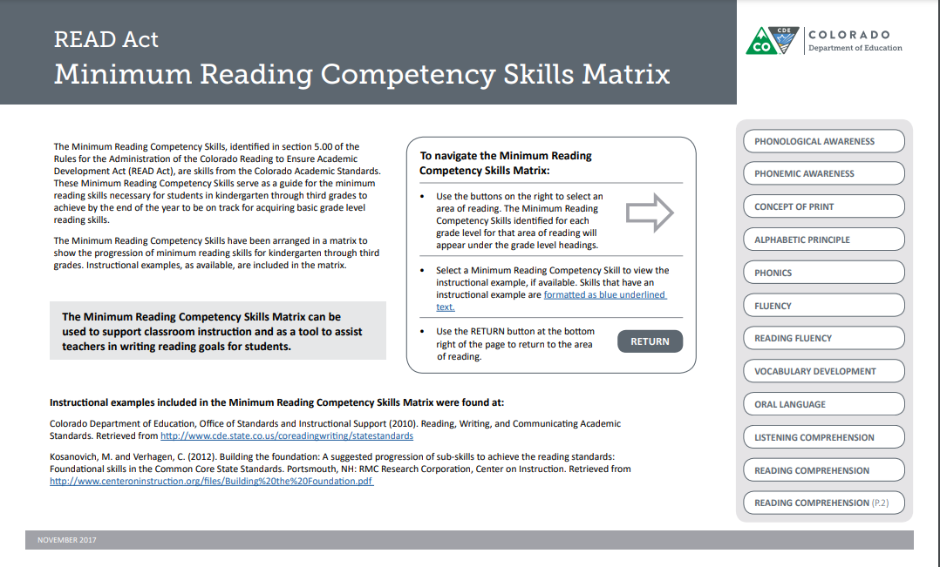
Resources
http://www.cde.state.co.us/coloradoliteracy/minimumcompetencylinkedmatrix
http://www.cde.state.co.us/coloradoliteracy/bodyofevidence
Notes:
Today we will discuss the Body of Evidence guidance document and associated recorded webinar titled: Body of Evidence, Data to Document Reading Competency and Inform Instruction.
The Body of Evidence guidance document includes the sample data collection template shown in the presentation. Gionna will add the link to the Body of Evidence Document into the chat.
http://www.cde.state.co.us/coloradoliteracy/bodyofevidence
Gionna will also add the link to the recorded webinar. http://www.cde.state.co.us/coloradoliteracy/bodyofevidencewebinarvideo
There are additional resources on the CDE website to support literacy educators in compiling and utilizing a body of evidence.
The READ Act Minimum Competency Skills Matrix, also listed in the references and linked on the slide, provides a snapshot of the minimum literacy standards and skills students should master for each component of reading from kindergarten through grade three. Gionna will add that link into the chat as well. http://www.cde.state.co.us/coloradoliteracy/minimumcompetencylinkedmatrix

Slide 4
READ Act Office Hours Purpose
The purpose of the monthly live READ Act Office Hours is to provide:
Information and guidance on specific topics related to the READ Act and
An opportunity for stakeholders to ask specific questions related to the specific topic
Notes:
During the year the literacy team will offer a variety of office hours. The purpose of the monthly live READ Act office hours is to provide information and guidance on specific topics related to the READ Act and also to provide an opportunity for stakeholders to ask specific questions related to the specific topic.

Slide 5
READ Act Office Hours Procedure
Prior to the scheduled office hours, participants will review guidance documents and/or pre-recorded webinar that align with the specific topic that will be discussed.
At least 1 week prior to the scheduled office hours, participants will submit questions they have about the specific topic through the Office Hours Questions Google form linked on the CDE READ Act Office Hours webpage
During the office hours, CDE will:
Introduce the topic being presented and provide a short summary of the topic
Answer questions submitted 1 week prior to the scheduled office hours
Allow for participants to ask questions live during the office hours
Notes:
In order to facilitate the conversation we ask that prior to the scheduled office hours participants review the guidance documents and any associated prerecorded webinars on the topic. At least one week prior to the scheduled office hours we ask that you submit any questions you have regarding the office hours topic to the office hours question google form located on the ELSR Team Office Hours page.
At the beginning of each office hours participants will also have the opportunity to share questions with a consultant in a breakout room. Then the literacy team will give a brief introduction of the topic being presented and provide a short summary of the topic. The literacy team will answer any questions previously submitted. Participants are also invited and welcome to ask questions live.

Slide 6
READ Act Office Hours Logistics
Each Office Hour is scheduled to address questions related to a specific topic.
The topic today is: Body of Evidence
First, SLCs will go into small breakout rooms to collect and synthesize your questions.
Then we will share a short overview of the topic and walk through the questions related to this topic submitted via the Google form linked to the Office Hours webpage and through small group discussions.
After we walk through the questions submitted prior to the scheduled Office Hours, there will be designated time for participants to enter questions in the Q&A feature that are related to today’s topic.
Some questions will be answered during the webinar and others will be captured for further consideration.
Additionally:
For general questions about the CDE-Provided Teacher or Administrator Training options email: ReadActTraining@cde.state.co.us
For READ Act Data Inquires email READActData@cde.state.co.us
For all other questions related to the READ Act email: ReadAct@cde.state.co.us
Notes:
Every month during the office hours the team will address a specific READ Act related topic. Today we will discuss Body of Evidence. We will share questions submitted on this topic via the google form. There will also be time for you to ask any additional questions via the Q&A feature to be answered live. We may have to capture further questions for a future response.
If you have general questions about the CDE-Provided Teacher or Administrator training please email: readacttraining@cde.state.co.us. For questions regarding READ act data please reach out to readactdata@cde.state.co.us. Please direct all other questions related to the READ Act to Readact@cde.state.co.us.

Slide 7
READ Act Office Hours Breakout Rooms
The purpose of the READ Act Office Hours is to address questions stakeholders have related to a specific topic
In order to address any questions you may have, today’s office hours will start with Senior Literacy Consultants collecting questions in a breakout room
Notes:
We are going to start today in small breakout rooms. The purpose of the READ Act office hours is really an organic conversation where the Elementary Literacy and School Readiness office can address any questions the field may have. In a few minutes you will be moved into breakout rooms with a senior literacy consultant. In the breakout rooms please share any questions you may have about today’s topic of Body of Evidence. SLCs will not be answering questions but just recording and synthesizing questions. Once we come back to the main room, I will share a short overview of information and then address any questions already submitted. The SLCs will type your questions into the Q and A section to be addressed when we get to that portion of the content in the presentation. During our office hours today, we will only be addressing questions regarding Body of Evidence.

Slide 8
Breakout Rooms: What questions do you have? What do you hope to learn today?
Notes:
We will now move into breakout rooms of approximately 4-5 people. We will have approximately 5-8 minutes. You can always join the main room again if you find you have finished your conversation. Please discuss what questions you have or what you hope to take away from today.

Slide 9
READ Act Office Hours Objectives:
Overview of Body of Evidence and the CDE Body of Evidence Guidance document
Review and respond to questions submitted prior to today's Office Hours
Respond to topic related questions submitted live
Notes:
Today we have three main objectives. The team will provide an overview of body of evidence and the CDE body of evidence guidance document. We will review and respond to questions submitted prior to today’s office hours and we will also allow time to respond live to questions regarding our topic of body of evidence.
Image:
Image from: http://www.picpedia.org/highway-signs/a/agenda.html

Slide 10
READ Act Office Hours Colorado READ Act-It Is About Prevention
READ Act
Passed by the Colorado legislature in 2012
Focuses on early literacy development for all students in kindergarten through 3rd grade
Preventative in nature
Scientifically and evidence-based reading instruction
Assessment
READ plans
Parent communication monitoring
Ensure every student in Colorado Reaches reading proficiency by the end of 3rd grade
Notes:
Speaker notes:
The Colorado Reading to Ensure Academic Development Act (READ Act), was passed by the Colorado legislature in 2012
The READ Act focuses on literacy development for kindergarteners through third-graders - especially for students at risk for not reading at grade level by the end of third grade.
The READ Act is preventative in nature:
The READ Act requires that all school districts ensure that students in K-3rd grade receive scientifically and evidence-based reading instruction
The READ Act requires teachers to assess the literacy development of K-3rd grade students in the areas of phonemic awareness; phonics; vocabulary development; and reading fluency, which includes mastery of oral skills and reading comprehension. By assessing students early, teachers are able to identify students who struggle or may struggle with learning to read.
The READ Act also requires the development and implementation of individual intervention plans (READ Plans) for students who are identified as having a significant reading deficiency.
Parent communication is also apart of the READ Act. Under the READ Act, parents and school personnel should make decisions collaboratively throughout the READ Plan implementation process.
Parents should receive regular, ongoing updates from the student’s teacher concerning results of the intervention instruction and the student’s progress in achieving reading competency
To ensure students receive the instruction they need to achieve reading competency by the end of 3rd grade and become lifelong readers, teachers must have a deep understanding of the science of reading and understand the structures of language and the English writing system. We know that teacher knowledge and practice are critical. The legislature also knew this because in 2019 they amended the READ Act to require all K-3rd grade teachers receive training in evidence-based practices in teaching reading. With SB 22-004 the READ Act training requirement was amended to include 4-12 reading interventionists and school administrators.
Again, the READ Act is about prevention.

Slide 11
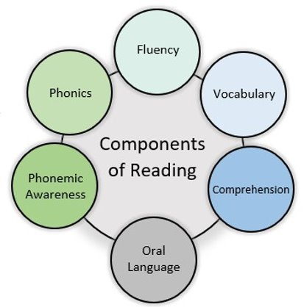
READ Act Office Hours Body of Evidence
The Colorado READ Act defines a body of evidence as a collection of information about a student’s academic performance which, when considered in its entirety, documents the level of a student’s academic performance. A body of evidence, at a minimum, shall include scores on formative or interim assessments and work that a student independently produces in a classroom, including but not limited to the school readiness assessments adopted pursuant to section 22-7-1004(2)(a), C.R.S. A body of evidence may include scores on summative assessments if a local education provider decides that summative assessments are appropriate and useful in measuring students’ literacy skills (C.R.S. 22-7-1203).​
Considers all components of reading plus oral language​
Includes the interim assessment and diagnostic assessment
Forms a complete picture of students’ literacy skills to support instruction and document progress toward reading competency
http://www.cde.state.co.us/coloradoliteracy/readactstatuteandstateboardrules​
Notes:
A key component in determining a significant reading deficiency or SRD is the body of evidence. While sometimes overlooked in the process, it is important to note that the READ Act requires a body of evidence as the final piece in determining an SRD.
When diagnostic assessments indicate a skill deficit, multiple data points for that skill and/or associated skills should be compiled within the body of evidence. Additional qualitative and quantitative data in the body of evidence may include but are not limited to school readiness assessments, summative assessments, observations, and samples of classroom work. Information about students’ language proficiency, family history, and other factors that influence academic performance may also be gathered.
A complete body of evidence for students’ literacy skills may include formal and informal data and should include all components of reading plus oral language. When selecting materials to include in the body of evidence, teachers should ensure the data accurately measures the skills and areas of need identified in the interim and diagnostic assessments.

Slide 12
READ Act Office Hours Body of Evidence Purpose
The purpose of the body of evidence is to document reading competency and inform literacy instruction for all students. Instruction should be:
Scientifically and evidence-based
Explicit and systematic
Aligned to individual student needs
Targeted interventions, when needed
Continually monitored to evaluate effectiveness
Notes:
The purpose of the body of evidence is to inform literacy instruction for all students.
Instruction should be:
From programming that is scientifically and evidence-based. A list of READ Act approved programming can be found on the CDE website.
Next, literacy instruction should be explicit and systematic and
Aligned to individual student needs.
Targeted interventions should be implemented, when needed.
Finally, student data should be used to continually monitor and evaluate the effectiveness of instruction.

Slide 13
READ Act Office Hours BOE and the READ Act
Regardless of SRD determination, the interim assessment, diagnostic assessment, and body of evidence are used to document the level of reading competency and inform scientifically and evidence-based instruction and intervention for all students.
Interim Assessment
Diagnostic Assessment
Body of Evidence
http://www.cde.state.co.us/coloradoliteracy/srd_determination
http://www.cde.state.co.us/coloradoliteracy/readactstatuteandstateboardrules
Notes:
The READ Act requires that all students receive scientifically and evidence-based core instruction throughout the SRD determination process. Between interim and diagnostic assessments, students shall continue receiving this core instruction and shall also begin receiving interventions that align with identified skills deficits from the interim assessment. Regardless of SRD determination, the body of evidence and Multi-Tiered System of Supports (MTSS) process are used to inform implementation of scientifically and evidence-based core and intervention programming for all students.

Slide 14
READ Act Office Hours A Body of Evidence Includes:
Approved interim and diagnostic assessments
Informal and formal assessment information
Qualitative and quantitative data
Language proficiency data and native language assessment data
Any information about factors that influence academic performance
Data that addresses all components of literacy plus oral language
Notes:
A complete body of evidence for students’ literacy skills includes multiple data points and sources of information. This includes interim and diagnostic assessments, informal and formal assessment information, qualitative and quantitative data, language proficiency data and native language assessment data. Information about other factors that influence academic performance should also be included.
A complete body of evidence documents students’ literacy skills and informs instructional needs by addressing all components of literacy and oral language.

Slide 15
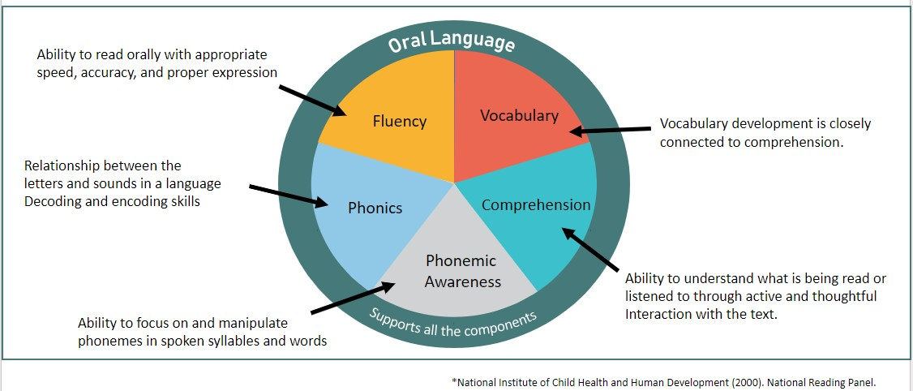
READ Act Office Hours Body of Evidence Components of Reading
A complete body of evidence for students’ literacy skills includes multiple sources of formal and informal data that address all components of reading and oral language. ​
Notes:
A complete body of evidence for students’ literacy skills includes multiple sources of formal and informal data that address all components of reading and oral language.
The components of reading are phonemic awareness, phonics, fluency, vocabulary, and comprehension, with oral language supporting all the components.

Slide 16
Purpose of the Body of Evidence
Notes:
We are now going to expand on the purpose of the body of evidence.

Slide 17
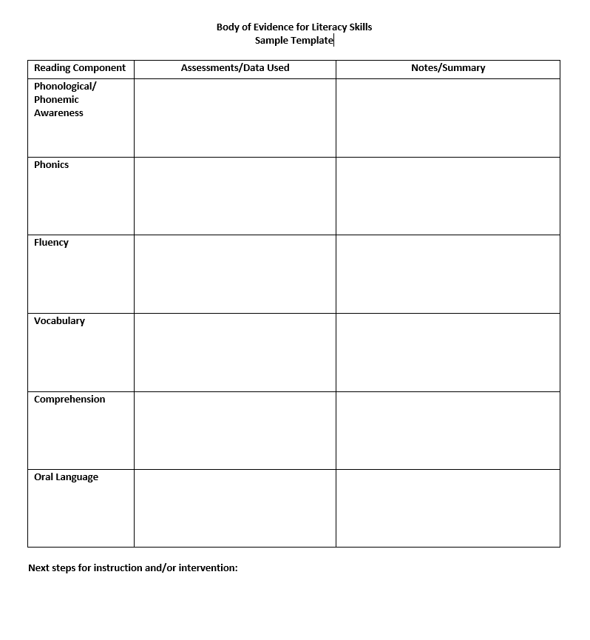
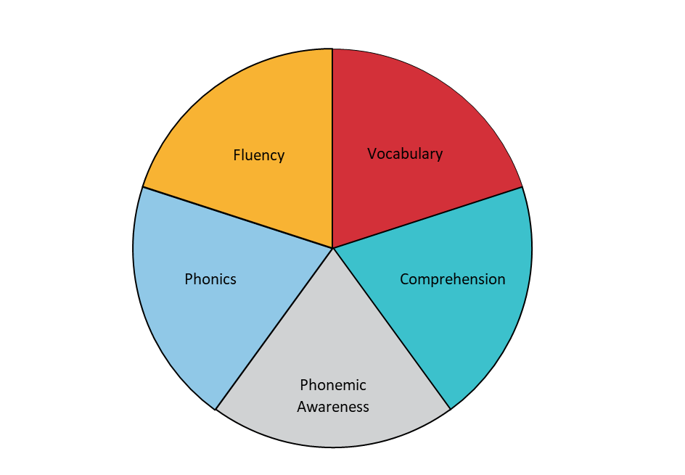
The purpose of collecting a body of evidence is to identify areas of need and to effectively inform literacy instruction, all components of reading and oral language should be addressed in the body of evidence.
Oral Language
http://www.cde.state.co.us/coloradoliteracy/bodyofevidence
Notes:
As previously stated the purpose of a body of evidence is to identify areas of need and to effectively inform literacy instruction, information about all components of reading and oral language should be compiled in the body of evidence. The sample template on the slide is a simple tool to organize data and ensure all components are included. This template can be found via the link on the slide and on page 3 of CDE’s Body of Evidence guidance document.

Slide 18
READ Act Office Hours: How to Use a Body of Evidence
1. Define the problem
2. Gather data
3. Identify causal factors
4. Determine the root cause
5. Solution, recommendation, and implementation
Interim assessment indicates risk of reading difficulties
Diagnostic assessment and other evidence are compiled to provide more in-depth information about skill deficits
Body of evidence is analyzed for trends and causal factors
Specific skill deficits are identified
Plan and implement instruction and intervention
Notes:
With a complete body of evidence compiled, educators can perform a root cause analysis for the purpose of determining the student’s individual instructional needs. This slide provides a general outline of the steps in a root cause analysis protocol, though it is important that schools have systems and structures in place for data-driven instruction.
We begin by defining the problem, or in this case, the risk that is indicated by the interim assessment. From here, we will begin adding to our body of evidence with the administration of a diagnostic assessment and collection of other data and information. With the complete body of evidence compiled, we can identify specific skill deficits and causal factors. Finally, this information is used to plan and implement instruction and/or intervention to meet the individual student’s literacy needs.

Slide 19
READ Act Office Hours: READ Act Requirements for the Body of Evidence
Interim Assessment
First alert that students may need extra support to make adequate progress with reading
Diagnostic Assessment
Identifies specific skill deficits
Body of Evidence
Oral Language
Includes multiple sources of formal and informal data that address all components of reading and oral language. When selecting evidence, teachers should ensure that the assessments or tasks align with the skills and competencies for the components of reading.
Notes:
Let’s review how the body of evidence fits into the requirements and process of the Colorado READ Act. The interim assessment is the first alert that students may need support to make adequate progress with reading, and its also an important piece of the body of evidence. The next piece of evidence is the diagnostic assessment, which identifies specific skill deficits. Third, a complete body of evidence, including the interim and diagnostic assessments, is compiled with information that addresses all components of reading and oral language.

Slide 20
Frequently Asked Questions
Notes:
Now we will move into some of the frequently asked questions.

Slide 21
Question: What is the purpose of the BOE?
The purpose of the body of evidence is to document reading competency and inform literacy instruction for all students.
For this reason, the body of evidence should include multiple sources of data and information that identify specific skill deficits and strengths.
Notes:
The first question is, What is the purpose of a Body of Evidence?
The READ Act requires an approved interim assessment (which is a universal screener) be administered to all students. Based on the interim assessment results an approved diagnostic may be given to pinpoint areas of specific weakness and provide in-depth information about instructional needs. The READ Act requires a Body of Evidence as a third component. The purpose of the body of evidence is to document reading competency and inform literacy instruction for all students. Given this the body of evidence should include multiple sources of data and information that identify specific skill deficits and strengths.

Slide 22
Question: How is a body of evidence utilized when determining an SRD?
Interim and diagnostic are part of BOE
The body of evidence provides additional information about a student’s academic performance to plan for instructional support
Notes:
The next frequently asked question is: How is a body of evidence utilized when determining an SRD?
The Rules for the Administration of the READ Act specify that a determination that a child has an SRD in grades K-3 will be based on the results of the interim assessment, results from the diagnostic assessment and a body of evidence.
The body of evidence includes the interim and diagnostic assessment data and also provides additional information about a student’s academic performance that helps to identify skill strengths and areas to target instruction.

Slide 23
Question: What information needs to be included in the BOE?
The body of evidence may include, but shall not be limited to:
Approved interim
Diagnostic assessments
Informal and formal assessment information
Qualitative and quantitative data
Language proficiency data and native language assessment data
Any information about factors that influence academic performance
Data that addresses all components of literacy plus oral language
Notes:
The next question is what information needs to be included in the Body of Evidence?
The body of evidence includes the approved interim assessment. This is a required component of your body of evidence. If your student falls below the cut score on the interim assessment, then you will need to administer a diagnostic assessment(s). The diagnostic assessment is the second piece of information in your body of evidence.
The body of evidence may also include, but shall not be limited to:
Informal and formal assessment information
Qualitative and quantitative data
Language proficiency data and native language assessment data
Any information about factors that influence academic performance
Data that addresses all components of literacy plus oral language

Slide 24
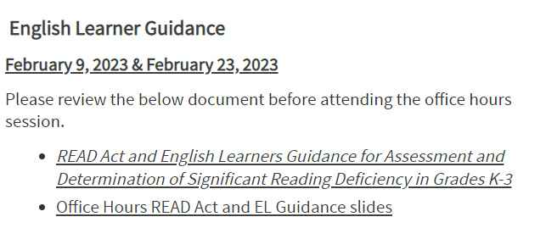
Question: What data should be included in a BOE for English Learners?
BoE considerations for ELs include:
Length of time the student has been enrolled in a U.S. school
English Language proficiency data and growth over time
Native language literacy assessment data
Progress over time on English literacy assessments
Language and literacy progress in relation to English learner peers
Historical background of the English learner’s LIEP(s)
Notes:
The question is: What data should be included in a body of evidence for English Learners?
For English Learners, careful consideration of the body of evidence in relation to language proficiency data and native language literacy assessment data is important when determining whether a student has a significant reading deficiency. Considerations in the body of evidence include:
Length of time the student has been enrolled in a U.S. school
English Language proficiency data and growth over time
Native language literacy assessment data
Progress over time on English literacy assessments
Language and literacy progress in relation to English learner peers
Historical background of the English learner’s LIEP(s) (Language Instruction Educational Program (receiving English language development instruction)
The office hours topic in February was English Learner Guidance. Those slides have been archived on the website if you would like to access them or the English Learner Guidance for Assessment and Determination of SRD in grades K-3.
http://www.cde.state.co.us/coloradoliteracy/readactandelguidanceslides

Slide 25
Question: Can the BOE be used to override the findings of the interim and diagnostic assessments when determining SRD?
No, the body of evidence cannot be used to override the findings of the interim and diagnostic assessments when determining an SRD.
Note: The interim and diagnostic assessments are key pieces in the body of evidence.
Notes:
The next question is Can the Boe be used to override the findings of the interim and diagnostic assessments when determining an SRD? The body of evidence cannot be used to override the findings of the interim and diagnostic assessments when determining an SRD. Both the interim and the diagnostic assessments are key pieces in the body of evidence.

Slide 26
Question: Does the BOE need to be updated?
Yes, the body of evidence includes progress monitoring data and should be continually updated, analyzed, and utilized to inform students’ individual instructional needs.
For students with an SRD, a body of evidence is required for monitoring and documenting progress toward mastery of minimum reading competency skills.
Notes:
The next question is: Does the BOE need to be updated?
Yes, the body of evidence includes progress monitoring data and should be continually updated, analyzed, and utilized to inform students’ individual instructional needs.
For students with an SRD, a body of evidence is required for monitoring and documenting progress toward mastery of minimum reading competency skills.

Slide 27
Question: Why do we need to continue to collect an updated BOE for students identified as having an SRD?
Students with an SRD
Body of evidence is used to monitor and document progress toward mastery of minimum reading competency skills
Exiting a Student from a READ Plan
Assessment scores and body of evidence demonstrate the student has reached grade level reading competency
http://www.cde.state.co.us/coloradoliteracy/exitingareadplan
Notes:
The next question is, Why do we need to continue to collect an updated body of evidence for students identified as having an SRD?
The Colorado READ Act requires a body of evidence in supporting students with an SRD and exiting students from a READ Plan.
For students with an SRD, a body of evidence is required for monitoring and documenting progress toward mastery of minimum reading competency skills.
To exit a student from a READ Plan, assessment scores and a body of evidence documenting a student has mastered the grade level minimum reading competencies are required to demonstrate the student has reached grade level reading competency.

Slide 28
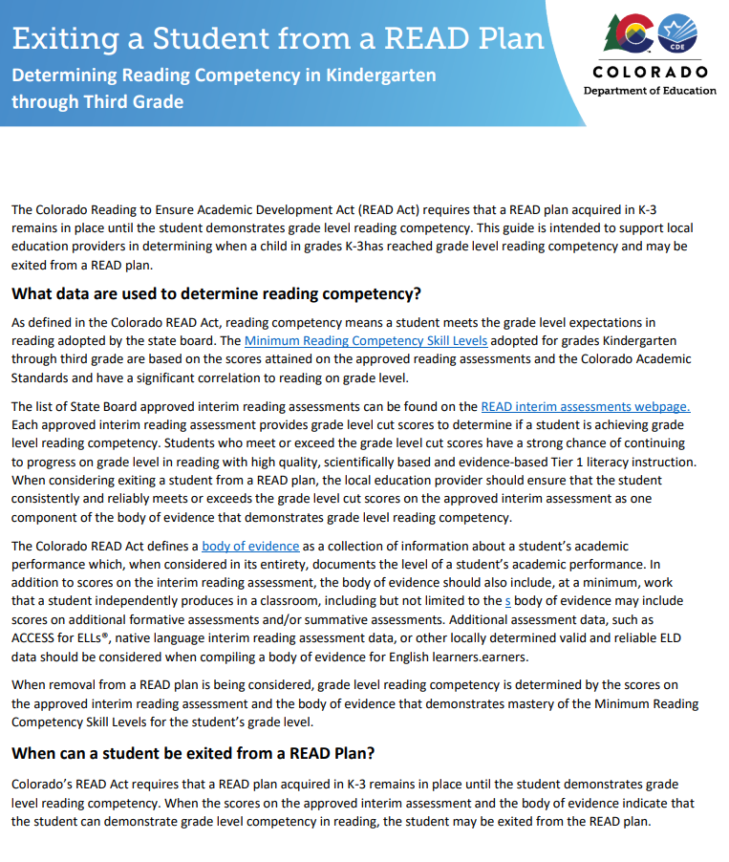
Question: How is the body of evidence used to exit a student from a READ Plan?
To exit a student from a READ Plan, assessment scores and a body of evidence documenting that a student has mastered the grade level minimum reading competencies are required to demonstrate the student has reached grade level reading competency.
Notes:
The final question in this section is How is the Body of Evidence used to exit a student from a Read plan? To exit a student from a READ Plan, assessment scores and a body of evidence documenting that a student has mastered the grade level minimum reading competencies are required to demonstrate the student has reached grade level reading competency.
I would like to take a moment to invite you to the April Office Hours where we will discuss exiting students from a READ Plan. We will put links into the chat where you can find the exiting a student from a READ Plan document on the CDE website. Please review this document prior to the office hours and submit any questions you may have to the google form by April 6th.

Slide 29
Questions
Notes:
At this point we will address any additional questions you may have.

Slide 30
Body of Evidence Examples
Notes:
Let’s spend some time looking at what a body of evidence could include for each component of reading.

Slide 31
Phonological and Phonemic Awareness Evidence
Teacher observation
Family input
Speech/language evaluations
Auditory/verbal response activities done without the use of visual letters addressing syllables, rhyming, alliteration, onset-rime, isolating, blending, segmenting, and manipulating phonemes
Vocabulary
Comprehension
Phonemic Awareness
Phonics
Fluency
Notes:
In addition to the interim and diagnostic assessments, data and information to address phonological and phonemic awareness within the body of evidence may include:
Teacher observation
Family input
Speech/language evaluations
Auditory/verbal response activities done without the use of visual letters addressing syllables, rhyming, alliteration, onset-rime, isolating, blending, segmenting, and manipulating phonemes

Slide 32
Phonics Evidence
Letter naming assessments
Letter-sound correspondence assessments
Blending and segmenting with print
Phonics surveys
Spelling inventories
Nonsense words
Writing samples
Vocabulary
Comprehension
Phonemic Awareness
Phonics
Fluency
Notes:
In addition to the interim and diagnostic assessments, data and information to address phonics within the body of evidence may include:
Letter naming assessments
Letter-sound correspondence assessments
Blending and segmenting with print
Phonics surveys
Spelling inventories
Nonsense words
Writing samples

Slide 33
Fluency Evidence
Oral reading fluency assessments
Words correct per minute (WCPM)
Error analysis
Connected text
Teacher observation
Word, phrase, sentence, and passage reading
Vocabulary
Comprehension
Phonemic Awareness
Phonics
Fluency
Notes:
In addition to the interim and diagnostic assessments, data and information to address fluency within the body of evidence may include:
Oral reading fluency assessments
Words correct per minute (WCPM)
Error analysis
Anecdotal records for the reading of connected text
Teacher observation
Word, phrase, sentence, and passage reading

Slide 34
Vocabulary Evidence
Vocabulary
Comprehension
Phonemic Awareness
Phonics
Fluency
Word knowledge checklists
Morphology assessments
Vocabulary assessments
Frayer templates
Teacher observation
Writing samples
Notes:
In addition to the interim and diagnostic assessments, data and information to address vocabulary within the body of evidence may include:
Word knowledge checklists
Morphology assessments
READ Act approved assessments with vocabulary components
Picture vocabulary tests
Frayer templates and graphic organizers
Teacher observation
Writing samples

Slide 35
Comprehension Evidence
Classroom comprehension activities
Listening comprehension tasks
Graphic organizers
Retell
Summary
Categorizing activities
Cloze reading assessment
Assessments for sentence structure, text structure, and background knowledge
Vocabulary
Comprehension
Phonemic Awareness
Phonics
Fluency
Notes:
In addition to the interim and diagnostic assessments, data and information to address comprehension within the body of evidence may include:
Classroom comprehension activities
Listening comprehension tasks
Graphic organizers
Retell
Summary
Categorizing activities
Cloze reading assessment
Assessments for sentence structure, text structure, and background knowledge

Slide 36
Oral Language Evidence
Home language survey
Teacher observation
Speech/language evaluations
English language proficiency assessments
Family input
Observation-based assessment system
Vocabulary
Comprehension
Phonemic Awareness
Phonics
Fluency
Oral Language
Notes:
In addition to the interim and diagnostic assessments, data and information to address oral language within the body of evidence may include:
Home language survey
Teacher observation
Speech/language evaluations
English language proficiency assessments
Family input
Observation-based assessment system

Slide 37
Other Data and Information
A body of evidence may also include information about other factors that influence academic achievement, such as:
Attendance
Family history
English language proficiency data
Medical diagnoses
Comorbidities
Behavior
MTSS records
Notes:
Beyond the components of reading, there are many other factors that can influence academic achievement. When available and appropriate, this information should also be added to the body of evidence. Additional information may include, but shall not be limited to:
Attendance
Family history
English language proficiency data
Medical diagnoses
Comorbidities
Behavior
MTSS records

Slide 38
Questions
Notes:
I will pause again to address any questions.

Slide 39
Data Driven Instruction
Notes:
In the next section we will look at some sample bodies of evidence and how we can use that data to drive classroom instruction.

Slide 40
Example 1: Kindergarten Student, Beginning of Year
Phonemic Awareness | Interim and diagnostic assessment indicate low scores in phonological awareness. Teacher observation notes the student has trouble clapping syllables and demonstrating other phonological skills. Phonological awareness screener shows student has not yet developed syllable awareness, ability to identify onset and rime, or isolate phonemes in words.
Phonics | Diagnostic assessment confirms student knowledge of some letter names. Teacher observation notes that student can sing the alphabet but struggles to identify all letter names in alphabet activities. Writing samples demonstrates student’s ability to write words that the student has memorized (mom, dad, etc.)
Fluency | Interim assessment indicates adequate scores in letter naming fluency.
Vocabulary | Teacher-created checklist indicates student’s correct use of vocabulary words that have been explicitly taught and practiced during classroom instruction.
Comprehension | Oral retelling assessments indicate the student can identify story elements from classroom read alouds.
Oral Language | Kindergarten School Readiness Assessment note typical oral language skills in classroom discussion and conversations.
Student needs additional instruction and support in developing phonological and phonemic awareness skills as basic phonics concepts are practiced and introduced.
Body of Evidence
Notes:
Now that we have taken some time to define a body of evidence, we are going to look at an example of what a body of evidence might look like for individual students and how this information is used to inform scientifically and evidence-based instruction.
The first example is a kindergarten student at the beginning of the year. Following the interim assessment, diagnostic assessments were administered to identify specific skill deficits. These assessments indicate low scores in phonological awareness. Now let’s look at the other pieces of data and information that are compiled to form a complete picture of this kindergarten student’s early literacy skills.
In the area of phonemic awareness, teacher observation notes the student has trouble clapping syllables and demonstrating other phonological skills in small group activities. A phonological awareness screener shows the student has not yet developed syllable awareness, the ability to identify onset and rime, or isolate phonemes in words.
For phonics, a letter naming assessment confirms student knowledge of some letter names. Writing samples demonstrate the student’s ability to write words the student has memorized.
For fluency at the kindergarten level, the interim assessment indicates adequate scores in letter naming fluency. Remember, we gathered more specific evidence about the student’s knowledge of letter names with the diagnostic assessment.
A teacher-created checklist indicates the student’s correct use of vocabulary words that have been explicitly taught and practiced during classroom instruction.
Since our kindergarten student is not yet able to read proficiently, oral retelling assessments are used to measure comprehension. The student was able to identify story elements from classroom read alouds and no comprehension concerns were noted.
Lastly, data from the Kindergarten School Readiness assessment indicates typical oral language skills in classroom discussion and conversation.
*With each component of literacy addressed, we can now view a complete picture of the student’s literacy skills and make informed decisions about the student’s reading competency and individual instructional needs. To briefly summarize next steps, this kindergarten student will likely benefit from additional instruction and support in developing phonological and phonemic awareness skills as basic phonics concepts are introduced in the kindergarten curriculum.

Slide 41
Example 2: First Grade Student, Beginning of Year
Phonemic Awareness | Interim assessment indicates low benchmark-level phonemic awareness skills with segmentation tasks for CVC, CCVC, and CVCC words. A phonological awareness screener shows the student is proficient with basic phonemic awareness.
Phonics | Interim assessment indicates benchmark-level skills with letter sound correspondence and decoding CVC and CCVC words in isolation. Teacher observation notes that the student often disengages with writing and struggles to construct simple sentences. Phonics survey confirms proficiency with consonants, long and short vowels, and consonant digraphs.
Fluency | Interim assessment and diagnostic assessments indicate approaching grade-level expectations with letter naming and letter sound fluency.
Vocabulary | Picture vocabulary assessment indicates below benchmark-level skills. Classroom vocabulary activities note the student has difficulty using sentence level context clues to determine the meaning of unknown words.
Comprehension | Student has difficulty answering questions about what they have read on curriculum-based assessments for decodable texts . Oral retelling assessments demonstrate the student has difficulty identifying story elements from read alouds.
Oral Language | Teacher observation and anecdotal records note the student has difficulty producing complete sentences in classroom discussions and activities. Parent input notes that the student was delayed in learning to speak and is often “shy”.
Student needs additional instruction and support with oral language and language comprehension skills, including appropriate scaffolds for writing.
Body of Evidence
Notes:
Our next example is a first-grade student at the beginning of the year. Again, we will gather and view evidence for each component of reading.
For phonemic awareness, the interim assessment indicates benchmark-level phonemic awareness skills with segmentation tasks for CVC, CCVC, and CVCC words. A phonological awareness screener shows the student is proficient with basic phonemic awareness skills.
As we look at the area of phonics, the interim assessment indicate benchmark-level skills with letter sound correspondence and decoding CVC and CCVC words in isolation. Teacher observation notes that the student disengages with writing and struggles to construct simple sentences. A phonics survey confirms proficiency with consonants, long and short vowels, and consonant digraphs.
To add to our body of evidence for fluency at the first-grade level, interim and diagnostic assessments indicate approaching grade-level expectations with letter naming and letter sound fluency.
For vocabulary, a picture vocabulary test demonstrates benchmark-level skills, and classroom vocabulary activities note the student has difficulty using sentence level context clues to determine the meaning of unknown words.
Since our first-grade student is in the initial reading and decoding phase, comprehension is viewed from multiple angles. Curriculum-based assessments note that the student has difficulty answering questions about decodable texts. Oral retelling assessments demonstrate that the student has difficulty identifying story elements from read alouds.
Finally, oral language evidence provides more valuable information about the student’s literacy skills and instructional needs. Teacher observation and anecdotal records note the student has difficulty producing complete sentences in classroom discussions and activities. Parent input notes that the student was delayed in learning to speak and is often “shy”.
*As we view the complete body of evidence for this first-grade student, we can see that the student’s skill deficits are primarily in the area of language comprehension. This student is likely to benefit from additional instruction and support with oral language and language comprehension skills, including appropriate scaffolds for writing.

Slide 42
Example 3: Second Grade Student, Beginning of Year
Phonemic Awareness | Phonemic awareness screener indicates student’s proficiency segmenting and blending. However, the student struggles with advanced phonemic awareness and manipulation tasks.
Phonics | Interim and diagnostic assessments indicate proficiency with short vowels, common vowel teams, and consonant digraphs. Phonics screener demonstrates difficulty decoding variant vowel digraphs, diphthongs, and multisyllabic words. Spelling inventory reveals student is missing spellings on vowel teams. Teacher notes orthographic spelling errors in student writing samples. Teacher observation notes that student seems to enjoy writing, but typically uses the same words.
Fluency | Interim and diagnostic oral reading fluency assessments indicate 60 WCM with 80% accuracy. The student attends to punctuation, but often reads in a dysfluent manner.
Vocabulary | Classroom vocabulary activities note the student’s ability to determine the meaning of unknown words using root words and affixes and correctly use new words that have been explicitly taught.
Comprehension | Interim and diagnostic assessments indicate the student is approaching grade level with reading comprehension. The student has difficulty recounting events and summarizing the main idea in text they read independently but is able to demonstrate skills with listening comprehension activities.
Oral Language | Teacher observations note typical oral language skills in classroom discussion and conversations.
Student needs instructional support and practice with advanced phonics skills: variant vowel digraphs, diphthongs, and multisyllabic word reading. Writing scaffolds are needed.
Body of Evidence
Notes:
Next, we will look at the beginning of year body of evidence for a second-grade student.
We will begin by looking at fluency and comprehension, two areas of concern that were indicated by the interim and subsequent diagnostic assessments. These assessments have indicated that the student reads 60 words correct per minute with 80% accuracy. The student attends to punctuation but often reads in a dysfluent manner.
The interim and diagnostic assessments also indicate the student is approaching grade level with reading comprehension. The student has difficulty recounting events and summarizing the main idea in text they read independently. However, they are able to demonstrate those same skills through listening comprehension activities.
A phonemic awareness screener indicates the student’s proficiency with segmenting and blending. However, the student struggles with advanced phonemic awareness and manipulation tasks.
In the area of phonics, the interim and diagnostic assessments indicate the student’s proficiency with short vowels, common vowel teams, and consonant digraphs. Further evidence gathered with a phonics screener demonstrates difficulty decoding variant vowel digraphs, diphthongs, and multisyllabic words. A spelling inventory confirms the student is not yet proficient with vowel teams. Writing samples reveal orthographic spelling errors and teacher observations note that the student seems to enjoy writing, but typically uses the same words.
Skipping down to vocabulary, classroom vocabulary activities note the student’s ability to determine the meaning of unknown words using root words and affixes. The student correctly uses new words that have been explicitly taught.
Finally, teacher observations note typical oral language skills in classroom discussion and conversations.
*With this second-grade student, the evidence supports proficient language comprehension skills, and pinpoints the skill deficits in the area of word recognition and decoding. This student will likely benefit from instructional support with specific advanced phonics skills: variant vowel digraphs, diphthongs, and strategies for reading multisyllabic words. Scaffolds for writing are also needed to support the student’s application of these skills through encoding.

Slide 43
Example 4: Third Grade Student, Beginning of Year
Phonemic Awareness | Student demonstrates strong basic and advanced phonics skills. Previous assessments demonstrate proficiency with advanced phonemic awareness skills.
Phonics | Diagnostic assessment indicates strong decoding abilities with basic and advanced phonics skills. High-frequency word assessments indicate student has a large high-frequency word bank.
Fluency | Interim assessment indicates 95% accuracy and slightly low rate of reading fluency with 70 WCM.
Vocabulary | Diagnostic assessments indicate the student’s difficulty with academic language and domain-specific vocabulary in text. Additional vocabulary assessments indicate strong vocabulary in the student’s native language.
Comprehension | Interim assessments demonstrate student is below grade-level expectations with comprehension. Diagnostic assessments reveal the student has difficulty using semantic cues and signal words (because, although) when reading in English.
Oral Language | Language proficiency assessments indicate the student’s expanding ability to connect ideas by building on guided conversations with peers. Difficulty with stating conditions for cause and effect and elaborating on details of content-related procedures were noted.
To support overall comprehension and oral language development, the student needs explicit instruction and scaffolding with domain-specific vocabulary and the use of semantic cues. Additional practice with fluency at the word and sentence level is likely to be beneficial. Instruction should utilize student’s skills and assets in their home language.
Body of Evidence
Notes:
For our last example, we will look at a third grade, bilingual student at the beginning of the year.
The interim assessment revealed strong accuracy and a slightly low rate with reading fluency. However, the results of the interim assessment indicated gaps in comprehension that needed further analysis. A diagnostic assessment was given to identify potential skill deficits, and strong decoding abilities with both basic and advanced phonics skills were noted. Because of the evidence that was gathered demonstrating proficiency with advanced phonics skills, additional assessments for phonemic awareness are not needed. In this case, a teacher may choose to look back at the student’s previous scores in this area to confirm phonemic awareness skills. High frequency word assessments demonstrate the student has a large high-frequency word bank.
The diagnostic assessment has also provided evidence in the area of vocabulary. Here, it is noted that the student has some difficulty utilizing English academic language and domain-specific vocabulary in text to support comprehension. Additional vocabulary assessments indicate strong vocabulary skills in the student’s native language.
Diagnostic assessments reveal the student has difficulty using semantic cues and signal words (because, although) to identify cause/effect and compare/contrast relationships when reading in English.
Finally, in the area of oral language, language proficiency assessments indicate the student’s expanding ability to connect ideas by building on guided conversations with peers. Difficulty with stating conditions for cause and effect and elaborating on details of content-related procedures were noted.
This example of a third-grade student reinforces the importance of considering all components that contribute to our ultimate goal of skilled reading and text comprehension. The Reading Rope model reminds us that text comprehension is dependent upon many strands, and that when students are struggling with comprehension, we must look at the individual strands to determine the underlying cause.
*Our third-grade student has strong phonics and decoding skills but would benefit from additional practice with fluency at the word and sentence level. To support comprehension and oral language skills, this student will likely benefit from explicit instruction and scaffolding to help support the development of semantics, academic language, and domain-specific vocabulary, while capitalizing on the students many strengths and assets as a multilingual learner.

Slide 44
Questions
Notes:
I will pause one final time to see if there are any questions.

Slide 45
Contact Information
•For general questions about the CDE-Provided Teacher or Administrator Training options email: ReadActTraining@cde.state.co.us
•For READ Act Data inquires email READActData@cde.state.co.us
•For all other questions related to the READ Act email: ReadAct@cde.state.co.us
Notes:
We are always here to support you with questions. If you have general questions about the the CDE-Provided Teacher or Administrator Training options email: ReadActTraining@cde.state.co.us
•For READ Act Data inquires email READActData@cde.state.co.us
•For all other questions related to the READ Act email: ReadAct@cde.state.co.us

Slide 46
Helpful Links
READ Act Main Page:
http://www.cde.state.co.us/coloradoliteracy
Webinar/Office Hours Information: https://www.cde.state.co.us/coloradoliteracy/elsrliteracyteam-officehours
READ Act Statute and Rules: http://www.cde.state.co.us/coloradoliteracy/readactstatuteandstateboardrules
READ Plans:
https://www.cde.state.co.us/coloradoliteracy/readplans
READ and English Learners:
https://www.cde.state.co.us/coloradoliteracy/readandel
Science of Reading Resources: https://www.cde.state.co.us/coloradoliteracy/scienceofreadingresources
Educator Resources: https://www.cde.state.co.us/coloradoliteracy/readacteducatorresources
Body of Evidence: Webinar and Guidance Document:
http://www.cde.state.co.us/coloradoliteracy/readplans
Notes:
Here are some helpful links from the CDE website.

Slide 47
References
Colorado Department of Education. (2022). Body of evidence: Data to measure literacy skills and inform instruction. http://www.cde.state.co.us/coloradoliteracy/bodyofevidence
Colorado Department of Education. (2022). Exiting a student from a READ Plan: Determining reading competency in kindergarten through third grade. http://www.cde.state.co.us/coloradoliteracy/exitingareadplan
Colorado Department of Education. (2017). READ Act minimum reading competency skills matrix. http://www.cde.state.co.us/coloradoliteracy/minimumcompetencylinkedmatrix
Colorado Reading to Ensure Academic Development Act, Colo. Rev. Stat. §§ 22-7-1201-1214, (2019).
Gough, P. B. & Tunmer, W.E. (1986). Decoding, reading, and reading disability. Remedial and Special Education, 7(1).
Moats, L.C. (2009). Getting up to speed: Developing fluency, 2nd edition. Boston, MA: Sopris West.
National Reading Panel. (2000). Teaching children to read-An evidence-based assessment of the scientific research literature on reading and its implications for reading instruction (NIH Publication No. 00-4769) Washington, DC: National Institutes of Child Health and Human Development.
Rules for the Administration of the Colorado Reading to Ensure Academic Development Act, 1 Colo. Code Regs. 301-92 (2017).
Scarborough, H. S. (2001). Connecting early language and literacy to later reading (dis)abilities: Evidence, theory, and practice.
Stahl, S. A., & Nagy, W. E. (2006). Teaching word meanings. Mahwah, NJ: Erlbaum.

Slide 48
Thank You!
Notes:
Thank you for attending today. We very much value your time and continued partnerships. The Elementary Literacy and School Readiness office is here to support the work you do.

