Slide 1
Comprehensive Early Literacy Grant Program: Cohort 5
Application Information Webinar
November 18, 2020

Slide 2
Webinar Overview
Webinar topics
Background information
Implementation/plan requirements
Application process
Pay attention to the RFA, don’t make assumptions,
and ask us questions.

Slide 3
Questions? (Please put them in the Q&A.)

Slide 4
Background Information

Slide 5
Introduction
The Colorado READ Act established the Comprehensive Early Literacy Grant (ELG) Program to provide funding for K-3 literacy support. It is designed to improve students’ reading competency by supporting the essential components of reading instruction.

Slide 6
Purpose
Establish K-3 reading teaching systems based on scientifically based reading research (SBRR).
Implement a Multi-Tiered System of Supports (MTSS).
Increase professional development so that educators understand how and have the skills to increase K-3 reading achievement.
Administer and interpret CDE-approved assessments, including progress monitoring.
Implement CDE-approved programming (core programs and programs designed for targeted and intensive instructional interventions).

Slide 7
Eligibility
Eligible LEPs:
school district
BOCES
district charter school
institute charter school
An LEP may apply:
individually (either for a single school, or multiple schools under one district/BOCES/authorizer) or
as part of a collaborative group of different LEPs (a consortium).
Former Comprehensive ELG grantees are eligible to apply.
Will provide additional information based on their past participation.
Must have remained in good standing and/or have taken steps to ensure future success.
Grant plans should reference prior awards.

Slide 8
Priority Considerations
Priority will be given to applications for:
rural schools,
schools with a high percentage of students eligible for free and reduced lunch,
schools with a high percentage of minority students, and/or
schools with a high percentage of students with SRDs
(CDE will provide this information to application reviewers.)

Slide 9
Available Funds, Grant Duration, & Continued Funding
This grant will be implemented as a four-year grant cycle.
Year 1 (2020-2021, through June of 2021): planning (and initial implementation) year
Years 2-4: three years of operationalizing the grant
After Year 4, grantees may apply for a one-year Sustainability Grant.
Approximately $1.8 million is available for this grant per year of the four-year cycle. The recommended (but not required) maximum request amount per year is:
$100,000 for single school applicants
$250,000 per year for multi-school and consortium applicants (2+ schools)
Applicants must include budget information for all four years. Funding is contingent on Colorado State Legislature approval and meeting one or more of the grant goals.

Slide 10
Grant Goals
Students in the well below benchmark category make above average progress or well above average progress in reading each year.
Students make above average progress or well above average progress achieving grade-level reading proficiency.
50% of students scoring below benchmark move up at least one performance category.

Slide 11
Implementation/Plan Requirements

Slide 12
Uses of Funds
Funding must support the K-3 literacy program. Funds may only supplement and not supplant any moneys currently used for this purpose.
Allowed:
Staff salary, stipends, and/or benefits
CDE-approved instructional programming
CDE-approved professional development in teaching reading
ELG-approved Implementation Consultant support
Travel, registration, and entrance costs to attend in-state training and conferences
K-3 literacy instructional materials
Not allowed:
Technological equipment not related to assessment purposes
Capital needs
Out-of-state travel
Professional development not on CDE’s Advisory List of Professional Development
Assessment materials not on CDE’s approved list of interim and diagnostic assessments
Instructional programming not on CDE’s Advisory List of Instructional Programming
Technical/coaching/consulting support not on CDE’s Advisory List of Professional Development

Slide 13
Critical Application Components
It is critical that each plan and application:
Demonstrates the five essential components of effective reading instruction;
Includes effective, coherent literacy program elements;
Details how all activities incorporate SBRR;
Includes a plan to implement an MTSS, demonstrating plan of instruction both system-wide and among the tiers of instruction within each grade level; and
Addresses program sustainability.

Slide 14
Critical Application Components: Highlights
It is critical that each plan and application:
Demonstrates the five essential components of effective reading instruction;
Includes effective, coherent literacy program elements;
“An aligned professional development plan for principals and teachers”
“Dynamic instructional leadership, including that of school and district leaders”
“this program will support schools in developing and/or maintaining an SLT”
Details how all activities incorporate SBRR;
Includes a plan to implement an MTSS, demonstrating plan of instruction both system-wide and among the tiers of instruction within each grade level; and
Addresses program sustainability.
“describe the school’s current capacity to implement the grant requirements”

Slide 15
Additional Application Components
In addition to the 5 critical application components, include:
Participation in the ELAT Project (Amplify) OR purchase of Acadience Reading and Acadience Data Management or mCLASS for reporting
Which diagnostic reading assessment(s) from CDE's Advisory List each school currently uses or plans to use
Which core program from CDE's Advisory List each school currently uses or the plan to purchase a core program
Which program(s) from CDE's Advisory List each school currently uses for interventions or the plan to purchase intervention program(s)

Slide 16
Additional Application Components Cont’d
In addition to the 5 critical application components, include:
Budgeting for
2.5 days of CDE-provided PD for the SLT
1 additional day of PD for the literacy coach
Ongoing assistance (1+ day/month per school) from an ELG-approved Implementation Consultant
2.5 days for the ELG Implementation Consultant to attend the Office of Literacy Reading Conference with the SLT
A K-3 literacy coach if not already in the school

Slide 17
Application Process

Slide 18
Technical Assistance
Rural applicants may request and submit a simplified grant application.
A BOCES serving districts with fewer than 4,000 students receives funding to assist districts applying for grants. Contact your local BOCES for additional information.

Slide 19
Review Process & Timeline
CDE staff and peer reviewers will ensure applications contain required components and evaluate their content.
December 15, 2020: Applications due
January 13, 2021: Applicants notified of final award status
February 2021: Funding recommendations presented
March 2021: Funds distributed
This is a competitive process.
Applicants must score at least 75 points.
Applicants that score below 75 points may be asked to submit revisions.
There is no guarantee that submitting an application will result in funding or funding at the requested level.
All award decisions are final.

Slide 20
Submission Process & Deadline
Completed applications must be submitted via Smartsheet by Tuesday, December 15, 2020.
Upload the Program Assurances Form and Excel Budget Workbook to the Smartsheet form before submitting.
Incomplete or late applications will not be considered. If you do not receive an email confirmation within 24 hours after the deadline, email CompetitiveGrants@cde.state.co.us.
Application resources are available on the CDE ELG website.

Slide 21
Required Elements
Complete all parts through the Smartsheet application.
Parts I-II: Applicant Information, Participating Schools, and Program Assurances Form [Not Scored]
Download and submit the Program Assurances Form.
Part III: Application Narrative and Budget
Executive Summary [Not Scored]
Section A: Knowledge of the Five Components of Effective Reading Instruction
Section B: Coherent Structure of Effective Reading Instruction
Section C: Program Sustainability Beyond Grant Funding
Section D: Budget Narrative and Excel Budget Workbook
Download and submit the Excel Budget Workbook as an Excel file.

Slide 22
Parts IA: Lead Applicant Information & Part IB: Participating Schools Information

Slide 23
Part III Executive Summary & Part III, Section A: 5 Essential Components of Effective Reading Instruction

Slide 24
Part III, Section B: Coherent Structure of Effective Reading Instruction, SBRR, & MTSS

Slide 25
Part III, Section C: Program Sustainability Grant Funding

Slide 26
Part III, Section D: Budget

Slide 27
Application Questions
Submit applications via Smartsheet.
Smartsheet does not save works in progress.
You may want to fill in these forms in Word and copy and paste into Smartsheet.
27

Slide 28
Smartsheet Form
28

Slide 29
Smartsheet Form Attachments
29

Slide 30
Program Assurances

Slide 31
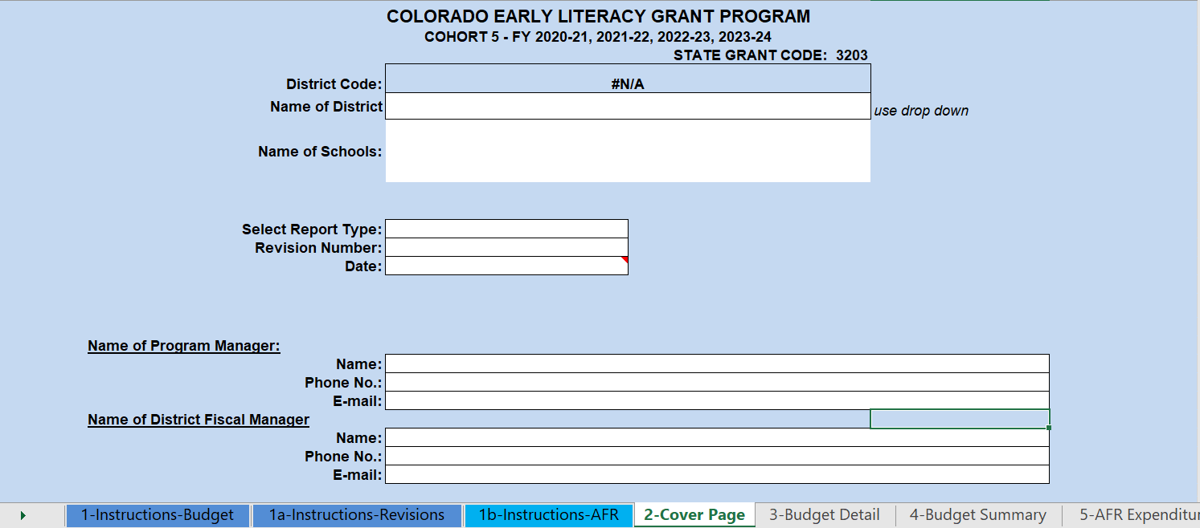
Budget Workbook: Cover Page
Select the name of the district.
Enter the name of the school(s).
Select the appropriate type of report (“budget” first).
Enter the appropriate revision number and the date.
Enter contact information for grant program and fiscal managers.

Slide 32
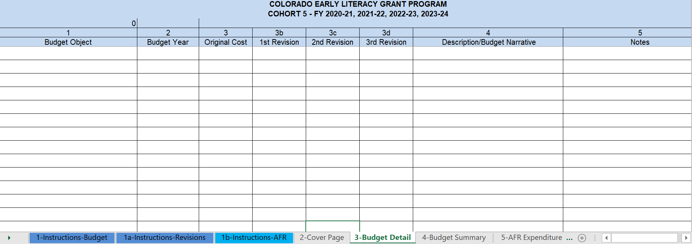
Budget Workbook: Budget Detail
Enter expenditure information:
Program
Object
Project number
Original amount
Description
This budget will remain the fiscal document used over the course of the four-year grant cycle.

Slide 33
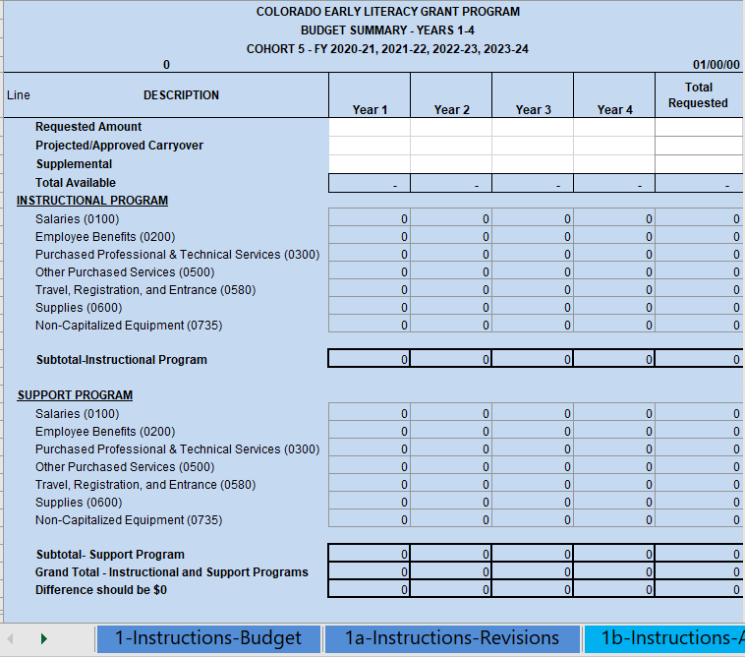
Budget Workbook: Budget Summary
The budget detail worksheet populates the budget summary.
NEW: Enter the total amount requested for each year.

Slide 34
Questions? (Please put them in the Q&A.)

Slide 35
Contact Information
Program Questions
Laura Stelling, READ Act Grants Project Manager
303-866-6971, Stelling_L@cde.state.co.us
Budget/Fiscal Questions
Marti Rodriguez, Lead Fiscal Analyst
303-866-6769, Rodriguez_M@cde.state.co.us
Matt Freeman, Fiscal Analyst
303-866-5692, Freeman_M@cde.state.co.us
Application Process Questions
Mandy Christensen, Competitive Grants and Awards
303-866-6250, Christensen_M@cde.state.co.us

