Slide 1

Comorbidity Among Learning Disorders
Bruce F. Pennington
University of Denver
Distinguished University Professor Emeritus
Supported by grants from NIH (HD-2780 and HD 049027)

Slide 2



Outline
Background
  Comorbidity: Importance and Reasons
  Multiple Deficit Model
  Diagnostic Definitions
    Dyslexia (RD)
    Speech Sound Disorder (SSD)
    Language Impairment (LI)
    ADHD
II. Neuropsychology
  Dyslexia, SSD, and LI
  ADHD
  Shared cognitive risk factors
Etiology: Genes and Environment
Summary

Slide 3
Why is Comorbidity Important?
Clinical: One disorder may influence course and treatment of the other.
Taxonomic: Comorbidities may lead to remapping diagnostic categories.
Basic Science: Comorbidities can provide insight into neurobiology and development.

Slide 4
Explanations of Comorbidity
(from Caron & Rutter, 1991; Neale & Kendler, 1995)
Chance - two disorders co-occur but not more frequently than chance would predict (chance = rate 1 x rate 2)
II. Artifactual
A. Referral bias (e.g. Berkson’s bias)
B. Rater biases
C. Definitional overlap
D. Population stratification, e.g. non-random mating
III. Causal Relation
A. Same etiology with severity continuum: A or A+B
B. Partly shared etiology: A, B, A+B
C. Etiological subtype: 3 distinct etiologies
D. One disorder causes the other: A → B

Slide 5
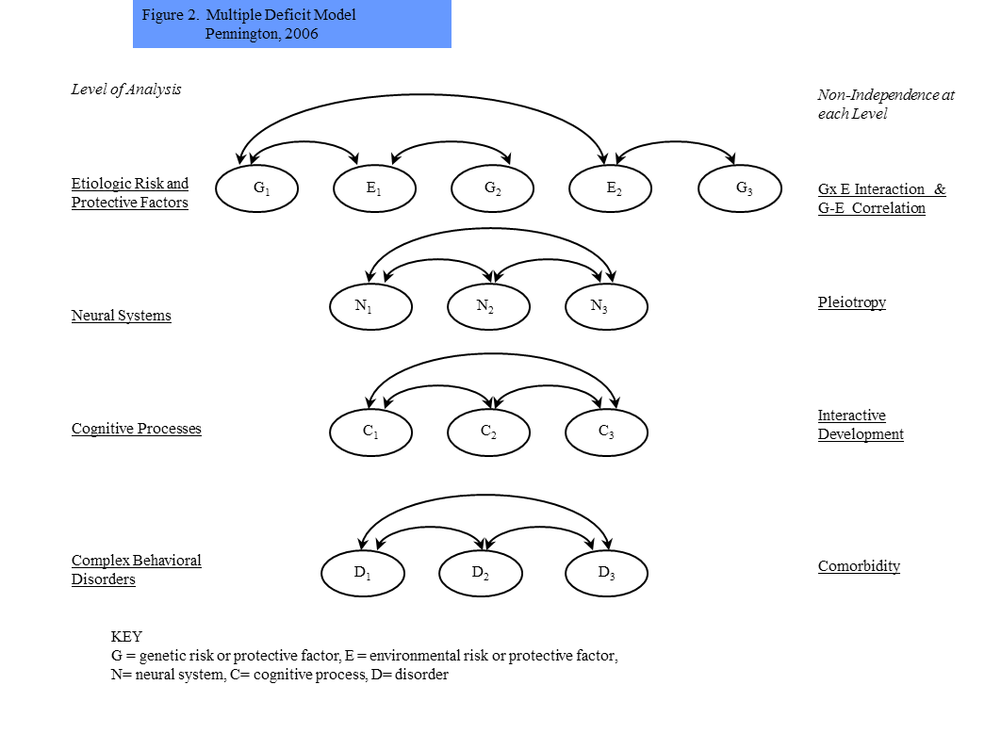

Slide 6
Bottom Line
  Partly shared risk factors across levels of analysis cause comorbidity.

Slide 7
Definition of Dyslexia (RD)
IDA & NICHD (2002)
Dyslexia is a specific learning disability that is neurobiological in origin. It is characterized by difficulties with accurate and/or fluent word recognition and by poor spelling and decoding abilities. These difficulties typically result from a deficit in the phonological component of language that is often unexpected in relation to other cognitive abilities and the provision of effective classroom instruction. Secondary consequences may include problems in reading comprehension and reduced reading experience that can impede growth of vocabulary and background knowledge.

Slide 8
Definition of Speech Sound Disorder (SSD)
A delay in the acquisition of developmentally appropriate speech sounds, resulting in reduced intelligibility. Not due to peripheral problems (e.g. hearing loss or cleft palate) or a known syndrome (e.g. autism or mental retardation). Distinct from stuttering or mutism. Formerly called articulation disorder and phonological disorder (DSM-IV-TR).

Slide 9
Classic Errors in Speech Sound Disorder
Omissions:
bathtub → “batub”
blue → “ bue”
Christmas tree → “Chistmas tee”
Substitutions:
cup → “tup”
shovel → “sobel”
bathtub → “baftub”
Omissions and substitutions can co-occur:
sleeping → “feeping”
brush → “bus”

Slide 10
Definition of Language Impairment (LI)
  Unexplained impairment in acquisition of spoken language in one or more domains (morphology, syntax, or vocabulary).
  Not due to peripheral auditory or motor impairment, ID, autism, or known neurological disorder.
  Distinction between SLI (with NVIQ discrepancy) and LI (without NVIQ discrepancy) not empirically validated.

Slide 11
DSM IV (1994) Criteria for
Attention-Deficit/Hyperactivity Disorder
Inattention (6 for subtype)
1. Poor attention to details
2. Cannot sustain attention in tasks or play
3. Does not seem to listen
4. Fails to finish tasks
5. Difficulty organizing
6. Avoids sustained mental effort
7. Loses things
8. Easily distracted
9. Forgets to do things

Slide 12
DSM IV (1994) Criteria for
Attention-Deficit/Hyperactivity Disorder (cont’d)
Hyperactivity
1. Fidgets or squirms
2. Leaves seat
3. Runs or climbs inappropriately
4. Lack of quiet play
5. On the go, “driven by a motor”
6. Talks excessively
Impulsivity
1. Blurts out answers
2. Can’t wait for turn
3. Interrupts or intrudes
Total of 6 for H-I subtype

Slide 13
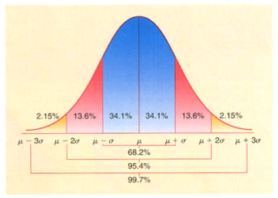
RD: Epidemiology
Depends on definition (how bad do “difficulties” have to be)
Part of the normal distribution of reading
Common definition = 7%
  ~1 child per grade school classroom
Slightly more boys than girls, but many more boys than girls identified

Slide 14
Visual Disorder or Language Disorder?
r t x o p l m
ח ל ע ף ש ק
Vellutino and colleagues (1970s):
Studied English-speaking dyslexic and typical readers who were unfamiliar with Hebrew characters.
Reversal errors:
In Hebrew, dyslexic = typical
In English, dyslexic > typical
Conclusion: Dyslexia is a disorder of language development.

Slide 15
WORD ATTACK
ift fit
bim bim
ut ut
rayed rate
kak cake
maft mat
nen any or en
ab add
tash trash/tash
wip’s wippies
beb bid

Slide 16
Reading Comprehension
Components
Fluent Printed Word Listening Discourse–Specific
Recognition Skills (WR) Comprehension (LC) Comprehension Skills
Phonological Coding Orthographic Coding
(PC) (OC)
Precursors
Phoneme Awareness Rapid Serial Naming Phonological Memory Oral Vocabulary Syntax
(PA) (RSN) (PM) (OV) (S)

Slide 17
Dyslexic Individuals Have Particular Difficulty with Phonological Awareness
Phonological awareness = ability to manipulate and attend to individual sounds in words (phonemes)
  How many sounds in “cat”? In “check”?
  Say “fixed.” Now say “fixed” without the /k/.”
  Say “funny” backwards.

Slide 18

Why Does Poor Phonological Awareness Interfere with Learning to Read?
= cat
“cat” = /k/ /a/ /t/
Each sound can be represented by a particular letter (or set of letters).
Must learn mapping between letters and sounds.

Slide 19
Other Language Difficulties in Dyslexia
Phonologically-based speech errors
  Volcano for tornado
Rapid Naming deficits

Slide 20
Cognitive Mechanisms in ADHD
Distinctive cognitive Profile Douglas (1988)
Impairments in vigilance,
systematic search, motor
inhibition, tasks without
extrinsic rewards.
Not impaired on basic verbal
and nonverbal memory tasks.
Executive Deficits Pennington &
Consistent for MFFT errors Ozonoff (1996)
and Motor Inhibition Tasks,
like Go No-Go, Stopping.
Not consistent for WCST, Fluency tasks

Slide 21
Predicting AD/HD Ratings
(n=671)
 | Adjusted R² | R² Change | p
PS Motor | .235 | .236 | <.001
Inhibition | .291 | .057 | <.001
SDRT | .296 | .006 | .022
Vigilance | .302 | .007 | .011
PS Verbal | .305 | .004 | .040
Working Memory | - | - | -

Slide 22
Shared Cognitive Risk Factors:
General (IQ) and Specific
Phonological Awareness (PA)
Phonological Memory (PM)
Rapid Serial Naming (RSN)
Processing Speed (PS)
Others?

Slide 23
Revised Bifactor model
PIAT Read
.33**
.85**
PIAT Spell
.31**
.72**
TLWRT
.39**
Decode/
Encode
.87**
TOWRE
.18**
.78**
.37**
.81**
GORT Fluency
.43**
.75**
WRAT Spell
.79**
PIAT Comp
.21**
Academic
g
.50**
QRI Read Quest
.40**
.81**
.26**
Read Comp
.55**
WJ Pass Comp
.47**
.52**
GORT Comp
.71**
Handwrite copy
.52**
WJ Write Flu
.63**
WJ Write Samp
.68**
.72**
Wechsler Arith
.47**
WRAT Math
.37**
Math
.43**
PIAT Math
Model fit: Χ²(91) = 471.79, p<.001, CFI=.95, RMSEA=.071
Notes:
When delete writing factor, handwriting copy and writing fluency loadings increased a bit, otherwise all other loadings are comparable.

Slide 24
Summary of Bifactor Model Results
All academic skills, reading, writing, math, are highly correlated and thus all DSM-5 SLDs are highly comorbid.
A single factor, psychometric g, partly explains their connection.
DSM-5 SLD writing disorder is not valid, at least with current writing measures.
Dyslexia, poor RC, and math disorder are valid and somewhat specific LDs.

Slide 25
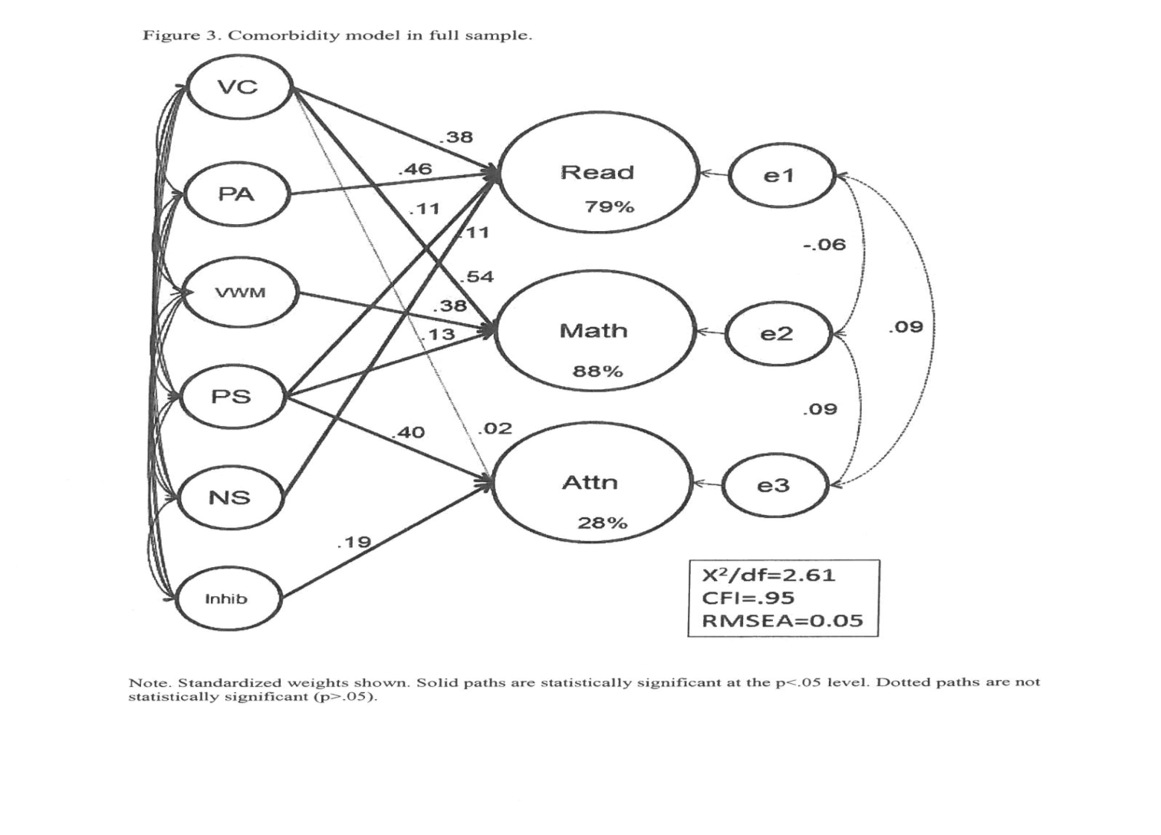

Slide 26
Summary of RD, Math, and ADHD Comorbidity
When math is added to previous model, its comorbidity with both reading and ADHD is explained by PS Motor.
Multiple cognitive factors are needed to predict math. They are language skill (VC), verbal working memory (VWM), and PS Motor.

Slide 27
Measures
Latent Variable Measures Used to Predict Latent Variable
_____________________________________________________________________________
Reading Ability Time limited word recognition task, PIAT Reading Recognition,
& PIAT Spelling
Inattention Symptoms Mother, Father, Teacher, & Examiner Ratings
Hyperactive/Impulsive
Symptoms Mother, Father, Teacher, & Examiner Ratings
PA Phoneme Deletion (% correct, blocks 1 & 2), Pig Latin test, & the Lindamood Auditory Conceptualization task
WM Nonword Repetition, Digit Span (Forward & Backward), Sentence Span & Counting Span
Inhibition Gordon Diagnostic System commission errors (Vigilance & Distractibility), & Stop Signal Reaction Time from the Stop Task
PS WISC-R Coding, WISC-III Symbol Search, Colorado Perceptual Speed Task,Identical Pictures, Trailmaking Test, Rapid Automatized Naming Task (Colors, Numbers, Letters, & Pictures) & Stroop Task (Word Naming & Color Naming)
_____________________________________________________________________________________
Note. For ADHD, mean severity ratings from each rater were used as the indicators. This strategy allows for more variance than the more typical strategy of defining ADHD using symptom counts.
Note. Errors from the same instrument (e.g., WISC Coding and Symbol Search) were allowed to correlate in both measurement models.
McGrath et al (2011)

Slide 28
Endophenotypes
Symptoms
Phonemic
Awareness
Single Word
Reading
.
.
PS Motor
.
.
Inattention
PS Verbal
.
.
Working
Memory
Hyperactive/
Impulsive
Inhibition
.

Slide 29
75%
Phonemic
Awareness
Single Word
Reading
.59***
Results
Measurement Models
The best fitting DV measurement model was one which created separate latent variables for the continuous symptoms of inattention and symptoms of hyperactivity/impulsivity
The best fitting measurement model was one which split Processing Speed into Verbal and Motor components
Full SEM Model
The full SEM model was also a good fit, χ2/df = 2.39, CFI = .96, RMSEA = .043.
.
.10ns
35%
.25*
.11**
Inattention
PS Motor
.36***
.08ns
PS Verbal
.25*
.60***
-.23*
16%
Working
Memory
Hyperactive/
Impulsive
.37**
Inhibition
.37**

Slide 30
Summary of Results and Discussion
This model accounted for 75% of the variance in RD, 35% of the variance in symptoms of inattention, and 16% of the variance in symptoms of hyperactivity/impulsivity.
Furthermore, it reduced the relationship between RD and inattention symptoms from a zero-order correlation of .425 to a non-significant partial correlation of .10, which implies that PS explains a significant amount of their overlap.
It also reduced the relationship between RD and hyperactivity/impulsivity from 0.215 to .08, suggesting that PS partially explains this relationship.
Contrary to prediction, WM did not contribute uniquely to either RD or ADHD symptoms.
These results indicate that PS is a shared cognitive risk factor for RD and ADHD, especially between RD and Inattention symptoms.
Moreover, by using latent traits of symptoms of inattention and hyperactivity/impulsivity and their neuropsychological predictors, we were able to explain a much greater amount of the variance (24-39%) of the symptoms of ADHD than is typically found in the literature (10-12%).

Slide 31
Genetic Cholesky decomposition analysis of ADHD, reading, and processing speed. Solid paths are significant (p < .01).
A1
.76
Processing Speed
.49
A2
.56
.52
Naming Speed
.16
.49
.03
.00
A3
.21
Word Reading
.60
.09
.07
A4
.71
Inattention
.61
Hyperactivity-Impulsivity
A5
.57
Willcutt, et al. (2010).

Slide 32
Summary of RD and ADHD Comorbidity
Multiple cognitive factors are needed to predict single word reading and ADHD
For reading, PA, PS Motor and PS Verbal accounted for 75% of variance
For ADHD Inattention, Inhibition and PS Motor accounted for 35% of variance
PS Motor completely accounts for the comorbidity between reading and ADHD, both at the cognitive and genetic levels.

Slide 33
Etiology
  Genes and Gene Families
  Environmental Risk Factors
  Shared etiologic risk factors for these 5 disorders
  Gene-Environment Interplay

Slide 34
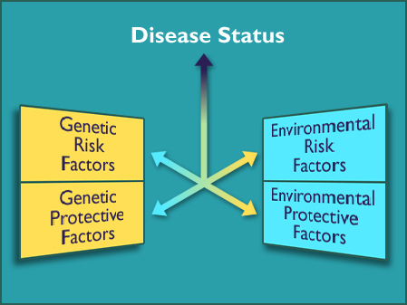
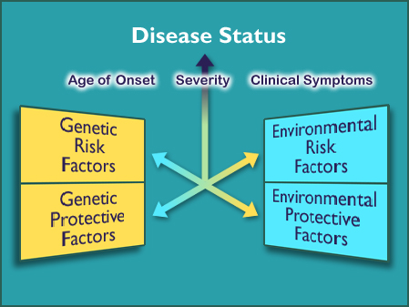

Slide 35
Finding Genes
  Heritability
  Linkage
  Association and GWAS
  Candidate Genes
  Molecular Signaling Pathways

Slide 36
Y Chromosome Map
Testis determining factor (TDF)
Channel Flipping (FLP)
Catching & Throwing (BLZ-1)
Self-confidence (BLZ-2)
Ability to remember & tell jokes (GOT-1)
Air Guitar (RIF)
Ability to identify aircraft (DC-10)
Facination with Reptilia & Arachnoidia (MOM-4U)
Spitting (P2-E)
Lack of recall for dates (OOPS)

Slide 37
X Chromosome Map
Shoe Collection Factor (DSW)
Remembering what you said (LTM)
Lie Detection Factor
Jewelry Locus (ShaneCo)
Does this make my butt look big? locus
Multi tasking locus (on multiple loci)
Asking for Directions locus
X

Slide 38
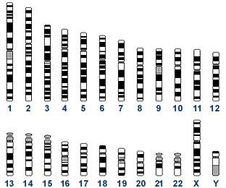
Regions of the genome showing linkage to Dyslexia

Slide 39
Key Candidate Loci & Genes for RD, SSD, & LI
Locus | Location | Gene | Overlap
SPCH1 | 7q31.1 | FOXP2 | LI, RD
SLI4 | 7q35-36 | CNTNAP2 | RD etc.
SLI1 | 16q23-24 | CMIP ATP2C2 | RD
DYX1 | 15q21.1 | DYXC1 | (SSD)
DYX2 | 6p22.2 | KIAA0319 | LI, (SSD)
 | 6p22 | DCDC2 | -
DYX3 | 2p15-16 | MRPL19/C20RF3 | IQ
DYX5 | 3p12-q13 | ROBO1 | LI, (SSD)
DYX6 | 18p11.2 | MC5R, DYM, NEDD4L | -
(SSD) = linked to chromosomal region

Slide 40
Summary
  There is extensive comorbidity among neurodevelopmental disorders.
  Shared risk factors across levels of analysis explain comorbidity.
  At the cognitive level, both general and specific cognitive risk factors lead to comorbidity.
  At the genetic level, both generalist and more specific genes cause comorbidity.

