Slide 1
Literacy Programs & Assessment Reporting Webinar
March 2022

Slide 2
Introduction
Whitney Hutton
Literacy Data/Business Analyst, Preschool through 3rd Grade Office
(E): Hutton_w@cde.state.co.us
(P): 720-636-2584
READ Act Data Collections in Data Pipeline & Web Management
Required Data Submissions
21-22 Spring READ Assessment Reporting
22-23 Literacy Programs & Assessment Reporting
21-22 READ Budget Revisions
22-23 READ Budget Submissions
22-23 Teacher Training Completion Reporting
Notes:
Speaker Notes:

Slide 3
Included Topics:
Purpose of the literacy programs and assessment reporting collection
Website review
2021-22 timeline
2022-23 file layout and definitions
Complete process
Notes:
Image:
Image from: http://www.picpedia.org/highway-signs/a/agenda.html

Slide 4
Purpose of Literacy Programs & Assessment Collection

Slide 5
Purpose The Colorado READ Act
Literacy Curriculum Transparency Act
The Act amends the Colorado READ Act to require Local Education Providers (LEPs) to report all K-3 instructional literacy programs and READ Act interim and diagnostic assessments used in their district
LEPs are required to report the READ Act administered interim and diagnostic assessments along with their core, supplemental, and intervention instructional literacy programs for grades K-3 for each school in their district (including charter schools)
All literacy instructional programs used in the district should be reported

Slide 6
Purpose The Colorado READ Act
Literacy Curriculum Transparency Act
Definitions
READ Act Interim Assessments: The State Board approved interim reading assessment(s) given to all students at the beginning and end of year to determine if students have a significant reading deficiency (SRD)
READ Act Diagnostic Assessments: The State Board approved diagnostic assessment(s) given to students identified as having an SRD for the purpose of identifying the child’s specific reading deficit(s)
Core Program: An evidence or scientifically-based core instructional program is a comprehensive program used to teach initial and differentiated instruction in the classroom
Supplemental Program: An evidence or scientifically-based supplemental instructional program is selected to supplement core reading instruction when the core program does not provide enough instruction or practice in key areas to meet student needs
Intervention Program: An evidence or scientifically-based intervention instructional program selected for students identified as having an SRD or as reading below grade level
Other Supports: Evidence or scientifically-based services and other supports selected for students identified as having an SRD or as reading below grade level

Slide 7
Purpose READ Collection Overview
READ Act Data Collections
21-22 READ Spring Assessment Data (April –June)
22-23 Literacy Programs & Assessment Data (April – June)
READ Budgets (April – June)
Data Collected Through Data Pipeline
Data Collected Through Data Pipeline & Attached to District UIP
Data Collected Through Different Web Application
22-23 Teacher Training Completion (August)
Data Collected Through Data Pipeline
Notes:
Speaker notes:

Slide 8
Website Review READ Data Collection & Data Pipeline

Slide 9
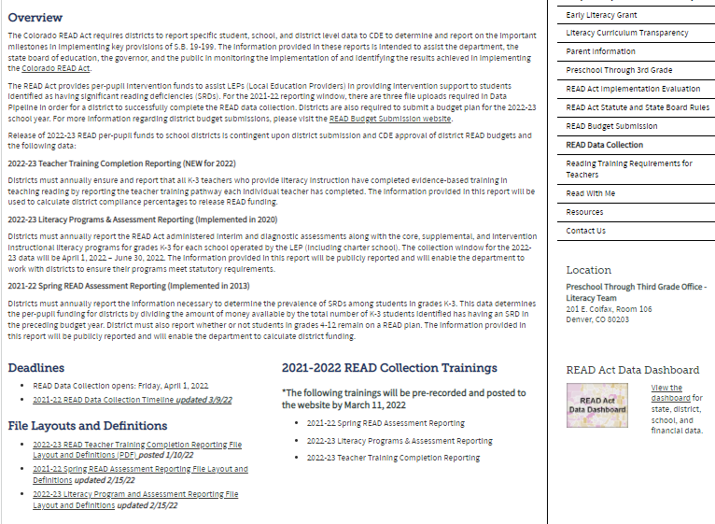
Website Review http://www.cde.state.co.us/coloradoliteracy/readdatapipeline
Timeline
File Layouts
Notes:
Speaker notes:

Slide 10
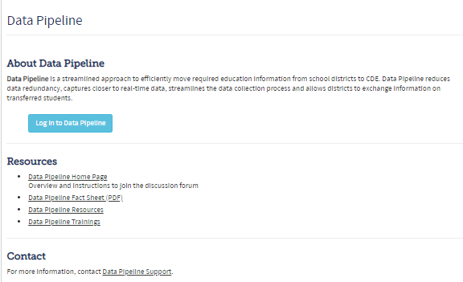
Website Review https://www.cde.state.co.us/idm/datapipeline
Data Pipeline is a streamlined approach to efficiently move required education information from school districts to CDE
Click here to Login to the Data Pipeline System
Note: before new data respondents can login to Data Pipeline, you must contact your Local Access Manager (LAM) and ask them to assign you the REDLEAUSER or REDLEAAPPROVER role in Identity Management (IdM) system
Notes:
Speaker notes:

Slide 11
Timeline

Slide 12
Timeline
Friday, April 1, 2022 – Literacy Programs & Assessment collection opens, and files may be uploaded in Data Pipeline
Friday, June 17, 2022 – Date by which district should have uploaded a file at least once
Friday, July 1, 2022 – Data collection closes
November 2022 – Distribution of 22-23 READ funds
December 2022 - Literacy Curriculum Transparency Dashboard will be updated with 22-23 data

Slide 13
22-23 Collection Data Elements

Slide 14
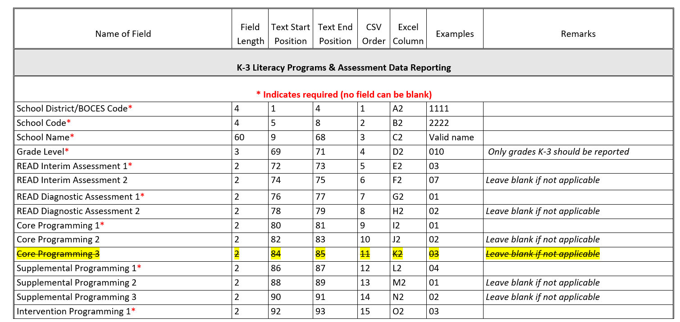
22-23 Collection Data Elements
The data collection window for the 2022-23 school year will be April 1, 2022 – July 1, 2022

Slide 15
22-23 Collection Data Elements
Note: Only fields with an astrict are required. If you are not using multiple assessments or programs in your district, then you can leave additional fields blank
For example, your Excel file template could look like this…

Slide 16
22-23 Collection Data Elements
For a file layout template with pre-populated school names and grade levels, please pull the “READ K-3 Literacy Programs Schools List” report in Cognos

Slide 17
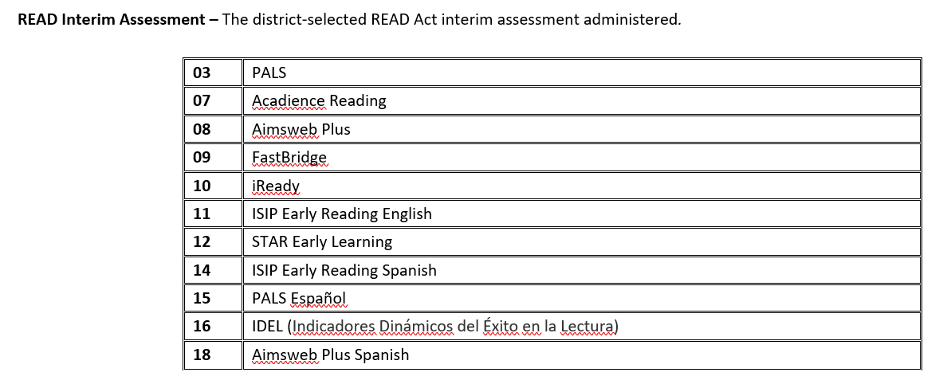
22-23 Collection Data Elements

Slide 18
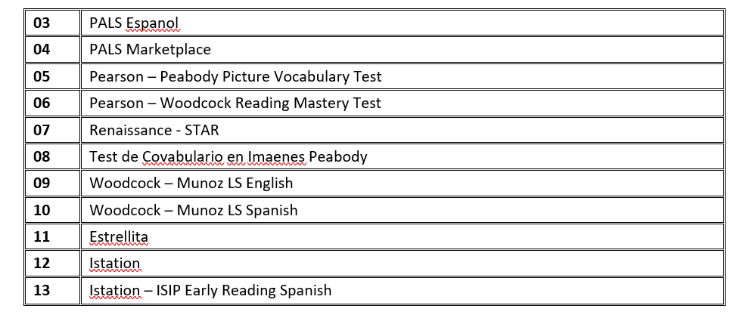
22-23 Collection Data Elements

Slide 19
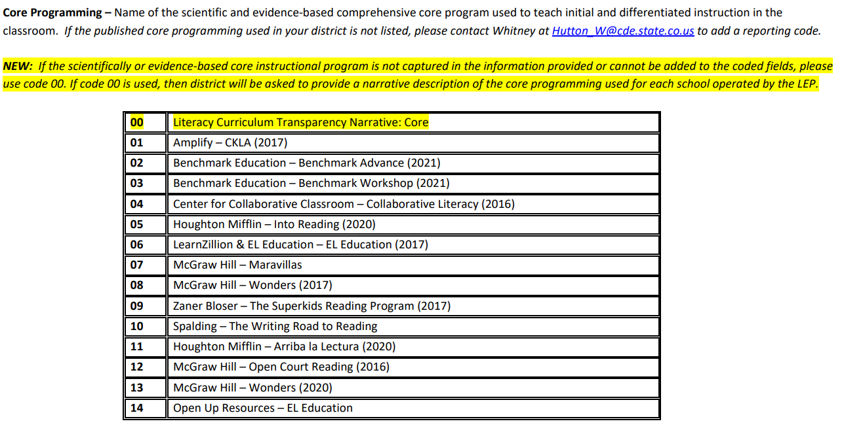
22-23 Collection Data Elements
For a full list of programs available in the collection, please view the File Layout & Definitions document

Slide 20
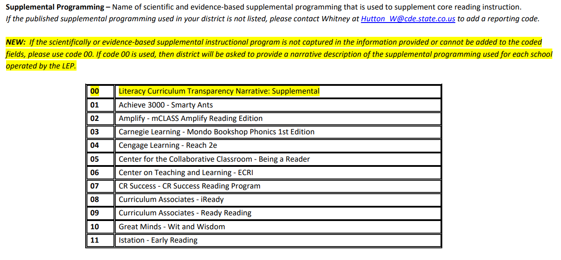
22-23 Collection Data Elements
For a full list of programs available in the collection, please view the File Layout & Definitions document

Slide 21
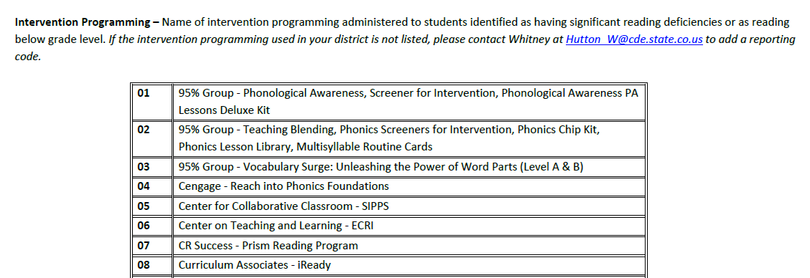
22-23 Collection Data Elements
For a full list of programs available in the collection, please view the File Layout & Definitions document

Slide 22
22-23 Collection Data Elements

Slide 23
Complete Process Overview

Slide 24
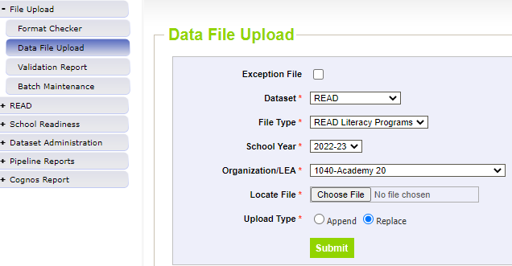
Complete Process Overview How to Upload a File
After logging into Data Pipeline…
1
2
3
4
5

Slide 25
Complete Process Overview How to Check for Errors
Errors are edits in place to assist with providing the most accurate information to CDE
Errors must be corrected in the file before finalizing the data
Error message should provide adequate information to assist you with determining the corrections needed
Find the data field(s) in the data file upload and make appropriate adjustments and then re-upload the fixed data file again into data pipeline

Slide 26
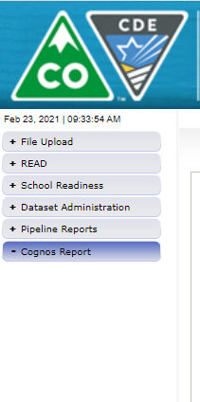
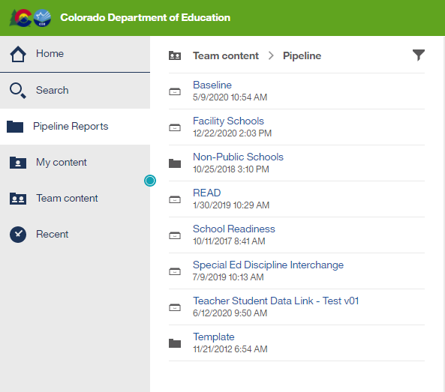
Complete Process Overview How to Check for Errors
2
1
3
4

Slide 27
Complete Process Overview Finalizing Steps
Once all errors are resolved…
Review, review, review your data for accuracy!
If mistakes/misreporting is found, correct files again and reload data
If data reports are all accurate you must finalize the data by clicking the green Submit to CDE tab in the Status Dashboard
REDLEAAPPROVER for district will need to “Submit to CDE”

Slide 28
Thank you for reviewing!
Whitney Hutton
(E): Hutton_w@cdestate.co.us
(P): 720-636-2584
Visit the CDE READ Data Collection website for more information about the READ Act Data Collections

