Slide 1
Multi-Tiered System of Supports (MTSS)
Family, School, and Community Partnering (FSCP) Implementation Guide
Supporting Every Student’s Learning
July 2016
Step One: ENSURE SHARED MTSS AND FSCP KNOWLEDGE OF THE WHAT, WHY,WHO, WHEN AND HOW
Overview Slides with Presentation Notes
Exceptional Student Services Unit
Notes:
Key Points:
These slides are the Instructional Slides and Presentation Notes for Step One: ENSURE SHARED MTSS and FSCP KNOWLEDGE of the MTSS FSCP Partnering Implementation Guide. They can be used as is for presentation or slides taken and used as needed. There are presentation notes for each slide so that there can be the same shared information with all stakeholders.

Slide 2

Apply to Site or Situation
  Share the What, Why, Who, and When of Family, School, and Community Partnering
  Use a Multi-Tiered, Layered Continuum of Supports for Students and Families
  Implement the National Standards for
  Family-School Partnerships for EVERY Family
  and Educator
  Create a Dual Capacity-Building Framework
Notes:
Key Points:
In response to “how”, apply the following:
Share equally with all stakeholders – What, Why, Who, and When
MTSS
National Standards
Dual Capacity-Building

Slide 3
CDE Strategic Goals:
Every Student Every Step of the Way
…and…
Every Family
Start strong
Read by third grade
Meet or exceed standards
Graduate ready
Notes:
Key Points:
These are CDE’s current goals for every student; this slide adds families as they are partners from early childhood through postsecondary education.
Families provide the continuity and consistency from teacher to teacher and grade to grade and level to level.

Slide 4
MTSS FSCP Implementation Guide: Outcomes
Each adult learner will:
Access the research & legal base describing how partnering positively supports academic and behavioral learning
Implement partnering within a Multi-Tiered System of Supports (MTSS) framework, applying the National Standards for Family-School Partnerships; actively team throughout the special education process.
Apply each of these three steps to one’s site or situation, using adult learning principles:
        ENSURE SHARED MTSS AND FSCP KNOWLEDGE OF THE WHAT, WHY, WHO, WHEN, AND HOW
        USE DATA TO CREATE MULTI-TIERED FSCP ACTION PLANS (MORE ABOUT HOW)
        ADAPT MULTI-TIERED FSCP TOOLS, INCLUDING SPECIFIC SPECIAL EDUCATION SUPPORTS (MORE ABOUT HOW)
Practice ongoing, strategic, effective partnering every day.
Notes:
Key Points:
These are the goals of the MTSS FSCP Implementation Guide.
They are all action-based.
The materials in the Guide relate to these identified outcomes.

Slide 5

Family, School, and Community Partnering
Adult Learning
All adult stakeholders are adult learners: family members, educators, community collaborators. Adult learning refers to a collection of theories and methods for describing the conditions under which the processes of learning are optimized. Specific, effective factors incorporated into this Guide include:
Introductory Information
Self-instruction
Demonstration
Application
Reflection and Evaluation
Multiple Hours Over Time
(Trivette, Dunst, Hamby, & O’ Herin, 2009)
Notes:
Key Points:
These adult learning principles are incorporated into the MTSS FSCP Implementation Guide.
Educators, family members, and community resources are all adult learners.
Applying these principles shifts partnering into a “learning” arena, where new skills are to be introduced, practiced, applied, and reflected upon - over time; this is a new way of viewing partnering for some.

Slide 6

Closing the FSCP
Implementation Gaps
Research Practice
Belief Practice
Law Practice
Resources Practice
Notes:
Key Points:
It can be helpful to think about “closing implementation gaps” by actually applying strategic, ongoing, effective partnering practices.
These gaps have been identified in the partnering research.
Research – there is over 50 years of supporting studies identifying how partnering improves student achievement.
Beliefs – most stakeholders believe that partnering is important for students.
Law – state and federal laws mandate partnering.
Resources – there are hundreds of excellent and useable resources for educators, families, and community members.

Slide 7
MTSS FSCP Implementation Guide
Three Steps
Step One: ENSURE SHARED MTSS AND FSCP KNOWLEDGE OF THE WHAT, WHY, WHO, WHEN, AND HOW
  Partners benefit from sharing the same evidence and understanding of effective collaboration to support student learning.
Step Two: USE DATA TO CREATE MULTI-TIERED FSCP ACTION PLANS
  Partners continuously improve their collaborative efforts when they use data to strategically plan, evaluate, and revise goals.
Step Three: ADAPT MULTI-TIERED FSCP TOOLS, INCLUDING SPECIFIC SPECIAL EDUCATION SUPPORTS
  Partners can be efficient, timely, and strategic when they access specific resources and apply those supports to their sites or situations.
Notes:
Key Points:
These are three steps, as identified in the MTSS FSCP Implementation Guide, which can guide family, school, and community implementation in a school community.
Thinking about these in developing effective practices can hopefully help provide information as to the WHAT, WHY, WHO, WHEN, and HOW of partnering effectively.
School communities all have some partnering practices in place, but they may not be as strategic, data-based, or effective as desired.
The focus of partnering is always on student success.

Slide 8




MTSS FSCP Implementation Guide
Four Areas of Study
For each step, the Implementation Guide includes:
A. Information
    Articles, Research Briefs
    Tools, Data Sources
B. Demonstration
    Videos
    Stories From the Field
C. Application
    Activities Applied to Site, Situation
D. Resources
    Documents, Websites, Organizations, and Books
Notes:
Key Points:
The MTSS FSCP Implementation Guide, in following adult learning principles, includes these four areas of study for each step.
Each provides information in different ways and with specific purpose, but are aligned and intended to reinforce learning and support implementation.
Stakeholders are encouraged to review all initially and then experience those which are most helpful and relevant to a specific site or situation.

Slide 9
Step One: ENSURE SHARED MTSS AND FSCP KNOWLEDGE of THE WHAT, WHY, WHO, WHEN, AND HOW
Partners benefit from sharing the same evidence and understanding of effective collaboration to support student learning.
This Step includes information on the following:
    Multi-Tiered System of Supports (MTSS)
    Family, School, and Community Partnering (FSCP)
      WHAT
      WHY
      WHO
      WHEN
      HOW
This overview presentation includes slides and presentation notes which can be used by school communities.
Notes:
Key Points:
These are the key information points described in Step One of the MTSS FSCP Implementation Guide.
There are many different viewpoints, experiences, beliefs, levels of knowledge, and perceptions of how families should be involved with schools.
This information hopes to create a shared knowledge base so that there can be true collaboration, problem solving, and focusing on student success.

Slide 10
Step One: ENSURE SHARED KNOWLEDGE
Multi-Tiered System of Supports (MTSS)
Notes:
Key Points:
There is specific information on understanding the Colorado MTSS framework.

Slide 11
Response to Intervention (RtI)
Colorado Legislation
Response to Intervention (RtI) is incorporated within a Multi-Tiered System of Supports (MTSS)
One of the criteria for a specific learning disability (SLD)… The child does not make sufficient progress to meet age or state-approved grade-level standards in the area(s) identified when using a PROCESS BASED ON THE CHILD’S RESPONSE TO SCIENTIFIC, RESEARCH-BASED INTERVENTION. (ECEA,CDE, 2007)
SACPIE shall inform … concerning best practices and strategies… for increasing parent involvement in public education and promoting family and school partnerships, in… (c) Involving parents in RESPONSE TO INTERVENTION PROGRAMS in public schools and districts. (SB 09-90)
If a student’s reading levels are below grade level … or if the student has a significant reading deficiency, the local education provider shall ensure that the student receives appropriate interventions through the RESPONSE TO INTERVENTION FRAMEWORK. (READ Act, HB 12-1238)
Notes:
Key Points:
RtI is in Colorado legislation in three different statutes.
RtI is incorporated into a Multi-Tiered System of Supports (MTSS).
RTI is also mentioned in Colorado’s Exceptional Children’s Education Act (ESEA), Rules for Gifted Education (2015); this in 12.02(2(9c) and states: In traditionally underrepresented student groups and visual/music/performing arts student groups or talent pools, identification may require the collection of student information over time, using additional data points from a response to intervention approach, or additional assessment.

Slide 12
Multi-Tiered System of Supports (MTSS)
Academic
Supports
RtI
MTSS
Family and
Community
Supports
PBIS
Behavior
Supports
Notes:
Key Points:
Family and community supports have been a key component of both RtI and PBIS since these began in Colorado.
Now, all these systems of supports are included in the MTSS framework.

Slide 13

8 Guiding Principles of SW PBIS
Administrative Leadership
Team Implementation
Define Concrete Expectations
Teach Behavior Expectations
Acknowledge and Reward Positive Behavior
Monitor and Correct Behavior
Use Data for Decision Making
Family and Community Partnerships
MTSS
Components
Team-Driven Shared Leadership
Data-Based Problem Solving & Decision-Making
Layered Continuum of Supports
Evidence-Based Practices
Family, School, and Community Partnering
6 Components of RtI
Leadership
Problem Solving
Curriculum and Instruction
Assessment/Progress Monitoring
Positive School Climate and Culture
Family, School, and Community Partnering
Notes:
Key Points:
Colorado MTSS brings together components of PBIS and RtI into one framework, focusing on academic and behavioral learning.
The braiding of the two initiatives provides a visual of how PBIS and RtI work together.
Family, school, and community partnering has been one of the essential components of each initiative.

Slide 14
Definition: Multi-Tiered System of Supports (MTSS) in Colorado
CO-MTSS is a prevention-based framework of team-driven data-based problem solving for improving the outcomes of every student through family, school, and community partnering and a layered continuum of evidence-based practices applied at the classroom, school, district, region, and state level.
Notes:
Key Points:
This is the definition of Colorado Multi-Tiered System of Supports (MTSS).
An important word is “every”.
Family, school, and community partnering is an essential component throughout all levels.

Slide 15
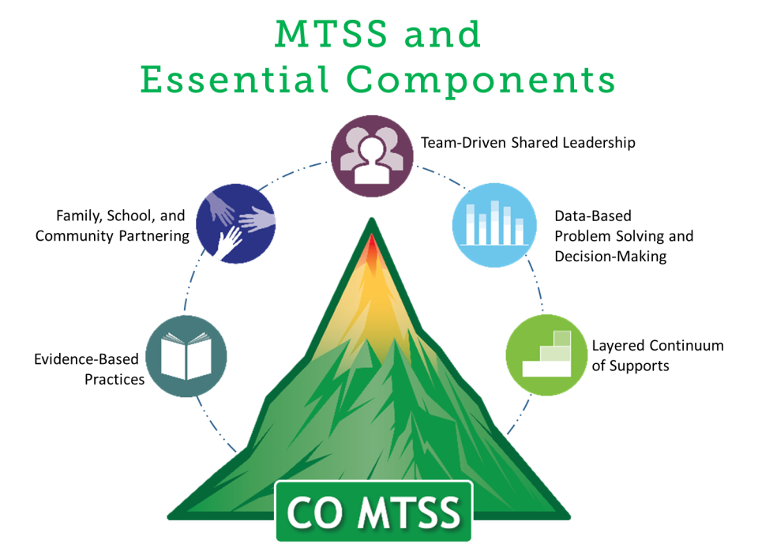
Notes:
Key Points:
This is the “logo” or graphic representation of the MTSS framework and its five essential components. Each component is referenced in the definition.
The components are Team-Driven Shared Leadership, Data-Based Problem Solving and Decision-Making, Family, School, and Community Partnering, Layered Continuum of Supports, and Evidence-Based Practices.

Slide 16
MTSS Definition “chunked out”
Prevention-based
Framework
Team-driven
Data-based
Problem solving
Improved outcomes
Every student
Family, school, and community partnering
Layered continuum
Evidenced-based practices
Classroom, school, district, regional, and state level
Notes:
Key Points:
Here are all the elements of the definition.
The bulleted points that are highlighted in green are ones that have additional description in the following slides.

Slide 17
Notes:
Key Points:
The focus of the MTSS Implementation Guide is on Family, School, and Community Partnering or FSCP, which is defined within the MTSS framework as: The collaboration of families, schools, and communities as active partners in improving learner, classroom, school, district, and state outcomes.
Other component definitions, which are integrated into Family, School, and Community Partnering are as follows:
Team-Driven Shared Leadership
Teaming structures and expectations distribute responsibility and shared decision-making across school, district, and community members (e.g. students, families, generalists, specialists, district administrators, etc.) to organize coordinated systems of training, coaching, resources, implementation, and evaluation for adult activities.
Data-Based Problem Solving and Decision-Making
A consistent process is used by stakeholder teams and applied at multiple levels to analyze and evaluate relevant information to plan and implement strategies that support sustainable improved student and system outcomes.
Layered Continuum of Supports
Ensuring that every student receives equitable academic and behavioral support that is culturally responsive, matched to need, and developmentally appropriate, through layers that increase in intensity from universal (every student) to targeted (some students) to intensive (few students).
Evidence-Based Practices
Approaches to instruction, intervention, and assessment that have been proven effective through research indicating improved outcomes for students.
Family, School, and Community Partnering
The collaboration of families, schools, and communities as active partners in improving learner, classroom, school, district, and state outcomes.

Slide 18
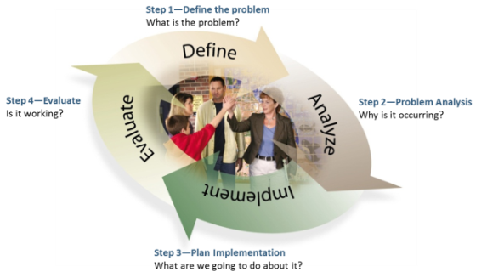
MTSS is Data-Driven
(CO MTSS Problem Solving Process)
There is efficient collection and use of data.
The process is informed by data and the team is informed by data.
Problem-solving teams use data to make decisions.
Problem-solving teams represent the educational setting.
Family members are partners at all levels in the problem-solving process.
Notes:
Key Points:
This is the Colorado problem solving process.
It is cyclical and ongoing, always using data and including stakeholders on the team.
Data drives the decision making.
Family members, student, and educator are “high fiving” in the inner circle.

Slide 19

MTSS is Prevention-Based
Preventative Approach Applied Across All Tiers
Identify who needs support as early as
possible; Implement supports
when needed; and Determine if
those supports are effective
Prevent development of
new problems
Reduce the number of
existing challenges
Reduce the intensity and complexity
of needed supports
Notes:
Key Points:
MTSS works to prevent problems, intervene early, and use data to make such decisions.
Supports are always evaluated for effectiveness and revised according to data.

Slide 20
Learning Outcomes in MTSS
“Academic Achievement + Social Competence”
(Academic Learning) (Behavioral Learning)
A responsive environment is created.
A culture of learning exists.
Joint planning of educators and families results in shared accountability and improved student achievement.
MTSS
Integrated Continuum
Academic Continuum
Behavior Continuum
(Note: Visual graphic
Representation
Adapted from OSEP PBIS TA Center)
Notes:
Key Points:
Academic and behavioral learning are the goals in MTSS.
Families and educators share in planning, results, and accountability.
There is continuum of needs and related interventions.
Academic and behavioral learning are connected.

Slide 21
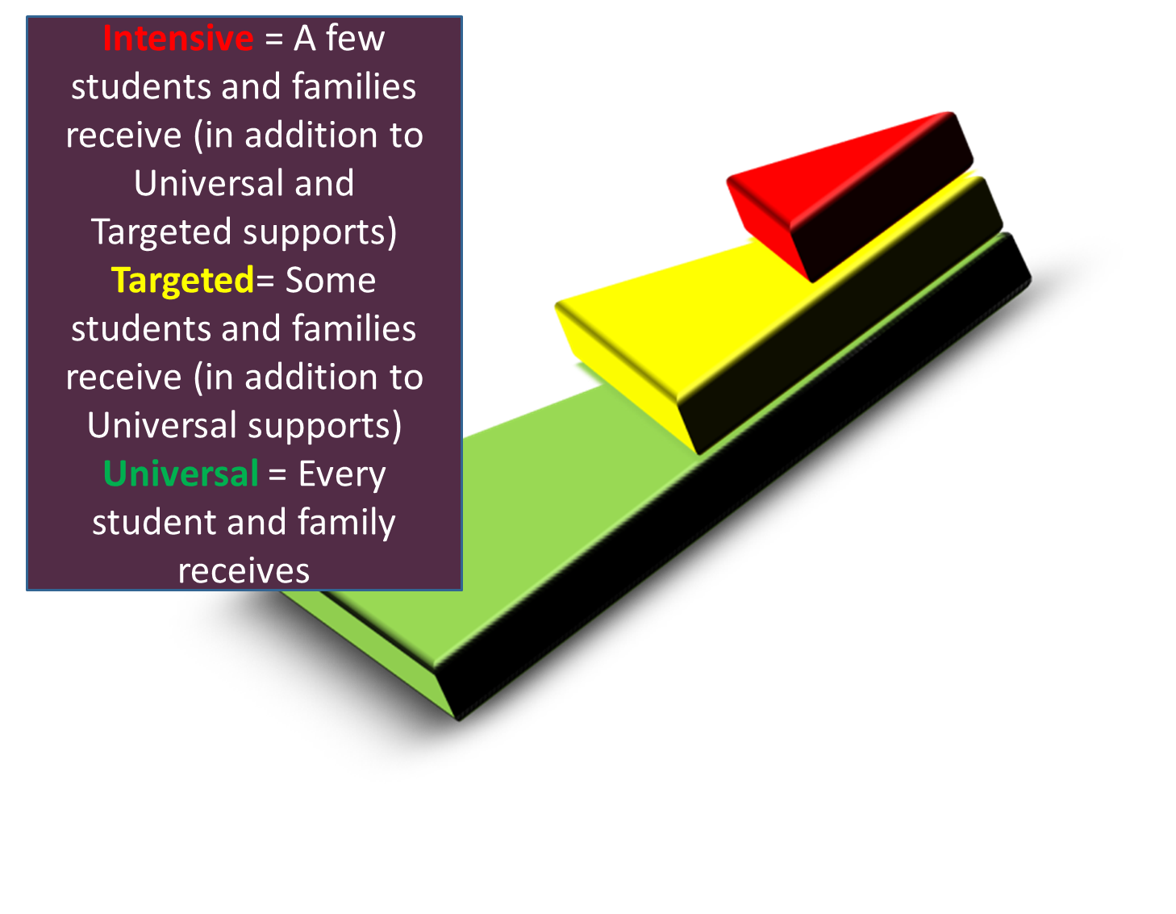
Support Matched to Stakeholders’ Needs in MTSS
Intensive
Targeted
Universal
“The Layered Continuum of Supports”
(Note: Visual graphic
Representation
Adapted from Practitioners)
Notes:
Key Points:
“We layer supports on…(matching to need)…students do not ‘move through tiers’ (as if it were a “maze” for them to navigate).”High quality instruction is provided to all students.
Some students benefit from additional instruction, progress monitoring and support to ensure educational gaps are eliminated.
Also, a few students benefit from more precise and explicit support to ensure their persistent academic or behavioral needs are met.
This illustrates that a well-designed MTSS framework will have hierarchical tiers of instruction and supports provided to every student within the school. These layered tiers increase in intensity; these tiers also apply to family supports.
Specifically, Universal (Tier 1) instruction and supports, if designed and delivered well, should meet the needs of most students and families. The goal of the Universal tier is to promote positive skill development and partnering, prevent problems from emerging, and reduce the need for supports at subsequent tiers.
Even with effective Universal instruction and supports, some student and families will need Targeted (Tier 2) interventions and supports. The goal of the Targeted tier is to supplement the Universal tier and improve outcomes for this small percentage of students.
When Universal and Targeted supports are designed and delivered well, there will still be a few students and families who will need Intensive (Tier 3) interventions and supports. The goal of the Intensive tier is to enhance existing supports to improve individual academic and/or behavioral outcomes for students.

Slide 22
Step One: ENSURE SHARED KNOWLEDGE
What, Why, Who, When, Why and How of Family, School, and Community Partnering
Exceptional Student Services Unit
Office of Learning Supports
Notes:
Key Points:
These slides are the Instructional Slides and Presentation Notes for Step One: ENSURE SHARED KNOWLEDGE of the MTSS FSCP Partnering Implementation Guide. They can be used as is for presentation or slides taken and used as needed. There are presentation notes for each slide so that there can be the same shared information with all stakeholders.

Slide 23
Family, School, and Community Partnering (FSCP)
Active partnering is a relationship demanding close
collaboration, communication, and coordination between parties having shared responsibilities.
(adapted from Christenson & Sheridan, 2001)
WHAT?
Definitions
Multi-Tiered, Layered FSCP
National Standards for Family-School Partnerships
Dual Capacity Framework
Notes:
Key Points:
It is important to have shared definitions and understandings between all stakeholders.
In addition to definitions and principles, FSCP is a component of a Multi-Tiered System of Supports and can be thought of as a continuum of supports.
The National Standards for Family-School Partnerships are cited in SB 09-90 and SACPIE, the State Advisory Council for Parent Involvement in Education, must align its work with these standards.
The Dual Capacity-Building Framework was developed by the U.S. Department of Education and highlights the importance of training and learning for all stakeholders in order to build effective partnerships.

Slide 24

Partnering Principles
The focus is always on student success
It is about ongoing, sustainable,
intentional relationships
Differences are directly addressed, so that:
  students see their worlds working together.
  a forum is created for understanding the culture of the family and the culture of the school (cultural sharing).
(Garcia Coll & Chatman, 2005)
Notes:
Key Points:
Families and teachers work together at all times and then right away when student might be struggling; all try to problem solve solutions together.
This keeps students engaged in the learning process.
Easier to learn about differences and share cultures when focusing on student success.
A key message is that partnering is with EVERY family, for EVERY student, by EVERY educator – this involves culture sensitivity and understanding of difference.s
Relationships, relationships, relationships…
Students see adults in their lives caring and sharing and working together.

Slide 25
Research-Based Partnering Definitions
Family and Community Partnering is the collaboration of schools, families, and communities as equal partners in improving learner, classroom, school, and district outcomes. (CDE, 2013)
In effective Family and Community Partnering, each stakeholder shares responsibility for learners’ success by:
      establishing and sustaining trusting relationships;
      understanding and integrating family and school culture;
      maintaining two-way communication;
      engaging in collaborative problem-solving:
      coordinating learning at home, school, and in the
      community, using data;
      acknowledging and celebrating progress.
      (CDE, 2010)
Notes:
Key Points:
These definitions have been developed by the Colorado Department of Education and can be used as examples
They are based on the research and the goals of partnering – improving every student’s school success.

Slide 26
More Partnering Definitions
  Family-school partnering can be defined as the collaboration that drives student achievement. (Flamboyan Foundation, 2013)
  Partnering is being on the same team and sharing goals and knowledge. (Family Member, 2014)
  Family-school partnering is sharing responsibility for a student’s school success. (Lines, Miller, & Arthur-Stanley, 2011)
  Partnering is coordinating learning between home and school by communicating and collaborating. (School Intervention Team, 2012)
Notes:
Key Points:
These examples are from various sources. It might be helpful to ask stakeholders for their definition of partnering and/or do an online search.
Definitions should be meaningful and purposeful.
The use of “ing” and a verb implies ongoing actions.

Slide 27
Partnering Vocabulary
Words:“WE”, “OUR”, “US”
Goals: What do we want to ACHIEVE TOGETHER?
Roles: How can WE PARTNER around that?
Data: How will WE KNOW it is working?
Input: What does the family or school or community resource THINK, FEEL, KNOW?
Decisions: WE ALL are “at the table” and “on the team”.
Responsibilities: What are WE EACH doing?
Students: What is BEST for OUR student?
Notes:
Key Points;
When students are learning new concepts, we teach, practice new words.
Same true if partnering as adults - pronouns shift from “I’s” to “we’s” & focus in on shared goals, data, input, decision-making & responsibilities.
Always ask “what is best for ‘our student’?” Might not always be agreement, but will always be a focus.
Some training participants have suggested posting shared language in conference/meeting room so s can cue “team building” and conversation - between all partners.

Slide 28
Multi-Tiered Family, School, and Community Partnering: Supporting EVERY Student’s Learning
Intensive – Few
Families
Targeted – Some Families
Universal - Every Family
“The Layered Continuum of Supports”
(Note: Visual graphic
Representation
Adapted from Practitioners)
Notes:
Key Points:
“We layer supports on…(matching to need)…students do not ‘move through tiers’ (as if it were a “maze” for them to navigate).”High quality instruction is provided to all students.
Some students benefit from additional instruction, progress monitoring and support to ensure educational gaps are eliminated.
Also, a few students benefit from more precise and explicit support to ensure their persistent academic or behavioral needs are met.
This illustrates that a well-designed MTSS framework will have hierarchical tiers of instruction and supports provided to every student within the school. These layered tiers increase in intensity; these tiers also apply to family supports.
Specifically, Universal (Tier 1) instruction and supports, if designed and delivered well, should meet the needs of most students and families. The goal of the Universal tier is to promote positive skill development and partnering, prevent problems from emerging, and reduce the need for supports at subsequent tiers.
Even with effective Universal instruction and supports, some student and families will need Targeted (Tier 2) interventions and supports. The goal of the Targeted tier is to supplement the Universal tier and improve outcomes for this small percentage of students.
When Universal and Targeted supports are designed and delivered well, there will still be a few students and families who will need Intensive (Tier 3) interventions and supports. The goal of the Intensive tier is to enhance existing supports to improve individual academic and/or behavioral outcomes for students.

Slide 29
National Standards for Family-School Partnerships (National PTA, 2008)
Welcoming All Families
Communicating Effectively
Supporting Student Success
Speaking Up for Every Child
Sharing Power
Collaborating with Community
Notes:
Key Points:
These are the National Standards for Family-School Partnerships developed by the PTA, based on the research of Joyce Epstein and her associates at Johns Hopkins University.
They are all action words, using “ing” and thus implying ongoing partnering actions.
These standards are identified in Colorado Senate Bill 09-90 and the State Advisory Council for Parent Involvement in Education (SACPIE) must align its work with them.

Slide 30
Welcoming All Families into the School Community
Families are active participants in the life of the school, and feel welcomed, valued, and connected to each other, to school staff, and to what students are learning and doing in class.
Create a welcome climate.
Build a respectful, inclusive school community.
PTA (2009). PTA National Standards for Family-School Partnerships: An Implementation Guide.
Notes:
Key Points:
This is the definition of this standard and suggested actions or goals.
It is important to think how these apply to EVERY family, including those with language, socioeconomic, cultural, and learning differences; and EVERY staff member in a school community.
It might be helpful to ask stakeholders what this standard might “look like”.

Slide 31
Communicating Effectively
Families and school staff engage in regular, two-way, meaningful communication about student learning.
Share information between school and families.
Communication should be two-way and on-going.
PTA (2009). PTA National Standards for Family-School Partnerships: An Implementation Guide.
Notes:
Key Points:
This is the definition of this standard and suggested actions or goals.
It is important to think how these apply to EVERY family, including those with language, socioeconomic, cultural, and learning differences; and EVERY staff member in a school community.
It might be helpful to ask stakeholders what this standard might “look like”.

Slide 32
Supporting Student Success
Families and school staff continuously collaborate to support students’ learning and healthy development both at home and at school, and have regular opportunities to strengthen their knowledge and skills to do so effectively.
Share information about student progress.
Support learning by engaging families.
PTA (2009). PTA National Standards for Family-School Partnerships: An Implementation Guide.
Notes:
Key Points:
This is the definition of this standard and suggested actions or goals.
It is important to think how these apply to EVERY family, including those with language, socioeconomic, cultural, and learning differences; and EVERY staff member in a school community.
It might be helpful to ask stakeholders what this standard might “look like”.

Slide 33
Speaking up for Every Child
Families are empowered to be advocates for their own and other children, to ensure that students are treated fairly and have access to learning opportunities that will support their success.
Understand how the school system works.
Empower families to support their own and other children’s success in school.
PTA (2009). PTA National Standards for Family-School Partnerships: An Implementation Guide.
Notes:
Key Points:
This is the definition of this standard and suggested actions or goals.
It is important to think how these apply to EVERY family, including those with language, socioeconomic, cultural, and learning differences; and EVERY staff member in a school community.
It might be helpful to ask stakeholders what this standard might “look like”.

Slide 34
Sharing Power
Families and school staff are equal partners in decisions that affect children and families and together inform, influence, and create policies, practices, and programs.
Strengthen the families’ voice in shared decision-making.
Build families social and political connections.
PTA (2009). PTA National Standards for Family-School Partnerships: An Implementation Guide.
Notes:
Key Points:
This is the definition of this standard and suggested actions or goals.
It is important to think how these apply to EVERY family, including those with language, socioeconomic, cultural, and learning differences; and EVERY staff member in a school community.
It might be helpful to ask stakeholders what this standard might “look like”.

Slide 35
Collaborating with the Community
Families and school staff collaborate with community members to connect students, families, and staff to expanded learning opportunities, community services, and civic participation.
Connect the school with community resources.
Have the school give back to the community.
PTA (2009). PTA National Standards for Family-School Partnerships: An Implementation Guide.
Notes:
Key Points:
This is the definition of this standard and suggested actions or goals.
It is important to think how these apply to EVERY family, including those with language, socioeconomic, cultural, and learning differences; and EVERY staff member in a school community.
It might be helpful to ask stakeholders what this standard might “look like”.

Slide 36
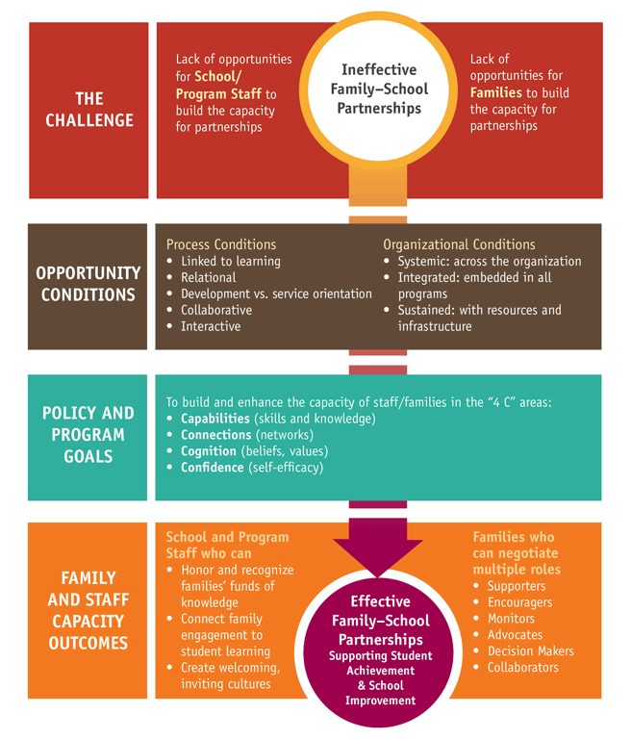
THE
DUAL CAPACITY –BUILDING FRAMEWORK (U.S. Department of Education, 2013)
Notes:
Key Points:
The FRAMEWORK was formulated using research on:
Effective home-school partnership strategies
Parent organizing
Adult learning and motivation
Leadership development – cultivating leaders
This is the new framework developed by the U.S. Department of Education which clearly states that both families and educators must have training and support in learning to partner effectively.
There are challenges and these must be overcome with intentional support and planning.

Slide 37
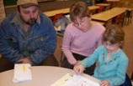

Dual-Capacity Building Framework:
Families & Educators Both Need…
Capabilities (skills & knowledge)
Connections (networks)
Cognition (beliefs, values)
Confidence (self-efficacy)
U.S. Dept. of Ed. Dual Capacity-Building Framework (2013)
http://www.ed.gov/family-and-community-engagement
Notes:
Key Points:
This slides describes what families and educators both need to partner effectively.
It is helpful to think about this in terms of adult learning over time, with practice, and with support.
Many educators and families do not receive formal instruction in partnering knowledge and skills, nor do they have support networks.
Confidence comes with skill, knowledge, and support.
Values come from discussion and sharing and knowledge.

Slide 38
Family, School, and Community Partnering (FSCP)
…parents are a child’s first teachers…
(Adams, Boyd, Cunningham & Gailunas-Johnson, 2003)
WHY?
Research
Laws
The Shift
Notes:
Key Points:
It is important for all stakeholders understand the rationale for partnering – there is a strong research base as to its effectiveness in improving student achievement
Federal and state laws have been created based on the strong research base.
Because of the research and laws, there is a national shift for educator and families.

Slide 39
Research:
Time In and Out of School
Students Spend More
Than 70% Of Their
Waking Hours Outside
of School.
(Clark,1990; Callender & Hansen, 2004)
Notes:
Key Points:
This statistic is an important part of the rationale for the partnering of families, schools, and communities for student success.
What happens out of school is crucial and a key aspect of the achievement gap.
It is important to intentionally coordinate learning between home and school – expanding, extending, reinforcing, and generalizing.

Slide 40
Research:
Summary of 50 Years
For Students:
  Higher achievement, more homework completion, come to school more and stay in school longer, observing more similarities between home and school.
For Families:
  Becoming more supportive of child and teachers, becoming more confident in how to help child learn, learning more about education programs.
For Teachers and Schools:
  Improved teacher morale, higher ratings of teachers by parents, parents support schools and bond issues.
  (Esler, Godber, & Christenson, 2008)
Notes:
Key Points:
Summary of converging research reports on the benefits of partnership for all stakeholders.
Focus on benefit, support & strengthening of learning opportunities for student.

Slide 41
Research:
Student Achievement
On the Colorado TELL Survey, the teaching condition with the strongest connection to high student achievement and growth is:
Community Support and Involvement
…whether parents/guardians in the community are engaged, influential, and supportive of teachers and schools – across all school levels. This finding has been found in 2009, 2011, 2013!
(New Teacher Center, 2014)
Notes:
Key Points:
The TELL Survey which has asked educators in Colorado about their work - in 2009, 2011, and 2013 - has highlighted a key finding: the teaching condition with the strongest connection with high student achievement is whether parents/guardians in the community are engaged, influential, and supportive of teachers and schools, across all school levels.
This finding is similar to many studies over the past fifty years, which continuously support the importance of families in their child’s education.

Slide 42
Research:
Student Achievement
The C’s: Coordinated or Connected or Continuous or Complementary Learning
Practice increases memory traces and fluency.
Spaced practice (school, then out of school) increases retention.
Applying learned knowledge in the real world reinforces concepts and increases generalization.
Summarizing learned information to others forces more in-depth processing and personal application.
(Gage &Berliner, 1998)
Notes:
Key Points:
The “C’s” are words starting with the letter C that help describe why learning supported at both home and school is so important.
Other “C” words might be consistent, congruent, collaborative, communicated.
The four facts about learning are based on many years of research in cognitive and educational psychology.
Practice, generalization, and depth of processing all can occur both in and out of school.
Students who talk everyday about their learning with their families or caregivers outside of school increase their understanding and retention.

Slide 43
Research:
Student Achievement
Home Environment Components That WORK AT ALL LEVELS - Supporting School at Home
1. Communication About School:
  Frequent and systematic discussions with child about school.
  Parents encouraging their children regarding schoolwork.
  Parents providing resources to help child do schoolwork (including community partnering).
2. Supervision of homework, TV viewing, after-school activities (including community partnering).
(Marzano, 2003)
Notes:
Key Points:
These simple actions have been shown by many researchers to positively influence student achievement.
Every family and/or caregiver can discuss and encourage learning – every day.
After school time is often a combined, shared responsibility between families and community resources and school supports – it is important to coordinate efforts.

Slide 44

Research:
Student Achievement
All students benefit from family-school partnering, including those who are at the secondary level and those who experience differences in culture, learning, and economic status. (Jeynes, 2005, 2007)
School-initiated, specific family participation programs – such as shared reading, homework checking, and teamed two-way communication – are significantly and positively related to academic achievement for students at all levels. (Jeynes, 2012)
Notes:
Key Points:
Applying partnering efforts to families with culturally & linguistically diversity can be challenging, complex – but is beneficial and important.
Additional time & resources often needed.
Research cited above validates why & how schools need to pursue outreach to every student & families with perseverance and intentionality.
Specific programs that relate to sharing about learning are important.

Slide 45
Research:
Student Achievement
Homework has a positive effect on achievement. The key is in the design.
Communicate regularly about homework expectations – two-way!
Ensure every child is successful.
Guide families in supporting learning at home.
Jointly problem-solve concerns early.
Try Interactive Homework (TIPS – Teachers Involving Parents in Schoolwork).
(Van Voorhis, 2011)
Notes:
Key Points:
It is important to stress that a key is making homework a natural “touch point” between home and school.
Homework can involve others besides family members and often needs to – because of time, logistics, skill levels.
Homework needs to be considered as both home and school learning.
”Interactive homework” is when the teacher assigns a task for families and students to accomplish together; can be a student teaching a lesson.
Homework is to be considered “expanded learning” – and every child needs to have this opportunity.
If problems, these should be solved mutually with school, home, student, and resources if appropriate.
Basic actions can improve student achievement and are manageable strategies for most families.
Important for families to have information and to know how to access support if difficulties.
Important for educators to embrace concept that for many families actions are how they support the school, teachers and learning at home vs. more traditional “at school” activities.

Slide 46

Research:
Student Achievement
Finding Solutions
Educators AND families need:
  Defined roles and responsibilities.
  Workable times and logistics.
  Self-confidence. (Hoover-Dempsey, Whitaker & Ice, 2010)
When students struggle in school, the most effective interventions are when families and school personnel work together, use two-way communication, and implement mutually developed plans and strategies.
(Cox, 2005)
Notes:
Key Points:
There are always challenges in school, family, and community partnering – and solutions.
It is important to know what the research says works: defining specific responsibilities for each party (including everyone in the school, students too!), making communication and times work; “out of the box” thinking – such as about flexible hours, meeting in community centers, providing transportation, home visits – is helpful.
When there are learning concerns, partnering intensity and communication frequency increase; it is always most effective to work with all adults in a student’s life to problem-solve and intervene effectively.

Slide 47
Research: Secondary Schools
Personal Contact and Outreach Works!
When school staff contact families about postsecondary plans… | …families talk about college and attend workshops.
When school staff contact families about study support at home… | …families work more often with teenagers on homework.
When school staff contact families about school-related issues such as academic programs and class content… | …families talk with their students more often about school-related issues.
When teachers assign “interactive homework”… | …students and parents complete it together.
(Simon, 2001)
Notes:
Key Points:
Some specific strategies that have reported effectiveness supporting secondary family-school partnering.
Partnering is still very important in secondary schools – it needs to be intentional, strategic, and thorough.
Families need to know their “job” and what is available.
Families need to know how to support postsecondary workforce readiness.
Conclusion: when schools take lead, reach out, make personal contact & provide information, families & students respond (& educators learn too & feel supported!).

Slide 48
Laws: Informed by
Research, Focused on Results
Federal:
    Elementary and Secondary Education Act (ESEA)
    Individuals with Disabilities Education Act (IDEA)
    Improving Head Start for School Readiness Act
    Workforce Investment Act (WIA)
Colorado:
    Exceptional Children’s Educational Act (ECEA)
    Colorado Preschool Program Act (C.R.S. 22-28-101 through 110)
    Colorado’s Achievement Plan For Kids (SB 08-212)
    Individual Career and Academic Plan (ICAP) (SB 09-256)
    Education Accountability Act (SB 09-163)
    State Advisory Council for Parent Involvement in Education
    (SB 09-090)
    Educator Effectiveness (SB10-191)
    READ Act (HB 12-1338)
    Increasing Parent Engagement in Public Schools
    (SB 13-193)
Notes:
Key Discussion Points:
Laws are continually being revised and reauthorized. It is important to monitor and revise practices accordingly.
Recent federal and state laws have been informed by the research and focus on the importance of partnering with families in student achievement.
We won’t discuss each, but we show them here for your reference.
Each has clear and explicit mandates which need to be integrated into the everyday practices of educators and families in working with students.
Federal laws provide the overall framework.
ESEA - defines parent involvement, first statutory definition:
Regular, two-way communication.
Integral role in assisting with children’s learning.
Full partners in education.
IDEA – meaningful opportunities at home and school, member of team.
WIA – includes adult education and family literacy.
Colorado laws are very clear:
ICAP – assist a student and his/her parent in exploring postsecondary careers, aligning coursework, planning.
Education Accountability – SACs, DACs.
Educator Effectiveness – Teacher and Principal Quality Standards both include working with families; a section of the rules and sample rubrics discuss how partnering is important, artifacts from students and families are important data.
READ – Families are key partners in literacy learning.
SB13-193 – new on how to partner with families.
These are only samples of key recent legislation.

Slide 49
What is the Shift?
Traditional Parent Involvement
Parents
School-initiated, set formal meetings; one night events.
Homework is often seen solely as the child’s responsibility, with consequences for lack of completion.
Family Partnering
Family
Flexible hours and meeting venues; ongoing.
Homework is seen as an important home-school link and communication tool, with successful completion related to achievement; problem-solving occurs to ensure success.
Notes:
Key Points:
Comparisons highlight the shifts in beliefs and practices that are occurring because of the research, laws and their focus on educational outcomes for all students. The shift is summarized as being between traditional parental involvement and family partnering.
Nothing “wrong” about traditional family involvement - has served many well and much of can and should continue.
Our understanding & knowledge are growing and with it, an expanded view of how family-school-community partnering supports educational success.

Slide 50
What is the Shift?
Traditional Parent Involvement
Parents give consent to educational plans.
Structured volunteering at school.
Schools are responsible.
Family Partnering
Educational plans
(ICAP, RtI, IEP, Truancy) are jointly developed
and delivered.
Supporting learning at home and school.
There is shared responsibility.
Notes:
Key Points:
Comparisons highlight the shifts in beliefs and practices that are occurring because of the research, laws and their focus on educational outcomes for all students. The shift is summarized as being between traditional parental involvement and family partnering.
Nothing “wrong” about traditional family involvement - has served many well and much of can and should continue.
Our understanding and knowledge are growing and with it, an expanded view of how family-school-community partnering supports educational success.

Slide 51
How is the Shift Applied to Special Education?
Traditional Parent Involvement
Often more of a compliance focus
Annual, triennial reviews tend to be primary touch points, with formal progress reports
Schools and home both working towards goals, but often separately
Family Partnering
Stronger focus on student outcomes along with compliance
Also includes school and home progress monitoring and two-way communication
Coordinated learning between home and school, focused on goals and outcomes
Notes:
Key Points:
Comparisons highlight the shifts in beliefs and practices that are occurring because of the research, laws and their focus on educational outcomes for all students as applied to SPECIAL EDUCATION. There is a shift from just compliance to expanding student learning for students with disabilities. The shift is summarized as being between traditional parental involvement and family partnering.
Nothing “wrong” about traditional family involvement - has served many well and much of can and should continue.
Our understanding and knowledge are growing and with it, an expanded view of how family-school-community partnering supports educational success.
Start with the “end in mind” – what the shift looks like in practice.

Slide 52
Family, School, and Community Partnering (FSCP)
…No matter how skilled professionals are, nor how loving families are, each cannot achieve alone, what the parties, working hand-in-hand, can accomplish together.
(Adapted from Peterson and Cooper as cited by Future of School Psychology Task Force on Family-School Partnerships, 2007)
WHO?
Families
Educators, All School Staff Members
Community Resources
Students
Notes:
Key Points:
Partnering involves everyone!
Important to think how everyone in a student’s life can partner.

Slide 53

Educators, Families, Students, and Community Resources: “On the Team”
On a football team, every player has a job to do and a role to play. Each player is respected for his/her unique expertise. Each player practices and works to become better at executing personal responsibilities. The team works together to obtain the best results possible.
Notes:
Key Points:
Families, educators and community resources all want school success for their students.
Each person, including student, has specific responsibility which is unique and special.
Best possible outcome obtained when individuals & teams practice, respect each “player”and share goal – school success, “touchdown”, school completion, progress down the field.
“How does it take a team to help a child? support learning? and ensure positive postsecondary outcomes?”

Slide 54

Educators, Families, Students, and Community Resources: “At the Table”
Picture a table where people are
discussing a challenge.
  Respecting and listening
  Understanding different perspectives
  Focusing on positive outcomes
  Disagreeing at times
  Intentionally working to compromise
  Each involved party has a place “at the table,” even if he/she can’t attend. All voices are heard.
Notes:
Key Points:
Families, students, educators and community resources all have same mission and equal voices at table.
Goal is positive outcomes for all.
Focus is on student’s success.
Round tables are best – equalize roles.
Even if someone not present – has a voice.

Slide 55
What About a Partnering “Job Description” That Works?
For Family Members, Educators, Community Collaborators…
What can I DO to be an effective partner?
What would “OUR” student say is the ideal partnership between adults for his or her success?
What SUPPORTS might I need to fulfill my partnering responsibilities and where can I access these?
How can I LEARN about my role?
What are OUR TEAM’S responsibilities?
Notes:
Key Points:
These are some questions to ask in developing a personally meaningful job description.
Job descriptions can help in putting actions to words.
Sometimes helpful to work with someone else in answering these questions and coming up with a simple description of what you can do to partner effectively.

Slide 56
Everyone Has a Partnering Role
What Is Yours?
SCHOOL/DISTRICT | FAMILIES AND COMMUNITY
District Leader/Principal | Family
Teacher | Student
Specialist | Community Members
School Mental Health | PTA or PTO; School or District Accountability Committees
“Front Line Staff” (Clerical etc.) | Other
Notes:
Key Points:
Summary of converging research reports on the benefits of partnership for all stakeholders.
Focus on benefit, support & strengthening of learning opportunities for student.
Everyone has a role in supporting student success. Think of specific actions for each of these positions, roles, groups.

Slide 57
Family, School, and Community Partnering (FSCP)
WHEN?
Preschool – High School
Every Day, Every Month, Every Year
Anytime, Anywhere
Children and youth thrive when they have opportunities to explore, learn, and cultivate
their interests seamlessly, in and out of school.
(Weiss and Lopez, 2015)
Notes:
Key Points:
It is important to realize that since students spend the majority of their time out of school, learning must be coordinated and seamless between multiple settings and adults.
It is important to think of multiple caretakers and families who have several jobs, thus limited time.

Slide 58
Personal Partnering Calendar:
Days, Months, Years, School Career
What Do I Do Every Day of the Week to Partner in Supporting “Our” Student’s Learning and School Success? How Am I Accountable?
Monday | Tuesday | Wednesday | Thursday | Friday | Saturday | Sunday
Notes:
Key Points:
It can be helpful to note planned partnering actions on a calendar – can be in a “day-timer”, phone, tablet, or computer.
Noting if completed and any observations or ideas for revision can be helpful.
Day-to-day and week-to-week planning can provide consistency and build new partnering “habits”.
Stakeholders from the field have shared that “if you have it on the calendar, it gets done”.

Slide 59
Personal Partnering Calendar:
Days, Months, Years, School Career
What Do I Do Every Month of the Year to Partner in Supporting “Our” Student’s Learning and School Success? How Am I Accountable?
August | September | October | November
December | January | February | March
April | May | June | July
Notes:
Key Points:
It can be helpful to think about what can be done each month of the year to actionalize family, school, and community partnering.
Think about connecting with every teacher or family at the beginning of the year, agreeing to partner, and exchanging contact information.
Think about checking in to see how things are going midyear.
Think about sending good news to school or good news to home.
Think about preparing for family-teacher conferences on both sides.
Think about continuous learning over vacations and weekends.
Think about asking for feedback.

Slide 60
Family, School, and Community Partnering (FSCP)
HOW?
DISTRICTS, SCHOOLS, CLASSROOMS
What, Why, Who, When…
Multi-Tiered, Layered Continuum of Supports
National Standards for Family-School Partnerships
Dual Capacity-Building Framework
The goal is that educators and family members “are on the team and at the table” in supporting every student’s school success.
(Colorado Department of Education, 2009)
Notes:
Key Points:
People often say “how do we do this?
Step Two and Three of the MTSS Partnering Implementation Guide share more specifics on the HOW – USE DATA and ADAPT AND APPLY TIERED TOOLS.
Also, CDE and other resources in the state provide support, information, and trainings.

Slide 61
Apply to Site or Situation
  Share the What, Why, Who, and When of Family, School, and Community Partnering
  Use a Multi-Tiered, Layered Continuum of Supports for Students and Families
  Implement the National Standards for
  Family-School Partnerships for EVERY Family
  and Educator
  Create a Dual Capacity-Building Framework
Notes:
Key Points:
In response to “how”, apply the following:
Share equally with all stakeholders – What, Why, Who, and When
MTSS
National Standards
Dual Capacity-Building

Slide 62
Family, School, and Community Partnering (FSCP)
Tell Me I Forget. Show Me I Remember, Involve Me I Understand.
(Chinese Proverb)
MORE ABOUT HOW…
Step Two: USE DATA TO ACTION PLAN
Step Three: ADAPT TIERED TOOLS
Notes:
Key Points:
“How” also involves using data to strategically plan, implement and evaluate partnering practices, including looking at what is in place and what is needed.
“How” also involves sharing and adapting tools, resources, and materials so as to honor time and be practical, actually implementing concrete and visible actions.

Slide 63
References
Adams, D., Boyd, K., Cunningham, D., & Gailunas-Johnson, A. (2003). Including every parent: A step-by-step guide to engage and empower parents at your school. Chicago, IL: Independent Publisher’s Group.
Christenson, S. L., & Sheridan, S. M. (2001). Schools and families: Creating essential connections for learning. New York: Guilford Press.
Clark, R.M. (1990). Why disadvantaged students succeed: What happens outside of school is critical. Public Welfare, (17-23).
Callender, S. & Hansen, A. (2004). Family-School Partnerships: Information and approaches for educators. NASP Helping Children at Home and School II. Baltimore, MD: National Association of School Psychologists.
Cox, D. D. (2005). Evidence-based interventions using home-school collaboration. School Psychology Quarterly, (20)(4), 473-497.
Notes:
Key Points:
These are the references cited in this presentation.

Slide 64
References
Colorado Department of Education (2009). Response to intervention (RtI): Family & community partnering: “On the team and at the table” toolkit: Denver, CO: Author.
Esler A.N., Godber Y., & Christenson, S. L. (2008). Best practices in supporting home-school collaboration. In A. Thomas & J. Grimes (Eds.), Best practices in school psychology V (pp. 917-936)). Bethesda, MD: National Association of School Psychologists.
Flamboyan Foundation. Retrieved from http://flamboyanfoundation.org/areas-of-focus/family-engagement/
Future of School Psychology Task Force on Family-School Partnerships.(2007). Retrieved from
http://cyfs.unl.edu/futures/
Gage, N.L. & Berliner, D.C. (1998). Educational psychology (6th ed.). Boston: Houghton-Mifflin.
Notes:
Key Points:
These are the references cited in this presentation.

Slide 65
References
Garcia Coll, C., & Chatman, C. (2005). Ethnic and racial diversity. In H. Weiss, H.Kreider, M.E. Lopez, & C. Chapman (Eds.), Preparing educators to involve families: From theory to practice (pp. 135-142). Thousand Oaks, CA: Sage Publications.
Hoover-Dempsey, K.V., Whitaker, M.C., & Ice, C.L. (2010). Motivation and
commitment to family-school partnerships. In S.L. Christenson & A.L. Reschly (Eds.),
Handbook of school-family partnerships (pp. 30-60). New York: Routledge.
Jeynes, W. H. (2005). Parental involvement and student achievement: A meta-analysis. Harvard Family Research Project. Retrieved January 1, 2007, from http://www.gse.harvard.edu/hfrp/publications_resources/publications_series/family_involvement_research_digests/parental_involvement_and_student_achievement_a_meta_analysis.
Jeynes, W. H. (2007). The relationship between parental involvement and urban secondary school student achievement: A meta-analysis. Urban Education, 42, 82-110.
Notes:
Key Points:
These are the references cited in this presentation.

Slide 66
References
Jeynes, W.H. (2012). A meta-analysis of the efficacy of different types of parental involvement programs for urban students. Urban Education, 47(4), 706-742.
Lines, C., Miller, G.L., & Arthur-Stanley, A. (2011). The power of family-school
partnering (FSP): A practical guide for school mental health professionals and educators.
New York: Routledge.
Marzano, R. J. (2003). What works in schools: Translating research into action. Alexandria, VA: Association for Supervision and Curriculum Development.
National Parent Teachers Association (2008, 2009). PTA national standards for family-school partnerships: An implementation guide. Retrieved fromhttp://www.pta.org/Documents/National_Standards_Implementation_Guide_2009.pdf
New Teacher Center. (2014). TELL Colorado student achievement and teacher retention
analyses. Retrieved from
http://www.tellcolorado.org/uploads/File/CO%20std%20achieve%20&%20teach
%20retent%20brief%203-14%20v4_to%20client.pdf
Notes:
Key Points:
These are the references cited in this presentation.

Slide 67
References
Simon, B. S. (2001). Family involvement in high school: Predictors and effects. NASSP Bulletin, 85 (627), 8-19.
Trivette, C.M., Dunst, C.J., Hamby, D.W. & O’Herin, C. E. (2009). Characteristics and consequences of adult learning methods and strategies. Winterberry Research Syntheses, 2(2), 31-33.
U.S. Department of Education (2013). Partners in education: A dual capacity building framework for family-school partnerships. Washington, DC: Author. Retrieved from http://www2.ed.gov/documents/family-community/partners-education.pdf
Van Voorhis, F (2011). Maximum homework impact: Optimizing time, purpose, communications, and collaboration. In Redding, S., Murphy, M., & Sheley, P. (Eds.) Handbook on family and community engagement (pp. 21-28). Lincoln, IL: Academic Development Institution.
Weiss, H., & Lopez, M.E. (2015). Engage families for anywhere, anytime learning. Phi Delta Kappan. 96(7), 14-19.
Notes:
Key Points:
These are the references cited in this presentation.

