Slide 1
General Supervision and Monitoring
New Directors’ Orientation August 26, 2021

Slide 2
What is General Supervision and Monitoring?

Slide 3
IDEA (Sec. 616)
MONITORING, TECHNICAL ASSISTANCE, AND ENFORCEMENT
“(a) Federal and State Monitoring.
(1) In general.--The Secretary shall -- (A) monitor implementation of this part through -- (i) oversight of the exercise of general supervision by the States, as required in section 612(a)(11); and (ii) the State performance plans, described in subsection (b); (B) enforce this part in accordance with subsection (e); and (C) require States to -- (i) monitor implementation of this part by local educational agencies; and (ii) enforce this part in accordance with paragraph (3) and subsection (e).”
Notes:
Monitoring, technical assistance and enforcement of IDEA. We are required, by law, to follow IDEA and to ensure that all AUs are implementing IDEA

Slide 4
IDEA (Sec. 616) (continued)
“(2) Focused Monitoring.
The primary focus of Federal and State monitoring activities described in paragraph (1) shall be on -- (A) improving educational results and functional outcomes for all children with disabilities; and (B) ensuring that States meet the program requirements under this part, with a particular emphasis on those requirements that are most closely related to improving educational results for children with disabilities.”
Notes:
IDEA is a funding statue. When we accept funds, and pass them on to you, we agree to meet all requirements. GSM is the process in which we prove to OSEP that we have spent the funds appropriately.

Slide 5
Components of General Supervision
State Performance Plan
Policies, Procedures, and Effective Implementation
Integrated Monitoring Activities
Data on Processes and Results
Fiscal Management
Improvement, Correction, Incentives & Sanctions
Targeted Technical Assistance & Professional Development
Effective Dispute Resolution
Notes:
Fiscal management is in the center – all of what GSM covers relates back to ensuring that States distribute IDEA funds to AUs in a way that is aligned with the requirements of IDEA. The puzzle piece visual helps show that this is a system and all parts are connected. For example, we look at the state performance plan to identify and drive the type of targeted technical assistance and professional development that we provide to an AU, and then examine the data on processes and results to determine if the assistance was effective.

Slide 6
What is Results Driven Accountability?
Results Driven Accountability (RDA) is the accountability system in which general supervision and monitoring operates, with an emphasis on compliance as well as academic results of students with disabilities.
Notes:
Results Driven Accountability is the accountability system in which GSM operates. Compliance will always be a part of GSM, but RDA places emphasis on compliance AND academic results of students with disabilities.

Slide 7
Meet the Results Driven Accountability Team
Kerry Whitmore
Supervisor, General Supervision and Monitoring
Becky O’Malley
Special Education Monitoring and Technical Assistance Consultant
Megan Tannozzini
Special Education Monitoring and Technical Assistance Consultant
To be hired!
Cindy Petersen, Program Support
Notes:
We are also currently in the middle of hiring 2 additional team members.

Slide 8
What does RDA monitor?

Slide 9
State Performance Plan/Annual Performance Report (SPP/APR)
The State Performance Plan is Colorado's plan (submitted to the US Department of Education, Office of Special Education Programs (OSEP) that evaluates the State's efforts to implement the requirements and purposes of Part B of the IDEA and how the State will improve the implementation of IDEA Part B.
The SPP contains measurable and rigorous targets in 17 indicators that were established by the US Department of Education. These indicators fall into three monitoring priority areas identified by OSEP:
Provision of a Free, Appropriate Public Education (FAPE) in the least restrictive environment (LRE)
State engagement in general supervision, including child find, effective monitoring, the use of resolution meetings, mediation, and a system of transition services
Disproportionate representation of racial and ethnic groups in special education and related services, to the extent the representation is the result of inappropriate identification
Notes:
OSEP = US Dept of Education, Office of Sped Programs
CDE is required to submit a SPP annually to OSEP. This plan evaluates the State’s efforts to implement the requirements of Part B of IDEA and our identified areas of improvement. The SPP/APR contains targets for 17 indicators which fall into 3 monitoring priority areas:
FAPE/LRE
Engagement in general supervision and effective monitoring to include the use of DR options as well as transition services
Examining the disproportionate representation of racial and ethic groups (identification)

Slide 10
SPP Indicators
Notes:
This is a chart of the 17 indicators that we report to OSEP on the SPP.
Blue indicators = result indicators (state is evaluated based on achievement)
Green indicators = compliance indicators (state is evaluated based on the extent to which compliant with IDEA)
All go into SPP report to OSEP. We gather information from AUs (ex. Dec Count, EOY, disciple data) and then use it to formulate our report to OSEP
Recommendation that Directors keep this list of the indicators printed out or handy as often referred to by just number and it’s a good quick reference list

Slide 11
What happens when a District/AU fails to meet an indicator?
OSEP Memo 09-02
Corrective Action Plans (CAPs)
Notes:
Link to OSEP Memo 09-02
The state must demonstrate correction in all instances of non-compliance. We have to identify where it occurred, what happened, percentage level of noncompliance and the root cause. In some instances, this may result in us having AUs revise policies, procedures, and/or practices that contributed or resulted in the noncompliance.
In addition to identifying and correcting the non-compliance, we also have to determine whether or not the AU is implementing the required regulatory measures. We do this by reviewing updated data. It’s not enough to just go back and correct the areas of non-compliance, but we must also ensure that the problem or cause of the noncompliance doesn’t persist.
If AU is continually non-compliant in a particular area for an extended period of time, ex. 3 years, we may issue a CAP to the AU. This is not a punitive measure, but rather providing to the AU a tool to analyze and identify new processes and activities to resolve the issue. We partner with AUs to help analyze data, identify root causes, and provide the technical assistance needed to create and carryout the activities in the CAP. This process is very much a collaborative approach with AUs.

Slide 12
State Determination Ratings
34 CFR §300.603 requires that the U.S. Department of Education, Office of Special Education Programs (OSEP) make determinations based on information provided by the State in the State's annual performance report, information obtained through monitoring visits, and any other public information made available. OSEP determines if the State meets requirements; needs assistance; needs intervention; or needs substantial intervention in its ability to carry out the duties required of Part B of the Act.
Notes:
OSEP rates states annually and provides each with a determination: meets requirements, needs assistance, needs intervention or needs substantial intervention.
The determination is based on the SPP report, on-site monitoring visits and any other public information made available.

Slide 13
What rating did Colorado receive in 2021?
Needs Assistance
CDE Determination 2021
CDE Part B Results-Driven Accountability Matrix 2021
Notes:
Needs assistance rating

Slide 14
Does each District/Administrative Unit receive a rating?
The CDE uses the same categories the OSEP uses for making determinations for states:
Meets Requirements
Needs Assistance
Needs Intervention
Needs Substantial Intervention
Notes:
Significant Needs Intervention rarely used by OSEP and the CDE has not given such a determination since 2009.
Similarly, CDE issues a determination for each AU annually and uses the same categories. You can find your AU’s 2021 determination by logging into the DMS and looking in the Profile tab. The determinations are also made public, so you can view them on the CDE website (type “determinations” in the search bar).
While all AUs received a determination for 2021, many data points in SY19-20 were compromised or unavailable due to the pandemic and the suspension of in-person learning. Because of this, CDE employed an abbreviated version of the Compliance Matrix which only included the compliance elements that were not negatively impacted by the pandemic to make AU determinations. So, keep in mind the 2021 Determination report will look different than typical and it may be helpful to look back at 2020 report as well.
If your AU received a “needs assistance” determination, take a look at the matrix to identify the specific areas of need and see how you can incorporate more training or focus on those areas as you plan for this school year.

Slide 15
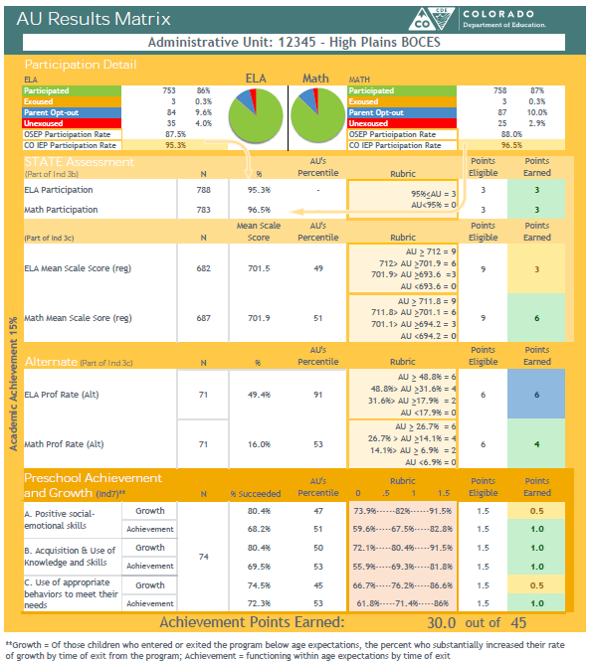
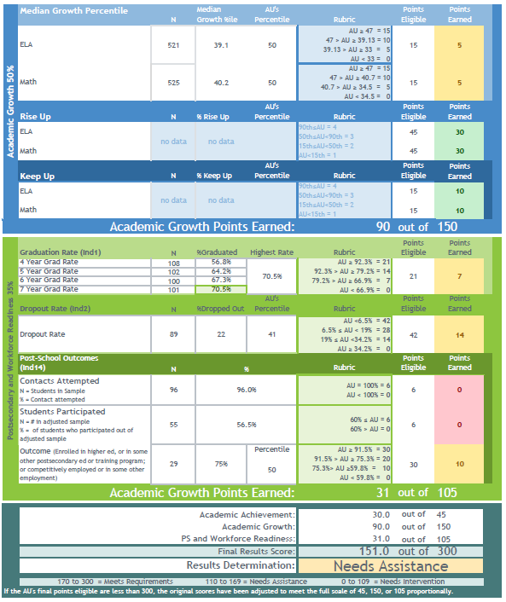
Annual District/AU Determinations
Academic Growth
50%
Postsecondary and Workforce Readiness
35%
Results Summary
Academic Achievement 15%
Notes:
OSEP gives each state a determination as to how much we are meeting the requirements of IDEA. The state agency, in turn, is required to give determinations to each LEA within the state. So, here is how CO gives the determinations.
We do a combination of the results matrix and compliance matrix. What you’re seeing here is the results matrix that includes all indicators and non-indicators about the student academic performance. We have the Academic Achievement portion which is worth 15% of the results portion of the determination, Academic Growth is worth 50% and then Postsecondary and Workforce Readiness is 35%
Based on that we give the results summary determination. In this example, this AU received the “needs assistance” determination.

Slide 16
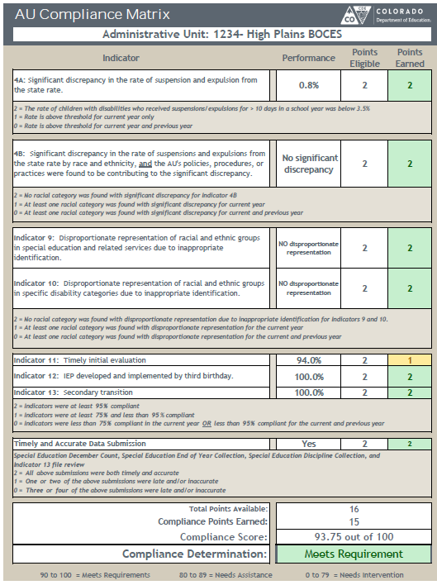
Compliance Matrix
Included in the compliance matrix:
Indicator 4A, 4B, 9, 10, 11, 12, 13, Timely & Accurate Data Submission
Each compliance indicator received 0, 1, or 2 points.
Compliance Determination Rubric:
90-100 = Meets Requirements
80-89 = Needs Assistance
0-79 = Needs Intervention
For more detail, see the rubric under each indicator
Notes:
This is the compliance matrix. It covers compliance indicators: 4A, 4B, 9, 10, 11, 12, and 13 as well as the timely and accurate data submission. Each indicator can receive 0, 1 or 2 points and there is a description under each indicator outlining how points are given.
We also give a compliance determination. So, for this example, the AU received a “meets requirements” determination. The rubric provides a breakdown of the point ranges for each determination category.

Slide 17
Summary Page
Notes:
We give the results determination and the compliance determination and then this a summary page that we give with the determination each year. So, as you can see with this fictitious High Plains BOCES, they received an AU percentage of 90.8% with a determination of “meets.” This is the official determination that we report publicly and to OSEP. Then, below you can see the breakdown of the sub-scores for the compliance and results sections. In this example, the BOCES received a “meets” determination in both compliance and results. However, you can see on the scale, that this BOCES is meets compliance at 100% and is doing very well, but on the results score, you can see that, although the BOCES received a meets, their percentage places them close to the “needs assistance” range.
So, you may be in “meets” in both areas, but you can see where on the band you fall within a given determination category.
If you are in a BOCES – check with the BOCES director for a copy of your AU’s Determinations.

Slide 18
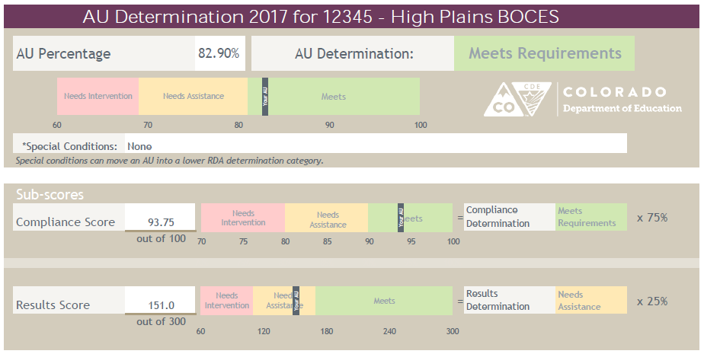
2020 AU Determinations
2020 AU Determinations were made based on the data collected during SY2018-19
Compliance Matrix
Compliance Score_______x.50
Compliance Determination________
Results Matrix
Results Score_______x.50
Results Determination________
Final Determination
Score_______
Determination______
Notes:
Compliance and Results are 50/50 –
So, in 2020, determinations were made in April. 50% of the determination came from compliance score and another 50% came from results score. The total of that is the final determination.

Slide 19
2021 AU Determinations
Compliance Matrix
Compliance Score_______
Compliance Determination________
2021 AU Determinations were made based on the data collected during SY2019-20
Final Determination
Score_______
Determination______
Notes:
However, due to COVID, the 2021 determinations differed from the “typical” process since many data points from SY2019-20 were compromised or unavailable.
The 2021 determinations were sent out in April and were based on an abbreviated version of the Compliance Matrix only. The abbreviated version of the compliance matric included indicators 4A, 4B, 9, 10 and 13 as well as timely and accurate data submission. Historically, indicators 11 and 12, are included in the compliance matrix as well, but were eliminated for the 2021 AU determinations due to the negative impact resulting from the pandemic during SY2019-20.

Slide 20
Where does the data come from?
CDE gathers data from Administrative Units and State Operated Programs through:
December count (Indicators 5, 6, 9, 10) plus personnel data
Special Education End of Year (Indicators 1, 2, 11, 12)
Discipline collection (Indicator 4)
Indicator 13, 14, and 8 data is collected via file reviews and surveys
State assessments
Notes:
Mention that data is also collected from:
Assessment and performance data
Dispute resolution outcomes
CIMP data collection
Indicator 8-parent survey
Indicator 13 SRR for transition requirements
Indicator 14, post school outcomes survey
Results Matter, preschool outcome data
Fiscal audit findings
Other sources

Slide 21
Resource
How The Colorado Department of Education Exceptional Student Services Unit Made Determinations 2020
Under Section 616 (D) of the Individuals with Disabilities Education Act Part B

Slide 22
News!
The CDE, in partnership with stakeholders across the state are developing new tools to help Districts/AU’s develop effective monitoring strategies.
Notes:
We are working to develop a new monitoring tool that will support AUs as they engage in their own self-monitoring. CDE is always looking for better ways to provide meaningful monitoring practices that help students with disabilities thrive, so be on the lookout for upcoming guidance.

Slide 23
Significant Disproportionality

Slide 24
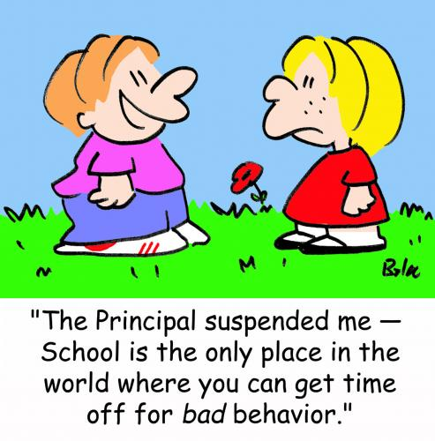
What is significant disproportionality?
IDEA section 618(d):
Are students of a particular race more likely to be:
than students of other race in your school district/BOCES?
placed in a more restrictive classroom setting
identified as students with disabilities/particular disability category
disciplined
Notes:
Significant disproportionality is a requirement within special education, specified in the statue. More specifically, it’s in IDEA section 618 (d).
Significant disproportionality is simply asking, are students of a particular race more likely to be identified as students with disabilities or with a particular type of disability?
students of a particular race more likely to be placed in a more restrictive classroom setting?
Or students of a particular race more likely to be disciplined?
Compared to students of other race in a school district, and in Colorado’s case, BOCES?
States are required to examine that no particular race is treated differently than others in regards to identification, placement, and discipline within special education every year.
This is an important requirement to ensure equity, especially racial equity in special education.
Now, let’s explore these 3 big categories - identification, placement, and discipline - more closely.

Slide 25
Significant Disproportionality Categories
December count is analyzed
AUs are notified in May
SPED Discipline is analyzed
AUs are notified in Nov
Identification (age 3-21)
Educational Environment (age 6-21)
Discipline (age 3-21)
All Disability Categories
Autism Spectrum Disorder
Serious Emotional Disability
Intellectual Disability
Other Health Impairment
Specific Learning Disability
Speech Language Impairment
Inside regular class <40% of the time
Separate Settings
In-school suspensions ≤10 days
In-school suspensions >10 days
Out-of-school suspensions/expulsions ≤10 days
Out-of-school suspensions/expulsions >10 days
Disciplinary removals in total
Hispanic/Latino of any race
Asian
White
Black or African American
American Indian or Alaska Native
Native Hawaiian or Other Pacific Islander
Two or more races
Notes:
Under the category of identification, states are required to examine racial equity in the following sub categories.
First, a state must examine that children of no particular race are more likely to be identified as children with disabilities. So, that includes all disability categories.
Additionally, a state also must examine possible racial disproportionality in:
Autism Spectrum Disorder
Serious Emotional Disability
Intellectual Disability
Other Health Impairment
Specific Learning Disability
And Speech Language Impairment
These are the categories specified in the regulation and some other disability categories are not included, such as visual impairment and hearing impairment.
Under the category of educational environment, a state must examine possible racial disproportionality in:
Placement of children with disabilities in the regular classroom (that is a classroom in which students with disabilities receive instruction with non-disabled peers) less than 40% of the time.
Also, placement of children with disabilities in separate settings, such as a classroom only for students with disabilities.
Under the category of discipline, a state must examine possible racial disproportionality in :
In-school suspensions of 10 or fewer days
In-school suspensions of greater than 10 days
Out-of-school suspensions/expulsions of 10 or fewer days
Out-of-school suspensions/expulsions of more than 10 days
And Disciplinary removals in total.
In-school and out-of-school suspensions or expulsions are the count of students who receive such disciplinary actions. On the other hand, “disciplinary removals in total” is the count of disciplinary incidents or actions rather than students.
A state must examine if any of these 14 categories are disproportionately over-represented by a particular race/ethnic group every year.
The regulation specifies that states must examine 7 racial categories including Hispanic or Latino of any race, Asian, white, black or African American, American Indian or Alaska Native, Native Hawaiian or Other Pacific Islander, and Two or more races.
So, for example, in a school district, Hispanic students might be more likely to be identified as having a specific learning disability than non-Hispanic peers. Or Black students might be more likely to be placed in separate settings than non-Black peers.
When a state finds such tendency during the annual examination, the state must determine that school district as having a significant disproportionality.

Slide 26
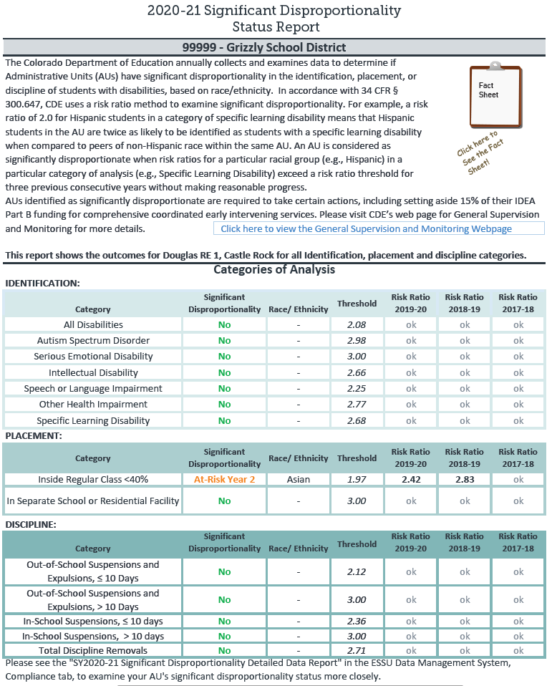
Status report AUs receive in May & Nov
Risk Ratio = 2.0 means a racial group is as twice as likely to receive the treatment.
We want to see a Risk Ratio close to 1.0.
AU’s risk ratio for the given category must be lower than the threshold.
When AU’s risk ratio for a given racial group exceeds the threshold for 3 consecutive years, the AU will be determined as significantly disproportionate.

Slide 27
What happens when an AU is significantly disproportionate?
When significant disproportionality is determined in an AU;
Review, and if appropriate revision of policies, practices, and procedures
Identify the factors contributing to the significant disproportionality
Comprehensive Coordinated Early Intervening Services (CCEIS) – 15% of IDEA $ set-aside
The $ must be used to address the identified factors contributing to the sig dispro

Slide 28
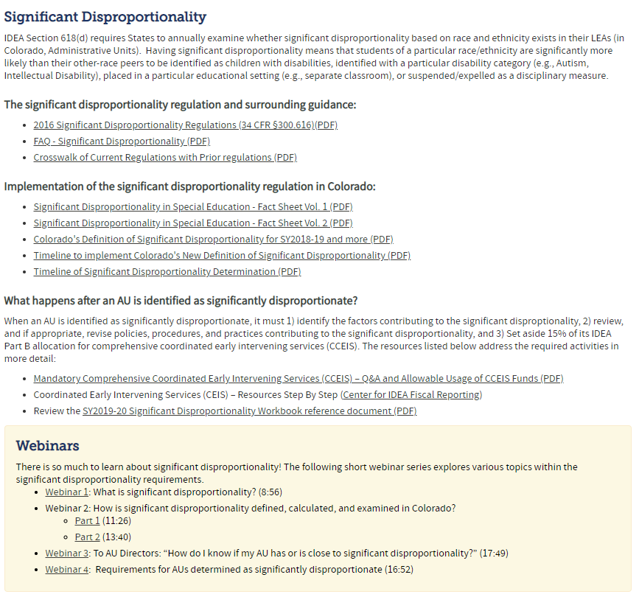
More info about significant disproportionality
General Supervision/Monitoring | CDE (state.co.us)
Regulation
Implementation of sig dispro in Colorado
Helpful webinars!

Slide 29
Questions?

Slide 30
Contact Information
Kerry Whitmore
Supervisor, General Supervision and Monitoring
Whitmore_k@cde.state.co.us
Becky O’Malley
Special Education Monitoring and Technical Assistance Consultant
O’Malley_r@cde.state.co.us
Megan Tannozzini
Special Education Monitoring and Technical Assistance Consultant
Tannozzini_m@cde.state.co.us

