Slide 1
New Director’s Orientation August 2021
Secondary Transition
Services and Supports

Slide 2
Secondary Transition Services & Supports
Secondary Transition Planning
Prepares students for life after they leave high school
Bridge between school programs and the opportunities of adult life
Including higher education or training, employment, independent living and community participation
Notes:
The work that I do:
Support you and your team by providing training on all aspects of secondary transition planning
Training that includes EB and promising practices that lead to successful outcomes for students with disabilities

Slide 3
Secondary Transition
Transition planning provides opportunities for students with disabilities to experience positive post-school outcomes, such as:
higher graduation rate
lower dropout rates
increased enrollment in colleges and universities
higher rates of competitive employment
increase levels of independence
Notes:
As a secondary transition specialist, it is my role to support you and your team by provided training, technical assistance, and coaching opportunities to build systems that lead to…..

Slide 4
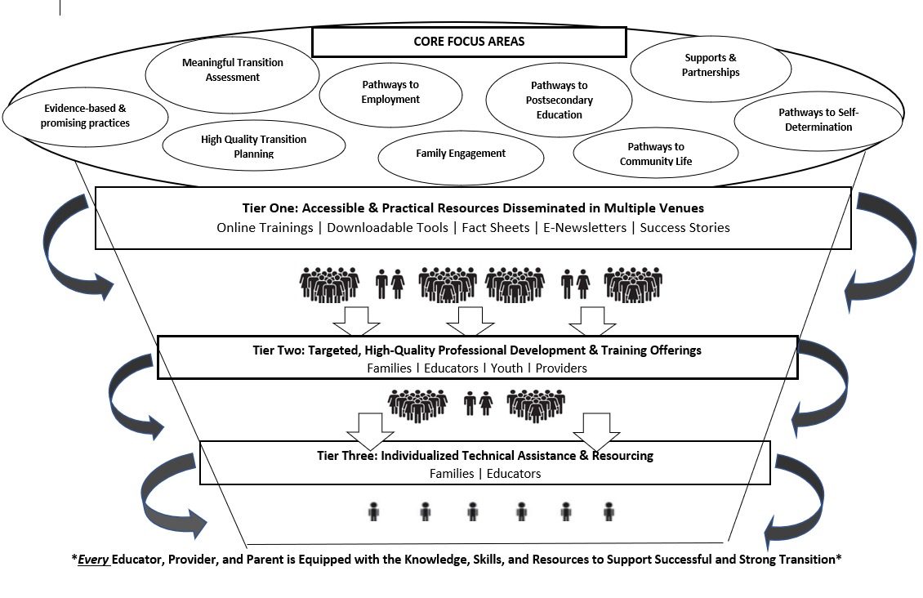
CORE Focus Areas

Slide 5
Levels of Support
Tier One
Broad universal training – Transition Leadership Institute
Customized training – Regional training
Targeted TA – District-level supports related to evidence- based practices, data, general supervision findings, and/or field-specific requests
Lead statewide advisory group
List serves
Develop and disseminate resources
Notes:
To accomplish my goal, I have created a system of tier professional develop

Slide 6
Tier One: Universal Support
Transition Leadership Institute
Online Trainings/Webinars
Transition Talks
Office Hours
Online Resources/Padlet
Transition Coalition/NTACT
Transition Planning
List Serves
Secondary Transition Taskforce

Slide 7
Tier Two: Targeted Support
District-level supports related to evidence- based practices, data, general supervision findings, and/or field-specific requests
Families
Coaching
Regional Meetings
STEPSS
Transition Quality Indicators
IEP Development (district teams)
Data discussions
Notes:
STEPSS – state toolkit for examining post-school success
STEPSS is a web-based, multi-phase process in which stakeholders:
Examine graduation, dropout, secondary transition components of the IEP, and post-school outcomes data;
Assess progress toward meeting targets in each outcome area listed above;
Select predictors of post-school success, and
Develop and implement an Action Plan designed to improve in-school, secondary transition programs for students with disabilities.

Slide 8
Tier 3: Individualized technical assistance and support
Individual coaching and mentoring
Provided through email, phone calls, and virtual platforms
Individual requests

Slide 9
Current Projects
Transition 101 Training Modules – Module 3
Piloting Quality Indicators for Secondary Transition Programs – Goal is to be able to identify model transition sites
Sequencing of Services Model in collaboration with Katie Oliver and various state agencies (HCPF, CDLE, OEF, ILC, DVR,CTE, IHE)
Student outcomes from junior high through exit
Roles and responsibilities of each state agency to assist students in experiencing successful outcomes
Working with UCCS and Metro State to develop a transition specialist credential

Slide 10
More Current Projects
District teams who attended the transition leadership institute should be finalizing their transition action plans
Technical soundness checks will occur in October 2021, December 2021, March 2022, and May 2022
Post-school Outcomes Interview Process
Data collection ends 5pm, September 31, 2021
Resources: Secondary Transition http://www.cde.state.co.us/cdesped/transition
Secondary Transition Training Request – lott_g@cde.state.co.us

Slide 11
Monthly Office Hours
September 14, 2021; 3:30-4:30pm – Transition tips to start the year off right
October 12, 2021 – Transition Specialist Credential
November 9, 2021 - Supporting the mental health needs of transition-aged youth
December 14, 2021 – Self-determination, self-advocacy, and student led IEPs
*More like a town hall forum where there will be a little bit of training and information provided, then time for questions, sharing, and application.

Slide 12
Monthly Office Hours
January 11, 2022 – PSO data discussion
February 8, 2022 – Guardianship and supported decision making
March 8, 2022 – Family engagement and empowerment
April 12, 2022 - Equitable access to CTE programming for students with disabilities
May 10, 2022 – Critical reflection with transition service providers
*Look for additional information in the upcoming ESSU newsletter
http://www.cde.state.co.us/cdesped/transition_covid

Slide 13
Upcoming Training - Equity and Students with Disabilities
National Alliance for Partnership in Equity (NAPE)
PIPELine to Career Success for Students with Disabilities – Increase successful enrollment, matriculation, graduation, and transition to postsecondary education and employment for SWDs through CTE.
Micromessaging to Reach and Teach Every Student - Micromessages are small, subtle, often semiconscious messages we send while communicating with others, whether by voice, action, or body language. These messages which can be either positive or negative, stem from our implicit biases, and affect
Relationships
Inspiring Courage to Excel through Self-Efficacy - Self-efficacy and self-confidence are student attributes that teachers and faculty can influence through micro-affirmations.
Notes:
PIPELine to Career Success for Students with Disabilities – Increase successful enrollment, matriculation, graduation, and transition to postsecondary education and employment for SWDs through CTE.
Micromessaging to Reach and Teach Every Student - Micromessages are small, subtle, often semiconscious messages we send while communicating with others, whether by voice, action, or body language. These messages which can be either positive or negative, stem from our implicit biases, and affect
Relationships
Inspiring Courage to Excel through Self-Efficacy - Self-efficacy and self-confidence are student attributes that teachers and faculty can influence through micro-affirmations.

Slide 14
Upcoming Training/Projects
Focus Groups for parents/families of students with disabilities
August 24, 2020; 12-1pm
August 24, 2021; 6-7pm
September 22, 2021; 12-1pm
September 22, 2021; 6-7pm (Spanish-speaking families)
Register here

Slide 15
Upcoming Training/Projects
Parent/family training to support effective transition
Person-centered planning
Transition Coalition self-study pilot – IDEA and secondary transition

Slide 16
Regional Meetings/Cadres
Regional Support Model – Transition Cadres
Regional Meetings for Secondary Transition Personnel – We Need to Hear from You!
What is going on in your region? What topics are relevant to you? What challenges are you facing? How might your state transition team assist you?
Please share your needs via the Secondary Transition Providers link to communicate your needs .

Slide 17
Regional Meetings
October 6, 2021 (NC/NE) – 9am-12pm
October 20, 2021 (Metro)
November 10, 2021 (PP/SC/SE)
February 8, 2022 (NC/NE)
February 22, 2022 (Metro)
April 6, 2022 (PP/SC/SE)
April 20, 2022 (Western Slope - tentative)
Registration

Slide 18
Supports During the Pandemic
Providing Secondary Transition Services during COVID-19
Career/Employment
National Resources
Families
Postsecondary Education
Independent Living
Transition Assessment
Virtual/Remote
Helpful Online Resources
http://www.cde.state.co.us/cdesped/transition_covid

Slide 19
How Might I Assist You?
Please let me know your training needs related to secondary transition
Improving graduation rates
Decreasing dropout rates
Trainings related to writing quality secondary transition plans
Improving postsecondary career/employment, education/training, and independent living outcomes
Please encourage your staff to participate in trainings and share the work occurring withing your AU
Provide feedback on what works from you

Slide 20
Contact Information
Secondary Transition Specialist Gail Lott, Ed.D. Lott_g@cde.state.co.us
(303) 501-0347
10

