Slide 1
SY2025-26
Indicator 8: Parent Involvement
Parent Surveys
Colorado Department of Education
Exceptional Student Services Unit
August 2025
Notes:
Hello and thank you for joining. Each year, the Office of Special Education at the Colorado Department of Education conducts a parent survey. This webinar will provide an overview of how the survey will be conducted for the 2025–2026 school year.
My name is Beth Donahue and I am the Family Engagement Specialist with CDE’s Exceptional Student Services Unit in the Office of Special Education and I am also the Indicator 8 Lead.

Slide 2

Why survey parents?
Individuals with Disabilities Act (IDEA) regulations
In developing an Individual Education Program (IEP), the team “must consider the concerns of the parents for enhancing the education of their child.” 34 CFR § 300.324(a)(1)(ii)
The IEP team must include the child’s parents. 34 CFR § 300.321(a)(1)
Case law
The IDEA’s procedural requirements for developing a student’s IEP are designed to provide a collaborative process that “places special emphasis on parental involvement.” Sytsema v. Academy School District No. 20, 538 F.3d 1306, 1313 (10th Cir. 2008)
This Photo by Unknown Author is licensed under CC BY-SA
Notes:
Federal regulations clearly state that IEP teams must consider the concerns of the parents when developing an IEP. Beyond just meeting attendance, parents should be considered active team members and should be seen as a collaborative process as IEPs are developed. This ensures that family perspectives are actively shaping educational decisions.
IDEA mandates that parents are included as official members of the IEP team. They’re not just informants—they’re decision-makers at the table.
And finally, supporting case law, like Sytsema v. Academy School District No. 20, reinforces this emphasis on collaboration. The court described IDEA's process as one that specifically highlights and protects parental involvement.
This legal foundation helps ensure that families are engaged, empowered, and legally protected as key partners in the education of their child.

Slide 3




Why survey parents? (continued)
To use the learning to better serve children, parents, teachers, and the whole IEP process
Report the % of parents who believe schools facilitate parents’ involvement to U.S. Dept of Education (Ind8)
To learn how parents are involved in children’s special education
Notes:
We conduct parent surveys every school year to learn how parents perceive their involvement in their child’s special education program.
The results can be used by Administrative Units and the Colorado Department of Education to identify areas of strength and areas of opportunities to improve outcomes of students with disabilities.

Slide 4


What is the State Performance Plan (SPP)
Annual Performance Report (APR)?
States submit various data/reports to the U.S. Dept of Education
Office of Special Education Programs (OSEP) at U.S. Dept of Education evaluates States’ special education programs
(SPP/APR) = State’s report to OSEP on how the State’s special education program is doing
  Due every February
Data (SPP/APR)
Evaluation
Notes:
All states and territories submit various data and reports to the U.S. Department of education.
We, in special education, submit data and reports to the Office of Special Education Programs (OSEP) at the U.S. Department of education.
The State Performance Plan and Annual Performance Report (the SPP-APR) is of these reports that all states and territories must submit to OSEP. OSEP uses the SPP-APR submitted by the states to evaluate how special education programs are working in states.
The SPP-APR is due every February. The public input the CDE is collecting for the 2025-26 school year will be submitted to OSEP on Feb 1st, 2027.

Slide 5
Parent Survey and the SPP/APR
Indicator 8: Parent Involvement is a Results Indicator included in the SPP/APR
Colorado uses the Parent Survey to collect the data needed for reporting Indicator 8 results.
Colorado reports:
Percent of parents with a child receiving special education services who report that schools facilitated parent involvement as a means of improving services and results for children with disabilities
Response rate
Representativeness of race/ethnicity in the responses
Representativeness of responses by geographical region
Notes:
Indicator 8 measures how well schools facilitate parent involvement to improve services and results for children with disabilities.
The Parent Survey is how Colorado collects data on Parent Involvement for Indicator 8. This is used to report data for the State Performance Plan/Annual Performance Report (SPP/APR). The state reports on the percentage of parents who feel supported in involvement, overall response rates, and the representativeness of responses by both race/ethnicity and geographic region.
The aggregated state-wide results are reported publicly and to the U.S. Department of Education as the state performance plan indicator 8.

Slide 6







SY2025-26 Surveys will be completed online
Administrative Unit (AU, e.g. district or BOCES)
Parents
Notes:
In SY2025-26, all parent surveys will be completed online.
The CDE will provide the list of students whose parents are pre-selected for participation on the ESSU Data Management System family-school tab, as in the last few years.
AUs will send the survey link to the parents so that they can complete it online.

Slide 7
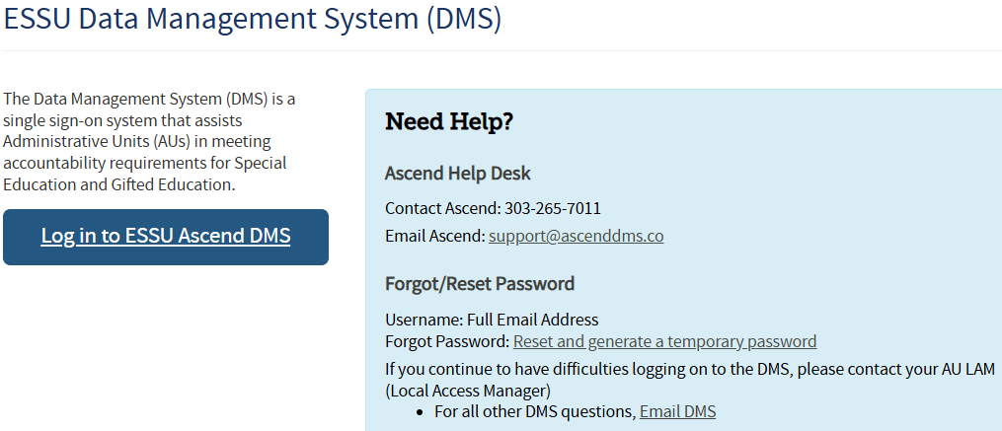
Logging in to the DMS
Sign in to DMS from The ESSU Data Management System webpage using your single sign-on.
Notes:
AUs will find the list of students whose parents are pre-selected for participation in the ESSU Data Management System.
Please sign in to the DMS from the CDE single-sign-on as you have in the past. If you forgot your password click the “Reset and generate a temporary password” link.

Slide 8

Accessing the 2025-26 Parent Survey
Indicator 8 uses the Ascend Data Management System (DMS).
To access the Parent Survey content, you will need one of the following roles:
AU – Monitoring Director (MD)
AU – Gifted and Monitoring Director (GDnMD)
AU – Monitoring Record Reviewer (MRR)
Notes:
All aspects of the Indicator 8 survey go through Ascend. You will need to have one of the following roles in the Ascend system to access the Indicator 8 – Parent Survey content.
AU – Monitoring Director (MD)
AU – Gifted and Monitoring Director (GDnMD)
AU – Monitoring Record Reviewer (MRR)

Slide 9
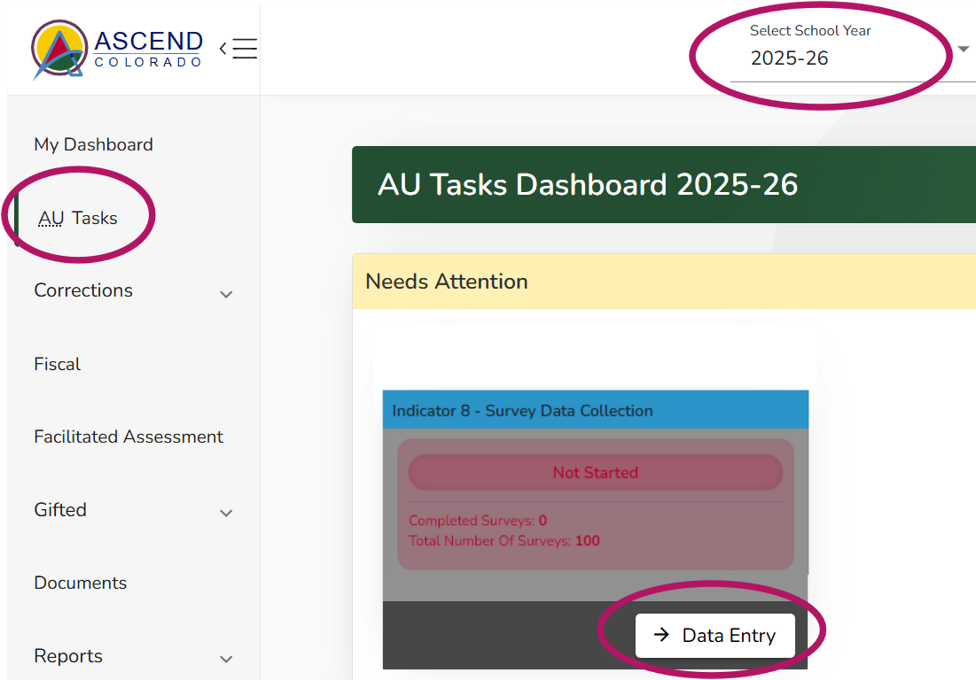
Your Student List in the DMS
Student lists are available August 31st when the survey opens. Start by making sure you have the 2025-26 school year selected at the top of the welcome page. Then select AU Tasks on the left navigation pane. Click the “Data Entry” button on the I-8 tile to be taken to the Parent Survey Dashboard
Notes:
Once you log in, you will see the Ascend DMS Dashboard.
Make sure that the School Year at the top points to the 2025-26 School Year
Select AU Tasks.
Student lists are available August 31st when the survey opens.
You will see the message “Needs Attention” and the “Indicator 8 – Survey Data Collection” tile.
Click on the “Data Entry” button.

Slide 10
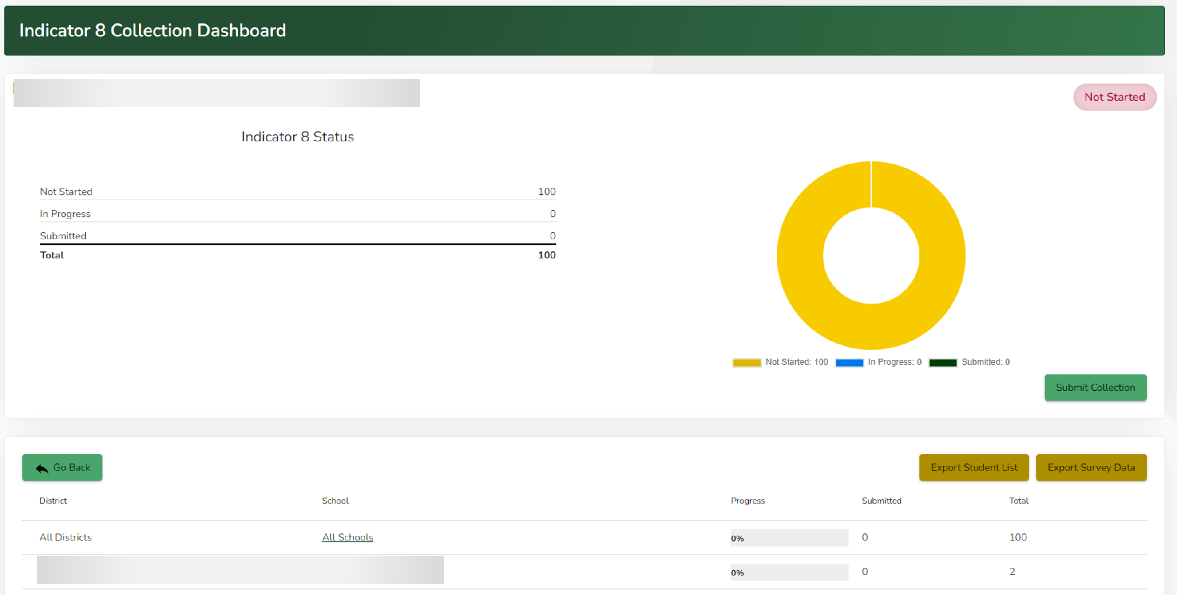
Indicator 8 Dashboard – Status and Student List
Select “All Schools” or a
specific school
Notes:
When you first land on the Indicator 8 Collection Dashboard you will see your status showing how many students are in your sample, if they are “in-progress” or “submitted.” This Dashboard also shows you a list of schools with surveys and their progress on their surveys.
If you click on “All Schools” or one of the school names you will see a list of students. Click on the Export Student List button to download your list. If you are in a single school, clicking the export button from this screen will give you the file for only that school. Selecting All Schools will give you the entire list of students.
The Export Survey Data button will populate with the survey data as it comes in from parents. The Survey Data will update as surveys are completed.

Slide 11
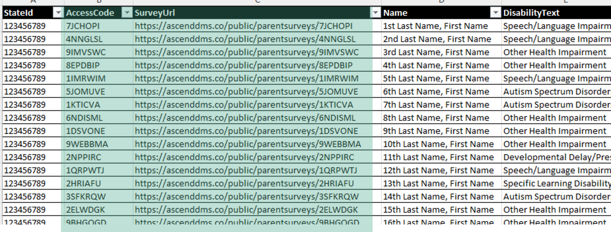
Your Student List
Each student has a unique access code included in the survey URL.
Parents need this URL code to participate in the online survey.
 | Number of students with Disabilities | Sample Size
Small AUs | 1 - 49 | Census
Mid-sized AUs | 50 - 1,000 | 50
Large AUs | 1,001 – 5,000 | 100
Large AUs | 5,000+ | 200
Notes:
Your student list comes from December Count 2024 data and contains the number of required names for parent surveys. Please go through the list find who are still enrolled within your AU with active IEPs.
In SY2025-26, the CDE asks that small AUs survey the exact number of parents. Mid-sized AUs will survey 50 parents from the list. Large AUs will survey 100 parents from the list. Lastly, AUs with more than 5,000+ will survey 200 parents from the list.
Each student is assigned a unique access code (see the teal highlight). This code is tied directly to the student’s name.

Slide 12
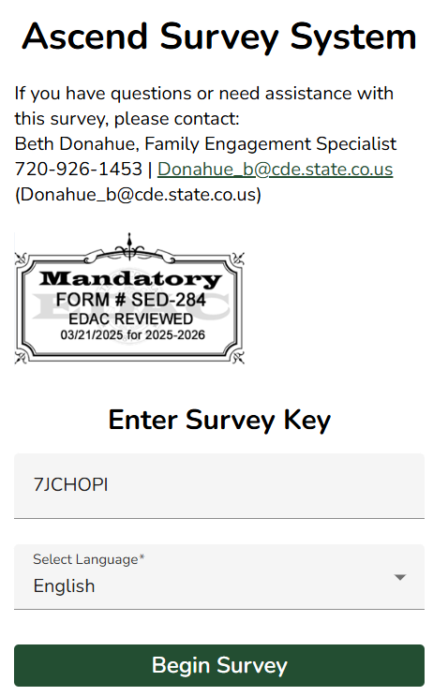
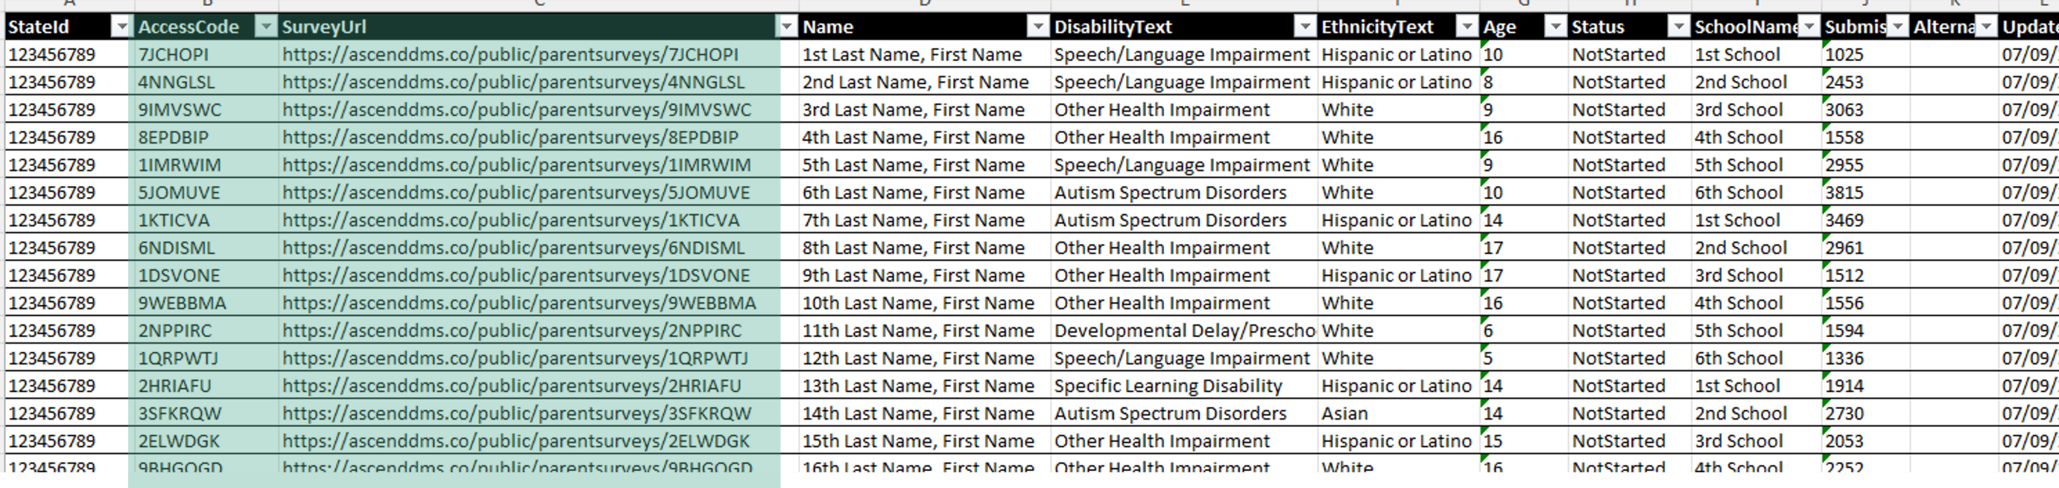
The pre-selected student list unique URL
Notes:
The individualized survey links should be provided to parents and used in any communication to parents. These URL links will take the parents directly to the login page for the survey and pre-fill the survey key.

Slide 13
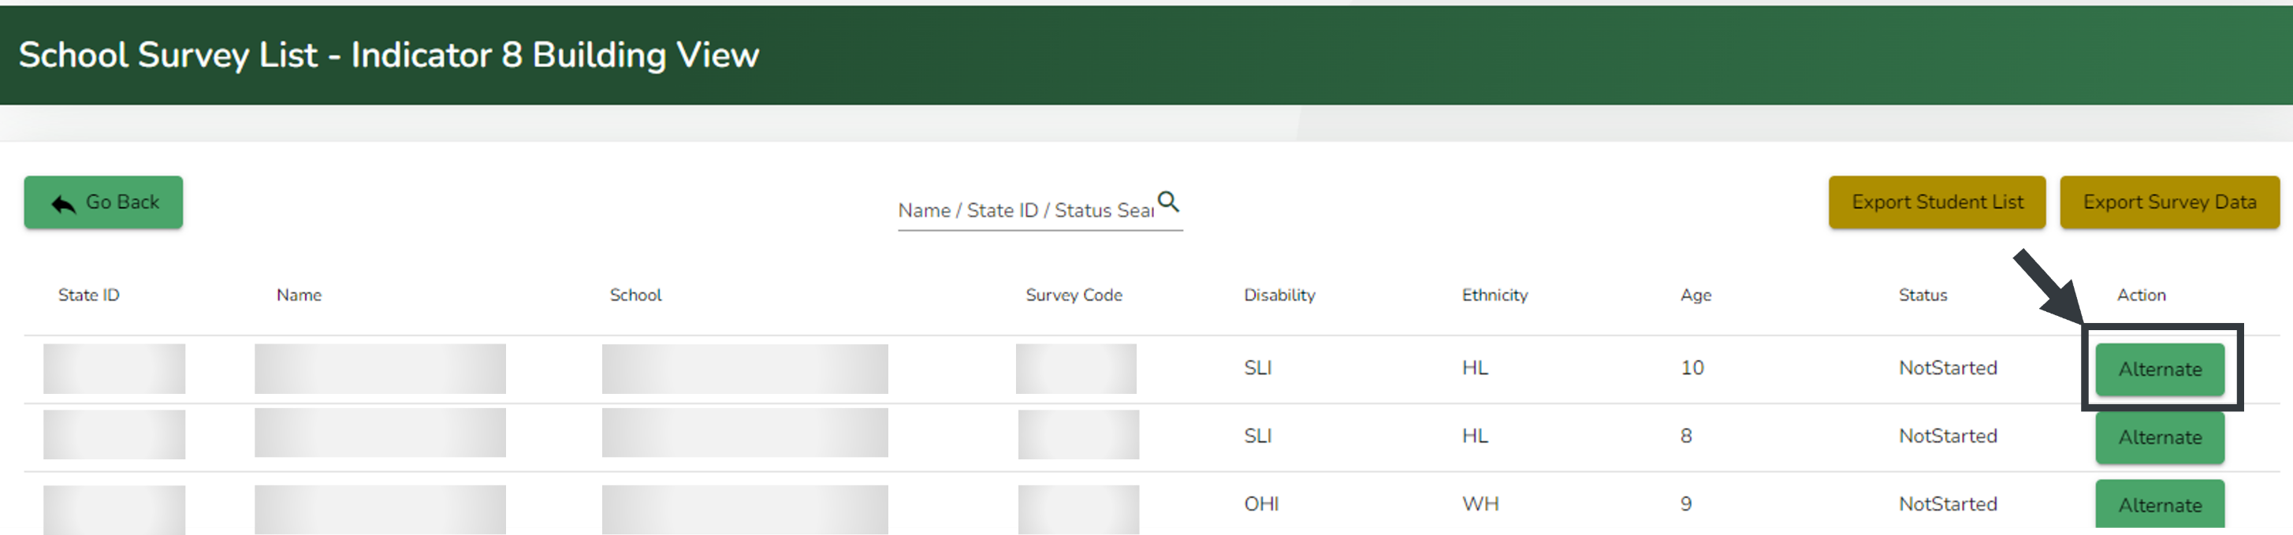
Requesting Alternate Students *New this year!*
You can replace a student with an alternate student for either of these CDE-approved reasons:
  Student is no longer in the AU’s jurisdiction
  Student is no longer receiving special education services
Click on the “Alternate” button in the row of the student you wish to replace.
Notes:
New this year, we have added a feature to request alternate students for a student that is no longer in your AU’s jurisdiction or is no longer receiving special education services. While looking at your student list in DMS you can find the student you need to replace and click the green Alternate button on the right-hand side.

Slide 14
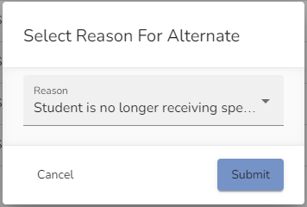
Requesting Alternate Students (continued)
A Select Reason for Alternate pop-up window will appear.
Click in the Reason field to select the reason
Click the blue “Submit” button.
The student will be replaced with a random student who has the same race/ethnicity from the sample pool. If no more students are available with the same race/ethnicity for your AU, then a random student is sampled from the entire sample pool.
If an AU has used all the alternates available for their assigned sample, please contact Josh Fails. Fails_j@cde.state.co.us
Notes:
A Select Reason for Alternate pop-up window will appear. Click in the Reason field to select the reason then the blue button to submit
The student will be replaced with a random student who has the same race/ethnicity from the sample pool. If no more students are available with the same race/ethnicity for your AU, then a random student is sampled from the entire pool
If an AU has used all the alternates available for their assigned sample, please contact Josh Fails.

Slide 15
Using your Student list export

Slide 16
Sample Communication - English
Dear Parent(s) of 1st Student
The Colorado Department of Education and your local special education administrative unit (e.g., school district, BOCES) conduct a survey every school year to learn how parents are involved in their child’s special education program.
The responses you share will be used to improve the education of children with disabilities in your school district and throughout the State of Colorado. The state-wide results will be reported publicly and to the U.S. Department of Education after the completion of the school year.
  Your Personal Survey Link https://ascenddms.co/public/parentsurveys/AccessCode
  Due: June 30, 2026
Student Name
Notes:
Here is a sample for you to use in writing your parent communication. Notice that it has the Student’s name, the unique survey link which includes the Access Code.
AUs are welcome to write their own communication, but please make sure to include the student-specific unique survey link.

Slide 17
Sample Communication – English continued
We greatly appreciate your participation!
For information and resources for families of students with disabilities in Colorado, please visit this Colorado Department of Education webpage.
If you have questions or need assistance with this survey, please contact:
Beth Donahue, Family Engagement Specialist
720-926-1453 | Donahue_b@cde.state.co.us
Notes:
This is a continuation of the sample letter. You can include the link to the CDE webpage for Family Engagement. It also includes my contact information if parents have questions about the survey.

Slide 18
Sample communication - Spanish
Estimados padres de “1st Name”
El Departamento de Educación de Colorado y la unidad administrativa de educación especial de su localidad (es decir, el distrito escolar, BOCES) realizan una encuesta cada año escolar para conocer la participación de los padres en el programa de educación especial de sus hijos.
Las respuestas que comparta se utilizarán para mejorar la educación de los niños con discapacidad en su distrito escolar y en todo el Estado de Colorado. Los resultados de todo el estado se harán públicos y se informarán al Departamento de Educación de EE. UU.
  Su enlace de encuesta personal: https://ascenddms.co/public/parentsurveys/AccessCode
  fecha de vencimiento: 30 de junio de 2026
Student Name
Notes:
Here is the Spanish version. The language can be selected at the survey level (which we will see in a bit). Again, please include the student-specific unique access link.

Slide 19
Sample communication – Spanish continued
¡Agradecemos mucho su participación!
Para obtener información y recursos para las familias de estudiantes con discapacidad de Colorado, visite esta página web del Departamento de Educación de Colorado (Colorado Department of Education, CDE).
Si tiene preguntas o requiere asistencia con la encuesta, comuníquese con:
Beth Donahue, Especialista en Participación Familiar
720-926-1453 | Donahue_b@cde.state.co.us
Notes:
Here is the Spanish version continued.

Slide 20


Options on how AUs can distribute the survey to parents
Regardless of the distribution method, give the student-specific URL LINK to the parents
Send the link and access code via chat after a virtual IEP meeting
Print a paper survey for printing or Mailmerge
English Parent Survey
Spanish Parent Survey
1. Add student name and unique link
2. Scan and upload completed paper survey to the DMS, tag “SPP” and “Indicator 8”
3. Email Josh Fails that the completed surveys were uploaded
Email
If you are unfamiliar with mail merge, this mail merge video will be helpful!
On a tablet/laptop after an in-person IEP meeting
Text Message
Notes:
AUs can choose any method to distribute the online survey link to parents.
AUs can email the parents. If you are unfamiliar with mail merge, the short video that is linked here might be helpful.
AUs can text message the parents.
If AUs are conducting in-person IEP meetings this school year, you can give the survey on a tablet or laptop afterwards.
AUs can send the URL link via chat after a virtual IEP meeting.
If a paper survey is preferred, you can download a PDF version from the link on the slide.
The AU will need to add the student's name and URL link to each printed survey.
When parents return a printed paper survey, please scan and upload the completed survey to the DMS Documents (tag the document SPP>Indicator 8) and email Josh Fails to let him know that the completed surveys were uploaded.
Regardless of the distribution method, please give the student-specific ACCESS LINK to the parent.

Slide 21

When parents use their unique link
Notes:
Here is what the parent will see when they use their unique link. Their Survey Key will automatically populate in the Survey Key field.
Parents can select English or Spanish on this page.

Slide 22
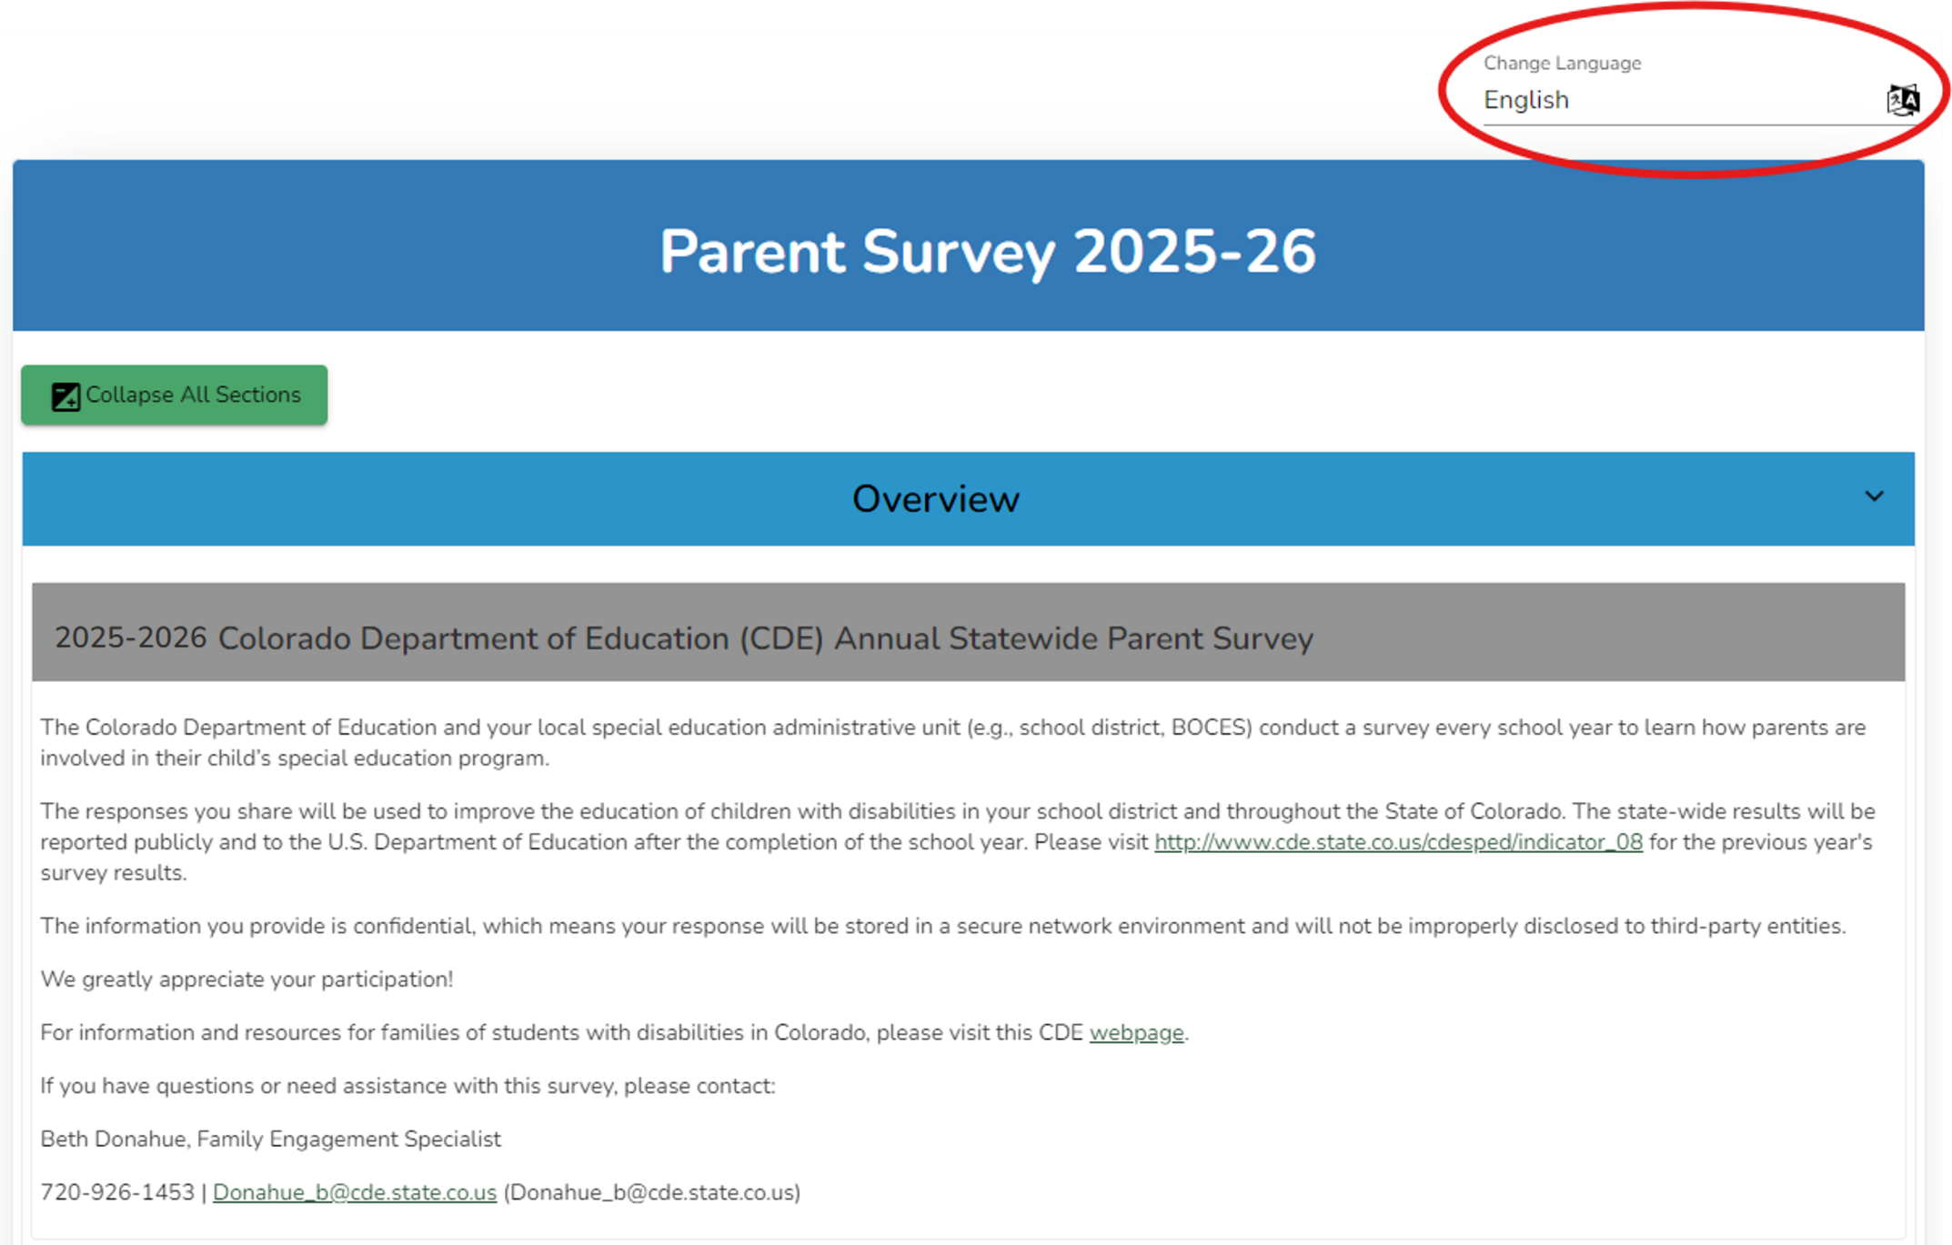
Parents are greeted with an overview
Notes:
Parents are greeted with an overview and instructions. The language preference can be changed here as well. You can see that parents can toggle from English to Spanish in the upper right hand corner.

Slide 23
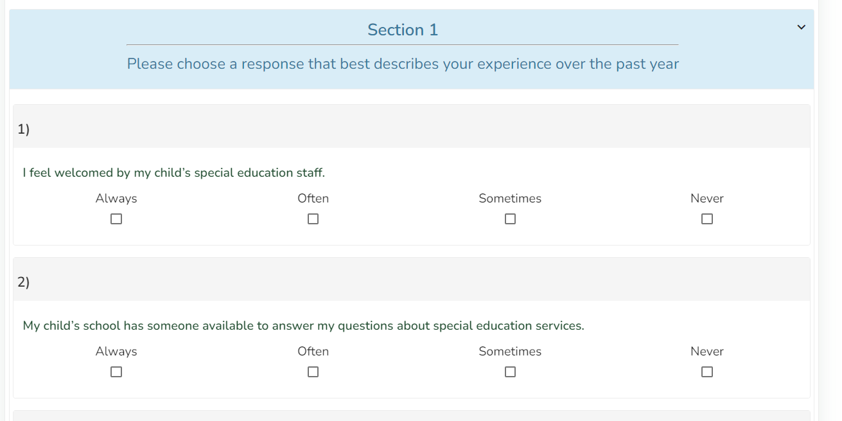
Survey Questions
Notes:
The format in the DMS should be considered easy navigate and is accessible to screen readers. All questions are accessed by scrolling down the page.

Slide 24
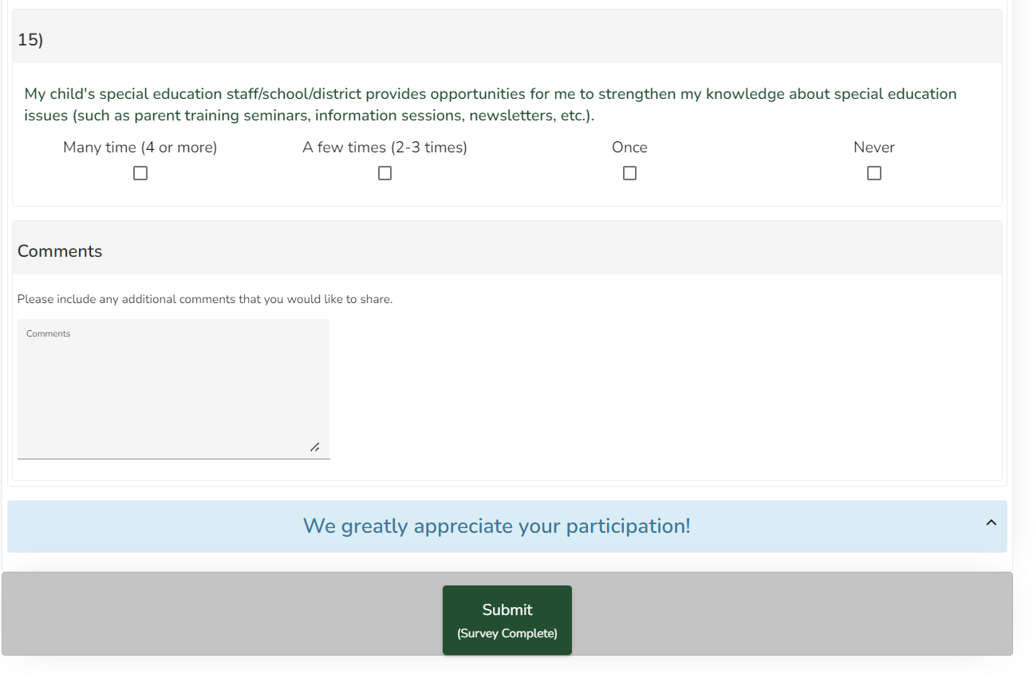
Comments
Notes:
There is a field for comments at the end of the survey.

Slide 25
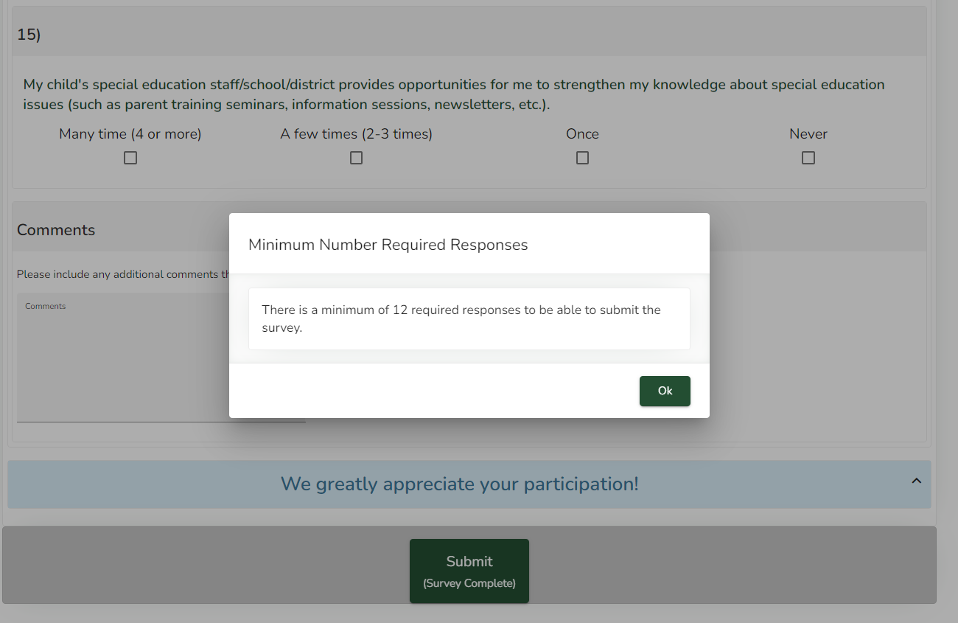
Required Minimum
Notes:
Parents must answer at least 12 questions in order for the survey to be submitted and included in the Indicator 8 calculation. The survey platform will prompt parents to answer at least 12 questions before they can submit the survey.
If they don’t answer 12 questions and stop the process, the survey will not be submitted however, their answers will still be saved. The survey will appear as “In Progress” on the Indicator 8 Dashboard until the date that the survey closes.
I get a few emails and calls each year from parents wanting to re-open the survey. Once surveys have been submitted they are not able to be reopened for editing or deletion.

Slide 26
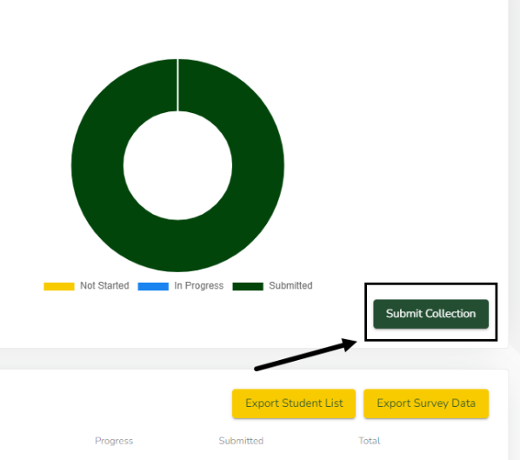
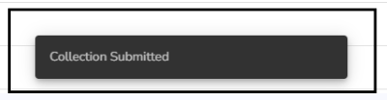
Completing Your Collection
After the survey closes on June 30, 2026, the submit button on the Indicator 8 Collection Dashboard will become active.
You have until July 7, 2026 (one week) to submit your collection after the survey closes
If you attempt to submit your collection before the survey closes you will get an error.
You will see a “Collection Submitted” message pop-up if the submission is successful.
Notes:
After the survey closes on June 30, 2026, the submit button on the Indicator 8 Collection Dashboard will become active.
You have until July 7, 2026 (one week) to submit your collection after the survey closes
If you attempt to submit your collection before the survey closes you will get an error.
You will see a “Collection Submitted” message pop-up if the submission is successful.

Slide 27
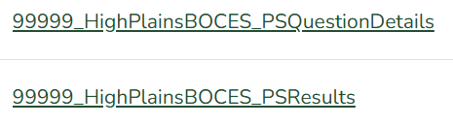
2024-2025 Parent Survey Results
Your results from last school year’s Parent Survey collection are in the DMS. There are two files. The Question Detail file has every question broken down by responses and other important data points. The PS Results file has your Indicator 8 score, and the response rates for the last three years disaggregated by different demographics.

Slide 28

Summary
The SY2025-26 survey is open August 31, 2025 – June 30, 2026
Student names are randomly selected from December Count 2024 data
AUs will review their student list to see if any students need alternates because the original student is not in their AU’s jurisdiction or no longer receiving special education services
Include the unique student survey link in your communication
  AUs choose how to distribute the survey
  Microsoft Mailmerge YouTube Tutorial
  Gmail Mailmerge YouTube Tutorial
Monitor progress as responses come into the DMS
Notes:
A few points to summarize and then we will have time for questions.
The survey period is from August 31, 2025 through June 30th, 2026.
AUs can send the surveys to the parents anytime during this period.
The students whose parents will participate in the survey have been randomly selected by the CDE.
AUs will review their student list to see if any students need alternates because the original student is not in their AU’s jurisdiction or no longer receiving special education services
Please send the student-specific access Link.
AUs can distribute the survey using any method they find effective. If you need a refresher on how to mail merge, please see the linked short video.
We recommend that AUs monitor the progress as responses come in on the DMS AU Tasks>Indicator 8 Dashboard.

Slide 29

Thank you for your work in gathering parents’ feedback!
Questions?
Family Engagement Specialist – Beth Donahue: Donahue_b@cde.state.co.us
Indicator 8 – Orla Bolger: Bolger_O@cde.state.co.us
DMS – Josh Fails: Fails_J@cde.state.co.us
Annie Haberkorn: Haberkorn_A@cde.state.co.us
Notes:
Thank you for working with CDE to gather parents’ feedback!
If you have ANY questions or concerns, please reach out to Beth, Orla, Josh, or Annie.

