Slide 1
Tier II/III Fiscal Monitoring Process
October 11, 19 and 25, 2023
Notes:
Housekeeping items:
Introductions
Recording will be posted after all trainings along with an FAQ of all the questions
Slides to be sent out after the training to the emails from the registration

Slide 2
Agenda
Overview of the fiscal monitoring process
Where and when to submit documents in Syncplicity
Walk through of the various documents requested
Lessons learned from previous years

Slide 3
Overview - Why Must We Monitor?
CDE has the obligation to monitor all grant allocations that pass-through our office (2 CFR §200.331 and 332)
  Review is at the LEA level - both districts and BOCES monitored on the direct awards received
  Fiscal review and program review are collaborative but tend to be at varying depths and times during any given year
  Broken into three tiers (Tier I is high level, Tiers II/III are more in depth)
Fiscal monitoring process focuses on compliant policies and procedures as well as actual expenditures
  Main goal is to provide technical assistance and help LEAs ensure they are currently or can become compliant
Fiscal compliance is based mainly on the requirements outlined in the Uniform Grant Guidance (UGG)
  Fiscal compliance is generally consistent across all federal funds
  Fiscally compliant procedures under one federal award are typically compliant under most federal awards
Notes:
Note, this presentation focuses on the Tier II/III process. Tier I is very high level and will have it’s own training at a later date.

Slide 4
Overview - What Are We Reviewing?
CDE will review fiscal compliance across four main areas
  Time and Effort
  Procurement
  Capital Property and Equipment
  Construction
We typically look at policies, procedures and transactions across these four areas
Focus is solely on monitoring those areas with actual expenditures during the most recent completed fiscal year
  During this upcoming 2023-2024 monitoring year, the fiscal review will focus on actual FY23 expenditures
Note any entity receiving federal funds must comply with the UGG and other award requirements independent of any monitoring
Notes:
Single Audit threshold of $750K - may be new territory now with the spike in ESSER funds
Note, at this point, samples may not be selected from READ GLs (will be doing an allowability review however)

Slide 5
Overview - How Will We Communicate?
Communication typically by email
  Teams meetings as needed
Initially directed to the ESSER III application contacts and READ contacts
  Initial document requests, follow up questions, etc.
  Can include others as requested by LEA
  Final report will be sent to these same contacts
Communication during the process
  ESSER and/or ESEA - from the Grants Fiscal team
  READ - from the Elementary Literacy and School Readiness team
Notes:
Note, the initial document request covers all awards including READ.

Slide 6
Overview - Outline of the Process
Risk assessment
Notification letter
Fiscal monitoring training
LEA initial Syncplicity submission (see slides below)
CDE follow up with LEA
  Clarification regarding documentation review
  Expenditure sample request
LEA follow up Syncplicity submission
CDE additional review
Draft fiscal monitoring report
CDE and LEA work together to revise the report
Final fiscal monitoring report

Slide 7
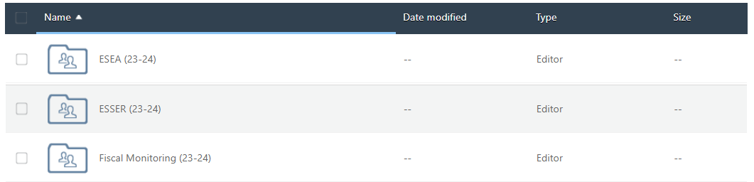
Syncplicity - Where to Submit
Just as with the Program monitoring, all fiscal documents will be submitted through Syncplicity
Separate folder titled Fiscal Monitoring (23-24)
  Reach out to GFMU_Monitoring@cde.state.co.us if your LEA does not have this folder
CDE Fiscal Team requests documentation at different stages of the process

Slide 8
Initial Documentation Request
Completed Fiscal Monitoring Questionnaire
Detailed FY23 General Ledger as noted in notification letter
  All buckets of ESSER (I, II, III; supplementals; State Reserve; etc)
  ESEA
  READ
  Should be broken out by grant award code
  This may include subledgers (e.g., payroll) to provide sufficient detail
Complete, documented process
  Process from A to Z - always more than just CASB Board policies
  If process is not already documented, provide a brief narrative
Notes:
Note when we say all buckets, make sure you confirm we have GLs showing ALL activity for FY23 - not just what was originally budgeted.

Slide 9
Fiscal Monitoring Questionnaire - Overview
2023/2024 Fiscal Monitoring Questionnaire (FMQ)
Completed FMQ expedites the process for everyone
LEA answers used as a guide during the monitoring engagement
Helps the Fiscal Team identify opportunities for additional technical assistance
See the link above or on the Initial Documentation Request slide below
Composed of six main sections - General, Time and Effort, Procurement, Capital Property and Equipment, Construction, and LEA Contacts and Certification

Slide 10
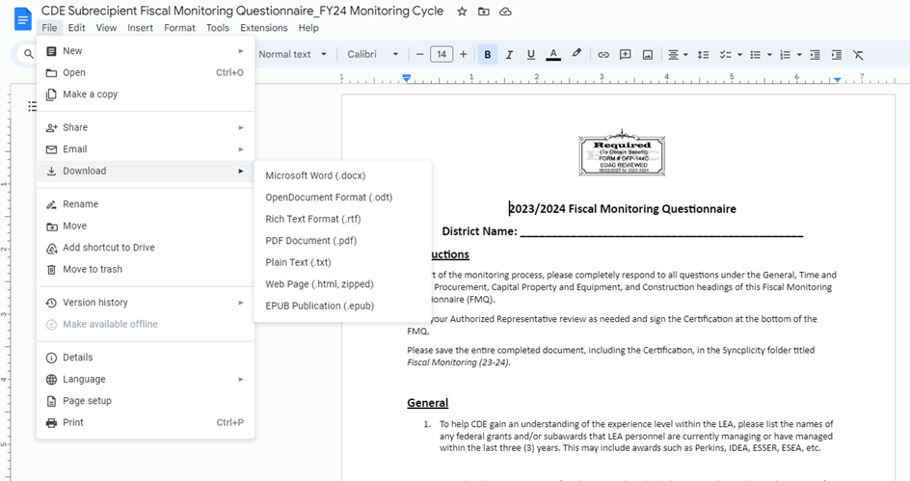
Fiscal Monitoring Questionnaire - Save a Copy
Navigate to the provided link and save a copy (do not request access)
Can be copied into a Google Drive, saved as a Google Doc, or downloaded into a variety of formats
Keep in mind, completed document will be submitted through Syncplicity

Slide 11
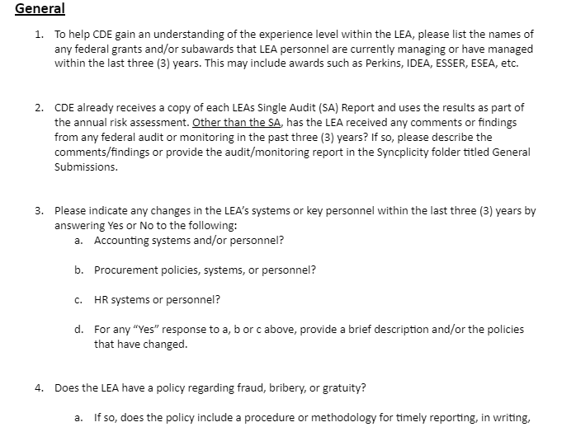
Fiscal Monitoring Questionnaire - General
Detailed answers help CDE better understand your LEA’s federal grant process and things like
  Control environment
  Experience with and exposure to federal grants
  Understanding of fiscal compliance requirements.
Notes:
Note, CASB policies we have seen do not necessarily have the reporting mechanisms asked in the questions. We are not saying the reporting mechanisms are required in the CASB policy but they need to be documented somewhere for the LEA to be in compliance with this section of the requirements. Also, definitely encourage just adding a link and not uploading policies as some we need a more in depth review than others. This can save time on both sides.

Slide 12
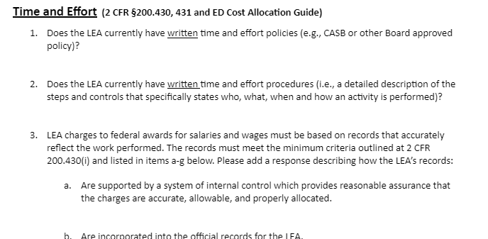
Fiscal Monitoring Questionnaire - Time and Effort
Focus on your LEA’s documented policies and procedures
  What currently exists?
    If nothing, answer accordingly and provide a brief narrative as a jumping off point
  Should be a walk through of your process from A-Z

Slide 13
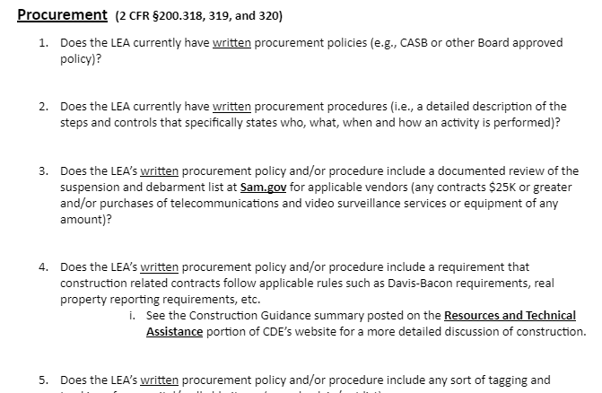
Fiscal Monitoring Questionnaire - Procurement
Again, looking for documented process
Some questions related to the types of supporting documentation your LEA requires for purchases
Also used during review of actual expenditures selected by CDE

Slide 14
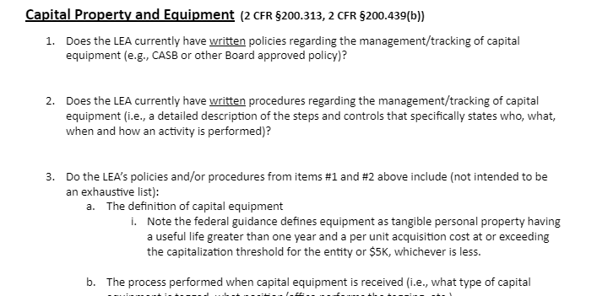
Fiscal Monitoring Questionnaire - Capital Property and Equipment
Typically builds upon Procurement process
Some questions related to tracking process

Slide 15
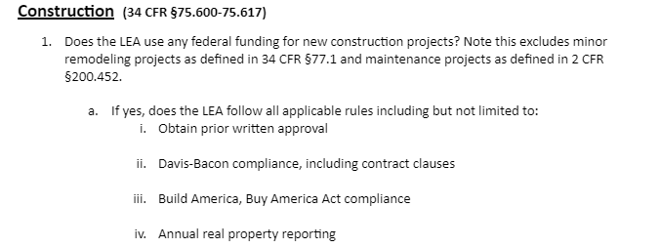
Fiscal Monitoring Questionnaire - Construction
Focuses on federal requirements unique to construction
If your LEA has any FY23 expenditures related to construction, a supplemental Construction Questionnaire will be included with the follow up documentation requested by CDE
  More detailed questions related to LEA’s process around construction

Slide 16
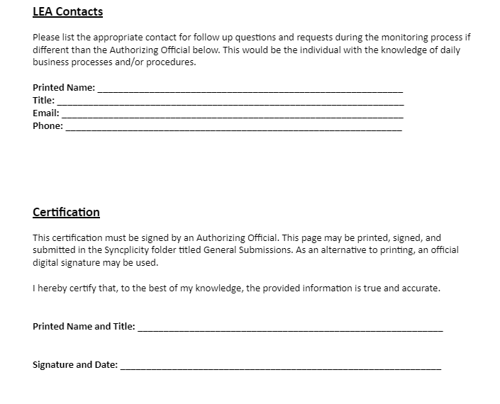
Fiscal Monitoring Questionnaire - LEA Contacts and Certification
Signed by Authorized Representative
Printed and signed or digital signature are both options
Can be submitted as separate page in Syncplicity

Slide 17
Documented Processes - What Does That Mean?
As mentioned in the Overview above, our review is focused on one of four main areas. In order to conduct that review, we need to know how your LEA’s process works - what are the steps from start to finish to accomplish a task?
Typically documented through a combination of policies and procedures
Policy
A guiding principle used to set direction in an organization.
Changes infrequently
States generally who, what, when, or why
Is broad and general
Procedure
A series of steps to be followed as a consistent and repetitive approach to accomplish a result.
Continuously changes and improves
States specifically who, what, when, and how
  CDE recommends using titles rather than names when documenting the “Who”
Offers a detailed description of activities

Slide 18
Documented Processes - So What Should We Submit?
Start with what, if anything, is documented. Any relevant CASB (or other Board approved) policies as the first stepping stone?
Does that tell the whole story? If not (and have not seen an instance where Board approved policy alone qualifies), fill in the gaps. The end result should be a documented process at a level of detail that would describe all the steps needed from start to finish to accomplish a task (e.g. – make a purchase, document time and effort, receive and track capital assets, etc.).
If nothing is currently documented, indicate this on the FMQ. Then draft a narrative of how your LEA’s process works.
Ensure the process works at your LEA. You may choose to have more controls or be more restrictive than the federal guidance. However, an LEA must follow their internal process, so avoid adding steps to a process your LEA is not prepared to follow.
To help facilitate this internal process evolution, CDE has compiled some rules and guidance an LEA should incorporate. Your LEA will need to determine how best to fit the required elements into the documented processes.
Notes:
The documented narrative can serve both as the required submission for our review as well as the start of getting your processes documented.

Slide 19
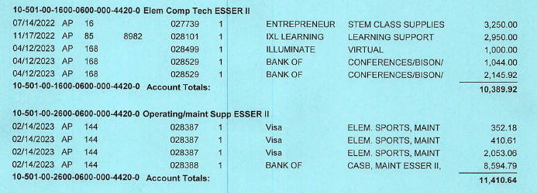
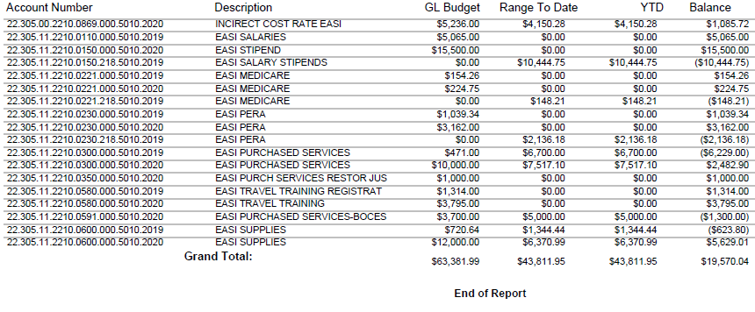
Detailed General Ledger vs Summary - What Actually Happened?
Need detailed general ledger
Individual transactions leading to summary totals
If accounting system can generate Excel type export of raw data - that is preferred
DETAILED EXAMPLE
Multiple Uses
Budget-to-Actual - what was budgeted versus what was posted in your accounting system
Sample selections - look at support to see the process was followed
SUMMARY EXAMPLE
Notes:
Make sure it is a system generated report exporting to Excel (or some version of spreadsheet) as the best format. Please have pertinent personnel reach out with specific questions about your LEA’s accounting system if needed to ensure the best format is used. Also, very helpful to have the parameters used when pulling the report - helps confirm the date range and other pertinent fields. PDF format can work on smaller data pulls but become extremely time consuming to analyze when they become much larger (recently had an LEA with several 50+ page GL reports).

Slide 20
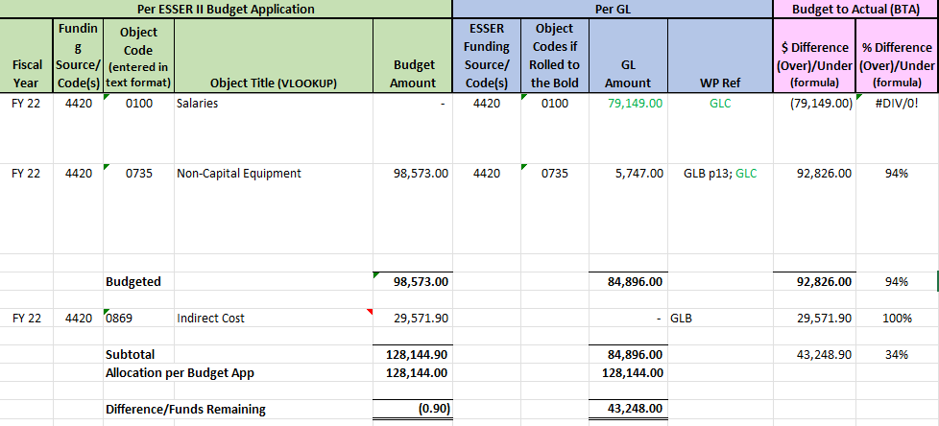
How Does CDE Review My Docs? - Budget to Actual
Comparing budgeted amounts to actual expenditures - by year and by object code
Where do things differ and why?
Notes:
Note: screenshots are straight from CDE’s internal review workbook

Slide 21
Lessons Learned - Budget to Actual
Not all GLs submitted initially
  Activity in a given year but not provided (maybe it was originally budgeted in a prior year but not spent until a subsequent year)
Not following the CDE Chart of Accounts
  Not posting to correct grant award code or object code
Budget differs from actual - typically due to a lack of PAR submission
  Greater than 10% difference in activity amount or new activities not originally budgeted
  Budgeted indirect but all funds spent on direct activities
  Recommend a periodic budget to actual reconciliation even high level to help mitigate these errors
0600 (Supplies) vs 0735 (Noncapital Equipment)
    Recommendation (“should”) in lieu of Corrective Action (“must”)
Notes:
Corrective Action = required by guidance (federal or otherwise) but no evidence it’s being done
Recommendation = not specifically required but encouraged as a best practice

Slide 22

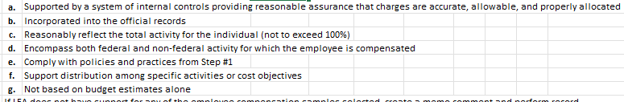
How Does CDE Review My Docs? - Time and Effort
Always starts with how does your process work - previous slides
In the absence of existing procedures, provide a narrative of the process to start
Reviewed for a complete process including, at a minimum:
CDE then selects a sample of employees from provided GL
  How does the time and effort support compare with the process for your LEA?
  How does it meet the minimum requirements from 2 CFR 200.430(i)?

Slide 23
Lessons Learned - Time and Effort
No documented process from start to finish - common theme
  Typically receive high level CASB policies and nothing else (remember the narrative if nothing else)
Minimal time and effort support
  Payroll ledgers do not reconcile with charges to grant
  Stipends - how is this determined, who receives, documented policy?
    Hazard pay is a prime example with ESSER
Not following internal process
  Not all fields completed on a required form
  Is the internal process too restrictive?
Federal guidance does not require timesheets or semi-annual certifications but these can be used
  CDE Grants Fiscal will be posting some examples

Slide 24
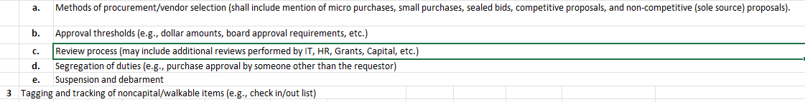
How Does CDE Review My Docs? - Procurement
Just like with time and effort, starts with how does your process work - if nothing is documented provide a narrative
Reviewed for a complete process including, at a minimum:
Note the tagging item - strongly encouraged
CDE then selects a sample of transactions from provided GL
  Important to have a transaction level GL
  Are you following your internal process as well as the items listed below

Slide 25
Lessons Learned - Procurement
No documented process from start to finish - once again
  Many CASB policies speak to purchase levels and methodologies - ensure these are followed if in the policy (Board approval for all purchase over $XXX)
No indication of review for suspension and debarment
  Screenshot or other documented review of Sam.gov at a minimum
Not following internal process - another common theme
Not required to track items under the equipment threshold but …
  Highly walkable may be scrutinized under audit
  Strong internal controls

Slide 26
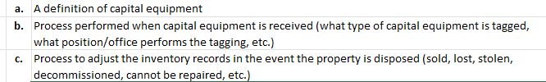
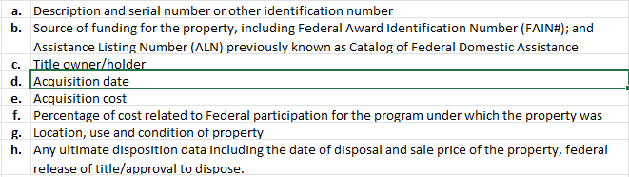
How Does CDE Review My Docs? - Capital Property & Equipment
You guessed it, this starts with how does your process work
  Document, document, document
  Most likely builds off the procurement process
Key items to consider:
CDE will review property and equipment records
  Even partially funded with federal funds, records must track at least:
Do you reconcile your inventory records to a physical count at least once every two years?
Notes:
Note the federal definition of equipment is poised to change from $5,000 to $10,000 … stay tuned

Slide 27
Lessons Learned - Capital Property and Equipment
No documented process from start to finish
Property records insufficient
  Some fields are more prevalent than others in records
  Purchased in whole or in part with federal funds
No physical inventory with results reconciled to property records

Slide 28
How and Why Does CDE Review My Docs? - Construction
Not common in USDE grants until ESSER - and maybe not again anytime soon
Really tied in closely with Procurement process
  Check with legal team if possible - starts with the contract
Davis Bacon and Related Acts takes center stage. Rules apply if contract:
  Exceeds $2,000
  Is federally financed (in whole or in part)
  Is for the construction, alteration, or repair (including painting and decorating) of public buildings and public works
  Involves the employment of mechanics or laborers
Keep in mind monitoring is “after the fact”
Notes:
After the fact = anything noted has already been done and, for construction, may mean some significant steps to come in to compliance.

Slide 29
Lessons Learned - Construction
Davis-Bacon Compliance
  LEAs must be periodically monitoring for this
  Collect and review weekly certified payrolls - looking for assurance of prevailing wage being paid
  May include on-site reviews for required wage notifications
Contract Clauses
  Review contracts for any projects currently in progress and issue addendums
  May even be required to amend contracts for projects already complete
Notice of Federal Interest
  Have requested sample language from ED
  County departments may have standard forms/language
Projects that have been completed are not “out of the woods”
  CDE must contact the U.S. Department of Labor when contractors are unwilling to address Davis-Bacon violations

Slide 30
Resources:
2 CFR §200 - the Uniform Grant Guidance
ED Cost Allocation Guide - additional time and effort requirements
Fact Sheet #66: The Davis-Bacon and Related Acts (DBRA)
Grants Fiscal Helpful Resources
January 26, 2023 Office Hours on Construction
CDE Construction Guidance
Sam.gov
Colorado READ Act webpage
Technical assistance opportunities
  Office Hours
  Targeted trainings on specific activities throughout the year
  Subject matter expert events - BruMan, KPMG, etc.

Slide 31
CDE Fiscal Monitoring Contacts
Bill Parsley
ESSER Fiscal Monitoring Supervisor
Office of Grants Fiscal Management
EMAIL: Parsley_b@cde.state.co.us
Hilery Morris
Fiscal Monitoring Specialist
Office of Grants Fiscal Management
Email: Morris_h@cde.state.co.us
Kristina Jones
Federal Fiscal Monitoring & Reporting Specialist
Office of Grants Fiscal Management
Email: Jones_Kristina@cde.state.co.us
Werner Hagemann
ESSER Fiscal Monitoring Specialist
Office of Grants Fiscal Management
Email: Hagemann_w@cde.state.co.us
Grants Fiscal Monitoring
Email: GFMU_Monitoring@cde.state.co.us
Nancy Taylor
READ Act Senior Literacy Consultant
Elementary Literacy and School Readiness
Email: Taylor_n@cde.state.co.us

Slide 32

Questions

