Slide 1
Financial Policies and
Procedures Meeting
June 26, 2025
District Facilitator
Cathy Watts, Academy 20

Slide 2
AGENDA
Call to Order
Approval of Agenda
Approval of Minutes
Legislative Session
Rulemaking Updates
CDEC Updates
Interest Free Loan Program
Office of the State Auditor
Financial Reporting
Trainings
Call for Membership
Other Topics of Interest
Proposed Meetings
Adjourn

Slide 3
Approval of Agenda

Slide 4
Approval of Minutes

Slide 5
Legislative Session

Slide 6
FY 2025-26 School Finance Bill as Amended
Implementation of the New School Finance Formula
Extends the implementation period for the new funding formula per HB24-1448 by one year, from 6 to 7 years
Phase-in (difference between new formula and old formula) of the new formula for the first three years:
  15% of the new funding formula in 2025-26
  30% of the new funding formula in 2026-27
  45% of the new funding formula in 2027-28

Slide 7
FY 2025-26 School Finance Bill as Amended (continued)
Addresses averaging
Maintains 4-year averaging in 2025-26
Reduces to 3-year averaging in 2026-27 only if the new funding formula is implemented at 30%, otherwise 4-year averaging will be maintained
3-year averaging in 2027-28 and each year after, or a smoothing factor if the State Education Fund balance is below $200 million

Slide 8
FY 2025-26 School Finance Bill as Amended (continued 2)
Holds schools harmless to 2024-25 funding for the 2025-26 and 2026-27 school years. The hold harmless as written in HB24-1448 will continue beginning in FY 2027-28.
Continues JBC oversight to review fiscal impacts annually and develop a sustainability plan for full funding of the new formula.
Maintains the JBC and Legislature tools provided in HB24-1448 (such as the economic triggers) to ensure stable and predictable funding of schools year after year.
Removes MDOL student counts in the size factor calculation
Final bill changed ASCENT funding per pupil to $7,104 with the last minute passage of SB25-315, also known as the PWR bill.

Slide 9
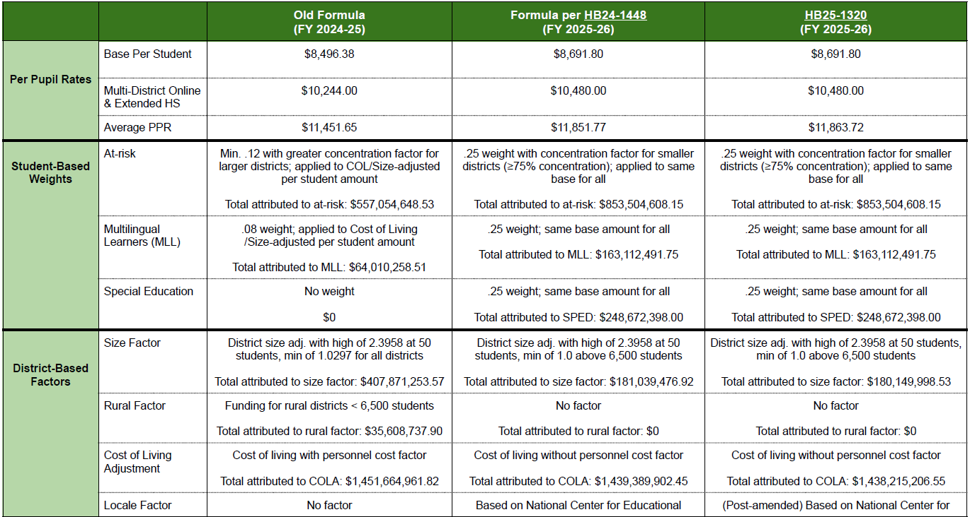
School Finance Comparison

Slide 10
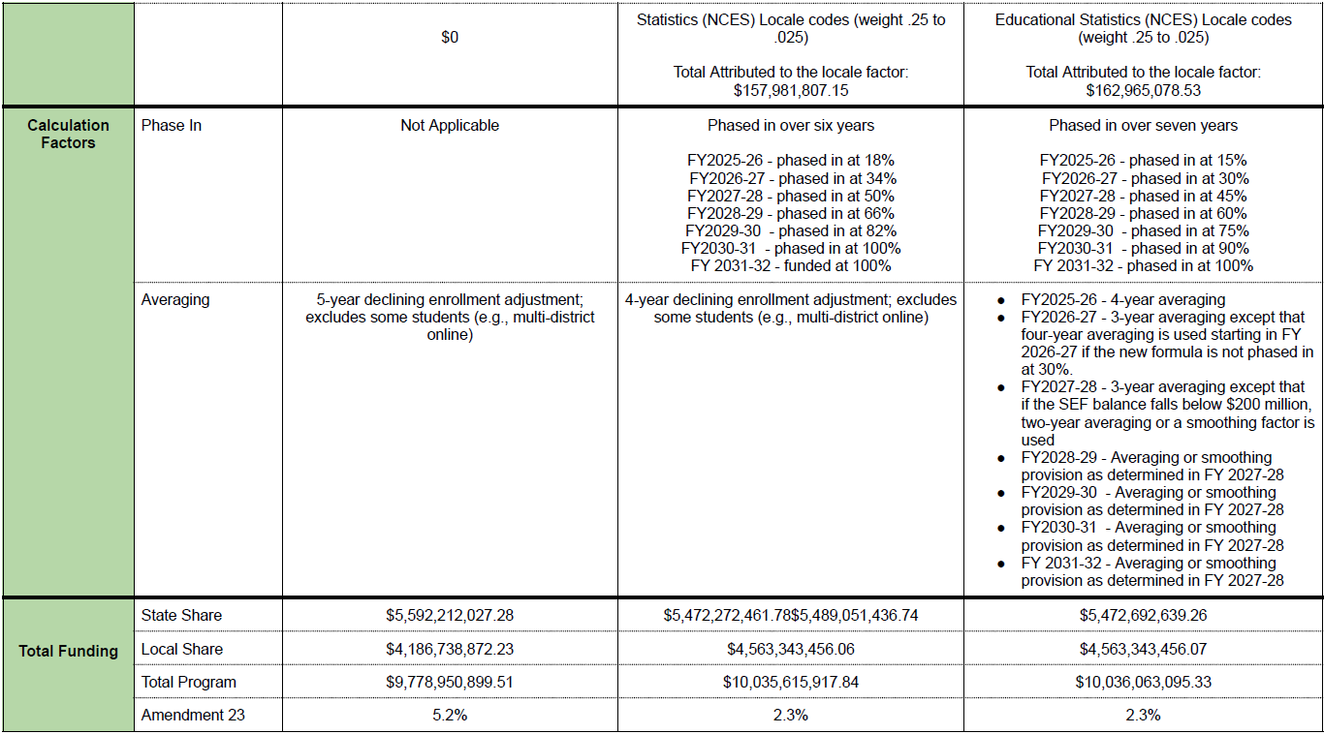
School Finance Comparison continued

Slide 11
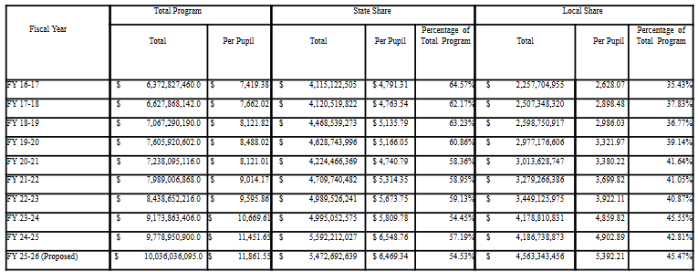
Total Program Breakdown Between State Local Share
4

Slide 12
Legislative Session
SB25-315 Post Secondary and Workforce Readiness
More detail to come

Slide 13
Legislative Session
Mill Levy Match
Prepared by Marc Carey at Legislative Council Services (LCS) with input from CDE staff
Formula does not include the HB 1448 adjustments for FY 2023-24
Funding and communication to be released soon
Non-recurring funds
Funding for FY 2025-26 is questionable and no appropriation for this funding currently exists

Slide 14
Rulemaking Updates

Slide 15
Legislative Rule Changes

Slide 16
Rule Changes Per SB 25-125
Current rules defined an 11-day window for counting students, including 5 days before and after the official count date (Rule 3.04). This allowed for limited transfer exceptions for students who enroll within 5 days after the Count Day.
Legislative Legal Services determined these provisions conflicted with statute.
Under SB 25-125, the rule related to student transfers expired on May 15, 2025.
These rule changes DO NOT impact the student count process, except for the transfer enrollment students.

Slide 17
Student Count Process Not Impacted
Statutes define pupil enrollment as those enrolled on the pupil enrollment count day within the applicable budget year, as evidenced by the actual attendance of such pupils prior to said date.
We have a single enrollment date (October Count Day) and a window for attendance in the event that a student enrolled prior to the count day is absent on the count day.
The rule change does not change the window for attendance. If an enrolled student is absent on count day, they are still eligible for funding if they resume attendance within 30 calendar days.

Slide 18
Proposed Rule Changes

Slide 19
Proposed rules address 8 issues for SBE consideration
Refinement of at-risk counts
Census block data collection
Questions related to private school pupils
Supplemental online clarification
Technical adjustments related SB 25-125 changes
Meal time standards
Work-based learning definition
Special Education funding in School Finance

Slide 20
Issue #1- Addressing Corrections of At-Risk Counts
In October 2024, over 20,000 students were misreported as “Paid” when they qualified for Free or Reduced-Price Lunch, which required significant corrections by districts.
This was largely due to confusion around CEP eligibility, which can carry forward for four years, unlike other statuses (like FRL forms) which are one year.
The rapid expansion of CEP schools has increased the risk of reporting errors:
  SY 21–22: 101 sites → SY 24–25: 1,359 sites
A rule change is proposed to align all eligibility statuses to reflect one year carry forward. This should not impact the number of eligible at-risk students, but will reduce future reporting discrepancies.

Slide 21
Issue #1- Addressing Corrections of At-Risk Counts (continued)
The proposal is to delete the following rule:
6.02(4) For a district with a school or schools operating under a federal Special Assistance Certification and Reimbursement Alternative, documentation must include evidence of the pupil’s inclusion on the district’s base year count and further evidence that such pupil remains included in a Special Assistance Certification and Reimbursement Alternative site within the district’s pupil enrollment. This method shall not be available if a district alters the boundaries of the participating schools.

Slide 22
Issue #2 - Census Block Data Collection
HB 25-1320 allows the State Board to pause collection of student-level census block data if it closely mirrors Free and Reduced-Price Lunch data used to identify at-risk students.
The Board may also restart data collection if needed in the future.
Proposed language changes for the rules are being developed.

Slide 23
Issue #3 - Questions Related to Private School Pupils
While current rules prohibit funding students receiving instruction in tuition-based private schools, questions have emerged about contracted services and homeschool enrichment models.
  Not Eligible: If parents pay private school tuition and the district provides services via contract, students cannot be counted for funding.
  Potentially Eligible: If parents enroll directly with the district for classes (even if held at a private site), students may be eligible for part-time funding—if instruction is separate from the private school’s tuition-based curriculum.
Clearer guidance is needed to distinguish allowable funding models from ineligible private arrangements.
Notes:
The described “partnerships” would not be appropriate as including these students in the district’s funded pupil count would use public funding to:
Reduce private school tuition for some students OR
Increase revenues of private school OR
Decrease expenses of private school

Slide 24
Issue #3 - Proposed Change to Private School Pupils
The proposal is to change the following rule:
1.14 “Private school pupil” means a pupil enrolled in an independent or parochial school which provides a basic academic education pursuant to Section 22-33-104(2)(b), C.R.S. and who has is also been enrolled by a parent or guardian and receiving instruction part-time from a Colorado public school.
Notes:
This will not fully address the issue as we have seen private schools instruct parents to enroll their children in the public school system in order to qualify for the discounted tuition

Slide 25
Issue #4 - Supplemental Online Clarification
Current rules require students enrolled in brick-and-mortar schools taking only off-site online K–12 courses to be enrolled in an official online program.
CDE guidance for FY 2024–25 clarified that this does not apply to homebound, expelled, or incarcerated students.
These students can take supplemental online courses without needing to be enrolled full-time in an online program.
A rule update would formally reflect this exception in policy.

Slide 26
Issue #4 - Supplemental Online Clarification (continued)
The proposal is to change the following rule:
5.09 Pupils exclusively enrolled in online K-12 courses that take place off-site, but are not enrolled in an online school, must be enrolled in an online program. A student is not exclusively enrolled in online K-12 courses if they have at least one course scheduled to take place on-site, in-person, at a regularly scheduled time during regular school hours and where attendance is mandatory.
5.09(1) Exception: Home-bound pupils, including expelled and incarcerated pupils, as defined in section 1.09, do not need to be enrolled in an online program.

Slide 27
Issue #5 - Technical adjustments related SB 25-125 changes
As discussed above, SB 25-215 made rule changes. The proposal is to make corresponding adjustments:
3.05 In no instance shall a district solicit pupils from other districts for the sole purpose of attendance for the applicable pupil enrollment count date during the applicable count period.
3.06 In no instance shall a district solicit pupils from the home school population solely for purposes of attendance for the applicable pupil enrollment count date during the applicable count period.

Slide 28
Issue #6 - Meal Time
Current rules exclude lunch from instructional time.
CDE has received questions about required lunch durations for students. Additionally, instances have been identified during audits where students are scheduled for 6 continual hours of instruction with no break to reach the minimum 90 hours needed for part-time funding. In these instances, either:
  Students are getting no lunch - which is not healthy, or
  Students are getting a lunch, losing out on instructional time, and are not actually meeting the minimum 90 hour requirement for part-time funding
Currently, there is no law or rule mandating a minimum lunch period in Colorado. While School Finance rules exclude lunch from instructional time, they leave meal break decisions to districts.
The State Board may consider setting minimum lunch break expectations in rule to support student well-being and consistent funding criteria.

Slide 29
Issue #6 - Meal Time Guidance Provided by CDE
There is considerable research supporting the benefits to student learning when students have access to healthy meals. Therefore, districts should ensure appropriate meal breaks are implemented for students in all educational settings offered by the district.
The American Academy of Pediatrics and the Center for Disease Control and Prevention recommend students have at least 20 minutes of seated lunch time.
Employment requirements may also be a model for districts (e.g. 30-minute meal break for 5 hours and 10-minute rest break for every 4 hours).
Form AUD108 requires contracted services to be “of comparable quality and meet the same requirements and standards” at school/district (e.g. contractors should match typical lunch period at district school).

Slide 30
Issue #6 - Potential Rules Changes related to Meal Time
The State Board may wish to include requirements in rule:
2.05(1)(c)(II) Time provided for breakfast or lunch may not be included as instructional time for purposes of determining funding eligibility.
2.05(1)(c)(II)(i) A lunch break of at least 20 minutes must be provided to students scheduled for more than five hours of daily instruction.

Slide 31
Issue #7 - Work Based Learning Definition
Current rules provide examples of work-based learning that can be included in instructional time for school finance funding.
This year’s legislation on Postsecondary & Workforce Readiness Programs (SB25-315) includes a definition of work based learning.
It may be appropriate to align the definition of work-based learning.
Notes:
"Work-based learning" means demonstrating learning through work or at work, consistent with the work-based learning quality expectations established pursuant to section 8-83-602 (5). "Work-based learning" includes the same meaning as set forth in section 8-83-601(15):
(a) “Work-based learning” means learning that occurs, in whole or in part, in the workplace that provides youth and adults, including teachers in K-12 classrooms, with hands-on, real-world experience and training for skills development.
(b) “Work-based learning” includes activities such as job shadowing, internships, externships, pre-apprenticeships, apprenticeships, residencies, and incumbent-worker training.
(c) “Work-based learning” also includes externships in STEM or STEM-related fields tailored to provide K-12 teachers with knowledge to improve classroom curriculum.

Slide 32
Issue #7 - Work Based Learning Definition (continued)
The proposal is to change the following rule:
1.01 “Alternative teacher-pupil instruction” means the organized delivery of educational content (aligned to state standards where applicable) for pupils enrolled in a brick-and-mortar public school under the supervision of a licensed educator that may take place asynchronously. The following types of courses with alternative teacher-pupil instruction can be funded with appropriate documentation: independent study, work-based learning (demonstrating learning through work or at work, consistent with the work-based learning quality expectations established pursuant to section 8-83-602 (5), such as work-study, internships, apprenticeships, supervised entrepreneurship experiences), blended learning, and supplemental online learning.
1.01(1) Work-based learning courses are credit-bearing courses that must be incorporated within the student’s Individual Career and Academic Plan (ICAP) in order to qualify for funding. They are learning opportunities that occur in part or in whole in the workplace and provide the learner with hands-on, real-world experience and training for skills development.

Slide 33
Issue #7 – Impact of Updated WBL Definition
In many instances, WBL courses are included in students’ scheduled based upon part-time jobs. Part-time jobs appear to meet the statutory definition in Section 8-83-601, C.R.S., specifically "...learning that occurs, in whole or in part, in the workplace that provides...hands-on, real-world experience and training for skills development”.
  The following activities would not meet the statutory definitions: career coaching, counseling, and planning, career fairs, career presentations, externships, industry speakers, informational interviews, job shadowing, mentoring, project-based learning, and worksite tours.
  Thus, the new definition should not have an impact on WBL courses that can be included for funding.

Slide 34
Issue #8 – Special Education Counts
The New Public School Finance Formula includes District Special Education Funding.
This funding is based upon the District’s Special Education Pupil enrollment.
Special Education pupils are defined as the number of district pupils who are children with disabilities as defined in Section 22-20-103(5), C.R.S.

Slide 35
Issue #8 – Special Education Rule Language
The proposal is to add the following rules:
6.04 Consistent with Section 22-54-103(10)(a)(II)(10.8), C.R.S., funding eligible pupils are considered Special Education Pupils if they are identified as Special Education based upon a reported primary disability as defined in Section 22-20-103(5), C.R.S.
  6.04(1) Special Education Pupils must be identified by a district with an active Individualized Education Plan (IEP) as of the applicable count date in order to be included in the District’s Special Education Pupil Count.

Slide 36
Upcoming Rulemaking
The State Board of Education is scheduled to consider the following Notice of Rulemakings at the August SBE meeting:
1 CCR 301-14: Rules for the Administration of the Public School Transportation Fund
  Change definition of capital outlay from an expenditure in excess of $1000 to an expenditure in excess of $10,000 to align with federal Uniform Guidance
  Update definition of pupil transportation vehicles to align with definition in 1 CCR 301-25
  Add definition of legal residence to align with Section 22-32-113(4)
  Clarify expenditures are to the state border
  Update allowable additions or alterations
  Remove required documentation for list of pupils scheduled to be transported
1 CCR 301-11: Rules for Accounting and Budgeting
  Add references to Universal Preschool Program and Healthy School Meals for All
  Remove reference to Breakfast After the Bell Nutrition Program
1 CCR 301-26: Rules for the Operation, Maintenance, and Inspection of School Transportation Vehicles
  Clarify language for “proper use of physical restraint and intervention of students” from “the proper use of restraints on students” for consistency throughout rule
Details of the proposed changes are available at: https://www.cde.state.co.us/cdefinance/noticerulemaking_1ccr30139_psfa

Slide 37
CDEC Updates

Slide 38
CDEC Updates
CDE provided the following feedback to CDEC on behalf of districts:
It would be helpful to have more reporting/information available to districts.
It would be helpful to be able to delete duplicate entries in the system. Currently (at least one) district will send an email to the Local Coordinating entities. Together they determine which entry will be tied to the student. However, they are not sure if the other applications remain in the system as there is no final tie up for these duplicates. For example, parents may still be referencing a different application number.
Districts requested a follow-up on the request for quarterly reporting of financial data and status of EDAC submission, since this is a duplicative data request (districts already provide this information annually to CDE).
District contacts have been dropped from Colorado gov emails. CDEC is working on this. It would be helpful to know the status.

Slide 39
Interest Free Loan Program

Slide 40

ETRANS Interest Free Loan Program
Program Updates

Slide 41
Program Updates
The State is currently in the process of sizing the upcoming series of Notes, with an expected closing occurring in mid-August
The size of the Notes are dictated by the cash flow needs of participating districts
District’s must complete a cashflow worksheet, with the help of RBC, to determine whether or not they will need to participate in the program
  District’s must demonstrate a negative cash flow in order to participate
Due to the issuance being moved back one month, Districts will be able to utilize an actual July 1, 2025 cash balance (vs. normally being an estimate)
  Starting cash balance is one of the most important inputs to the amount that is borrowed on behalf of Districts
  The State is paying very close attention to the amount borrowed due to increasing interest costs

Slide 42
Assessed Value Changes
This August, County assessors will provide refined assessed value estimates
  Due to it being a reassessment year and other property tax measures rolling off, most Districts will experience a large increase in assessed value
  The current estimates from Legislative Council likely skew too high – all else equal, lowering equalization for Districts
CDE will recalculate state equalization funding based on actual 2025 assessed values and “true-up” equalization funding though the months of December to June of 2026
SB24-017 will further concentrate this “true-up” because no equalization will be received in March, May and June
Please contact RBC Capital Markets, the State’s Financial Advisor
to the State Interest Free Loan program.

Slide 43
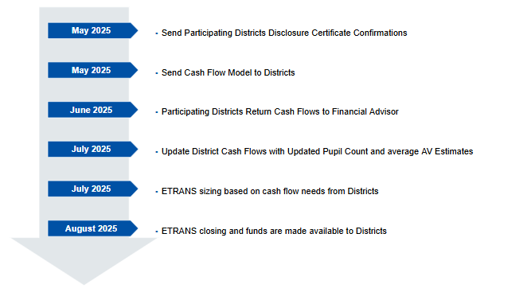
Sample ETRANs 2025 Timeline

Slide 44
Contact Information
Anthony Singh
Associate
Tel: 303-595-1201
anthony.singh@rbccm.com
Dan O’Connell
Managing Director
Tel: 303-595-1222
dan.oconnell@rbccm.com

Slide 45
Disclaimer
This presentation was prepared exclusively for the benefit of and internal use by the recipient for the purpose of considering the transaction or transactions contemplated herein. This presentation is confidential and proprietary to RBC Capital Markets, LLC (“RBC CM”) and may not be disclosed, reproduced, distributed or used for any other purpose by the recipient without RBCCM’s express written consent.
By acceptance of these materials, and notwithstanding any other express or implied agreement, arrangement, or understanding to the contrary, RBC CM, its affiliates and the recipient agree that the recipient (and its employees, representatives, and other agents) may disclose to any and all persons, without limitation of any kind from the commencement of discussions, the tax treatment, structure or strategy of the transaction and any fact that may be relevant to understanding such treatment, structure or strategy, and all materials of any kind (including opinions or other tax analyses) that are provided to the recipient relating to such tax treatment, structure, or strategy.
The information and any analyses contained in this presentation are taken from, or based upon, information obtained from the recipient or from publicly available sources, the completeness and accuracy of which has not been independently verified, and cannot be assured by RBC CM. The information and any analyses in these materials reflect prevailing conditions and RBC CM’s views as of this date, all of which are subject to change.
To the extent projections and financial analyses are set forth herein, they may be based on estimated financial performance prepared by or in consultation with the recipient and are intended only to suggest reasonable ranges of results. The printed presentation is incomplete without reference to the oral presentation or other written materials that supplement it.
IRS Circular 230 Disclosure: RBC CM and its affiliates do not provide tax advice and nothing contained herein should be construed as tax advice. Any discussion of U.S. tax matters contained herein (including any attachments) (i) was not intended or written to be used, and cannot be used, by you for the purpose of avoiding tax penalties; and (ii) was written in connection with the promotion or marketing of the matters addressed herein. Accordingly, you should seek advice based upon your particular circumstances from an independent tax advisor.

Slide 46
Office of the State Auditor

Slide 47

School District Fiscal Health Analysis
Fiscal Years ended 2021, 2022, 2023
Sent data for review 5/22/2025
Contact Lynn or Crystal at the OSA if there are any questions.
  lynn.obremski@coleg.gov
Legislative Audit Committee presentation planned for
  October 20, 2025
Notes:
Additional info possibly at the Sept FPP meeting

Slide 48

Colorado Office of the State Auditor
1525 Sherman Street, 7th Floor, Denver, Colorado 80203
303.869.3000 http://www.colorado.gov/auditor/ osa.lg@coleg.gov
Crystal Dorsey: crystal.dorsey@coleg.gov (303) 869-3002

Slide 49
Financial Reporting

Slide 50
Financial Transparency Website
FY2023-2024 data files have been prepared - must be available on the public site by July 1st, per statute.
Results were ready for District review as of June 17
Statewide (descriptive) data sets are available on the PSFU website (Financial Transparency) under ‘Additional Resources’
Any District Narratives submitted for FY2023-24 will appear on the Live site by July 1st
Please share any feedback or questions directly:
Kelly Wiedemer - wiedemer_k@cde.state.co.us
Yolanda Lucero - lucero_y@cde.state.co.us

Slide 51
Financial Transparency - Required Documents
Website Accessibility
Required Documentation
Annual Budgets for FY25-26, FY24-25 and FY23-24.
Uniform Budget Summary Sheet
Financial Audit for FY24-25, FY23-24 and FY22-23.
Salary Schedules or Policies for FY25-26, FY24-25 and FY23-24
Financial Data File for FY24-25, FY23-24 and FY22-23.
List of Waivers Received by the School District / Charter School
Standardized Description and Rational for Each Automatic Waiver
Federal Form 990, 990-EZ, or 990-PF and any associated schedules
Plan for Distributing Additional Mill Levy Revenue or Statement of Intent to Distribute
Additional Required Links:
(charter schools only): Link to Authorizing School District/CSI FT webpage
Link to the CDE School Finance Unit webpage
Link to Financial Transparency for Colorado Schools website view
Notes:
We understand that the audit might not be the responsibility of the district for Accessibility - so work with your auditor on that. Make sure that the source docs pass accessibility - the majority are excel or word.

Slide 52
Financial Transparency - Tips
Website Accessibility
Add Alternative Text to all pictures, symbols and screen shots
Avoid merging cells in excel
Use the CDE Templates - they pass the accessibility checker, if the District has an accessibility process that should also be used once the templates are populated with the Districts information.
Run the Accessibility Checker in the Original Version prior to converting to PDF
Accessible Documents Toolkit (States Resource Page)
https://oit.colorado.gov/standards-policies-guides/a-guide-to-accessible-web-services/accessible-documents-toolkit
Notes:
There is an undue burden exclusion - reach out to your district’s communication or IT/website re accessibility policies.

Slide 53
Financial Transparency
Proposed changes per HB24-1448
Due to requirements in HB 24-1448, CDE will be adding Per-Pupil Funding (PPF) & Per-Pupil Revenue (PPR) figures to the website as follows:
District-level only (at the top of the district’s landing page):
  A PPR figure will be displayed based on total Local/State/Federal revenues reported by the district (excluding ‘Other’ revenues*) divided by the Total District Membership as displayed at the top of the district’s FTCS page.
Note that ‘Other’ revenues on the FTCS site are defined as follows: Other revenues not received through local, state, or federal sources. They include proceeds from the sale of bonds, accrued interest, and other extraordinary items.
2. At the district level and the school level, a PPF figure will be added to the bottom of the district or school page to align with requirements set forth in Section 5 of HB 24-1448 (on pages 20-21):
Using Total Program Per Pupil Funding for each District, which is based on Funded Pupil Count (FPC) at the District level, we will display the following at the bottom of the school or district’s FT page:
  Projected Share of Total Program Per Pupil Funding multiplied by Total Membership as displayed on the school or district’s FTCS page.

Slide 54
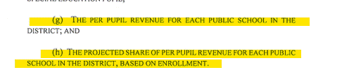
Financial Transparency
Proposed changes per HB24-1448 (continued)
(from Section 5 of HB24-1448):
Disclaimer (draft): We know there will be variations with actual school-specific revenue, but due to data constraints, this level of detail meets statutory requirements in HB 24-1448 (Section 5).
Note that we are in the draft stage of adding this information – which must be reported beginning in January 2026 – and would love to gather feedback from you all (including whether you’d like to be involved in these discussions).

Slide 55
Collection Update
Financial December
Soft Open available on August 1st
Official Open TBD: waiting for districts to finalize FY2023-24
Submissions are Due December 31st
Extensions may be granted for 60 days, from OSA
CDE honors the extension approved by OSA
Financial Data Warehouse Reports
Excel Files vs PDF Files
Planned Office Hours in Fall, Thursdays at 9:00 am
Data Submission - August 14th
Data Pipeline Reports - August 21st
Data Pipeline Resources - August 28th
Notes:
Can provide pdf - unless they are needed. We can provide them on request. Please let us know your preference.
New edits are primarily around the account code changes made through the subcommittee for the FY24-25 COA.

Slide 56
Collection Updates:
Pupil Route Transportation (CDE-40) Reimbursement Funding
2nd Transportation Payment for FY 2023-24
Have been processed and sent to School Districts
FY 2024-25 - Submission Opens July 1
Statutory deadline for submission is September 15th - No Extensions!
1st Payment to be Issued November 15th
Transportation Funding Webpage Resources
http://www.cde.state.co.us/cdefinance/sftransp
Public Route Transportation CDE-40 Resource Guide
Sample CDE-40 Calculation Worksheet
Training Video Series: The Transportation CDE-40 Step by Step
Notes:
Yolanda

Slide 57
Collection Updates - Recommendations:
Pupil Route Transportation (CDE-40) Reimbursement Funding
Collection Recommendations
Review resources:
  Review Appendix F of the Resource Guide for detailed recommendations of how to proceed.
  Obtain the optional updated District Calculation worksheet and begin to complete.
  Review the prior year’s submission, as well as the High Level Review.
    Contact School Finance if you need a copy of your district’s High Level Review.
Ensure that the accounting system is categorizing and describing accounts as accurately as possible.
Yearly Mileage for all vehicles with costs in Program 2700+
  Obtain the ending odometer readings for each vehicle as of June 30.
  Ensure that the mileage for vehicles can be split into route, activity and non-pupil mileage.
Review the routes that were scheduled as of count day and determine if a split calendar calculation is needed.
School Finance: Training and Office Hours
https://www.cde.state.co.us/cdefinance/upcomingschoolfinancetownhallsandtrainings
Pupil Route Transportation Overview July 24th, 2025 (9:00 AM)

Slide 58
Updates to FPP Handbook
Updates made
Dates, cover page, Colorado State Board of Education, Critical Dates, Table of Contents and Table of Authorities.
Accessibility for alt-text, merged cells, tables, color contract, etc..
Inactive webpages to be current webpages
Working with the County Treasurer: Fees
Fund 07 Total Program Reserve Fund to be optional, repealed per SB 24-188
Equipment threshold from $5,000 to $10,000.
Single Audit threshold from $750,000 to $1,000,000
FPP Handbook - Draft to be posted the 1st week of July
To be finalized and posted in August to include updated (FPP) Advisory Committee

Slide 59
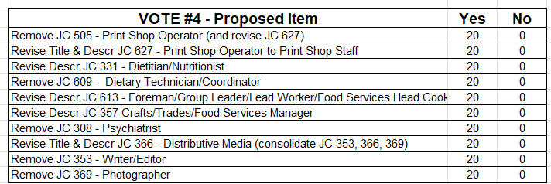
Updates to Chart of Accounts
Vote 4
The changes related to Vote 4 were presented at the November FPP meeting.

Slide 60
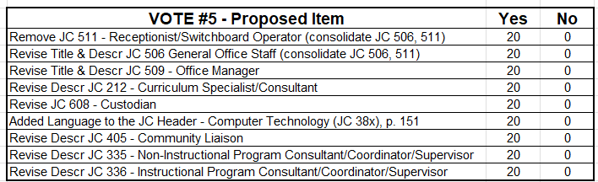
Updates to Chart of Accounts
Vote 5
The changes related to Vote 5 were presented at the November FPP meeting.

Slide 61
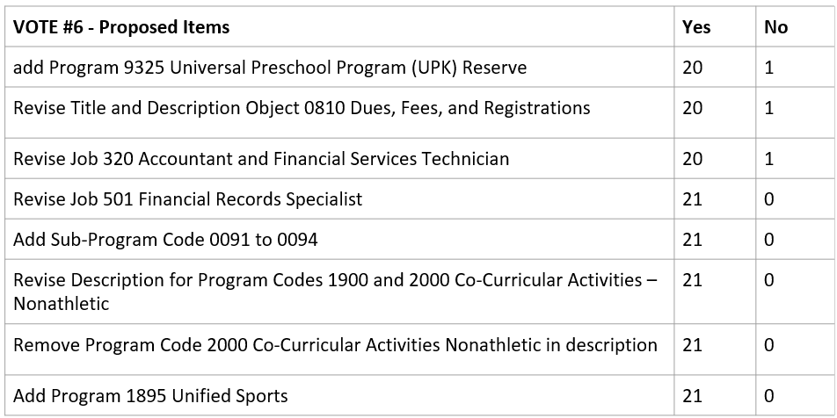
Updates to Chart of Accounts
Vote 6
The changes related to Vote 6 were presented at the February FPP meeting.

Slide 62
Updates to Chart of Accounts
Updates made
Dates, cover page, Colorado State Board of Education and Table of Contents
Accessibility for alt-text, merged cells, tables, color contrast, etc..
Fund 07 Total Program Reserve Fund to be optional, repealed per SB 24-188
FPP Chart of Accounts - Draft to be posted the 1st week of July
To be finalized and posted in August to include updated (FPP) Advisory Committee

Slide 63
Trainings

Slide 64
Trainings
Office Hours, Thursdays 9:00am-10:30am
July 10th: Intro to Governmental Accounting/Audit Preparation
July 17th: Single Audit Preparation
July 24th: Pupil Route Transportation Overview
August 14th: Data Pipeline Part I Submission Process
August 21st: Data Pipeline Part II Cognos Reports
August 28th: Data Pipeline Part III Website Resources
CDE/CSFP Strategic School Finance Training
June 26-27: Santa Fe Trail BOCES
July 31 – Aug 1: Montrose SD, Montrose, Co
Sept 25 – 26: Parachute, CO
October 2 -3: Lewis Palmer SD, Monument, Co

Slide 65
Call For Membership

Slide 66
Call for Membership
Open Vacancies
Five committee positions to be filled by representatives from school districts with terms ending August 2028
One committee positions to be filled by representatives from school districts with terms ending August 2026
One committee position to be filled by representative from BOCES with term ending August 2027
Three committee position to be filled by representative from Charter School with term ending August 2027
A meeting will be held in July with the five school districts with terms ending August 2025 to review the applicants.
Vote for selected member will be sent in to Committee in August.
New members will be announced at the September FPP meeting.

Slide 67
Other Topics of Interest

Slide 68
Other Topics of Interest
CASBO
📍 Fall Conference
September 24–26, 2025 | The Hythe, Vail
Join colleagues and leaders from across the state for learning, networking, and celebration in the beautiful Colorado mountains.
🏆 Introducing the CASBO Summit Award
Celebrating Excellence in Team Innovation
Applications due August 1, 2025
Nominate a team whose collaborative work has made a meaningful impact!

Slide 69
Other Topics of Interest
CASBO (continued)
🎉 A Fond Farewell to Stephanie Watson
Our Executive Director, Stephanie Watson, is retiring.
Join us for a special farewell gathering during the conference to celebrate her leadership and contributions to CASBO.
🏫 District Memberships – A Smart Investment
Enhance your district's engagement with CASBO through the School District Organizational Plan (SDOP). This calendar-year membership includes:
Spring & Fall Conference Registrations
Professional Development Opportunities
Access to Resource Library
Networking Events
Career Opportunity Postings

Slide 70

Other Topics of Interest
CGFOA
Membership to CGFOA
Mentor Program
Summer Conference in Glenwood Springs: July 24-25
Fall Conference in Loveland: November 18-21
email chelsea@cgfoa.org with any questions

Slide 71
Other Topics of Interest
CASB
CASBO
CASE-DBO
COCPA

Slide 72
Proposed Meetings
FY 2025-2026

Slide 73
Proposed Meetings FY 2025-2026
September 18th, 2025
November 13th, 2025
February 12th, 2026
April 16th, 2026
June 18th, 2026

Slide 74
Meeting Adjourn

