Slide 1
CoAlt Science and Social Studies Test Administration Training
2017

Slide 2
Who are the Students?????
Students with the most significant cognitive disabilities…
Receive instruction on the Extended Evidence Outcomes (EEOs)
Requires extensive, repeated, and individualized instruction
Uses substantially adapted and/or modified materials
Not IDEA category specific
CANNOT have a Specific Learning Disability (SLD)
Generally – ID, MD, Autism, D/B
Not all students with ID should qualify
CoAlt intended for students 3 SD below mean (~55>)

Slide 3
Why is this Important?
Ensure the correct students participate in the correct test…
Federal Law (IDEA, ESSA 1% cap)
IQ tests have ranges and error bands
Instruction linked to EEOs and not general standard
Graduation rates for students with disabilities are 20% lower (Schiffer, 2016)
84% vs. 63%
51% of students with ID graduated with diploma/certificate
15% of adults with ID are employed (thearc.org, 2016)

Slide 4
CoAlt Assessment Administration
Students with the most significant cognitive disabilities take the Colorado Alternate Assessments (CoAlt)
Science and Social Studies (Colorado-developed)
Elementary, Middle, and High School Assessments
Science: grades 5, 8, and 11
Social studies: grades 4 and 7
A sample of schools will administer the social studies assessments
English language arts and mathematics (DLM-developed)
Grades 3-8, 9-11
Alternate for ELA and Math, PSAT and SAT

Slide 5
CoAlt: Science and Social Studies
Paper-based assessment
Individually administered
Scored locally by the Test Examiner
Scores are entered into the PearsonAccess^{next} portal

Slide 6
Score Entry
Test Examiners enter scores into PA^{next}
Score entry window closes Wednesday, May 2, 2018
DO NOT return any materials until you have verified that the student scores have been entered
Do not assign a teacher both TE and TA roles
Limits other functions

Slide 7
CoAlt: ELA and Math (DLM)
Computer-based assessment
Individually administered
Test Administrators/DACs use Educator Portal for student management
Students test using KITE Client
Same window as CMAS: ELA and Math
If using the 3-week window (paper-based or online), have the same 3 week window for DLM.
If using the 6-week extended window for the general online assessments, have the same 6-week window for DLM.

Slide 8
Administering CoAlt: SC/SS
Student is presented with three or four answer options
Represent prompt at level four only when the student does not respond
Student will work with the item until the correct answer is received or the maximum number of attempts is reached
CoAlt Test Examiners may not rephrase the prompt
An additional prompt is included at level three to help engage the student
Only one data point is recorded

Slide 9
Administering CoAlt: SC/SS
Paper-based assessment
Online score entry in PearsonAccess^{Next}
Test books are oriented to the Test Examiner and the student face each other
Two items
Selected Response
Supported Performance Tasks

Slide 10
Chain of Custody
A documented chain of custody must be kept
Test materials must be secure at all times
With the SAC before and after testing session
With the Test Examiner during testing session
Access before testing may be needed to create accommodations
Notes:
- Secure storage: CoAlt Test Examiners must account for and return test materials and individualized accommodations to the SAC for storage in a secure and locked location immediately after administration, at least on a daily basis. Test materials must not be stored in classrooms.
SAC distributes materials to Test Examiners: The SAC is responsible for the distribution of test materials to CoAlt Test Examiners and for the collection of the test materials during the preparations or accommodations as well as on each day of testing. SACs will have Test Examiners sign the CoAlt materials out and back in once returned. Only materials for the student being assessed at that time should be distributed to the Test Examiner.
-Due to the unique nature of the CoAlt: Science and Social Studies assessments, Test Examiners may need access to a student’s materials prior to the test’s administration in order to prepare any necessary accommodations and organize the provided student materials and manipulatives.

Slide 11
Test Materials
Grade 8 and 11 have two unique forms
Grades 4, 5, and 7 have one form
Task manipulatives are shrink-wrapped with each test book
Each student must be assessed with “their” book and manipulatives
Notes:
Your school will get an even distribution of each form for each subject. It is not required that the student takes the same form for each subject.
Each student MUST be assessed with the same book and corresponding manipulatives per subject. The task manipulatives are shrink-wrapped together with the test book. Its important to keep the test materials that were shrink-wrapped, together.

Slide 12
Test Materials
Before Testing
Write the student’s name on the test book
Write the student’s name on the secure return envelope
Cut apart the task manipulatives
Paper clip them to the corresponding page
Keep materials together

Slide 13
Task Manipulatives
CoAlt Test Examiners should use the picture symbols in the test materials provided, except :
The student needs to use objects rather than pictures.
The student needs pictures of real objects rather than drawings.
The student has a personal lexicon with a specific representation for the concept or words in the student answer choices.
In this case, all answer choices must be from the student’s personal lexicon.

Slide 14
Task Manipulatives
The student facing pages of test items may need to be adapted:
Size
Color
Contrast levels
Dimension
Assistive technology / AAC
Tactile / Objects

Slide 15
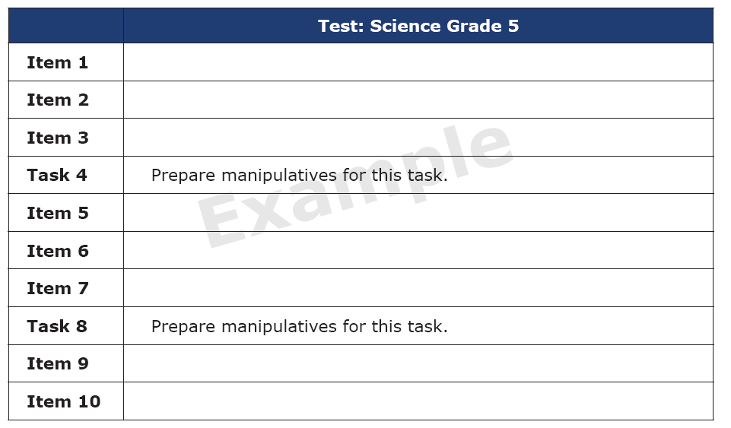
Test Layout
The beginning of each test shows the order of items and tasks.
Remember not all items have to be administered in one session.

Slide 16
Scheduling
Individual administration
Untimed
Estimated times in minutes
Spring 2015 | Mean | Max
Grade 4 | 34 | 150
Grade 5 | 30 | 165
Grade 7 | 35 | 180
Grade 8 | 33 | 139
Notes:
Remember this is an untimed individually administered assessment, and students should be provided the time they need to complete the assessment.
To help with scheduling, I have provided the mean and median times from spring 2015 administration.

Slide 17
Selected Response Items

Slide 18
Present the Primary Prompt
Student Responds Correctly
4
Student Does Not Respond
Repeat the Primary Prompt
Student Responds Correctly
4
Student Responds Incorrectly OR Student Does Not Respond (after repeating the Primary Prompt)
Present the Additional Prompt and then present the Primary Prompt again
Student Responds Correctly
3
Student Responds Incorrectly OR Student Does Not Respond
Present the Correct Answer and then present the Primary Prompt again
Student Responds Correctly
2
1
NR
Student Responds Incorrectly
Student Does Not Respond

Slide 19
Selected Response
Teacher Facing Page
Notes:
I am now going to walk through the 4th grade Social Studies Selected Response item with you.
This is the teacher facing page.
Read through the page to yourself before presenting the item to the student
What the Test Examiner says is in bold font highlighted in gray.
Notice in the instructions the Test Examiner is to point to the picture and answer options as they read them.
The correct answer is also provided.

Slide 20
Selected Response
Student Facing Page
Notes:
This is the student facing page.
I am going to read through the item with you as if you were the student, and I am the teacher. You will not see what I am reading.
Point to the picture at the top of the page.
Read the prompt: Colorado has geographic features such as lakes, mountains, and plains. Which geographic feature is shown on this map of Colorado?
Point to and read each answer option aloud:
Lakes, Mountains, Plains
Choose your answer.
Pause and allow the student time to respond.
If the student responds correctly you will mark a 4 on the score sheet for this item and move on to the next item in the book. Remember you will have to turn two pages to get to the next primary prompt – be sure to check that you are at the beginning of the next item before starting.
If the student does not respond – you may repeat the prompt once exactly as it appears– test examiners may not reword prompts or explain any of the words.
If the student responds incorrectly – you will turn the page and move to the additional prompt.

Slide 21
Selected Response
Student Facing Page
Notes:
If at this point the student picks Mountains, then the answer is correct. The Test Examiner marks the score sheet with 4 points.

Slide 22
Selected Response
Student Facing Page
Does not respond?
Notes:
In this case, after waiting several seconds, you determine the student is not going to respond.

Slide 23
Selected Response
Teacher Facing Page
Notes:
Read the primary prompt one more time – exactly as written. Make sure that you point to the answer choices again.

Slide 24
Selected Response
Student Facing Page
Notes:
Point to the picture at the top of the page.
Read the prompt: Colorado has geographic features such as lakes, mountains, and plains. Which geographic feature is shown on this map of Colorado?
Point to and read each answer option aloud:
Lakes, Mountains, Plains
Choose your answer.
Pause and allow the student time to respond.
If the student responds correctly you will mark a 4 on the score sheet for this item and move on to the next item in the book. Remember you will have to turn two pages to get to the next primary prompt – be sure to check that you are at the beginning of the next item before starting.
If the student does not respond – you may repeat the prompt once exactly as it appears.
If the student responds incorrectly – you will turn the page and move to the additional prompt.

Slide 25
Selected Response
Student Facing Page
Notes:
If the student responds on the second reading of the prompt, even thought they did not respond the first time, they can still score a 4.

Slide 26
Selected Response
Student Facing Page
Responds incorrectly?
Notes:
If the student responds incorrectly, the Test Examiner presents the alternate prompt to engage the student in testing.

Slide 27
Selected Response
Teacher Facing Page
Notes:
If the student responds incorrectly or does not answer at all, you will turn the page and read an additional prompt

Slide 28
Selected Response
Teacher Facing Page
Notes:
This is the teacher facing page for the additional prompt for level 3.
Notice the teacher words are still in bold and highlighted.
Also the instructions to point to the pictures are still here.

Slide 29
Selected Response
Student Facing Page
Notes:
This is the student facing page for the additional prompt.
Again, I am going to read through the item with you as if you were the student, and I am the teacher. You will not see what I am reading.
Point to the picture on the page.
Read the additional prompt: Here is an example of another geographic feature on a map of Colorado. Rivers are the geographic feature shown on this map of Colorado. Pause, and then turn back to the primary prompt.

Slide 30
Selected Response
Teacher Facing Page
Notes:
Now, read the primary prompt one more time, pointing to the answers.

Slide 31
Selected Response
Student Facing Page
Notes:
Once again, read the primary prompt. Point to the picture at the top of the page.
Read the prompt: Colorado has geographic features such as lakes, mountains, and plains. Which geographic feature is shown on this map of Colorado?
Point to and read each answer option aloud:
Lakes, Mountains, Plains
Choose your answer.
Pause and allow the student time to respond.
If the student responds correctly you will mark a 3 on the score sheet for this item and move on to the next item in the book.

Slide 32
Selected Response
Student Facing Page
Notes:
If the student responds correctly, score a 3.

Slide 33
Selected Response
Student Facing Page
Does not respond or responds incorrectly?
Notes:
If the student responds incorrectly the Test Examiner presents the correct answer to the student.

Slide 34
Selected Response
Teacher Facing Page
Notes:
At score level 2, the Test Examiner shows the student the correct response. The
Test Examiner then repeats the primary prompt and answer choices and allows the
student an opportunity to respond. The student receives a score of 2, 1, or NR
based on the response given.

Slide 35
Selected Response
Student Facing Page
Notes:
Mountains are the geographic feature shown on this map of Colorado.

Slide 36
Selected Response
Teacher Facing Page
Notes:
Now, read the primary prompt one more time, pointing to the answers.

Slide 37
Selected Response
Student Facing Page
Notes:
Point to the picture at the top of the page.
Read the prompt: Colorado has geographic features such as lakes, mountains, and plains. Which geographic feature is shown on this map of Colorado?
Point to and read each answer option aloud:
Lakes, Mountains, Plains
Choose your answer.
Pause and allow the student time to respond.

Slide 38
Selected Response
Student Facing Page
Notes:
If the student gets the answer correct, they score a two.

Slide 39
Selected Response
Student Facing Page
Responds incorrectly?
Notes:
If the student answers incorrectly, the student scores a one.

Slide 40
Selected Response
Student Facing Page
Does not respond?
NR
Notes:
Only if the student does not respond at all, they earn a “NR.”

Slide 41
Peer Practice

Slide 42
Supported Performance Tasks
(SPT)

Slide 43
Supported Performance Task
Identified as Task # within the test book
Three prompts related to one task
Student manipulates option cards by placing them on the student response page (or indicates location for placement)

Slide 44
Supported Performance Task
Present the Prompt
Student Responds Correctly
2
Student Responds Incorrectly
1
Student Responds Correctly
2
Student Does Not Respond
Repeat the Prompt
Student Responds Incorrectly
1
Student Does Not Respond
NR
Notes:
SPTs are identified as “Task ##” within the test book and are made up of three prompts related to an overall task. These items require the student to manipulate option cards by placing them on the student response page (e.g., placing option cards in designated boxes within a chart or diagram). As with Selected Response items, Test Examiners have flexibility for presentation (i.e., representative objects) and response (i.e., using the student’s particular mode of communication) with the SPTs. However, the scripted text and the order of the answer options and prompts within each item must be presented exactly as they appear in the test book.
CoAlt Test Examiners score the student’s performance on each of the three prompts using a two-point scoring rubric found on the examiner-facing pages. There are six total points possible for each SPT.

Slide 45
Task Manipulatives
Prepare task manipulatives prior to testing
Notes:
Each student must be tested using his or her own materials. These materials must be prepared a head of time. It is recommended that the teacher paper clip the response cards to the correct page in the book so that they are readily available when needed.

Slide 46
Supported Performance Task
Teacher Facing Page
Notes:
I am now going to walk through the 5th grade Science Supported Performance task with you.
This is the teacher facing page. For supported performance tasks there are two teacher facing pages.
Read through the page to yourself before presenting the item to the student
The first portion of the task sets up the activity and tells the student what to do.
What the Test Examiner says is in bold font highlighted in gray.
Notice in the instructions the Test Examiner is to point to the picture and answer options as they read them.

Slide 47
Supported Performance Task
Teacher Facing Page
Notes:
After the set up is complete you will begin with the first prompt.
Remember the instructions are to point to the first column and answer options as they are referenced.
The prompt will only be presented one time.
If the student responds correctly, the student receives a score of 2.
If the student responds incorrectly, the student receives a score of 1.
If the student does not respond, the student receives a score of NR.
Leave the option card in place on the student-response page. If the student does not respond correctly, pick up and place the option card in the correct response box and read the text highlighted in grey at the end of the prompt.

Slide 48
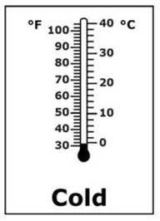
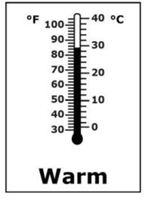
Supported Performance Task
Student Facing Page
Notes:
The prompt will only be presented one time.
If the student responds correctly, the student receives a score of 2.

Slide 49
Supported Performance Task
Student Facing Page
Notes:
If the student answers incorrectly, the test examiner scores a 1 and reads the script. Pick up the incorrect answer and place the correct one on the page.

Slide 50
Supported Performance Task
Student Facing Page
Notes:
Always end with the correct answer on the document.

Slide 51
Supported Performance Task
Student Facing Page
NR
Notes:
If the student does not answer, the test examiner places the correct answer and reads the script.

Slide 52
Supported Performance Task
Student Facing Page
Notes:
If the student does not answer, the test examiner places the correct answer and reads the script.

Slide 53
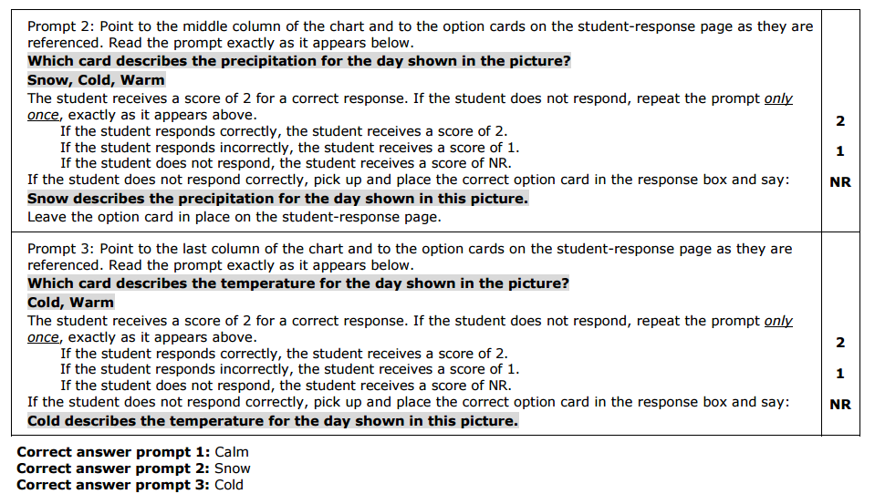
Supported Performance Task
Teacher Facing Page
Notes:
The same protocol is followed with the second prompt. Remember to leave the response card from the previous prompt on the student facing page.

Slide 54
Supported Performance Task
Student Facing Page

Slide 55
Supported Performance Task
Student Facing Page
Notes:
The student got the correct answer, so the Test Examiner scores a 2.

Slide 56
Supported Performance Task
Student Facing Page
Notes:
The student got the wrong answer, so the Test Examiner scores a 1 and reads the script.

Slide 57
Supported Performance Task
Student Facing Page
Notes:
Always end with the correct answers in the corresponding boxes.

Slide 58
Supported Performance Task
Student Facing Page
NR
Notes:
If the student does not answer, the test examiner places the correct answer and reads the script.

Slide 59
Supported Performance Task
Student Facing Page
Notes:
If the student does not answer, the test examiner places the correct answer and reads the script.

Slide 60
Supported Performance Task
Teacher Facing Page
Notes:
The same protocol is followed with the third prompt. Remember to leave the response card from the previous prompt on the student facing page.

Slide 61
Supported Performance Task
Student Facing Page

Slide 62
Supported Performance Task
Student Facing Page
Notes:
The student answered correctly so the Test Examiner scores a 2.

Slide 63
Supported Performance Task
Student Facing Page
Notes:
Present item and wait for a response.
If the student answers incorrectly they score a 1. The test examiner removes the incorrect card and places the correct answer in the box.

Slide 64
Supported Performance Task
Student Facing Page
Notes:
Always end with the correct answers in the corresponding boxes.

Slide 65
Supported Performance Task
Student Facing Page
NR
Notes:
If the student does not answer, the test examiner places the correct answer and reads the script.

Slide 66
Supported Performance Task
Student Facing Page
Notes:
Always end with the correct answers in the corresponding boxes.

Slide 67
Peer Practice

Slide 68
Wrap - Up

Slide 69
Notes for Training
Train-the-trainer model
Teachers must be trained on both ELA/Math and SC/SS annually
Teachers must have the opportunity to practice
Some teachers had difficulty with the scaffolds
Some teachers did not prepare materials before hand
Emphasize the need for school staff to support teachers during administration
Students are to test in a one-on-one environment
Remind staff to not enter room while testing

Slide 70
Notes for Training
DLM is only for ELA/Math
Do not roster a student to science
Will not receive a test through Educator Portal/KITE
Emphasize SC/SS is paper test
DLM ELA/Math is the alternate for 9,10, and 11
Do not test these students on PSAT/SAT
CoAlt Monitoring
Used for training purposed
Not intended as a “gotcha”

Slide 71
Score Entry
Test Examiners enter scores into PA^{next}
Score entry window closes Wednesday, May 2, 2018
DO NOT return any materials until you have verified that the student scores have been entered
Do not assign staff both TE and TA roles
TE role limits other functions
Can create separate accounts or DAC can complete score entry

Slide 72
Questions?

