Slide 1
ATTENTION
Please review slides before local use.
Update information in red font with local assessment administration policies.

Slide 2
Colorado Measures of Academic Success Test Administrator Training for Computer-based Testing
Spring 2019

Slide 3
Topics
CMAS Administration Overview
Testing Schedule
Administration Policies and Testing Security
Tasks to Complete Before Testing
Tasks to Complete During Testing
Tasks to Complete After Testing
Resources and Support

Slide 4
CMAS Administration Overview

Slide 5
Annual Training Requirement
Everyone involved in CMAS math, ELA, science, and social studies administration must be trained each year
Includes Assessment Coordinators, Test Administrators, Test Examiners, technology personnel, and any other school or district staff involved in administration
Assessment Coordinators are responsible for ensuring that all individuals involved in test administration and/or handling secure materials receive training and sign the CMAS and CoAlt Security Agreement

Slide 6
Acronyms
CBT – Computer-Based Testing
CDE – Colorado Department of Education - Assessment Unit
CMAS – Colorado Measures of Academic Success
CoAlt – Colorado Alternate
CSLA – Colorado Spanish Language Arts
DAC – District Assessment Coordinator
EL – English Learner
ELA – English Language Arts
PA^{next} - PearsonAccess^{next}
PBT – Paper-Based Testing
SAC – School Assessment Coordinator
S/SS – Science and Social Studies
TA – Test Administrator
TAM – Test Administrator Manual
TTS – Text-to-Speech
UAR – Unique Accommodation Request
UI – User Interface (in PA^{next})

Slide 7
Test Administrator Manual (TAM)
Information in this presentation is found in the Spring 2019 CMAS Computer-based Testing Test Administrator Manual
Security measures, administration policies, and procedures identified in the TAM must be maintained
Refer to checklists in TAM for before, during, and after testing tasks

Slide 8
Spring 2019 CMAS Window
Assessment | Grade(s) | Official State Window
CMAS and CoAlt: Social Studies | 4¹, 7¹ | April 8 - 26, 2019
CMAS and CoAlt: Science | 5, 8, 11
CMAS: Math and ELA (CSLA²) | 3-8
CoAlt: DLM ELA and Math | 3-11 | Aligned to CMAS: Math and ELA schedule
¹Grades 4 and 7 Social Studies are administered on a sampling basis
²CSLA is for eligible English learners in grades 3 and 4 only

Slide 9
Social Studies
Individual schools are sampled once in three years
2018-19 is Year 1 of the second social studies assessment cycle
Sampling plan priorities:
Reduce testing burden
Avoid creating cohorts of social studies students
Minimize the number of students who will test as 4th and 7th graders
Provide state level results that can be compared from administration to administration
See notification in Syncplicity for list of selected schools and grades

Slide 10
Overview of What’s New this Year
CMAS
In PearsonAccess^{next}, all content area assessments (i.e., math, ELA, science, and social studies) are listed under CMAS Spring 2019
Math
No advanced math options (Algebra I, Geometry, Integrated Math I or Integrated Math II)
All 7th grade students take CMAS Grade 7 Math
All 8th grade students take CMAS Grade 8 Math

Slide 11
Testing Schedule

Slide 12
Spring 2019 CMAS Window
Insert the selected district testing window information
All testing in all districts must end on or before April 26, 2019
Returning materials
All secure computer-based testing materials (nonscorable) must be shipped back to Pearson with a pick up by May 3, 2019
Districts need to create an internal return schedule to meet the May 3, 2019 deadline

Slide 13
Guidelines for Administration Time
Task | Time to be Allotted for an Administration
Prepare for testing (includes reading SAY directions script from TAM and answering student questions) | 10 minutes (recommended)
Distribute test materials | 5 minutes (recommended)
ELA/CSLA unit testing time Math unit testing time ES/MS Science/Social Studies unit testing time HS Science unit testing time | 90-110 minutes* 65 minutes 80 minutes 50 minutes
Complete end-of-unit activities, including closing units and collecting test materials | 5–15 minutes (recommended)
*Testing time depends on grade level/course — refer to Unit Testing Times and Testing Multiple Groups at http://www.cde.state.co.us/assessment/cmas_2019_unittimes_multgroups

Slide 14
Unit Testing Times: Grades 3-5
Assessment | # of Units | Section | Minutes
Math Grades 3-5 | Unit 1 | Non-calculator | 65
 | Unit 2 | Non-calculator | 65
 | Unit 3 | Non-calculator | 65
ELA Grades 3-5 | Unit 1 |  | 90
 | Unit 2 |  | 90
 | Unit 3 |  | 90
Social Studies Grade 4 | Unit 1 |  | 80
 | Unit 2 |  | 80
 | Unit 3 |  | 80
Science Grade 5 | Unit 1 |  | 80
 | Unit 2 |  | 80
 | Unit 3 |  | 80

Slide 15
Unit Testing Times: Grades 6-8 ELA, Science and Social Studies
Assessment | # of Units | Section | Minutes
ELA Grades 6-8 | Unit 1 |  | 110
 | Unit 2 |  | 110
 | Unit 3 |  | 110
Social Studies Grade 7 | Unit 1 |  | 80
 | Unit 2 |  | 80
 | Unit 3 |  | 80
Science Grade 8 | Unit 1 |  | 80
 | Unit 2 |  | 80
 | Unit 3 |  | 80

Slide 16
Unit Testing Times: Grades 6-8 Math
Assessment | # of Units | Section | Minutes
Math Grades 6-8 | Unit 1 | Non-calculator | 65
 |  | Calculator
 | Unit 2 | Calculator | 65
 | Unit 3 | Calculator | 65

Slide 17
Unit Testing Times: Grade 11
Assessment | # of Units | Section | Minutes
High School Science | Unit 1 |  | 50
 | Unit 2 |  | 50
 | Unit 3 |  | 50

Slide 18
Guidelines for Administration Time
Add the unit testing time to the start time to determine the stop time
Triple check this! Miscalculation of unit testing time will result in misadministration and invalidation or suppression of student test scores
Provide the entire amount of unit testing time
Once the unit testing time is met, the unit must end
A student may only be allowed an extended time accommodation if listed in his or her IEP, 504, or EL Plan
If all students complete testing before the unit testing time is met, the unit may be ended (no minimum testing time)
Test Administrators may not encourage students to finish any unit early
A student may be allowed an extended time accommodation only if listed in his or her IEP, 504 Plan, or EL Plan
Math and ELA: time-and-a-half is not included in unit testing time
Science and social studies: time-and-a-half is included in the unit testing time

Slide 19
Administration Policies and Test Security

Slide 20
Active Administration
Maintain standardization of the assessments:
Ensure students have all necessary materials for each unit
Ensure a standardized testing environment
Follow all directions and scripts exactly as written
Move throughout the room during testing
Re-read and clarify TAM “SAY” directions (general administration directions read aloud to all students from the TAM) to students when asked
Use proximity to keep students on task
Use “continue working” script from TAM for off-task students

Slide 21
Prohibited Activities
Test Administrators may not engage in activities that impact validity, reliability, or fairness of the tests:
Provide feedback or coach students
Clarify test questions
Read passages, sources, or test questions to students*
Answer content related questions
Interfere with the students’ demonstration of skills
Interact with students in any way that would impact student responses
Allow students to communicate with each other in any way, or use prohibited materials
Engage in other tasks during test sessions
Actively read or view assessment items or content before, during, or after testing*
Actively read, view, score (formally or informally), or comment on student responses*
Leave test materials unsecured
Discuss or disclose test content through verbal exchange, email, social media, or any form of communication
Download any part of the assessments*
*Except as part of specific accommodations

Slide 22
Guidelines for Breaks
Between units, scheduled breaks may occur
Students may not have access to cell phones during scheduled breaks
During units, short “stand-and-stretch” breaks may be permitted at the Test Administrator’s discretion
Time stops for the unit, but only for up to 3 minutes
If it is known when the 3 minute break will be taken, add the time into the timing box at the beginning
Restroom breaks during testing do not stop the clock
Activity | Time
Unit 1 | 8:00 a.m. – 10:00 a.m.
Scheduled Break | 10:00 a.m. – 10:15 a.m.
Unit 2 | 10:15 a.m. – 12:15 p.m.

Slide 23
Make-Up Testing
Students who are absent, become ill, or who can no longer test because of classroom or school interruptions during originally scheduled units participate in make-up testing
Students are not allowed to return to any completed portion of a unit
Test security and administration protocols apply
All units for all content areas must be administered in sequential order, including for make-up testing
NOTE: It is a misadministration to administer units out of order.

Slide 24
Guidelines for Administration
After students finish each unit, individual students are to…
Sit quietly?
Leave and go to a location outside of the testing environment?
Read? (cannot use any electronic reading devices)
Will there be a minimum time set for the testing environment?
What are TAs to do when all students have completed a unit?
School Site Considerations if releasing students to an outside location:
Where will they go?
To whom will students be released?

Slide 25
Guidelines for Administration
Optional Text in “SAY” Directions
Read the following script option regarding allowable activities if students finish early (Identify which of these options the district will allow)
Scratch paper option in ELA, science, and social studies “SAY” directions
Option A Students are to sit quietly when they are done testing.
Option B Students will be dismissed when they are done testing.
Option C Students may read when they are done testing.
If no scratch paper is to be provided, | Skip ahead to the “SAY” directions that appear after this option box.
If scratch paper is to be provided, | SAY If you would prefer to use scratch paper for taking notes, raise your hand. Distribute blank scratch paper, as requested…

Slide 26
Administrative Considerations
Changes to the conditions of testing that may benefit a student
Available to any student as long as test security is not compromised and test environment requirements are met
Available Administrative Considerations:
Adaptive and specialized equipment or furniture
Frequent breaks (do not stop the clock)
Noise buffers/headphones
Small group testing
Specified, separate, or alternate area or seating
Time of day

Slide 27
Emergency Accommodation
A case where a student needs a new accommodation immediately due to unforeseen circumstances
Cases could include students who have a recently-fractured limb (e.g., arm, wrist, or shoulder); whose only pair of eyeglasses have broken; or a student returning from a serious or prolonged illness or injury
Contact the SAC so the Emergency Accommodation form can be completed and the appropriate steps can be taken to provide the accommodation

Slide 28
CSLA Accommodated Form
Colorado Spanish Language Arts (CSLA) is a paper/pencil language arts accommodated form
Available for eligible 3rd and 4th grade students who are English learners
Administered in place of ELA
These students take the math assessment in Spanish
4th graders at schools selected for social studies take the social studies assessment in Spanish

Slide 29
Accommodations and Accessibility Features
If administering the following accessibility features or accommodations, ensure training is received this school year:
Auditory Presentation (Oral Script and Text-to-Speech)
ELA - unique accommodation requiring a CDE-approved UAR
Oral script for signed presentation only
English Text-to-Speech
Math, science, and social studies
English Text-to-Speech
Spanish Text-to-Speech
Oral script only for translation into a language other than English or Spanish, including signed presentation
Scribe
ELA constructed response – unique accommodation requiring a CDE-approved UAR
ELA selected response - accommodation
Math, science, and social studies – accommodation

Slide 30
Technology for Medical Monitoring
Students who use a phone, tablet, or other device to monitor a medical condition may have the device in the testing room
Documentation of medical necessity must be kept at the school and district
Follow the district’s plan for use of these devices:
Where the device is located and who has control of the device
If the student has control, the device must be visible at all times and may not be used for any other purpose
Procedures for if/when the device alerts and what action is necessary
If student has to leave the testing environment, follow procedures for students who become ill

Slide 31
Chain of Custody
Document any movement of secure materials before, during, and after testing
Sign/complete the chain-of-custody form when checking materials out/in
Receive materials (e.g., scratch paper, oral script for translation, Student Testing Tickets) from SAC only on the day of testing
Receive only the content area and grade level being assessed at that time
At the end of the testing session, return all materials to the designated secure location
Materials must not be stored in classrooms

Slide 32
Maintaining Security of the Assessments
All test materials must be secured while in the Test Administrator’s possession
No duplication of secure materials is permissible
No cell phones or other communication, reproduction or recording devices are allowed during test sessions unless required for accessibility
Students should be aware that cell phones or other electronic devices are prohibited. Students who are found with electronic devices in their possession during testing (including if they have finished testing but other students have not) or during a break may lead to the invalidation of not only their test, but to the invalidation of others’ tests as well.
All individuals are strictly prohibited from taking photos of TestNav screens and all secure test materials

Slide 33
Test Materials Security
CBT Secure
Non-Secure
Student Testing Tickets
Rosters printed from PA^{next} with student information
Oral scripts
Used scratch paper
Any student work/responses (e.g., printed from AT device)
Printed math reference sheets just prior to testing
If written on, cannot be reused
Test Administrator Manuals (TAM)
Procedures Manual
Unused scratch paper
Math reference sheets if not written on

Slide 34
Headphones
Required for use with text-to-speech forms
To be in a testing room with other students, headphones must be worn
Students must be tested separately if they are unable to wear headphones
Available for use as noise buffers
Note: CMAS assessments do not contain audio unless TTS is used

Slide 35
Testing Different Grades Together
If the unit testing time and directions are the same, different grades can be administered in the same room
A separate testing environment is needed for:
PBT and CBT (administration SAY directions and materials are different)
ELA and math (unit testing times and SAY directions are different)
Directions read aloud in a language other than English
English tests and Spanish accommodated forms
Science/social studies and ELA/math (testing times and SAY directions are different)
PBT science and social studies (materials and SAY directions are different)
High school science/social studies and elementary/middle school science/social studies (different unit times)
Math grades 3-5 and math grades 6-8 (different SAY directions)
Math grades 6-8 unit 1 and math grades 6-8 units 2 and 3 (different SAY directions)
http://www.cde.state.co.us/assessment/cmas_2019_unittimes_multgroups

Slide 36
Room Configuration
Students should not be able to see each other’s work from a normal testing position
Consider the following seating configurations to maintain test security:
Seat students in every other seat (useful in a computer lab setup)
Arrange monitors back-to-back
Seat students back-to-back
Seat students in a semicircle (useful for schools using laptops)
Seat students in widely spaced rows or in every other row (appropriate for a classroom setup)
Dividing screens or other privacy materials may be used if students cannot be placed far enough away from each other

Slide 37
Test Environment
The testing environment must:
Be adequately lit, quiet, free of distractions, and heated or cooled
Provide an adequate writing surface (paper-based)
Be free of electronic devices and music
“Do Not Disturb/Only Authorized Personnel Allowed” sign must be placed on the door during test sessions
Display unit testing time for students:
Unit Name: | Grade 8 Science, Unit 1
Unit Testing Time: | 80 Minutes
Start Time: | 9:00
Stop Time: | 10:20
Note: Triple check unit testing time and stop time calculation

Slide 38
Test Environment
Prohibited Materials
All cell phones
Exception: TA may have a cell phone for emergency use ONLY, but the ringer must be turned off
Exception: Student medical monitoring devices
Electronic devices including, but not limited to:
E-readers
Personal document scanners
Electronic pens
Smartwatches
iPods, MP3 players, or other music players
Instructional aids relevant to content being assessed
Reference books (exception: word-to-word dictionaries for EL)
No food or drinks are allowed on desks or near test materials

Slide 39
Test Environment
The testing environment must be free of any content related posters or aids that may suggest possible answers to students
Posters that do not include content specific definitions, content related processes, or solutions may remain on the wall
Prohibited visual aids in the test environment must be removed or covered
Number lines
Word walls
Steps for solving math equations
Maps
Charts
Models
Any content related materials
Any resource that defines, explains, or illustrates terminology or concepts
General Rule: When in doubt, cover it.

Slide 40
Student-to-Test Administrator Ratio
Student-to-Test Administrator ratio must not exceed 30 to 1
Test Administrator must be able to actively monitor the space within the physical testing environment
Consider room configuration
Make special considerations for large testing environments or environments with complicated configurations
Test Administrators must:
Actively proctor
Remain attentive and in the room during the entire testing unit
Circulate throughout the room during the test
Should be able to see students working, not student work

Slide 41
Unauthorized Visitors and the Media
Only students, Test Administrators/Examiners, and authorized school, district, state personnel, or state-sanctioned test monitors may be in testing areas during administration
Media are not allowed to have access to the tests before, during, or after test administration, or take pictures or video of testing materials or testing students
Parents are not allowed in the testing room with their child

Slide 42
Security Breaches
Reporting Testing Irregularities and Security Breaches:
All instances of testing irregularities and security breaches must be immediately reported to the SAC, and subsequently, the DAC
Should a testing irregularity or security breach occur, be prepared to provide a written statement of the incident to the SAC

Slide 43
Safety Threats and Severe Weather
Know the Plan for Safety Threats and Severe Weather:
Note the time of the disruption and time remaining in unit
Secure test materials as specified in the School Security Plan
Upon return, prepare students for the continuation of the unit and resume tests
Document the situation in writing (report a testing irregularity or security breach to the SAC)

Slide 44
Before Testing

Slide 45
Student Readiness
Student practice resources are available
ePATs for computer-based testing
Walk through all item types
ePAT Guides include script for adult as well as scoring information such as rubrics and sample student responses
During testing, Test Administrators cannot help students with TestNav navigation
May not help with how to answer a question
May not show how to go to the next question or use the review screen
May not assist with drag and drop or other technology enhanced items
Strongly recommend students are provided with access to practice resources prior to testing
Includes forms with accessibility features and accommodations

Slide 46
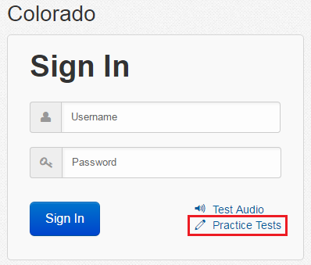
Student Readiness
Computer-based practice resources can be accessed through:
TestNav App
Navigate to “Colorado” sign in page and click “Practice Tests” link
PAnext Training Center
Requires login from student testing ticket
Secure practice sessions must be setup in advance
On TestNav Home Screen, click:

Slide 47
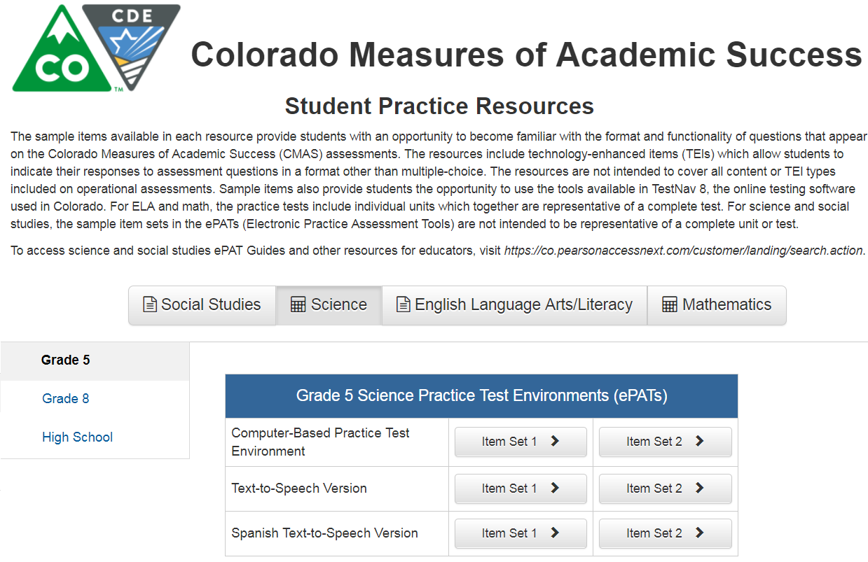
Student Readiness

Slide 48
Accommodations and Accessibility Features
To prepare for providing accommodations:
Administer the accommodated student practice resources to students
https://co.pearsonaccessnext.com/ > Student Resources
Review resources at http://www.cde.state.co.us/assessment/trainings:
Section 6.0 in the Spring 2019 CMAS and CoAlt Procedures Manual
CMAS Accessibility Features and Accommodations Trainings
Auditory presentation: oral scripts – supervised early access to script for rehearsal, if applicable
Confirm students with accommodations are testing in an appropriate environment
On the “Students in Session” screen in PA^{next}, confirm that the student has the correct form marker displayed on the screen (e.g., TTS, SPAwTTS, AT)

Slide 49
Form Assignment Markers in PAnext
A marker appears next to a SASID on Students in Session screen if a form-dependent accommodation/accessibility feature was identified for the student on the Manage Student Tests screen or through an SR/PNP import
Indicator | Accommodation/ Accessibility Feature
 | Text-to-Speech
 | Spanish or Spanish with Text-to-Speech (Math, Science, and Social Studies)
 | Assistive Technology (Math and ELA)
Notes:
These are independent forms that cannot be combined
All Spanish forms automatically include TTS – student does not have to use TTS tools if TTS is not needed
Assistive Technology form only available for math and ELA

Slide 50
Test Administrator Access to Materials
TA access to test materials is only available on the day of testing
Check materials out using school chain-of-custody form
Administer assessment
Check materials in using school chain-of-custody form
There are early access exceptions for some accommodations
See accommodations training information
Secure test materials must:
Not be removed from the school’s campus
Never be left unattended
Be secure while in the TA’s possession

Slide 51
Tasks to Complete Before Testing
At least one week before testing:
Review the Test Administrator Manual and attend training to understand policies and instructions for the spring 2019 test administration
Sign the CMAS and CoAlt Security Agreement form
Prepare to administer accommodated tests, if necessary
Ensure PA^{next} can be accessed
Optional: Administer the computer-based testing student resources (ePATs)

Slide 52
Tasks to Complete Before Testing
One day before testing:
Prepare the testing environment
Ensure the spring 2019 administration instructions (TAM) are available
Know what, when, and where testing will take place
Arrange for school-supplied materials (e.g., scratch paper, calculators)

Slide 53
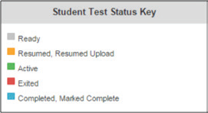
Session Management in PearsonAccess^{next}
Overview of Managing and Monitoring Test Sessions in PA^{next}
Log into PA^{next}
Start test sessions
Unlock/lock unit
Students log in to TestNav
Understand the testing status indicators
Manage test interruptions and Resume student tests, as needed
Verify units are in Completed status
Stop test sessions only after all units are completed
Information on how to complete these activities is found in the PA^{next} Training Modules
http://avocet.pearson.com/CO/Home
https://support.assessment.pearson.com/display/PAsup/PearsonAccess+Next+Online+Support

Slide 54
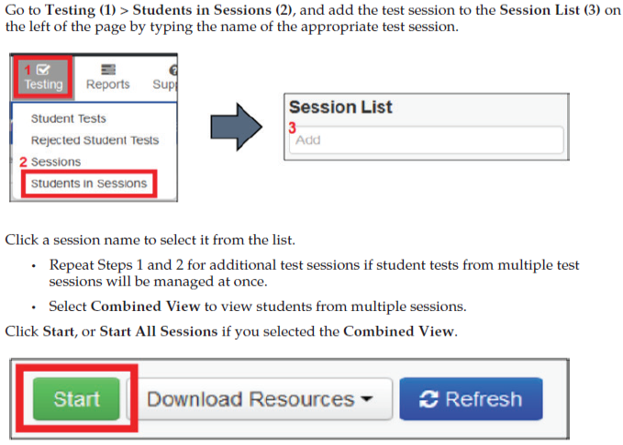
Starting Test Sessions
Start Test Session in PA^{next}
If the Start button is not available, contact the SAC to have the test session Prepared (only SACs and DACs can prepare test sessions)

Slide 55
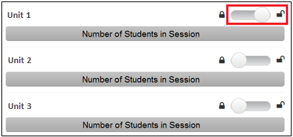
Unlocking Test Units
At the session level in PA^{next}, unlock the unit that is to be tested before reading the “SAY” directions
At the student level, lock ($$) the unit for any absent students
At the student level, unlock () appropriate test units for any make-up students
Only one unit can be unlocked at one time for a student
Students who are taking make-up units can be unlocked individually
Units must be administered in sequential order – out of order testing is a misadministration

Slide 56
During Testing

Slide 57
Maintain Test Security
Administer test sessions properly and securely according to protocol
Refer to training and TAM
Administer all tests
Focus full attention on the testing environment at all times during testing
Ensure students do not participate in any form of cheating
Do not provide students with assistance that could impact answers
Follow proper test security procedures for providing accessibility features or accommodations
Follow chain-of-custody requirements to return all test materials after testing

Slide 58
Tasks to Complete the Day of Testing
On the Day of Testing:
Receive test materials
Headphones required for students using TTS
Manage test sessions in PA^{next}
Read the appropriate “SAY” directions from the TAM
Distribute test materials to students
Help students log in to TestNav
Keep/monitor time
Supervise and monitor test activity
Provide three minute stand and stretch break, if applicable
Report testing irregularities or security breaches to SAC
NEW!
The following icon appears in the “SAY” directions when the materials are to be distributed:

Slide 59
Supported Apps
The following TestNav apps can be used for testing:
Desktop
Chromebook
iPad
Browser-based testing is not supported.

Slide 60
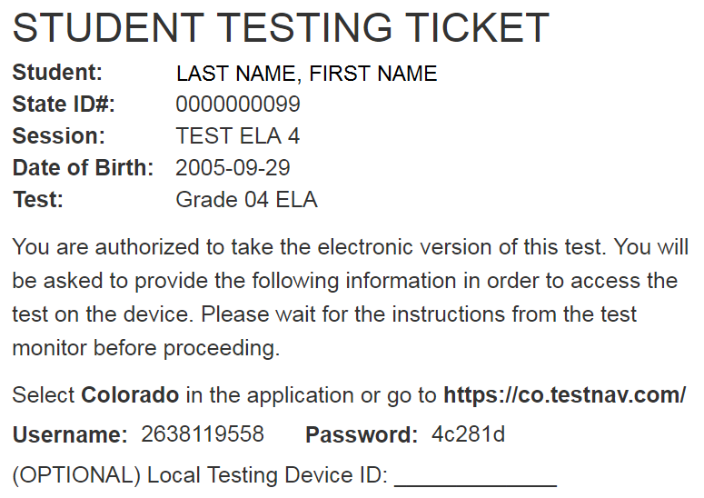
Identify Student Testing Device on Student Testing Ticket
Strongly suggest identifying the device on which the student tests. Use the same device each day of testing for a content area. For example, the student tests all ELA units on device #11, but math could be taken on a different device.

Slide 61
Interruptions During Testing
If there is an interruption to testing, including if a student becomes ill, the student should:
Select the button next to his or her name displayed in the top right corner of the screen
Choose the option Sign out of TestNav; then select Save and Return Later on the Exit Test screen
The test will close on the student’s device and the student will be listed in Exited status on the Students in Sessions screen
A Test Administrator must Resume the student’s test before the student can continue with the same test
If a student exits TestNav (either unintentionally or intentionally) before completing a test unit:
Verify TestNav shut down on the student’s device
Resume the student’s test in PAnext
The student’s test will resume from the point at which the test was interrupted
The system will upload any test responses that the student entered after the interruption if resumed on the same testing device

Slide 62
Interruptions During Testing
To resume* units in PA^{next}, take the following steps on the TA’s device
From the Students in Session screen, use one of two options:
Resume a small number of students:
Select the drop-down arrow next to the student’s unit status; select Resume or Resume Upload.
If TestNav is shut down on the student device and the unit status is:
Exited, select Resume
Active, select Resume Upload
Resume several student tests at the same time:
Select the checkbox next to the student(s) whose unit status needs to be updated
Open the task list, select Resume Student Tests, and click Start
Select the checkbox next to the unit that is to be resumed for the student(s); click Resume
*A unit cannot be resumed if it is Resumed, Marked Complete, or Completed
NOTE: Units only go into Completed status if the student selects the green Yes, Submit Final Answers button on the Test Submit Warning screen. Units will not be unsubmitted for students who take this action prematurely.

Slide 63
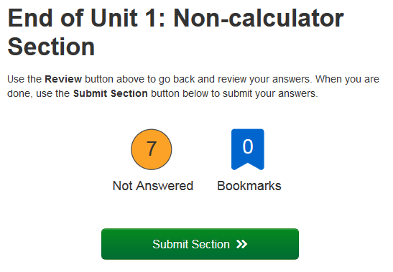
Math Units with Two Sections
This icon appears by calculator references in the “SAY” directions.
Unit 1 for Math Grades 6, 7, and 8 contains two sections:
Unit 1 Section 1 = non-calculator
Unit 1 Section 2 = calculator
Both sections must be completed during Unit 1 testing time
Math Grades 6-8 - 65 minute unit testing time
When 20 minutes remain in the unit, there is a reminder in the “SAY” directions
If requested, distribute calculators after students submit the first section
Multi-section units only:
At the end of the first section, the following screen appears:
TAs may look at this screen and tell the student to submit this section to continue into the Calculator section of this unit
The second End of Unit screen reads End of Unit 1: Calculator Section - students submit final answers from this screen

Slide 64
Student Submits Test
Once a student goes through the multi-step process to submit their answers for a unit, that unit is complete and will not be re-opened.
Steps that must be taken to move a unit into Completed status:
Use navigation arrows through the last question or select the Review button and scroll to the bottom of the drop-down menu and select the End of Section option
Select Submit Final Answers on the End of Section screen
Confirm Yes, Submit Final Answers on the Test Submit Warning screen
A message appears on the screen: Sign out complete. Thank you for using TestNav.
Units only go into Completed status if the student selects the green Yes, Submit Final Answers button on the Test Submit Warning screen.

Slide 65
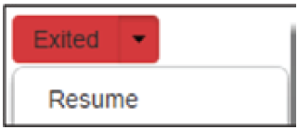
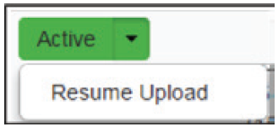
Verify Answers are Submitted
At the end of each unit, verify in PA^{next} that all students who just completed testing show a unit status of Completed in the unit column on the Students in Session screen
If any students are in Exited status, they did not submit their final answers before signing out of TestNav
Resume the student’s test through Panext
Have the student use their Student Testing Ticket to sign in to TestNav on the same device they used to test
The student should then go through the proper steps to submit their final answers
Confirm that the student’s unit status changes to Completed in PA^{next}
If any students are in Active status, but are no longer signed in to TestNav, they are not properly logged out of the test (e.g., the computer froze or the browser crashed during testing or while the student was submitting their answers)
Select Resume Upload, then follow the previous steps

Slide 66
Lock Unit at the End of Each Testing Session
Lock the tested unit at the session level
The unit status for students who just completed testing should now be locked and Completed
The unit status for students who were absent should be locked and Ready
Sign out of PA^{next}
Do not stop the test session in PA^{next} until all units are completed by all students
Collect Student Testing Tickets, any accommodated test materials, and used scratch paper and place in an unsealed secure return envelope
Return the secure return envelope to the SAC
Document the return of all secure test materials (used and unused) on the school’s chain of custody form

Slide 67
Troubleshooting Guidance
When a technology disruption affecting a single student occurs, Test Administrators take the following steps:
Note the time of the disruption
Follow procedures for troubleshooting and support
If the issue persists, move the student to another testing device
Document the situation in writing
When a technology disruption affecting multiple students occurs, Test Administrators take the following steps:
Pause testing
Note the time of the disruption
Follow procedures for troubleshooting and support
Resume testing
Document the situation in writing

Slide 68
Troubleshooting Resources
Test Administrator Manual
2.4.2 Stops in Testing
Appendix D: TestNav 8 Error Codes and Resolutions
TestNav 8 Online Support Guide
Troubleshooting - https://support.assessment.pearson.com/x/UQUqAQ
Error Codes - https://support.assessment.pearson.com/display/TN/Error+Codes

Slide 69
Issues with Individual Items
If a student reports that an item is not functioning or does not have an answer:
DO NOT read the item
For items not displaying properly, instruct the student to go to the next item and then return to the item
Note:
Content area
Grade level
Form number
Unit number
Item number
Test format
Provide information to the SAC
Wording from the test must NEVER be included verbally or in writing
The SAC will contact the DAC and Pearson

Slide 70
After Testing

Slide 71
Tasks to Complete after Testing
After each unit has been administered:
Ensure all materials are returned to the SAC
Test Administrator Manual
Student Testing Tickets
School-supplied mathematics reference sheets
Calculators (if applicable)
Used and unused scratch paper
Headphones
Report any testing irregularities or security breaches to SAC, including missing materials
After all units are completed, stop test sessions in PA^{next}

Slide 72
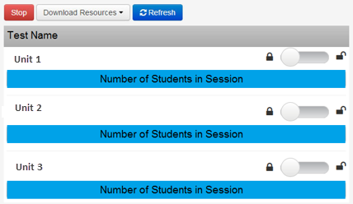
Stop Test Session after Last Unit
Once all students are in Completed or Marked Complete status for all units, the test session should be stopped
If any units for any students need to be Marked Complete, inform the SAC. A reason for marking complete must be provided to the SAC; however, this does not invalidate a test.

Slide 73
Resources and Support

Slide 74
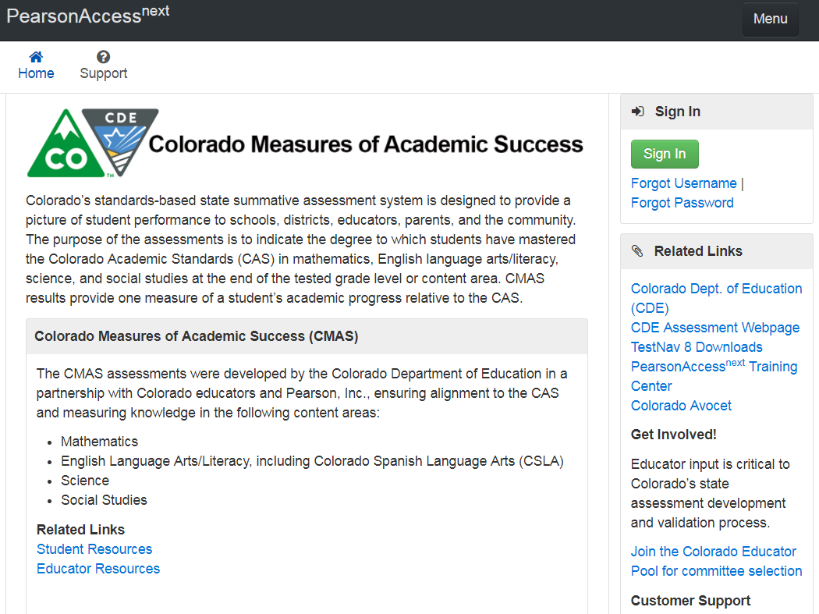
PearsonAccess^{next} Landing Page
https://co.pearsonaccessnext.com
Resources for all CMAS content areas
Includes links to:
Student Resources
(practice tests)
Educator Resources
Avocet - online index
for assessment manuals
and materials
Customer Service
Contact Information

Slide 75
Customer Support
Contact Support for assistance with:
Navigating PearsonAccess^{next}
Navigating the Training Center
Setting up test sessions
Managing test sessions
Troubleshooting error codes
Accessing resources
Managing user IDs and passwords
CMAS Support
Call Toll Free: 1-888-687-4759
Monday – Friday
7:00 am - 6:00 pm (MST)
https://co.pearsonaccessnext.com > Contact COLORADO Support
Chat is available

Slide 76
Communication
If an issue is experienced and guidance and support are needed, go through the proper channels (including when students submit final answers prematurely)
Test Administrator contacts School Assessment Coordinator (SAC)
SAC contacts District Assessment Coordinator (DAC)
DAC contacts CDE
NOTE: Submitted units will not be re-opened as students have to go through multiple steps and confirmations before their status changes to Completed.

Slide 77
Security Agreement Form
Sign the Security Agreement form for
Spring 2019 CMAS and CoAlt: Math, ELA, Science and Social Studies
http://www.cde.state.co.us/assessment/cmas_coalt_2019_secagree
Return the signed form to the SAC.

Slide 78
Get Involved!
Educator input is critical to Colorado's state assessment development and validation process
Educators may participate in committees related to the following state assessments:
CMAS: Science, Social Studies, Mathematics and English Language Arts/Literacy (ELA)
Colorado Spanish Language Arts (CSLA)
CoAlt: Science and Social Studies
Join the Colorado Educator Pool for assessment development committee selection at https://pearson.cvent.com/COEducatorDatabase

Slide 79
Thank you!

