Slide 1
Spring 2019 CMAS Administration Training for DACs
Science, Social Studies, Math & ELA including CSLA
October and November 2018

Slide 2
Good Morning
The PearsonAccess^{next} Training Center will be used for demonstrations
Please log in to confirm access so you can follow along
http://trng-co.pearsonaccessnext.com
If your account credentials do not work or you need assistance, please notify Pearson or CDE staff before the training begins

Slide 3
Welcome & Agenda
General Info & Call-drivers
Timeline & Assessment Structure
PearsonAccess^{next}
Before Testing
Registering Students, Ordering Materials & Setting Up PAnext Test Sessions
Technology Overview
Administrative Considerations, Accessibility Features & Accommodations
Testing Environment
Receiving Materials & Test Security
During Testing
Administering Tests
Basic Technical Troubleshooting
Make-up Testing
After Testing
Returning Materials
PAnext Clean-up
Additional Information
Resources & Support

Slide 4
General Information

Slide 5
Handouts
Handout
CMAS Overview
Technology Overview
Before Testing Checklist
Unit Testing Times and Testing Multiple Groups Guidance
Assessment Acronyms
Creating Sample Students in the PAnext Training Center
Forms
CMAS and CoAlt Security Agreement
DAC - sign and return during this training
Verification of District Training
Post Test Compliance

Slide 6
Assessment Acronyms*
Handout
AO: Additional Order
CBT: Computer-Based Test
CMAS: Colorado Measures of Academic Success
CoAlt: Colorado Alternate
CSLA: Colorado Spanish Language Arts
DAC: District Assessment Coordinator
DTC: District Technology Coordinator
EL: English Learner
ELA: English Language Arts/Literacy
ET: Extended Time
HS: High School
PAnext: PearsonAccess^{next}
PBT: Paper-Based Test
PII: Personally Identifiable Information
SAC: School Assessment Coordinator
SR/PNP: Student Registration/ Personal Needs Profile
S/SS: Science and Social Studies
SWD: Students with Disabilities
TAM: Test Administrator Manual
TTS: Text-to-Speech
UAR: Unique Accommodation Request
UI: User Interface
*See handout for additional acronyms and definitions

Slide 7
Overview of What’s New this Year
CMAS Math, ELA, Science, and Social Studies
Listed as CMAS Spring 2019 in PearsonAccess^{next}
One SR/PNP for all CMAS (CoAlt is still separate)
All CMAS content area materials returned together after testing, including CSLA
Math
No advanced math options (Algebra I, Geometry, Integrated Math I or Integrated Math II)

Slide 8
Paper-based Testing §22-7-1013(6), §22-7-1006.3(1)(d-e)
Each LEP must adopt and implement a written policy by which it decides whether to request the paper form of the state assessments for its students
Decision must be made in consultation with schools and parents
Copy of policy must be shared with parents and posted on LEP website
LEP may make the decision by school or class (i.e., grade level and content area)
LEP will report to CDE the number of students who will take the paper form (indicated prior to initial order deadline)
Considerations
Technology capacity
Logistics
Must have the grade appropriate calculators for math (grades 6-8)
Paper form always available to individual students as an accommodation
Online form is also available as an accommodation
Must commit to meeting security requirements and accounting for all secure materials
Chain-of-custody documentation and reports for missing materials

Slide 9
Assessment Information and Calendar §22-7-1013(7)(a)
LEP will annually distribute to parents and post on its website, as early in the school year as possible, written information regarding its assessments, including:
The state and local assessments that the LEP will administer
Identify whether it is required by federal law, required by state law or selected by the LEP
Assessment calendar:
Estimated hours of testing each testing day for specific classes/grades for each assessment
Identify whether the assessment is required by state law, federal law or locally selected
The purposes of the assessments
The manner in which assessment results will be used

Slide 10
Parent Excusals §22-7-1013(8)(a-c)
A student’s parent may excuse the student from participating in a state assessment
Each LEP will adopt and implement a written policy and procedure by which a student’s parent may excuse the student from participating in one or more of the state assessments.
If a parent excuses his or her student, the LEP shall not impose negative consequence on the student or parent including:
Prohibiting school attendance; imposing an unexcused absence; or prohibiting participation in extracurricular activities.
NEW: Prohibiting the student from participating in an activity, or receiving any other form of reward that the LEP provides to students who participate in the state assessment.
LEP shall not impose an unreasonable burden or requirement on a student that would:
Discourage the student from taking a state assessment or
Encourage the student’s parent to excuse the student from taking the state assessment.

Slide 11
Personally Identifiable Information (PII)
State and Federal laws require student PII to be protected
PII is any information that, alone or in combination, could identify an individual student (e.g., name, SASID, detailed demographics)
Emails can be intercepted, forwarded, and misrouted and are not secure methods for transmitting PII
It is CDE policy that any email with PII sent to, from, and within CDE must be encrypted
CDE strongly recommends that you encrypt emails with PII that are sent to other parties (other districts, within the district, vendors, etc.)
Additional Resources: http://www.cde.state.co.us/dataprivacyandsecurity

Slide 12
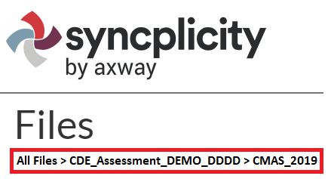
Syncplicity
Use Syncplicity to transfer secure information and PII to CDE
User Guide available at http://www.cde.state.co.us/assessment/ausyncug
All documents from previous years were removed and archived externally by CDE
Folder structure for 2018-19
Ensure documents are placed in correct folders
Provide notice of uploaded files to the appropriate contact at CDE
Email file path and include the file name
Recommended: Discontinue use of the Syncplicity desktop app – use the browser version (unsync local devices from the desktop app)
Files loaded through the browser are shared/updated faster than those loaded through the desktop app
Continuous syncing of desktop app devices sometimes causes reappearance of old documents and duplication of folders

Slide 13
Top Call-drivers 2018

Slide 14
Top Call-drivers 2018
Top Customer Service call-drivers from the spring 2018 administration
Students testing on paper who continued testing into the next unit early
Student who wasn’t assigned TTS but it’s in his/her IEP/504
Where is speech-to-text indicated?
Error assigning TTS form and AT form together
PAnext password reset
Returning paper materials early
Requests for return materials
Can materials from multiple schools be shipped back in the same box?

Slide 15
Timeline & Assessment Structure

Slide 16
Spring 2019 CMAS Window
Assessment | Grade(s) | Official Window
CMAS and CoAlt: Social Studies | 4¹, 7¹, 11¹ | April 8 - 26, 2019
CMAS and CoAlt: Science | 5, 8, 11²
CMAS: Math and ELA (CSLA³) | 3-8²
CoAlt: DLM ELA and Math | 3-11 | Aligned to CMAS: Math and ELA schedule
¹Grades 4, 7, and 11 Social Studies are administered on a sampling basis
²See following slides for early window options
³CSLA is for eligible English learners in grades 3 and 4 only

Slide 17
Spring 2019 CMAS Window
Official window: April 8 – 26, 2019
All elementary and middle school science and social studies administrations must be completed within this window
All school-wide paper-based administrations for math and ELA must be completed within this window
Students requiring paper accommodations in schools utilizing the extended online window options may test at the same time as their peers (this includes CSLA)

Slide 18
CMAS Early Window Options
Handout
Math and ELA
To compensate for technology capacity, the math and ELA window can open early for online administrations only
Earliest start date for online math and ELA: March 18, 2019
This is an extended window – total of 5 testing weeks
High school science and social studies
To accommodate high school assessment schedules including SAT, AP, and IB exams, the high school window can open and close early
Early window options for high school:
March 25 – April 12, 2019
April 1 – 19, 2019
This is an early window – total of 3 testing weeks
Notify CDE of intent to participate in early windows by December 15

Slide 19
Spring 2019 Critical Dates – Tentative
Activity | Extended Math and ELA (CBT) | Early High School S/SS | Elementary/Middle School S/SS and Math/ELA (PBT)
Submit updates through UI or SR/PNP for initial orders | January 7 – 25
Online test session set-up begins | February 1
Materials scheduled to arrive in districts* | March 4 Student materials, student ID labels (accommodations only) | March 4 Student materials, student ID labels | March 25 Student materials, student ID labels
Proctor caching test content begins | March 4 | March 4 | March 25
Prepare Test Sessions | March 15 | March 22 | April 5
* Materials will arrive in two waves based on selected district testing windows - Assessment Coordinator Kits and TAMs will be sent in Wave 1 (March 4)

Slide 20
Spring 2019 Critical Dates – Tentative
Activity | Extended Math and ELA (CBT) | Early High School Science | Elementary/Middle School S/SS and Math/ELA (PBT)
Additional Orders – Secure Materials | March 5* – April 23 |  | March 26* – April 23
Additional Orders – Non-secure Materials | March 5* – April 30
Deadline for UPS scorable pickups** | May 1 Schedule pickup by April 30
Deadline for UPS nonscorable pickups | May 3 Schedule pickup by May 2
*Additional orders placed prior to receiving Wave 1 materials will not be reviewed or approved (i.e., if only the regular window will be used, do not place additional orders until March 26).
**If scorable materials are not picked up by May 1, 2019 there is no guarantee that records for these PBT students will be included in SBD or scored.

Slide 21
Spring 2019 Critical Dates – Tentative
Description | Post Testing Clean-up Tasks | Window Dates
Initial PAnext Clean-up (School and District) | Confirm Student Registrations Update Used Accommodations Mark Complete Units* Stop Sessions Indicate Not Test and Void Test Score Reasons/Codes Resolve Rejected Student Tests | Prior to May 10
Final PAnext Clean-up (District) | Demographics and invalidations cleaned in PAnext | May 13 – 15
Student Biographical Data (SBD) Review** (District) | Demographics and invalidations cleaned in CDE’s Data Pipeline | May 20 – 30
*Marked Complete Reasons are for local purposes only and DO NOT invalidate tests. Not Tested and Void Test Score Reasons/Codes must be indicated separately.
**If scorable materials are not picked up by May 1, 2019 there is no guarantee that records for these PBT students will be included in SBD or scored.

Slide 22
Social Studies
Individual schools are sampled once in three years
2018-19 is Year 1 of the second social studies assessment cycle
Sampling plan priorities:
Reduce testing burden
Avoid creating cohorts of social studies students
Minimize the number of students who will test as 4th and 7th graders
Provide state level results that can be compared from administration to administration
Notification emailed to DACs
List posted in CDE Assessment Syncplicity > CMAS_2019

Slide 23
Colorado Spanish Language Arts (CSLA)
Qualifying students
English Learners (NEP, LEP)
Grades 3 and 4
Language arts instruction in Spanish within the past 9 months
Students in an English language development program for less than five years
Eligibility flowchart http://www.cde.state.co.us/assessment/cmas_spaassessflowchart_18-19
CSLA is a paper-based accommodated version of ELA
Follows the design, guidelines, and scheduling of ELA
Assign Test Code SLA03 or SLA04 instead of ELA03 or ELA04
Because CSLA is an EL accommodation, other EL accommodations are not allowed on CSLA
Connect with the district’s EL coordinator

Slide 24
First Year in US English Learners – ELA Only
Districts determine whether to administer the CMAS ELA assessment to their ELs who enrolled in a US school for the first time on or after April 10, 2018 (first year in the US) based on the following guidance:
Students who are NEP, based on WIDA Screener and a local body of evidence, are exempt from the ELA assessment
3rd and 4th grade NEP students whose native language is Spanish and who have received language arts instruction in Spanish during the current school year are required to take CSLA
Students identified as NEP whose native language is not Spanish, or whose native language is Spanish but who have not received Spanish language arts instruction in the current school year, are exempt
A parent/guardian of a student who meets exemption guidelines may choose to have their child participate in ELA testing. Results for these students will be included in accountability and growth calculations for the following year.
Students who are LEP, based on WIDA Screener and a local body of evidence, must take the state language arts assessment that best matches their instruction: CMAS ELA, CSLA (if eligible), or CoAlt (if eligible)

Slide 25
Guidelines for Administration Time
Task | Time to be Allotted for an Administration
Prepare for testing (includes reading SAY directions script from TAM and answering student questions) | 10 minutes (recommended)
Distribute test materials | 5 minutes (recommended)
ELA/CSLA unit testing time Math unit testing time ES/MS Science/Social Studies unit testing time HS Science/Social Studies unit testing time | 90-110 minutes* 65 minutes 80 minutes 50 minutes
Complete end-of-unit activities, including closing units and collecting test materials | 5–15 minutes (recommended)
*Testing time depends on grade level/course — refer to Unit Testing Times and Testing Multiple Groups handout

Slide 26
Guidelines for Administration Time
Schedule the entire amount of unit testing time
Once the unit testing time is met, the unit must end
A student may only be allowed an extended time accommodation if listed in his or her IEP, 504, or EL plan
If all students complete testing before the unit testing time is met, the unit may be ended (no minimum testing time)

Slide 27
Unit Testing Times: Grades 3-5
Handout
Assessment | # of Units | Section | Minutes
Math Grades 3-5 | Unit 1 | Non-calculator | 65
 | Unit 2 | Non-calculator | 65
 | Unit 3 | Non-calculator | 65
ELA Grades 3-5, incl. CSLA Grades 3-4 | Unit 1 |  | 90
 | Unit 2 |  | 90
 | Unit 3 |  | 90
Social Studies Grade 4 | Unit 1 |  | 80
 | Unit 2 |  | 80
 | Unit 3 |  | 80
Science Grade 5 | Unit 1 |  | 80
 | Unit 2 |  | 80
 | Unit 3 |  | 80

Slide 28
Unit Testing Times: Grades 6-8 ELA, Science and Social Studies
Handout
Assessment | # of Units | Section | Minutes
ELA Grades 6-8 | Unit 1 |  | 110
 | Unit 2 |  | 110
 | Unit 3 |  | 110
Social Studies Grade 7 | Unit 1 |  | 80
 | Unit 2 |  | 80
 | Unit 3 |  | 80
Science Grade 8 | Unit 1 |  | 80
 | Unit 2 |  | 80
 | Unit 3 |  | 80

Slide 29
Unit Testing Times: Grades 6-8 Math
Handout
Assessment | # of Units | Section | Minutes
Math Grades 6-8 | Unit 1 | Non-calculator | 65
 |  | Calculator
 | Unit 2 | Calculator | 65
 | Unit 3 | Calculator | 65

Slide 30
Unit Testing Times: Grade 11
Handout
Assessment | # of Units | Section | Minutes
High School Science | Unit 1 |  | 50
 | Unit 2 |  | 50
 | Unit 3 |  | 50
High School Social Studies | Unit 1 |  | 50
 | Unit 2 |  | 50
 | Unit 3 |  | 50

Slide 31
Guidelines for Breaks
Between units, scheduled breaks may occur
Students may not have access to cell phones during scheduled breaks
During units, short “stand-and-stretch” breaks may be permitted at the discretion of the Test Administrator
Time stops for the unit, but only for up to 3 minutes
If you know you will take the 3 minute break, add the time into the timing box at the beginning
Activity | Time
Unit 1 | 8:00 a.m. – 10:00 a.m.
Scheduled Break | 10:00 a.m. – 10:15 a.m.
Unit 2 | 10:15 a.m. – 12:15 p.m.

Slide 32
Scheduling Considerations
Test units must be administered to students in consecutive order
All content areas
Includes make-up testing
Excluding make-ups, determine
Whether one content area will be completed before beginning the next, or if testing will alternate between the content areas
Whether the district will condense testing or spread throughout the testing window
How many units will be taken by students per day
All tests must be completed by April 26
Plan extra days at the end of the window to account for cancellations due to snow or other unexpected closures
Plan time for make-up testing

Slide 33
Scheduling Considerations
Paper-based testing
PBT window does not open until April 8, 2019
Exception: Three week high school window can open as early as March 25
A school must administer the same unit to all PBT students within the same day (e.g., all Grade 4 Math Unit I on Tuesday)
Schools must have the grade level appropriate calculator (grades 6-8) if administering math on paper
CBT accommodations should be administered on the paper schedule
Computer-based testing
Math and ELA CBT window can open as early as March 18
Three week high school window can open as early as March 25
Elementary and middle school science and social studies CBT window cannot open until April 8
To the extent possible, all students within the school should be assessed at the same time
If not possible, all students should be assessed within the shortest timeframe practicable
PBT accommodations should be administered on the online schedule

Slide 34
Scheduling Considerations
To the extent possible, a student taking CoAlt in a content area for which the student is participating in a general education class should be assessed at the same time as their peers to avoid missed instruction
Ensure students taking these assessments do not miss instruction from their general education class

Slide 35
Scheduling Sessions
Handout
If the unit testing time and directions are the same, different grades can be administered in the same room
A separate testing environment is needed for:
Paper-based and computer-based (administration SAY directions and materials are different)
ELA and mathematics (unit testing times and administration SAY directions are different)
Directions read aloud in a language other than English
English tests and Spanish accommodated forms
Science/social studies and ELA/math (unit testing times and administration SAY directions are different)
Paper-based science and social studies (materials and administration SAY directions are different)
High school science/social studies and elementary/middle school science/social studies (different unit times)
Math grades 3-5 and math grades 6-8 (different administration SAY directions)
Math grades 6-8 unit 1 and math grades 6-8 units 2 and 3 (different administration SAY directions)

Slide 36
Afternoon Testing
If the school is having technology issues, do not start a unit unless there is enough time left in the day to complete the unit
It is a misadministration for a testing group to start the test and then stop and complete it the next day
This is only allowed for illnesses and unforeseen situations (e.g., school power outage)

Slide 37
After Hours Testing
If a school will test later than 4:30 p.m.
ASAP, email CDE the name of the school and the name of the individual test session (session name that appears in PAnext) that will test after hours
loerzel_s@cde.state.co.us
The test session will need to be granted permission by CDE to test after hours
District/school must “start” the test session first

Slide 38
PearsonAccess^{next}

Slide 39
User Accounts
User Roles - PAnext users must be assigned roles
Permissions - Each user role contains permissions that determine which tasks can be performed in PAnext
Once a user has a specific role, they can grant that role to another user account
Reference the User Role Matrix on PAnext > Support> Documentation for additional information on role permissions and which roles can be assigned

Slide 40
Base User Roles for CMAS
CMAS | PearsonAccess^{next} Role
District Assessment Coordinator (DAC) | LEA/District Test Coordinator
School Assessment Coordinator (SAC) | School Test Coordinator
District Technology Coordinator (DTC) | Technology Coordinator
Test Administrator | Test Administrator
CoAlt S/SS Test Examiner | Test Examiner

Slide 41
User Account Add-on Roles
Add-on Roles Assigned to DACs
Sensitive Data Role – View and edit sensitive student data
Users with this PAnext role have access to PII
Must have this role to import SR/PNP files
Delete Student – Delete students
CDE will check October Count numbers against final test registrations in PAn
Published Reports – Provides access to post-test reports (i.e., results) and data files
OnDemand Admin Report Access – Provides access to post-test on-demand individual student reports – these reports do not include comparative data
Student Test Update – Allows export/import of STU file to batch update Void and Not Tested codes/reasons
Note: Roles are added/removed from accounts throughout the year

Slide 42
User Roles
The following user roles limit permissions and should not be assigned to users with other roles
Test Examiner
OnDemand Teacher Report Access Role
Users with these roles can only see students/data to which they are assigned
Example: A SAC who is assigned the School Test Coordinator and Test Examiner roles cannot function as a SAC
Can only see CoAlt students to whom they are assigned
If the school has 250 students and the SAC is assigned to 2 students taking CoAlt, they cannot see the other 248 student test records

Slide 43
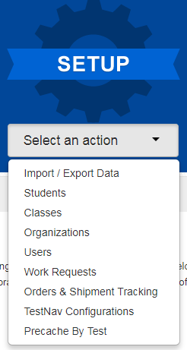
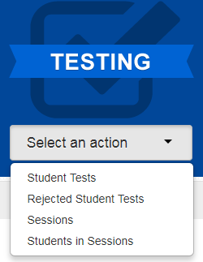
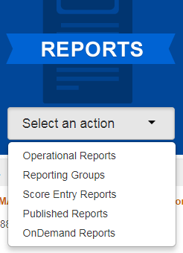
PAnext
CMAS or CoAlt
Administration
(back to 2013-2014)
Change your view
Menus
Organization

Slide 44
PAnext – Setup Actions
Import/Export Data
Student Registrations (SR/PNP), Enrollment Transfers, Student Test Updates (STU), Users
Students
Create and edit student records
Register students for the current test administration - indicate demographic information
Manage student tests – add test assignments and update PNP
Classes
Create and edit classes to assign groups of students to online test sessions
Organizations
Check contact information
Verify enrollment counts before January 25 initial orders pull (material quantities that will be received)

Slide 45
PAnext – Setup Actions (continued)
Users
Create and edit user accounts
Work Requests
Submit student record transfer requests to other districts
Review, approve, and reject student record transfer requests received from other districts
Orders & Shipment Tracking
Order additional materials
Track material shipments
TestNav Configurations
Configure TestNav settings
Precache By Test
Proctor cache test content

Slide 46
PAnext – Testing Actions
Student Tests
All tests assigned to students in the selected organization
Edit student tests (PNP)
CoAlt only – enter CoAlt scores
Rejected Student Tests
After testing for PBT only
Resolve demographic mismatches for scanned test books
Sessions
Create and edit online test sessions
Add students to sessions
Lock all units for all tests in the selected organization
Students in Sessions
Print Student Testing Tickets and Session Rosters
Verify special form assignment
Manage live testing – start sessions, resume and unlock units, mark tests complete, move students between sessions

Slide 47
PAnext – Reports Actions
Operational Reports
Run live reports on student data, online testing, orders, etc.
Reporting Groups
For OnDemand Reports
Create and manage reporting groups of students
Assign and remove users from reporting groups
Score Entry Reports
CoAlt administration
Monitor completion of score entry for CoAlt assessments
Published Reports
After testing
Results – data files and reports
OnDemand Reports
After testing
Preliminary student performance results
Comparative data not included (state-, district-, school-level)

Slide 48
Before Testing
Handout

Slide 49
Annual Training Requirement
Everyone involved in CMAS math, ELA, science, and social studies administration must be trained each year
Includes DACs, SACs, Test Administrators, Test Examiners, technology personnel, and any other school or district staff involved in administration
DACs and SACs are responsible for ensuring that all individuals involved in test administration and/or handling secure materials receive training and sign the CMAS and CoAlt Security Agreement
http://www.cde.state.co.us/assessment/annual_trng_requirements

Slide 50
Training
Comprehensive training must include:
Test Security
Standardized Test Environment
Test Administration
Test Session Management (for appropriate personnel)
Test Administrator Role vs. Teacher Role
Opportunity for personnel to ask questions
CDE will provide a basic PPT that districts may update and use for Test Administrator trainings
Districts will need to add district-specific instructions

Slide 51
Who Can Administer a Test?
School and district employees who are trained on this year’s procedures and security
Long term subs may be Test Administrators
Student Teachers are NOT allowed to be the only person in the room or responsible for the administration of the assessment
Student teachers may be an additional person (proctor) in the room during testing

Slide 52
Student Readiness
Student practice resources are available
ePATs for computer-based testing
Paper Practice Items for paper-based testing
Walk through all item types
ePAT Guides include script for adult as well as scoring information such as rubrics and sample student responses
During testing, Test Administrators cannot help students with TestNav navigation and answering questions in test books
May not help with how to answer a question
May not show how to go to the next question or use the review screen
May not assist with drag and drop or other technology enhanced items
Strongly recommend students are provided with access to practice resources prior to testing
Includes forms with accessibility features and accommodations

Slide 53
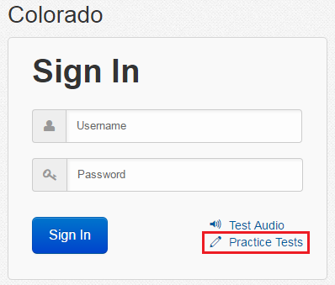
Student Readiness
Computer-based practice resources can be accessed through:
TestNav App
Navigate to “Colorado” sign in page and click “Practice Tests” link
PAnext Training Center
Requires login from student testing ticket
Secure practice sessions must be setup in advance
On TestNav Home Screen, click:

Slide 54
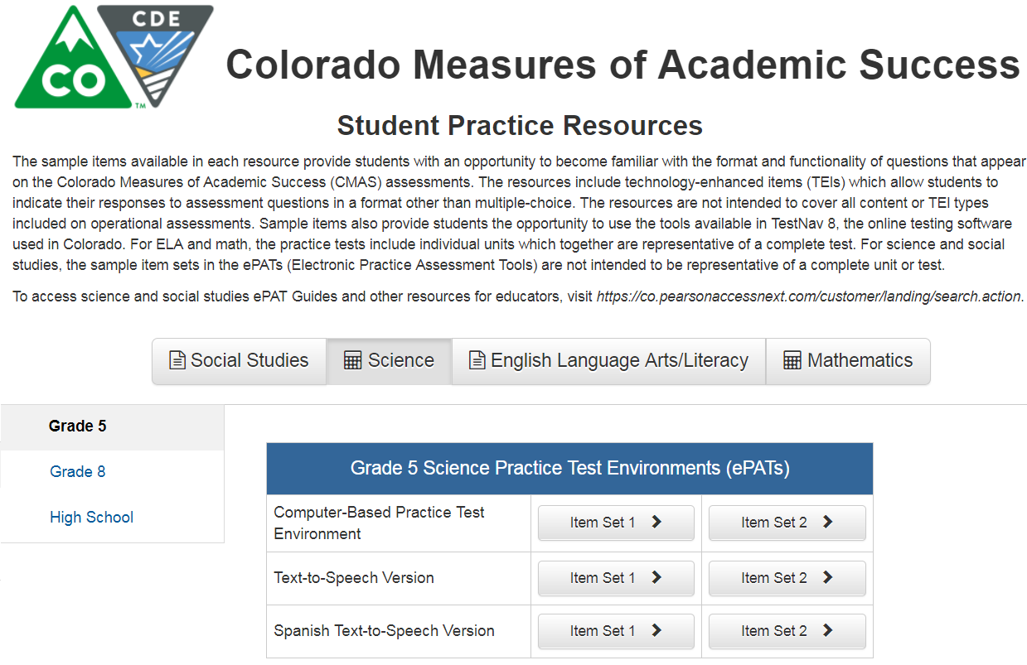
Student Readiness

Slide 55
Registering Students, Ordering Materials & Setting Up PAnext Test Sessions

Slide 56
Student Registration Reminders
Middle name field can be left blank
New students must be added into PAnext prior to testing, including for PBT
Temporary SASIDs should only be used for homeschool students
Other than for homeschool students, do NOT use temporary SASIDs without permission from Sara Loerzel at CDE
There are several fields in the SR/PNP that are used to validate selected accommodations
If an error is received upon import, check cross-validation fields
These can only be seen by PAnext users with the Sensitive Data role

Slide 57
Registering for PBT
Initial orders for PBT materials are generated using information indicated for students in the SR/PNP as of January 25
PBT for district/school/grade/content area
Paper format will be indicated for you if intent to use PBT is submitted to CDE by December 15
If PBT selection is not provided to CDE by December 15, district/school needs to indicate
Additional orders for whole districts/schools/grades/content areas will not be approved (including when tests are not updated from English to Spanish)
Ensure charter school selections are indicated
Individual students using PBT accommodated forms
Indicate Spanish Transadaptation prior to January 25
CDE will add braille registrations into the initial upload for students who were assigned to braille last year (district/school adds grade 3)

Slide 58
Accommodated Forms Ordering by January 25*
Ensure that all large print and braille registrations are in PAnext
Oral scripts must be indicated
CSLA and other Spanish forms must be identified
CDE will indicate UAR-dependent accommodations
Must meet December 15 UAR deadline
* Exception for new students who arrive after January deadline – DACs will need to place an additional order for PBT or accommodated materials after updating student registrations

Slide 59
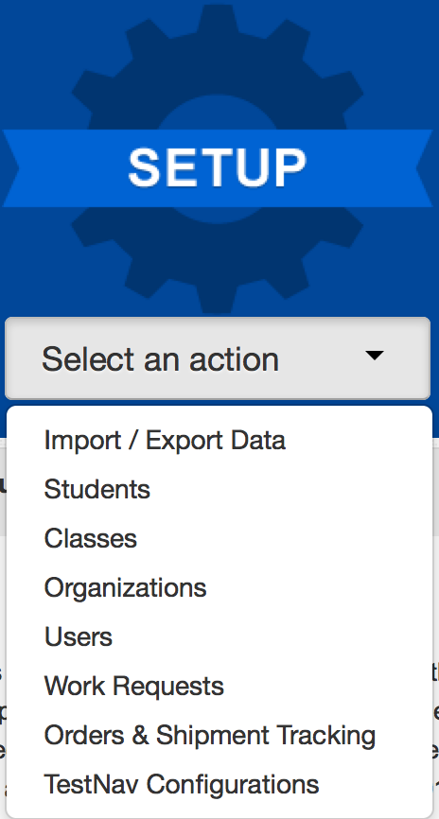
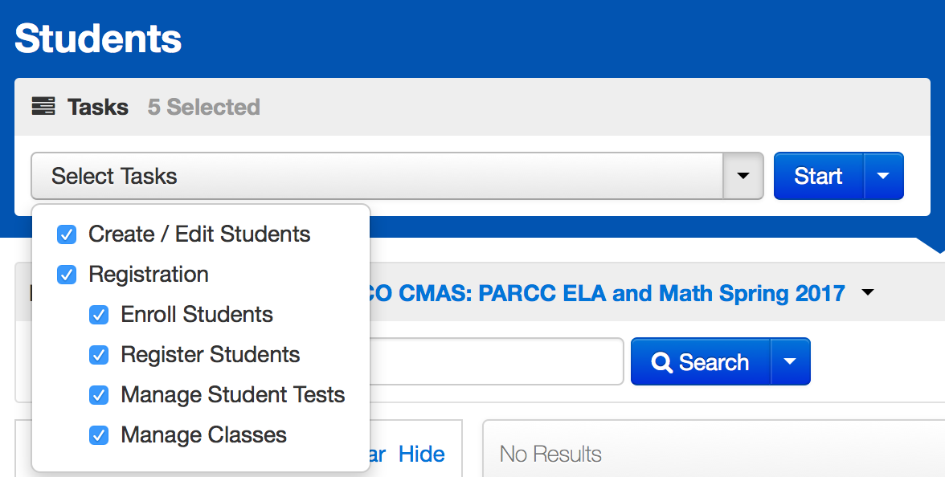
Registering a Student in PAnext
Select the Setup menu and choose Students
Choose the Tasks and click Start

Slide 60
Operational Reports within PAnext – Help with Registration
Recommended reports
PNP Report – accessibility features and accommodations for student tests
Students with multiple tests of same subject area
Students where responsible district/school is different from testing district/school – use for transfer students
Students registered but not assigned to a test
Students with online test but not assigned to session
Additional reports may be available this spring
Information will be shared during CMAS Office Hours and in *DAC* emails when available

Slide 61
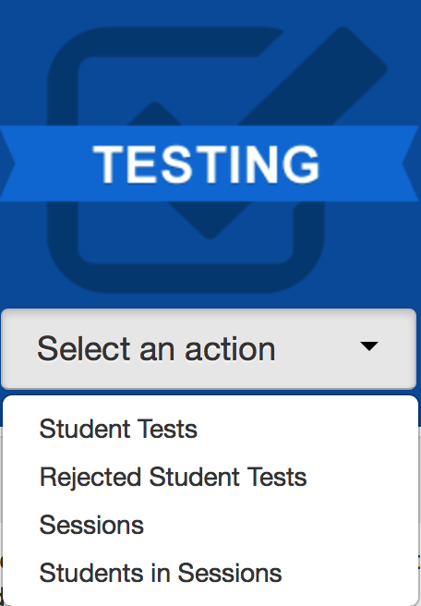
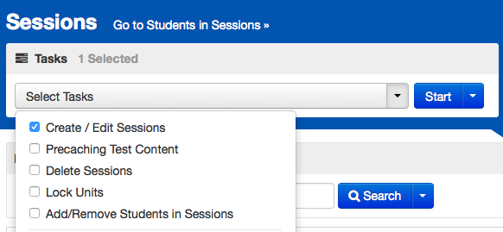
Online Testing Management
Select the Testing menu and choose Sessions
Choose the Tasks and click Start

Slide 62
New Students
Student arrives | Action | Example: ELA initial testing window is April 8-12
Initial testing window (by each content area)
Student will need to test
Student arrives on April 9th and will need to test
Make-up testing window (by each content area)
District decides if student will test
Student arrives April 13th, district has the option to test to receive data
Note: Registrations and online test assignments for students who transfer from another school district (did not complete testing before transfer) are transferred using the Work Request process

Slide 63
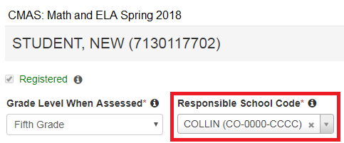
Work Request – Student Transfer Process
Student transfers from District A to District B prior to beginning testing:
District B attempts to register student in PAnext, but receives an error stating, “The student can only be enrolled in 1 organization.”
District B completes a Work Request to transfer the student to District B (through UI or file import)
An email is sent to District A’s Work Request contact and a red bell appears at the top of District A’s home screen
District A confirms that student transferred and approves the request (through UI or file import)
The student’s record is moved to District B
District B must go into the student registration screen and make necessary changes to the Responsible School Code field
If District A does not approve the transfer – the student’s record remains with District A

Slide 64
Work Request – Student Transfer Process (CBT/PBT) During Testing
The student started an online test:
District B completes a work request within PAnext
District A approves the work request
The online tests assigned to the student are automatically transferred to District B
The tests are placed in test sessions named “Transferred [Grade - Subject]”
The tests must be moved into another test session
DO NOT add fake or temporary SASIDs into PAnext unless CDE approves their use; use the transfer process
If you cannot find the student in PAnext, contact CDE for assistance. Typical errors involve hyphenated names, nicknames instead of birth names (e.g., Liz instead of Elizabeth), and DOB format (yyyy-mm-dd)

Slide 65
Work Request – Releasing District
Check email and PAnext periodically
Look for the red bell at the top of the PAnext home screen
Click on the bell to go to the pending requests
Verify the student listed in the Work Request has moved away from your district
Approve the transfer
If the student has not moved from your district
Reject the transfer
Will have to provide reason (e.g., student did not move)
The other district may have requested the wrong student
If there is an error in the school field upon opening the work request, decline the request (the student was previously removed from your district)

Slide 66
Work Request – Receiving District
Review the student registration in all applicable administrations and update the responsible school and district (if needed – BOCES might not need to update this field)
Updates to a responsible school that is not within your district must be done via a file upload or by CDE (call Sara Loerzel)
Updates to schools within your district can be made through the UI or via a file upload
Use the Operational Report “Students Where Responsible District/School is different from Testing District/School”
If your district should be the responsible district, change this in the student’s registration either via the UI or through a SR/PNP file upload

Slide 67
Work Request – PBT Student Transfer
Complete a Work Request in PAnext
For a non-started test, no physical material transfers are necessary
The new school can provide a test book or can assign the student to an online assessment
If the transferred student started testing on PBT:
Contact the other district and arrange for secure transfer of the test book
In-person DAC to DAC hand-off
Via Fed Ex or UPS – track shipment
Students should not retest a unit that they took in a previous school
Provide a chain of custody for the transferred test materials
Both districts must keep a copy of chain of custody documents

Slide 68
Technology Overview

Slide 69
Technology Updates
Handout
Browser-based testing is not supported for 2019
Use TestNav app
Desktop/laptop computer
Chromebook
iPad

Slide 70
Administrative Considerations, Accessibility Features & Accommodations

Slide 71
Accessibility Features and Accommodations
Resources
Accommodations webinars posted on http://www.cde.state.co.us/assessment/trainings
Accommodations Crosswalk
CMAS and CoAlt Procedures Manual Section 6.0

Slide 72
For Unique Accommodation Requests, students must have an active IEP or 504
UARs
Students must have an active IEP/504/ELP
Accommodations
May include students with active IEP/504/ELP (but not required)
Accessibility Features
Administrative Considerations
All Students

Slide 73
Administrative Considerations
Available to any student:
Adaptive and specialized equipment or furniture
Frequent breaks (do not stop the clock)
Noise buffers/headphones
Small group testing
Specified, separate, or alternate area or seating
Time of day
Administrative considerations do not need to be captured on the SR/PNP

Slide 74
Accessibility Features Identified in Advance
Available to any student and must be marked in the SR/PNP:
Auditory Presentation:
Text-To-Speech (CBT) Math, Science, Social Studies
Oral Script (PBT) Math, Science, Social Studies
Color Contrast
Note: Auditory Presentation of ELA is a unique accommodation that requires a CDE Assessment Unit-approved UAR
While accessibility features are available to any student, they may not be appropriate for all students. Students should use similar access strategies during instruction.

Slide 75
Extended Time
Extended time accommodations must be administered in a separate room from standard unit testing time administrations
CDE does not recommend providing more than double time
Unit must be completed on the day it was started
Science and social studies
Time-and-a-half built into unit time
Double time as an accommodation
Elementary and middle school – 110 minutes
High school – 70 minutes
Math and ELA
Extended time is not included in unit time

Slide 76
Speech-to-Text
Use of internet-based speech-to-text (STT) devices/software is not allowed
Privacy and security issues
A student’s voice is PII
Exposure of test content to STT provider
Embedded operating system accessibility features may not be used
Contact Mindy Roden (roden_m@cde.state.co.us) with questions about using STT

Slide 77
Clarifications
Differences between Text-to-Speech and Oral Script
Auditory Presentation: Text-to-Speech (TTS) – TestNav reads the content via the embedded TTS functionality
Computer-based testing
This form is not for blind or low-vision students
TTS is an accessibility feature for math, science, and social studies
TTS is a unique accommodation for ELA
Auditory Presentation: Oral Script – Assessment is read aloud by Test Administrator
Typically paper-based testing
Oral script is an accessibility feature for English PBT math, science, and social studies only
Oral script is a unique accommodation for ELA and CSLA
Note: Visually-impaired students may use a screen reader program that reads the screen (e.g., JAWS) together with the Assistive Technology with Braille form for math and ELA

Slide 78
Auditory Presentation
Computer-based testing
Students use Text-to-Speech in English (TTS) or Spanish (STTS)
ELA TTS must be approved via UAR process
Math, science, and social studies oral scripts available for:
Translation into language other than Eng/Spa, including sign language
Student responses translated and transcribed into TestNav
Paper-based testing
Math, science, and social studies oral scripts available for:
English
Spanish
Translation into language other than Eng/Spa, including sign language
Student responses translated and transcribed into test book
ELA and CSLA
Must be approved for UAR
English and sign language for ELA, Spanish for CSLA
No script – follow audio guidelines

Slide 79
Auditory Presentation – Oral Script
Oral script guidelines
A trained Test Administrator may be provided to read the entire test orally to a student who is unable to decode text
Individual words must not be read to students
Oral scripts should be provided to students on an individual basis
A student should have the option of asking a reader to slow down or repeat text
Math, science, and social studies: The Test Administrator must follow the script and not read from a test book or device screen
Scripts are secure and must be returned to Pearson
CBT with oral script
Must be in a separate test session in PAnext (cannot be in same online test session as non-oral script tests)
Test session Form Group Type must be set to Oral Script or student’s test will not match the oral script

Slide 80
Technology for Medical Monitoring
Students who use a phone, tablet, or other device to monitor a medical condition may have the device in the testing room
Documentation of medical necessity must be kept at the school and district
District plan for use of these devices must include:
Where the device is located and who has control of the device
If the student has control, the device must be visible at all times and may not be used for any other purpose
Procedures for if/when the device alerts and what action is necessary
If student has to leave the testing environment, follow procedures for students who become ill

Slide 81
Accommodations for ELs
English Learner Accommodations
Extended Time
Word-to-Word Dictionary
Admin (SAY) Directions Read Aloud, Clarified, and Repeated in Native Language
Spanish Transadaptation - Math, Science, Social Studies
CSLA in Grades 3 & 4 - ELA
Non-English Response
Oral Script in Native Language - Math, Science, Social Studies
Note: EL accommodations are not available on CSLA as the student is testing in his or her native language

Slide 82
Administering Language Accommodations
Spanish forms - CSLA, Math, Science, Social Studies
Test Administrators must be bilingual to administer assessments in Spanish
ELA
Only SAY directions can be provided in languages other than English
Auditory presentation of ELA in other languages is not allowed
Math, Science, and Social Studies may be translated into other languages using the provided oral script (CBT or PBT)
CBT oral script is ONLY for translation
SAY directions are available in English and Spanish
All other languages must be translated locally

Slide 83
Non-English Responses
Indicate in PNP (through UI or file)
Non-English Response
01 = Spanish – Written
02 = Spanish – Oral (Scribe Only)
03 = Lang other than Eng/Spa – Written (Transcription)
04 = Lang other than Eng/Spa – Oral (Scribe and Transcription)
Math, Science, and Social Studies
If Spanish responses are identified, they will be scored by a Spanish speaking scorer
If student responds in a language other than English or Spanish, responses must be locally translated and transcribed for scoring
ELA and CSLA
On ELA, only English responses will be scored
On CSLA, only Spanish responses will be scored
Student responses on ELA cannot be translated

Slide 84
Transcription Guidelines
PBT and CBT Transcription
At least two persons must be present during any transcription of student responses
One person to transcribe
One person to verify the transcription
The student’s responses must be transcribed verbatim into the test book or TestNav
Note for braille transcription: Only a braille certified Test Administrator may transcribe student responses
After transcription, shred any responses printed from an assistive technology device
Complete the Verification of Removal of Saved Data form

Slide 85
Transcription Guidelines
CBT Transcription
Student:
Responds to constructed response (CR) questions on their assistive device
Student may respond to selected response items in TestNav
Device with saved responses is secure until student responses are removed
Exits the unit, but the student should not submit the unit
Student responses to CR questions should be entered into TestNav by the Test Administrator before the next unit
Transcriber:
Resumes the student’s test in PAnext
Logs-in as the student and transcribes the CR responses
Submits responses for the transcribed unit
Student continues testing in the next unit
Note: Because units cannot be administered out of order, transcription must take place before the student can take the next unit

Slide 86
Prior Access to Secure Test Materials
Prior access must be supervised by the SAC
Access to test questions and test materials prior to testing is limited to the following:
4 days for Auditory Presentation: Oral script for translation into language other than Eng/Spa, including sign language
24 hours for Auditory Presentation: Oral script in English or Spanish
Paper-based testing only
24 hours for braille
TVIs may review Teacher Notes 24 hours prior to testing
TVIs may NOT review the test content
Test materials must be secure at all times and follow chain of custody protocols
Test items may not be copied or discussed

Slide 87
Unique Accommodation Requests (UARs)
A very limited number of students who meet specific criteria may qualify for unique accommodations
These accommodations might impact the construct being measured. For that reason, additional documentation is required.
Use of unique accommodations must be approved by the CDE Assessment Unit
UARs are due to the CDE Assessment Unit by December 15
Email Mindy Roden once posted on Syncplicity
Post together if submitting for multiple students
Do not email the UARs, just that UARs are posted for review
An approved UAR is required for:
Auditory presentation of the ELA or CSLA assessment (i.e., text-to-speech, oral script, signed presentation)
Calculation device on the non-calculator portion of the math assessment
Scribe on constructed response questions of the ELA or CSLA assessment
Any accommodations not listed in the Procedures Manual
UAR Guidance Documents - http://www.cde.state.co.us/assessment/trainings

Slide 88
UARs
Only use the 2019 forms
All criteria within each form must be completed
Data/test results from the current school year must be included
CDE will update PAnext with the Unique Accommodation
Unique Accommodation field will not be visible in the UI, but will be available on reports
Reminder: Number lines are not allowed

Slide 89
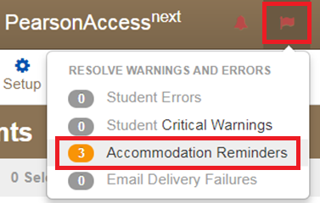
Accommodation Reminders
PAnext displays reminders for all students identified with the following accommodations:
TTS for ELA
Scribe for ELA
Oral Script/Signer for ELA
Calculation Devices and/or Math Charts and/or Counters
Reminders cannot be removed unless the accommodation is removed
If these reminders appear, check the students with reminders against the list(s) of students with:
CDE-approved UARs
District-approved UARs for math charts and counters

Slide 90
UAR Reminder
Compare list in PAnext to approved UAR list from CDE
If students are approved:
Student is able to use the accommodation during the state assessment and will receive a valid score
If students are not approved:
If student uses the accommodation during the state assessment the results will not be considered valid
The score will be invalidated as a misadministration or suppressed
This counts against participation

Slide 91
Form Assignment Markers in PAnext
A marker appears next to a SASID on Students in Session screen if a form-dependent accommodation/accessibility feature was identified for the student on the Manage Student Tests screen or through an SR/PNP import
Indicator | Accommodation/ Accessibility Feature
 | Text-to-Speech
 | Spanish or Spanish with Text-to-Speech (Math, Science, and Social Studies)
 | Assistive Technology (Math and ELA)
Notes:
These are independent forms that cannot be combined
All Spanish forms automatically include TTS – student does not have to use TTS tools if TTS is not needed
Assistive Technology form only available for math and ELA

Slide 92
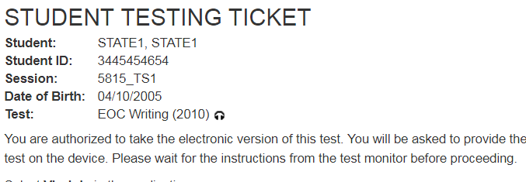
New! Form Assignment Markers on Testing Ticket
A marker appears next to a SASID on a student’s testing ticket if they have been assigned a TTS or Oral Script form.
Indicator | Accommodation/ Accessibility Feature
 | Text-to-Speech
 | Oral Script

Slide 93
Emergency Accommodation
A student needs a new accommodation immediately due to unforeseen circumstances
Cases could include students who have a recently-fractured limb (e.g., arm, wrist, or shoulder); whose only pair of eyeglasses have broken; or a student returning from a serious or prolonged illness or injury
Emergency accommodation form must be completed and maintained in the district
Refer to Appendix G for Emergency Accommodation Form
This will be identified in PAnext on the Manage Student Tests screen (through the UI or SR/PNP file upload)
Scribe
Other

Slide 94
Testing Environment

Slide 95
Student-to-Test Administrator Ratio
Student-to-Test Administrator ratio must not exceed 30 to 1
Test Administrator must be able to actively monitor the space within the physical testing environmen
Consider room configuration
Make special considerations for large testing environments or environments with complicated configurations
Test Administrators must:
Actively proctor
Remain attentive and in the room during the entire testing unit
Circulate throughout the room during the test
Should be able to see students working, not student work

Slide 96
Test Environment
The testing environment must:
Be adequately lit, quiet, free of distractions, and heated or cooled
Provide an adequate writing surface (paper-based)
Be free of electronic devices and music
“Do Not Disturb/Only Authorized Personnel Allowed” sign must be placed on the door during test sessions

Slide 97
Test Environment
No food or drinks are allowed on desks or near test materials
The testing environment must be free of any content related posters or aids that suggest possible answers to students:
Word walls
Steps for solving math equations
Any content related materials
Any resource that defines, explains, or illustrates terminology or concepts
General rule: When in doubt, cover it.

Slide 98
Test Environment
Generally, posters that do not include content specific definitions, content related processes or solutions may remain on the wall
Display unit testing time for students:
Unit Name: | Grade 8 Science, Unit 1
Unit Testing Time: | 80 Minutes
Start Time: | 9:00
Stop Time: | 10:20

Slide 99
Room Configuration
Students should not be able to see each other’s work from a normal testing position
Consider the following seating configurations to maintain test security:
Seat students in every other seat (useful in a computer lab setup)
Arrange monitors back-to-back
Seat students back-to-back
Seat students in a semicircle (useful for schools using laptops)
Seat students in widely spaced rows or in every other row (appropriate for a classroom setup)
Dividing screens or other privacy materials may be used if students cannot be placed far enough away from each other

Slide 100
Headphones
Text-to-Speech
To be in a testing room with other students, headphones must be worn
Students must be tested separately if they are unable to wear headphones
Note: CMAS assessments do not contain audio unless TTS is used

Slide 101
Unauthorized Visitors and the Media
Only students, Test Administrators/Examiners, and authorized school, district, state personnel, or state-sanctioned test monitors may be in testing areas during administration
Media are not allowed to have access to the tests before, during, or after test administration, or take pictures or video of testing materials or testing students
Parents are not allowed in the testing room with their child

Slide 102
Receiving Materials & Test Security

Slide 103
Test Security Protocols
Protection of student information and data
Protecting the validity of the state assessments
Financial considerations
State law: Maintain the integrity of the assessment

Slide 104
Security Plan
Successful Security Plan requirements:
All personnel have appropriate annual training
All involved personnel understand security protocols
All involved personnel have signed security agreements
Think about anyone who may be in/enter the testing environment
Test environments are secured against unauthorized personnel
Establish a documented/physical chain of custody form process
Materials are kept in a central, secure, and locked location with limited access
If materials are missing, follow up will be needed
Ensure that barcodes are identified

Slide 105
Test Materials Security
Non-Secure
Secure
Student Testing Tickets
Paper-based test books
Social Studies source books
Periodic Table (PBT HS Sci)
Oral scripts
Used scratch paper
Any student work/responses
Math reference sheets just prior to testing
If written on, cannot be reused
Test Administrator Manuals (TAM)
Procedures Manual
Unused scratch paper
Math reference sheets if not written on

Slide 106
Maintaining Security of the Assessments
All secure test materials must be secured while in the Test Administrator’s possession
No duplication of secure CMAS materials is permissible
No cell phones or other communication, reproduction, or recording devices are allowed during test sessions unless required for accessibility
Students should be aware that cell phones or other electronic devices are prohibited. Having these devices during testing (including if a student finishes testing but other students have not) or during a break may lead to the invalidation of not only that student’s test, but to the invalidation of others’ tests as well.
All individuals are strictly prohibited from taking photos or video of TestNav screens and paper test materials. Ensure individuals in your district are aware of this critical instruction.

Slide 107
Receiving Test Materials
Initial materials will be received in two waves based on the selected district start date(s)
Wave 1
Assessment Coordinator Kits
Test Administrator Manuals (to be used for all content areas)
Extended CBT math and ELA window – accommodated materials and corresponding student ID labels
Early high school window – student materials and corresponding student ID labels
Wave 2
Regular PBT math and ELA window – student materials and corresponding student ID labels
Elementary and middle school science and social studies window - student materials and corresponding student ID labels
Materials are packaged by school and shipped to the district
No overages will be sent

Slide 108
Contents of Shipments
Wave 1
Assessment Coordinator Kit
Re-sealable plastic bag (holds all materials)
Paper bands
Pearson scorable and nonscorable labels (different colors)
UPS Ground return labels for scorable and nonscorable materials
Pre-printed/pre-gridded header sheets
Test Administrator Manuals
Waves 1 and 2 (as applicable)
Packing list and chain of custody form
Student test materials (if indicated by January 25 in PAnext)
Test books
Math reference sheets, rulers, and protractors, if applicable
Accommodated test books: large print, braille, Spanish including CSLA
Oral scripts
Student ID labels and rosters (with corresponding student materials only)

Slide 109
Header Sheets and Labels
Header sheets and shipping labels are in the SAC kits
DACs may want to take these out of the school kits
If sent to the school, ensure they are returned at check in
These are needed for return of all secure materials

Slide 110
DAC – Receipt of Test Materials
Upon Receipt of Test Materials, DACs:
Remove packing list, chain of custody form, and DAC Kit from Box 1
Inventory materials immediately to verify all were received and that there is an adequate number for administration
Optional: Take header sheets and labels out of SAC Kits
DAC may order additional material, if necessary
Keep all test materials in a centrally locked storage area with limited access until distributing to schools
Ensure chain of custody procedures are followed at all times
Deliver materials to schools no more than one week in advance of school testing window

Slide 111
SAC – Receive Materials & Chain of Custody
Receive materials from DAC no more than one week in advance of school testing window
Document any movement of secure materials before, during, and after testing
Schools inventory materials using the provided security checklist
Deliver test materials to Test Administrators only on the day of testing
Must use a chain of custody process
Distribute only the content area being assessed
As close to testing time as possible
Store materials in a designated secure location
As soon as possible after the unit is complete
Materials must not be stored in classrooms
Return secure materials to DAC after testing is completed
Includes oral scripts

Slide 112
Chain of Custody Form
Districts may use the forms that are shipped with the materials or create their own to track all secure materials
If creating a district/school chain of custody form, for each day of testing the form must include:
Security barcode/number
Test Administrator signature
Date and time checked out
SAC (or designee) signature for verifying return
Date and time returned
Chain of custody forms are kept on file for three years
If materials are missing, these will be sent to CDE

Slide 113
Documenting and Storing Test Materials
Keep all boxes in which the test materials were delivered and use them to return scorable and nonscorable materials after testing is completed
Report the following occurrences immediately to Pearson Customer Service using the Form to Report Contaminated, Damaged, or Missing Materials (Appendix E):
Non-receipt of any materials listed on the School Packing List
Discovery of damaged test material
Discovery of missing or duplicate sequence numbers on any test books

Slide 114
Steps to Order Additional Materials
Orders can be submitted only by the official DAC
Quick Reference Guide to Additional Orders (Appendix H: PAnext)
PAnext Additional Orders Training Module
Note: CDE will only review/approve AOs for materials if:
Placed no more than two weeks before the district’s selected test window (by test)
The ordered materials can be matched to a student registration in Panext
The registration/accommodation information must be entered on the student’s SR/PNP before placing the AO

Slide 115
Key Information to Order Additional Materials
Keep in mind when ordering additional material:
Do not submit AOs prior to receiving the initial shipment of test materials
All test materials must be inventoried prior to placing an AO
Once an AO is approved, allow 4-5 business days for shipment delivery
AOs are packaged by district and shipped to the district

Slide 116
Key Information to Order Additional Materials
Keep in mind when ordering additional material:
Ancillary materials for return shipping are not automatically included in the AO
Shipping labels
Header sheets
Account for the need of these additional materials when an AO is placed
Check for return labels and header sheets prior to the end of the testing window as these will not have expedited shipping

Slide 117
During Testing (Administering Tests)

Slide 118
CBT Task “Prepare” Test Sessions
“Prepare” sessions at least one school-day prior to starting a test session
Allows for the starting of multiple test sessions at one time
Can only be done by users with LEA or STC roles (DAC, SAC)
This step assigns forms to each student in the test session
Prior to completing this step, ensure students are assigned to the appropriate form-dependent accommodations and accessibility features (e.g., TTS)
If not indicated prior to this step, remove student from the test session, update PNP, then add back to the test session
Once the session is “prepared” and the window is open, the test session can be started

Slide 119
Incorrect Form Assignment
Check form assignments before students log in
Incorrect forms must be identified before students log in to test
If errors are identified after students log in to test, the options are:
Continue with the test and suppress the score
Student receives an ISR, but the scores will not be aggregated
Counts against participation for the school and district
Stop the test and invalidate with Void 06
Misadministration = the student will not receive an ISR
Counts against participation for the school and district

Slide 120
PAnext Test Session Life Cycle
Create
Session Form Group Type can be set to Oral Script if the session is not in prepared status
Prepare
Test forms are assigned when session is prepared
Start
Must be started prior to student being able to test
Can be started on the day the state window opens
Stop
Students’ PNPs can be updated if session is not in prepared status
DAC or SAC can prepare sessions (TA cannot prepare)
Students can be added to a prepared session through the UI only
Students can be added through the UI only
Stop sessions once all students complete testing
All units for all students in the session must be in “complete” or “marked complete” status to stop the session
Code and remove students with all units in “ready” status

Slide 121
PAnext “Prepare” Test Session
Checklist Prior to Preparing a Session
□ | All students’ PNP attributes are correct
□ | Students requiring auditory presentation of tests in languages other than English or Spanish, including sign language, are added to separate sessions and those sessions are set to Oral Script
□ | Test content is proctor cached (recommended)

Slide 122
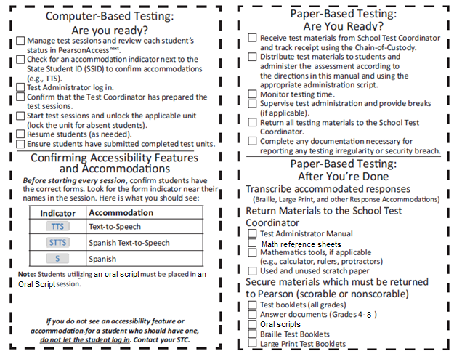
TAM Reminders
DRAFT

Slide 123
Tasks to Complete During Testing
On the Day of Testing (CBT):
Distribute test materials
Ensure TAMs have 2019 on the cover
Ensure Test Administrators have a computer or tablet available
Check form assignment
Ensure accessibility features and accommodated forms are assigned to appropriate students
Monitor test activity
Be available to Test Administrators and Proctors
Investigate security breaches and testing irregularities
Follow protocol for contaminated or damaged test materials, safety threats, and severe weather
Respond to all technology related issues
Collect materials from Test Administrators after each test unit

Slide 124
During Testing – Security Breaches
Monitor and Report Security Breaches and Testing Irregularities
All instances of security breaches and testing irregularities must be reported immediately to the SAC, and subsequently the DAC
DAC will immediately contact CDE upon receiving notification
Testing Irregularity or Security Breach
SAC will complete the Form to Report a Testing Irregularity or Security Breach (Appendix E)
SAC will add incident to the TIR spreadsheet (found in Syncplicity)
DAC submits completed form and updated spreadsheet through CDE Assessment Syncplicity in the Assessment Forms folder
Notify Sara Loerzel of posted form (loerzel_s@cde.state.co.us)

Slide 125
During Testing – Contaminated & Damaged Materials
PBT - Contaminated or damaged test materials that must be replaced
Place student ID label on replacement document or complete entire data grid
Record security barcode number of the damaged and new documents
Submit the Form to Report Contaminated Damaged, or Missing Materials through CMAS folder on Syncplicity
Notify Sara Loerzel of posted form (loerzel_s@cde.state.co.us)
If possible, transcribe responses from contaminated test material into the replacement.
If not, contact Sara Loerzel
Destroy contaminated material according to local biohazards protocols

Slide 126
During Testing – Safety Threats and Severe Weather
Create a Plan and Train Staff for Safety Threats and Severe Weather
Test Administrators and Proctors must:
Note the time of the disruption
Secure test materials as specified in your School Security Plan
Prepare students for the continuation of the unit and resume tests
Document the situation in writing
If the disruption will cause the unit to be carried over into the next day, notify CDE

Slide 127
Test Administration Materials
2019 Test Administrator Manual (TAM)
Select district/school options for after the test session
Read SAY directions exactly as written (may clarify after)
Practice in advance
Each unit will be submitted independently
Student Testing Tickets
Hand out and collect in the test environment
Have a master list of students including accommodations
Student Testing Tickets are secure

Slide 128
District Decisions – After Students Finish Unit
District Decisions:
Will students be able to leave when they have finished testing? (no minimum time)
Sit quietly?
Read? (cannot use any electronic reading devices)
Should students be released to a location outside the testing area?
What to do when all students have completed the unit?
School Site Considerations:
Where will students go if they are released?
To whom will students be released?

Slide 129
Active Administration
Active Test Administrators:
Test Administrations May Not:
Ensure students have all necessary materials for each unit
Ensure a standardized testing environment
Read SAY directions exactly as written
Move throughout the room during testing
Re-read/clarify SAY directions to students when asked
Use proximity to keep students on task
Use “continue working” script
Provide feedback
Clarify test questions
Answer content related questions
Interfere with the students’ demonstration of skills
Interact with students in any way that would impact student responses
Engage in other tasks during test sessions
Read sources, passages, questions, or student responses
Help with TestNav navigation

Slide 130
Administration Steps for CBT
Prepare the test environment and situate students
Start test session (SAC must “prepare” first)
Unlock the unit being administered through PAnext
Follow directions and read SAY script from TAM
Hand out Student Testing Tickets and scratch paper when directed
Assist students with logging into TestNav 8
Actively administer each test unit
Collect Student Testing Tickets and scratch paper
Confirm students have submitted the unit
Lock the unit – each day
Stop test session in PAnext after last unit only
The status of all tests for all students in the session must be “Completed” or “Marked Complete”*
*At the end of the testing window, incomplete units should be “marked complete” by SACs – this does not invalidate tests. Invalidations are entered separately (Void).

Slide 131
Basic Technical Troubleshooting

Slide 132
Common Error Codes
1001: “Your test has been saved. Please notify your test administrator.”
Early Warning System initial message, does not indicate the issue, another error code will follow
1009: “Unable to download test content”
Network connection issue between the testing device and Pearson servers
3005: “TestNav has detected that another application attempted to become the active window”
Could be caused by pop-ups in the background or power saving features
TestNav exits the test and displays the following errors when a student types certain key combinations while testing – the test must be resumed before the student can sign in again:
3020: “TestNav has detected that Command+Option+Esc has been typed...”
3022: “TestNav has detected that Ctrl+Alt+Del has been typed...”
8026: “Unable to connect to the proctor caching computer. Please contact your administrator.”
Network connection issue between the testing device and the local proctor caching device

Slide 133
Common Error Codes – Next Steps
Resume the student’s test in PAnext
Have the student log in again on the same testing device
Do not move the student to another testing device unless the student safely exits the test using the “sign out” feature
If the same error occurs repeatedly, or if the same error is affecting multiple students, contact the Technology Coordinator

Slide 134
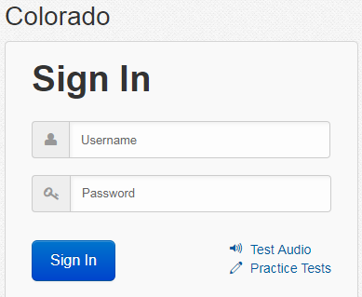
Common Errors – 9059
9059: “The username or password you entered is incorrect.”
If the username/password being used is accurate, the student may be on the incorrect login page
“Colorado”

Slide 135
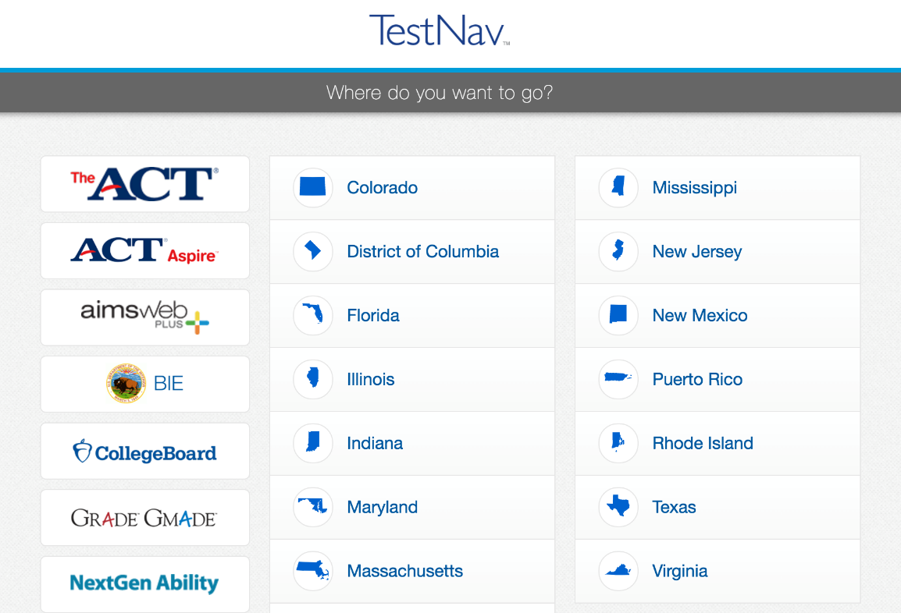
TestNav
Note: The Sign In page should say “Colorado” above the Username and Password fields. If it doesn’t click the User Icon and select “Choose a different customer”.

Slide 136
“Early Submission” of Test
There are no confirmed cases of a student getting “kicked out” of TestNav and the test submitting itself
In all cases where a student’s test was submitted and the log files were sent to Pearson, the student followed the on-screen logout procedures and hit the submit button
CDE will unsubmit tests for:
3rd graders one time only
Transcription
Other grades: If log files sent to Pearson show that the student did not submit the test

Slide 137
Student Logs into Another Student’s Test
Student A logs into Student B’s test
Immediately exit the test
Do not have Student A continue testing
School immediately contacts DAC
DAC immediately contacts CDE
If Student B hasn’t touched the test, CDE may be able to move the test into Student A’s name
Moves the whole test
Individual units cannot be moved
If Student B has taken one unit or more, CDE may have to void the unit taken by Student A to allow Student B to complete his or her test
Responses cannot be transferred to Student A’s test
Student A’s test may need to be invalidated as a misadministration
Not allowed to access test questions more than once

Slide 138
Technology Tip
Document the specific device on which each student tests for each unit
There is a space for this on the Student Testing Ticket
This will aid in response recovery if it becomes necessary (SRF)
If not identified, may not be able to recover responses
If a student receives an error do not immediately move them to a new device
Sign in using the same device again, then click the User icon in the top right to “Sign out”
This will send all responses saved on the device to the testing server
Always have the student “sign out” if they won’t be submitting their test
Never just power-off

Slide 139
Student Response Files (SRF)
If the device cannot send a response to Pearson, it will save the response on the device and in a secondary save location (if set up by Technology Coordinator)
Test Administrator should check item progress/response receipt in PAnext
If there is a discrepancy, call Pearson
May need to manually move the SRF
Additional SRF documentation
https://support.assessment.pearson.com/display/TN/Find+SRF+and+Log+Files

Slide 140
Make-up Testing

Slide 141
Make-Up Testing
Students who are absent, become ill, or who can no longer test because of classroom, school, or technical interruptions during originally scheduled units, may utilize make-up testing
Students may not return to previously answered questions
Test security and administration protocols apply
SACs will establish make-up testing schedules for their schools
Units may not be taken out of order for any content area
Priority: Minimize risk of prior exposure to test content that could result in an invalidation

Slide 142
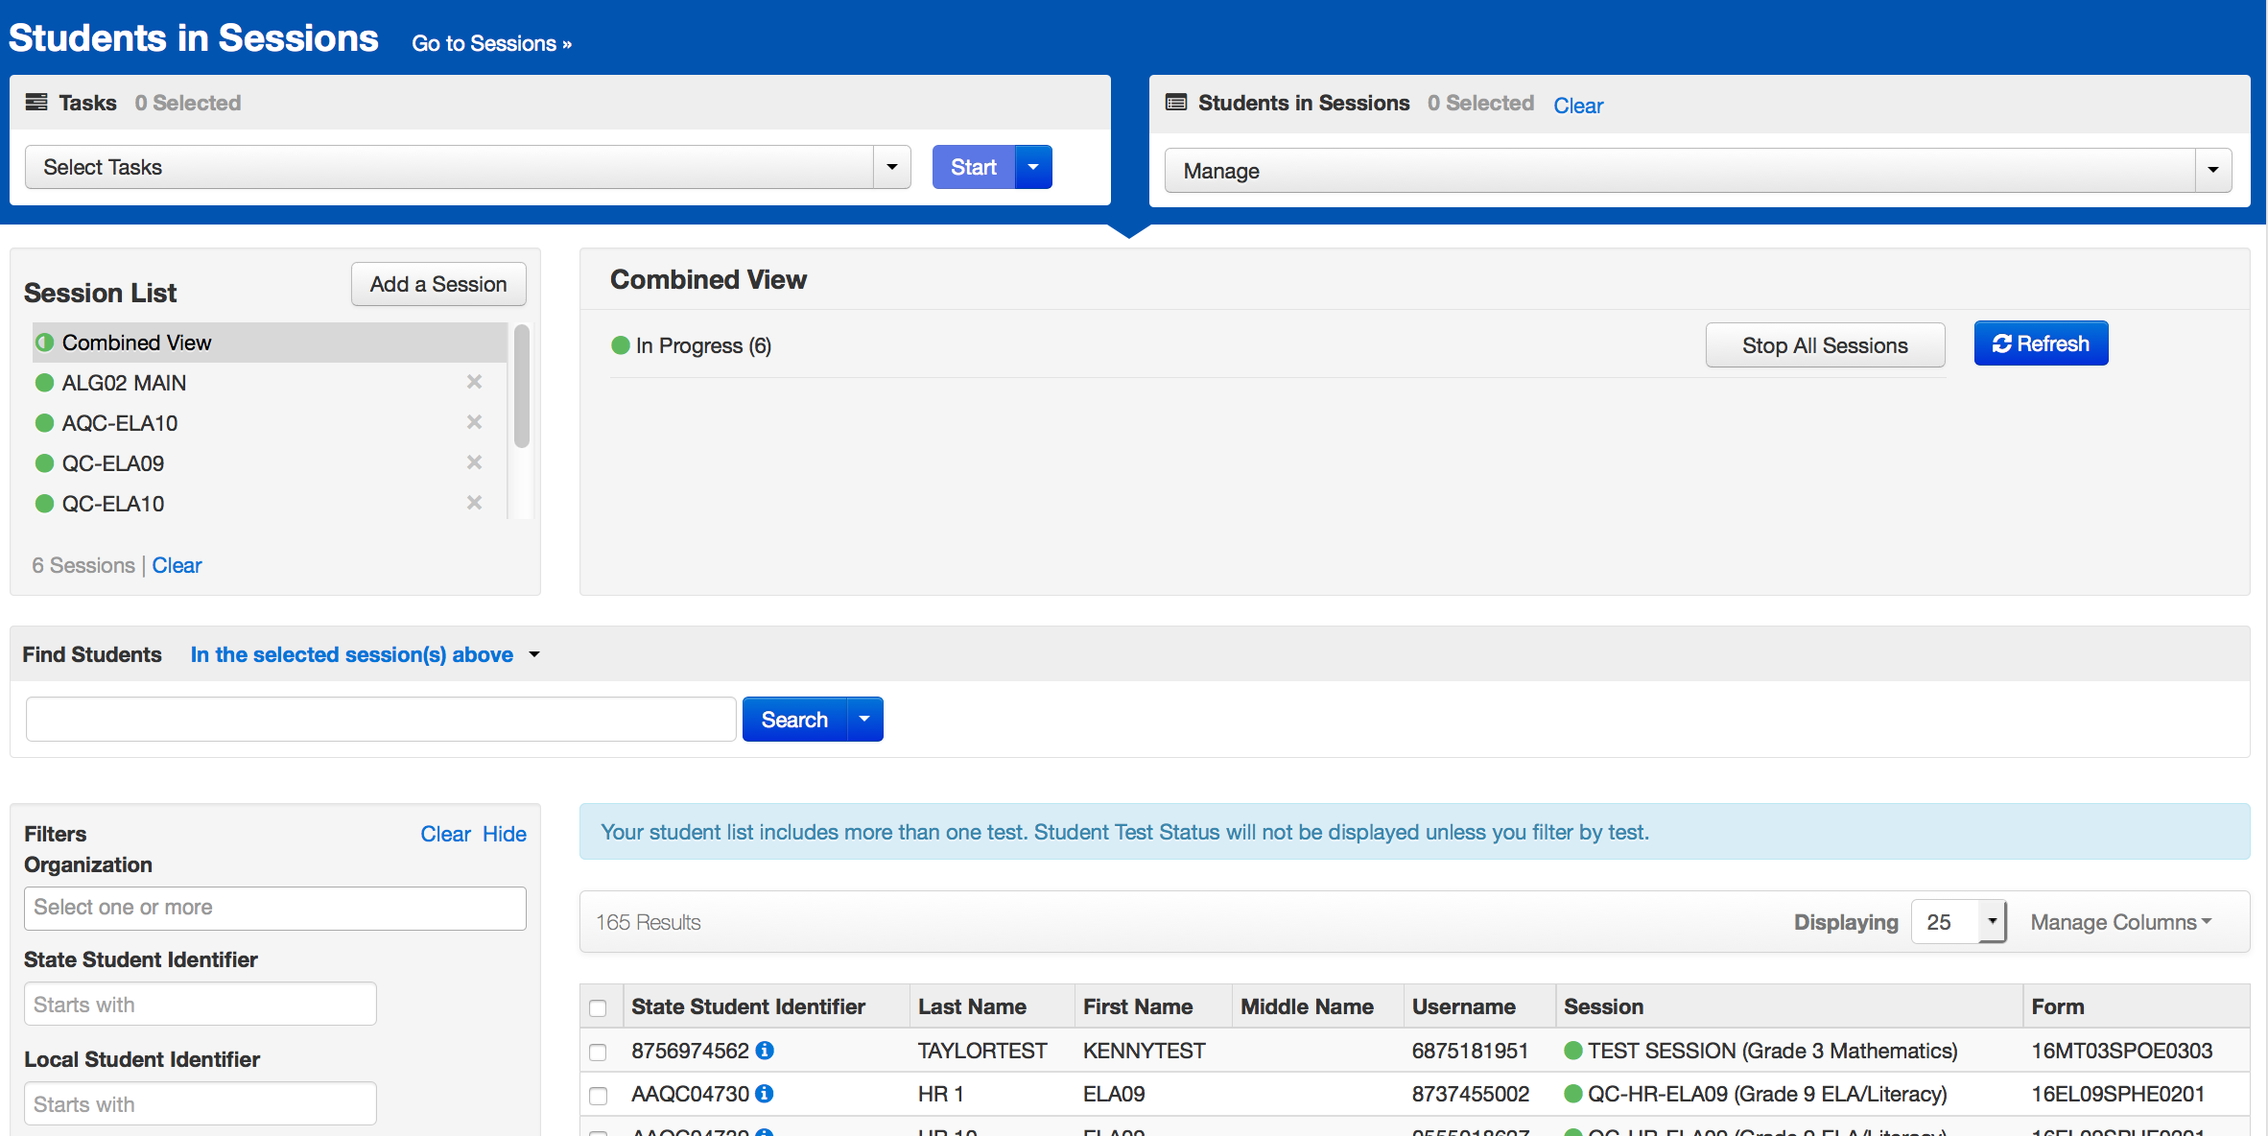
Online Test Management
Multiple sessions may be managed in PAnext at the same time

Slide 143
After Testing

Slide 144
Tasks to Complete After Each Testing Session
CBT – After Testing
The day of testing:
Collect materials (Student Testing Tickets, scratch paper, etc.)
Ensure students logged out of TestNav correctly
Return materials to SAC using chain of custody form
Notify SAC of absent students and/or needed transcriptions
PBT – After Testing
The day of testing:
Collect materials (test books, scratch paper, etc.)
Ensure names are on test materials
Return materials to SAC using chain of custody form
Notify SAC of absent students and/or needed transcriptions

Slide 145
Final Day – Tasks to Complete After Testing
CBT – After Testing
The final day of testing:
Collect materials (Student Testing Tickets, scratch paper, etc.)
Ensure all student test units are submitted/completed
Ensure all test sessions are stopped
Purge the cached test content
Return used scratch paper and AT printouts in provided envelopes
PBT – After Testing
The final day of testing:
Collect materials (test books, scratch paper, etc.)
Ensure labels are affixed or data grids are completed
Return scorable PBT materials to Pearson as soon as possible (by 5/1*)
Return used scratch paper and AT printouts in provided envelopes
*If scorable materials are not picked up by May 1, 2019 there is no guarantee that records for these PBT students will be included in SBD or scored.

Slide 146
Verification of Removal of Saved Data
Administration may require CMAS student responses to be temporarily stored on local devices
These materials are secure and must be treated as such
Student responses saved on secondary devices need to be transcribed into online or paper test forms in order to be scored
All student responses must be removed from the secondary device or flash drive immediately following transcription or printing for transcription purposes
It is the DAC’s responsibility to ensure all secure electronic content is deleted after CMAS transcription in a secure manner
Verification of Removal of Saved Data form (Appendix G)

Slide 147
Tasks to Complete After Testing
Up to one week after the final unit:
Resolve critical warning/alerts in PAnext
Organize and return nonscorable test materials
Identify transcribed and damaged test materials as “Do Not Score”
Return used scratch paper and AT printouts in secure return envelopes
Complete a single Post-Test Certification Form for all CMAS and CoAlt content areas and submit through CDE Assessment Syncplicity Assessment Forms folder
Keep records for three years

Slide 148
Returning Materials
Science, social studies, math, ELA, and CSLA can be returned together
DO NOT mix scorable and nonscorable materials
Use the correct labels for scorable and nonscorable materials
Program | Scorable | Nonscorable
CMAS: Science, Social Studies, Math, ELA, and CSLA | Orange | Blue
Note: CoAlt science and social studies materials are returned with nonscorable materials.

Slide 149
Student ID Labels
The student ID label will override any bubbled demographic information on the test
Set aside student ID labels that were not used to be securely destroyed/shredded (e.g., student left district, parent excuse)
If an ID label is not available, complete all fields on the test data grid (must match info in PAnext)
Incomplete or incorrect bubbling will lead to rejected student tests that must be resolved by the district

Slide 150
PBT Rejected Student Tests
Rejected student tests are paper tests that were returned for scoring but cannot be matched to a student registration in PAnext
Notification received through PAnext (est. mid-May)
Tests will not be scored if left unresolved
Created when:
All 6 student fields on the paper test data grid do not match PAnext
First name, last name, SASID, gender, date of birth, grade
Organization code cannot be matched
If student was registered for a CBT test but took the PBT version
Remove any form-dependent CBT accommodations and change the test to PBT

Slide 151
Return Shipping Labels & Header Sheets
Ensure labels and header sheets are received in initial shipment
Included in DAC and SAC kits
Additional orders for return materials will not be overnighted
Scorable material must be picked up by May 1*
Nonscorable material must be picked up by May 3
*If scorable materials are not picked up by May 1, 2019 there is no guarantee that records for these PBT students will be included in SBD or scored.

Slide 152
Packing Materials
Checklist to prepare materials for packing:
DAC receives materials from the SAC
Each scorable test material has a student ID label or hand-gridded student demographic data
School header sheets are completed for each grade level and/or subject
Ex: All Grade 7 ELA are under one header sheet for the school
All materials are packed in the boxes in which they were delivered
Boxes are not overfilled (under filled boxes are packed with crumpled paper)
One return shipping label (scorable or nonscorable) and one UPS label is placed on the top of each box

Slide 153
Secure Materials Must be Returned
Make sure all materials are accounted for and returned
Every test book and oral script has a secure barcode and is tracked by Pearson and CDE
Every secure test item must be returned, including oral scripts for math, science, and social studies
If any material must be destroyed locally (contaminated), complete Form to Report Contaminated, Damaged, or Missing Materials (Appendix E) and notify CDE
Keep track of UPS tracking numbers when returning materials to Pearson
If secure materials are not returned after testing, there is a process that must be followed to document each item that is missing

Slide 154
Secure Materials Must be Returned
If secure materials are missing, the following documentation must be sent to CDE:
Signed statement by the DAC
Signed statement by the SAC
Signed statements by any other involved personnel
Chain of custody documentation
Search documentation
Copies of signed Security Agreement forms for all involved persons
Form to Report Contaminated, Damaged, or Missing Materials (Appendix E)
Training materials relating to test security may also be requested.
CDE will maintain records of missing materials to identify patterns.
PBT reminder: Must commit to meeting security requirements, accounting for, and returning all secure materials

Slide 155
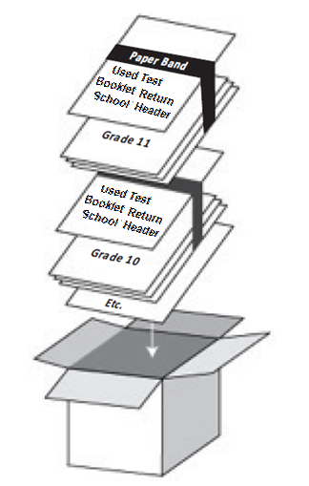
Packing Scorables
Scorable Materials:
Packing Scorable Materials for Return Shipment:
Used test books
Science, social studies, math, ELA, and CSLA materials returned together
Do not mix scorable and nonscorable materials in the same box
One school per box – do not combine materials from multiple schools in one box
Use appropriate shipping labels
Once all materials are in boxes, indicate the sequence of boxes being returned for the school (e.g., Box 1 of 3, Box 2 of 3, and Box 3 of 3) on the return shipping label

Slide 156
Nonscorable Materials
Nonscorable materials
Unused test books (e.g., absent students, parent excuse)
Used test books marked “Do Not Score” including:
Large print test books (student responses transcribed into regular print (scorable) test book included in kit)
Braille test books (student responses transcribed into regular print (scorable) test book included in kit)
Other used test books that should not go through scoring (e.g., parent excusal received after the student started testing)
CoAlt materials

Slide 157
Arrange for Pickup
Scorable materials must be picked up by May 1, 2019*
Contact UPS at 800-823-7459 to schedule pickup:
Pickups must be scheduled at least 24 hours in advance - call by May 1, 2019
UPS customer service is available 24/7 - tell UPS you are calling about a pickup request for Pearson and will be using their “Return Service”
Once pickup is confirmed, you will get a confirmation number from UPS that can be referenced if questions or changes arise
*If scorable materials are not picked up by May 1, 2019 there is no guarantee that records for these PBT students will be included in SBD or scored.

Slide 158
CMAS Forms
Handout
Return all district level forms through CDE Assessment Unit Syncplicity – Assessment Forms folder, then notify the appropriate CDE contact:
CMAS – Sara Loerzel (loerzel_s@cde.state.co.us)
CoAlt – Mindy Roden (roden_m@cde.state.co.us)
The following forms are found in the Procedures Manual:
Prior to testing
SAC, DTC, Sensitive Data, TA, TE Security Agreements - maintained locally
Security Agreement (DAC only)
Verification of District Training
During Testing
School Chain of Custody - maintained locally
Testing Irregularity or Security Breach
Test Incident Report spreadsheet
Contaminated, Damaged, or Missing Materials
After Testing
Post Test Compliance
Verification of Removal of Saved Data - maintained locally
Only use spring 2019 forms with CDE logo

Slide 159
Test Irregularities
When to submit a TIR form to CDE via Syncplicity:
Students were grouped incorrectly – not same directions or time
Students were given an incorrect amount of time (more or less)
Students were cheating or using a unapproved electronic device
Students used an unapproved accommodation or were not provided an accommodation according to IEP, 504, or EL plan
Math, science, or social studies test read aloud to students without the oral script
Test Administrator did not follow procedures
PBT student goes past stop sign at the end of the unit
Large number of students involved in a technology related irregularity
If technology issues cause testing to not be completed on one day
Test security breach
Student goes back into a unit on a different day and changes answers

Slide 160
PAnext Clean-up

Slide 161
PAnext Clean-up Activities – CBT and PBT
Use Operational Reports to ensure data accuracy:
Reports > Operational Reports > Students & Registrations >
Not Tested Student Tests (students with a NT Code/Reason applied)
Void Score Tests (students with a Void Code/Reason applied)
Students Registered but not Assigned to a Test
Student Tests that have been Assigned but Not Yet Completed
Students where Responsible District/School is Different from Testing District/School
Students with Multiple Tests of Same Subject Area
Reports > Operational Reports > Online Testing >
Online Student Tests Marked Test Complete
For School/District records only – Mark Test Complete Reason does not invalidate
Must enter Void Code/Reason separately

Slide 162
Coding Invalidations
There are two categories of invalidation codes:
Not Tested Reasons/Codes
Void Test Score Reasons/Codes
Coding can be indicated in PAnext in two ways:
Student-by-student through User Interface (Sensitive Data role)
Batch loaded through Student Test Update process (STU role)
Coding is unique to each test
Does not transfer across math, ELA, science, and social studies tests
Entered for each test as appropriate
“Marked Complete” does not invalidate tests
“Mark Test Complete Reasons” are for district/school use only
They do not “flow” into scoring/reporting

Slide 163
Not Tested Students
Students who were absent or not tested (did not access any part of the test):
PBT: Return test materials in nonscorable boxes with unused materials
ACTION: Indicate the Not Tested Reason/Code* in PAnext
CBT: DO NOT mark complete students who did not start testing
ACTION: Indicate the Not Tested Reason/Code* in PAnext
ACTION: Remove students from prepared/started test sessions
If test session is not prepared/started, do not have to remove students
*Not Tested and Void Reason/Codes are in the Procedures Manual in Appendix K: Data Section 3

Slide 164
Stop Test Sessions
Any test sessions that were started need to be stopped by May 10, 2019
Started test sessions cannot be stopped unless all units for all students are either “Completed” or “Marked Complete”
Student tests with all units in “Ready” status need to be removed and coded with Not Tested Reasons
Student tests with units in a combination of statuses need to be “Marked Complete” and may need to be voided

Slide 165
Combined Unit Statuses
Started sessions:
ACTION: “Mark Complete” any units for students who started, but did not complete testing
“Marked Complete Reasons” do not invalidate student tests (this information does not flow into scoring/reporting with the student test)
ACTION: If invalidation is needed, Void Student Test Reasons/Codes must be applied (Appendix K: Data Section 3)
To find started but not completed tests
Go to PAnext > Reports > Operational Reports > Online Testing
Select Session Roster
Request the report
Download Report
Tests with multiple unit statuses need to be “marked complete”

Slide 166
Test Marked Complete
Void Score Code Applied
Test is not scored
No Void Score Code Applied
Test is scored, counts for participation
Codes 2, 4, 5, 6 count against participation
Codes 1, 3, 7, 8, 9
do not count against participation
Not Tested Code Applied
Test is scored, counts for participation
ACTION:

Slide 167
Void Test Score and Not Tested Coding
Reasons/Codes are the same for math, ELA, science, and social studies
 | Void Test Score | Not Tested
Not Started Tests | NA | Yes
Started Test that will Not be Scored | Yes | Ignored
When can this be marked? | CBT: Once all test units are in completed/marked complete status PBT: Once tests are scanned into PAnext* | CBT: As long as test is not in a started session PBT: Any time
*If a PBT test was started/completed but should not be scored, write “Do Not Score” on material, return in nonscorable box, and indicate Not Tested coding in PAnext.
Note: “Marked Complete Reasons” do not invalidate tests or flow into scoring/report. MCRs are only for internal district/school use. Enter Voids separately.

Slide 168
Coding Parent Excusals
Documentation of parent excusals must be maintained locally
Parent excusal coding should never be indicated unless documentation is received from a parent/guardian
In order for schools and districts to have parent excusals not count against participation, the following coding MUST be applied in PAnext or during SBD:
For students who never started the test (CBT units not in “Complete” or “Marked Complete” status, PBT not returned with scorable materials)
Not Tested Code of 09
For students who started but did not complete the test, or were “Marked Complete” by the school
Void Test Score Code of 09
Note: “Marked Complete” text box “reason” does not indicate parent excusal for accountability purposes.

Slide 169
Suppressions
CDE adds suppression codes and actions
Suppression Reason | Receives Student Report | Impact to Participation
Home School Students | Yes | Does not impact school or district
Misadministration | Yes | Impacts participation

Slide 170
Additional Information

Slide 171
Student Biographical Data – Tentative Dates
Early 2019
Manual for SBD process will be available
Training Webinar
Clean-up in PAnext
Initial: Through May 10
Final: May 13 - 15 (District level only)
SBD via Data Pipeline
CMAS and CoAlt will be together
May 20 - 30

Slide 172
2019 Reporting Timeline – Tentative
Student data files expected in June
OnDemand student reports available at this time (no comparative data)
Individual student performance reports and summary data files
District- and school-level reports

Slide 173
Accountability Questions
Participation:
District and School Overall Results
http://www.cde.state.co.us/assessment/cmas-dataandresults
All students included in participation calculations
State accountability purposes
Parent excusals removed from participation calculations
The Assessment Unit does not produce growth data or performance frameworks.
If you have questions about how participation is calculated, growth, or performance frameworks, please contact the Accountability and Data Analysis Unit:
Dan Jorgensen - jorgensen_d@cde.state.co.us
Jessica Watson - watson_j@cde.state.co.us

Slide 174
Upcoming CMAS Due Dates
December 15
UARs due to CDE Assessment for approval
Submit
Request for extended/early testing windows
Notification of schools/grades/subjects that will test on paper to have CDE load student registrations as PBT for the initial load into PAnext
Transfer/Work Request contact information
Complete by January 25
All test assignments requiring physical materials in PAnext
School/grade/subject PBT selections
PBT accommodated forms
Large print
Braille
CSLA
Spanish math, science, and social studies
Oral scripts

Slide 175
CMAS Checklists
Manuals contain checklists in each section:
Before Testing – Section 3
During Testing – Section 4
After Testing – Section 5

Slide 176
Complete Security Agreement
Each year, each DAC must submit a signed Security Agreement to CDE
If not handed in at training, please post your signed CMAS and CoAlt Security Agreement in the Assessment Forms folder on CDE Assessment Syncplicity
Notify Sara Loerzel (loerzel_s@cde.state.co.us)

Slide 177
Reminder for DTCs
2018-19 DTC Kick-off Webinar
Wednesday, October 10
Verify the correct person is identified as the District Technology Coordinator for your district on the CDE website
http://www.cde.state.co.us/assessment/dtc
DTC will receive technology updates and invitations to trainings via email
DAC should connect with DTC regularly to ensure CBT readiness for spring 2019

Slide 178
Student Surveys
Student surveys will not be embedded in any assessment, online or paper
If student surveys are used this year, participation will be determined at the district or school level
Surveys would be accessed through a link that could be provided to students by the school

Slide 179
Get Involved!
Educator input is critical to Colorado's state assessment development and validation process
Educators may participate in committees related to the following state assessments:
CMAS: Science, Social Studies, Mathematics and English Language Arts/Literacy (ELA)
Colorado Spanish Language Arts (CSLA)
CoAlt: Science and Social Studies
Join the Colorado Educator Pool for assessment development committee selection
https://pearson.cvent.com/COEducatorDatabase

Slide 180
Test Monitoring
US DOE Peer Review Requirement
Monitoring is to take place for state assessments
DACs need to know school testing schedules
CMAS
DACs will be notified prior to school visits
CoAlt Science and Social Studies
Districts will be contacted in advance to schedule score monitors visits when testing will take place
Part of the validity research on CoAlt

Slide 181
CoAlt Assessments
Colorado Alternate (CoAlt) assessments are for students with significant cognitive disabilities
CoAlt Science and Social Studies
CoAlt ELA and Math (Dynamic Learning Maps (DLM))
Corresponding assessment to CMAS math and ELA for grades 3-8 and PSAT/SAT for grades 9-11
Same window as CMAS
Recorded trainings available through Assessment Unit Training webpage
http://www.cde.state.co.us/assessment/trainings
Annual training is required

Slide 182
Colorado PSAT and SAT
All 9th graders will take PSAT 8-9
All 10th graders will take PSAT 10
All 11th graders will take SAT
Webinar trainings will be presented by College Board

Slide 183
Resources & Support

Slide 184
Resources – PAnext Training Modules
The following modules are suggested for use by districts:
Available beginning mid-January (rolling release)
Welcome to PearsonAccessnext
User Accounts
Student Registration/Personal Needs Profile
Materials Management for DACs and SACs
Assessment Coordinator Session Management
Test Administrator Session Management
Additional Orders
Not Tested and Void Test Score Codes
Rejected Student Tests (PBT only)

Slide 185
Resources – Avocet
An online, alphabetical, topic-based index for assessment manuals and materials
Search capabilities
View pages, print results, and download full PDFs
http://avocet.pearson.com/CO/Home

Slide 186
Customer Support
Contact Support for assistance with:
Navigating PearsonAccess^{next}
Navigating the Training Center
Managing student registration data
Setting up test sessions
Managing user IDs and passwords
Accessing resources
Setting up proctor caching
Submitting additional orders
Inquiring about shipments
CMAS Support
Call Toll Free: 1-888-687-4759
Monday – Friday
7:00 am - 6:00 pm (MST)
https://co.pearsonaccessnext.com > Contact COLORADO Support
Chat is available

Slide 187
Resources
CDE training materials, PPTs, UAR Guidance, Accommodations Crosswalk
http://www.cde.state.co.us/assessment/trainings
Procedures Manual, TAMs
http://www.cde.state.co.us/assessment/cmas
Student Practice Resources
CBT - http://download.pearsonaccessnext.com/co/co-practicetest.html?links=1
PBT - http://avocet.pearson.com/CO/Home
PearsonAccess^{next}
Live Site: https://co.pearsonaccessnext.com
Training Center: http://trng-co.pearsonaccessnext.com/

Slide 188
Resources – Office Hours
CMAS Call-in Office Hours
Thursdays from 3-4
https://enetlearning.adobeconnect.com/assmtofficehrs/
866-783-5479
Next office hours:
November 15 and December 13
Bi-weekly beginning January 10
Weekly beginning February 28
Topics include
PearsonAccess^{next}
Policies and procedures
Updates
Packaging materials for return
Invalidation coding
*DAC* Emails
Assessment Unit updates and information emailed to DACs, as needed (typically weekly in the spring)

Slide 189
CDE Assessment Contacts
Questions | Contact | 303-866- | Email
CMAS & PAnext | Sara Loerzel | 3266 | loerzel_s@cde.state.co.us
CoAlt & Accommodations for Students with Disabilities | Mindy Roden | 6709 | roden_m@cde.state.co.us
ACCESS & Accommodations for English Learners | Heather Villalobos Pavia | 6118 | villalobospavia_h@cde.state.co.us
Technology & PAnext | Collin Bonner | 6752 | bonner_b@cde.state.co.us
CO PSAT & SAT | Jared Anthony | 6932 | anthony_j@cde.state.co.us
NAEP & International Assessments Coordinator | Collin Bonner | 6752 | bonner_c@cde.state.co.us

Slide 190
CDE Assessment Data Contacts
Staff | Programs | 303-866- | Email
Jasmine Carey (Psychometrician) | Psychometrics | 6634 | carey_j@cde.state.co.us
Shangte Shen | Data Support | 6877 | shen_s@cde.state.co.us

Slide 191
Thank You!

