Slide 1
Disclaimer Meeting Recording and Transcription Notice
Please be aware that the meeting will be recorded and transcribed for training and reference purposes. By participating in this meeting, you consent to the recording and the use of the transcript for training and accommodation purposes.
Disclaimer Artificial Intelligence
This online training event is offered by the CDE Assessment Division to support the District Assessment Coordinator prepare for the 2024-2025 ACCESS for ELLs administration window.
By participating in this event attendees agree that they will not record, capture, share, or publicly post its contents without expressed permission. Attendees may not use artificial intelligence (AI) software or services to capture the content of the event. CDE reserves the right to remove any attendee employing such services.

Slide 2


2024-25
District Assessment Coordinator
ACCESS Training
Heather Villalobos Pavia, EdD
villalobospavia_h@cde.state.co.us
September 2024

Slide 3
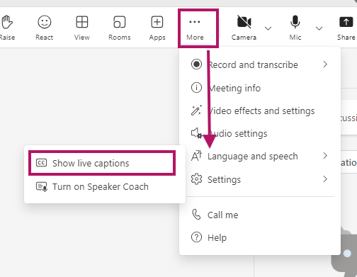
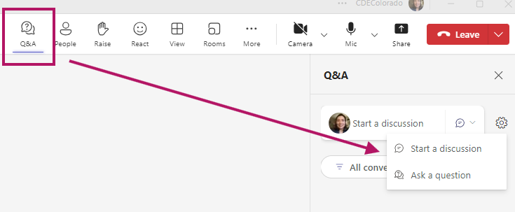
Teams Meeting Logistics
Enable closed captioning
Above More select the 3 dots (…) → Settings → Language and speech → Show live captions
Question and Answer (Q&A)
Select the Q&A icon → Ask a question

Slide 4
This training is to support District Assessment Coordinators prepare their district for the annual administration of the WIDA ACCESS suite of assessments including Kindergarten ACCESS for ELLs, ACCESS for ELLs 1–12 (online & paper), and Alternate ACCESS.

Slide 5
Agenda
ACCESS for ELLs District Assessment Coordinator Training 2024-2025
About ACCESS
Key Players
Important Dates
Student Participation
New for 2024-2025
Security and Training Requirements
Materials
Communication and Resources
Assessment Development Opportunities

Slide 6
What is the ACCESS Assessment?
ACCESS for ELLs is a standardized assessment that measures English language proficiency.
Purpose:
Helps educators make decisions about students' English language development.
Assists in appropriate program and instructional planning.
Meets state (Colorado Senate Bill 109, House Bill 14-1298) and federal requirements (Civil Rights Act, Every Student Succeeds Act).

Slide 7
Assessment Format
Kindergarten ACCESS: Paper-based, game-like format.
ACCESS for ELLs (Grades 1-12): Primarily computer-based; some parts on paper.
Alternate ACCESS: For students with significant cognitive disabilities; large-print and paper-based.

Slide 8
Key Players

Slide 9
District Level
District Assessment Coordinator (DAC): Oversees district-wide assessment processes.
Data Respondent: Ensures an accurate data file of NEP and LEP students is in data pipeline
School Assessment Coordinator (SAC): Manages school-level logistics and training.
District Technology Coordinator (DTC): Prepares and maintains testing technology.
Test Administrators (TAs): Administer the tests and ensure security.

Slide 10
Colorado Department of Education
ACCESS logistics
Heather Villalobos Pavia
Accommodations for students with an IEP or 504
Arti Sachdeva
ML Identification/WIDA Screener
Doris Brock-Nguyen
Data Pipeline/Coding
Brooke Wenzel

Slide 11
Vendors
WIDA
  WIDA is part of the University of Wisconsin–Madison and is housed in the Wisconsin Center for Education Research (WCER)
  WIDA members consist of 41 domestic states and territories and approximately 500 international schools throughout the world
Data Recognition Corporation (DRC)
  DRC is a long-standing WIDA partner responsible for the administration, scoring, and reporting for the ACCESS, Alternate ACCESS, and online WIDA Screener assessments
  WIDA and DRC administer the ACCESS assessments to 2.5 million students each year.

Slide 12
Dates

Slide 13
Important Dates 2024*
October 1st – November 1st: Initial Paper Materials Order (through Syncplicity/CDE)
October 23rd: Office Hours Begin
October 25th: DEADLINE for DAC Signed Security Agreement
October 30th: Weekly DAC ACCESS Office Hours Begin
November 1st: CDE sends DAC Verification of District Training form.
November 4th: Assessment Team pulls October Snapshot for WIDA AMS upload.
December 1st: DEADLINE for UAR (scribe) submission
December 3rd: WIDA AMS Opens
*Dates may change to accommodate unforeseen circumstances.

Slide 14
Important Dates 2025
January 6th: Additional Test Material Ordering Available Window (through CDE)
January 9th: DEADLINE for Verification of District Training Form
January 13th: Test Window Opens
January 31st: Enrollment Cutoff for New Students
February 4th: Last day to Order Additional Test Materials
February 14th: Last day of Test Window
February 19th: DEADLINE for Shipping Completed Test Materials to DRC
February 21st: LAST DAY to make updates in WIDA AMS
March 3rd: CDE sends Post-Test Compliance form
March 10th: DEADLINE Post-Test Compliance form
April 30th: Reports and Data Files Available in WIDA AMS
*Dates may change to accommodate unforeseen circumstances.

Slide 15
Student Participation

Slide 16
Student Participation
Multilingual Learners with a language proficiency designation of:
  01, Non English Proficient (NEP)
  02, Limited English Proficient (LEP)
including students with disabilities must participate in the state English language proficiency assessment.

Slide 17
Participation Options
Three participation options exist:
    The student participates in ACCESS for ELLs or Kindergarten ACCESS without an accommodation.
    The student participates in ACCESS for ELLs or Kindergarten ACCESS with accommodation(s).
    The student participates in Alternate ACCESS* only for students with the most significant cognitive disabilities.
  *It is not appropriate or ethical to give the Alternate ACCESS to students who do not qualify for the assessment. Student with a primary disability code of DD, SLD, SED, or SLI are not eligible for alternate assessments.

Slide 18
Testing students who have an IEP or 504 Plan
The educational team (ML and IEP or 504 as applicable), which must include the family, determines whether the student will take:
  ACCESS for ELLs or Kindergarten ACCESS with or without accommodations
  Alternate ACCESS for a student with the most significant cognitive disability who meets the participation requirements for the alternate assessment.
According to federal requirements, there must be evidence of alignment between a student’s educational plan, instruction, and the accommodations provided on any of the state assessments, as well as any determinations for students to participate in Alternate ACCESS.

Slide 19
Accommodations for Students
Accommodations are practices and procedures that provide equitable access during instruction and assessment for students with a documented need.
Who Qualifies?
Students with documented IEP or 504 Plans.
Examples of Accommodations: Manual control of audio, extended speaking time, signing in exact English, etc.
Unique Accommodation Requests (UAR) are due December 1

Slide 20
New for 2024-2025

Slide 21
Test Monitoring Application and Waiting Room
The Test Monitoring Application and Waiting Room are turned on for grades 9-12.
Do not turn it off
If you are creating your own registrations, you need to activate it for grades 9-12

Slide 22
Alternate ACCESS and
Accommodations
Students with a primary disability code of DD, SLD, SED, or SLI are not eligible for Alternate ACCESS.
The In-person Human Reader accommodation has primary disability code restrictions, reference the Colorado Accommodations Crosswalk.

Slide 23
Script Translations
WIDA is providing translated test instructions in ACCESS Online Test Administrator Scripts.
WIDA will offer electronic versions of the scripts with translated instructions in 16 languages.
The translated scripts are available through the WIDA Secure Portal and may be printed locally as needed.
WIDA is providing translations of the instruction text for the following scripts.
  ACCESS Online Grades 4–12 Test Administrator Script (all domains)
  Listening, Reading, and Speaking domains in the ACCESS Online Test Administrator Scripts for Grades 1–3
Guidelines for Using the Translated Instructions
  Only the instruction text will be translated for the student.
  Remind students to provide their responses in English.

Slide 24
Office Hours Invitation
The ACCESS Office hours invitation will be sent directly to all DAC calendars.
ACCESS Office hours are optional
Office Hours will be on select Wednesdays at 3:30 p.m.
October 23rd and 30th
November 20th
December 4th – February 12th
Cancelled Dec 25th and January 1st

Slide 25
WIDA AMS Enhancements
Highlights:
Track test and student status in the new interactive Operational Dashboard in Reporting Services.
Organize students and registrations more efficiently with new change assessment, regroup students, and registration import features, and add a new student to multiple ACCESS domain tests using the New Student tab in Test Management.
Test Monitoring Application Waiting Room
Make large-scale changes to ACCESS Online test registrations via a file in Import Management.
Print selected test tickets from the Registration Details screen.
Resources:
Watch the WIDA AMS and DRC Technical Enhancements for 2024-25 webinar recording
Select the Knowledge Articles button on the WIDA AMS landing page to access information on a variety of topics.
Access DRC’s Online Help feature from within an application for step-by-step instructions on how to complete tasks. Select the question mark icon in the upper right corner of the application to get started.
Contact DRC Customer Service at (855) 787-9615 or wida@datarecognitioncorp.com

Slide 26
Security and
Training Requirements

Slide 27
WIDA ACCESS Security
ACCESS Assessments
are secure tests
Colorado Security Agreement

Slide 28


Intellectual Property
All WIDA assessments and related materials are the copyright of the Board of Regents of the University of Wisconsin System. Should an egregious security incident occur compromising WIDA’s intellectual property remedies for violations will be governed by Wisconsin State Statutes.

Slide 29
Test Security and Integrity
Importance of maintaining the security of test materials and student data.
Key Actions:
  Secure storage and handling of materials.
  Signed security agreements from all involved.
  Chain of custody for test materials.
  Active Proctoring
  Use of Test Monitoring Application and Waiting Room

Slide 30
Ensuring a Smooth Testing Process
Before Testing:
  Authentic training and engagement
  Secure materials
  Review accommodations
  Prepare test environment
During Testing
  Standardized administration
  Proper use of materials
  Active monitoring
  Report any incidents
After Testing
  Return materials correctly and on time

Slide 31
Test Administrators
Training Requirements
Be trained annually
  Complete the requirements of the district/school annual ACCESS training.
  Complete the WIDA Training Module(s) (Oct 1, 2024 – January 8, 2025)
  Complete the WIDA Assessment Certification (Oct 1, 2024 – January 8, 2025)
Submit a signed Security Agreement to their SAC
Read the Colorado Resource Document, the WIDA TAM, and familiarize themselves with test administration procedures before administering the test to students.
Actively proctor the test administration in its entirety
If administering assessments in which students are provided accommodations, be trained appropriately.

Slide 32
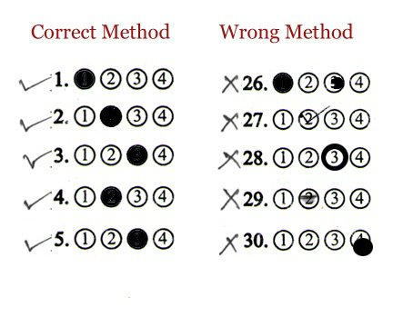
Marking student responses
TAs for Kindergarten and Alternate ACCESS must use a #2 pencil and completely bubble in the student response.

Slide 33
Materials

Slide 34
Initial Materials
Materials for:
  Kindergarten ACCESS
  ACCESS for ELLs Online
  Alternate ACCESS (Alternate Assessment Participation must be marked in Student Interchange*)
Are ordered automatically through the student count in your October Snapshot.
Materials orders ACCESS for ELLs Paper are ordered through CDE. Grade 1–12 paper assessments require IEP/504 documentation. Districts must submit this material via Syncplicity by November 1, 2024. DACs email Heather Villalobos Pavia to ask for this order form.
*Students with a primary disability code of DD, SLD, SED, or SLI are not eligible for alternate assessments.

Slide 35
Additional Materials
January 8 – February 4, 2025
Additional test materials are ordered through CDE via email.
DACs will submit an order through a CDE provided order form.
Hand Writing response books and Human Reader* scripts are ordered during this time was well.
*Very few students will use Human Reader scripts follow the guidelines in the Colorado Accommodations Crosswalk

Slide 36
Communication and Resources

Slide 37
Communication
CDE Assessment works with the official superintendent-appointed DAC and DTC
  School-level staff, including Test Administrators and school leadership, refer questions to the SAC
  SACs and district-level staff refer questions to the DAC and DTC
  Official DACs and DTCs refer questions to CDE Assessment
DACs and DTCs share information from CDE with district and school-level staff, as appropriate
Using this communication structure ensures local policies and procedures are communicated
Note: CDE Assessment and CDE Accountability are separate groups. The District Accountability Contact list is maintained by CDE Accountability. Direct questions about ACCESS Growth to CDE Accountability

Slide 38

Transmitting Secure Information
Use Syncplicity to send secure information to CDE
  Two users per district can access the CDE_Assessment folder
    The official DAC
    One additional individual, if requested
  CDE will email a list of users to each district
    Respond with updates
    New users must create/access their accounts within 90 days
Reminder: Do not send personally identifiable information (e.g., SASID, name, free and reduced lunch status, disability status, test scores, etc.) through email
CDE Assessment will not respond to emails containing PII
The email will be deleted
Remind all staff who may communicate with CDE

Slide 39
District and School Communication to Parents
Requirements & District Responsibilities Assessment Information
§22-7-1013(7)(a)
  LEP (Local Education Provider) will annually distribute to parents and post on its website, as early in the school year as possible, written information regarding its assessments, including:
  The state and local assessments that the LEP will administer
  Identify whether it is required by federal law, required by state law, or selected by the LEP
  Assessment calendar:
    Estimated hours of testing each testing day for specific classes/grades for each assessment
    Identify whether the assessment is required by state law, federal law or locally selected
  The purposes of the assessments
  The manner in which assessment results will be used

Slide 40
District and School Communication to Parents
Results
ISRs (Individual Student Reports) are to be shared with parents/guardians as soon as practicable.
Reports are confidential and distribution of both electronic and/or hard copy reports must be in accordance with state and federal privacy laws, and local school board policy

Slide 41
Colorado Specific Documents
CDE Assessment Division
Colorado WIDA ACCESS Training Information
Colorado Accommodations Training
Colorado ACCESS Checklist
CDE Office of Culturally and Linguistically Diverse Education
Identification
Language Proficiency Coding
Redesignation

Slide 42
WIDA and DRC Resources
WIDA
District and School Coordinator Manual
Test Administrator Manual
Test Administrator Essentials
Accessibility and Accommodations Manual
DRC
WIDA AMS User Guide

Slide 43
Assessment Development Opportunities

Slide 44
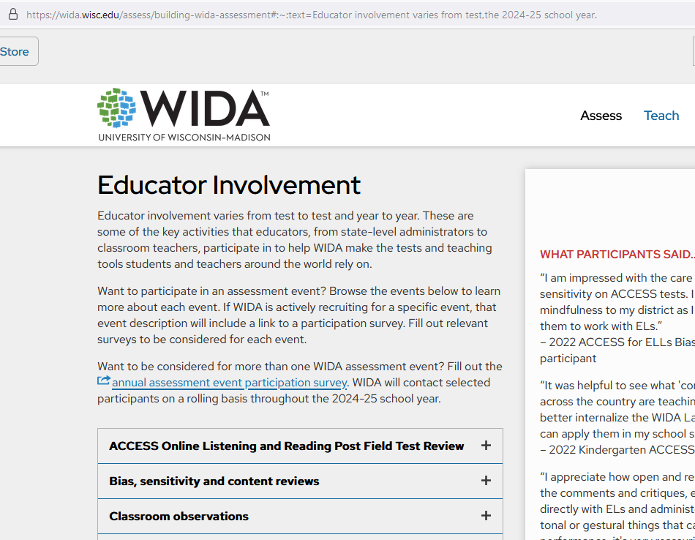
WIDA Assessments

Slide 45
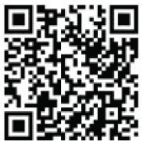


CMAS
Educator input is critical to Colorado's state assessment development and validation process. Educators may participate in committees related to the following state assessments:
  Colorado Measures of Academic Success (CMAS): Science, Social Studies, Mathematics and English Language Arts/Literacy (ELA)
  Colorado Spanish Language Arts (CSLA)
  Colorado Alternate (CoAlt) Assessment: Science and Social Studies
  State Assessment Development Flyer
  Join the Colorado Educator Pool for
  assessment development committee selection:
  CDE Assessment Educator Database
Scan Here!

Slide 46
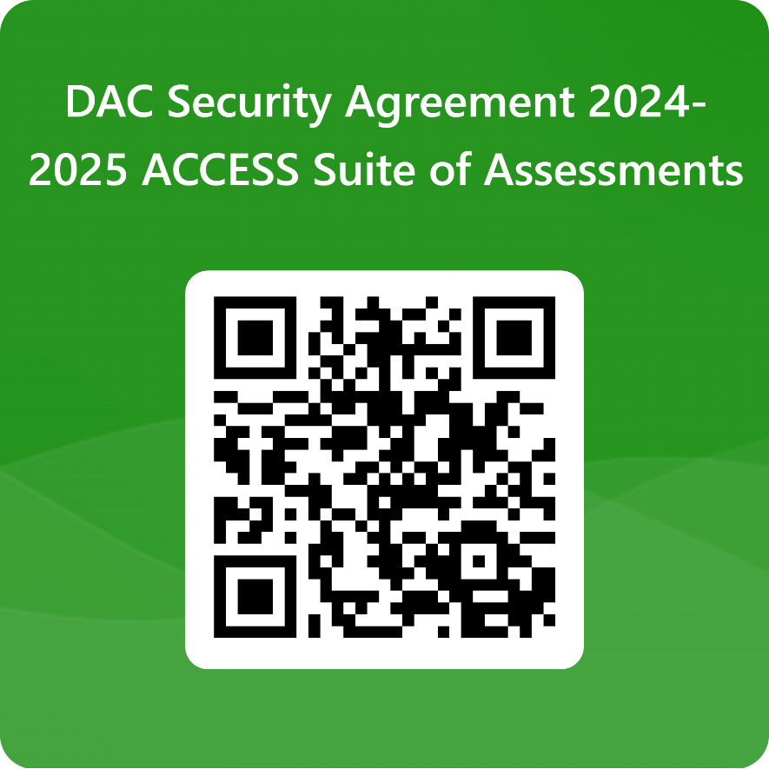
Thank you for attending the 2024-25 DAC Training.
DAC Security Agreement (to be completed ONLY by the official DAC)
https://forms.office.com/r/bkAVypeaYw

