Slide 1
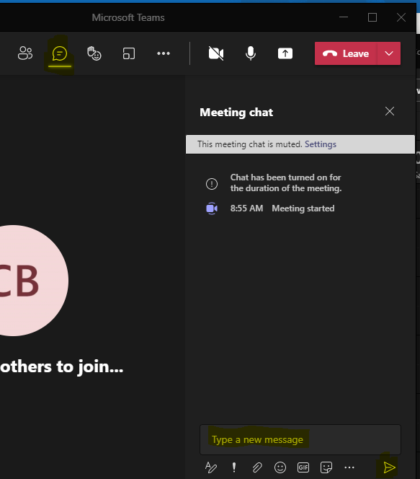
2023–2024 ACCESS for ELLs Training
Welcome!
Introduce Yourself
From the top of the navigation select the Chat icon
In the Type a new message section please share
Your name
District & Role
Something you are looking forward to this fall
Select the paper airplane icon in the bottom right corner of the window to send
Select the Chat icon
Tell us your name, district, and something you are looking forward to.
Send your message

Slide 2
ACCESS for ELLs, Kindergarten ACCESS, Alternate ACCESS Training for 2023–2024
September 2023

Slide 3
This training is to support District Assessment Coordinators prepare their district for the annual administration of the WIDA ACCESS suite of assessments including ACCESS for ELLs 1–12 (online & paper), Kindergarten ACCESS for ELLs, and Alternate ACCESS.

Slide 4
Agenda District level logistics for the ACCESS assessments
About ACCESS
Testing Requirements
Dates
What’s New
Resource Documents WIDA and DRC
Resource Documents Colorado
Accommodations
Test Materials
Break
Test Environment
WIDA Resources for Students and Educators
Contacts
Questions

Slide 5
WIDA, DRC, and the ACCESS Assessments

Slide 6
Standards Based Assessment
In Colorado, the standards based English language proficiency assessments are:
ACCESS for ELLs
Kindergarten ACCESS
Alternate ACCESS
The ACCESS assessments are standards based
Developed by WIDA, CAL (Center for Applied Linguistics), and WIDA members
The assessments are criterion-based
Colorado adopted the WIDA standards as the Colorado English Language Proficiency (CELP) Standards

Slide 7
Test Forms
ACCESS Online 1-12
By default of test design, the Writing domain for grades 1-3 is via paper test booklet
ACCESS Paper 1-12 (IEP/504 required)
Speaking and Listening are delivered through a CD
Speaking is scored locally
Kindergarten ACCESS
Paper
Administered 1-1
Scored locally
Alternate ACCESS (K-12)
Paper
Administered 1-1
Scored locally

Slide 8
WIDA
WIDA is part of the University of Wisconsin–Madison and is housed in the Wisconsin Center for Education Research (WCER), one of the first, largest, and most productive education research centers in the world.
Research-based system of language standards, assessments, professional learning and educator assistance.
WIDA members consist of 41 domestic states and territories and approximately 500 international schools throughout the world

Slide 9
DRC
Data Recognition Corporation (DRC)
DRC is a long-standing WIDA partner responsible for the administration, scoring, and reporting for the ACCESS, Alternate ACCESS, and online WIDA Screener assessments
DRC offers assessments for pre–K, K–12, and adult education markets, across the U.S. and internationally.
WIDA and DRC administer the ACCESS assessments to 2.5 million students each year.

Slide 10
Testing Requirements

Slide 11
Testing requirements
All Multilingual Learners (NEP and LEP), including students with disabilities, must participate in the state English language proficiency assessment system (WIDA ACCESS).
An English language proficiency assessment is required by federal and state law and is guaranteed to students under Civil Rights law of 1964 and The Office for Civil Rights Memorandum of 1970.
Federal Law
Title IA
20 U.S.C. 6301 §1111(b)(2)(C)(v)(II)(dd)
20 U.S.C. 6301 §1111(b)(3)(C)(ix)(III) & (x)
20 U.S.C. 6301 §1111(b)(6) & (7)
Title IIIA
State Law
Colorado Senate Bill 109 – C.R.S. 22-24-106 ELP Assessment
Colorado House Bill 14-1298 – C.R.S. 22-24-101 English Language Proficiency Act (ELPA)

Slide 12
Testing students who are NEP or LEP and have an IEP or 504 Plan
The educational team (ML and IEP or 504 as applicable), which must include the family, determines whether the student will take ACCESS for ELLs or Kindergarten ACCESS with or without accommodations or, for a student with the most significant cognitive disability, meets the participation requirements for the alternate assessment.
According to federal requirements, there must be evidence of alignment between a student’s educational plan, instruction, and the accommodations provided on any of the state assessments, as well as any determinations for students to participate in Alternate ACCESS.

Slide 13
ACCESS participation options
Three participation options exist:
The student participates in ACCESS for ELLs or Kindergarten ACCESS without an accommodation.
The student participates in ACCESS for ELLs or Kindergarten ACCESS with accommodation(s)*.
The student participates in Alternate ACCESS only for students with the most significant cognitive disabilities.
Note: It is not appropriate or ethical to give the Alternate ACCESS to students who do not qualify to take the assessment.
*Accommodations are practices and procedures that provide equitable access during instruction and assessment for students who have a documented need. To use accommodations on ACCESS for ELLs accommodations must be determined by the student’s educational team and documented in the student’s IEP or 504.

Slide 14
Dates

Slide 15
ACCESS - Test Window: 01/08/24 – 02/09/24 State established dates (slide 1 of 2)
CDE training: September 2023
Initial Materials order window: Present – 11/01/23
Paper materials as documented in IEP/504 Plans
Order placed to CDE through Syncplicity
ACCESS Office Hours: Wednesdays 10/25/23 – 02/07/24
(Cancelled on 11/22, and 12/27)
DACs request calendar invite through security agreement form
Student Data Pull for WIDA AMS: 11/03/23
Online, K and Alternate materials are based on this information
No action required
CDE sends Verification of District Training form: 11/01/23
Sent via DocuSign
Form is due 01/10/24
WIDA AMS opens: 11/29/23
UAR (scribe) submission: 12/01/23

Slide 16
ACCESS State established dates (slide 2 of 2)
Materials arrive: 12/14/23
Additional Materials order window: 12/18/23* – 02/02/24 (Through CDE)
Handwriting response booklets
Test Window: 01/08/24 – 02/09/24
Enrollment testing cutoff: 02/02/24
Return materials: 02/14/24
Results ACCESS for ELLs & Kindergarten ACCESS:
04/29/24** (downloadable reports)
05/09/24** (printed reports)
Results Alternate ACCESS:
09/12/24** (downloadable reports)
10/02/24 ** (downloadable reports)
*When placing an additional materials order be sure the district will be open to
receive and securely store materials
**Tentative

Slide 17
ACCESS District established dates
District/Site level trainings
Local testing schedule
Submitting the verification of district training form to CDE
Submit by 01/10/24
Distribution of results
ISRs are to be shared with parents/guardians as soon as practicable. Please keep in mind, the reports are confidential and distribution of both electronic and/or hard copy reports must be in accordance with state and federal privacy laws, and local school board policy.

Slide 19
Kindergarten Alternate
ACCESS Online, Paper & Alternate assessment training courses
Quiz completion window –
October 1, 2023 – January 8, 2024

Slide 20
WIDA AMS layout and terminology
Legacy Term | New Term
Test Session(s) | Registration(s)
Administration | Registration Window
Multiple Student Upload | Student Import
Screener Data Export | Screener Export
On-Demand Reports | Batch Download
Test Results | Published Reports

Slide 21
Paper 1–12 is only available through IEP/504 documentation
Paper materials are order through a file upload to Syncplicity
Submit Test Administrator information for all paper 1–12 tests

Slide 22
Transfer Requests are submitted through WIDA AMS
Invalidation code requests are through CDE
Reason Not Tested Codes entered into WIDA AMS
Verification of District Training & Post Test Compliance forms are through DocuSign

Slide 23
Assessment monitoring (not new, but returning)
Might look like-
Virtual pre-testing
In-person pre-testing
During testing site visit
Virtual post-testing
In-person post-testing

Slide 24
Reminders
Only district/school email addresses in:
WIDA AMS (DRC Insight)
WIDA Secure Portal
WIDA ACCESS Office Hours:
October 25 – February 7
(Cancelled on 11/22 and 12/27)
DACs request calendar invite through security agreement form

Slide 25
Resource Documents WIDA/DRC

Slide 26
Resource Documents WIDA and DRC
WIDA/DRC
District and School Coordinator Manual
Test Administrator Manual
Test Administrator Essentials
WIDA AMS User Guide
Accessibility and Accommodations Manual

Slide 27
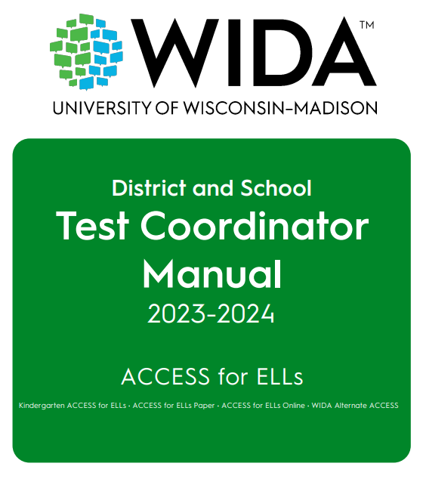
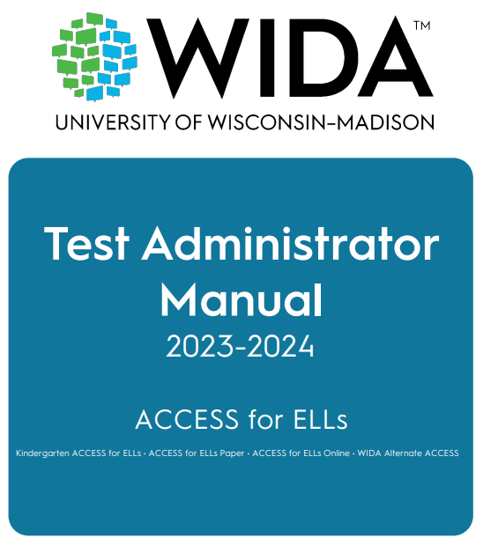
WIDA Role Specific Manuals
Test Administrator Manual (TAM)
For Test Administrators
District and School Manual (DSM)
For Test Coordinators

Slide 28
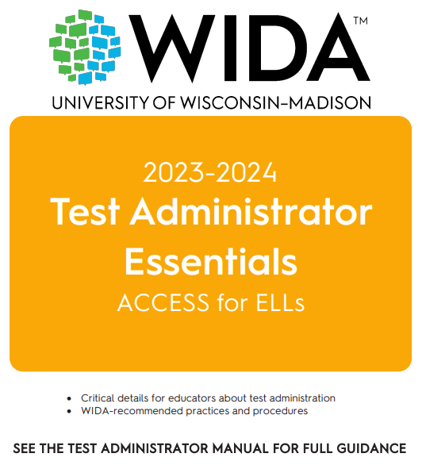
Test Administrator Essentials

Slide 29
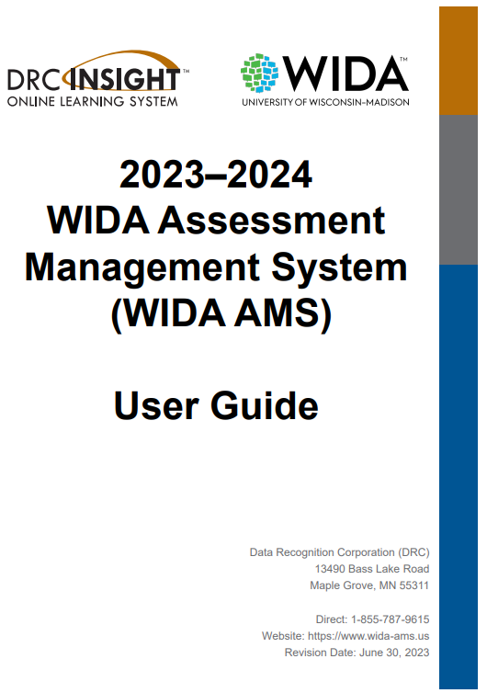
WIDA AMS User Guide

Slide 30
WIDA Assessment Management System (WIDA AMS)
Designated staff:
Access user guides or software downloads
Add students
Designate accommodations
Create test sessions
Print test tickets
View/print reports
Access the Student Status Dashboard
Submit Transfer Requests
Enter Reason Not Tested codes

Slide 31
Resource Documents CDE

Slide 32
Resource Documents Colorado
CDE Assessment Division
Colorado WIDA ACCESS Training Information
Colorado Accommodations Training
CDE Office of Culturally and Linguistically Diverse Education
Identification
Language Proficiency Coding
Redesignation

Slide 33
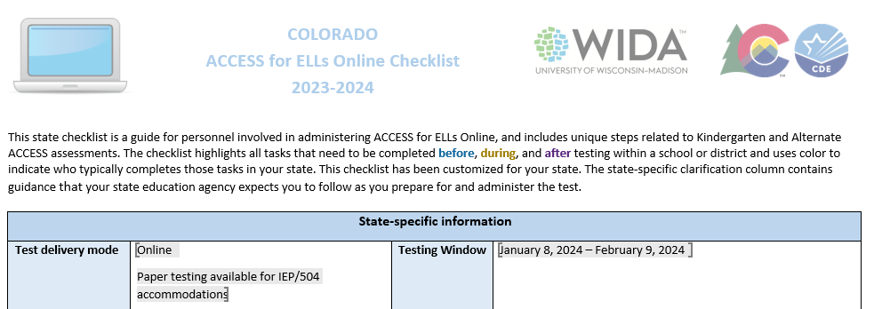
Colorado Checklist

Slide 34
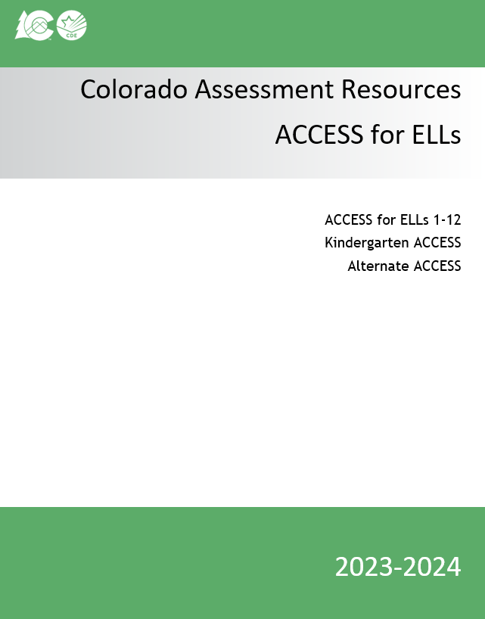
Colorado Assessment Resources

Slide 35
Security & Training Requirements

Slide 36
WIDA ACCESS Security
ACCESS Assessments
are secure tests
Colorado Security Agreement

Slide 37
Intellectual Property
All WIDA assessments and related materials are the copyright of the Board of Regents of the University of Wisconsin System. Should an egregious security incident occur compromising WIDA’s intellectual property remedies for violations will be governed by Wisconsin State Statutes.

Slide 38
Actions to maintain security
Use a chain of custody form
Do not leave materials unattended (includes test tickets, used scratch paper, etc.)
Keep testing materials in a secure area when not in use
Prepare a quiet secure testing environment
Actively proctor
Do not view, discuss, or reveal the contents of the test or student responses
Do not duplicate any portion of the test materials
Do not retain or discard WIDA ACCESS published materials
Kindergarten, Paper, Online 1–3, and Alternate Scripts are secure and must be returned
Account for all secure test materials at the end of the testing window
Creation of an exhaustive list of actions to maintain the security of the assessment is not realistic. Always refer to the general guidelines and expectations of assessment security for assessments in Colorado (and set forth by WIDA) when making decisions on best practices with assessment administration and materials.

Slide 39
Who can administer WIDA ACCESS
TAs must be employed by the school or district.
Preferably, TAs will be:
licensed teachers, licensed administrators, instructional support para-professionals, substitute teachers who hold a teaching certificate, school psychologists, school social workers, school librarians, school counselors, or speech pathologists
School/district employees may administer assessments at the grade levels of their own children, but they may not administer the test to their own children or relatives, nor be in the testing environment during testing.
For Kindergarten ACCESS or Alternate ACCESS, the TA needs to be able to model clear standard pronunciation of the English phonemes that may impact student responses.
TAs administering the Alternate ACCESS must hold a State of Colorado educator license.

Slide 40
Training requirements
Test Administrators must:
Be trained annually
Complete the requirements of the district/school annual WIDA ACCESS training
Participate in WIDA’s online training modules
Independently pass the quiz(zes) that correspond(s) to the assessment being administered
October 1, 2023 – January 8, 2024
Read instructions in the TAM and familiarize themselves with test administration procedures prior to administering the test
Be trained on specific accommodations if administering assessments in which students are provided accommodations
Submit to their SAC a signed Security Agreement
Notes
DACs submit Paper Test administrator names with materials order
Student teachers may not serve as Test Administrators who are in charge of administering WIDA ACCESS. They may serve as proctors who assist the Test Administrators.

Slide 41
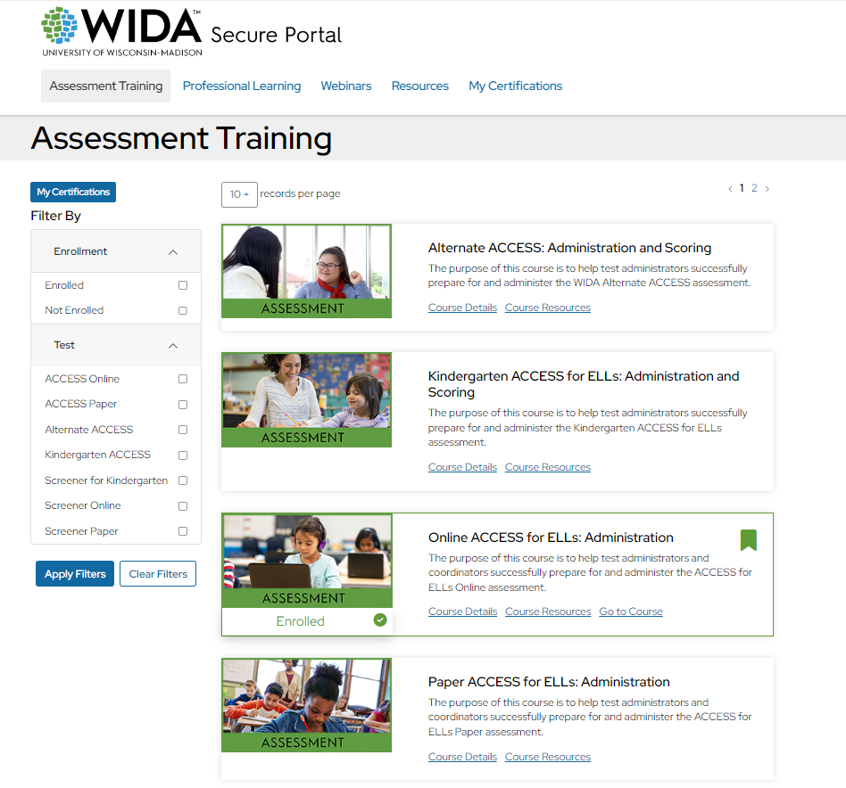
Quizzes
Quizzes in the WIDA secure portal are available after completing the modules.
DACs submit Paper Test administrator names with materials order.

Slide 42
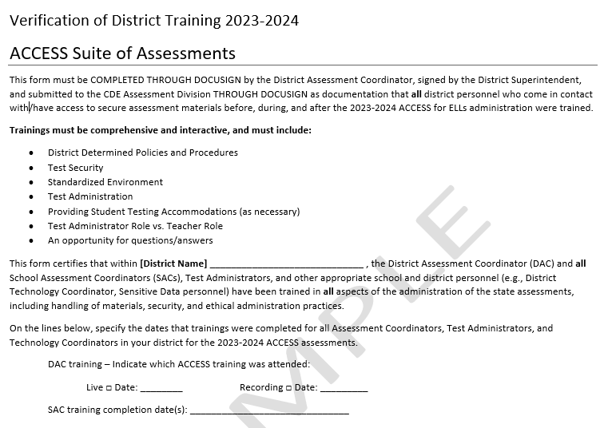
Verification of District Training
Completed through DocuSign
Sent via email through DocuSign on 11/01/23
Due 01/10/24

Slide 43
Accommodations IEP or 504 plan

Slide 44
Accommodations
Monitor accommodation assignment so that only students with an IEP or 504 are provided accommodations on an English language proficiency assessment
Paper 1–12 requires an IEP or 504

Slide 45
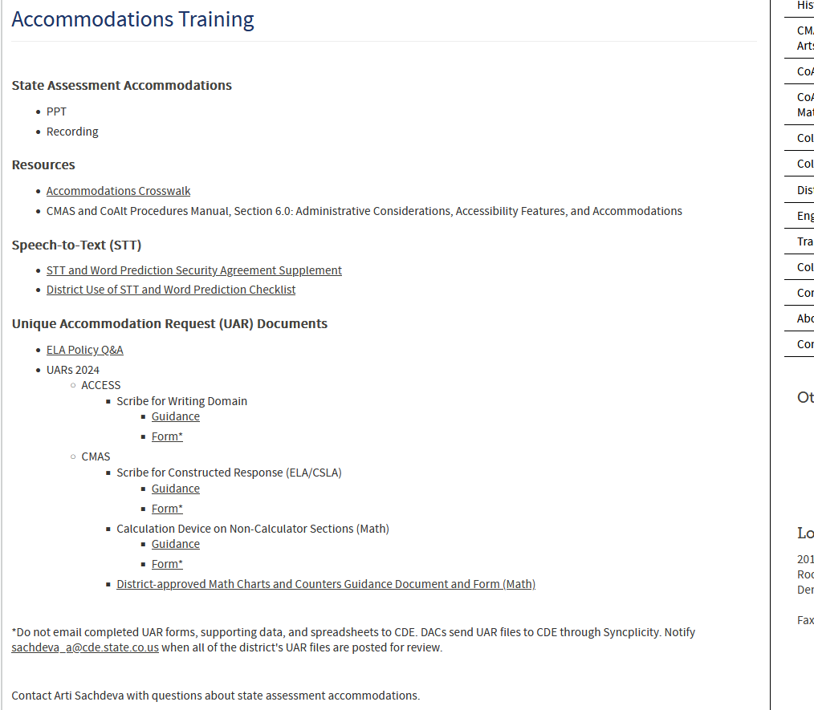
Accessibility and Accommodations
Colorado Accommodations Crosswalk
CDE Accommodations Training webpage
WIDA Accessibility and Accommodations Manual

Slide 46
Accommodations Frequently Asked Questions
Manual Control of item audio
When Manual Control of item audio is indicated in WIDA AMS it activates for all domains
The Colorado crosswalk indicates that it is an accommodation for Listening
In-person human reader (w/repeat if indicated by the IEP)
In Colorado, this accommodation is only allowed for paper testing. This accommodation requires a script that is ordered through DRC Customer Service.
This accommodation is appropriate when a student cannot access a audio from a computer or CD requires that the student looks at a speaker’s face/lips.

Slide 47
Online accommodations
Accommodations that must be pre-assigned via WIDA AMS
Manual Control of Item Audio
Repeat Item Audio
Extended Speaking Response Time
Do not broadly assign extended speaking time to all IEP/504 students who have extended time – be intentional about assigning this accommodation to students who need extended time specifically for speech issues.

Slide 48
Accommodations Unique Accommodation Request (UAR)
Only one Unique Accommodation applies to ACCESS for ELLs.
Scribe (which includes Speech-to-Text) for the Writing Domain
UAR for ACCESS is due December 1st
ACCESS for ELLs
Scribe for Writing Domain
Guidance
Form*
*Do not email completed UAR forms, supporting data, and spreadsheets to CDE. DACs send UAR files to CDE through Syncplicity. Notify sachdeva_a@cde.state.co.us when all ACCESS UAR files are posted for review.

Slide 49
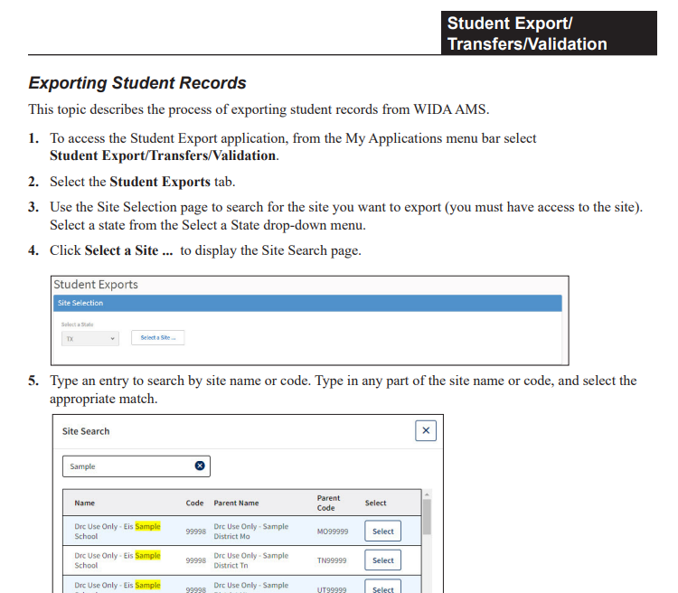
Checking accommodation assignment
Check accommodations assignment, use the Student Export feature in WIDA AMS.
Exporting Student Records instructions begin on p. 65, of the WIDA AMS User Guide.

Slide 50
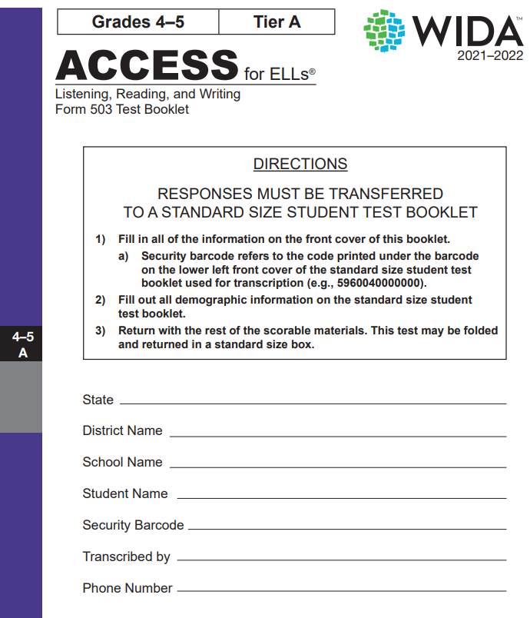
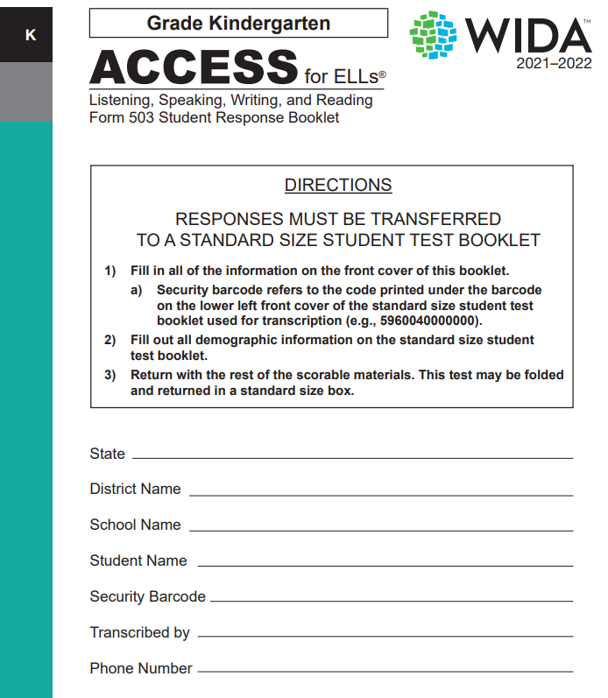
Paper accommodated form (grades 1–12) Large Print

Slide 51
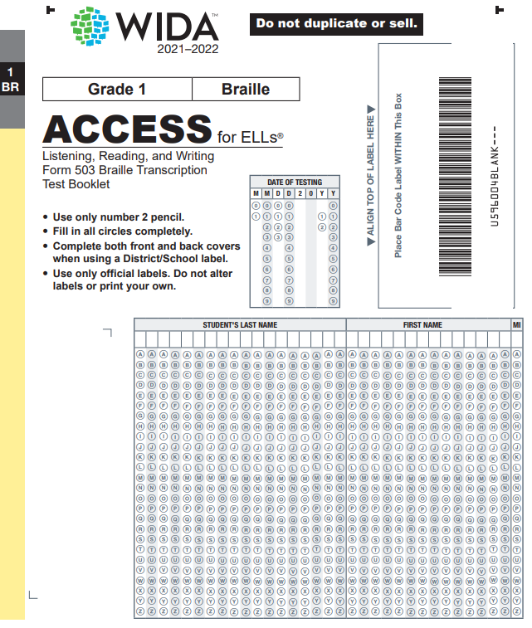
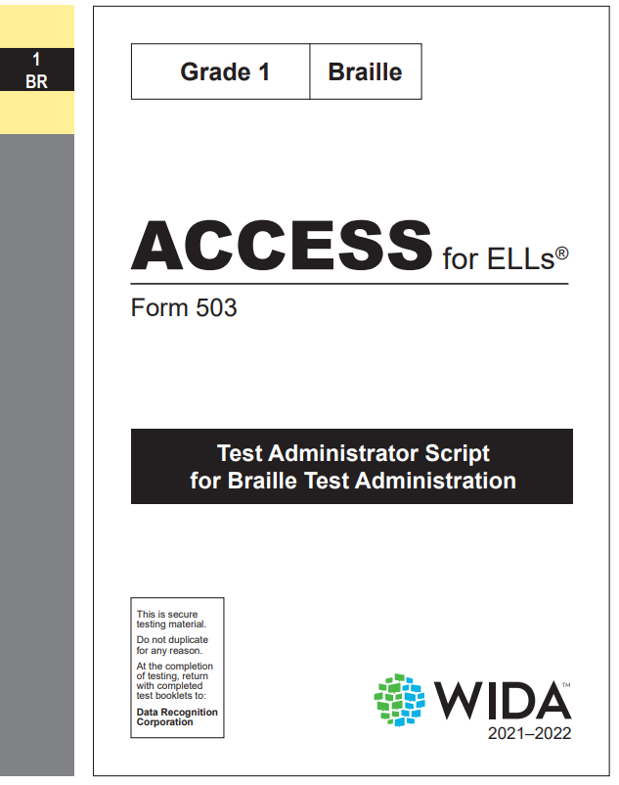
Paper accommodated forms (grades 1–12) Braille
CDE has a checklist available for students who cannot read Braille or cannot access signing.

Slide 52
Accessibility
If and when handwriting (HW) response is used as an accessibility feature (grades 4–12)
Handwriting response booklets need to be ordered during the additional materials order window
Place your order accordingly to ensure secure storage upon receipt.
Students in grades 4–12 who handwrite their Writing responses must be placed into a handwriting response (HW) session.

Slide 53
Materials

Slide 54
Materials ordering
Online, Kindergarten, and Alternate test materials are ordered automatically through the data pulled for the PreID upload
Data is pulled from the initial October Count snapshot in the Student Interchange
Students indicated as NEP or LEP under Language Proficiency
Alternate testers are indicated using the “Alternate Assessment Participation” field
The following require active order placement to CDE through Syncplicity
1–12 paper
Accommodated forms
Large print
Braille

Slide 55
Ordering paper materials though CDE/Syncplicity
For initial materials orders (due 11/01/23), DACs need to request the materials order Excel file from Heather Villalobos in the CDE Assessment Division.
In December (12/14/23), an additional materials order Excel file will be sent to all DACs
ALL Paper 1–12 materials, initial and additional, will be ordered by CDE using the data provided by the DAC in the Excel file uploaded to Syncplicity.

Slide 56
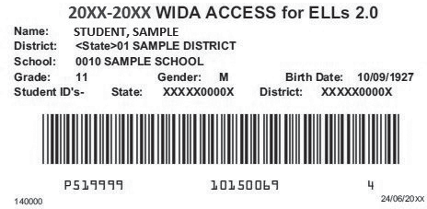
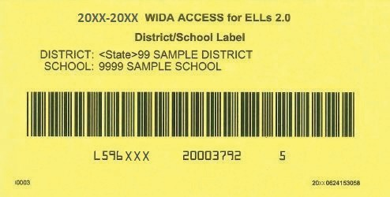
Labels
PreID label for ALL Students (reported as NEP/LEP) in the Student Interchange
District/School (3 pages), use when no PreID label is available
Scoreable materials need a label!
Remind staff to keep all Pre-ID or District/School labels until the end of the window.

Slide 57
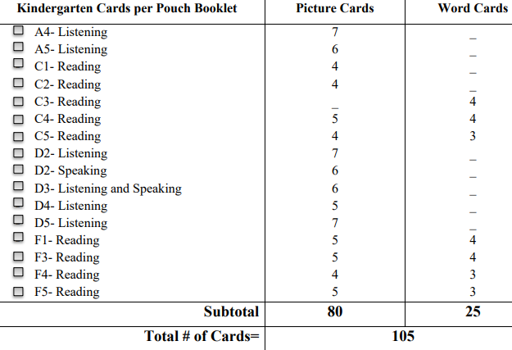
Kindergarten materials
Kindergarten
Student Storybook
Student Response Booklet
Test Administrator's Script
Student Activity Board
Cards
Card Pouch Booklet
At least two number 2 pencils

Slide 58
Alternate ACCESS K–12
Test Administrator's Script
Test Booklet
Student Response Booklet
(make sure it is the correct grade level)
At least two number 2 pencils

Slide 59
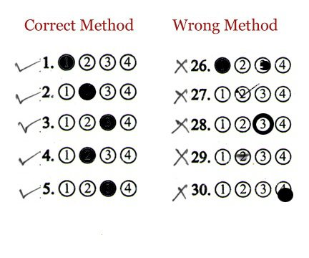
Marking student responses on Kindergarten & Alternate ACCESS.

Slide 60
Test Environment

Slide 61
Follows state of Colorado standardized testing expectations
Prepare a quiet secure testing environment
Post do not disturb and no cell phone use signs
Limit timers, bells, announcements, etc.
Keep cell phones and other like devices out of the testing area
Actively proctor
Follow seating chart/computer assignment

Slide 62
Timing
Untimed does not mean unlimited testing time
Use time estimates in the ACCESS for ELLs Test Administrator Manual & Colorado average testing times
Use of the Test Monitoring Application (TMA) in WIDA AMS allows Test Monitors to monitor student testing activity throughout the duration of their test using a secure dashboard.
Using the TMA is encouraged

Slide 63
Online testing order
In either order but first
Listening and Reading
Listening and Reading determine Writing and Speaking tier
In either order after Listening and Reading
Writing and Speaking

Slide 64
Student transfers are through WIDA AMS
See WIDA AMS User Guide pp. 70–71

Slide 65
Online testing
Reminders
Double-check test tickets are for the correct students
Make sure testing devices are charged
Headphones and microphones are reliable
Have back up devices (computer/Chromebook/tablets, and headphones/microphone) available
Have a plan in place in case of internet outages
How long do you wait
How many test attempts are appropriate
When to stop and try again the next day
Follow DRC guidelines, do not overtax the system

Slide 66
Preparing Students

Slide 67
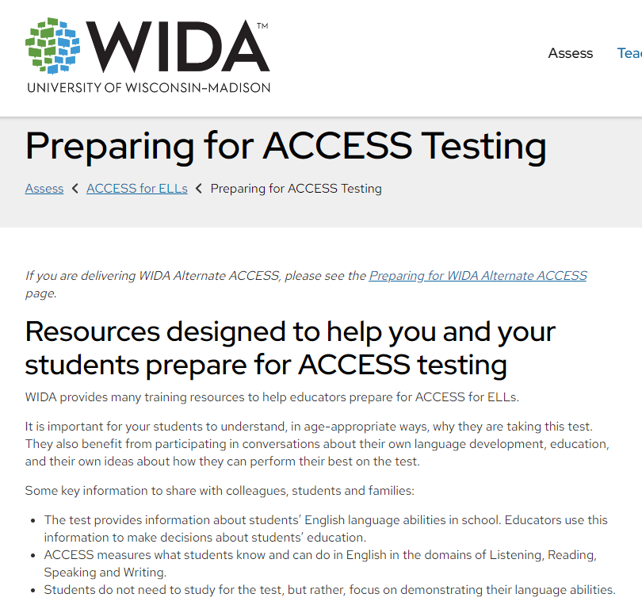
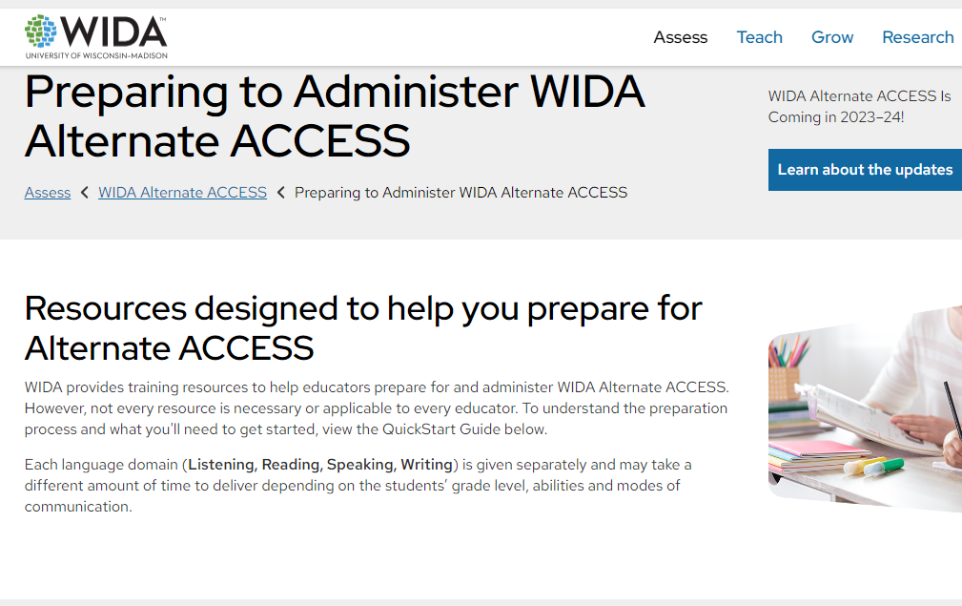
WIDA Resources
Preparing for ACCESS Testing
Preparing for WIDA Alternate ACCESS

Slide 68
Professional Development Resources
WIDA has free eLearning courses available to all educators in the Colorado public K–12 school system.
Virtual Self-Paced Workshops are available September 1, 2023, to August 31, 2024
To participate educators must have a WIDA Secure Portal account.
The Workshops are aligned to the English Learner Quality Standards. To view a list of the Workshops and which standards they align to, review the WIDA Self-Paced Workshop FAQs.
CDE’s Office of Culturally and Linguistically Diverse Education
Professional Learning Opportunities

Slide 69
Before administering WIDA ACCESS Summary
DACs complete and submit the Security Agreement to CDE
All others involved in ACCESS testing complete and submit the security agreement to the appropriate district/school assessment contacts
Order necessary materials (1–12 paper materials as needed by IEP/504)
District/school provided annual training(s)
DACs complete and submit
Verification of District Trainings (DocuSign by 01/10/24)
List of TAs who administer paper grades 1–12
Test administrators need to pass the quiz/quizzes (by 01/08/24) that align to the assessment they will administer.

Slide 70
Get Involved

Slide 71
Participate in an ACCESS Assessment Development Events
WIDA and our test development partners work hard to create an assessment that:
Reflects the diversity of multilingual learners
Positively portrays students with a range of backgrounds
Carefully avoids topics or situations that may evoke a negative reaction
WIDA invites educators to participate in review of test content in development.
If you would like to contribute to WIDA test development work, please visit the Building a WIDA Assessment page to learn more and apply.

Slide 72
Participate in Colorado Assessment Development Events
Educator participation is critical to Colorado's state assessment development and validation process. Colorado educators may serve on committees related to CMAS, CoAlt, and CSLA.
State Assessment Development Flyer
Register for assessment development committee selection.

Slide 73
Contacts

Slide 74
Colorado Department of Education
State Standardized Summative Assessments
ACCESS for ELLs and CMAS ML accommodations
Heather Villalobos Pavia
villalobospavia_h@cde.state.co.us
PA^{next} and CMAS logistics
Sara Loerzel
loerzel_l@cde.state.co.us
CoAlt (DLM) and CMAS and ACCESS IEP/504 Plan accommodations
Arti Sachdeva
sachdeva_a@cde.state.co.us
PSAT and SAT (College Board Assessments)
Melissa Carpenter
carpenter_m@cde.state.co.us
Assessment Data Contact
Tara Rhodes
rhodes_t@cde.state.co.us
Multilingual Learner Coding, Program and Instruction, Growth
ML Coding and October Count
Brooke Wenzel
wenzel_b@cde.state.co.us
ML Identification/Redesignation
Doris Brock-Nguyen
brock-nguyen_d@cde.state.co.us
ML Programing and Instruction Support
Lindsay Swanton
Swanton_l@cde.state.co.us
MLs with Educational Disabilities
Hunter Smith
Smith_h@cde.state.co.us
ACCESS Growth
Accountability and Continuous Improvement Unit Supports

Slide 75
Assessment Vendor
Contact the WIDA Client Services Center for questions regarding:
ACCESS for ELLs quizzes and certification
WIDA account usernames and passwords
WIDA eLearning
WIDA Screener Online and Paper quizzes and materials
help@wida.us​
1-866-276-7735​
Contact Data Recognition Corp (DRC) for questions regarding:
WIDA AMS
WIDA AMS logins
Test ordering and returning
Printing and test tickets
Editing student grade information
Generic test sessions
Tier reports
Pre ID labels
Entering accommodations
Using Chromebooks and iPads
DRC Central Office Services (COS) Device
WIDA@datarecognitioncorp.com
1-855-787-9615

Slide 76
CDE Assessment Team
Joyce Zurkowski
Chief Assessment Officer
Will Morton
Director of Assessment Administration
Christina Wirth-Hawkins
Executive Director of Assessment Development
Collin Bonner
NAEP, TIMSS & ICILS, Technology Support
Jasmine Carey
Psychometrics
Melissa Carpenter
PSAT 9, PSAT 10, SAT
Sara Loerzel
CMAS Administration & PA^{next}
Tara Rhodes
Data & SBD Specialist
Molly Mund
Content Development (Math & Science)
Arti Sachdeva
CoAlt and SPED Accommodations
Nathan Redford
Content Development (ELA & Social Studies)
Heather Villalobos Pavia
ACCESS, CSLA, ML Accommodations
Angela Landrum
Colorado Assessment Literacy Program

